Slide 1
CHAPTER 2.3
PROBABILITY
DISTRIBUTIONS

Slide 2


2.3 GAUSSIAN OR NORMAL ERROR DISTRIBUTION
The Gaussian distribution is an approximation to the binomial distribution for the special limiting case where the number of possible different observations n becomes infinitely large and the probability of success for each is finitely large so np >> 1.
It is also, as we observed, the limiting case for the Poisson distribution as μ becomes large.
There are several derivations of the Gaussian distribution from first principles, none of them as convincing as the fact that the distribution is reasonable, that it has a fairly simple analytic form, and that it is accepted by convention and experimentation to be the most likely distribution for most experiments.
In addition, it has the satisfying characteristic that the most probable estimate of the mean μ from a random sample of observations x is the average of those observations x.
Characteristics
The Gaussian probability density is defined as
This is a continuous function describing the probability of obtaining the value x in a random observation from a parent distribution with parameters μ and σ, corresponding to the mean and standard deviation, respectively.
Because the distribution is continuous, we must define an interval in which the value of the observation x will fall.
The probability density function is properly defined such that the probability dP_{G}(x; μ, σ) that the value of a random observation will fall within an interval dx around x is given by
dP_{G}(x;μ, σ) = P_{G}(x; μ, σ)dx (2.24)
considering dx to be an infinitesimal differential, and the probability density function to be normalized, so that

Slide 3
2.3 GAUSSIAN OR NORMAL ERROR DISTRIBUTION
The Gaussian distribution is an approximation to the binomial distribution for the special limiting case where the number of possible different observations n becomes infinitely large and the probability of success for each is finitely large so np >> 1.
It is also, the limiting case for the Poisson distribution as μ becomes large.
In addition, it has the satisfying characteristic that the most probable estimate of the mean μ from a random sample of observations x is the average of those observations x.
Characteristics
The Gaussian probability density is defined as
Continuous function describing the probability of obtaining the value x in a random observation from a parent distribution with parameters μ and σ, corresponding to the mean and standard deviation, respectively.
Distribution is continuous and an interval must be defined in which the value of the observation x will fall.
The probability density function is properly defined such that the probability dP_{G}(x; μ, σ) that the value of a random observation will fall within an interval dx around x is given by
dP_{G}(x;μ, σ) = P_{G}(x; μ, σ)dx (2.24)
Considering dx to be an infinitesimal differential, and the probability density function to be normalized, so that
The width of the curve is determined by the value of σ, such that for x = μ + σ, the height of the curve is reduced to e ^{-1/2} of its value at the peak:
The shape of the Gaussian distribution is shown in Figure 2.5.
The curve displays the characteristic bell shape and symmetry about the mean μ ·
We can characterize a distribution by its full-width at half maximum Γ, often referred to as the half-width, defined as the range of x between values at which the probability PG(x; μ, σ) is half its maximum value:
With this definition, we can determine from Equation (2.23) that
Γ = 2.354 σ (2.28)

Slide 4
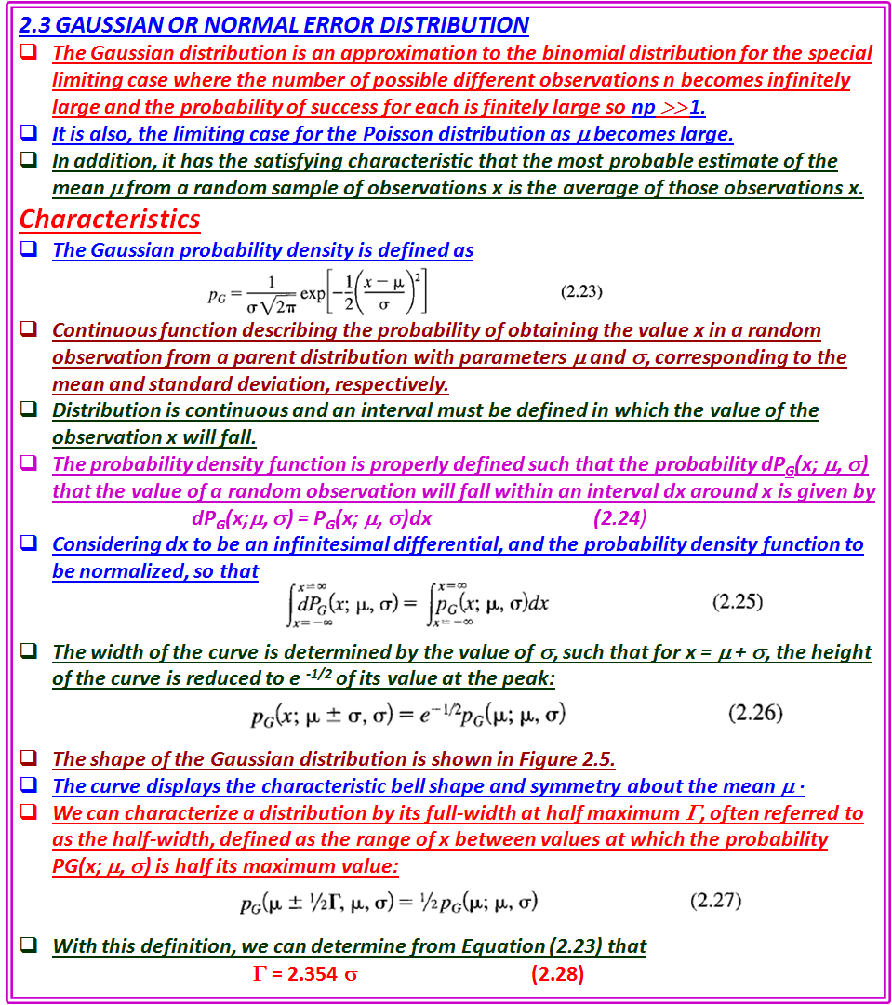

Slide 5
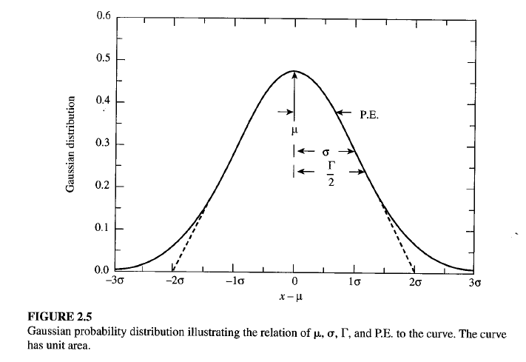
The width of the curve is determined by the value of σ, such that for x = μ + σ, the height of the curve is reduced to e ^{-1/2} of its value at the peak:
The shape of the Gaussian distribution is shown in Figure 2.5.
The curve displays the characteristic bell shape and symmetry about the mean μ ·
We can characterize a distribution by its full-width at half maximum Γ, often referred to as the half-width, defined as the range of x between values at which the probability PG(x; μ, σ) is half its maximum value:
With this definition, we can determine from Equation (2.23) that
Γ = 2.354 σ (2.28)
As illustrated in Figure 2.5, tangents drawn along a portion of steepest descent of the curve intersect the curve at the e^{-1/2} points x =μ ± σ and intersect the x axis at the points x = μ ± 2σ.

Slide 6
As illustrated in Figure 2.5, tangents drawn along a portion of steepest descent of the curve intersect the curve at the e^{-1/2} points x =μ ± σ and intersect the x axis at the points x = μ ± 2σ.

Slide 7
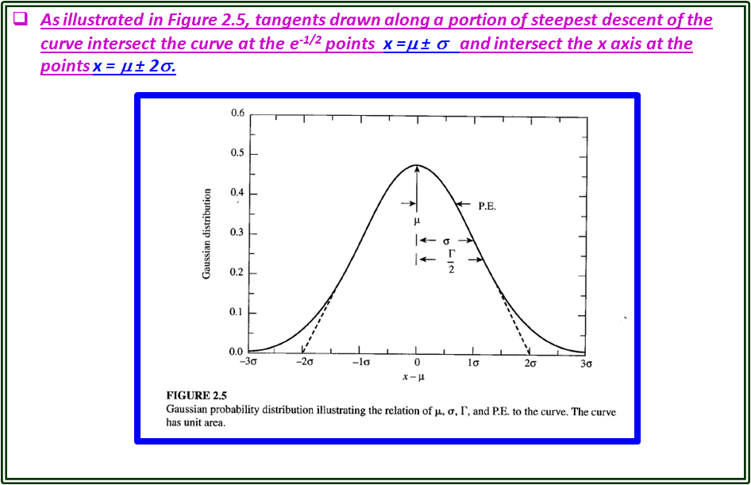

Slide 8

Standard Gaussian Distribution
It is generally convenient to use a standard form of the Gaussian equation obtained by defining the dimensionless variable z = (x -μ)/σ, because with this change of variable, we can write
Thus, from a single computer routine or a table of values of P_{G}(z), we can find the Gaussian probability function P_{G}(x; μ, σ) for all values of the parameters μ and σ by changing the variable and scaling the function by 1/σ to preserve the normalization.
Mean and Standard Deviation
The parameters μ and σ in Equation (2.23) for the Gaussian probability density distribution correspond to the mean and standard deviation of the function.
This equivalence can be verified by calculating μ and σ with Equations (1.13) and (1.14) as the expectation values for the Gaussian function of x and (x - μ)², respectively.
For a finite data sample, which is expected to follow the Gaussian probability density distribution, the mean and standard deviation can be calculated directly
from Equations (1.1) and (1.9).
The resulting values of x and s will be estimates of the mean μ and standard deviation σ. Values of , obtained in this way from the original 50 time measurements in Example 1.2, were used as estimates of μ and a in Equation (2.23) to calculate the solid Gaussian curve in Figure 1.2.
The curve was scaled to have the same area as the histogram.
The curve represents our estimate of the parent distribution based on our measurements of the sample.

Slide 9
Standard Gaussian Distribution
The standard form of the Gaussian equation obtained by defining the dimensionless variable z = (x -μ)/σ, because with this change of variable, we can write
Thus, from a single computer routine or a table of values of P_{G}(z), we can find the Gaussian probability function P_{G}(x; μ, σ) for all values of the parameters μ and σ by changing the variable and scaling the function by 1/σ to preserve the normalization.
Mean and Standard Deviation
The parameters μ and σ in Equation (2.23) for the Gaussian probability density distribution correspond to the mean and standard deviation of the function.
This equivalence can be verified by calculating μ and σ with Equations (1.13) and (1.14) as the expectation values for the Gaussian function of x and (x - μ)², respectively.
For a finite data sample, which is expected to follow the Gaussian probability density distribution, the mean and standard deviation can be calculated directly
from Equations (1.1) and (1.9).
The resulting values of x and s will be estimates of the mean μ and standard deviation σ. Values of , obtained in this way from the original 50 time measurements in Example 1.2, were used as estimates of μ and a in Equation (2.23) to calculate the solid Gaussian curve in Figure 1.2.
The curve was scaled to have the same area as the histogram.
The curve represents our estimate of the parent distribution based on our measurements of the sample.

Slide 10
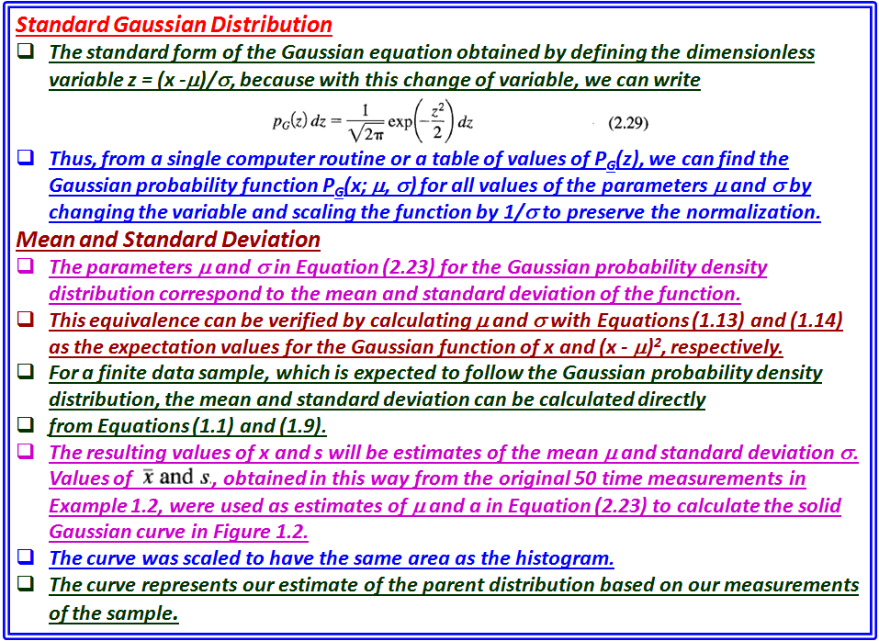

Slide 11


Integral Probability
We are often interested in knowing the probability that a measurement will deviate from the mean by a specified amount Δx or greater.
The answer can be determined by evaluating numerically the integral
which gives the probability that any random value of x will deviate from the
mean by less than ± Δx .
Because the probability function P G(x; μ, a) is normalized to unity, the probability that a measurement will deviate from the mean by more than Δx is just 1 - P_{G}(Δx; μ, σ).
Of particular interest are the probabilities associated with deviations of σ, 2σ, and so forth from the mean, corresponding to 1,2, and so on standard deviations.
We may also be interested in the probable error (σ_{pe} ), defined to be the absolute value of the deviation Ix - μl such that the probability for the deviation of any random observation Ix _{i} - μ I is less than 1/2.
That is, half the observations of an experiment would be expected to fall within the boundaries denoted by μ ± σ_{pe} ·
If we use the standard form of the Gaussian distribution of Equation (2.29), we can calculate the integrated probability P_{G}(z) in terms of the dimensionless variable z = (x - μ)lσ
where Δz = Δ x/σ measures the deviation from the mean in units of the
standard deviation σ.
The integral of Equation (2.31) cannot be evaluated analytically, so in order to obtain the probability P _{G}(Δx;μ, σ) it is necessary either to expand the Gaussian function in a Taylor's series and integrate the series term by term, or to integrate numerically.
With modem computers, numerical integration is fast and accurate, and reliable results can be obtained from a simple quadratic integration (Appendix A.3).

Slide 12
Integral Probability
We are often interested in knowing the probability that a measurement will deviate from the mean by a specified amount Δx or greater.
The answer can be determined by evaluating numerically the integral
which gives the probability that any random value of x will deviate from the
mean by less than ± Δx .
Because the probability function P G(x; μ, a) is normalized to unity, the probability that a measurement will deviate from the mean by more than Δx is just 1 - P_{G}(Δx; μ, σ).
Of particular interest are the probabilities associated with deviations of σ, 2σ, and so forth from the mean, corresponding to 1,2, and so on standard deviations.
We may also be interested in the probable error (σ_{pe} ), defined to be the absolute value of the deviation Ix - μl such that the probability for the deviation of any random observation Ix _{i} - μ I is less than 1/2.
That is, half the observations of an experiment would be expected to fall within the boundaries denoted by μ ± σ_{pe} ·
If we use the standard form of the Gaussian distribution of Equation (2.29), we can calculate the integrated probability P_{G}(z) in terms of the dimensionless variable
z = (x - μ)lσ
where Δz = Δ x/σ measures the deviation from the mean in units of the
standard deviation σ.
The integral of Equation (2.31) cannot be evaluated analytically, so in order to obtain the probability P _{G}(Δx;μ, σ) it is necessary either to expand the Gaussian function in a Taylor's series and integrate the series term by term, or to integrate numerically.
With modem computers, numerical integration is fast and accurate, and reliable results can be obtained from a simple quadratic integration (Appendix A.3).

Slide 13
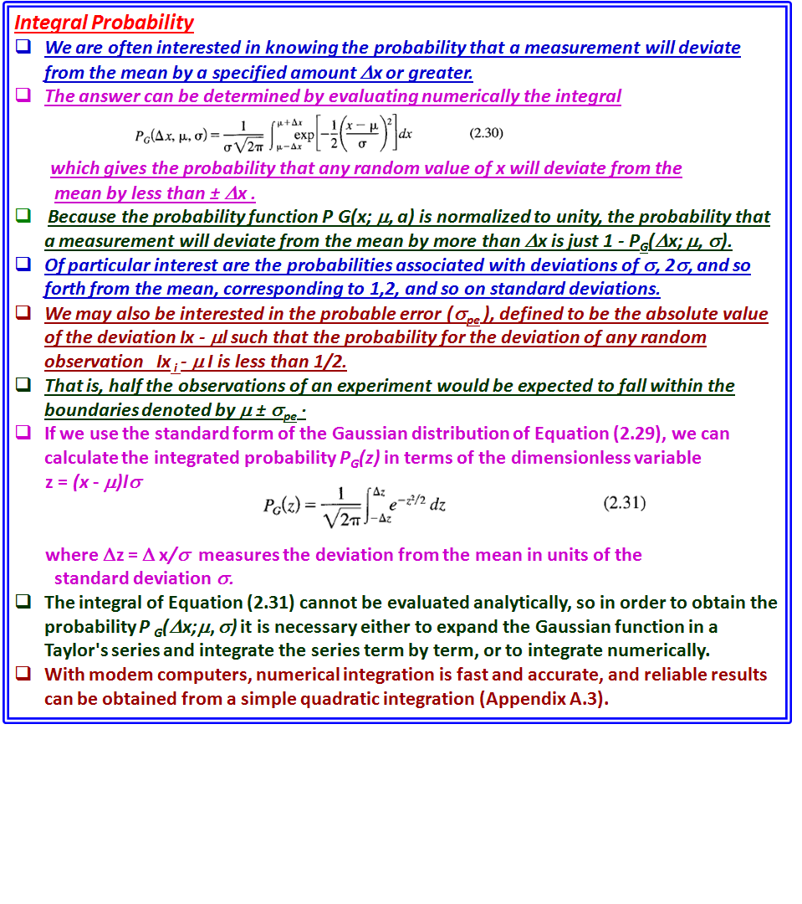

Slide 14
Tables and Graphs
The Gaussian probability density function P_{G}(z) and the integral probability P_{G}(z) are tabulated and plotted in Tables C.1 and C.2, respectively.
From the integral probability Table C.2, we note that the probabilities are about 68% and 9S% that a given measurement will fall within 1 and 2 standard deviations of the mean, respectively.
Similarly, by considering the 50 % probability limit we can see that the probable error is given by σ _{pe} = 0.6745σ.
Comparison of Gaussian and Poisson Distributions
A comparison of the Poisson and Gaussian curves reveals the nature of the Poisson distribution.
It is the appropriate distribution for describing experiments in which the possible values of the data are strictly bounded on one side but not on the other.
The Poisson curve of Figure 2.3 exhibits the typical Poisson shape.
The Poisson curve of Figure 2.4 differs little from the corresponding Gaussian curve of Figure 2.5, indicating that for large values of the meanμ, the Gaussian distribution becomes an acceptable description of the Poisson distribution.
Because, in general, the Gaussian distribution is more convenient to calculate than the Poisson distribution, it is often the preferred choice.
However, one should remember that the Poisson distribution is only defined at 0 and positive integral values of the variable x, whereas the Gaussian function is defined at all values of x.

Slide 15
Tables and Graphs
The Gaussian probability density function P_{G}(z) and the integral probability P_{G}(z) are tabulated and plotted in Tables C.1 and C.2, respectively.
From the integral probability Table C.2, we note that the probabilities are about 68% and 9S% that a given measurement will fall within 1 and 2 standard deviations of the mean, respectively.
Similarly, by considering the 50 % probability limit we can see that the probable error is given by σ _{pe} = 0.6745σ.
Comparison of Gaussian and Poisson Distributions
A comparison of the Poisson and Gaussian curves reveals the nature of the Poisson distribution.
It is the appropriate distribution for describing experiments in which the possible values of the data are strictly bounded on one side but not on the other.
The Poisson curve of Figure 2.3 exhibits the typical Poisson shape.
The Poisson curve of Figure 2.4 differs little from the corresponding Gaussian curve of Figure 2.5, indicating that for large values of the meanμ, the Gaussian distribution becomes an acceptable description of the Poisson distribution.
Because, in general, the Gaussian distribution is more convenient to calculate than the Poisson distribution, it is often the preferred choice.
However, one should remember that the Poisson distribution is only defined at 0 and positive integral values of the variable x, whereas the Gaussian function is defined at all values of x.

Slide 16
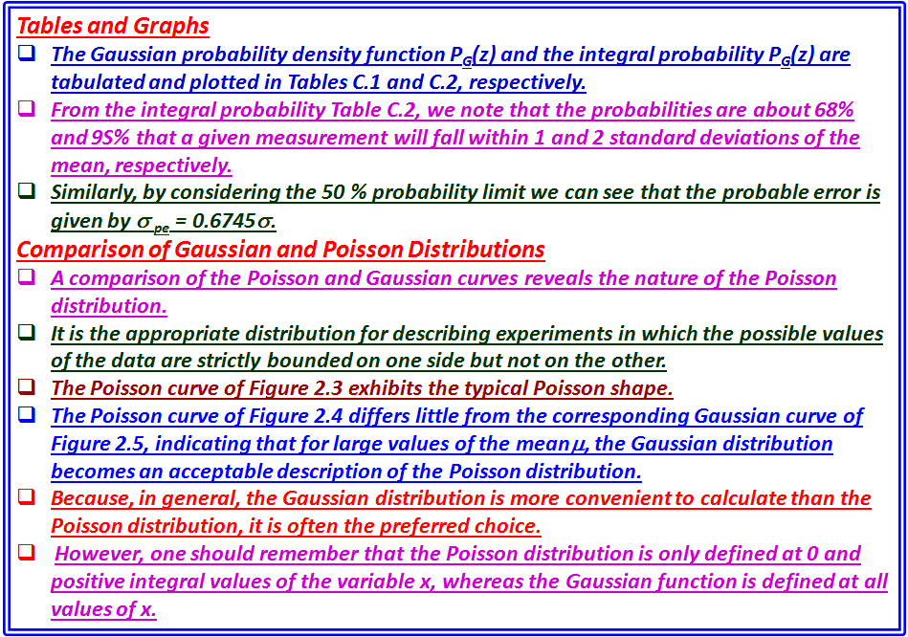

Slide 17


2.4 LORENTZIAN DISTRIBUTION
There are many other distributions that appear in scientific research.
Some are phenomenological distributions, created to parameterize certain data distributions.
Others are well grounded in theory.
One such distribution in the latter category is the Lorentzian distribution, similar but unrelated to the binomial distribution.
The Lorentzian distribution is an appropriate distribution for describing data corresponding to resonant behavior, such as the variation with energy of the cross section of a nuclear or particle reaction or absorption of radiation in the Mossbauer effect.
The Lorentzian probability density function P_{L}(X; μ, Γ), also called the Cauchy distribution, is defined as
This distribution is symmetric about its mean μ with a width characterized by its half-width Γ.
The most striking difference between it and the Gaussian distribution is that it does not diminish to 0 as rapidly; the behavior for large deviations is proportional to the inverse square of the deviation, rather than exponentially related to the square of the deviation.
As with the Gaussian distribution, the Lorentzian distribution function is a continuous function, and the probability of observing a value x must be related to the interval within which the observation may fall.
The probability dP_{L}(x; μ, Γ), for an observation to fall within an infinitesimal differential interval dx around x is given by the product of the probability density function P_{L}(x; μ, Γ), and the size of the interval dx:

Slide 18

2.4 LORENTZIAN DISTRIBUTION
There are many other distributions that appear in scientific research.
Some are phenomenological distributions, created to parameterize certain data distributions.
One such distribution in the latter category is the Lorentzian distribution, similar but unrelated to the binomial distribution.
The Lorentzian distribution is an appropriate distribution for describing data corresponding to resonant behavior, such as the variation with energy of the cross section of a nuclear or particle reaction or absorption of radiation in the Mossbauer effect.
The Lorentzian probability density function P_{L}(X; μ, Γ), also called the Cauchy distribution, is defined as
This distribution is symmetric about its mean μ with a width characterized by its half-width Γ.
The most striking difference between it and the Gaussian distribution is that it does not diminish to 0 as rapidly; the behavior for large deviations is proportional to the inverse square of the deviation, rather than exponentially related to the square of the deviation.
As with the Gaussian distribution, the Lorentzian distribution function is a continuous function, and the probability of observing a value x must be related to the interval within which the observation may fall.
The probability dP_{L}(x; μ, Γ), for an observation to fall within an infinitesimal differential interval dx around x is given by the product of the probability density function P_{L}(x; μ, Γ ), and the size of the interval dx:
The normalization of the probability density function P_{L}(X; μ, Γ) is such that the integral of the probability over all possible values of x is unity:
where z = (x - μ)/(Γ/2).

Slide 19
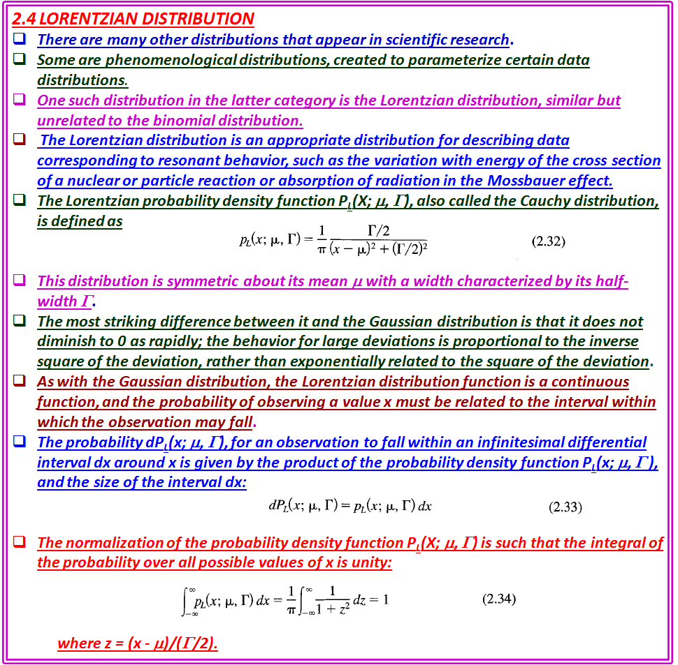

Slide 20

The normalization of the probability density function P_{L}(X; μ, Γ) is such that the integral of the probability over all possible values of x is unity:
where z = (x - μ)/(Γ/2).
Mean and Half-Width
The mean μ of the Lorentzian distribution is given as one of the parameters in Equation (2.32).
It is obvious from the symmetry of the distribution that μ must be equal to the mean as well as to the median and to the most probable value.
The standard deviation is not defined for the Lorentzian distribution as a consequence of its slowly decreasing behavior for large deviations.
If we attempt to evaluate the expectation value for the square of the deviations we find
that the integral is unbounded: the integral does not converge for large
deviations.
Although it is possible to calculate a sample standard deviation by evaluating the average value of the square of the deviations from the sample mean, this calculation has no meaning and will not converge to a fixed value as the number of samples increases.
The width of the Lorentzian distribution is instead characterized by the full width at half maximum Γ, generally called the half-width.
This parameter is defined such that when x = μ ± Γ/2, the probability density function is equal to one-half its maximum value, or P(μ ± Γ/2;μ, Γ) = ½ P(μ; μ, Γ).
Thus, the half-width Γ_{1/2} is the full width of the curve measured between the levels of half maximum probability.

Slide 21
Mean and Half-Width
The mean μ of the Lorentzian distribution is given as one of the parameters in Equation (2.32).
It is obvious from the symmetry of the distribution that μ must be equal to the mean as well as to the median and to the most probable value.
The standard deviation is not defined for the Lorentzian distribution as a consequence of its slowly decreasing behavior for large deviations.
If we attempt to evaluate the expectation value for the square of the deviations we find
that the integral is unbounded: the integral does not converge for large deviations.
Although it is possible to calculate a sample standard deviation by evaluating the average value of the square of the deviations from the sample mean, this calculation has no meaning and will not converge to a fixed value as the number of samples increases.
The width of the Lorentzian distribution is instead characterized by the full width at half maximum Γ, generally called the half-width.
This parameter is defined such that when x = μ ± Γ/2, the probability density function is equal to one-half its maximum value, or P(μ ± Γ/2;μ, Γ) = ½ P(μ; μ, Γ).
Thus, the half-width Γ_{1/2} is the full width of the curve measured between the levels of half maximum probability.
We can verify that this identification of Γ with the full-width at half maximum is
correct by substituting x = μ ± Γ/2 into Equation (2.32).

Slide 22
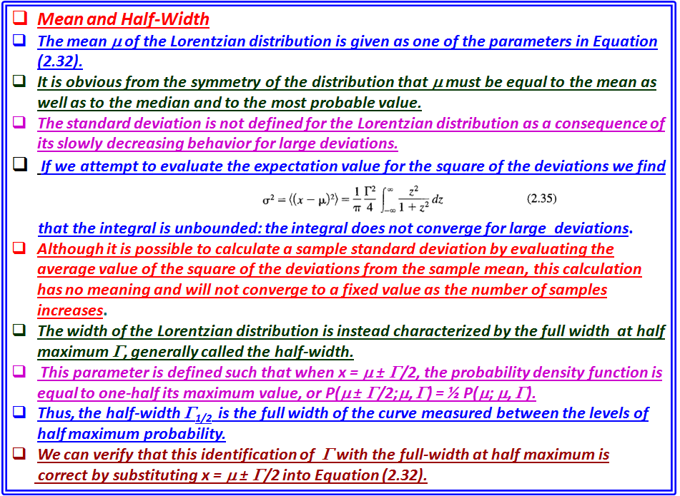

Slide 23

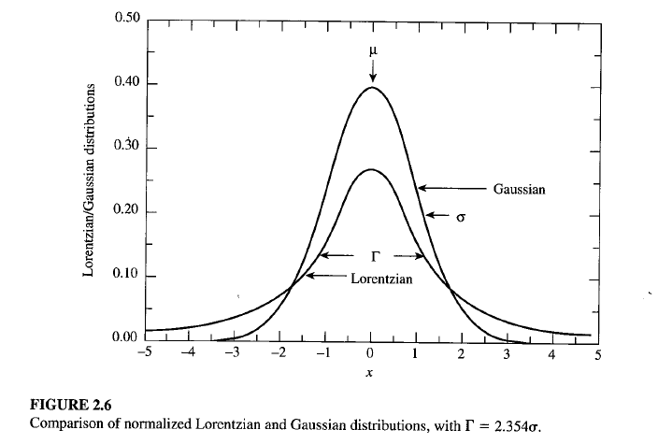
We can verify that this identification of f with the full-width at half maximum is
correct by substituting x = μ ± Γ/2 into Equation (2.32).
The Lorentzian and Gaussian distributions are shown for comparison in Figure
2.6, for μ = 10 and Γ = 2.354 (corresponding to σ = 1 for the Gaussian function).
Both distributions are normalized to unit area according to their definitions in
Equations (2.23) and (2.32).
For both curves, the value of the maximum probability is inversely proportional to the half-widthΓ.
This results in a peak value of 2/πΓ = 0.270 for the Lorentzian distribution and a peak value of 1/(σ√2π) = 0.399 for the Gaussian distribution.
Except for the normalization, the Lorentzian distribution is equivalent to the dispersion relation that is used, for example, in describing the cross section of a nuclear reaction for a Breit-Wigner resonance:

Slide 24
The Lorentzian and Gaussian distributions are shown for comparison in Figure
2.6, for μ = 10 and Γ = 2.354 (corresponding to σ = 1 for the Gaussian function).
Both distributions are normalized to unit area according to their definitions in
Equations (2.23) and (2.32).
For both curves, the value of the maximum probability is inversely proportional to the half-widthΓ.
This results in a peak value of 2/πΓ = 0.270 for the Lorentzian distribution and a peak value of 1/(σ√2π) = 0.399 for the Gaussian distribution.
Except for the normalization, the Lorentzian distribution is equivalent to the dispersion relation that is used, for example, in describing the cross section of a nuclear reaction for a Breit-Wigner resonance:

Slide 25
