Slide 1
CHAPTER 2
PROBABILITY
DISTRIBUTIONS

Slide 2


2.2 POISSON DISTRIBUTION
The Poisson distribution an approximation to the binomial distribution
special case where the average number of successes is much smaller than the possible number; that is, when μ<< n and p<< 1.
For such experiments the binomial distribution correctly describes the probability P_{B}(x; n, p) of observing x events per time interval out of n possible events exact evaluation from the binomial distribution impractical.
neither the number n of possible events nor the probability p for each is usually known.
known instead is the average number of events μ expected in each time interval or its estimate average x.
The Poisson distribution describes the probability distribution in terms of just the variable x and the Parameter μ .
Let us consider the binomial distribution in the limiting case of p<< 1
Case as n becomes infinitely large while the mean μ = np remains constant.
Equation (2.4) for the probability function of the binomial distribution can be written as
The second factor in Equation (2.8) thus asymptotically approaches n^{x}
The product of the second and third factors then becomes (np)^{x} = μ^{x}.
The fourth factor is approximately equal to 1 + px, which tends to 1 as p tends to 0.
The last factor can be rearranged by substituting μ/p for n and expanding the expression to show that it asymptotically approaches e^{−μ} :
binomial distribution probability function P_{B}(x; n, p) asymptotically approaches the Poisson distribution Pp(x; μ) as p approaches 0:

Slide 3
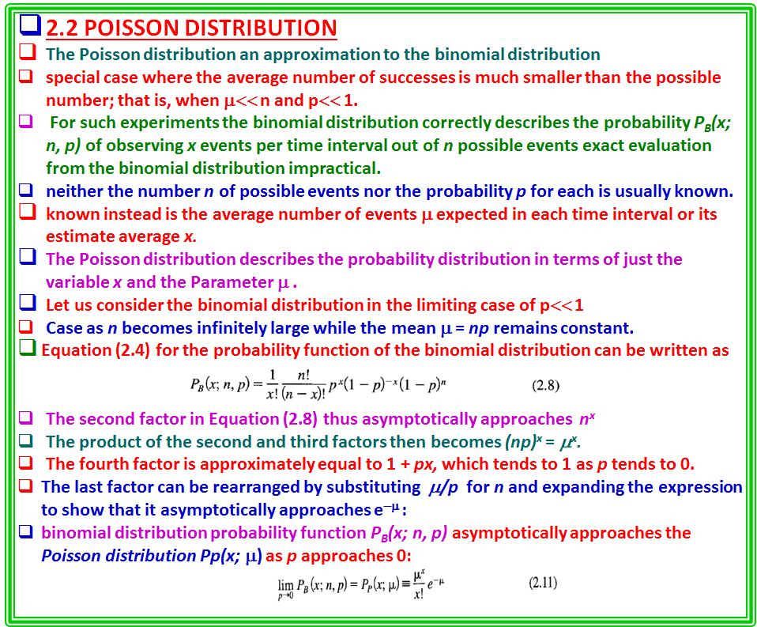

Slide 4

we can consider it to be the product of x individual factors, each of which is very nearly equal to n because in the region of interest.
The second factor in Equation (2.8) thus asymptotically approaches n^{x}.
The product of the second and third factors then becomes (np)^{x} = μ^{x}.
The fourth factor is approximately equal to 1 + px, which tends to 1 as p tends to 0.
The last factor can be rearranged by substituting μ/p for n and expanding the expression to show that it asymptotically approaches e^{-μ} :
Combining these approximations, we find that the binomial distribution probability function P_{B}(x; n, p) asymptotically approaches the Poisson distribution Pp(x; μ) as p approaches 0:
Because this distribution is an approximation to the binomial distribution for
the distribution is asymmetric about its mean μ and will resemble that of
Figure 2.2.
Note that P_{p} (x; μ) does not become 0 for x = 0 and is not defined for negative values of x.
This restriction is not troublesome for counting experiments because the number of counts per unit time interval can never be negative.

Slide 5




Derivation
The Poisson distribution can also be derived for the case where the number of events observed is small compared to the total possible number of events.
Assume that the average rate at which events of interest occur is constant over a given interval of time and that event occurrences are randomly distributed over that interval.
Then, the probability dP of observing no events in a time interval dt is given by
where P(x; t, τ) is the probability of observing x events in the time interval dt, τ is a constant proportionality factor that is associated with the mean time between events, and the minus sign accounts for the fact that increasing the differential time interval dt decreases the probability proportionally.
Integrating this equation yields the probability of observing no events within a time t to
be where P_{o} , the constant of integration, is equal to 1 because P(0; t,τ) = 1 at t = 0.
The probability P(x; t, τ) for observing x events in the time interval τ can be evaluated by integrating the differential probability
which is the product of the probabilities of observing each event in a different interval dt; and the probability e ^{-tlτ} of not observing any other events in the remaining time.
The factor of x! in the denominator compensates for the ordering implicit in the probabilities dP_{i} (1, t, τ) as discussed in the preceding section on permutations and combinations.
Thus, the probability of observing x events in the time interval t is obtained by integration

Slide 6
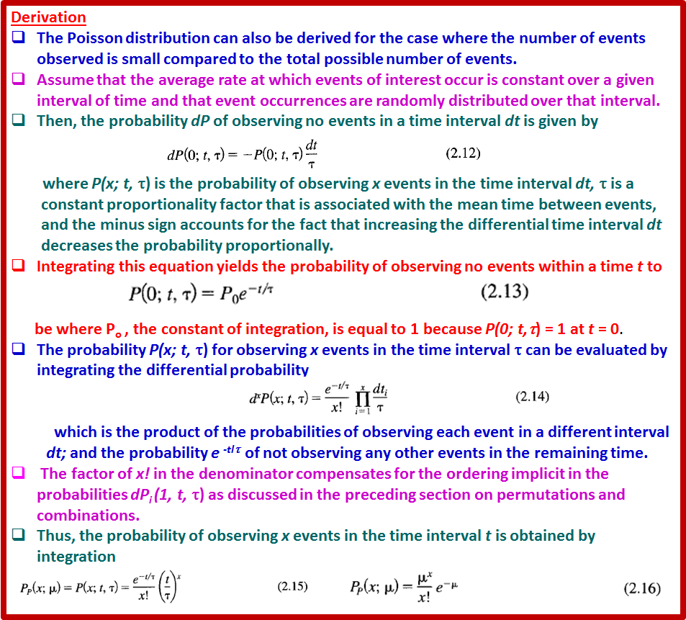

Slide 7




Equation (2.16) represents a normalized probability function; that is, the sum of the function evaluated at each of the allowed values of the variable x is unity:
Poisson Distribution Mean and Standard Deviation
The Poisson distribution, like the binomial distribution, is a discrete distribution.
it is defined only at integral values of the variable x, although the parameter μ Is a positive, real number.
The mean of the Poisson distribution is actually the parameter μ that appears in the probability function P_{P}(x;μ) of Equation (2.16).
To verify this, we can evaluate the expectation value of x <x>
To find the standard deviation σ , the expectation value of the square of the deviations can be evaluated:
This, the standard deviation σ is equal to the square root of the mean μ and the Poisson distribution has only a single parameter, μ.
Computation Of the Poisson distribution by Equation (2.16) can be limited by the factorial function in the denominator.
The problem can be avoided by using logarithms or by using the recursion relations

Slide 8
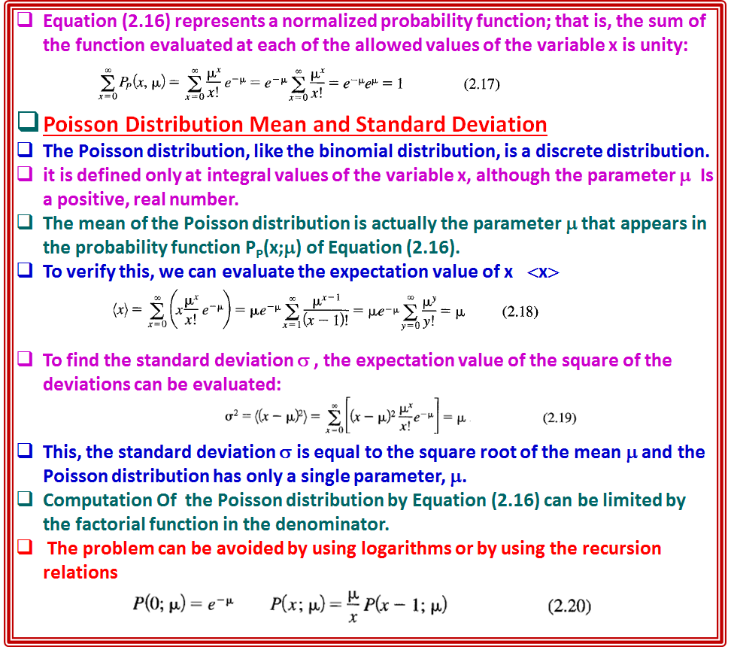

Slide 9
Example 2.4
As part of an experiment to determine the mean life of radioactive isotopes of silver, students detected background counts from cosmic rays. (See Example 8.1.)
They recorded the number of counts in their detector for a series of 100 2-s intervals, and found that the mean number of counts was l.69 per interval.
From the mean they estimated the standard deviation to be σ= √ 1.69 = 1.30, compared to s = 1.29 from a direct calculation with Equation (1.9).
The students then repeated the exercise, this time recording the number of counts in 15-s intervals for 60 intervals, obtaining a mean of 11.48 counts per interval, with standard deviations σ= √ 11.48 = 3.17 and s = 3.39.
Histograms of the two sets of data are shown in Figures 2.3, and. 2.4.
The calculated mean in each case was used as an estimate of the mean of the parent distribution to calculate a Poisson distribution for each data set.
The distributions are shown as continuous curves, although only the points at integral values of the abscissa are physically significant.

Slide 10
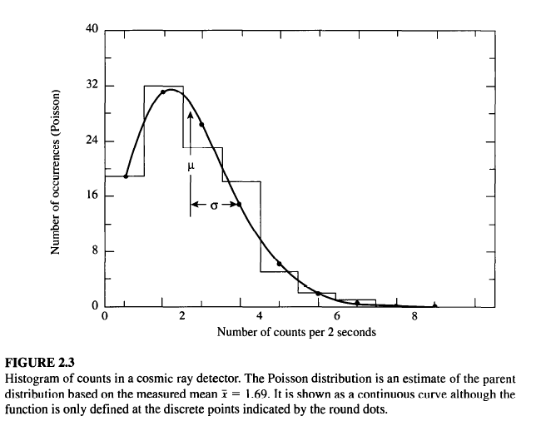
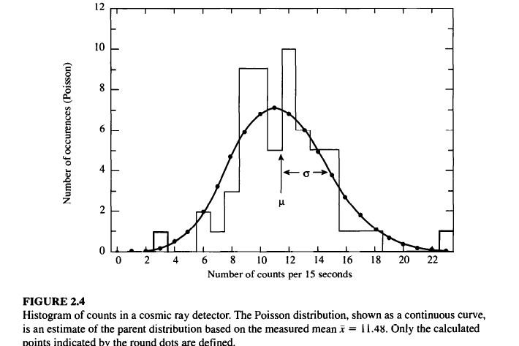
The asymmetry of the distribution in Figure 2.3 is obvious, as is the fact that the mean μ does not coincide with the most probable value of x at the peak of the curve.
The curve of Figure 2.4, on the other hand, is almost symmetric about its mean and the data are consistent with the curve.
As μ increases, the symmetry of the Poisson distribution increases and the distribution becomes indistinguishable from the Gaussian distribution.

Slide 11

Summed Probability
We may want to know the probability of obtaining a sample value of x between limits x₁ and x₂ from a Poisson distribution with mean μ.
This probability is obtained by summing the values of the function calculated at the integral values of x between the two integral limits x₁ and x₂,
More likely, we may want to find the probability of recording n or more events in a given interval when the mean number of events is μ.
This is just the sum
In Example 2.4, the mean number of counts recorded in a 15-s time interval was x = 11.48. In one of the intervals, 23 counts were recorded.
From Equation (2.22), the probability of collecting 23 or more events in a single 15-s time interval is - 0.0018, and the probability of this occurring in anyone of 60 15-s time intervals is just the complement of the joint probability that 23 or more counts not be observed in any of the 60 time intervals,
or p = 1 - (1 - 0.0018)60 = 0.10, or about 10%.
For large values of μ, the probability sum of Equation (2.22) may be approximated by an integral of the Gaussian function.

Slide 12


2.3 GAUSSIAN OR NORMAL ERROR DISTRIBUTION
The Gaussian distribution is an approximation to the binomial distribution for number of observations n becomes infinitely large and the probability p of success for each is finitely large so np >> 1.
It is also, the limiting case for the Poisson distribution as μ becomes large.
There are several derivations of the Gaussian distribution from first principles
it has the satisfying characteristic that most probable estimate of the mean μ from a random sample of observations x is the average of those observations x.
Characteristics
The Gaussian probability density is defined as
A continuous function describing the probability of obtaining the value x in a random observation from a parent distribution with mean parameters μ and standard deviationσ.
Because the distribution is continuous, we must define an interval in which the value of the observation x will fall.
The probability density function is properly defined such that the probability dP_{G}(x; μ, σ) that the value of a random observation will fall within an interval dx around x is given by
dP_{G}(x;μ, σ) = P_{G}(x; μ, σ)dx (2.24)
considering dx to be an infinitesimal differential, and the probability density function to be normalized, so that

Slide 13
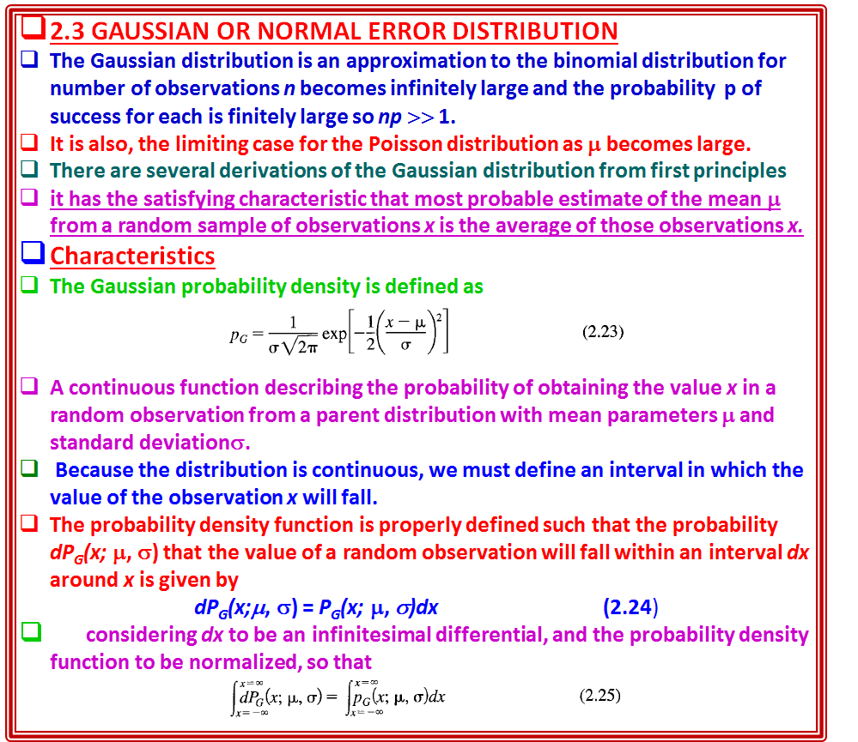

Slide 14
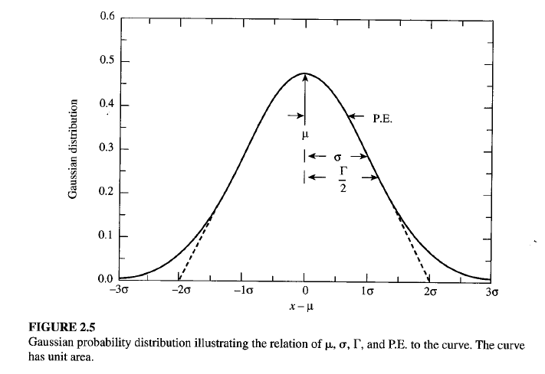
The width of the curve is determined by the value of σ, such that for x = μ + σ, the height of the curve is reduced to e ^{-1/2} of its value at the peak:
The shape of the Gaussian distribution is shown in Figure 2.5.
The curve displays the characteristic bell shape and symmetry about the mean μ ·
full-width at half maximum Γ the distribution by , often referred to as the half-width, defined as the range of x between values at which the probability PG(x; μ, σ) is half its maximum value:
With this definition, we can determine from Equation (2.23) that
Γ = 2.354 σ (2.28)
tangents drawn in Figure 2.5 along a portion of steepest descent of the curve intersect the curve at the e^{-1/2} points x =μ ± σ and intersect the x axis at the points x = μ ± 2σ.

Slide 15
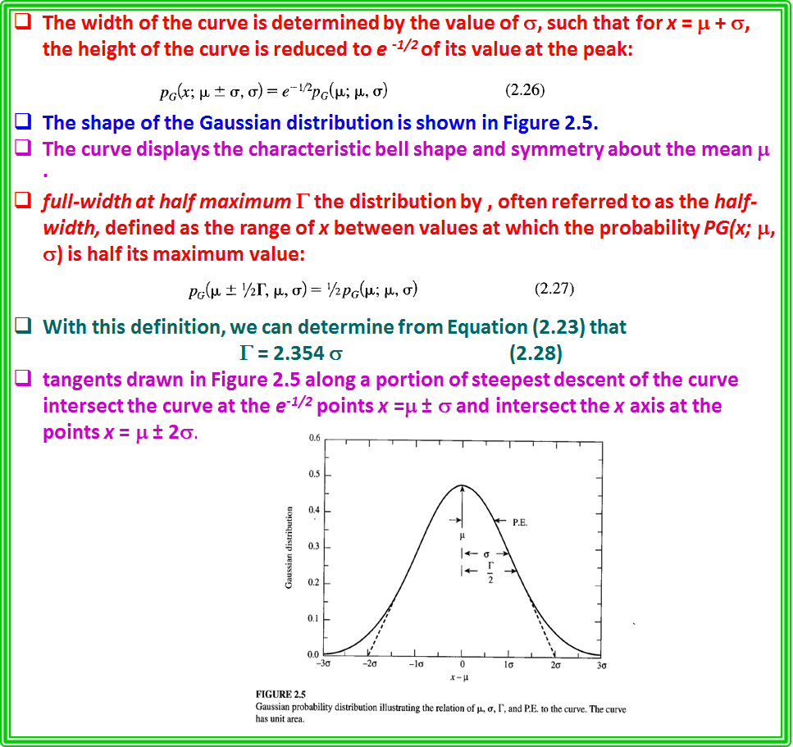

Slide 16

Standard Gaussian Distribution
a standard form of the Gaussian distribution a convenient form of Gaussian form by defining the dimensionless variable z = (x -μ)/σ, then
from a table of values of P_{G}(z), one can find the Gaussian probability function P_{G}(x; μ, σ) for all values of the parameters μ and σ by changing the variable and scaling the function by 1/σ to preserve the normalization.
Mean and Standard Deviation
The parameters μ and σ in Equation (2.23) for the Gaussian probability density distribution correspond to the mean and standard deviation of the function.
This equivalence can be verified by calculating μ and σ with Equations (1.13) and (1.14) as the expectation values for the Gaussian function of x and (x - μ)², respectively.
For a finite data sample, which is expected to follow the Gaussian probability density distribution, the mean and standard deviation can be calculated directly
from Equations (1.1) and (1.9).
The resulting values of x and s will be estimates of the mean μ and standard deviation σ. Values of , obtained in this way from the original 50 time measurements in Example 1.2, were used as estimates of μ and a in Equation (2.23) to calculate the solid Gaussian curve in Figure 1.2.
The curve was scaled to have the same area as the histogram.
The curve represents our estimate of the parent distribution based on our measurements of the sample.

Slide 17
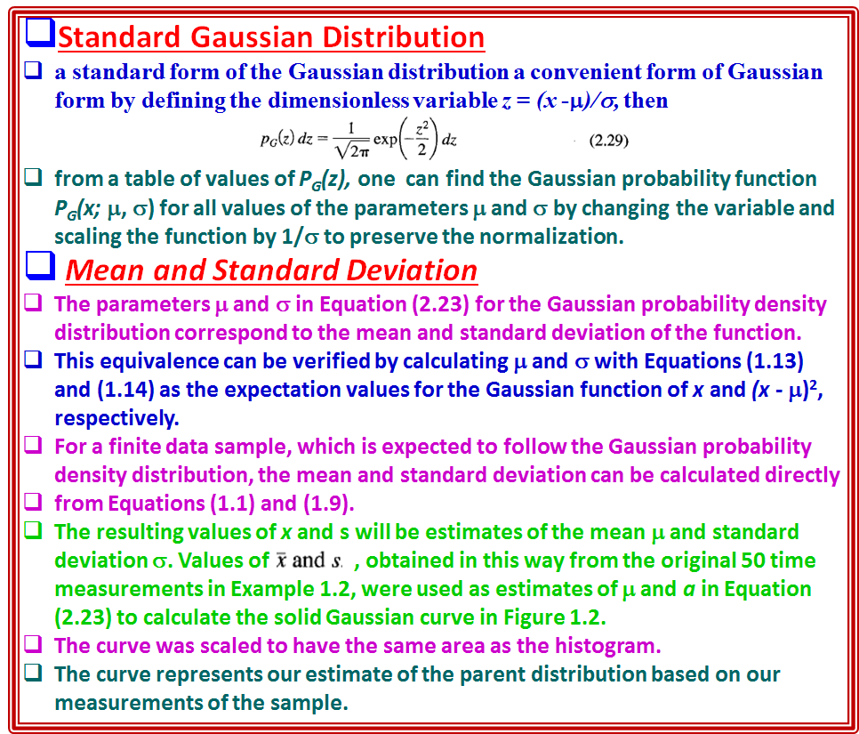

Slide 18


Integral Probability
We are often interested in knowing the probability that a measurement will deviate from the mean by a specified amount Δx or greater.
The answer can be determined by evaluating numerically the integral
which gives the probability that any random value of x will deviate from the
mean by less than ± Δx .
Because the probability function P G(x; μ, a) is normalized to unity, the probability that a measurement will deviate from the mean by more than Δx is just 1 - P_{G}(Δx; μ, σ).
Of particular interest are the probabilities associated with deviations of σ, 2σ, and so forth from the mean, corresponding to 1,2, and so on standard deviations.
We may also be interested in the probable error (σ_{pe} ), defined to be the absolute value of the deviation Ix - μl such that the probability for the deviation of any random observation Ix _{i} - μ I is less than 1/2.
That is, half the observations of an experiment would be expected to fall within the boundaries denoted by μ ± σ_{pe} ·
If we use the standard form of the Gaussian distribution of Equation (2.29), we can calculate the integrated probability P_{G}(z) in terms of the dimensionless variable z = (x - μ)lσ
where Δz = Δ x/σ measures the deviation from the mean in units of the
standard deviation σ.
The integral of Equation (2.31) cannot be evaluated analytically, so in order to obtain the probability P _{G}(Δx;μ, σ) it is necessary either to expand the Gaussian function in a Taylor's series and integrate the series term by term, or to integrate numerically.

Slide 19
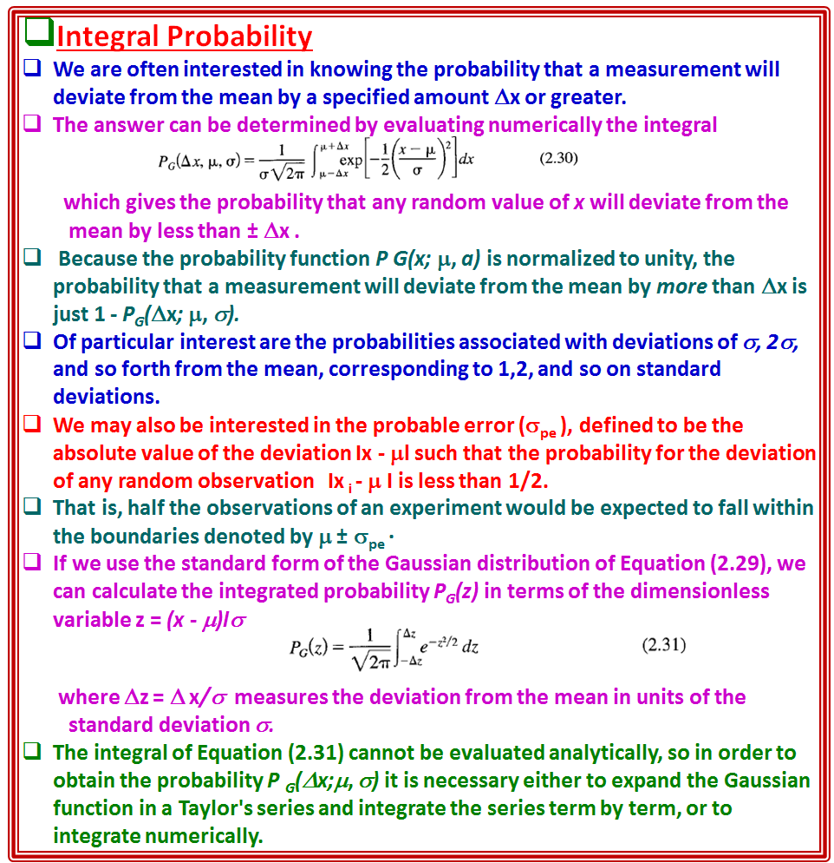

Slide 20
Tables and Graphs
The Gaussian probability density function P_{G}(z) and the integral probability P_{G}(z) are tabulated and plotted in Tables C.1 and C.2, respectively.
From the integral probability Table C.2, we note that the probabilities are about 68% and 9S% that a given measurement will fall within 1 and 2 standard deviations of the mean, respectively.
Similarly, by considering the 50 % probability limit we can see that the probable error is given by σ _{pe} = 0.6745σ.
Comparison of Gaussian and Poisson Distributions
A comparison of the Poisson and Gaussian curves reveals the nature of the Poisson distribution.
It is the appropriate distribution for describing experiments in which the possible values of the data are strictly bounded on one side but not on the other.
The Poisson curve of Figure 2.3 exhibits the typical Poisson shape.
The Poisson curve of Figure 2.4 differs little from the corresponding Gaussian curve of Figure 2.5, indicating that for large values of the meanμ, the Gaussian distribution becomes an acceptable description of the Poisson distribution.
Because, in general, the Gaussian distribution is more convenient to calculate than the Poisson distribution, it is often the preferred choice.
However, one should remember that the Poisson distribution is only defined at 0 and positive integral values of the variable x, whereas the Gaussian function is defined at all values of x.

Slide 21
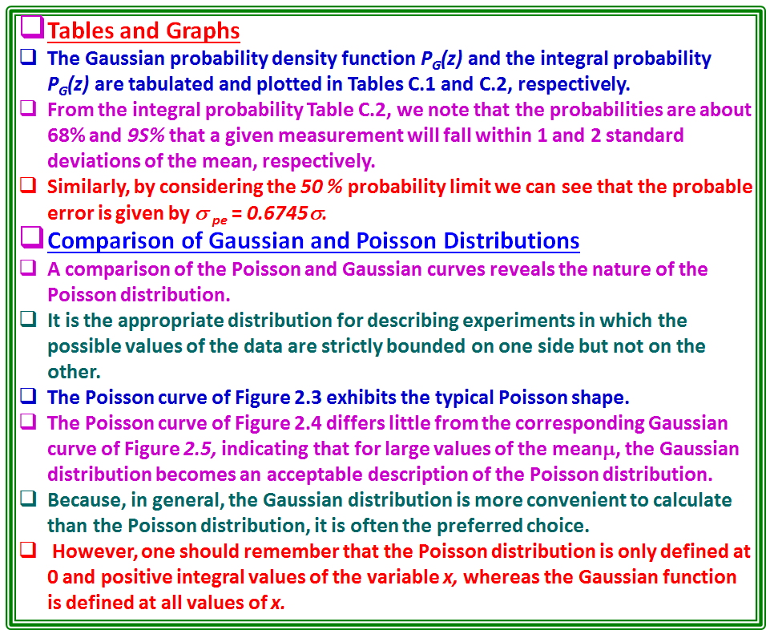

Slide 22


2.4 LORENTZIAN DISTRIBUTION
There are many other distributions that are phenomenological distributions that appear in scientific research to parameterize certain data distributions.
One such distribution is the Lorentzian distribution, similar but unrelated to the binomial distribution.
The Lorentzian distribution is an appropriate distribution for describing data corresponding to resonant behavior, such as the variation with energy of the cross section of a nuclear or particle reaction or absorption of radiation in the Mossbauer effect.
The Lorentzian probability density function P_{L}(X; μ, Γ), also called the Cauchy distribution, is defined as
This distribution is symmetric about its mean μ with a width characterized by its half-width Γ.
The most striking difference between Lorentzian and the Gaussian distribution is that it does not diminish to 0 as rapidly; the behavior for large deviations is proportional to the inverse square of the deviation, rather than exponentially related to the square of the deviation.
As with the Gaussian distribution, the Lorentzian distribution function is a continuous function, and the probability of observing a value x must be related to the interval within which the observation may fall.
The probability dP_{L}(x; μ, Γ), for an observation to fall within an infinitesimal differential interval dx around x is given by the product of the probability density function P_{L}(x; μ, Γ), and the size of the interval dx:

Slide 23
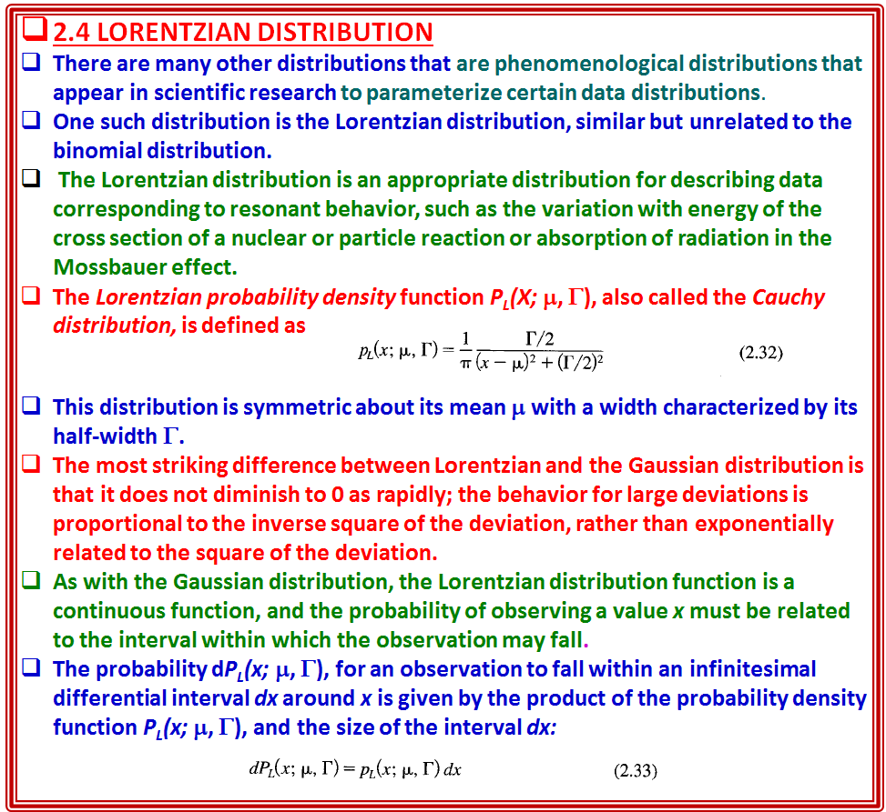

Slide 24


The normalization of the probability density function P_{L}(X; μ, Γ) is such that the integral of the probability over all possible values of x is unity:
where z = (x - μ)/(Γ/2).
Mean and Half-Width
The mean μ of the Lorentzian distribution is given as one of the parameters in Equation (2.32).
It is obvious from the symmetry of the distribution that μ must be equal to the mean as well as to the median and to the most probable value.
The standard deviation is not defined for the Lorentzian distribution as a consequence of its slowly decreasing behavior for large deviations.
If we attempt to evaluate the expectation value for the square of the deviations we find
that the integral is unbounded: the integral does not converge for large
deviations.
Although it is possible to calculate a sample standard deviation by evaluating the average value of the square of the deviations from the sample mean, this calculation has no meaning and will not converge to a fixed value as the number of samples increases.
The width of the Lorentzian distribution is instead characterized by the full width at half maximum Γ, generally called the half-width.
This parameter is defined such that when x = μ ± Γ/2, the probability density function is equal to one-half its maximum value, or P(μ ± Γ/2;μ, Γ) = ½ P(μ; μ, Γ).
Thus, the half-width Γ_{1/2} is the full width of the curve measured between the levels of half maximum probability.

Slide 25
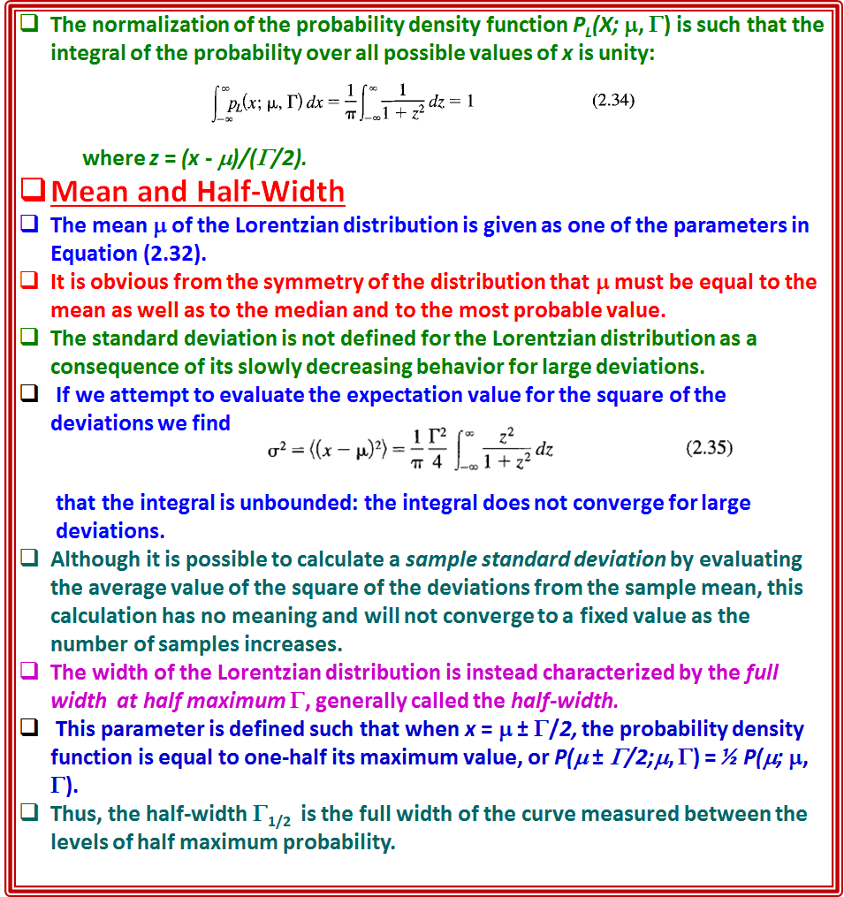

Slide 26

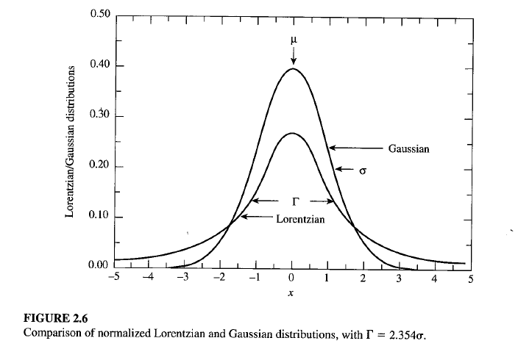
We can verify that this identification of f with the full-width at half maximum is
correct by substituting x = μ ± Γ/2 into Equation (2.32).
The Lorentzian and Gaussian distributions are shown for comparison in Figure
2.6, for μ = 10 and Γ = 2.354 (corresponding to σ = 1 for the Gaussian function).
Both distributions are normalized to unit area according to their definitions in
Equations (2.23) and (2.32).
For both curves, the value of the maximum probability is inversely proportional to the half-widthΓ.
This results in a peak value of 2/πΓ = 0.270 for the Lorentzian distribution and a peak value of 1/(σ√2π) = 0.399 for the Gaussian distribution.
Except for the normalization, the Lorentzian distribution is equivalent to the dispersion relation that is used, for example, in describing the cross section of a nuclear reaction for a Breit-Wigner resonance:

Slide 27
