Slide 1
CHAPTER 2.1
PROBABILITY
DISTRIBUTIONS

Slide 2
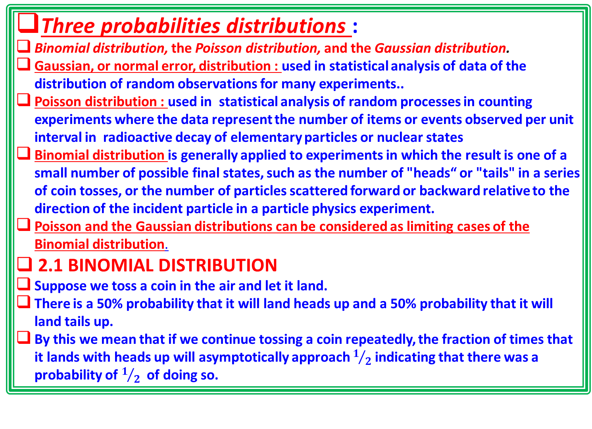
Three probabilities distributions :
Binomial distribution, the Poisson distribution, and the Gaussian distribution.
Gaussian, or normal error, distribution : used in statistical analysis of data of the distribution of random observations for many experiments..
Poisson distribution : used in statistical analysis of random processes in counting experiments where the data represent the number of items or events observed per unit interval in radioactive decay of elementary particles or nuclear states
Binomial distribution is generally applied to experiments in which the result is one of a small number of possible final states, such as the number of "heads“ or "tails" in a series of coin tosses, or the number of particles scattered forward or backward relative to the direction of the incident particle in a particle physics experiment.
Poisson and the Gaussian distributions can be considered as limiting cases of the Binomial distribution.
2.1 BINOMIAL DISTRIBUTION
Suppose we toss a coin in the air and let it land.
There is a 50% probability that it will land heads up and a 50% probability that it will land tails up.
By this we mean that if we continue tossing a coin repeatedly, the fraction of times that it lands with heads up will asymptotically approach $1/2$ indicating that there was a probability of $1/2$ of doing so.

Slide 3
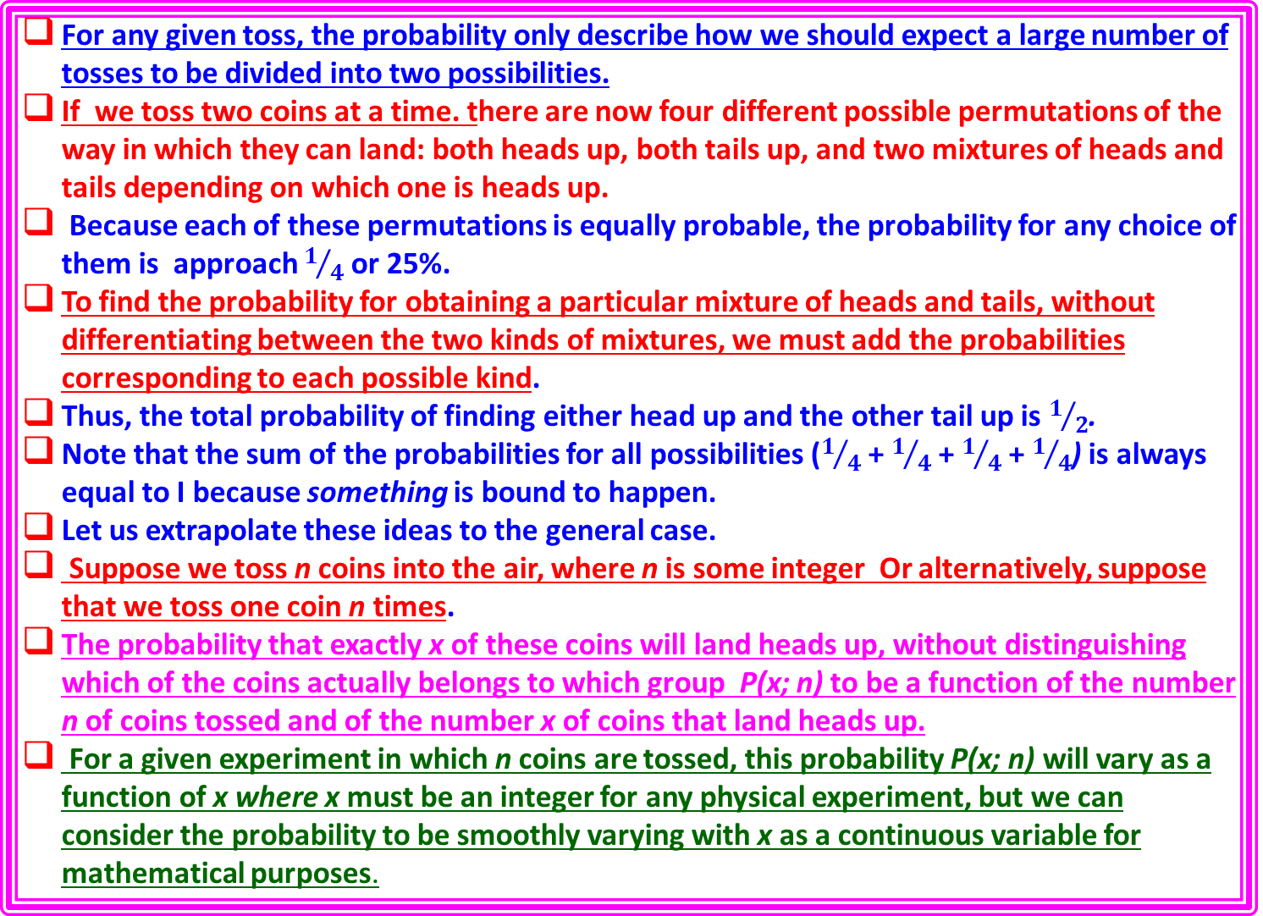
For any given toss, the probability only describe how we should expect a large number of tosses to be divided into two possibilities.
If we toss two coins at a time. there are now four different possible permutations of the way in which they can land: both heads up, both tails up, and two mixtures of heads and tails depending on which one is heads up.
Because each of these permutations is equally probable, the probability for any choice of them is approach $1/4$ or 25%.
To find the probability for obtaining a particular mixture of heads and tails, without differentiating between the two kinds of mixtures, we must add the probabilities corresponding to each possible kind.
Thus, the total probability of finding either head up and the other tail up is $1/2$.
Note that the sum of the probabilities for all possibilities ($1/4$ + $1/4$ + $1/4$ + $1/4$) is always equal to I because something is bound to happen.
Let us extrapolate these ideas to the general case.
Suppose we toss n coins into the air, where n is some integer Or alternatively, suppose that we toss one coin n times.
The probability that exactly x of these coins will land heads up, without distinguishing which of the coins actually belongs to which group P(x; n) to be a function of the number n of coins tossed and of the number x of coins that land heads up.
For a given experiment in which n coins are tossed, this probability P(x; n) will vary as a function of x where x must be an integer for any physical experiment, but we can consider the probability to be smoothly varying with x as a continuous variable for mathematical purposes.

Slide 4

Permutations and Combinations
If n coins are tossed, there are 2^{n} different possible ways in which they can land.
Because each of these possibilities is equally probable, the probability for anyone of these possibilities to occur at any toss of n coins is l/2^{n}
How many of these possibilities will result in our observations of x coins with heads up?
Imagine two boxes, one labeled "heads" and divided into x slots, and the other labeled "tails."
how many permutations of the coins result in the proper separation of x in one box and n - x in the other;
how many combinations of these permutations should be considered to be different from each other.
In order to enumerate the number of permutations Pm(n, x), let us pick up the coins one at a time from the collection of n coins and put x of them into the "heads“ box.
We have a choice of n coins for the first one - pick up, for second selection we can choose from the remaining n - 1 coins. Finally the range of choice for the last selection of the xth coin can be made from only n - x + 1 remaining coins.
The total number of choices for coins to fill the x slots in the "heads" box is the product of the numbers of individual choices:
Pm (n, x) = n (n - 1)(n - 2)··' (n - x + 2)(n - x + 1).;
number of permutations Pm(n, x) that will yield x coins in the “heads" box and n - x coins in the "tails" box, with the provision that we have identified which coin was placed in the "heads" box first which was placed in second, and so on.

Slide 5
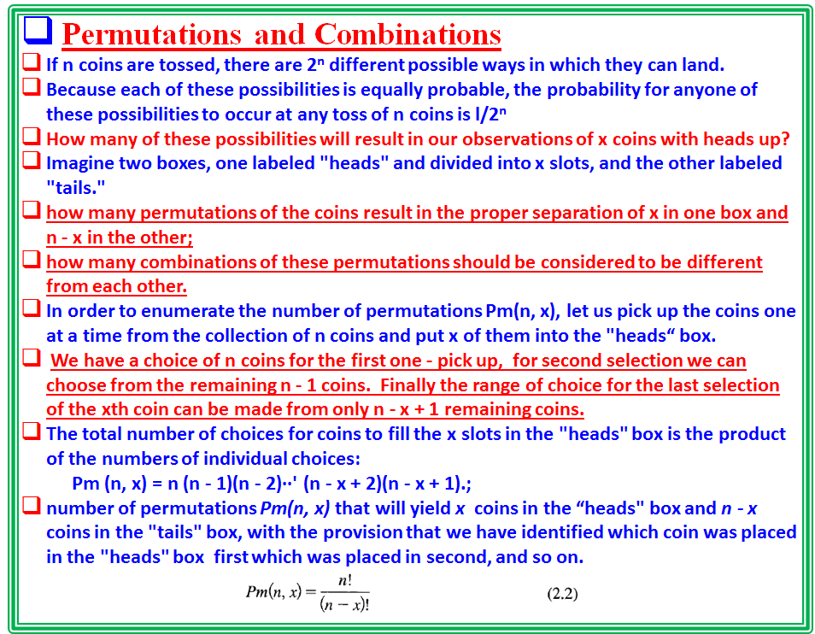

Slide 6
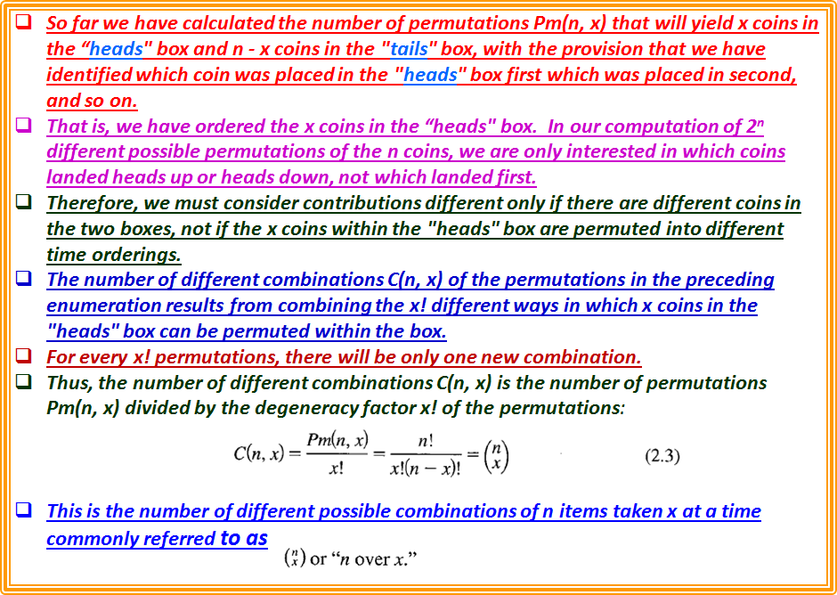

Slide 7
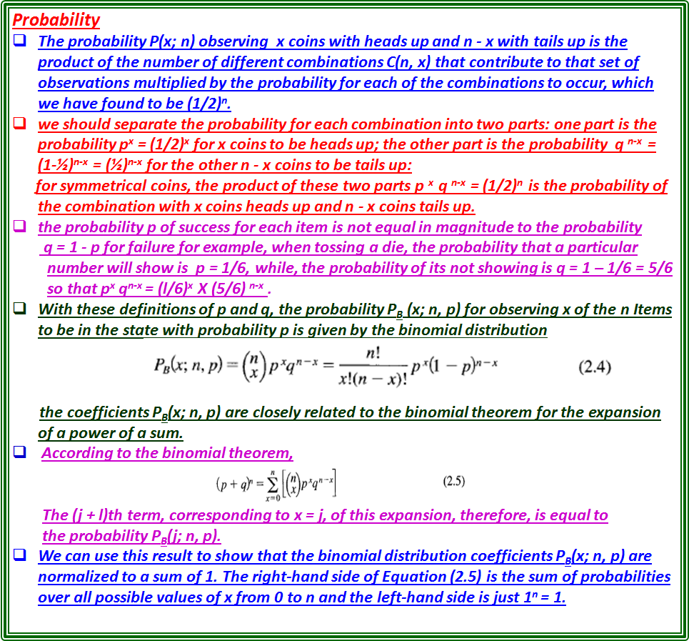

Slide 8
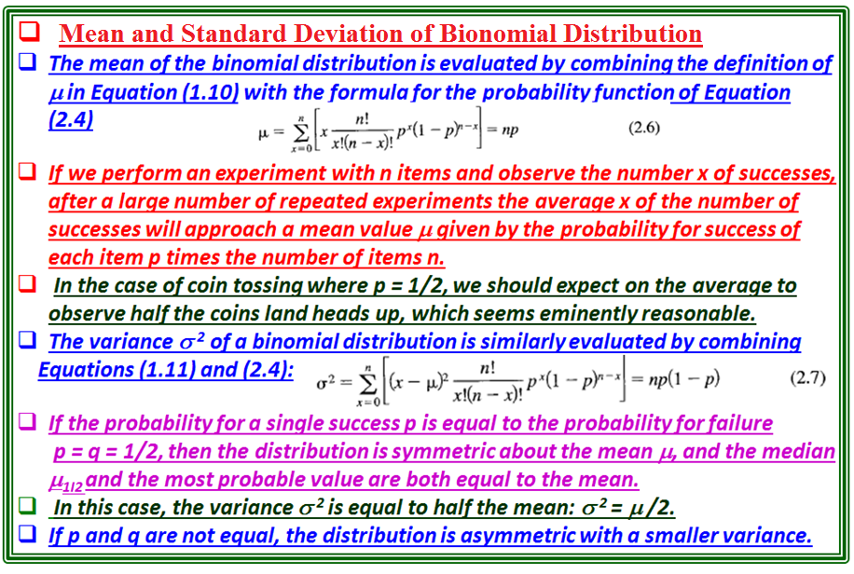

Slide 9
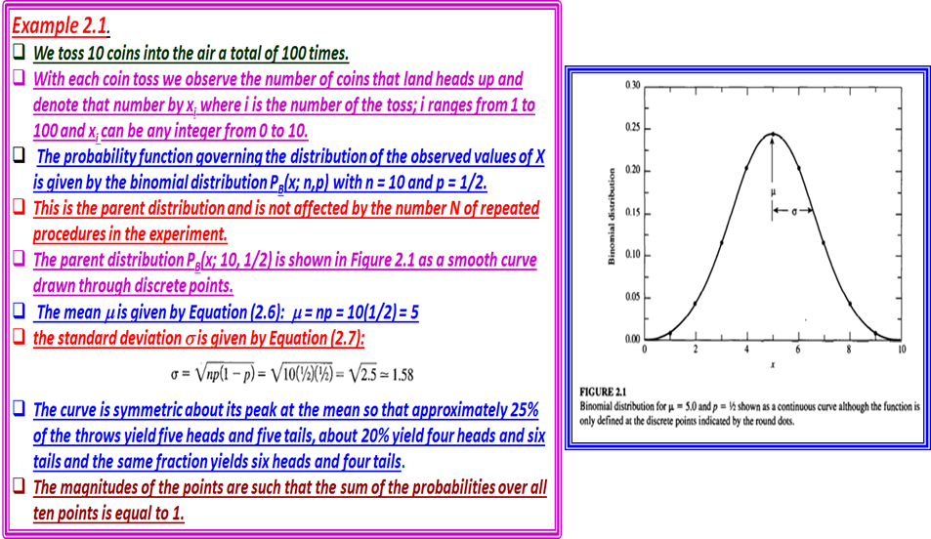

Slide 10
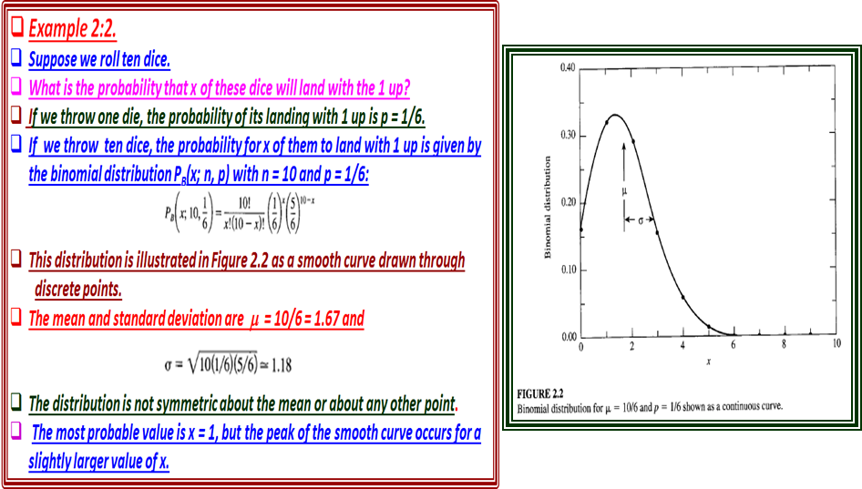

Slide 11
