Slide 1
CHAPTER – 1
UNCERTAINTIES
IN
MEASUREMENTS

Slide 2
1.3 PARENT AND SAMPLE DISTRIBUTIONS
If we make a measurement x_{i} in of a quantity x, we expect our observation to approximate the quantity, but we do not expect the experimental data point to be exactly equal to the quantity.
If we make another measurement, we expect to observe a discrepancy between the two measurements because of random errors, and we do not expect either determination to be exactly correct, that is, equal to x. As we make more and more measurements, a pattern will emerge from the data.
Some of the measurements will be too large, some will be too small. On the average, however, we expect them to be distributed around the correct value, assuming we can neglect or correct for systematic errors.
If we could make an infinite number of measurements, then we could describe exactly the distribution of the data points.
This is not possible in practice, but we can hypothesize the existence of such a distribution that determines the probability of getting any particular observation in a single measurement.
This distribution is called the parent distribution.
Similarly, we can hypothesize that the measurements we have made are samples from the parent distribution and they form the sample distribution.
In the limit of an infinite number of measurements, the sample distribution becomes the parent distribution.

Slide 3
1.3 PARENT AND SAMPLE DISTRIBUTIONS
If we make a measurement x_{i} in of a quantity x, we expect our observation to approximate the quantity, but we do not expect the experimental data point to be exactly equal to the quantity.
If we make another measurement, we expect to observe a discrepancy between the two measurements because of random errors, and we do not expect either determination to be exactly correct, that is, equal to x.
As we make more and more measurements, a pattern will emerge from the data.
Some of the measurements will be too large, some will be too small.
On the average, however, we expect them to be distributed around the correct value, assuming we can neglect or correct for systematic errors.
If we could make an infinite number of measurements, then we could describe exactly the distribution of the data points called the parent distribution.
This is not possible in practice, but we can hypothesize the existence of such a distribution that determines the probability of getting any particular observation in a single measurement.
This distribution is called the parent distribution.
Similarly, we can hypothesize that the measurements we have made are samples from the parent distribution and they form the sample distribution.
In the limit of an infinite number of measurements, the sample distribution becomes the parent distribution.
It is convenient to think in terms of a probability density function p(x), normalized to unit area (i.e., so that the integral of the entire curve is equal to 1) and defined such that in the limit of a very large number N of observations, the number ,)..N of observations of the variable x between x and x + Δx is given by M = Np(x) Δ x.
The solid and dashed curves in Figure 1.2 have been scaled in this way so that the ordinate values correspond directly to the numbers of observations expected in any range Δ x from a 50-event sample and the area under each curve corresponds to the total area of the histogram.

Slide 4
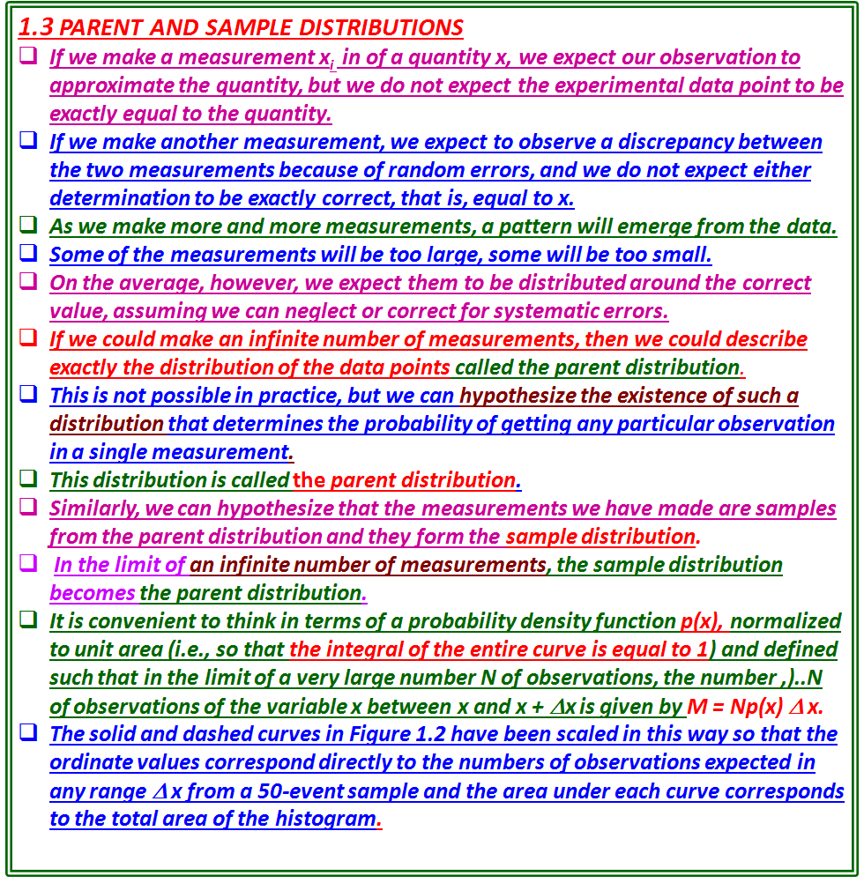

Slide 5
EXAMPLE 1.2
In a physics laboratory experiment, students drop a ball 50 times and record the time it takes for the ball to fall 2.00 m.
One set of observations, corrected for systematic errors, ranges from about 0.59 s to 0.70 s, and some of the observations are identical.
Figure 1.2 shows a histogram or frequency plot of these measurements. The height of a data bar represents the number of measurements that fall between the two values indicated by the upper and lower limits of the bar on the abscissa of the plot. (See Appendix D.)
If the distribution results from random errors in measurement, then it is very likely that it can be described in terms of the Gaussian or normal error distribution the familiar bell-shaped curve of statistical analysis, which we shall discuss in Chapter 2.
A Gaussian curve, based on the mean and standard deviation of these measurements, is plotted as the solid line in Figure 1.2.
This curve summarizes the data of the sample distribution in terms of the Gaussian model and provides an estimate of the parent distribution.
The measured data and the curve derived from them clearly do not agree exactly.
The coarseness of the experimental histogram distinguishes it at once from the smooth theoretical Gaussian curve.
We might imagine that, if the students were to make a great many measurements or combine several sets of measurements so that they could plot the histogram in finer and finer bins, under ideal circumstances the histogram would eventually approach a smooth Gaussian curve.
If they were to calculate the parameters from such a large sample, they could determine the parent distribution represented by the dotted curve in Figure 1.2.

Slide 6
EXAMPLE 1.2
A students drop a ball 50 times and record the time it takes for the ball to fall 2.00 m.
One set of observations, corrected for systematic errors, ranges from about 0.59 s to 0.70 s, and some of the observations are identical.
Figure 1.2 shows a histogram or frequency plot of these measurements.
The height of a data bar represents the number of measurements that fall between the two values indicated by the upper and lower limits of the bar on the abscissa of the plot. (See Appendix D.)
If the distribution results due to random errors in measurement, then it can be described in terms of the Gaussian or normal error distribution -the familiar bell-shaped curve of statistical analysis( Chapter 2).
A Gaussian curve, based on the mean and standard deviation of these measurements, is plotted as the solid line in Figure 1.2.
This curve summarizes the data of the sample distribution in terms of the Gaussian model and provides an estimate of the parent distribution.
The measured data and the curve derived from them clearly do not agree exactly.
The coarseness of the experimental histogram distinguishes it at once from the smooth theoretical Gaussian curve.
If the students were to make a great many measurements or combine several sets of measurements so that they could plot the histogram in finer and finer bins, under ideal circumstances the histogram would eventually approach a smooth Gaussian curve.
If they were to calculate the parameters from such a large sample, they could determine the parent distribution represented by the dotted curve in Figure 1.2.

Slide 7
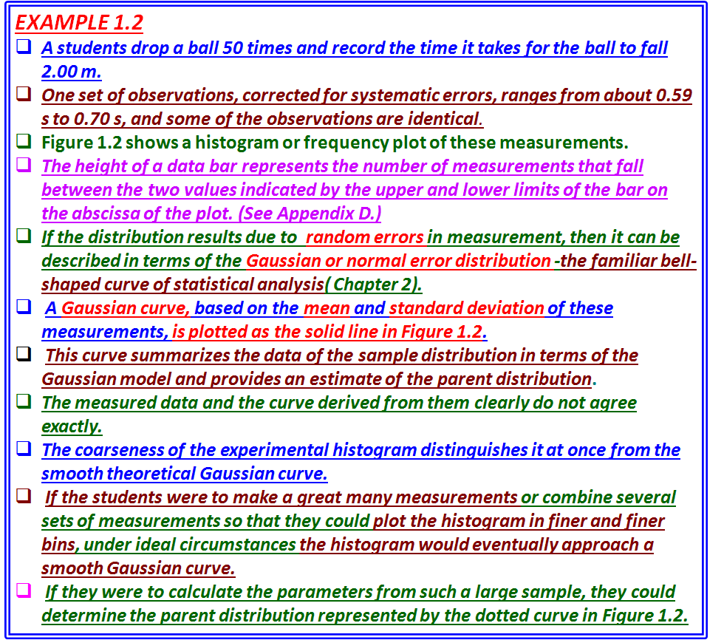

Slide 8
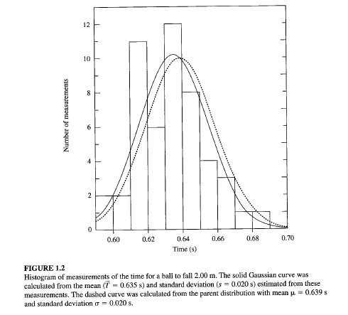

Slide 9

It is convenient to think in terms of a probability density function p(x), normalized to unit area (i.e., so that the integral of the entire curve is equal to 1) and defined such that in the limit of a very large number N of observations, the number ,)..N of observations of the variable x between x and x + Δx is given by M = Np(x) Δ x.
The solid and dashed curves in Figure 1.2 have been scaled in this way so that the ordinate values correspond directly to the numbers of observations expected in any range Δ x from a 50-event sample and the area under each curve corresponds to the total area of the histogram.
Notation
A number of parameters of the parent distribution have been defined by convention.
We use Greek letters to denote them, and Latin letters to denote experimental estimates of them.
In order to determine the parameters of the parent distribution, we assume that the results of experiments asymptotically approach the parent quantities as the number of measurements approaches infinity; that is, the parameters of the experimental distribution equal the parameters of the parent distribution in the limit of an infinite number of measurements.
If we specify that there are N observations in a given experiment, then we can denote this by (parent parameter) = lim (experimental parameter) N->∞ .
If we make N measurements and label them x₁, x₂, x₃, and so forth, up to a final measurement x_{N} , then we can identify the sum of all these measurements as

Slide 10


Notation
Greek letters to denote parameters of the parent distribution , and Latin letters to denote experimental estimates of them.
We assume that the results of experiments asymptotically approach the parent quantities as the number of measurements approaches infinity;
the parameters of the experimental distribution equal the parameters of the parent distribution in the limit of an infinite number of measurements.
If we specify that there are N observations in a given experiment, then we can denote this by (parent parameter) = lim (experimental parameter) N->∞ .
If we make N measurements and label them x₁, x₂, x₃, and so forth, up to a final measurement x_{N} , then we can identify the sum of all these measurements as
where the left-hand side is interpreted as the sum of the observations x_{i} over the index i from i = 1 to i = N inclusive.
Because we shall be making frequent use of the sum over N measurements of various quantities, we simplify the notation by omitting the index whenever we are considering a sum where the index i runs from 1 to N;

Slide 11
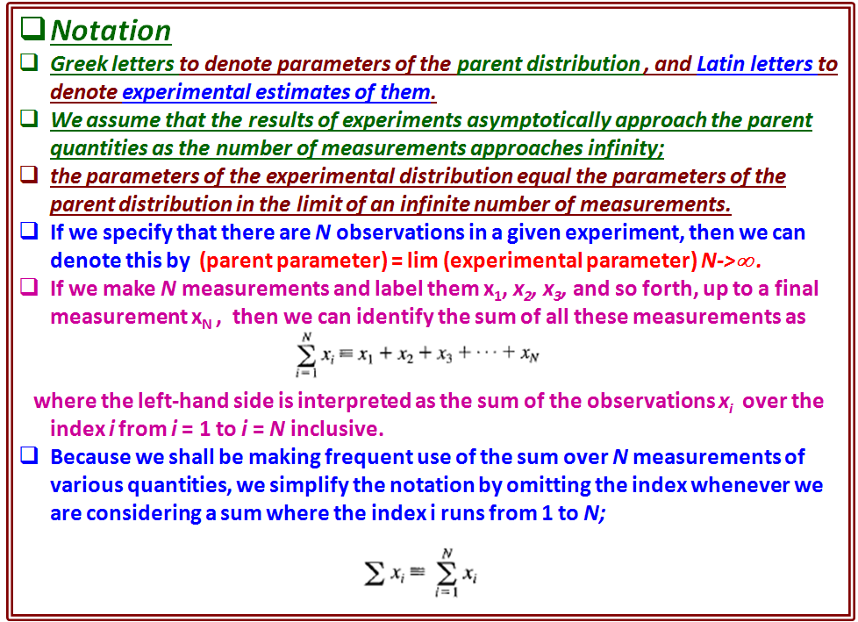

Slide 12


where the left-hand side is interpreted as the sum of the observations x_{i} over the index i from i = 1 to i = N inclusive.
Because we shall be making frequent use of the sum over N measurements of various quantities, we simplify the notation by omitting the index whenever we are considering a sum where the index i runs from 1 to N;
Mean, Median, and Mode
The of the experimental distribution is given as the sum of N determinations x_{i} of the quantity x divided by the number of determinations
Mean μ of the parent population is defined as the limit
The mean is therefore equivalent to the centroid or average value of the quantity x.
Median μ _{1/2} of the parent population μ _{1/2} is defined as that value for which, in the limit of an infinite number of determinations x_{i} half the observations will be less than the median and half will be greater.
In terms of the parent distribution, this means that the probability is 50% that any measurement x_{i} will be larger or smaller than the median

Slide 13


Mean, Median, and Mode
The of the experimental distribution is given as the sum of N determinations x_{i} of the quantity x divided by the number of determinations
Mean μ of the parent population is defined as the limit
; mean is therefore equivalent to the centroid or average value of the quantity x.
Median μ _{1/2} of the parent population μ _{1/2} is defined as that value for which, in the limit of an infinite number of determinations x_{i} half the observations will be less than the median and half will be greater.
The probability is 50% that any measurement x_{i} will be larger or smaller than the median μ _{1/2}
so that the median line cuts the area of the probability density distribution in half.
Mode, or most probable value μ_{max}, of the parent population is that value for which the parent distribution has the greatest value.
In any given experimental measurement, this value is the one that is most likely to be observed.
In the limit of a large number of observations, this value will probably occur most often
The relationship of the mean, median, and most probable value to one another is illustrated in Figure 1.3.
For a symmetrical distribution these parameters would all be equal by the symmetry of their definitions.
For an asymmetric distribution such as that of Figure 1.3, the median generally falls between the most probable value and the mean.
The most probable value corresponds to the peak of the distribution, and the areas on either side of the median are equal.

Slide 14
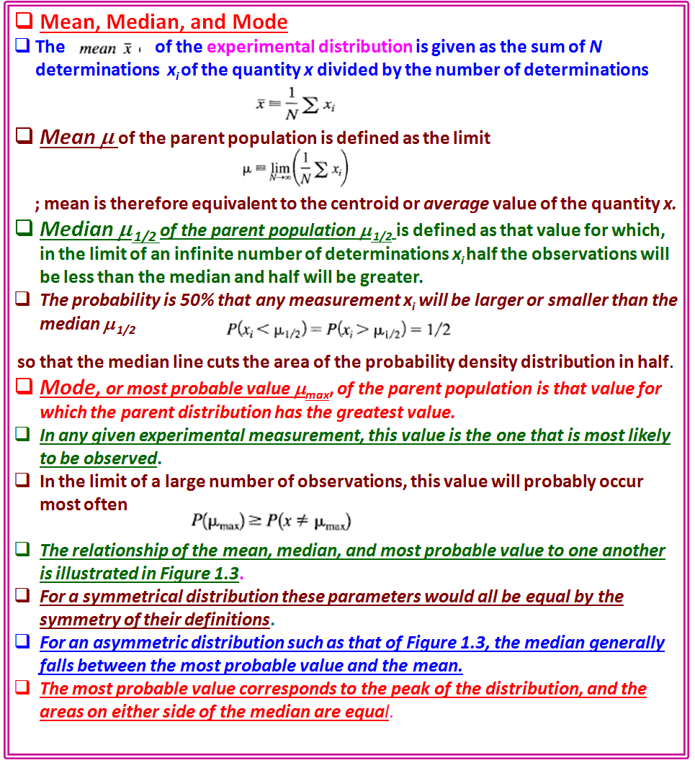

Slide 15
so that the median line cuts the area of the probability density distribution in half.
The mode, or most probable value μ_{max}, of the parent population is that value for which the parent distribution has the greatest value.
In any given experimental measurement, this value is the one that is most likely to be observed.
In the limit of a large number of observations, this value will probably occur most often
The relationship of the mean, median, and most probable value to one another is illustrated in Figure 1.3.
For a symmetrical distribution these parameters would all be equal by the symmetry of their definitions.
For an asymmetric distribution such as that of Figure 1.3, the median generally falls between the most probable value and the mean.
The most probable value corresponds to the peak of the distribution, and the areas on either side of the median are equal.

Slide 16
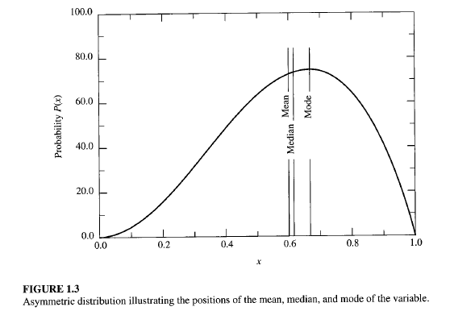

Slide 17



Deviations
The deviation di of any measurement x_{i} from the mean μ of the parent distribution is defined as the difference between x_{i} and μ :
If μ is the true value of the quantity, then d_{i} is also the true error in x_{i} .
The average of the deviations d must vanish by virtue of the definition of the
mean in Equation (1.2):
The average deviation α, therefore, is defined as the average of the absolute values of the deviations:
The average deviation is a measure of the dispersion of the expected observations about the mean.
A parameter that is a more appropriate measure of the dispersion of the observations is the standard deviation σ.
The variance σ² is defined as the limit of the average of the squares of the deviations from the mean μ:
and the standard deviation σ is the square root of the variance.
Note that the second form of Equation (1.8) is often described as "the average of the squares minus the square of the average.
The standard deviation is the root mean square of the deviations, and is associated with the second moment of the data about the mean.

Slide 18


Deviations
The deviation d_{i} of any measurement x_{i} from the mean μ of the parent distribution is defined as the difference between x_{i} and μ :
If μ is the true value of the quantity, then d_{i} is also the true error in x_{i} .
The average of the deviations d must vanish by virtue of the definition of the
mean in Equation (1.2):
The average deviation α, therefore, is defined as the average of the absolute values of the deviations:
The average deviation α is a measure of the dispersion of the expected observations about the meanμ.
Standard deviation σ is a measure of the dispersion of the observations about the the mean μ.
The variance σ² is defined as the limit of the average of the squares of the deviations from the mean μ:
and the standard deviation σ is the square root of the variance.
Note that the second form of Equation (1.8) is often described as "the average of the squares minus the square of the average.
The standard deviation is the root mean square of the deviations, and is associated with the second moment of the data about the mean.

Slide 19
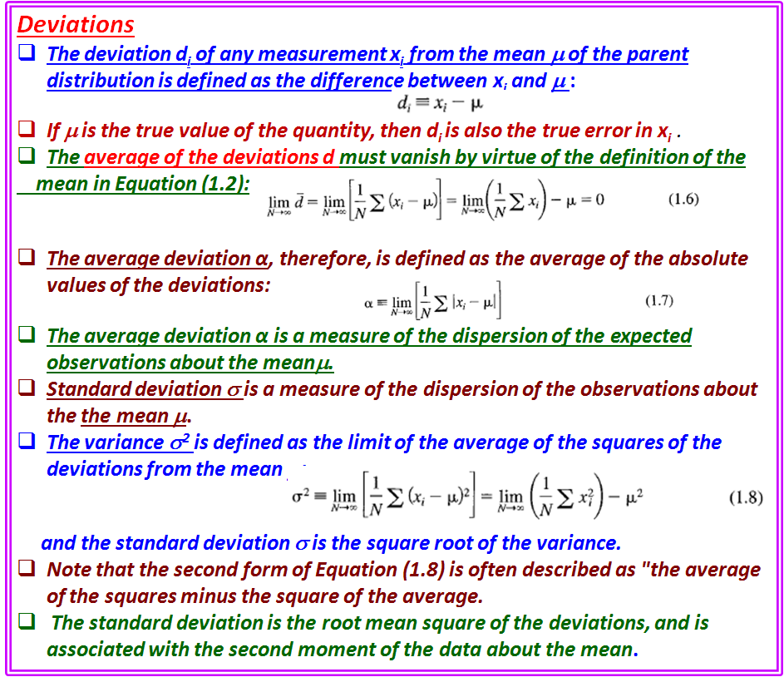

Slide 20

The corresponding expression for the variance s² of the sample population is given by
where the factor N - 1, rather than N, is required in the denominator to
account for the fact that the parameter 'x has been determined from the data
and not independently.
We note that the symbol σ(instead of s) is often used to represent the best estimate of the standard deviation of the parent distribution determined from a sample distribution.
Significance
We wish to describe our distribution in terms of just the mean and standard deviation.
The mean may not be exactly equal to the datum in question if the parent distribution is not symmetrical about the mean, but it should have the same characteristics.
The mean is one of the parameters that specifies the probability distribution: It has the same units as the "true“ value and, we shall consider it to be the best estimate of the "true" value under the prevailing experimental conditions.
The variance s² and the standard deviation s characterize the uncertainties associated with our experimental attempts to determine the "true" values.
For a given number of observations, the uncertainty in determining the mean of the parent distribution is proportional to the standard deviation of that distribution.
The standard deviation s is, therefore, an appropriate measure of the uncertainty due to fluctuations in the observations in our attempt to determine the "true" value.
The distribution resulting from purely statistical errors can be described well by the two parameters, the mean and the standard deviation,
At distances of a few standard deviations from the mean of an experimental distribution, nonstatistical errors may dominate.
Then it may be preferable to describe the spread of the distribution in terms of the average deviation, rather than the standard deviation, because the latter tends to deemphasize measurements that are far from the mean.
There are also distributions for which the variance does not exist. The average deviation or some other quantity must be used as a parameter to indicate the spread of the distribution in such cases.

Slide 21
The corresponding expression for the variance s² of the sample population is given by
where the factor N - 1, rather than N, is required in the denominator to account
for the fact that the parameter x has been determined from the data and not
independently.
Symbol σ (instead of s) is often used to represent the best estimate of the standard deviation of the parent distribution determined from a sample distribution.
Significance
We need to describe our distribution in terms of just the mean and standard deviation.
The mean may not be equal to exact reference point of the parent distribution, if it is not symmetrical about the mean, but it should have the same characteristics.
The mean is one of the parameters that specifies the probability distribution:
It has the same units as the "true“ value and, we shall consider it to be the best estimate of the "true" value under the prevailing experimental conditions.
The variance s² and the standard deviation s characterize the uncertainties associated with our experimental attempts to determine the "true" values.
For a given number of observations, the uncertainty in determining the mean of the parent distribution is proportional to the standard deviation of that distribution.
The standard deviation s is, therefore, an appropriate measure of the uncertainty due to fluctuations in the observations in our attempt to determine the "true" value.
The distribution resulting from purely statistical errors can be described well by the two parameters, the mean and the standard deviation,
At distances of a few standard deviations from the mean of an experimental distribution, nonstatistical errors may dominate.
Then it may be preferable to describe the spread of the distribution in terms of the average deviation, rather than the standard deviation, because the latter tends to deemphasize measurements that are far from the mean.
There are also distributions for which the variance does not exist.
The average deviation or some other quantity must be used as a parameter to indicate the spread of the distribution in such cases.

Slide 22
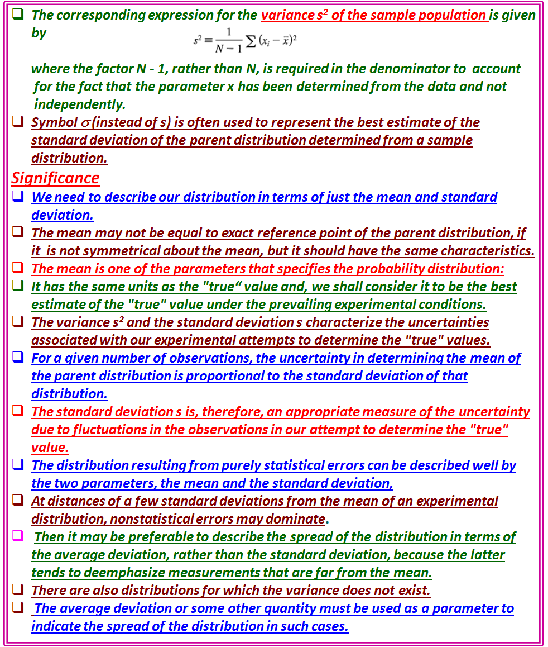

Slide 23
In the following sections, however, we shall be concerned mainly with distributions that result from statistical errors and for which the variance exists.
1.4 MEAN AND STANDARD DEVIATION OF DISTRIBUTIONS
We can define the mean μ and the standard deviation σ in terms of the distribution p (x) of the parent population.
The probability density p(x) is defined such that in the limit of a very large number of observations, the fraction dN of observations of the variable x that yield values between x and x + dx is given by dN = Np (x) dx.
The mean μ is the expectation value < x> of x, and the variance σ is the expectation
value <( x - μ)²> of the square of deviations of x from μ.
The expectation value <f(x)> of any function of x is defined as the weighted average of f(x), over all possible values of the variable x, with each value of f(x) weighted by the probability density distribution p (x).
Discrete Distributions
If the probability function is a discrete function P(x) of the observed value x, we replace
the sum over the individual observations ∑x_{i} in Equation (1.2) by a sum over
the values of the possible observations multiplied by the number of times these observations are expected to occur.
If there are n possible different observable values of the quantity x, which we denote by x_{j} (where the index j runs from 1 to n with no two values of x_{j} equal), we should expect from a total of N observations to obtain each observable NP(x_{j}) times.

Slide 24
1.4 MEAN AND STANDARD DEVIATION OF DISTRIBUTIONS
In the following , we shall be concerned mainly with distributions that result from statistical errors and for which the variance exists
The mean μ and the standard deviation σ can be defined in terms of the distribution p (x) of the parent population.
The probability density p(x) is defined such that in the limit of a very large number of observations, the fraction dN of observations of the variable x that yield values between x and x + dx is given by dN = Np (x) dx.
The mean μ is the expectation value < x> of x, and the variance σ is the expectation value <( x - μ)²> of the square of deviations of x from μ.
The expectation value <f(x)> of any function of x is defined as the weighted average of f(x), over all possible values of the variable x, with each value of f(x) weighted by the probability density distribution p (x).
Discrete Distributions
If the probability function is a discrete function P(x) of the observed value x, we replace the sum over the individual observations ∑x_{i} in Equation (1.2) by a sum over the values of the possible observations multiplied by the number of times these observations are expected to occur.
If there are n possible different observable values of the quantity x, which we denote by x_{j} (where the index j runs from 1 to n with no two values of x_{j} equal), we should expect from a total of N observations to obtain each observable NP(x_{j}) times.

Slide 25
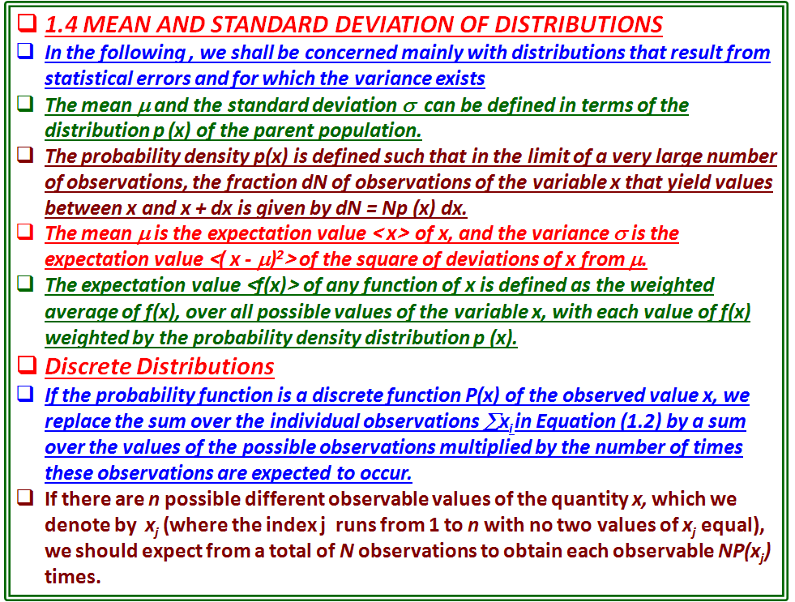

Slide 26
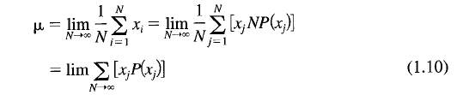





The mean can then be expressed as
Similarly, the variance σ in Equation (1.8) can be expressed in terms of the probability function P(x):
In general, the expectation value of any function of f(x) is given by
Continuous Distributions
If the probability density function is a continuous smoothly varying function p(x) of the observed value x, we replace the sum over the individual observations by an integral over all values of x multiplied by the probability p(x).
The mean μ becomes the first moment of the parent distribution
and the variance σ² becomes the second central product moment
The expectation value of any function of x is

Slide 27



The mean can then be expressed as
Similarly, the variance σ in Equation (1.8) can be expressed in terms of the probability function P(x):
In general, the expectation value of any function of f(x) is given by
Continuous Distributions
If the probability density function is a continuous smoothly varying function p(x) of the observed value x, we replace the sum over the individual observations by an integral over all values of x multiplied by the probability p(x).
The mean μ becomes the first moment of the parent distribution
the variance σ² becomes the second central product moment
The expectation value of any function of x is:

Slide 28
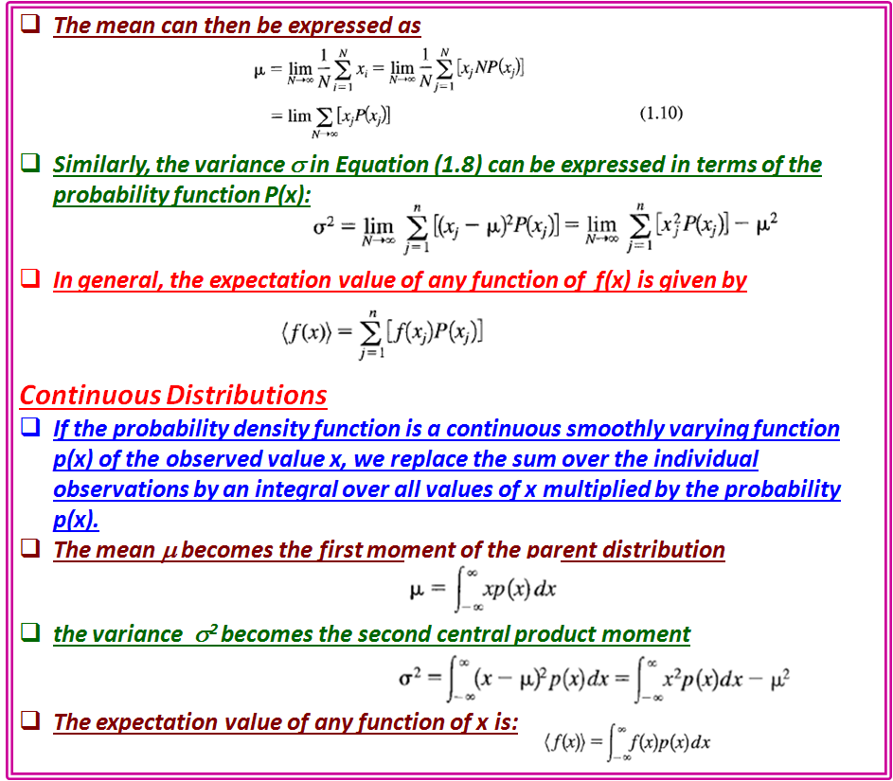

Slide 29
What is the connection between the probability distribution of the parent population and an experimental sample we obtain?
We have already seen that the uncertainties of the experimental conditions preclude a determination of the "true“ values themselves.
As a matter of fact, there are three levels of abstraction between the data and the information we seek:
From. our experimental data points we can determine a sample frequency distribution that describes the way in which these particular data points are distributed over the range of possible data points. We use x to denote the mean of the data and s² to denote the sample variance. The shape and magnitude of the sample distribution vary from sample to sample.
2. From the parameters of the sample probability distribution we can estimate the parameters of the probability distribution of the parent population of possible observations. Our best estimate for the mean μ is the mean of the sample distribution x, and the best estimate for the variance σ² is the sample variance s². Even the shape of this parent distribution must be estimated or assumed.
3. From the estimated parameters of the parent distribution we estimate the results sought. In general, we shall assume that the estimated parameters of the parent distribution are equivalent to the "true" values, but the estimated parent distribution is a function of the experimental conditions as well as the "true" values, and these may not necessarily be separable.

Slide 30
Relation between the probability distribution of the parent population and an experimental sample?
the uncertainties of the experimental conditions preclude a determination of the "true“ values themselves.
Three levels of abstraction between the data and the information we seek:
From experimental data points we can determine a sample frequency distribution that describes the way in which these particular data points are distributed over the range of possible data points. We use x _{avg} to denote the mean of the data and s² to denote the sample variance. The shape and magnitude of the sample distribution vary from sample to sample.
2. From the parameters of the sample probability distribution we can estimate the parameters of the probability distribution of the parent population of possible observations. Our best estimate for the mean μ is the mean of the sample distribution x, and the best estimate for the variance σ² is the sample variance s². Even the shape of this parent distribution must be estimated or assumed.
3. From the estimated parameters of the parent distribution we estimate the results sought. In general, we shall assume that the estimated parameters of the parent distribution are equivalent to the "true" values, but the estimated parent distribution is a function of the experimental conditions as well as the "true" values, and these may not necessarily be separable.

Slide 31
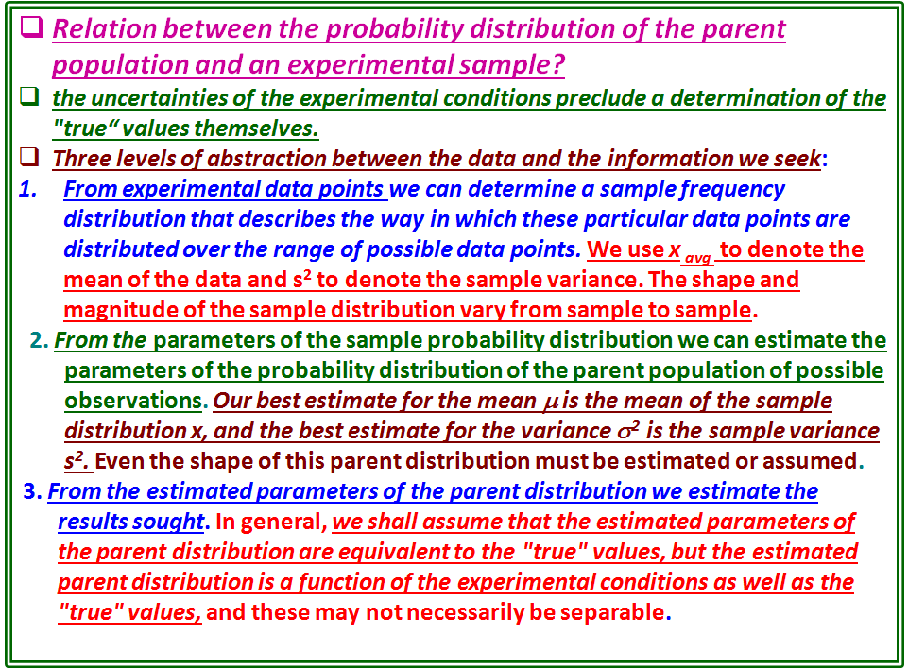

Slide 32
Let us refer again to Figure 1.2, which shows a histogram of time interval measurements and two Gaussian curves, a solid curve based on the parameters Average T = 0.635 s and s = 0.020 s, which were determined experimentally from the data displayed in the histogram, and a dotted curve based on the parameters μ = 0.639 s and σ= 0.020 s of the parent distribution. (Although, in general we don't know the properties of the parent distribution, they could have been estimated to high precision in another experiment involving many more measurements.)
Comparing the two curves, we observe a slight difference between the experimental mean T and the "true" meanμ, and between sand σ.
By considering the data to be a sample from the parent population with the values of the observations distributed according to the parent population, we can estimate the shape and dispersion of the parent distribution to obtain useful information on the precision and reliability of our results.
Thus, we consider the sample mean T to be our best estimate from the data of the mean μ, and we consider the sample variance s² to be our best estimate from the data of the variance σ², from which we can estimate the uncertainty in our estimate of μ·

Slide 33
Let us refer again to Figure 1.2, which shows a histogram of time interval measurements and two Gaussian curves, a solid curve based on the parameters Average T = 0.635 s and s = 0.020 s, which were determined experimentally from the data displayed in the histogram, and a dotted curve based on the parameters μ = 0.639 s and σ= 0.020 s of the parent distribution. (Although, in general we don't know the properties of the parent distribution, they could have been estimated to high precision in another experiment involving many more measurements.)
Comparing the two curves, we observe a slight difference between the experimental mean T and the "true" mean μ, and between s and σ.
By considering the data to be a sample from the parent population with the values of the observations distributed according to the parent population, we can estimate the shape and dispersion of the parent distribution to obtain useful information on the precision and reliability of our results.
Thus, we consider the sample mean T to be our best estimate from the data of the mean μ, and we consider the sample variance s² to be our best estimate from the data of the variance σ², from which we can estimate the uncertainty in our estimate of μ·

Slide 34
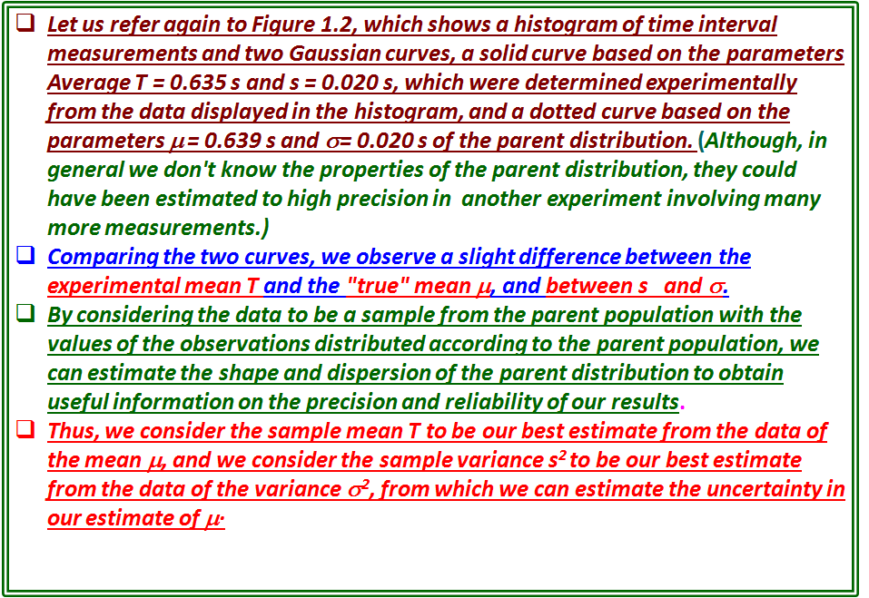

Slide 35
