Slide 1
CHAPTER – 1.2
UNCERTAINTIES
IN
MEASUREMENTS

Slide 2
1.3 PARENT AND SAMPLE DISTRIBUTIONS
In a measurement x₁ of a quantity x, our experimental data point to be not exactly equal to the quantity.
In repeated measurement of x₁ , because of random errors, we observe a discrepancy between the two repeated consecutive measurements
By making more measurements, a pattern will emerge from the data such that some of the measurements will be too large, some will be too small.
On the average, however we expect them to be distributed around the correct value, neglecting systematic errors.
If we could make an infinite number of measurements, then we could describe exactly the distribution of the data points.
infinite number of measurements is not possible in practice, but we can hypothesize the existence of such a distribution that determines the probability of getting any particular observation in a single measurement.
This distribution is called the parent distribution.
Similarly, we can hypothesize that the measurements we have made are samples from the parent distribution and they form the sample distribution.
In the limit of an infinite number of measurements, the sample distribution
becomes the parent distribution.

Slide 3
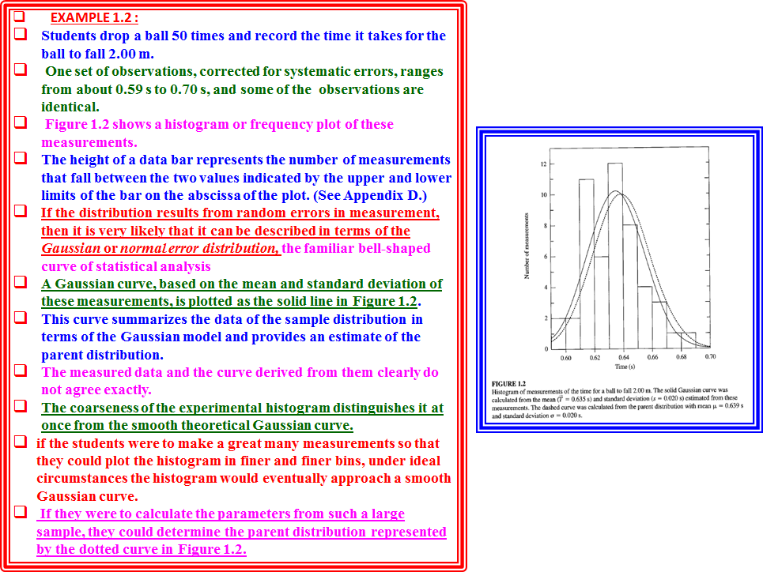

Slide 4
EXAMPLE 1.2 :
Students drop a ball 50 times and record the time it takes for the ball to fall 2.00 m.
One set of observations, corrected for systematic errors, ranges from about 0.59 s to 0.70 s, and some of the observations are identical.
Figure 1.2 shows a histogram or frequency plot of these measurements.
The height of a data bar represents the number of measurements that fall between the two values indicated by the upper and lower limits of the bar on the abscissa of the plot. (See Appendix D.)
If the distribution results from random errors in measurement, then it is very likely that it can be described in terms of the Gaussian or normal error distribution, the familiar bell-shaped curve of statistical analysis
A Gaussian curve, based on the mean and standard deviation of these measurements, is plotted as the solid line in Figure 1.2.
This curve summarizes the data of the sample distribution in terms of the Gaussian model and provides an estimate of the parent distribution.
The measured data and the curve derived from them clearly do not agree exactly.
The coarseness of the experimental histogram distinguishes it at once from the smooth theoretical Gaussian curve.
if the students were to make a great many measurements so that they could plot the histogram in finer and finer bins, under ideal circumstances the histogram would eventually approach a smooth Gaussian curve.
If they were to calculate the parameters from such a large sample, they could determine the parent distribution represented by the dotted curve in Figure 1.2.

Slide 5
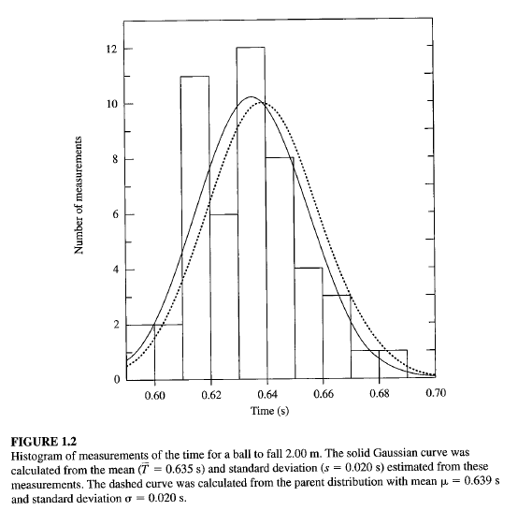

Slide 6
occurrence of events in terms of a probability density function p(x), normalized to unit area (i.e., so that the integral of the entire curve is equal to 1) shown in Fig.1.2
p(x), defined such that in the limit of a very large number N of observations, the number ΔN of observations of the variable x between x and x + Δx is given by
ΔN = Np(x)Δx.
The solid and dashed curves in Figure 1.2 have been scaled in this way so that the ordinate values correspond directly to the numbers of observations expected in any range Δx from a 50-event sample and the area under each curve corresponds to the total area of the histogram.
Notation
The parameters of the parent distribution are defined by Greek letters, and Latin letters to denote experimental estimates of them.
We assume that the results of experiments asymptotically approach the parameters of the parent distribution as the number of measurements approaches infinity;
the parameters of the experimental distribution equal the parameters of the parent distribution in the limit of an infinite number of measurements.
If we specify that there are N observations in a given experiment, then we can denote this by
(parent parameter) = lim _{N→∞}(experimental parameter)

Slide 7
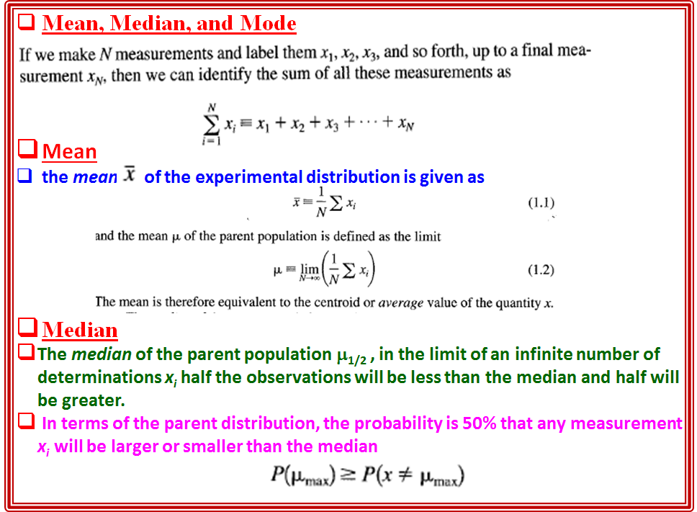

Slide 8
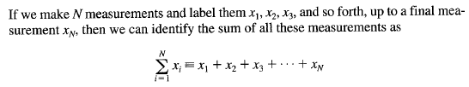
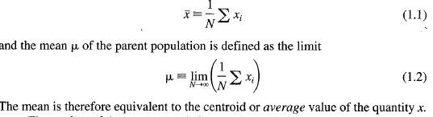

Mean, Median, and Mode
Mean
the mean of the experimental distribution is given as
Median
The median of the parent population μ_{1/2} , in the limit of an infinite number of determinations x_{i} half the observations will be less than the median and half will be greater.
In terms of the parent distribution, the probability is 50% that any measurement x_{i} will be larger or smaller than the median
Mode
The mode, or most probable value μ_{max} of the parent population is that value for which the parent distribution has the greatest value.

Slide 9
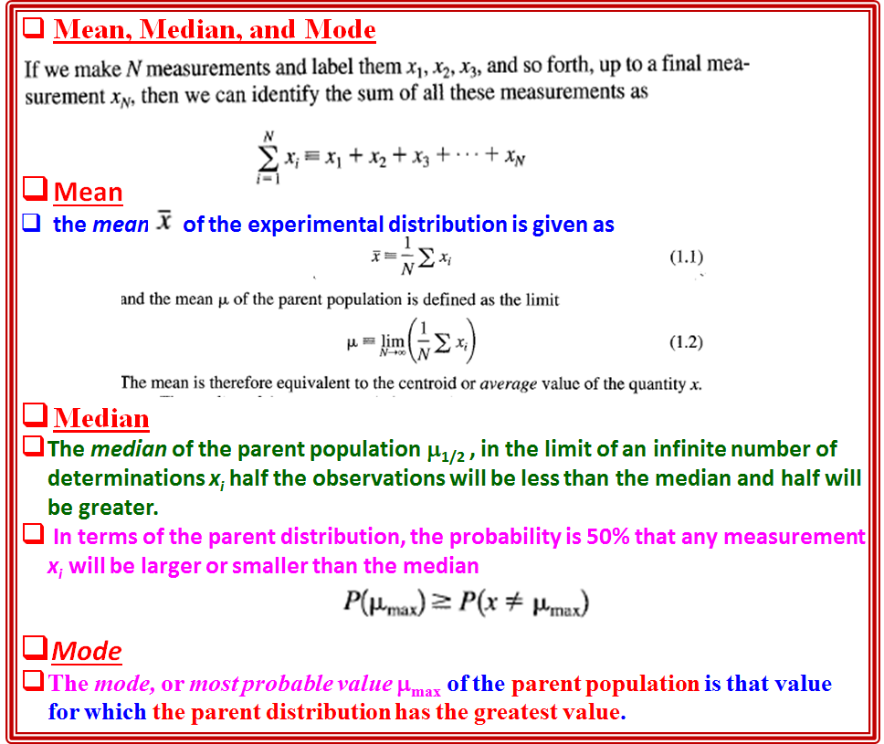
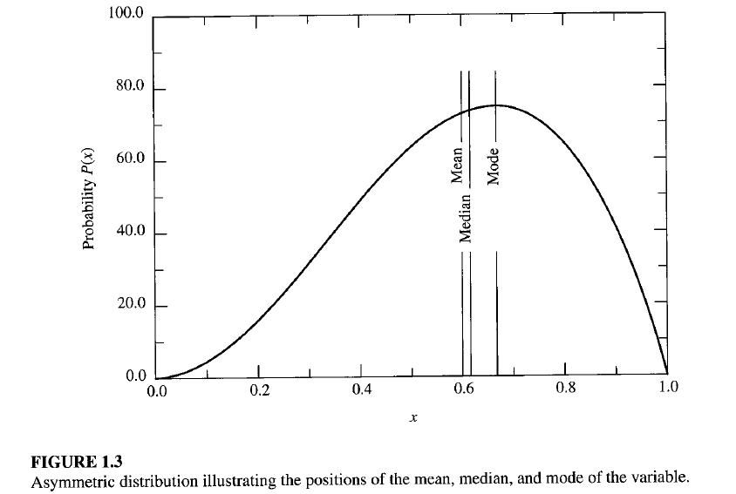

Slide 11
Mode
The mode, or most probable value μ_{max} of the parent population is that value for which the parent distribution has the greatest value.
In the limit of a large number of observations, this value will probably occur most often
The relationship of the mean, median, and most probable value to one another is illustrated in Figure 1.3.
For a symmetrical distribution these parameters would all be equal by the symmetry of their definitions.
For an asymmetric distribution such as that of Figure 1.3, the median generally falls between the most probable value and the mean.
The most probable value corresponds to the peak of the distribution, and the areas on either side of the median are equal.

Slide 13
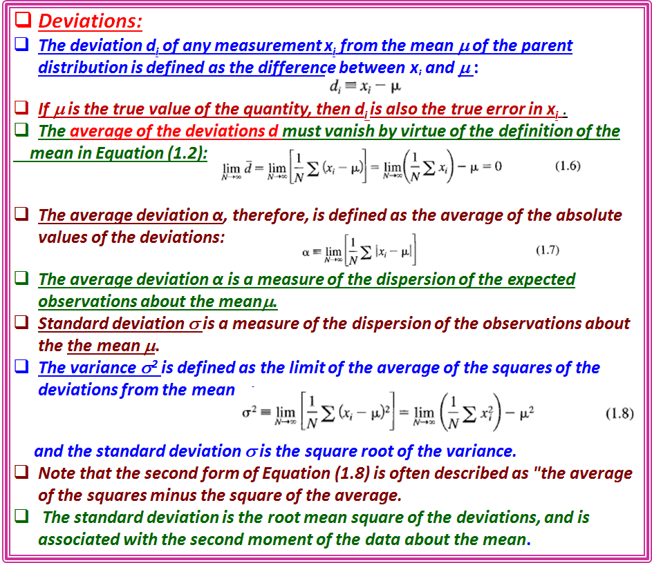

Slide 14

Sample variance :
The corresponding expression for the variance S² of the sample population is given by
where the factor N - 1, rather than N, is required in the denominator to account
for the fact that the parameter has been determined from the data and not
independently.
Symbol σ (instead of s) is often used to represent the best estimate of the standard deviation of the parent distribution determined from a sample distribution.
Significance of mean and variance
The mean μ and the standard deviation, as well as the median, the most probable value, characterize the information we are seeking when we perform an experiment.
the mean and standard deviation to describe our distribution.
Mean has the same units as the "true“ value and, it to be the best estimate of the "true" value
The variance S² and the standard deviation s characterize the uncertainties associated with our experimental attempts to determine the "true" values.
For N number of observations, the uncertainty in determining the mean of the parent distribution is proportional to the standard deviation of that distribution.
The standard deviation s is a measure of the uncertainty due to fluctuations in the observations in our attempt to determine the "true" value.

Slide 15
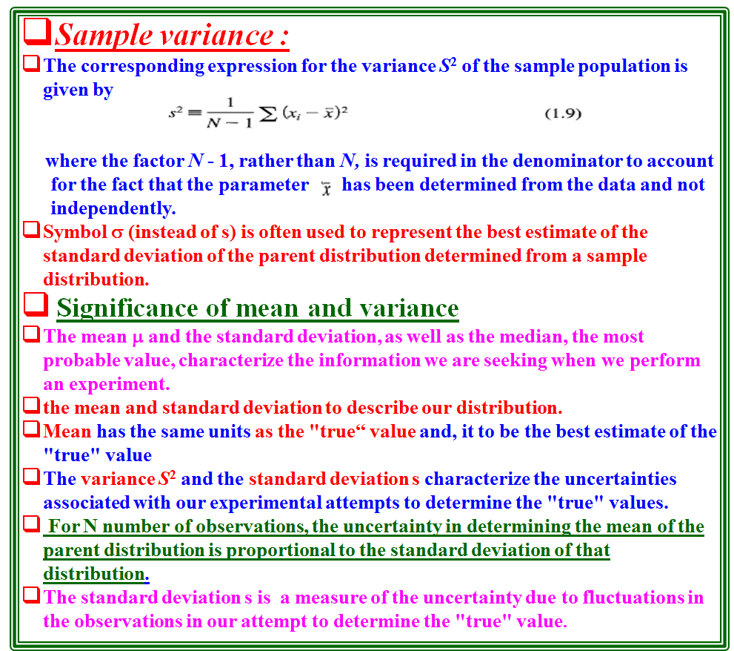

Slide 16
the distribution resulting from purely statistical errors can be described well by the mean and the standard deviation,
at distances of a few standard deviations from the mean, non statistical errors may dominate.
In especially severe cases, it may be preferable to describe the spread of the distribution in terms of the average deviation, rather than the standard deviation, because the latter tends to deemphasize measurements that are far from the mean.
There are also distributions for which the variance does not exist.
The average deviation or some other quantity must be used as a parameter to indicate the spread of the distribution in such cases.
1.4 MEAN AND STANDARD DEVIATION OF DISTRIBUTIONS
mean μ and the standard deviation σ in terms of the distribution p (x) of the parent population.
The probability density p(x) is defined in the limit of a very large number of observations, the fraction dN of observations of the variable x that yield values between x and x + dx is given by dN = Np (x) dx.
The mean μ is the expectation value < x> of x, and the variance σ² is the expectation value <( x - μ )²> of the square of deviations of x from μ .
The expectation value <f(x) > of any function of x is defined as the weighted average of f (x), over all possible values of the variable x, with each value of f (x) weighted by the probability density distribution p (x).

Slide 17
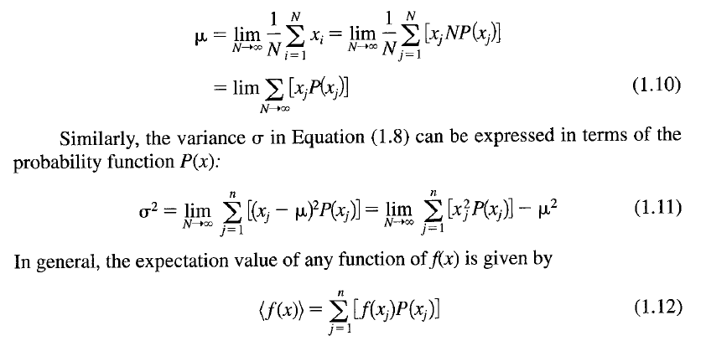
Types of Distributions: Discrete Distributions and Continuous Distributions
Discrete Distributions
For a discrete probability function P(x) of the observed value x , replace the sum over the individual observations Σx_{i} in Equation (1.2) by a sum over the values of the possible observations multiplied by the number of times these observations are expected to occur.
If there are n possible different observable values of the quantity x, which we denote by x_{J} (where the j index runs from 1 to n with no two values of x_{J} equal), we should expect from a total of N observations to obtain each observable NP(x_{J} ) times.

Slide 18
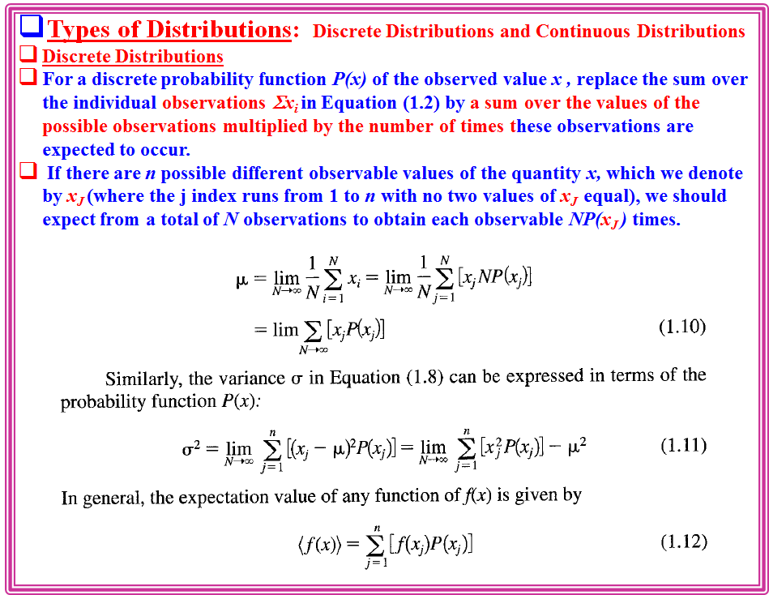

Slide 19
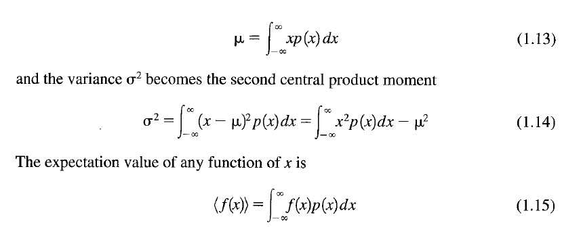
Continuous Distributions
If the probability density function is a continuous smoothly varying function p(x) of the value x, replace the sum over the individual observations by an integral over all values of x multiplied by the probability p(x).
The mean μ becomes the first moment of the parent distribution
What is the relation between the probability distribution of the parent population and an experimental sample we obtain?
Let us refer to Figure 1.2, which shows a histogram of time interval measurements and two Gaussian curves,
a solid curve based on the parameters T = 0.635 sand s = 0.020 s, which were determined experimentally from the data displayed in the histogram,
and a dotted curve based on the parameters μ = 0.639 s and σ = 0.020 s of the parent distribution

Slide 20
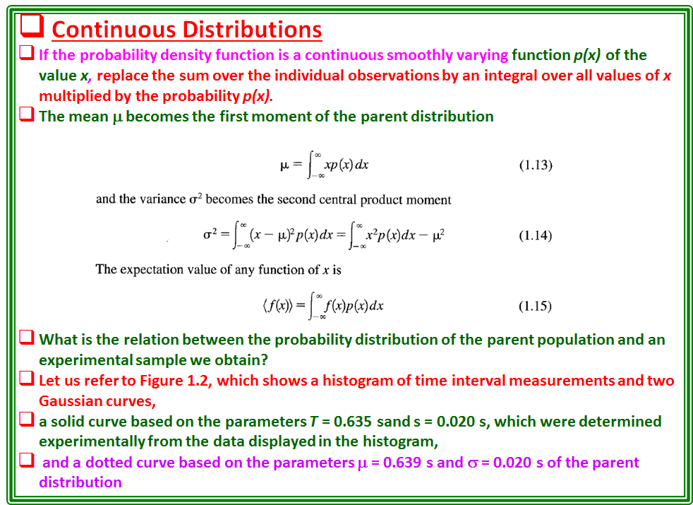

Slide 21
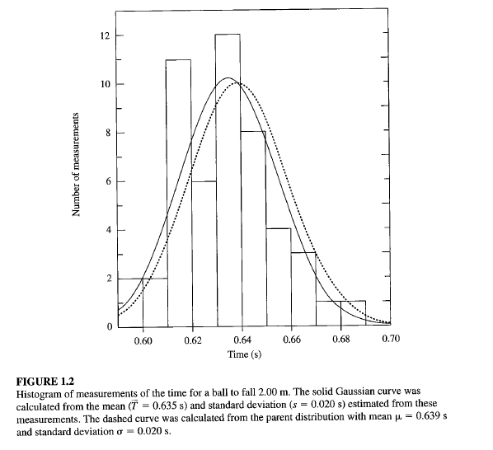
Comparing the two curves, we find a slight difference between the experimental mean T and the "true" mean μ, and between s and σ.
By assuming the data is a sample from the parent population with the values of the observations distributed according to the parent population.
Then we can estimate the shape and dispersion of the parent distribution to get useful information on the precision and reliability of our sample results.
the sample mean T to be our best estimate from the data of the mean μ, and we consider the sample variance S² to be our best estimate from the data of the variance σ², from which we can estimate the uncertainty in our estimate of μ·

Slide 22
