Slide 1
Lecture 5-2
xxxxxxx

Slide 3
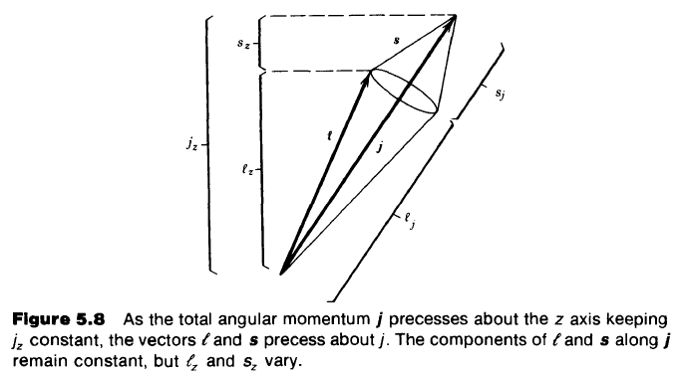

Slide 7
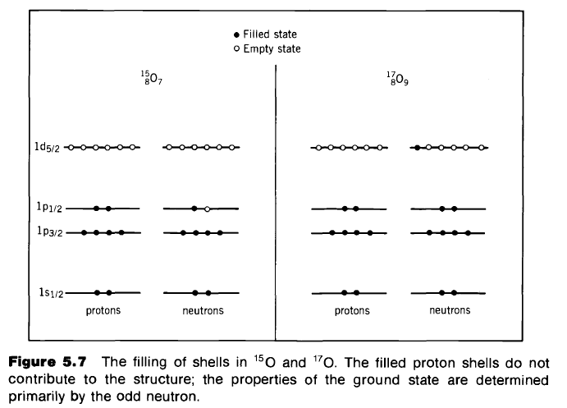

Slide 11
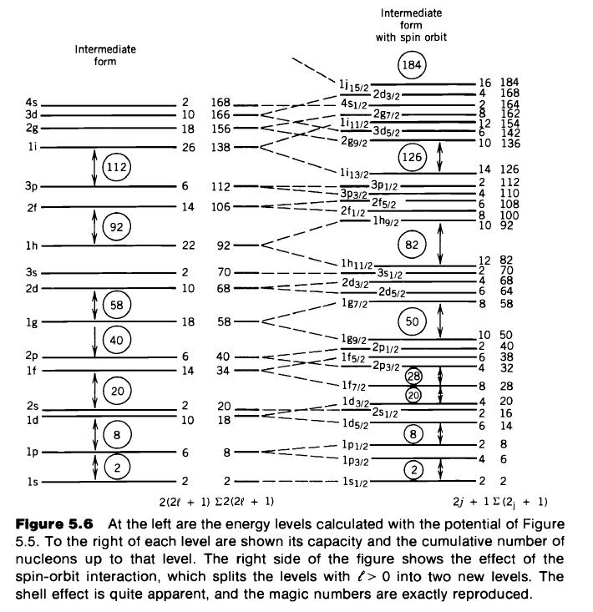

Slide 14
