Slide 1
Ch – 3-2 NUCLEAR PROPERTIES

Slide 2
Ch-3-2

Slide 7
3.3 NUCLEAR BINDING ENERGY
The mass energy m_{N}c² of a certain nuclide is its atomic mass energy m_{A}c² less the total mass energy of Z electrons and the total electronic binding energy:
The binding energy B of a nucleus is the difference in mass energy between a nucleus ^{A}X_{N} and its constituent Z protons and N neutrons:
We also define mass defect Δ = (m - A) c² , where m represents ^{A}X_{N.}
The neutron separation energy S_{n} is the amount of energy that is needed to remove a neutron from a nucleus ; equal to the difference in binding energies between
Similarly proton separation energy S_{p} is the amount of energy that is needed to remove a proton from a nucleus

Slide 9
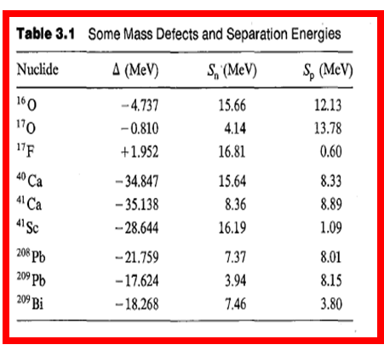

Slide 10
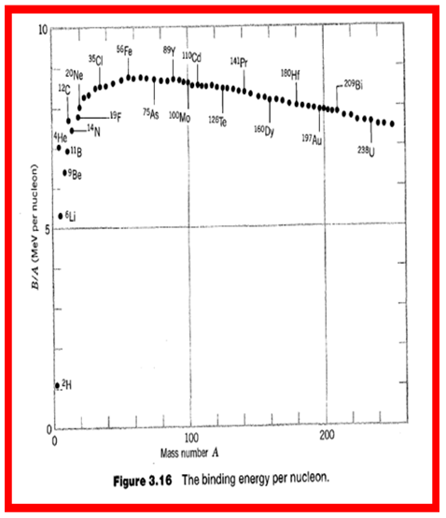
B/ A curve as a function of A

