Slide 1
Chapter 1O GAMMA DECAY

Slide 2
Pt-4

Slide 4
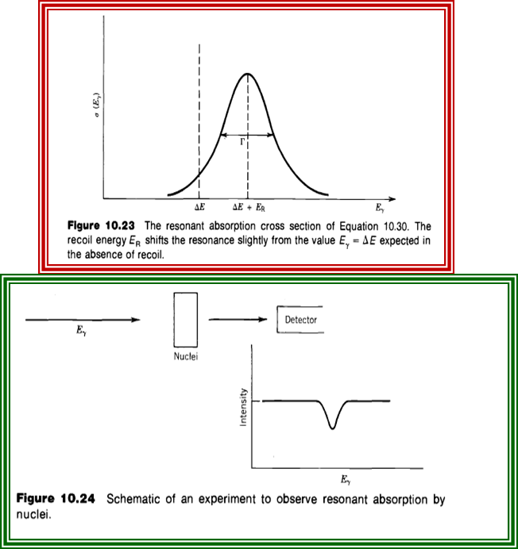

Slide 8
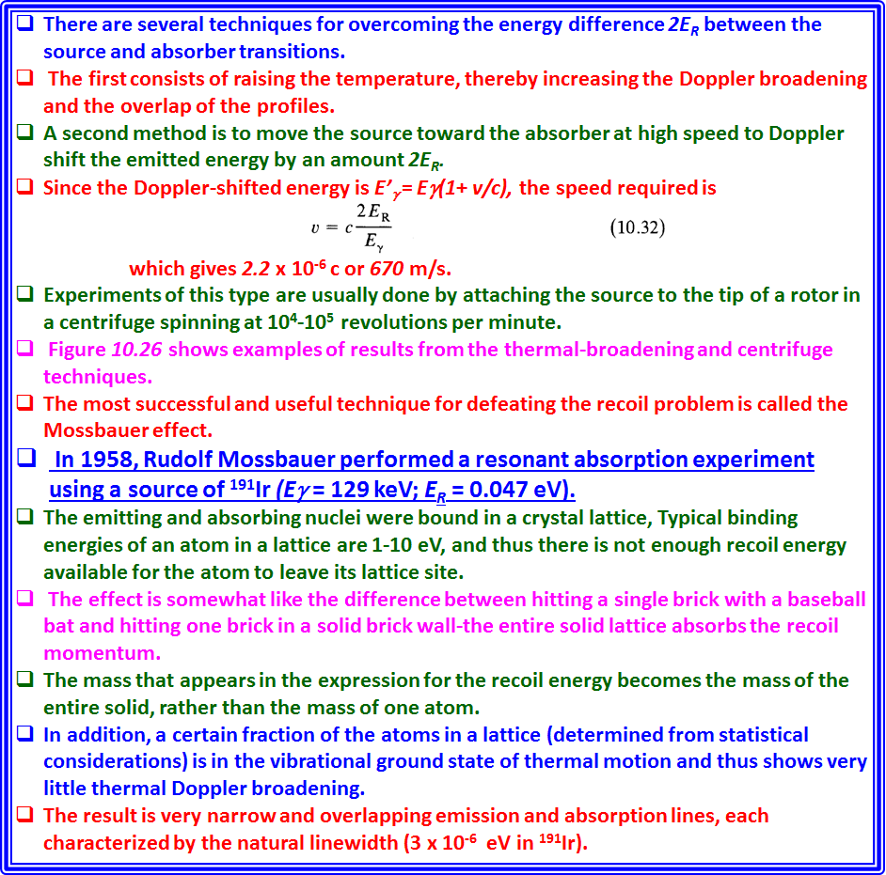

Slide 9
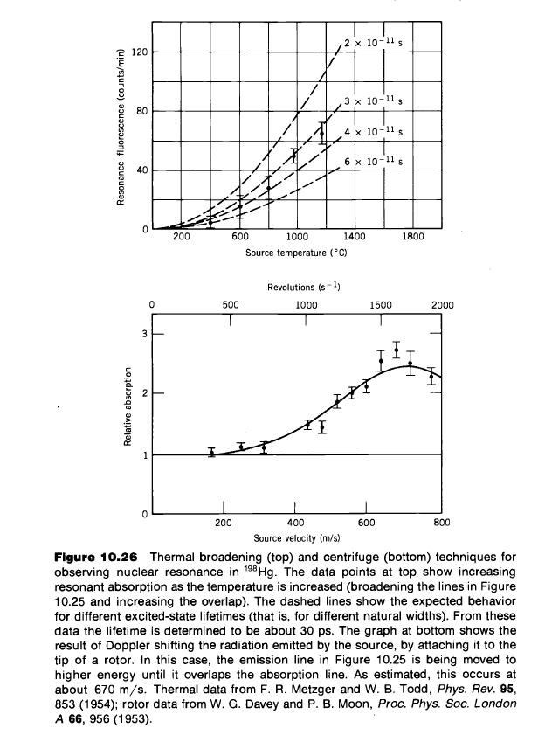

Slide 14
Applications

Slide 20
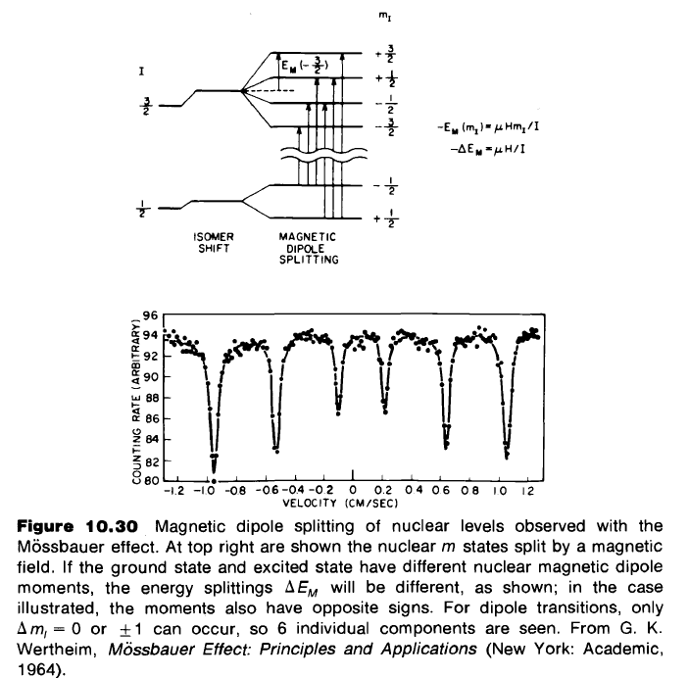

Slide 22
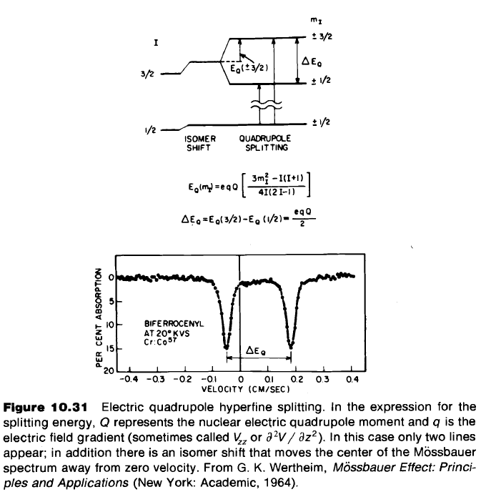

Slide 23
