Slide 1
Optical Pumping
Student : Ahmad Al-Jama
Supervisor : Dr.Akhtar Naqvi

Slide 2
Outline
Introduction
Theoretical Background
Experimental
Results and Discussion
Conclusion

Slide 3
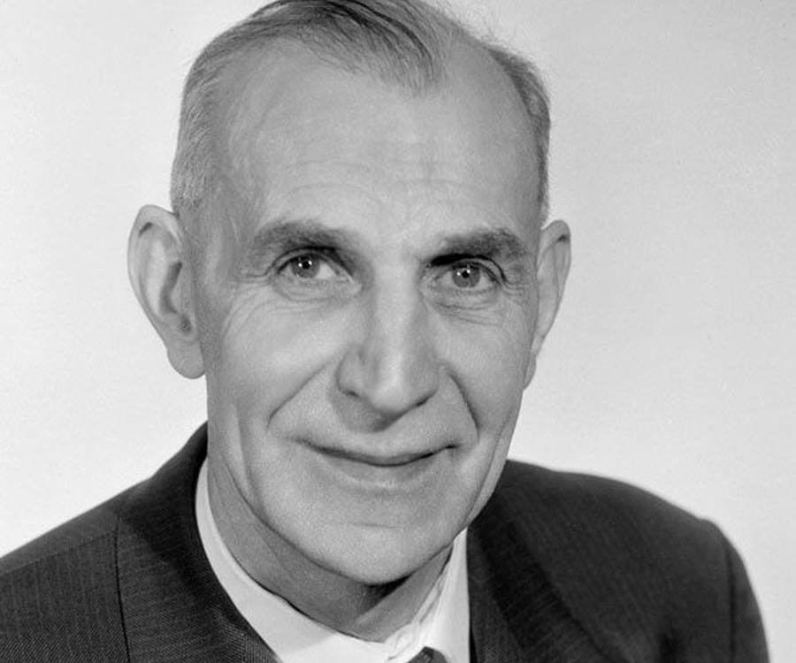
Introduction
Optical pumping is the process that uses photons to change the distribution of the stated occupied by a collection of atoms.
In 1966, Alfred Kastler won a Nobel Prize for his work on optical pumping.

Slide 4
Introduction
Rubidium has the electron configuration :
This means it’s a Hydrogen-like atom.
For such atoms, the complete inner shells can be
ignored.

Slide 5
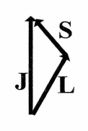
Theoretical Background
Fine Structure :
Results from J = S + L
Hyperfine Structure :
Results from F = I + J
The Zeeman Effect :

Slide 6
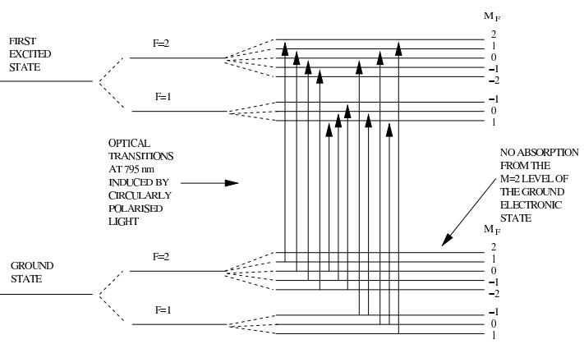
Theoretical Background (Cont’d)
Absorption :
Optical Pumping :
Using circularly polarized
light to excite electrons
where they can no longer
be excited.

Slide 7
Experimental Procedure : Equipments
Rubidium Discharge Lamp : Filled with Rb gas and Xenon Buffer Gas.
Lenses : One used to collimate the beam. The other used to focus it into the detector.
Filter : Excludes all lines except the near-IR 795 nm line.
Polarizer : Produces linearly-polarized light.
¼ Waveplate : Produces circularly-polarized light.

Slide 8
Experimental Procedure : Equipments (Cont’d)
Cell and heater : The cell is an insulated perspex cylinder with a bulb of rubidium and neon buffer gas. The bulb can be heated to change the Rb pressure and density.
Magnetic field coils : The vertical field is to cancel the local field due to the Earth’s magnetic field. The horizontal field is for the Zeeman effect and the sweep field is for viewing the B =0 resonance.
RF coils and signal generator : the RF magnetic field coils are located on the cell. The field is produced by a signal generator plugged into the electronics box.

Slide 9
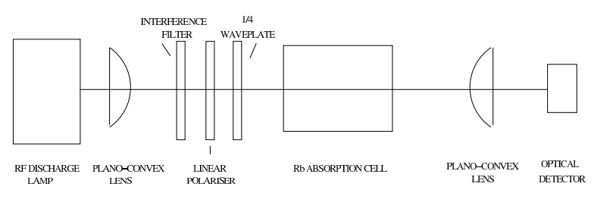
Experimental Procedure : Equipments (Cont’d)
RF coils and signal generator : the RF magnetic field coils are located on the cell. The field is produced by a signal generator plugged into the electronics box.

Slide 10
Experimental Procedure : Absorption Cross Section
We used the optical set-up in the last slide without the polarized and the ¼ plate.
We sat the cell’s temperature to different values between 300 and …. (10 K steps), and measured the voltage at each temperature.

Slide 11
Results and Discussion

Slide 12
Results and Discussion

Slide 13
Conclusion

Slide 14
Thanks for listening

