Slide 1


Conjugate Gradient Method for Indefinite Matrices

Slide 2


Conjugate Gradient
1) CG is a numerical method to solve a linear system of equations
2) CG is used when A is Symmetric and Positive definite matrix (SPD)
3) CG of Hestenes and Stiefel [1] is an effective popular method for solving large, sparse symmetric positive definite (SPD).
[1] M. R. Hestenes and E. Stiefel. Methods of conjugate gradient for solving linear systems. Journal of Research of the Natural Bureau of Standards, 49:409-435, 1952

Slide 3
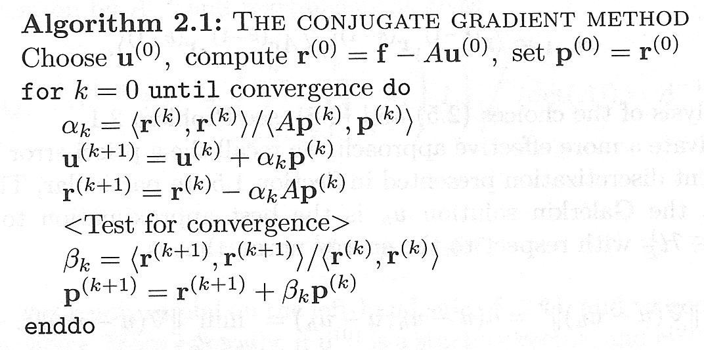
Conjugate Gradient
Standard inner product defined by:

Slide 4
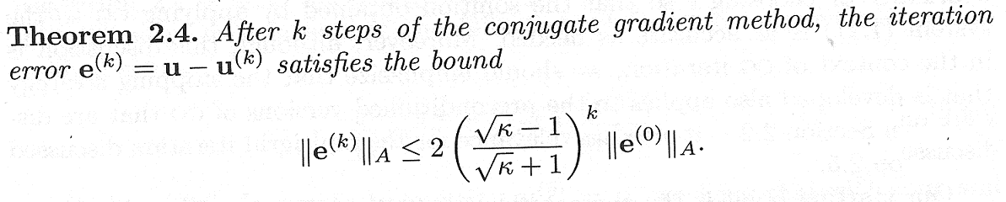

Preconditioning
Non-singular
Preconditioner

Slide 5
Non-standard Inner Product
Standard inner product defined by:
Definition
For any real symmetric
Defined by:
The symmetric bilinear form
Is an inner product
Pos. def.

Slide 6
Self-Adjoint
Definition
Self-adjoint in
Self-adjoint in
H-symmetric

Slide 7
Bramble-Pasciak CG
CG for Indefinite
Computational Fluid Dynamics
Symmetric
Indefinite
Optimizations
Saddle Point Problem
Non-symmetric
Positive definite
Preconditioner
Is H-symmetric and positive definite

Slide 8
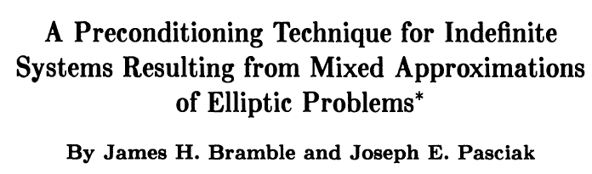

Bramble-Pasciak CG
CG for Indefinite
USE
Preconditioner
Inner Product
H
H
SPD in < , >H
H
H

Slide 9
Iterative Krylov Subspace Methods
SPD
Symm
Non-Sym
CG
MINRES
GMRES

Slide 10
Bramble-Pasciak CG
CG for Indefinite
USE
Preconditioner
Inner Product
H
H
SPD in < , >H
H
H

Slide 11






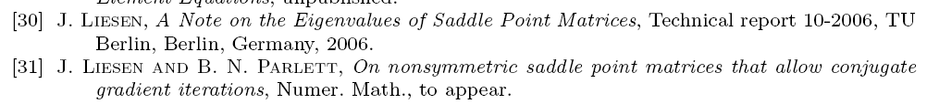
Bramble-Pasciak CG

Slide 12
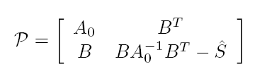

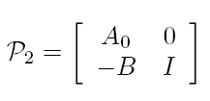
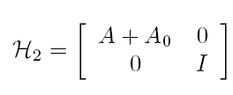


Bramble-Pasciak CG
2008

Slide 13
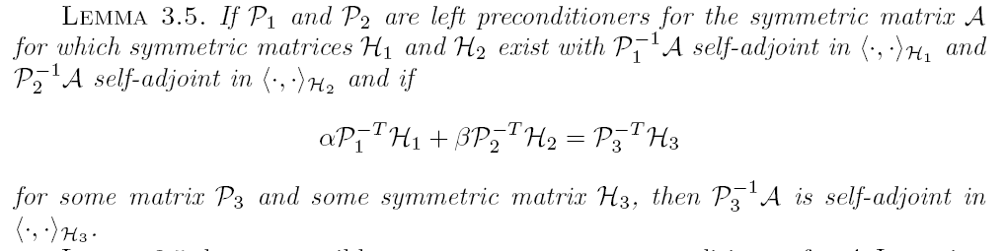
Bramble-Pasciak CG

