Slide 1
[Series Circuit]
KFUPM , MATH 202 , 072
1)Khalid Abdulghani
2)Khaldoon Al-Azzah
3)Yousef Al-Shaheen
4)Abdulrahman Al-Saggaf
5)Ibraheem Alsufyani
6) Abdul-Aziz Abdul Hanif

Slide 2
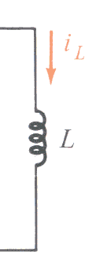
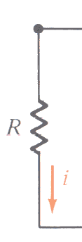
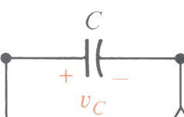
Engineering interest !!
Voltage
&
current
Inductors
resistors
Capacitors

Slide 3
The problem
For resistors
For capacitors and inductors
Ohms law can be applied easily by
V = ( I ) x (R)
the current and voltage are dependent of each other and functions of time .

Slide 4
capacitors
the current through the capacitor depends on the change of voltage across its terminals
I C = C dv / dt

Slide 5
Inductors
The voltage across the inductor depends on the change of the current passing through it
V = L d i / dt

Slide 6
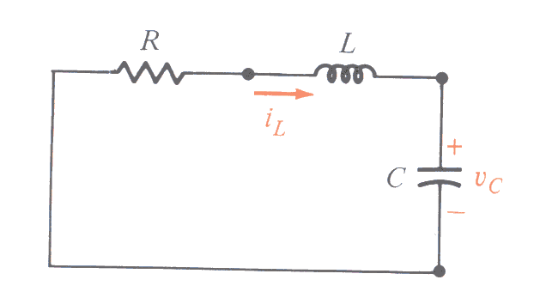
Series circuit analysis

Slide 7
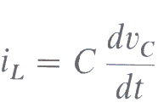
Series circuit analysis

Slide 8
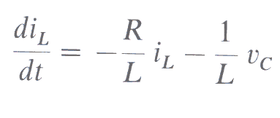
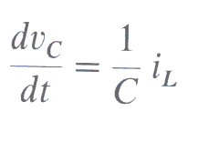
The solution

Slide 9
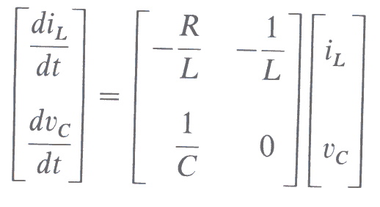
Converting the DEs into matrices

Slide 10
We solve it by applying KCL, KVL
By KVL
In loop (1):
………… (1)
Dividing by L₁ :
………… (2)
Now, we apply KCL in (2) Yields,
“First Eq.”

Slide 11
By KVL :
In loop (2) “The outer loop”
……. (3)
Dividing by L₂
………. (4)
Applying KCL ,then substitute in (4)
Taking i₃ as common factor
“second Eq.”

Slide 12
Now, we transfer the first and second DE’s to matrix system

Slide 13
Solving the DE using MATLAB
#33/P359:
We have the system of DE

Slide 14
function [t,i] = ES
t_interval =[0 4];
initial_condition=[0 0];
[t,i] = ode45(@rhs,t_interval,initial_condition);
plot(t,i(:,1),'-',t,i(:,2),'-.')
legend('i_1','i_2','Location','eastoutside');
sprintf(' t i1 i2')
[t,i]

Slide 15
function di = rhs(t,i)
di = zeros(2,1); % a column vector
di(1) = -11*i(1) + (3/1)*i(2) + ((100*sin(t))/1);
di(2) = (3/1)*i(1) - (3/1)*i(2) + 0;

Slide 16
The solution of the problem

Slide 17
The solution of the problem
t i1 i2
0 0 0
0.0073 0.0026 0.0000
0.0145 0.0100 0.0001
0.0218 0.0219 0.0005
0.0290 0.0381 0.0011
0.0363 0.0580 0.0021
0.0436 0.0815 0.0036
0.0508 0.1083 0.0055
0.0581 0.1382 0.0081
0.0676 0.1814 0.0123
0.0771 0.2289 0.0177
0.0865 0.2805 0.0244

Slide 18
Thank you very much

