Slide 1
Chapter 6
Break-Even and Leverage Analysis
Objectives
Differentiate b/w fixed and variable costs
Break-even points (units & dollar amount)
Define business, financial, and total risk.
Calculate the degree of each risk.
Show the dynamics of the degree of all 3 risks as the firm’s sales level changes

Slide 2
Introduction
The importance of managing the firm cost is as important as keeping track of its profits.
In fact, costs are an important component in determining the profitability of the firm.
Additionally, cost analysis will have a direct impact on managerial decisions regarding:
  How to price the firm products.
  How to finance the firms assets

Slide 3
General Type of Costs
Variable Costs
  Cost expected to change at the same rate as Sales.
  Such as sales commissions, raw material costs, hourly wages.
Fixed Cost
  Cost that are expected to remain constant regardless of the quantity produced.
  Such as building rents, salaries, depreciation

Slide 4
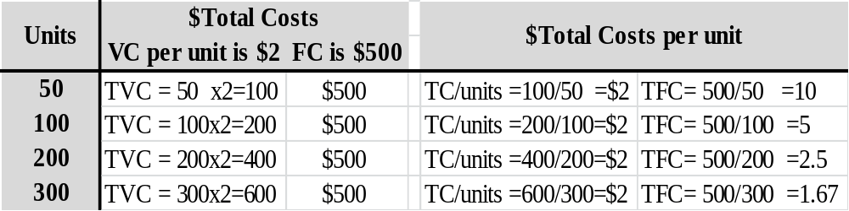
Properties of Each Cost Type
VC: are expected to change at a rate similar to Sales
Thus, the total VC increase as more units are produced.
However, the TVC/unit are always constant
FC: are expected to be constant regardless of unit produced.
Thus, Total FC will not change as more units produced
However, the TFC/unit is actually decreasing as more units produced

Slide 5
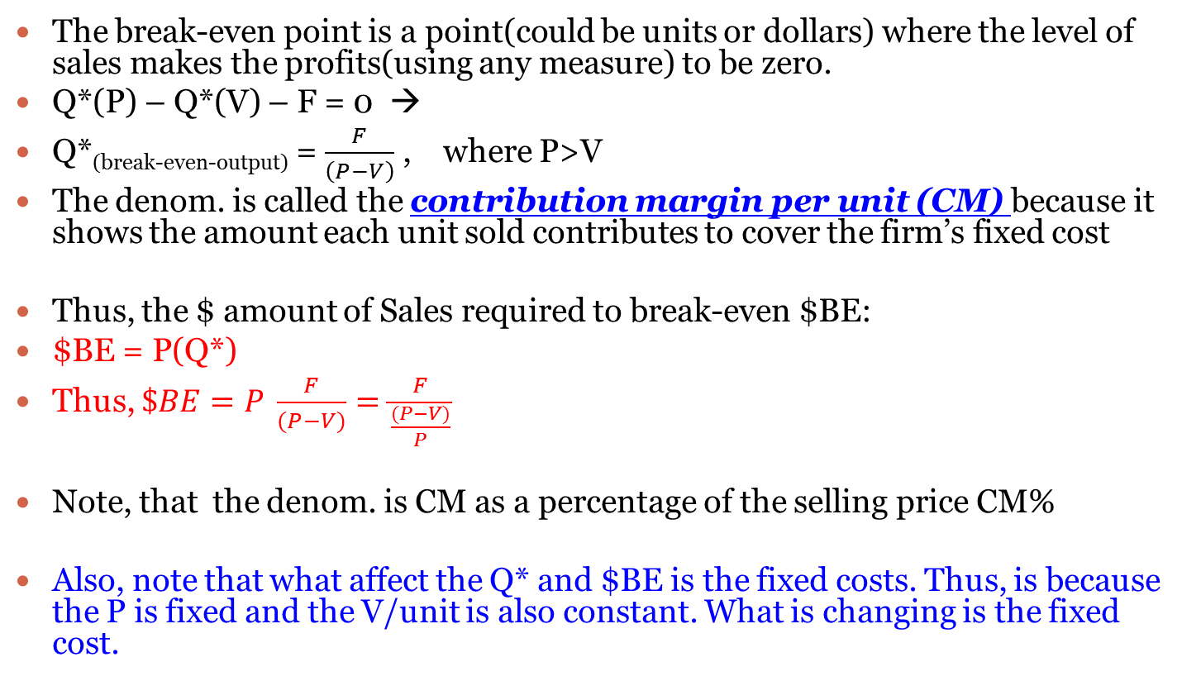
Break-even Analysis
The break-even point is a point(could be units or dollars) where the level of sales makes the profits(using any measure) to be zero.
Q*(P) – Q*(V) – F = 0 →
Q*_{(break-even-output)} = $\frac{F}{\left(P−V\right)}$ , where P>V
The denom. is called the contribution margin per unit (CM) because it shows the amount each unit sold contributes to cover the firm’s fixed cost
Thus, the $ amount of Sales required to break-even $BE:
$BE = P(Q*)
Thus, $\$BE=P \frac{F}{(P−V)}=\frac{F}{\frac{(P−V)}{P}}$
Note, that the denom. is CM as a percentage of the selling price CM%
Also, note that what affect the Q* and $BE is the fixed costs. Thus, is because the P is fixed and the V/unit is also constant. What is changing is the fixed cost.

Slide 6
Break-Even Chart
Total Revenues
Profits
Total Costs
REVENUES AND COSTS
($ thousands)
Fixed Costs
Losses
Variable Costs
QUANTITY PRODUCED AND SOLD

Slide 7
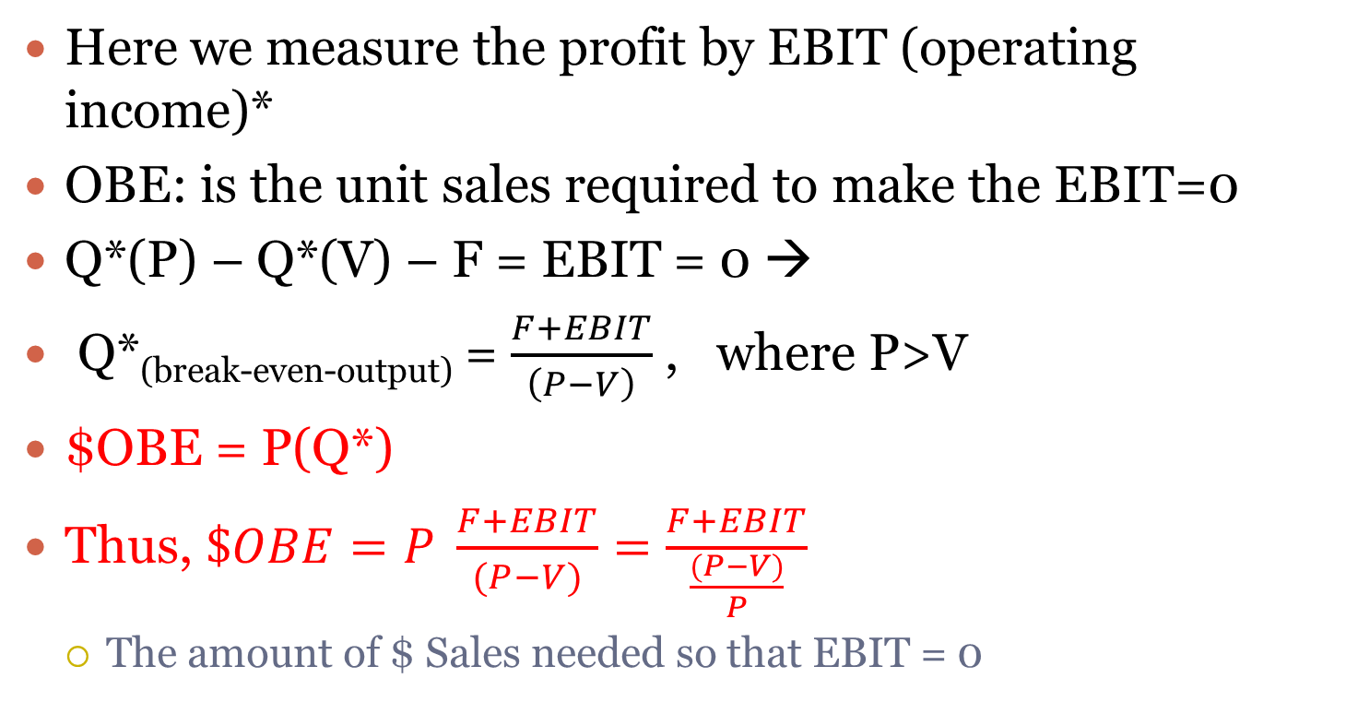
Operating Break-Even Point (OBE)
Here we measure the profit by EBIT (operating income)*
OBE: is the unit sales required to make the EBIT=0
Q*(P) – Q*(V) – F = EBIT = 0 →
Q*_{(break-even-output)} = $\frac{F+EBIT}{\left(P−V\right)}$ , where P>V
$OBE = P(Q*)
Thus, $\$OBE=P \frac{F+EBIT}{(P−V)}=\frac{F+EBIT}{\frac{(P−V)}{P}}$
  The amount of $ Sales needed so that EBIT = 0

Slide 8
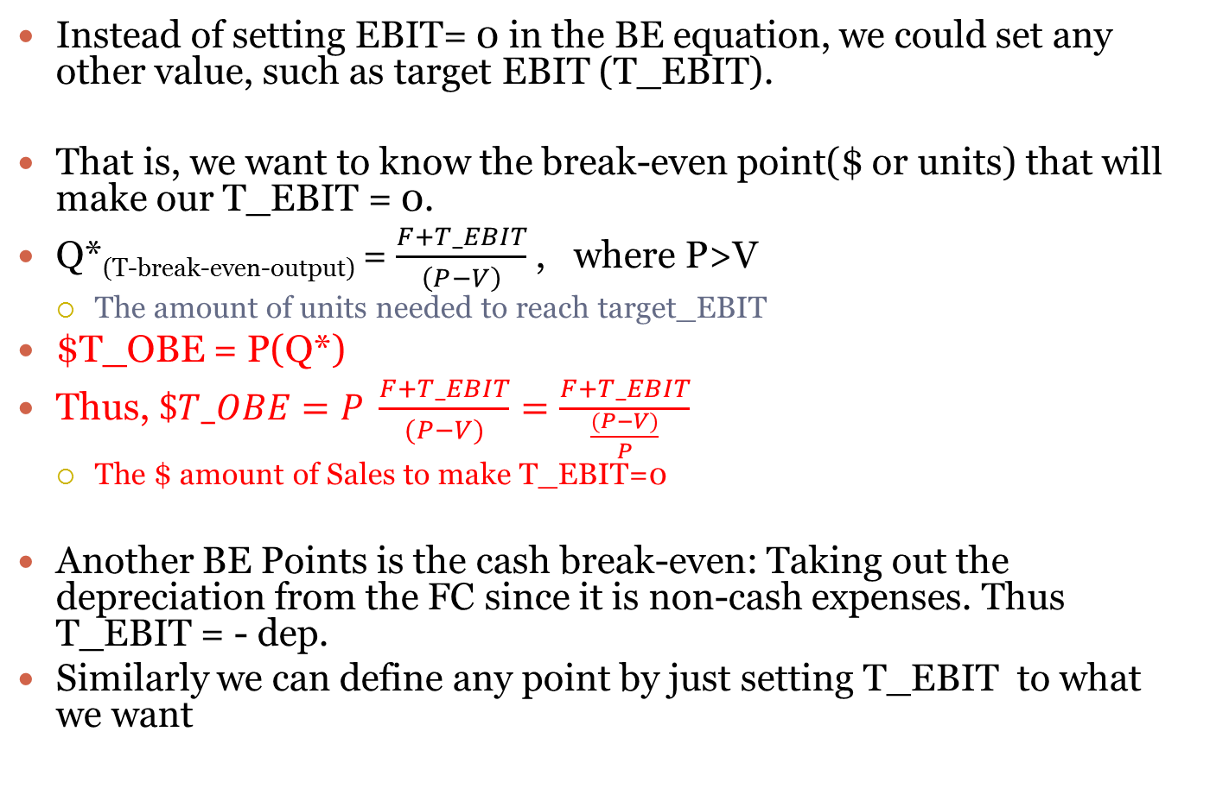
Other Break-Even Points
Instead of setting EBIT= 0 in the BE equation, we could set any other value, such as target EBIT (T_EBIT).
That is, we want to know the break-even point($ or units) that will make our T_EBIT = 0.
Q*_{(T-break-even-output)} = $\frac{F+T_EBIT}{\left(P−V\right)}$ , where P>V
  The amount of units needed to reach target_EBIT
$T_OBE = P(Q*)
Thus, $\$T_OBE=P \frac{F+T_EBIT}{(P−V)}=\frac{F+T_EBIT}{\frac{(P−V)}{P}}$
  The $ amount of Sales to make T_EBIT=0
Another BE Points is the cash break-even: Taking out the depreciation from the FC since it is non-cash expenses. Thus T_EBIT = - dep.
Similarly we can define any point by just setting T_EBIT to what we want

Slide 9
Examples
Firm x is selling computers for $30 per unit.
The variable costs are 2/3 of the selling price.
The Fixed cost is $100,000.
The target profit is $50,000
P= 30, V=2/3(30)=20, F=100,000
Q*= 100,000/(30-20) = 10,000 units to break-even
$BE= 30(10,000)=$300,000 in sales is needed to break=even.
The CM = 10, the CM%= 10/30 = 1/3= 33.33%
$BE = 100,000/33.33% = $300,000
$T_BE = (100,000+50,000)/33.33% = $450,000 is needed in sales so that the firm can have a profit of $50,000
T_Q* = 450,000/30 = 15,000 unit must be produced to have a profit of $50,000

Slide 10
Leverage Analysis
There are 2 main sorts of leverage that we will discuss.
Operating leverage:
  It is a measure that shows how operating income (EBIT) is sensitive to changes in Sales.
  Also, it is used to measure how risky is the operating income (EBIT).
  The use of fixed operating cost by the firm.*
  Operating fixed costs are the main driver for the OL
Financial leverage
  It is a measure that shows how Net income (NI) is sensitive to changes in fixed financing costs.
  Fixed financing costs (interest & preferred dividends) are the main driver of FL

Slide 11
Operating leverage OL
A firms that heavily use OL will have their operating income (EBIT) is more variable (high st. dev) than firms that do not.
Variability in EBIT is called Business Risk.
  The more variable (sales are relative to its cost, the more variable becomes the EBIT. This, in turn, will increase the probability that the firm will not be able to pay it expenses.
  Thus, firms that heavily use OL are exposed to a higher Business Risk than those that do not.
Examples of Business Risk
  The state of the economy, labor strike, firm competitive position, customers’ strike**
Overall, to a large degree, the firm management have little control over the business risk because it is a function of the industry in which the firm operate.

Slide 12
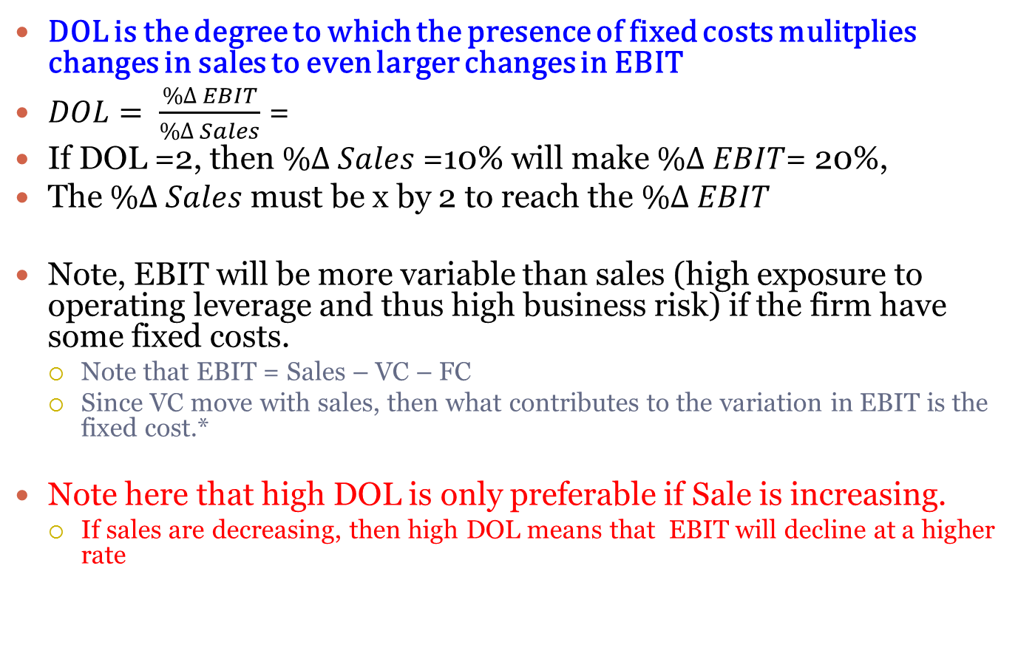
The Degree of the Operating Leverage DOL
DOL is the degree to which the presence of fixed costs mulitplies changes in sales to even larger changes in EBIT
$DOL= \frac{\%∆ EBIT}{\%∆ Sales}$ =
If DOL =2, then $\%∆ Sales$ =10% will make $\%∆ EBIT$= 20%,
The $\%∆ Sales$ must be x by 2 to reach the $\%∆ EBIT$
Note, EBIT will be more variable than sales (high exposure to operating leverage and thus high business risk) if the firm have some fixed costs.
  Note that EBIT = Sales – VC – FC
  Since VC move with sales, then what contributes to the variation in EBIT is the fixed cost.*
Note here that high DOL is only preferable if Sale is increasing.
  If sales are decreasing, then high DOL means that EBIT will decline at a higher rate

Slide 13
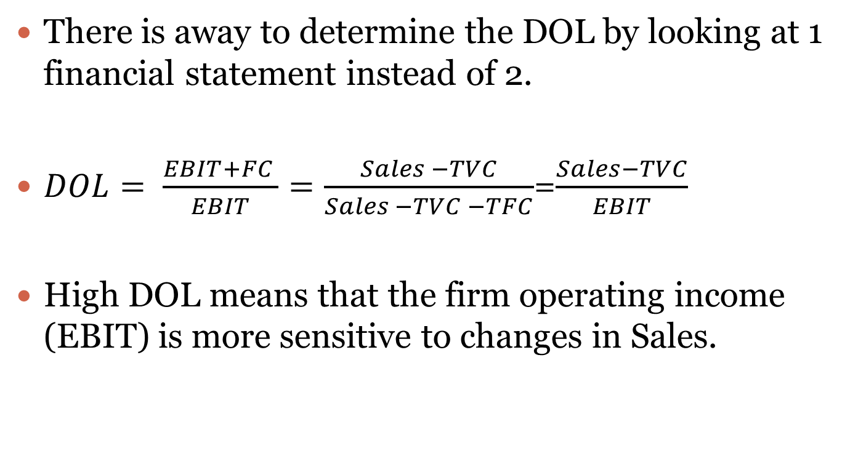
DOL in Corporate Finance
There is away to determine the DOL by looking at 1 financial statement instead of 2.
$DOL= \frac{EBIT+FC }{EBIT}=\frac{Sales −TVC}{Sales −TVC −TFC}$=$\frac{Sales−TVC}{EBIT}$
High DOL means that the firm operating income (EBIT) is more sensitive to changes in Sales.

Slide 14
Now, subject each firm to a 50% increase in sales for next year. Which firm do you think will be more “sensitive” to the change in sales
  Firm F Firm V Firm 2F
  Sales $10 $11 $19.5
  Operating Costs
  Fixed 7 2 14
  Variable 2 7 3
  Operating Profit $ 1 $ 2 $ 2.5
  FC/total costs .78 .22 .82
  FC/sales .70 .18 .72
(in thousands)

Slide 15
%50 increase in sales
  Firm F Firm V Firm 2F
  Sales $15 $16.5 $29.25
  Operating Costs
Fixed 7 2 14
  Variable 3 10.5 4.5
  Operating Profit $ 5 $ 4 $10.75
  Percent Change in EBIT*
  400% 100% 330%
  DOL 8 6.6 2
(in thousands)
(EBIT_{t} - EBIT _{t-1}) / EBIT _{t-1}
DOL = EBIT + FC / EBIT

Slide 16
Financial Leverage FL
The sensitivity of Net income to changes in fixed financing costs, such as interest expenses, preferred dividends.
  Thus, it is similar to the OL, but instead of fixed operating cost, we use fixed financing cost.
A high FL firm means that its profit (net income) is very sensitive to changes in fixed financing costs.
  Thus, it would be exposed to the financial risk
    High probability not meeting its fixed financing costs (default)
    Possible insolvency
    Bankruptcy if it defaulted on interest payment obligations
      Obviously, the more debt, the more levered the firm is, the more exposure to financial risk.

Slide 17
Financial leverage FL
Unlike operating leverage (OL), financial leverage can be controlled by management.
  It’s their decision to finance asset by equity, preferred equity, and/or debt.
  Its their say what type of debt to use (long vs short).
  Its their choice how much of each type of financing to use
Thus, the financial risk exposure is determined by management choices.

Slide 18
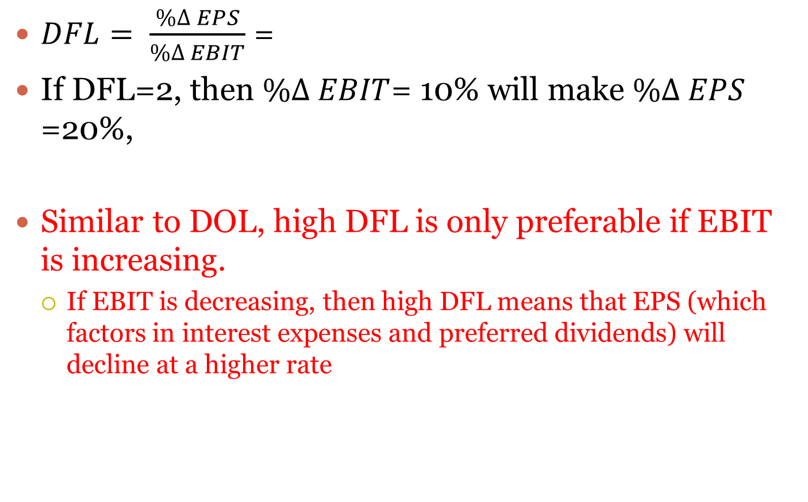
The Degree of the Financial Leverage (DFL)
$DFL= \frac{\%∆ EPS}{\%∆ EBIT}$ =
If DFL=2, then $\%∆ EBIT$= 10% will make $\%∆ EPS$ =20%,
Similar to DOL, high DFL is only preferable if EBIT is increasing.
  If EBIT is decreasing, then high DFL means that EPS (which factors in interest expenses and preferred dividends) will decline at a higher rate

Slide 19
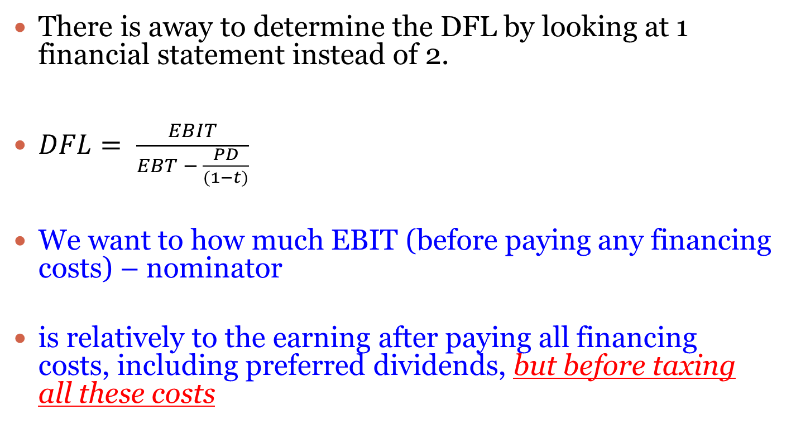
DFL in Corporate Finance
There is away to determine the DFL by looking at 1 financial statement instead of 2.
$DFL= \frac{EBIT}{EBT − \frac{PD}{(1−t)}}$
We want to how much EBIT (before paying any financing costs) – nominator
is relatively to the earning after paying all financing costs, including preferred dividends, but before taxing all these costs

Slide 20
The Combined Leverage (CL)
Is combining both leverages (operating and financial).
It is the variability of the net income measured by EPS. This is called the (Total Risk)
A firm with a high total leverage means that its EPS is highly sensitive to changes in sales.

Slide 21
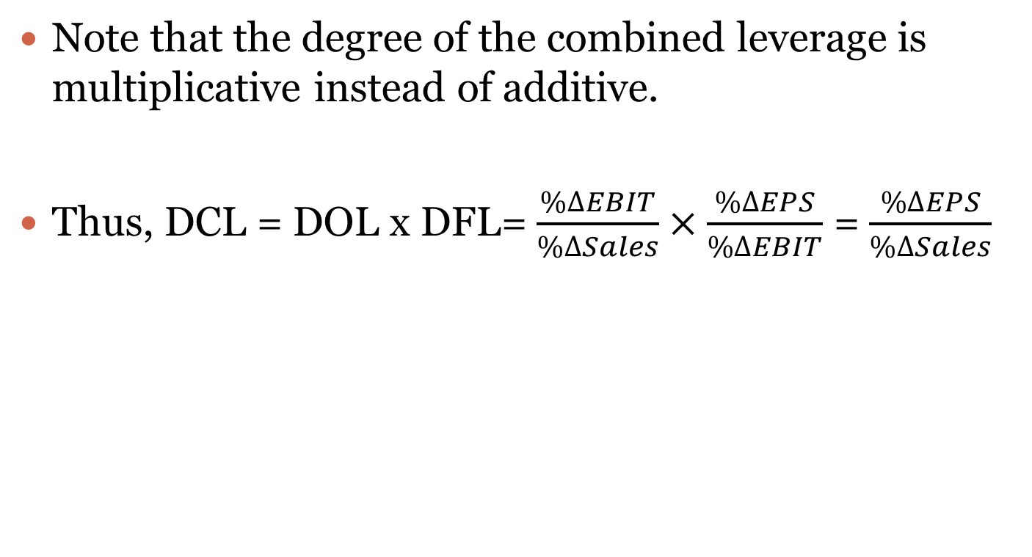
Degree of Combined Leverage (DCL)
Note that the degree of the combined leverage is multiplicative instead of additive.
Thus, DCL = DOL x DFL= $\frac{\%∆EBIT}{\%∆Sales}×\frac{\%∆EPS}{\%∆EBIT}$ = $\frac{\%∆EPS}{\%∆Sales}$

