Slide 1
GEOP501 - Reflection Seismology
Chapter 1
Introduction to Seismic Exploration
Abdullatif A. Al-Shuhail
Professor of Geophysics
Geosciences Department
ashuhail@kfupm.edu.sa
For more info, follow: http://faculty.kfupm.edu.sa/ES/ashuhail/GEOP315.htm

Slide 2
The basic principle
We send artificially-generated seismic waves into the subsurface.
The waves get reflected off layer boundaries.
We record the times and amplitudes of the reflected waves on the surface.
We process the records to enhance the signal and suppress the noise.
We interpret the records geologically.
Earth’s surface
S
R
Reflection point
Subsurface reflector

Slide 3
Seismic waves
Elasticity theory
  Stress (σ)
    Force per unit area, with units of pressure such as Pascal (N/m²) or psi (Pounds/in²).
  Strain (ε)
    Fractional change in a length, area, or volume of a body due to the application of stress.
    For example, if a rod of length L is stretched by an amount ΔL, the strain is ΔL/L.
L
F
ΔL

Slide 4
Seismic waves
Y
F
x
z
w
v
y
X
u
Z

Slide 5
Seismic waves
Elasticity theory
  Hooke’s Law
    For small strains (<10⁻⁶), stress is linearly proportional to strain:
  Elastic constants
    In the above equation, c is called the elastic constant.
    Most rocks (e.g., sandstones, limestones) are isotropic; where c is a combination of only two elastic constants (λ, μ) called Lame’s constants.
    Some rocks (e.g., shales) are anisotropic; where c is a combination of more than two elastic constants.
    Practically, isotropy means that seismic properties (e.g., velocity) is independent of measurement direction; while anisotropy is the opposite.

Slide 6
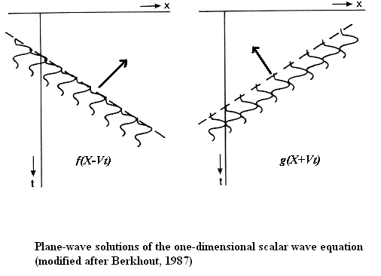
Seismic waves
Wave equation
  It relates displacements of earth particles in space and time as a seismic wave passes.
  For a seismic wave that propagates only along the x-axis:
    In the above equation:
      V: seismic wave velocity; u: particle displacement;
      x: distance along x-axis; t: time
    General solution:
      f and g are arbitrary functions of x and t; where f represents a wave moving along the positive x-axis and g represents a wave moving along the negative x-axis.

Slide 7
Seismic waves
General aspects
  The surface on which the wave amplitude is the same is called the wavefront (dashed lines in previous figure).
  The normal to the wavefront surface is called ray or propagation direction (arrows in previous figure).
  Wavefronts are spherical near the source and become planar far from it (planar in previous figure).
  A seismic wave is a sinusoid with a wide frequency band (2-120 Hz) and short time duration (50-100 ms) (a.k.a. wavelet) (circled in previous figure).

Slide 8
Seismic waves
General aspects
  Typical wave characteristics in petroleum seismic exploration:
    Most of the reflected energy is contained within a frequency range of 2 – 120 Hz.
    The dominant frequency range of reflected energy is 15 - 50 Hz.
    The dominant wavelength range is 30 – 400 m.
  Waves commonly encountered in seismic exploration include:
    Seismic wave: wave in the frequency range (0 – 1,000 Hz).
    Acoustic wave: P-wave.
    Sonic wave: wave in the hearing frequency range of humans (20 – 20,000 Hz).
    Ultrasonic wave: wave whose frequency is > 20,000 Hz, commonly used in logs and lab experiments.
    Infrasonic wave: wave whose frequency is <20 Hz, commonly encountered in earthquake studies.

Slide 9
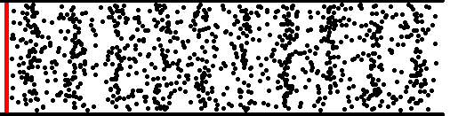
Seismic waves
Body waves
  P-wave
    Particle motion is parallel to propagation direction.
    Fastest: velocity (α) given by:
      ρ: material density
    Least expensive to generate, record, and process
    Most commonly used wave in seismic exploration
  R
  X
Propagation direction
Typical values:
  Air: 331 m/s (at STP)
  Water: 1500 m/s (at STP)
  Sedimentary rocks: 1800-6000 m/s (in situ)
  Z

Slide 10
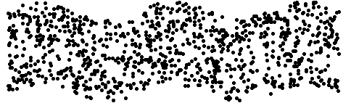
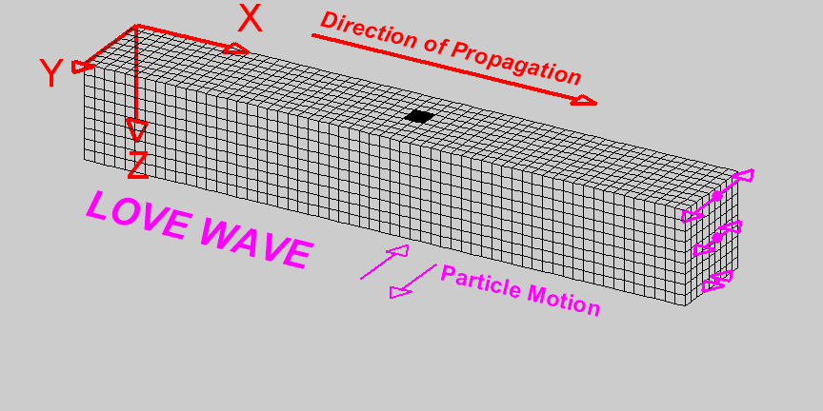
Seismic waves
Body waves
  S-wave
    Particle motion is perpendicular to propagation direction.
    Two S-waves in any solid material : vertical (SV) and horizontal (SH)
    Slower than P-waves (velocity is about half of P-wave in same medium):
    velocity (β) is given by:
    Expensive to generate, record, and process
    Rarely used in seismic exploration
  R
  X
Propagation direction
  R
SH
Typical values:
  Air: 0 m/s
  Water: 0 m/s
  Sedimentary rocks: 800-3000 m/s
  Z
SV

Slide 11
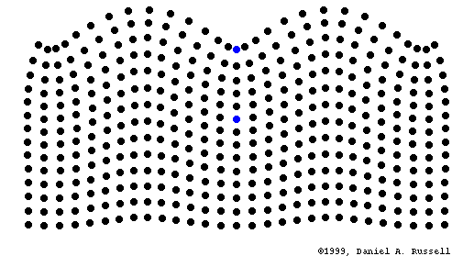
Seismic waves
Surface waves
  They exist due to the presence of a free surface
  (vacuum over any material) or an interface that
  separates two highly-contrasting media.
  They are called surface waves because they are
  tied to the free surface or an interface.
  Their amplitudes decay exponentially with the
  distance from the surface.
  Most commonly encountered surface wave in
  seismic exploration is the Rayleigh wave (ground roll)
    It propagates along the ground surface.
    Particle motion is elliptical.
    Velocity is slightly less than S-wave in the same medium.
    Most of the Rayleigh wave’s energy is confined to 1-2 wavelengths of depth.
    Considered noise in seismic exploration
  R
Propagation direction
Typical values:
  Air: 0 m/s
  Water: 0 m/s
  Sedimentary rocks: 500-2500 m/s

Slide 12
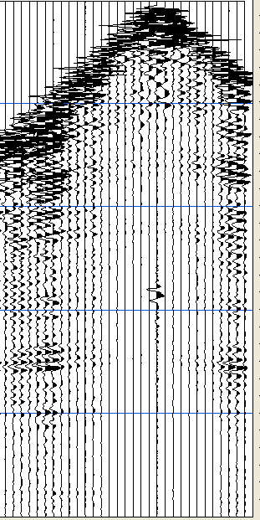
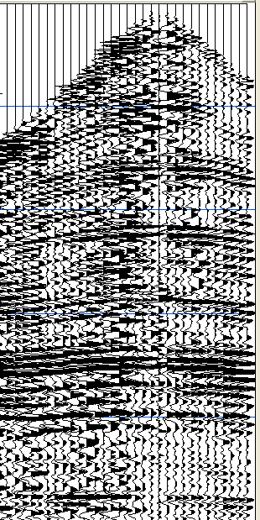
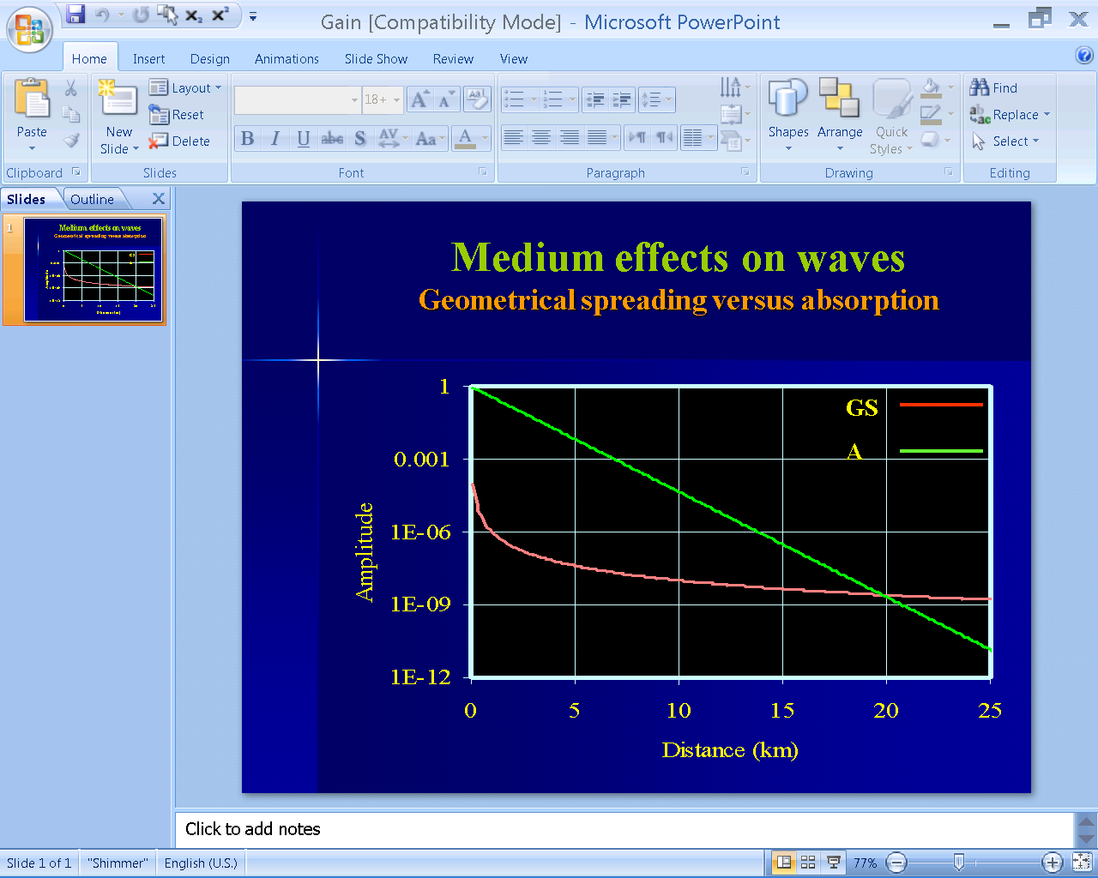
Seismic waves
Propagation effects on waves
  Effects on amplitude
    Geometrical spreading (spherical divergence): As the wavefront gets farther from the source, it spreads over a larger surface area causing the intensity (energy density) to decrease.
    Absorption: In some sediments (e.g., loose sand), considerable part of the seismic energy is lost as heat due to sand-particle friction.
Before gain
After gain
Mechanism | Effect | Correction
Geometrical
Absorption
Both
9/5/2022
12

Slide 13
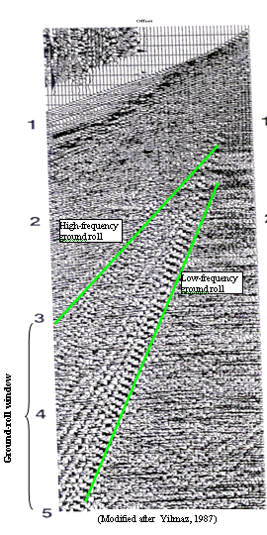
Seismic waves
Propagation effects on waves
  Effects on velocity
    Dispersion: Different frequencies of surface waves (e.g., ground roll) tend to travel with different velocities.
9/5/2022
13

Slide 14
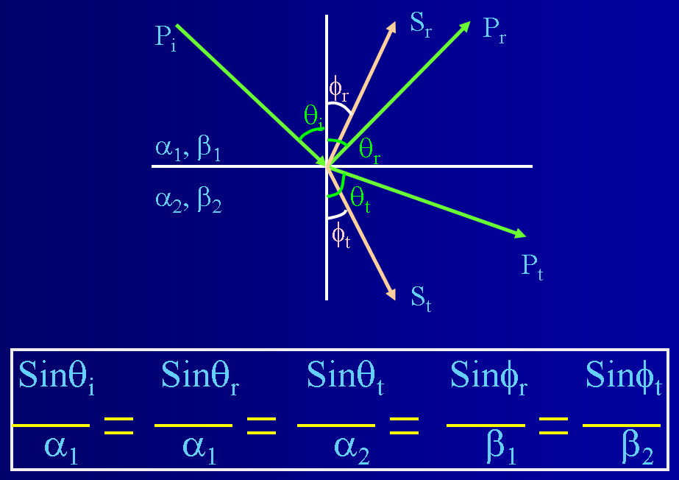
Seismic waves
Interface effects on waves
  Reflection
    When a wave encounters an interface (i.e., boundary between two layers), part of its energy is reflected and the rest is transmitted.
    Snell’s Law governs the angles of reflected and transmitted waves.
  Refraction
    It occurs when the angle of transmission is 90˚.
    Angle of incidence, in this case, is called the critical angle given as:
      v₁ and v₂ are wave velocities in the incidence and transmission media
9/5/2022
14

Slide 15
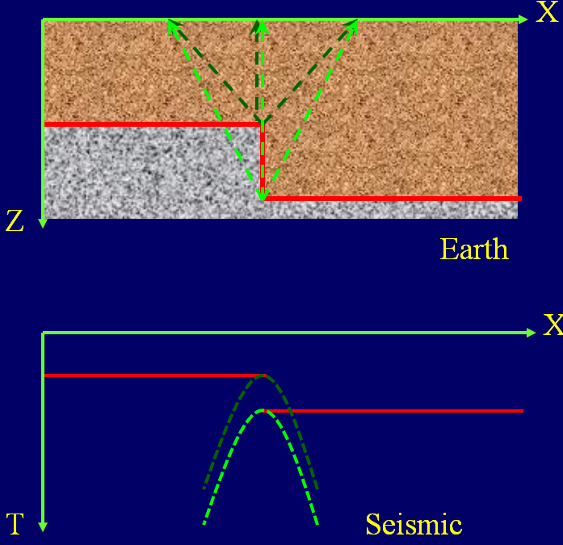
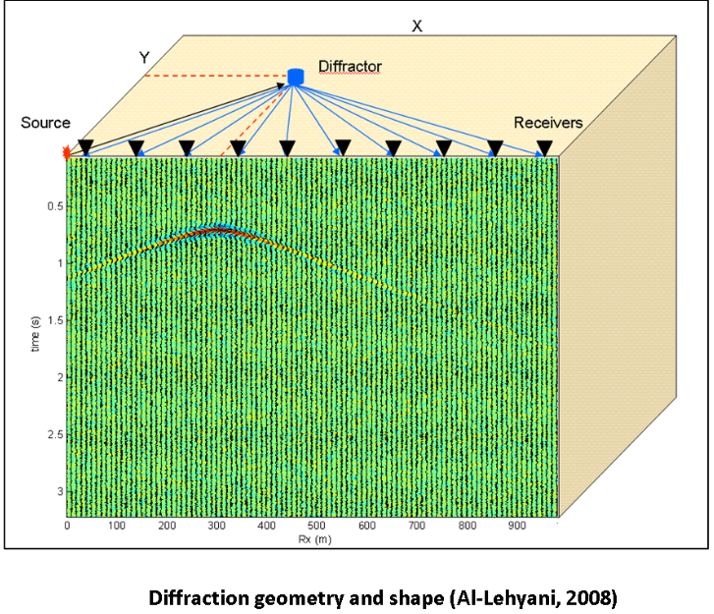
Seismic waves
Interface effects on waves
  Diffraction
    When a seismic wave encounters a sharp interface, its energy is diffracted (scattered) in all directions.
    Scattered energy produces a hyperbolic diffraction (scattering) on the seismic shot record.
    Solutions of the wave equation are required to handle diffractions because they do not follow Snell’s Law.
9/5/2022
15

Slide 16
Seismic waves
Interface effects on waves
  Reflection coefficients
    When a seismic wave encounters an interface, its energy is reflected, transmitted, and converted to other modes (i.e., P to S).
    Zoeppritz equations govern how much is reflected, transmitted, and converted to other modes.
    Zoeppritz equations are complicated functions of rock properties and angles.
    The reflection coefficient (RC) is the ratio of reflected to incident energy. At normal incidence angles (<15˚), it is given as:
Earth’s surface
S
R
RC
1
Reflection point
Subsurface reflector
ρ₁: density in incident medium
ρ₂: density in refraction medium
V₁: seismic velocity in incident medium
V₂: seismic velocity in refraction medium
9/5/2022
16

Slide 17
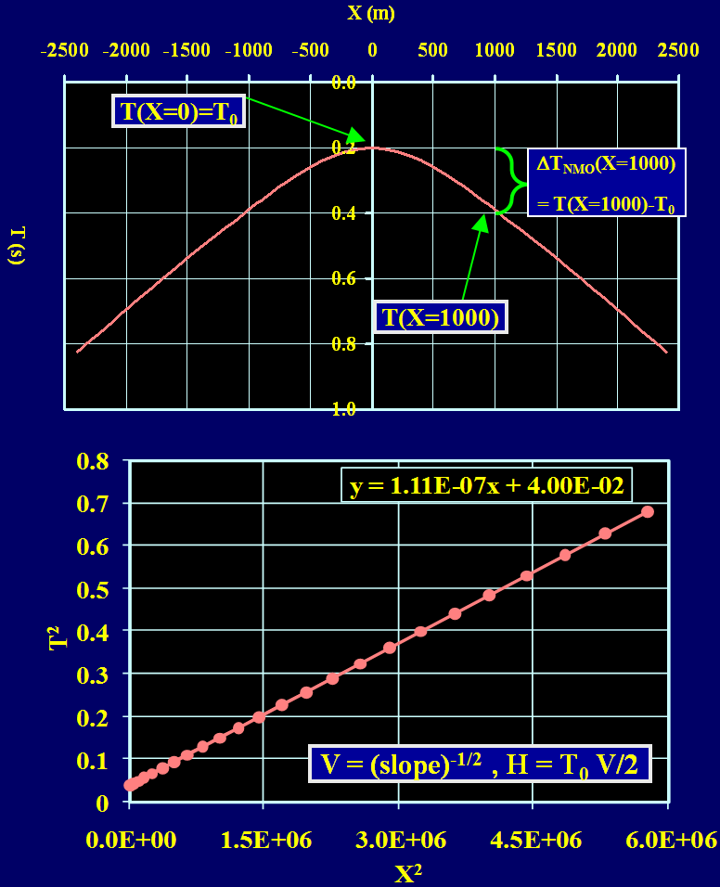
Time-distance (T-X) curves
Single horizontal layer
  T² = T₀² + X²/V²
  It is a hyperbola with apex at X= 0 and T₀= 2H/V
    V and H are the layer velocity and thickness
  T²-X² plot is a straight line whose slope= 1/V² and intercept = T₀²
  T²-X² plot can be used to find V and H
  Normal moveout (NMO)
    the difference between traveltimes at offsets X and 0
    ΔT_{NMO} (X)≈X²/(2T₀V²)
    used to flatten the T-X curve before stacking
  We usually know T, T₀, and X from the seismic section and we want to know V and H.
V (m/s) | H (m)
3000 | 300
9/5/2022
17

Slide 18
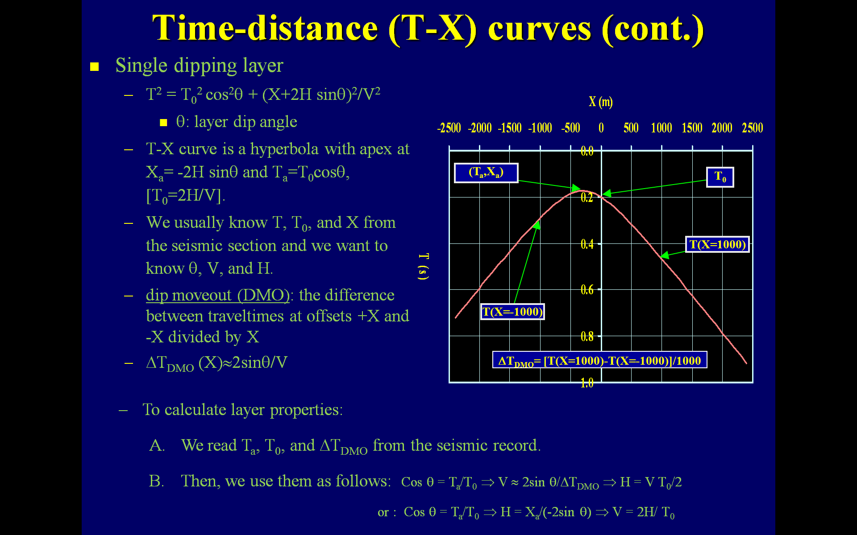
Time-distance (T-X) curves
Single dipping layer
  T² = T₀² cos²θ + (X+2H sinθ)²/V²
    θ: layer dip angle
  T-X curve is a hyperbola with apex at:
  X_{a}= -2H sinθ and T_{a}=T₀cosθ, [T₀=2H/V].
  We usually know T, T₀, and X from the seismic section and we want to know θ, V, and H.
  dip moveout (DMO): the difference between traveltimes at offsets +X and -X divided by X
    ΔT_{DMO} (X)≈2sinθ/V
  To calculate layer properties:
    We read T_{a}, T₀, and ΔT_{DMO} from the seismic record.
    Then, we use them as follows:
      Cos θ = T_{a}/T₀ ⇒ V ≈ 2sin θ/ΔT_{DMO} ⇒ H = V T₀/2
      Cos θ = T_{a}/T₀ ⇒ H = X_{a}/(-2sin θ) ⇒ V = 2H/ T₀
θ | V (m/s) | H (m)
30 | 3000 | 300
9/5/2022
18

Slide 19
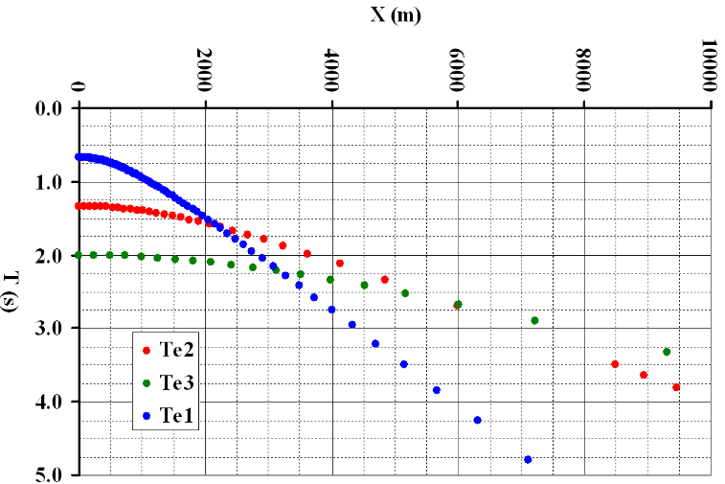
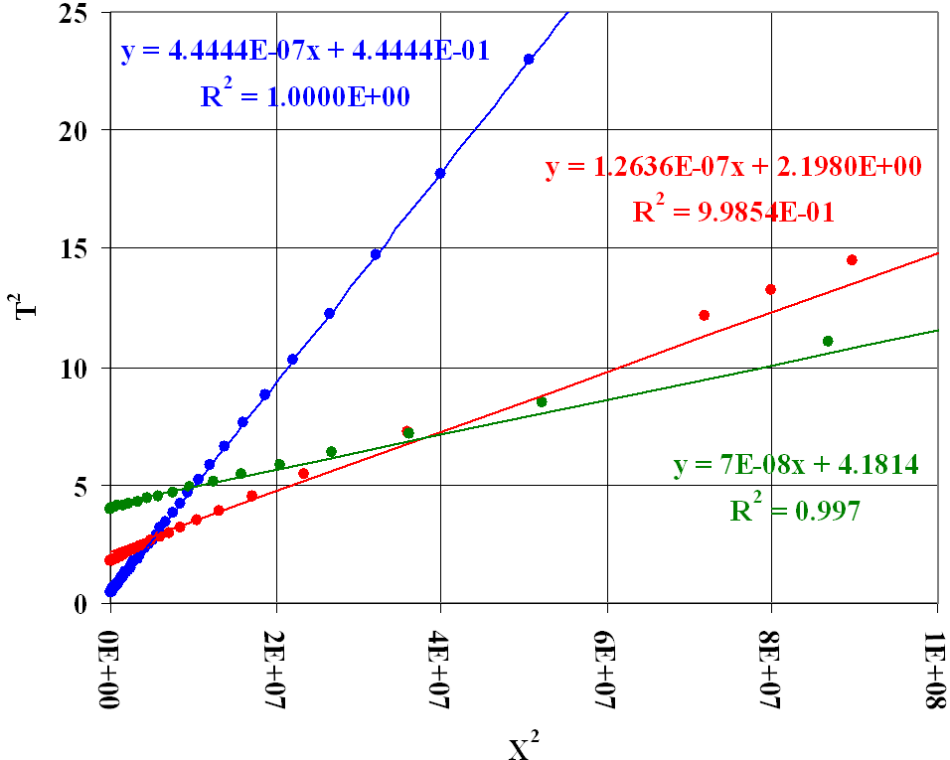
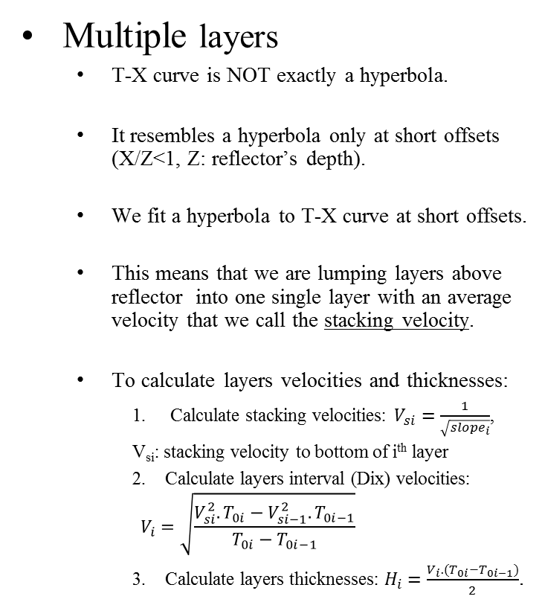
Time-distance (T-X) curves
Multiple layers
  T-X curve is NOT exactly a hyperbola.
  It resembles a hyperbola only at short offsets (X/Z<1, Z: reflector’s depth).
  We fit a hyperbola to T-X curve at short offsets.
  This means that we are lumping layers above reflector into one single layer with an average velocity that we call the stacking velocity.
  To calculate layers velocities and thicknesses:
    Calculate stacking velocities: $V_{si}=\frac{1}{\sqrt{{slope}_{i}}}$,
  V_{si}: stacking velocity to bottom of i^{th} layer
    2. Calculate layers interval (Dix) velocities:
  $$V_{i}=\sqrt{\frac{V_{si}^{2}.T_{0i}−V_{si−1}^{2}.T_{0i−1}}{T_{0i}−T_{0i−1}}}$$
3. Calculate layers thicknesses: $H_{i}=\frac{V_{i}.(T_{0i}−T_{0i−1})}{2}$.
i | Vi (m/s) | Hi (m)
1 | 1500 | 500
2 | 3000 | 1000
3 | 4500 | 1500
9/5/2022
19

Slide 20
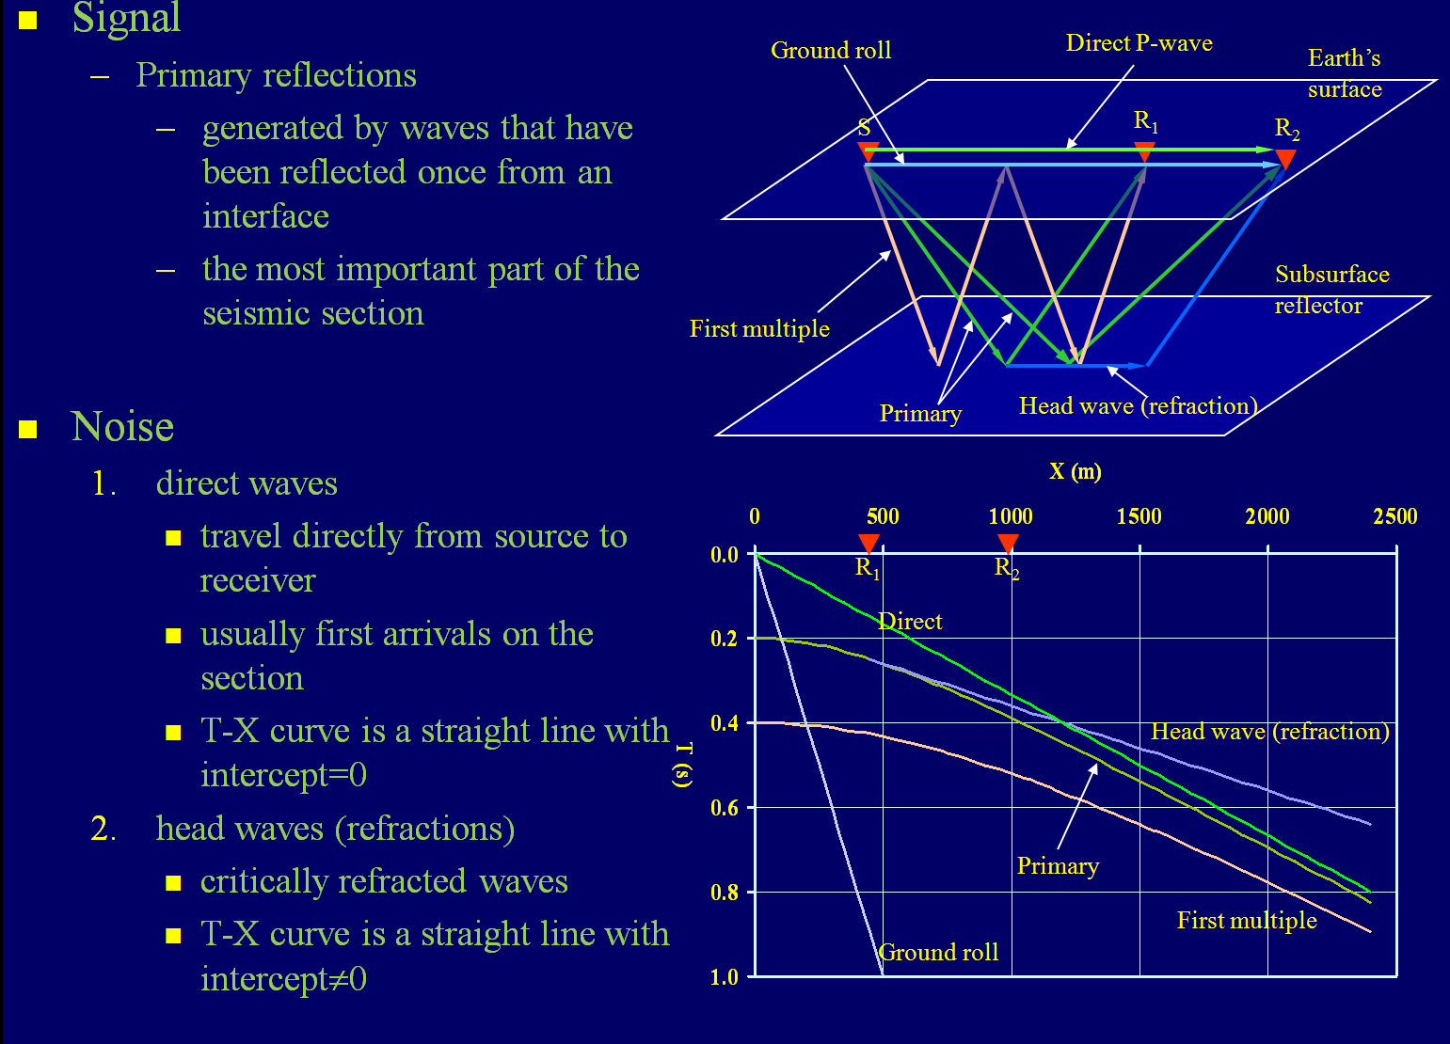
Seismic Signal and Noise

Slide 21
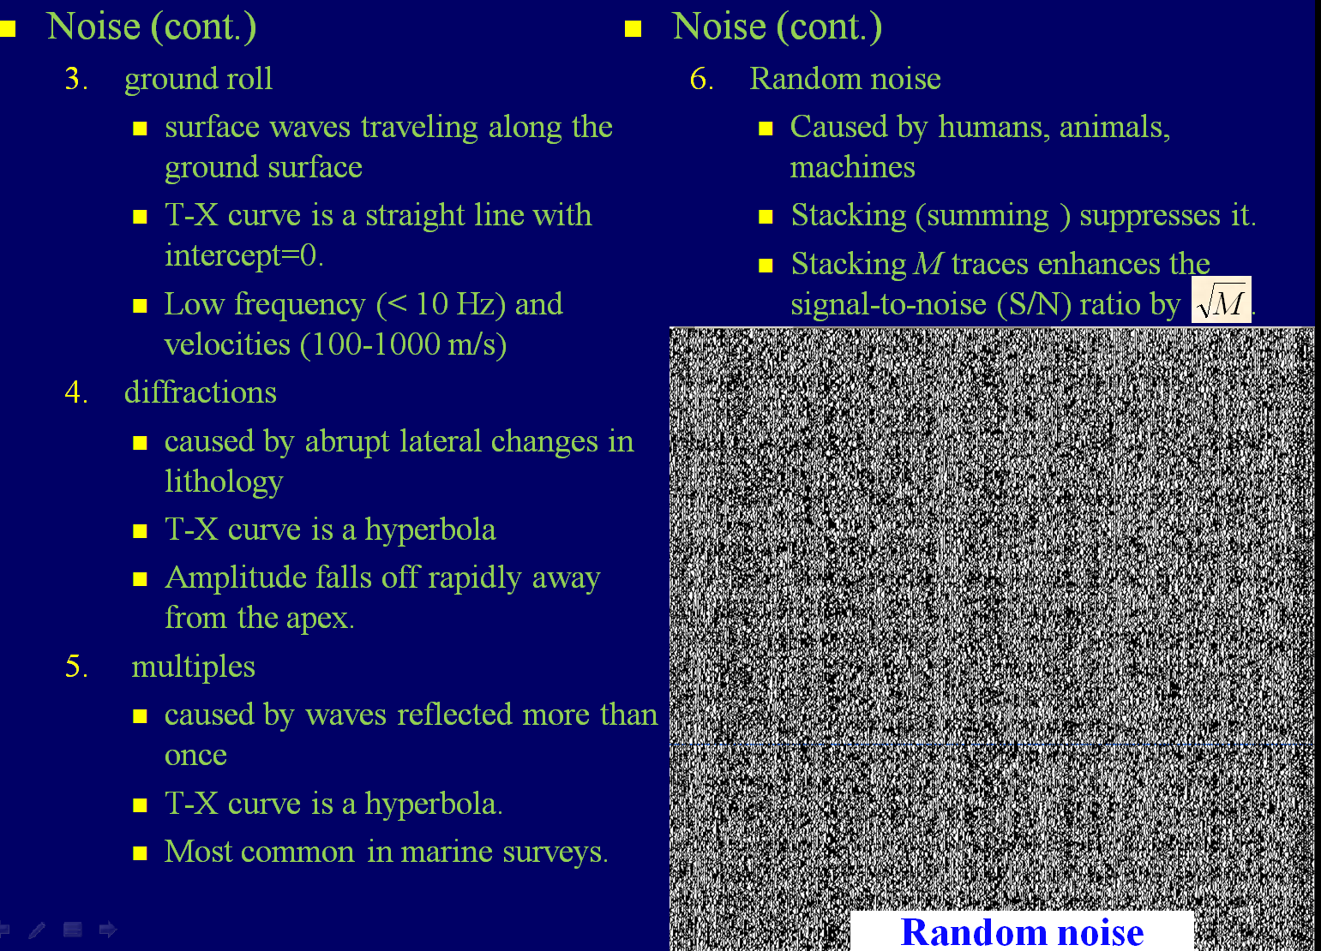
Seismic Signal and Noise

Slide 22
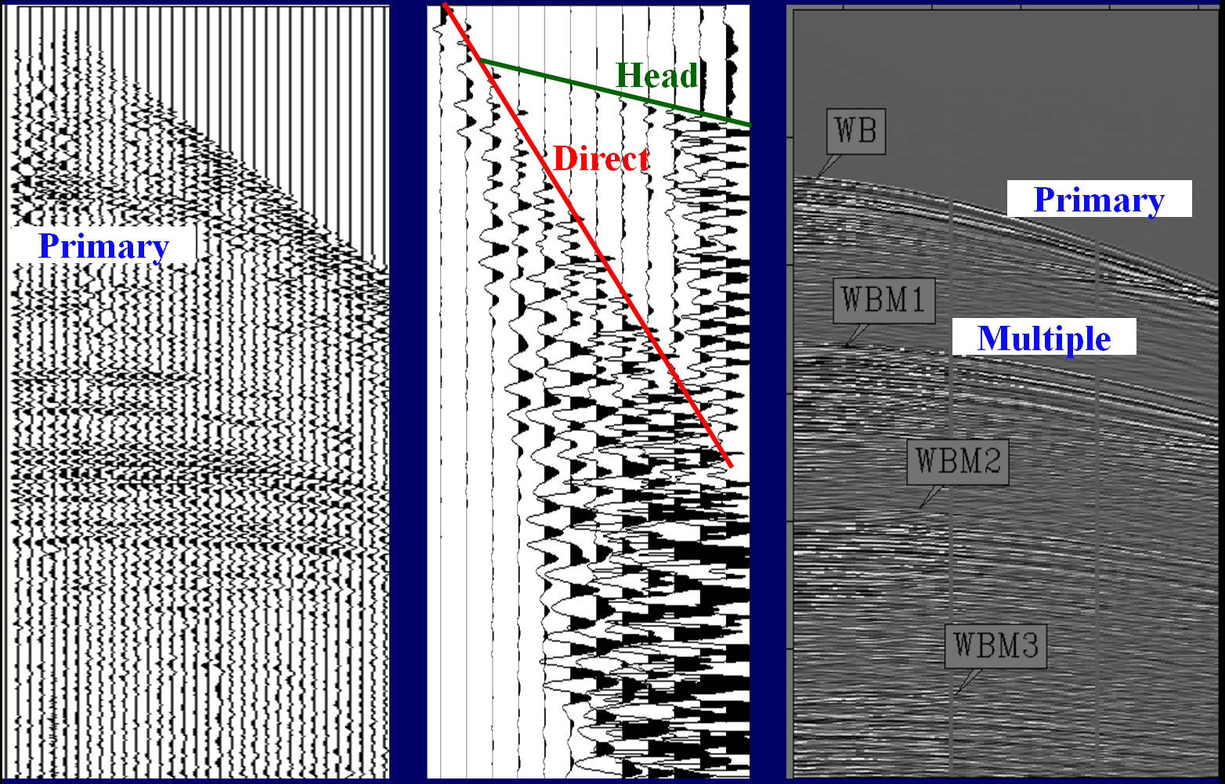
Seismic Signal and Noise

Slide 23
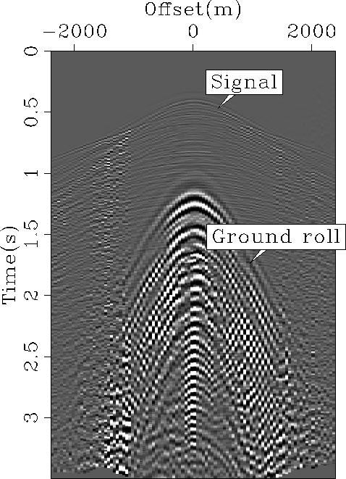
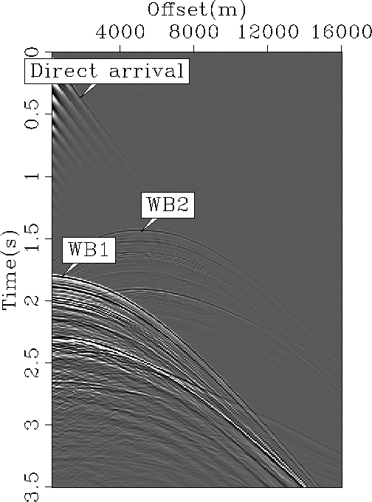
Seismic Signal and Noise
Diffraction

Slide 24
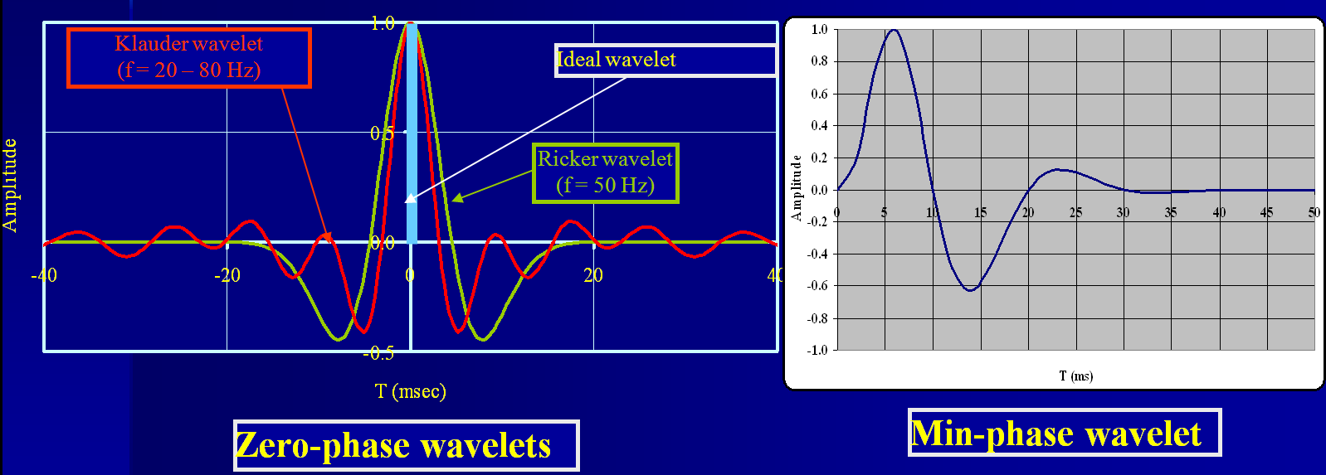
Seismic Signal and Noise
Seismic wavelets

Slide 25
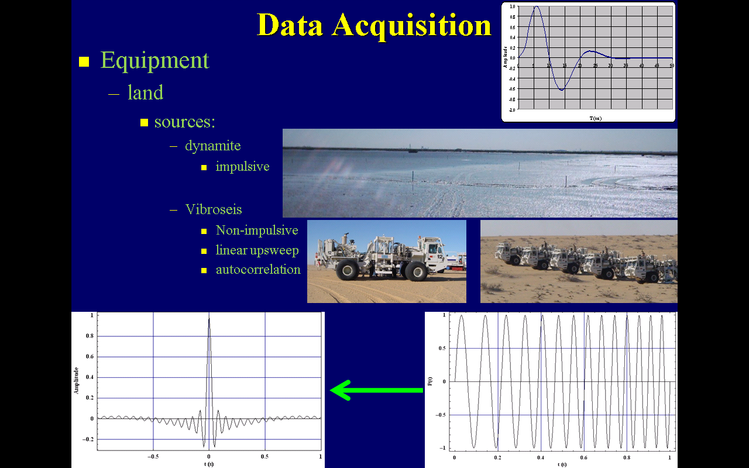
Data Acquisition

Slide 26
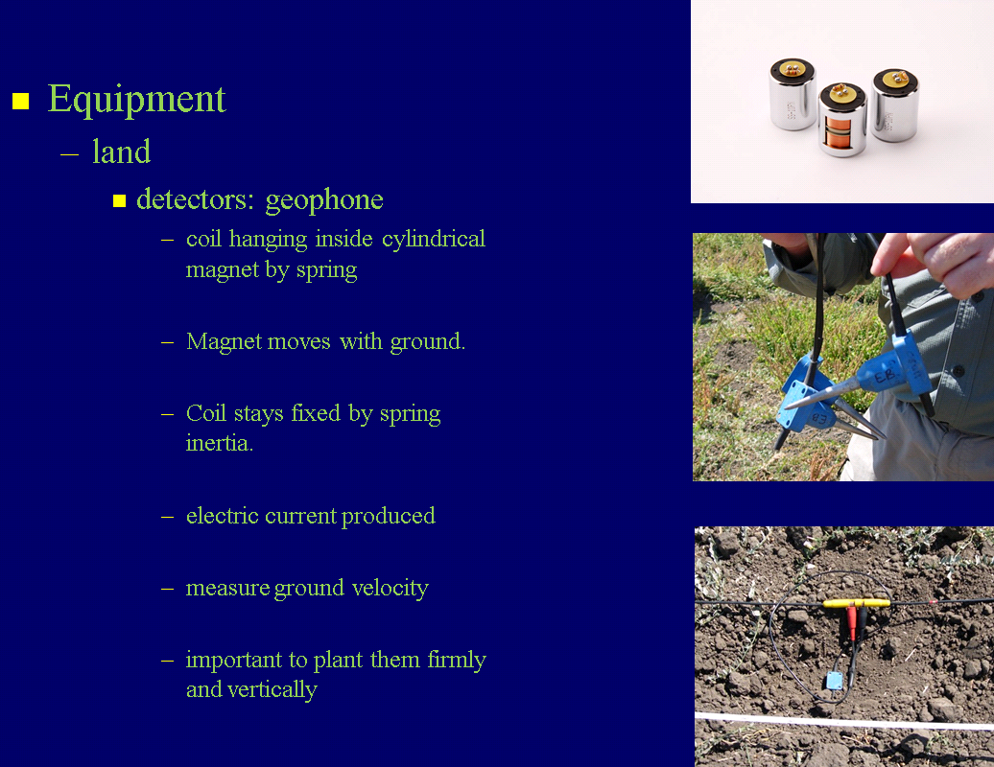
Data Acquisition

Slide 27
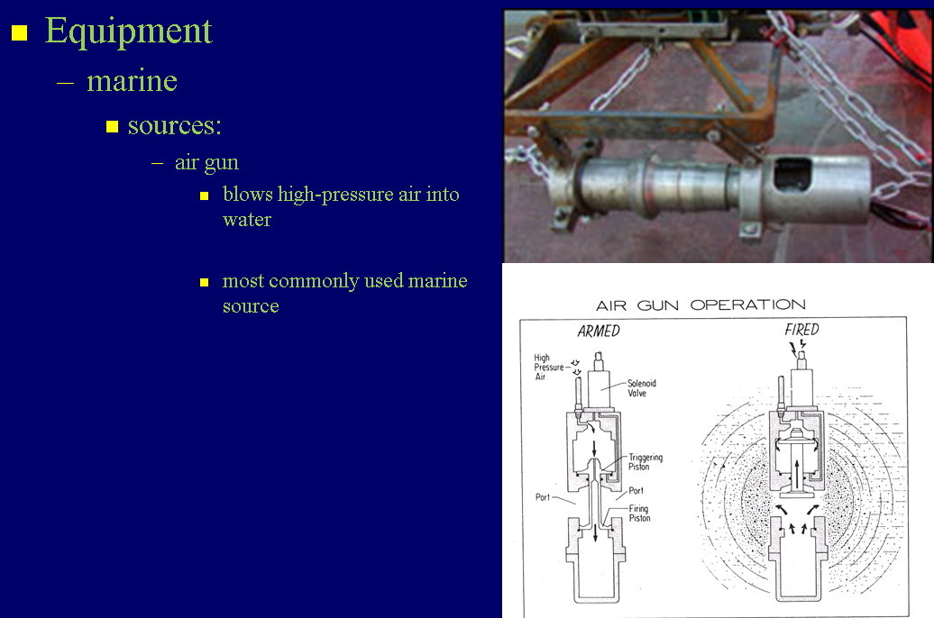
Data Acquisition

Slide 28
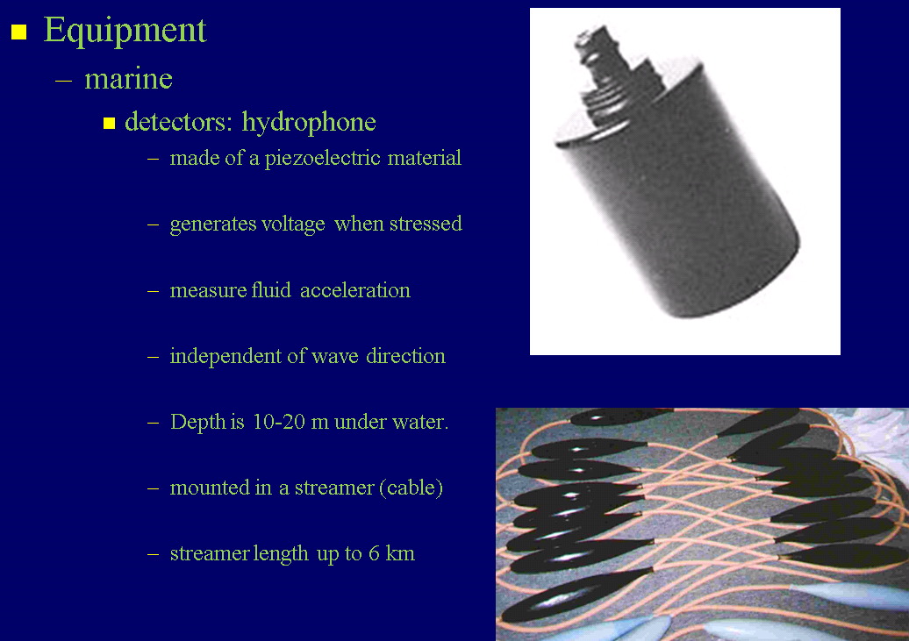
Data Acquisition

Slide 29
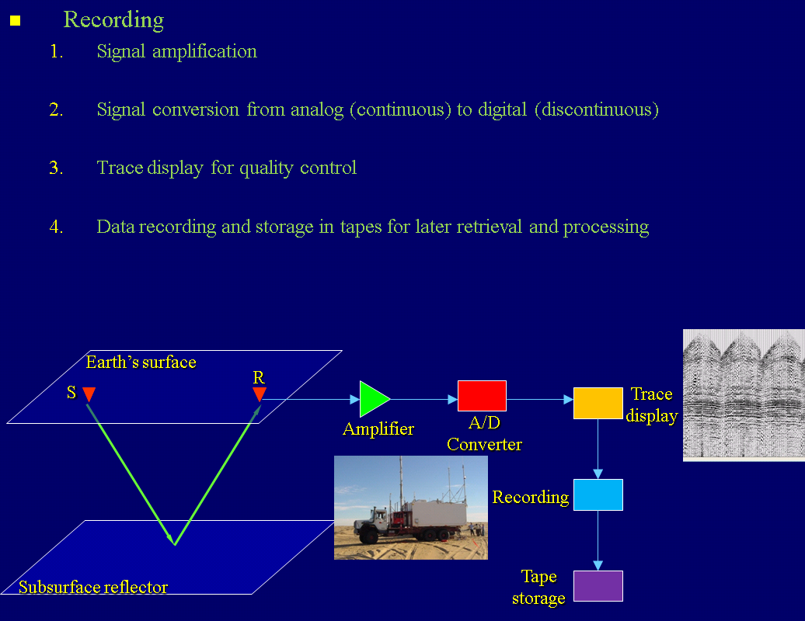
Data Acquisition

Slide 30
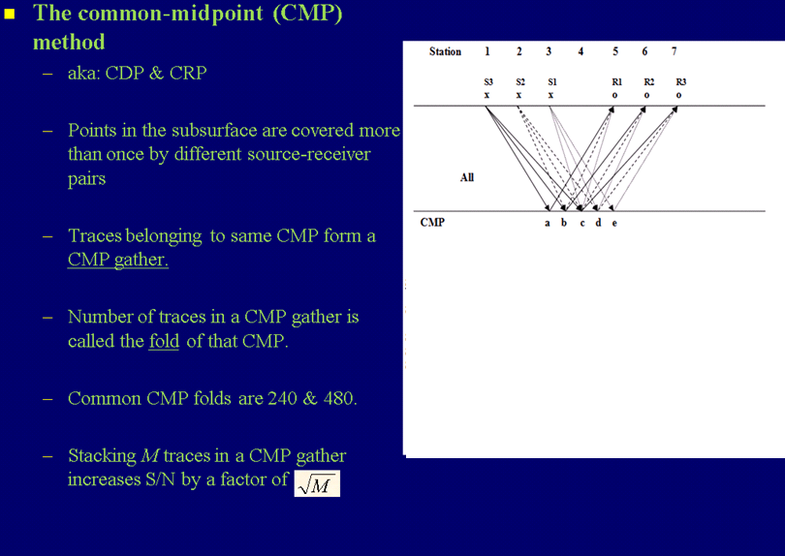
2-D Field Procedures

Slide 31
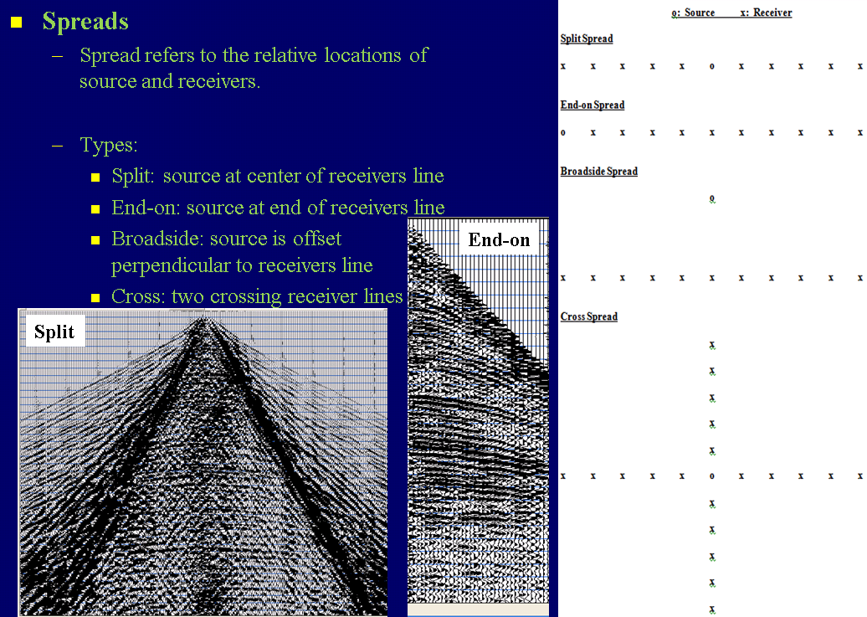
2-D Field Procedures

Slide 32
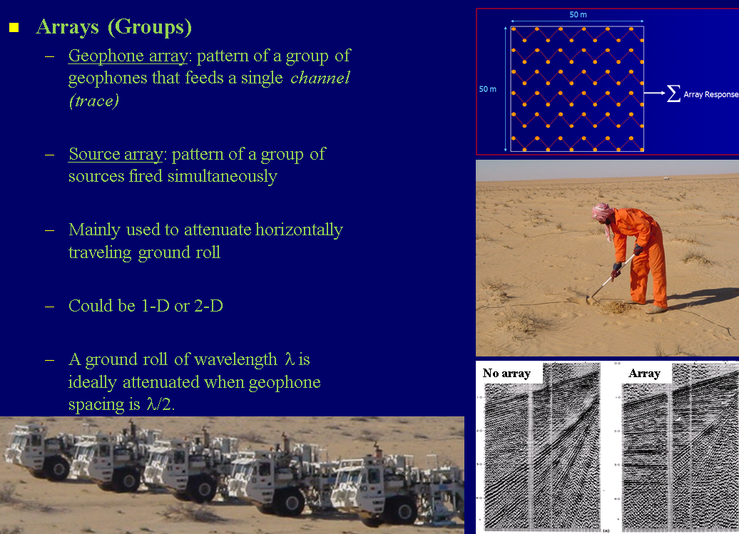
2-D Field Procedures

Slide 33
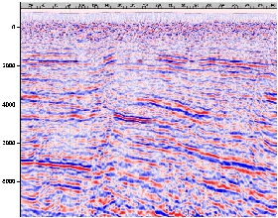
2-D Field Procedures
Example
www-gpi.physik.uni-karlsruhe.de

Slide 34
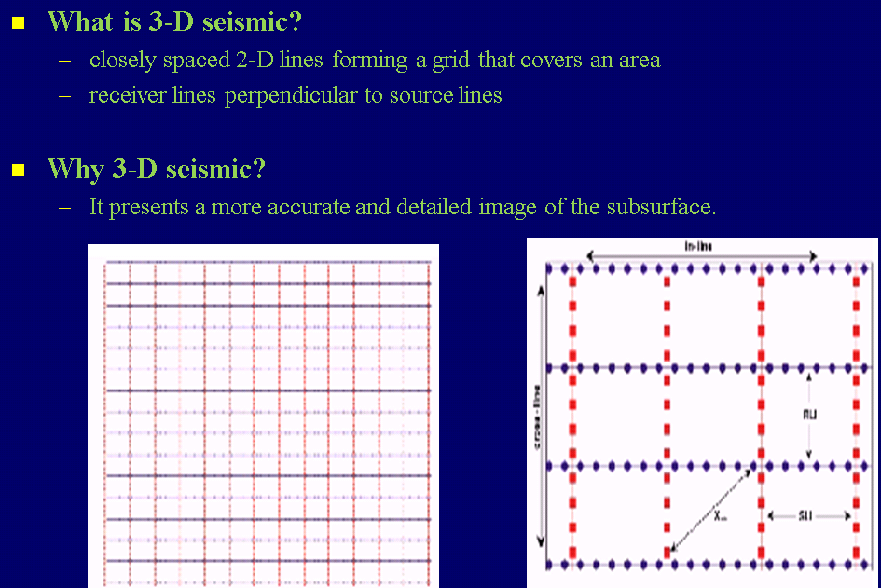
3-D Seismic Exploration
Cordsen et al., 2000

Slide 35
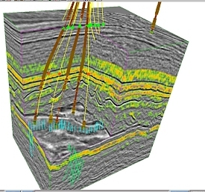
3-D Seismic Exploration
Example
www.oilandgas.org.uk

Slide 36
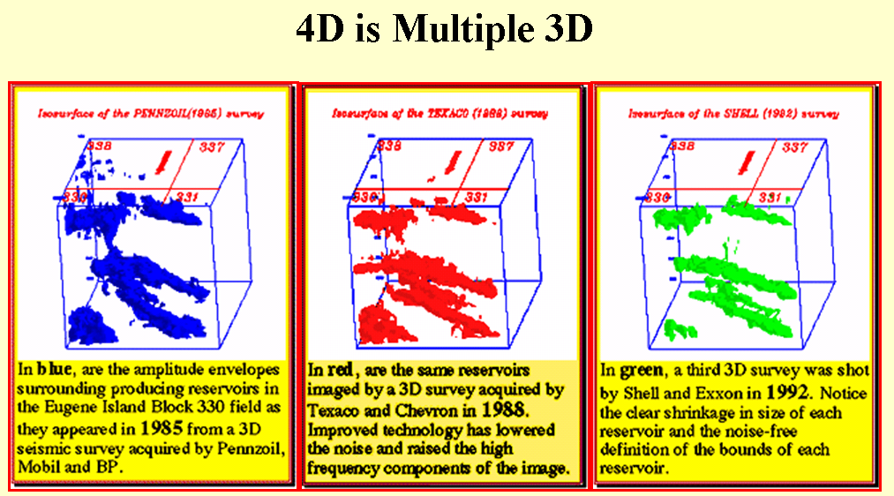
Time-Lapse (4-D) Seismic Exploration
www.ldeo.columbia.edu

Slide 37
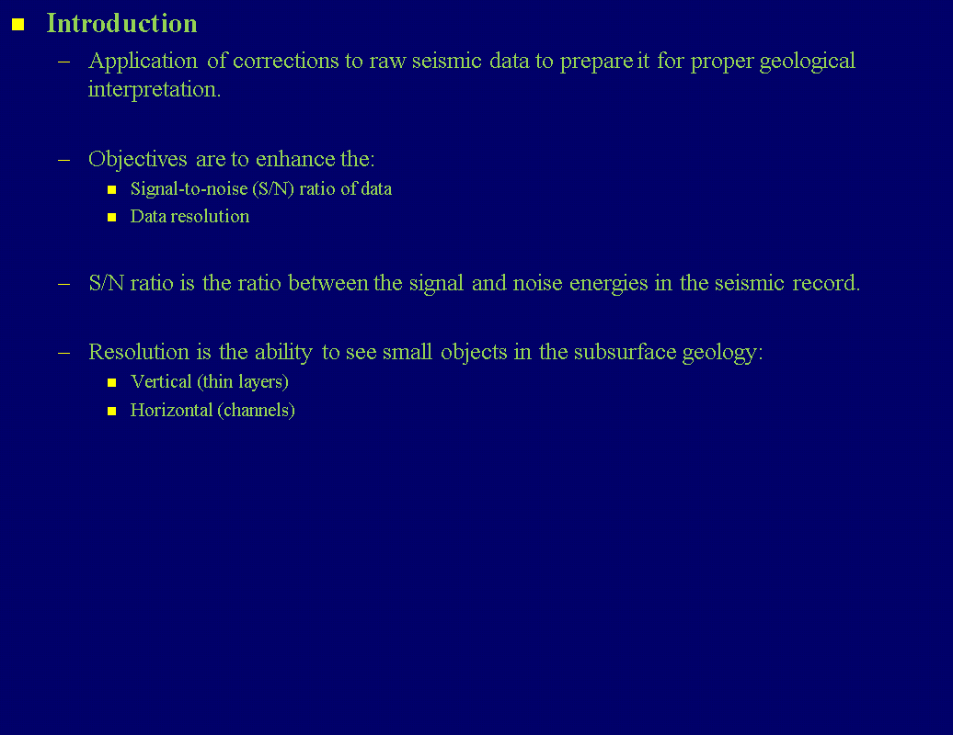
Seismic Data Processing

Slide 38
Seismic Data Processing
Conventional Processing Flow
  1. Preprocessing
    • Reformatting
    • Editing
    • Amplitude gain
    • Setup of field geometry
  2. Deconvolution and filtering
  3. CMP sorting
  4. Velocity analysis
  5. Static corrections
  6. NMO correction and muting
  7. Stacking
  8. Migration

Slide 39
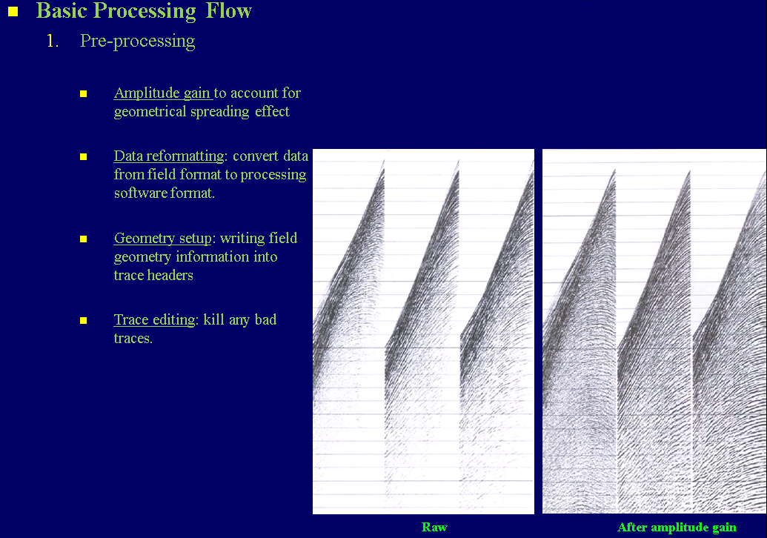
Seismic Data Processing

Slide 40
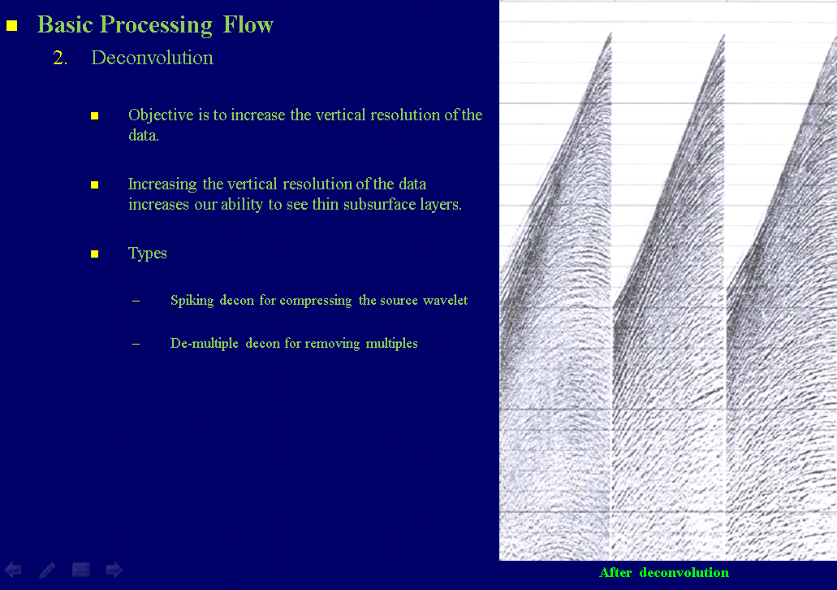
Seismic Data Processing

Slide 41
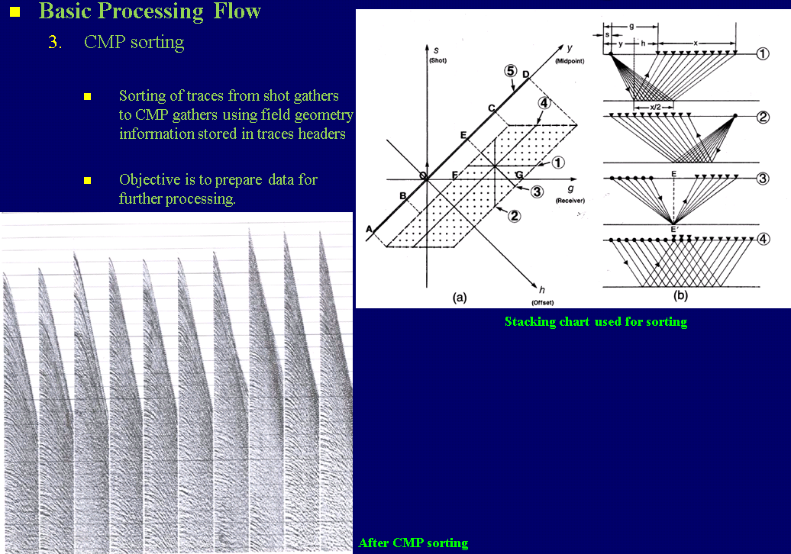
Seismic Data Processing

Slide 42
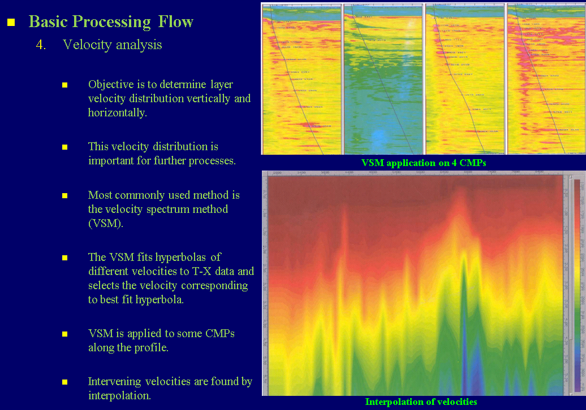
Seismic Data Processing

Slide 43
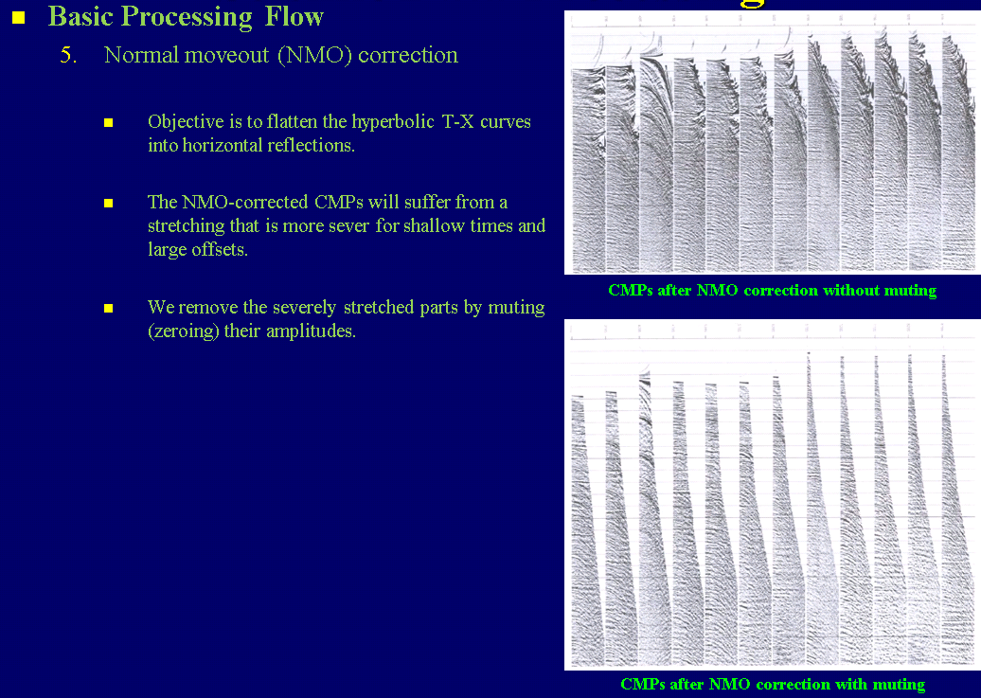
Seismic Data Processing

Slide 44
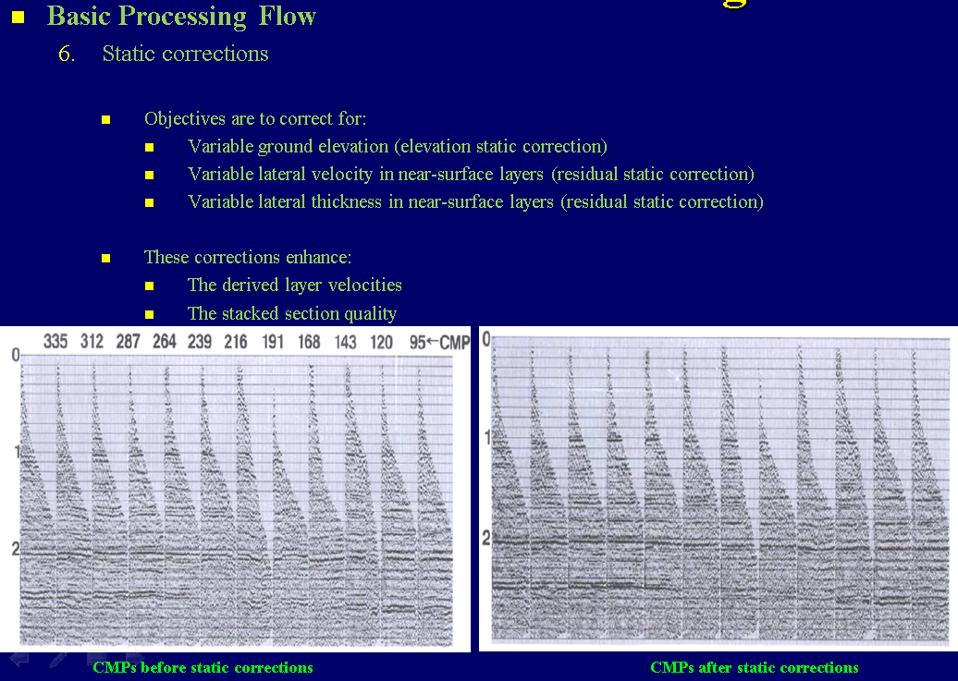
Seismic Data Processing

Slide 45
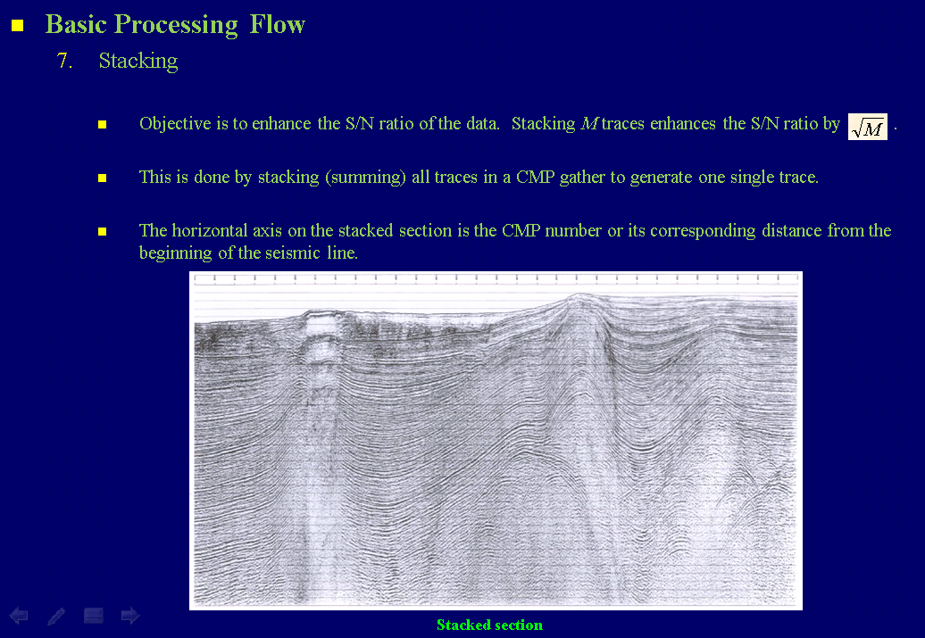
Seismic Data Processing

Slide 46
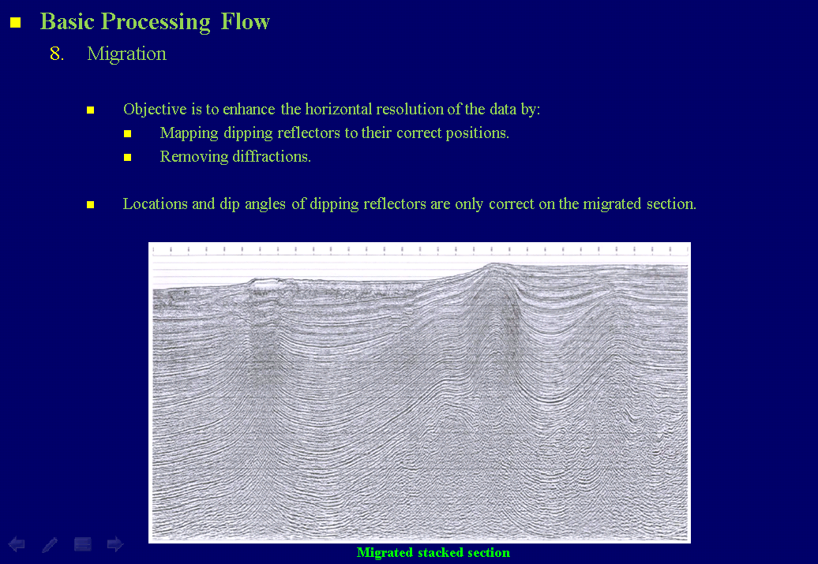
Seismic Data Processing

Slide 47
Seismic Data Interpretation
Introduction
  Seismic interpretation (SI) refers to the extraction of geological information from the seismic data.
  SI is performed on migrated and stacked seismic data.
  SI is usually supported by other non-seismic data such as gravity, magnetic, well-log, and geological data.
  SI is mainly used for two purposes:
    Prospect evaluation
    Reservoir development
  Although SI comes after seismic data acquisition and processing, it is important for acquisition and processing and interpretation professionals to communicate continuously.

Slide 48
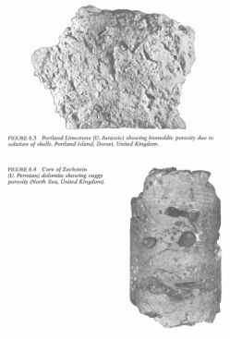
Seismic Data Interpretation
Introduction
  Occurrence of a commercial petroleum prospect requires the following factors:
    Source rock (high porosity but low permeability)
    Sufficient temperature and time to generate petroleum, but not destroy it
    Migration of petroleum from source to reservoir rock
    Reservoir rock (high porosity and high permeability)
    Trap
  These factors have to be timed appropriately to trap petroleum in commercial amounts.
  Porosity refers to the amount of pore space in the rock.
  Permeability refers to the ability of a rock to flow fluids.
Porous/permeable
Porous/impermeable

Slide 49
Seismic Data Interpretation
Structural
Diapiric |  | Fold |  | Fault
Shale | Salt | Compressional anticlines | Compactional anticlines | Normal | Reverse | Strike-slip
Trap
  A trap is a place where petroleum is barred from further movement (migration).
  The trap includes the reservoir and cap rock (seal).
  Traps can be divided into:
    Structural - Caused by tectonic processes
    Stratigraphic - Caused by depositional morphology or diagenesis
Stratigraphic
Associated with unconformity |  |  |  | Not associated with unconformity
Supra-unconformity |  |  | Sub-unconformity | Depositional |  |  |  | Diagenetic
Onlap | Valley | Channel | Truncation | Pinchout | Channel | Bar | Reef | Porosity and/or permeability transition

Slide 50
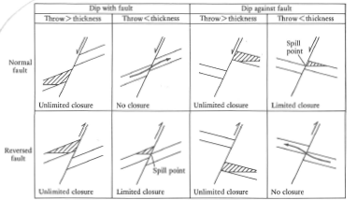
Seismic Data Interpretation
Structural Traps - Faults

Slide 51
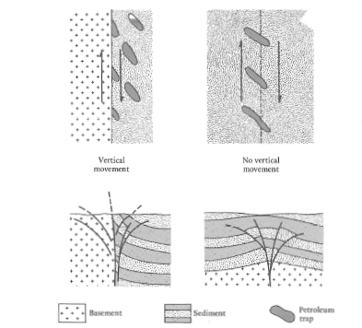
Seismic Data Interpretation
Structural Traps - Faults

Slide 52
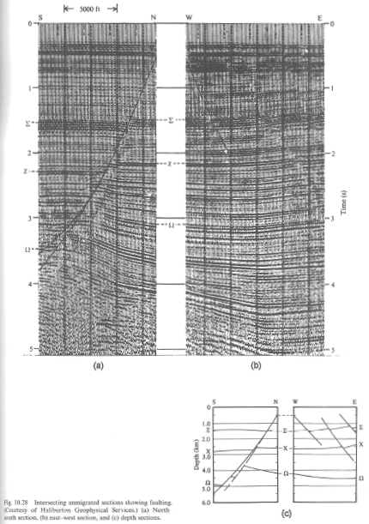
Seismic Data Interpretation
Structural Traps - Faults
Important evidences of faulting on seismic sections include:
  Reflection termination against the fault plane
  Diffractions along fault plane
  Offset (vertical and horizontal) of reflections across the fault plane
  Differential reflection dip across the fault plane

Slide 53
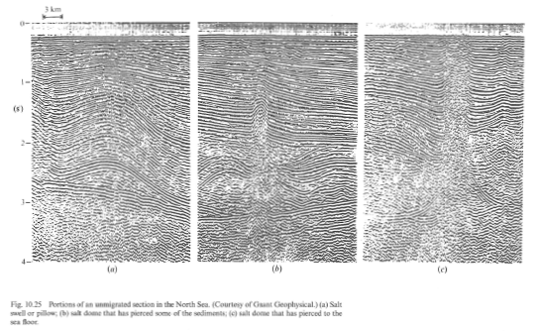
Seismic Data Interpretation
Structural Traps - Folds
Folding is associated with the following environments:
  Excessive horizontal compressive stresses
  Diapers:
    Salt
    Shale
  Differential compaction
  Arching due to intrusions

Slide 54
Seismic Data Interpretation
Structural Traps - Diapirs
Diapirs result from the movement of salt and shale due to rock density inversion together with pressure and temperature.

Slide 55
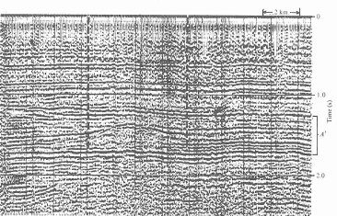
Seismic Data Interpretation
Stratigraphic Traps - Reefs
Reefs are carbonate depositional structures that develop in tropical areas.

Slide 56

Seismic Data Interpretation
Stratigraphic Traps - Channels
They are sediment-filled ancients streams (rivers).

Slide 57

Seismic Data Interpretation
Stratigraphic Traps - Channels

Slide 58

Seismic Data Interpretation
Stratigraphic Traps - Unconformities
They are time periods during which sediment erosion or no deposition occurred.

Slide 59

Seismic Data Interpretation
Stratigraphic Traps - Unconformities

