Slide 1
Miscellaneous Other Third Order Nonlinearities
There are many mechanisms through which light interacts with matter. For example, there are
local third order nonlinearities associated with the coupling of light to molecular degrees of
freedom like vibrational and rotational molecular motions which are relatively fast and occur on
100fs to the 10’s ps times scales.
New nonlinear effects occur in the transition from single molecules to condensed matter. Van der
Waals, coulomb and other interactions can lead to co-operative behavior on the scale of optical
wavelengths or larger, and/or to the weak breaking of molecular symmetries. For example, in
liquid crystals intermolecular interactions and geometry effects lead to strong inter-molecule
coupling in the relative orientation of molecules and the nonlinear response can be highly
non-local, and very slow. In photorefractive materials, charge transport due to Coulomb
interactions subsequent to the absorption of light also results in non-locality. The nonlinearities
in these two classes of materials can be very large and hence can be very accessible for simple
experiments at low powers. Unfortunately, in some cases they have erroneously been referred
to as Kerr nonlinearities.
Electrostriction, thermal effects and cascading of second order nonlinearities also lead to
nonlinear changes in the refractive index (or the phase of light beams) non-locally. They are
characterized by the propagation of mechanical effects (sound waves), thermal effects (heat)
and the coupling between optical waves at different frequencies via χ⁽²⁾ (“cascading’) respectively.

Slide 2
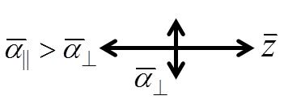
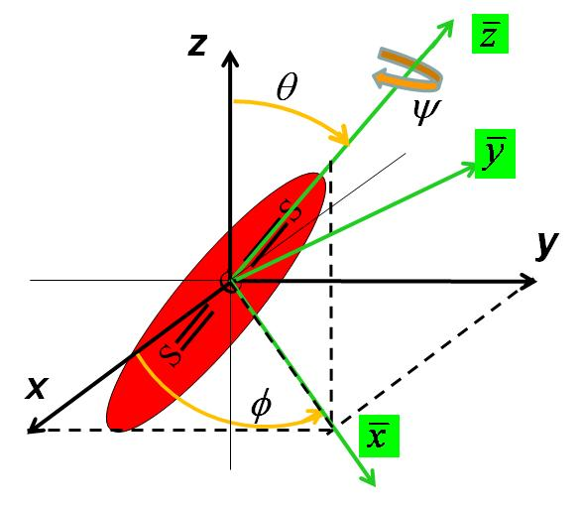
Single Molecule Re-orientation Effects in Liquids
Anisotropic molecules in a liquid re-orient in response to a light-induced torque, hindered by viscosity and randomized by thermal fluctuations in the positional, rotational and vibrational degrees of freedom. The “turn-on” time depends on the strength of the applied field, the liquid viscosity and molecular shape. The “turn-off”, ps – ns, depends on the latter two.
Consider CS₂
S C S
 | 0 | 0
0 |  | 0
0 | 0
Euler angles relate the polarization induced in a molecule
to the induced polarization in laboratory frame of reference
There is a torque exerted on a molecule by the strong field
which re-orients it towards z. The corresponding potential is given by
Temperature fluctuations of energy ∝ k_{B}T tend to randomize the
molecular orientation where k_{B} is Boltzman’s constant.
Molecular reoriention times (e.g. ps in CS₂) >> period of EM field oscillation
→ molecular re-orientation cannot follow the field at 2ω. It follows the time average of .

Slide 3
By definition, the net index change saturates when all of the molecules are lined up!
Approximate “turn-on” and “turn-off” times can be obtained from the Debye rotational diffusion
equation in terms of the “order parameter” Q given by
When the molecules are randomly oriented, Q=0 and when they are all aligned, Q=1.
Typical range from a few ps for simple molecules like CS₂ to ns for large molecules.

Slide 4
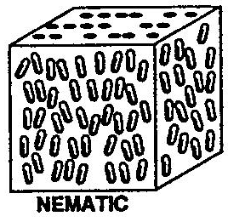
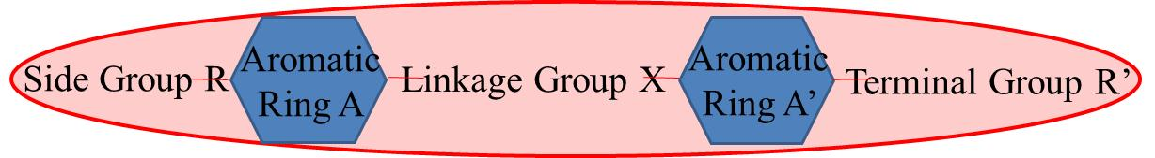
Liquid Crystals
Nonlinear optics of liquid crystals is in some ways closely related to the previous case. Strong inter-molecular forces between liquid molecules in the liquid state can lead to a unique form of matter in which molecular “clusters” exist, aligned along a direction in space (“director”). Note that in contrast to the solid state where X-ray diffraction patterns reveal 3D positional correlation, there is no such positional correlation between the molecules. The orientational correlation only exists over a finite temperature range above the melting point.
General Properties of Liquid Crystals
There are many “families” of liquid crystals. Most of the molecules can be considered to have
ellipsoidal shapes as shown below. The most commonly used and extensively studied molecule is
the nematic (at room temperature) 5CB, shown below.
Examples of R and R’ are C_{n}H_{2n+1},
C_{n}H_{2n+1}O, nitro, cyano (e.g. 5CB) etc.
CN
C₅H₁₁
A single molecular structure can take on different liquid crystal ordering as temperature or the side groups are changed. For example nCB is not a liquid crystal for n≤4, it is nematic for n=5-7 and then smectic for larger n. Note that the ordering is not perfect and is described by the “order parameter” Q. The average of the direction of α|| over all molecules, , called the “director”.

Slide 5
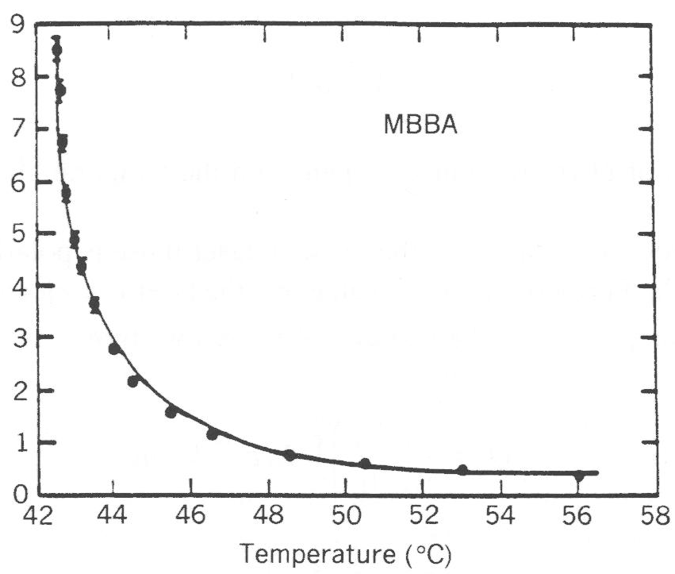
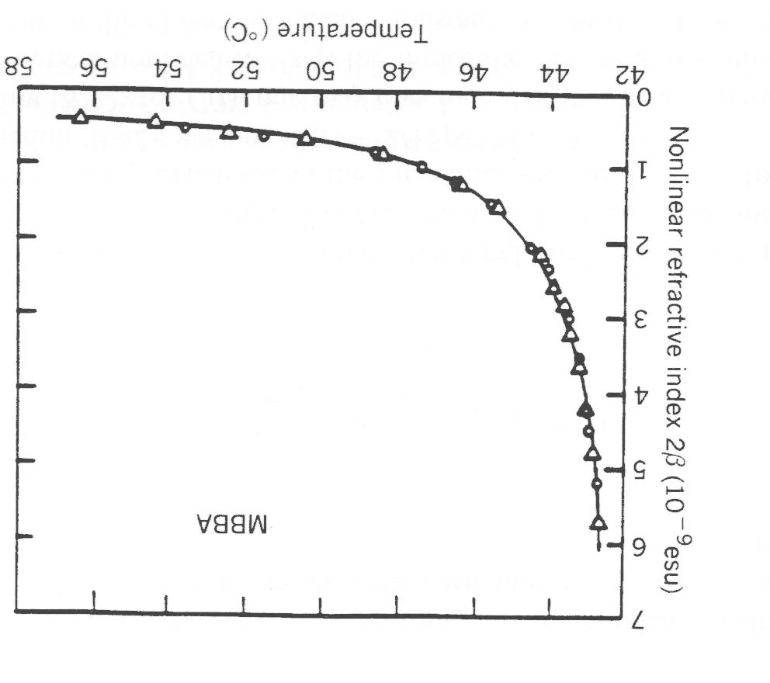



Liquid Crystals Nonlinear Optics - Re-orientation Effects
As the temperature is increased above the nematic-isotropic phase transition, limited orientational
order persists over sub-wavelength volumes with directors ( ) not parallel to each other.
These clusters behave like large, highly polarizable molecules and can be oriented by strong
optical fields as discussed before for the single molecule case. The larger the cluster size, the
larger the nonlinearity and the slower the response time, as shown below. As the temperature is
increased, the cluster size decreases until this re-orientational nonlinearity reaches the single
molecule value (∼10⁻¹³cm²/W).
∼10⁻¹¹cm²/W
Relaxation tin time τ_{r} ( 100 nsec)
n₂ (arbitrary units)
Temperature (⁰C)
Temperature (⁰C)
Temperature (⁰C)

Slide 6
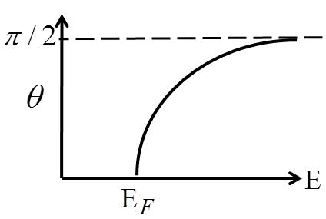
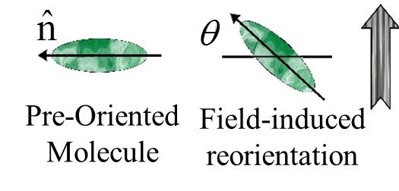
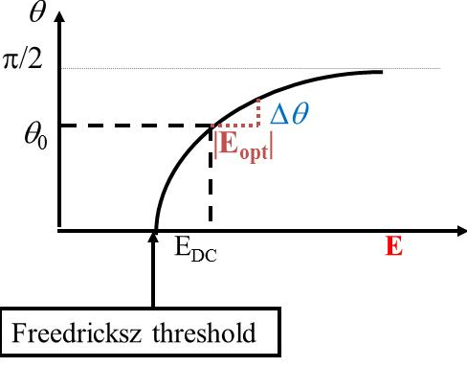
Enhanced Orientational Nonlinearity: Freedericksz Transition in Nematic Phase
For an increasing DC field, a phase transition (Freedericksz
transition) occurs at which the molecules begin to re-orient. The
required field is given by
where “d” is the plate separation, Δε=ε||-ε⊥, and K₁ is the “splay”
Frank elastic constant (∼10⁻¹¹ newtons).
Planar molecule alignment
in zero field
The Freedericksz transition can also be induced by the
time averaged as shown previously for single
molecule re-orientation.
Application of both a bias DC field and an optical field in transparent liquid crystals leads to nonlinear effects with very small optical powers, of order mW.

Slide 7
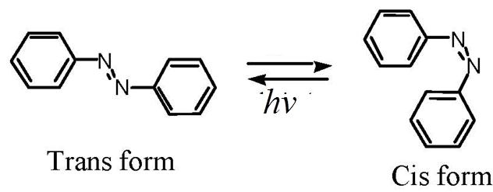
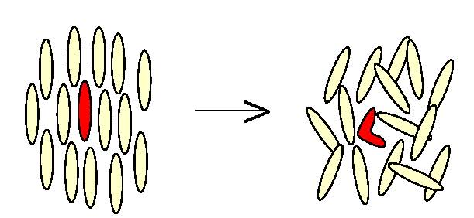
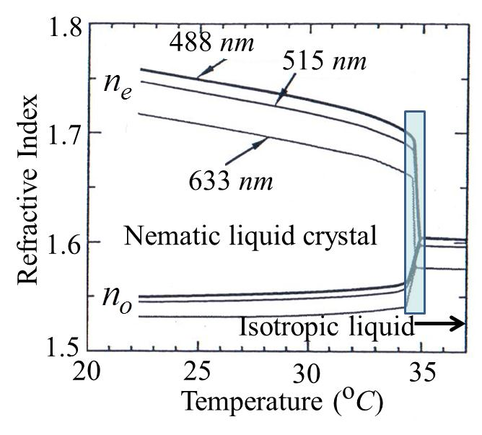
Giant Orientational Optical Nonlinearities in Doped Nematic Liquid Crystals
A photosensitive dye or molecule dopant is used to mediate, facilitate and enhance the
reorientation process. Largest effects are obtained with molecules which undergo trans-cis isomerization, e.g. azobenzenes.
Change in liquid crystal molecular
alignment due to isomerization.
Conformational change on photon absorption
by azobenzene molecules
Thermal Nonlinearities
The large ∂n/∂T in the region is a consequence of the rapid decrease with increasing temperature of the size of the aligned regions as the nematic to isotropic liquid crystal transition is approached. At the temperature at which the difference n_{e}-n_{o} vanishes, the domains become sub-wavelength and the material strongly scatters the light. These effects can be enhanced by
including other strongly absorbing molecules. The resulting nonlinearities can attain values of 1 cm²/W , usually with large attenuation coefficients.

Slide 8
Photorefractive Nonlinearities
These non-local nonlinearities occur due to a combination of physical phenomena which indirectly lead an index change that depends on the input intensity in electro-optic active media. Photorefractive materials have electron donor and acceptor states (defects, dopants etc.) which are located between the “valence” and “conduction” bands.
Conduction band
Ionized electron donor states
Electron donor states
Electron acceptor states
Valence band
The magnitude of n_{2,eff} can be very large. However, there is a nonlinearity - response time
≅ constant trade-off. It is the accumulated energy absorbed from a beam that is the key
parameter. There are a number of different photorefractive mechanisms possible which give
rise to nonlinear effects.. We focus on the steady state response due to the diffusion and
screening mechanisms which in electro-optic active materials lead to index changes.

Slide 9
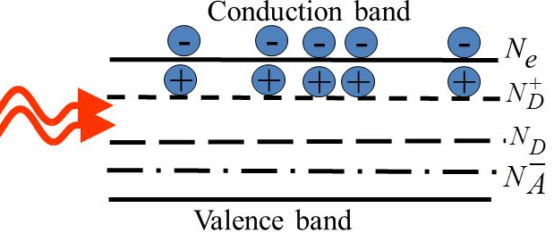
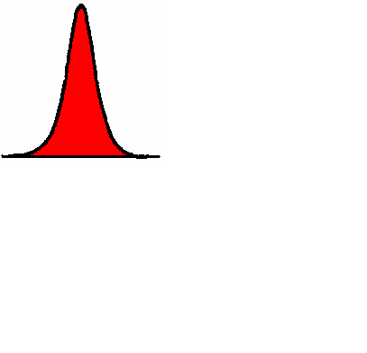
Screening Nonlinearity
No Applied DC field
Electrons are promoted from neutral electron donor states into the “conduction
band” by the absorption of light, resulting in ionized electron donor states.
Ionized electron donor states
Electron (neutral) donor states
Electron acceptor states
equivalent (dark) intensity due to
thermally excited electrons
recombination time
-
-
-
-
-
-
-
-
-
-
-
-
-
-
-
Initially density of electrons in the conduction band is highest at beam maximum.
x

Slide 10
2. Transport of electrons in response to:
Diffusion to regions of lower electron
density N_{e} in conduction band which
creates local space charge fields E_{sc}
electron mobility
carrier diffusion constant
Conduction band
-
-
-
-
-
x
+
+
+
+
+
Ionized electron donor states
Electron donor states
Electron acceptor states
Valence band
3. Electrons trapped in acceptor sites.
-
-
-
-
-
-
-
-
-
-
-
-
-
-
-
+
+
+
+
+
+
-
-
-
-
-
+
+
+
+
+
+
+
+
+
Conduction band
+
+
+
+
+
Ionized electron donor states
-
-
-
-
-
Electron donor states
Electron acceptor states
Valence band

Slide 11
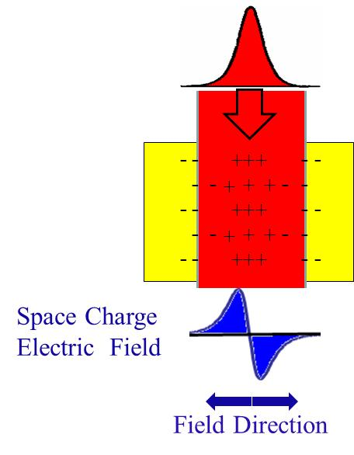
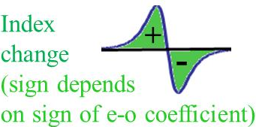
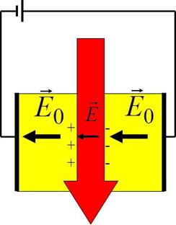
4. Since electrons trapped in new sites, charge separation produces “space charge” field E_{SC}
5. Refractive index change via electro-optic effect
“background” N_{th} in conduction band (thermal excitation etc.)
The “turn-on “and “turn-off “ response times are usually very slow
The “turn-on” time, μs→secs, is determined by the input integrated
absorbed flux and the carrier diffusion time. The “turn-off” time
depends on the thermal excitation rate of carriers and their diffusion time.
Screening Nonlinearity: Applied DC Bias Field
An additional possibility is to use a strong bias field so as to “overcome”
diffusion effects. In this regime the net field across the beam eclipses
small diffusion effects and hence the net space charge field varies with
the optical intensity (not with its derivative as with diffusion). The space
charge field opposes the applied field, reducing the net field in the region
of the optical beam. Furthermore, steady state “turn-on” time can also
be reduced by illuminating the whole sample uniformly, called I∞
which contributes an extra uniform background N_{e0}.

Slide 12

In steady-state J = constant, and in the limit that the diffusion terms can be neglected and
relatively broad beams, i.e, 1>> , the space charge field is given by
E_{total}
Index depressed less in this region
Material | Dopant | λ (μm) | n³r_{eff} (pm/V) | *τ_{diel}(sec) | Δn_{max} | E_{DC} (KV/cm)
Sr_{0.75} Ba_{0.25} Nb₂O₆ | Ce | 0.4-0.6 | 17390 | 0.1-1.0 | 0.005 | 3
Sr_{0.6} Ba_{0.4} Nb₂O₆ | Ce | 0.4-0.6 | 3000 | 0.1-1.0 | 0.0014 | 3
BaTiO₃ | Fe | 0.4-0.9 | 21,500 | 0.1-1.0 | 0.005 | 2.5
InP | Fe | 0.9-1.3 | 52 | 10⁻⁶-10⁻⁴ | **5x10⁻⁵ | 8
*at an intensity of 1 Watt/cm² ** with enhancement can go to 5x10⁻⁴

Slide 13


Novel π/2 Phase Shift Intensity Between Index Change Maxima
Gratings induced in photorefractive
media have some unusual properties.
Spatial Intensity Distribution
I(x)
θ
θ
ρ(x)
E_{sc}(x)
Δn(x)
Note the π/2 phase shift between I(x) and Δn(x).

Slide 14
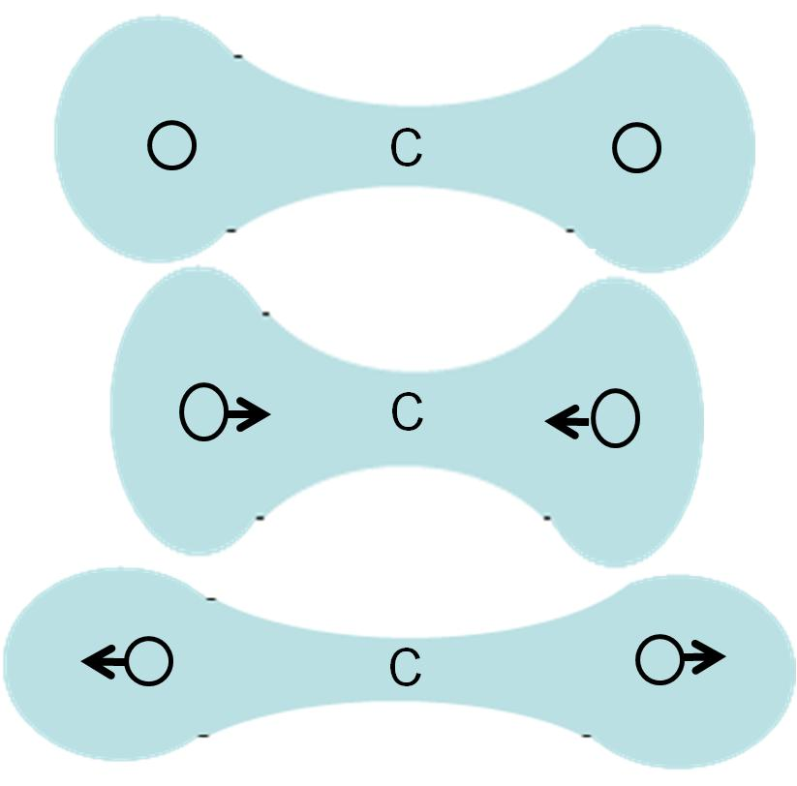
Nuclear (Vibrational) Contributions to Δn(I)
Light couples via electric dipole effects to the vibrational
(non-electronic) normal modes in matter. This leads to
significant contributions to n₂ (10-20% in glasses). The
formulation below is for the cw case normally valid for
pulse widths > 10ps.
e.g. CO₂ molecule
No vibration
(at rest)
The vibrations modulate the molecular polarizability
Vibrating
molecule
Summation over all
vibrational modes “β”
Vibration amplitude
(optically driven)
Raman
hyperpolarizability.
When an optical field of frequency ω is applied, this
gives rise to a nonlinear polarizability in the molecule
From classical mechanics, there is an all-optical force which induces the vibration in the β’th
mode with frequency Ω_{β} (approximated as a simple harmonic oscillator) in the molecule given by
where is the effective mass associated with the vibration.
Notes:
14

Slide 15
“virtual” state
Vibration driven at 2ω,
small response
Vibration driven at 0ω,
net displacement of atoms
“virtual” state
ω
ω
-ω
vibrational states
ω
vibrational states
Solving for the optically driven displacement and substituting into the nonlinear polarization gives
Notes:
15

Slide 16
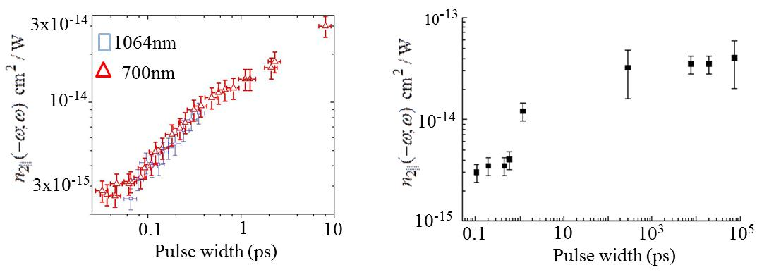
Fractional contribution of n_{2,nuc} to the total n₂
Glass | Wavelength | Nuclear Fraction | Measurement Method
Fused silica (SiO₂) | visible | ∼15-18% | Raman
87% GeS₂-13%Ga₂S₃ | 825 nm | 13±5% | 35fs OKE
64%PbO-14%Bi₂O₃-7%B₂O₃-15%SiO₂ | 825 nm | 12±5% | 35fs OKE
0%-50%GeO₂ in GeO₂-SiO₂ | 800 nm | 13-18% | 18fs SRTBC
e.g. linear molecule CS₂ (liquid)
Re-orientational
Single pulse measurements
SRTBC – spectrally resolved two beam coupling
n_{2,ef} cm²/W)
n_{2,ef} cm²/W)
Vibrational
Kerr

Slide 17
Electrostriction
Consider a capacitor
[Universal mechanism, always has the same sign (+ve)]
+++++++++++++
Due to the presence of the + and – charges there is an electric field and a compressive force squeezing the medium
This compressive force produces a strain field , S₁₁ in this case, associated with the electric field.
x
----------------------------
Elasto-optic interaction
compressive forces → Δρ increase (density change>0) → increase in local EM field energy density
Work done in compressing the medium (ΔU) = Increase in EM energy density (ΔW)

Slide 18
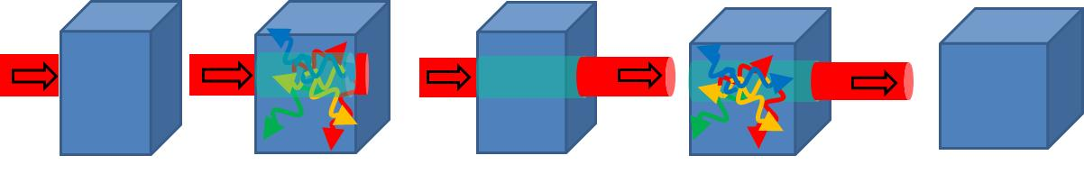
“Turn-on” and “turn-off” times are a complex issue because turning on or off an optical beam
involves compressive forces. They lead to the generation of a spectrum of acoustic waves. The
acoustic decay time τ_{s}(Ω_{s}) ∼ Ω_{s}⁻² and the details of beam shape, sample boundaries etc.
influence the acoustic spectrum generated which includes both compressional and shear waves.
Material in beam path densified.
Sound waves generated
When beam turned off,
sound waves generated
In an “infinite” medium, the shortest “turn-on” and “turn-off” times are given by the acoustic transit time across the optical beam [beam diameter]/v_{S}, with v_{S} ~1 micron/nsec giving μs-ns.
Material | Polarization λ (μm) | Elasto-optic coefficient | K (10¹⁰ m²/newton) | n | n_{2,eff} (cm²/W)
Fused silica | (0.63) | p₁₁= 0.12 | 3.69 | 1.46 | 0.4x10⁻¹⁶
GaAs | [110] (1.15) | = ∼0.14 | ∼7.6 | 3.37 | 1.6x10⁻¹³
Al₂O₃ | [001] (0.63) | p₃₃= 0.20 | ∼27.0 | 1.76 | 3.7x10⁻¹⁷
polystyrene | (0.63) | p₁₁= 0.31 | 0.54 | 1.59 | 2.4x10⁻¹⁵
Methanol |  | p₁₁= 0.32 | 0.083 | 1.33 | 5.7x10⁻¹⁵

Slide 19
Thermo-Optic Effect
This is a very complex problem in general which can be simplified in some useful limits.
α₁ (absorption coefficient) ρ (density)
C_{p} (specific heat) κ (thermal diffusion constant
The local temperature is given by the thermal diffusion equation
where Q is the absorbed power per unit volume per unit time.
Note that has the units of inverse time which we define as .
Assume so that maximum temperature distribution has the spatial distribution

Slide 20
Material | GaAs | Al₂O₃ | NaCl | ZnO | Acetone | C₆H₆ | methanol
τ_{th} (ms) | 0.080 | 3.1 | 0.72 | 0.39 | 45 | 24 | 20
dn/dT x10⁻⁴(/ºC ) | 1.6-2.7 | 0.13 | 0.25 | 0.1 | -5.6 | -6.2 | -4.0
Δt
Decay time τ_{th}
t
For high repetition rates (mode-locked lasers), the key question is the
energy accumulation over all the pulses within the time window τ_{th}!
e.g. For a mode-locked laser operating with 1ps pulses at a repetition rate
of 100 MHZ accumulates energy from 10³ pulses over τ_{th} giving
a cumulative

Slide 21
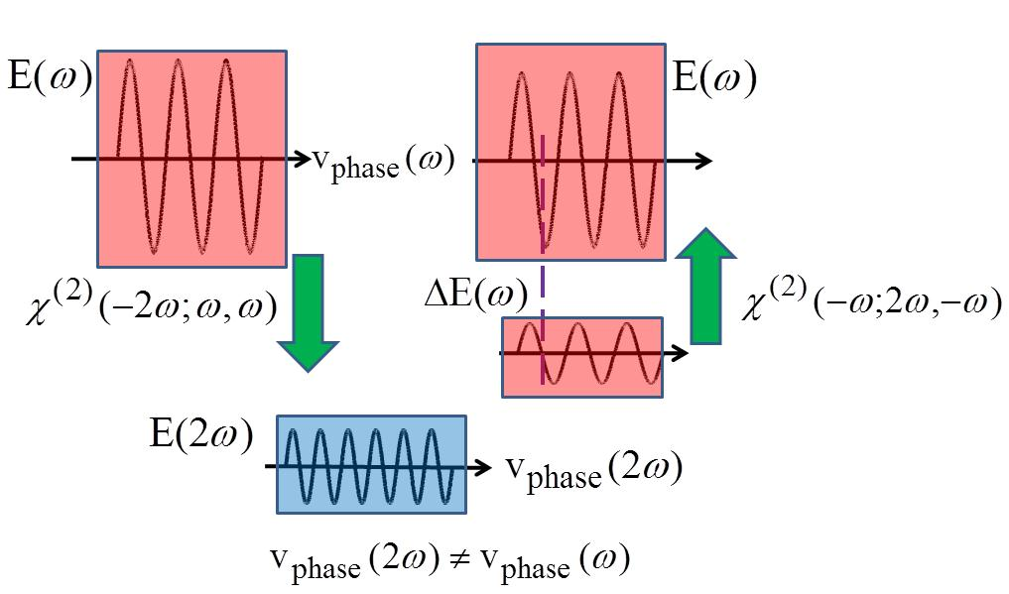
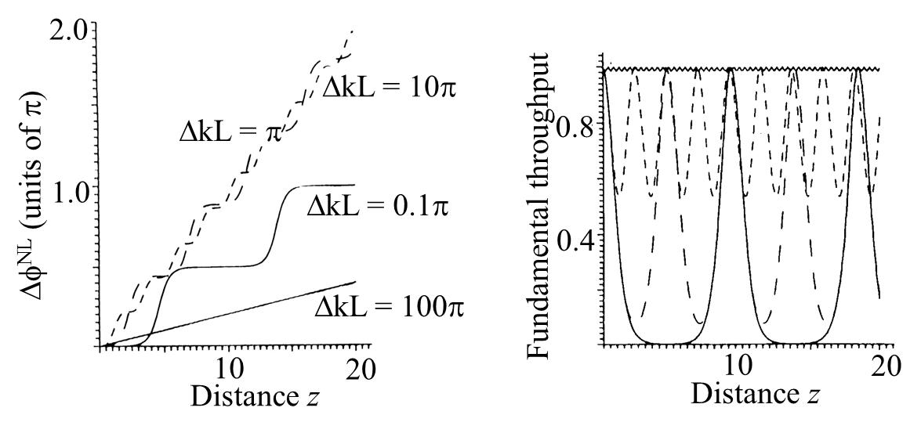
χ⁽³⁾ Via Cascaded χ⁽²⁾ Nonlinear Processes: Non-local
A nonlinear phase shift in
the fundamental beam
occurs when the
non-phase-matched
second harmonic
generated from the
fundamental interacts
with it on propagation.
That is, propagation
is required making the
process non-local.

Slide 22
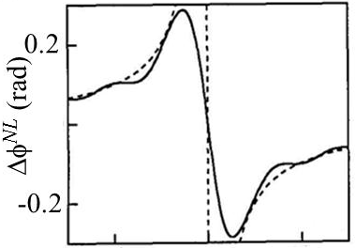
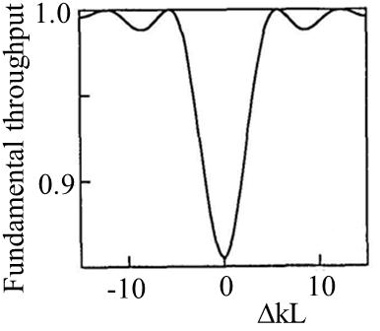
Low Fundamental Depletion Approximation
VNB: Sign of nonlinearity depends on sign of Δk, i.e. can be self-focusing or self-defocusing!
But, this is not really a n₂ process since there is no refractive index change. What can be measured is a nonlinear phase shift Δφ^{NL}.
e.g. QPM LiNbO₃, L=1cm: maximum =2x10⁻¹²cm² /W
e.g. DSTMS, : maximum =4x10⁻¹³cm² /W

