Slide 1
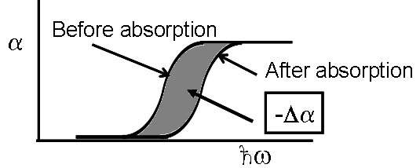
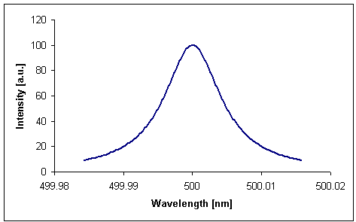
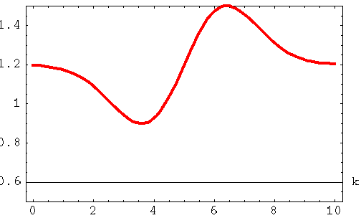
Charge Carrier Related Nonlinearities
Bandgap Renormalization (Band Filling)
Before Absorption
After Absorption
Absorption induced transition
of an electron from valence to
conduction band conserves k_{x,y}!
Conduction Band
E′_{gap}
E
k_{y}
E′_{gap}> E_{gap}
E_{gap}
τ
Recombination
time
k_{x}
Valence Band
Kramers-Kronig →
- frequency at which Δα occurs
ω - frequency at which n measured
∼0.01
E_{gap}
E_{gap}

Slide 2
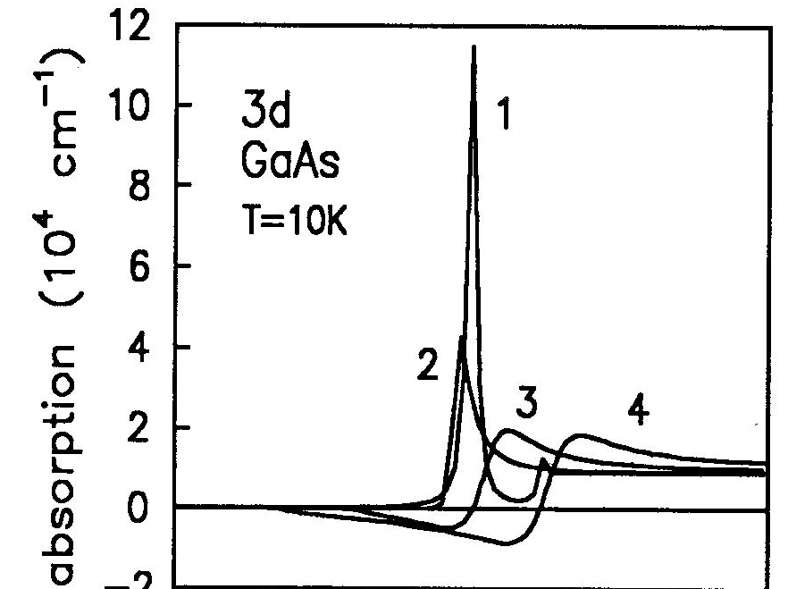
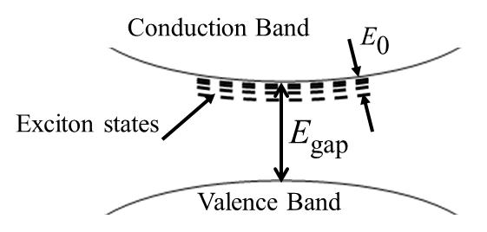
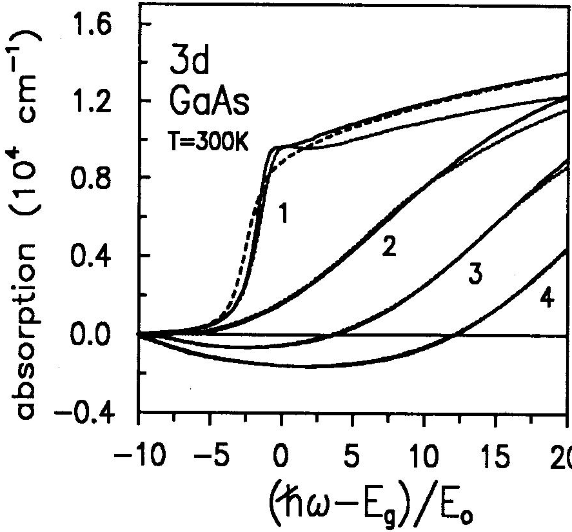
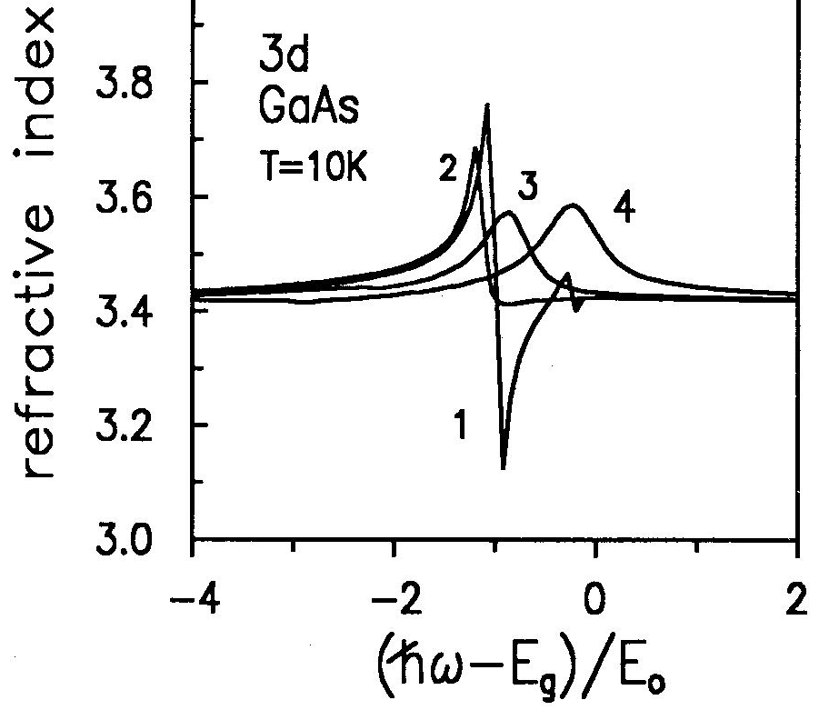
Exciton Bleaching

Slide 3
Charge Carrier Nonlinearities Near Resonance
Most interesting case is GaAs, carrier lifetimes are nsec → effective Γ_{e} (linewidths) meV
classical dispersion (Haug & Koch) is of form .
near resonance, as discussed before
E_{e} – electron energy level to which electron excited in conduction band
E_{h} – electron energy level in valence band from which electron excited by absorption
Simplest case of a 2 band model:

Slide 4
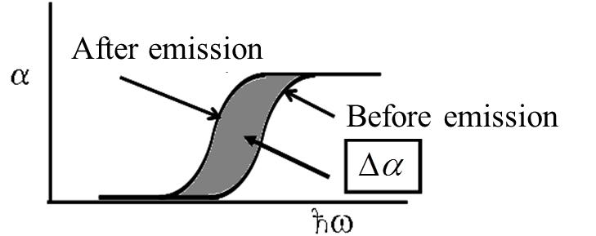
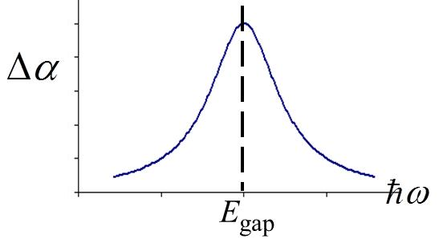
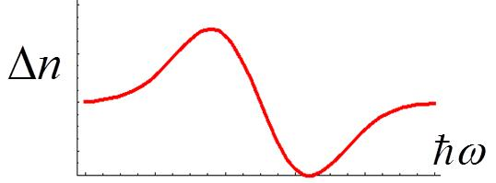
Active Nonlinearities (with Gain)
Optical or
electrical
pumping
-
Stimulated
emission
-
Get BOTH an index
change AND gain!
Kramers-Krönig used to calculate
index change Δn(ω) from Δα(ω).
Ultrafast Nonlinearities Near Transparency Point
“Transparency point”
At the transparency point, the losses are balanced by
gain so that carrier generation by absorption is no
longer the dominant nonlinear mechanism for
index change. Of course one gets the Kerr effect +
other ps and sub-ps phenomena which now dominate.
Gain
0
Loss

Slide 5
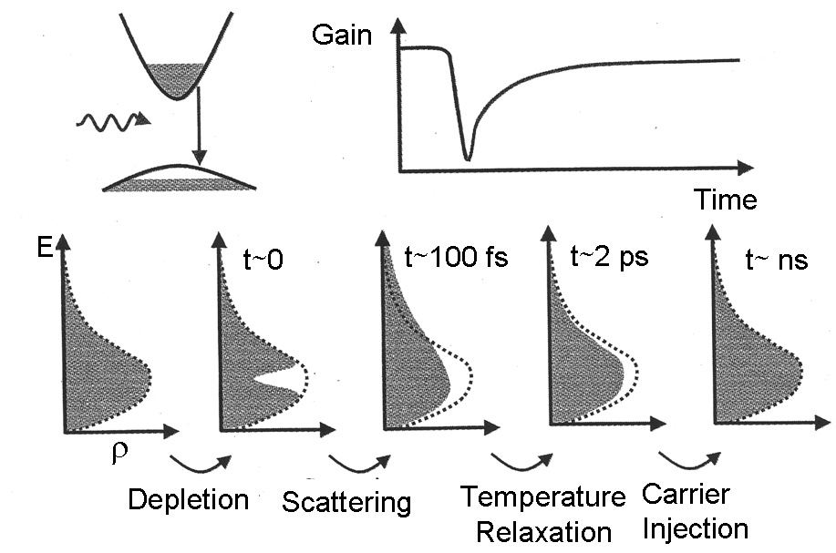
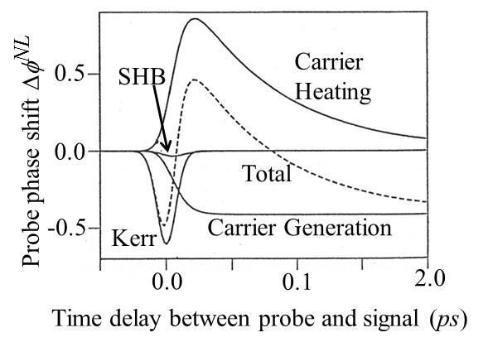
Evolution of carrier density in time
“Spectral Hole Burning”
“hole” in conduction band due to
to stimulated emission at maximum
gain determined by maximum
product of the density of occupied
states in conduction band and
density of unoccupied states in
valence band
“Carrier Heating”
(Temperature Relaxation)
electron collisions return carrier
distribution to a Fermi distribution
at a lower electron temperature
SHB – Spectral Hole Burning
Experiments have confirmed these calculations!

Slide 6
Semiconductor Response for Photon Energies Below the Bandgap
As the photon frequency decreases away from the bandgap, the contribution to the electron
population in the conduction band due to absorption decreases rapidly. Thus other mechanisms become important. For photon energies less than the band gap energy, a number of passive ultrafast nonlinear mechanisms contribute to n₂ and α₂. The theory for the Kerr effect is based on single valence and conduction bands with the electromagnetic field altering the energies of both the electrons and “holes”.
There are four processes which contribute, namely the Kerr Effect, the Raman
effect (RAM), the Linear Stark Effect (LSE) and the Quadratic (QSE) Stark Effect. Shown
schematically below are the three most important ones.
The theoretical approach is to calculate first the nonlinear
absorption and then to use the Kramers-Kronig
Relation to calculate the nonlinear index change .
Ω - frequency at which Δα occurs
ω - frequency at which Δn calculated

Slide 7
Kerr
Here E_{p} (“Kane energy”) and the constant K are
given in terms of the semiconductor’s properties.
K=3100 cm GW⁻¹ eV^{5/2}

Slide 8
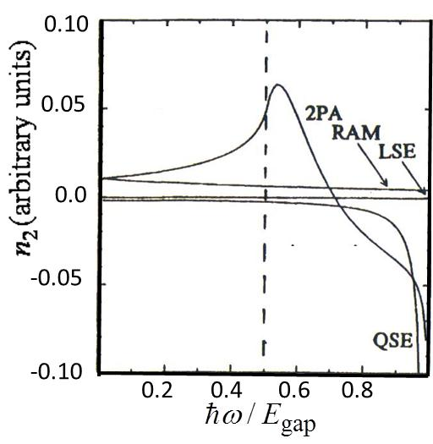
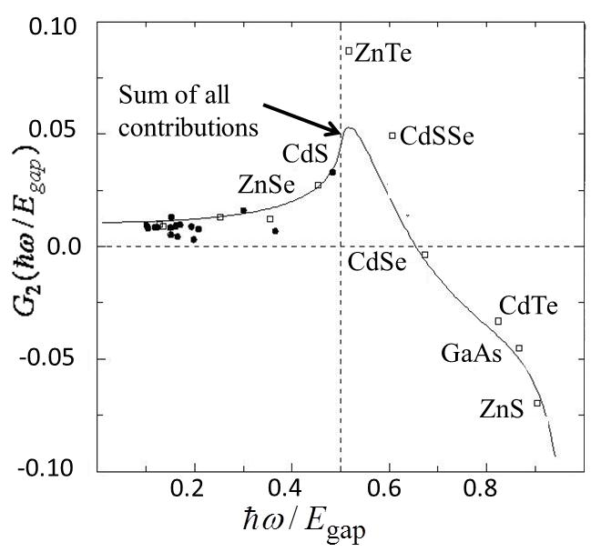
QSE
Kerr

Slide 9
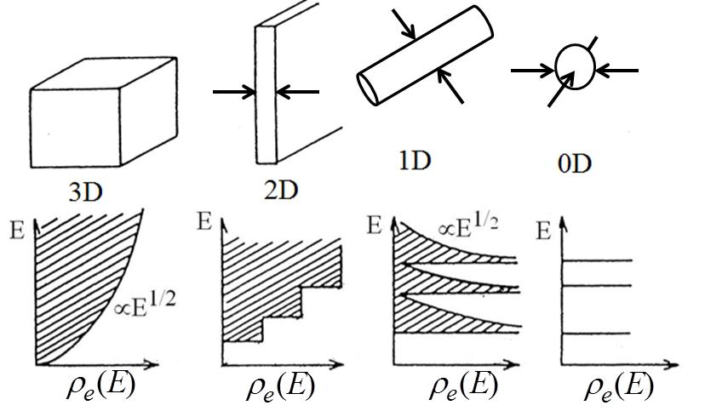
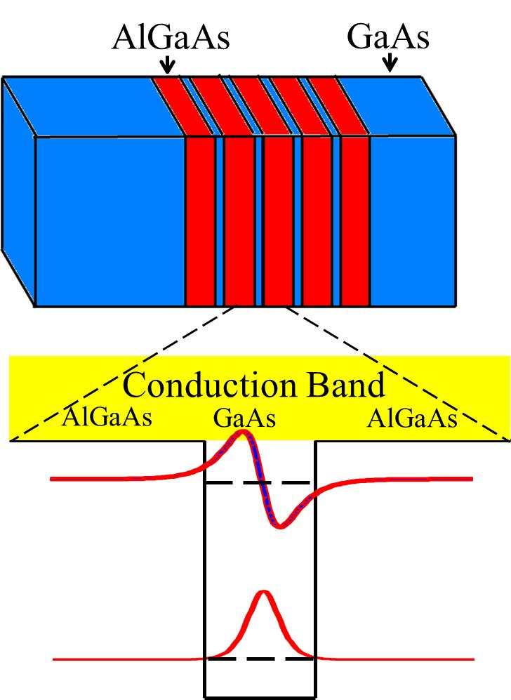
Quantum Confined Semiconductors
When the translational degrees of freedom of electrons in both the valence and conduction bands
are confined to distances of the order of the exciton Bohr radius a_{B}, the oscillator strength is
redistributed, the bandgap increases, the density of states ρ_{e}(E) changes and new bound states
appear. As a result the nonlinear optical
properties can be enhanced or reduced)
in some spectral regions.
Quantum Wells
-Absorption edge moves
to higher energies.
-Multiple well-defined
absorption peaks due to
transitions between
confined states
-Enhanced absorption
spectrum near band edge

Slide 10
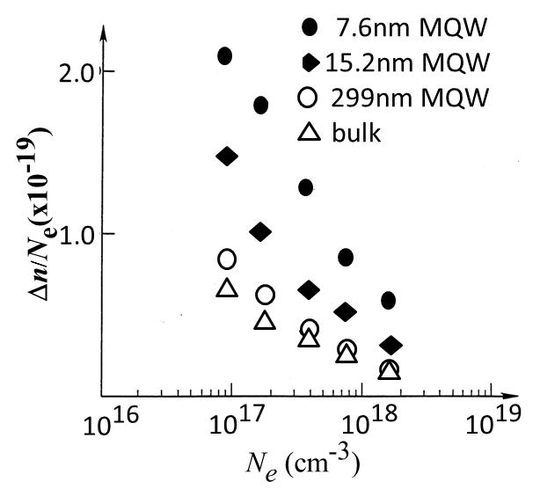
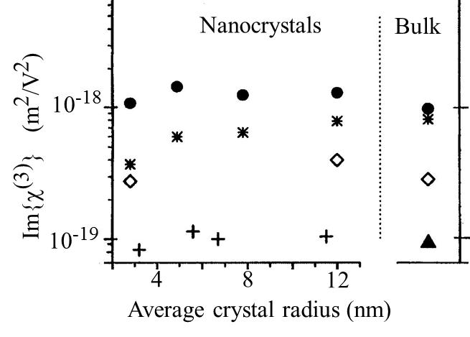
Example of Multi-Quantum Well (MQW) Nonlinearities
Nonlinear absorption change (room temp.)
measured versus intensity and converted
to index change via Kramers-Kronig
Index change per
excited electron
A factor of ∼3-4 enhancement!!
Quantum Dots
Quantum dot effects become important when the
crystallite size r₀ ≤ a_{B} (exciton Bohr radius). For example, the exciton Bohr radius for
CdS a_{B} = 3.2nm, CdSe a_{B} = 5.6nm, CdTe a_{B} = 7.4nm and GaAs a_{B} = 12.5nm.
Definitive measurements were performed
on very well-characterized samples by
Banfi. De Giorgio et al. in range a_{B} ≅ r₀ ≤ 3 a_{B}
Measurements at1.2μm (•), 1.4μm (∗) and
1.58μm () for CdTe
Measurements at 0.79μm (+) for CdS_{0.9}Se_{0.1}
Note the trend that Im{χ⁽³⁾} seems to fall
when a_{B} ≅ r₀ !

Slide 11
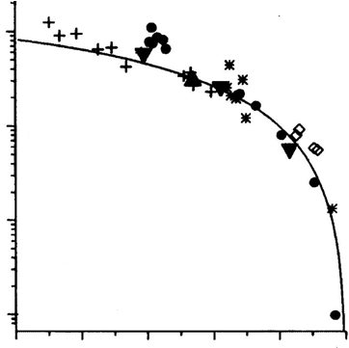
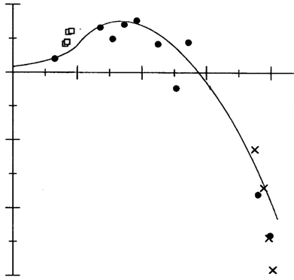
Nonlinear Refraction and Absorption in Quantum Dots for a_{B} ≅ r₀ ≤ 3 a_{B}:
II-VI Semiconductors
Experimental QD test of the previously discussed off-resonance universal F₂(x,x) and G₂(x,x) functions for bulk semiconductors (discussed previously) by M. Sheik-Bahae, et. al., IEEE J. Quant. Electron. 30, 249 (1994).
10⁻¹⁸
2
Nanocrystals
+ 0.79μm
• 2.2 μm
1.4 μm
 1.58μm
0
10⁻¹⁹
0.5
0.6
0.7
0.8
(ω/ω₀)⁴ Imag{χ⁽³⁾} in units of m²V⁻²
Real{χ⁽³⁾} in units of 10⁻¹⁹m²V⁻²
-2
10⁻²⁰
Bulk
CdS 0.69μm
▼ CdTe 12, 1.4, 1.58μm
-4
10⁻²¹
1.0
1.5
2.0
To within the experimental uncertainty (factor of 2), no enhancements were
found in II-VI semiconductors for the far off-resonance nonlinearities!

