Slide 1
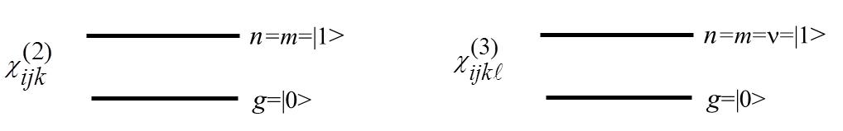
Molecular Nonlinear Optics: Two Level Model for
The Sum Over States model, although exact, requires a detailed knowledge of many parameters
which are not generally available. Experience has shown that the simplest model for molecules
with permanent dipole moments requires a minimum of two states, the ground state and one
excited state. In fact, such a two level model has been effective in predicting nonlinearities in
charge transfer molecules optimized for large second order nonlinearities.
The wavefunctions associated the electronic states of symmetric molecules (without permanent
dipole moments) have either even (gerade) or odd (ungerade) symmetry, with the ground states
exhibiting even symmetry. In the electric dipole transition approximation, one photon absorption
requires a minimum of one odd symmetry excited state and two photon absorption requires a
minimum of one even symmetry excited state and one odd symmetry excited state. Hence the
minimum for symmetric molecules is three levels.
The relevant states for the sum over states calculation in the two level model are

Slide 2
Two Level Model: Examples of Second Order Susceptibilities
e.g. In PPLN the dominant second order nonlinearity lies along the z-axis. The generation of new
frequencies is normally done away from the resonances and involves the real part of χ⁽²⁾:
The dispersion with frequency in NLSHO model is proportional to
which is different from the SOS result.
e.g. Sum frequency generation in Periodically Poled Lithium Niobate

Slide 3
Two Level Model: Third Order Susceptibilities
e.g. Third Harmonic Generation (z-polarized input)
Third harmonic resonance peaks
occur for and .
The anharmonic oscillator model
does not have the
resonance!

Slide 4
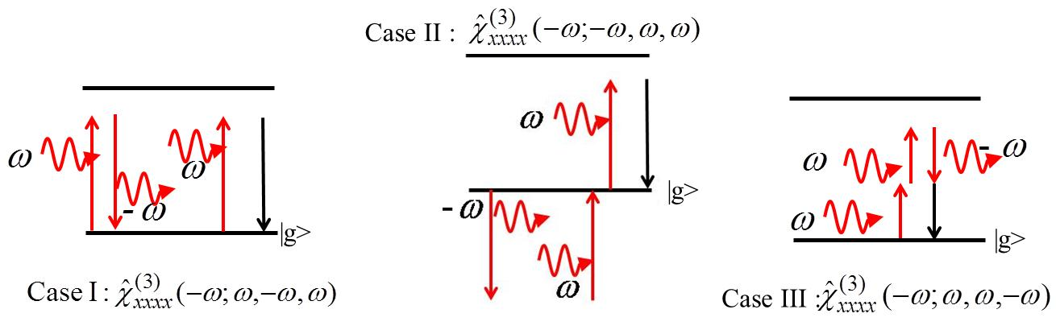
Two Level Model: for Nonlinear Refraction and Absorption
The three different needed to evaluate nonlinear absorption and refraction.

Slide 5
Case II:
Case III:
This last case is the only one which gives rise to a two photon peak! Hence the terms
proportional to are due to two photon transitions. Conversely, the terms
proportional to are associated with one photon transitions.

Slide 6
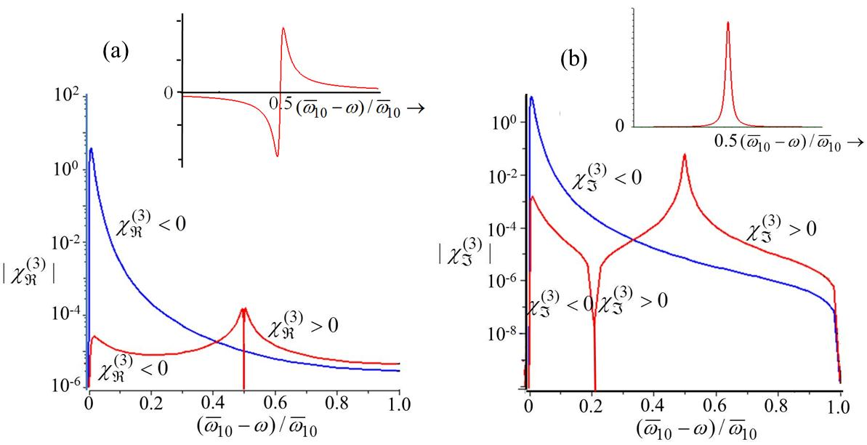
The typical frequency dependence of the different contributions to the total is shown below. Subscripts
The blue curves are for the total of the one photon terms ( ) and the red curves are for
the total two photon terms ( ). The upper insets show the dispersion of
the two photon resonance terms on a linear scale. assumed.
The key results here are that changes sign at the two photon resonance and that the imaginary
component goes to zero as ω→0.

Slide 7
It is instructive here to examine approximate formulas which are valid in each of the four
frequency regimes defined below.
“On and near resonance”
1 photon resonance: ( ) 2 photon resonance:
“Off-resonance”
“Non-resonant” (ω→0)
Dominant one photon terms
Near & On-resonance
Dominant two photon terms

Slide 8
Off-resonance
Non-resonant
All terms
are important
The sign of the non-resonant term depends on . Molecules with large
permanent dipole moments will always have a positive non-resonant nonlinear real
susceptibility.
Two Level Model: First Order Effect on of Population Changes
The assumption has implicitly been made that the excited state populations are very small and that the probability of exciting an electron to a higher lying state is independent of the excited state populations. Next it will be shown that this not the case by estimating the effect of the excited state population on the nonlinearity. The physics is simple: The probability of a linear one photon transition is proportional to the population difference between the ground state and the excited state and, when the two populations become comparable, saturation of the linear index change and absorption change occurs.

Slide 9
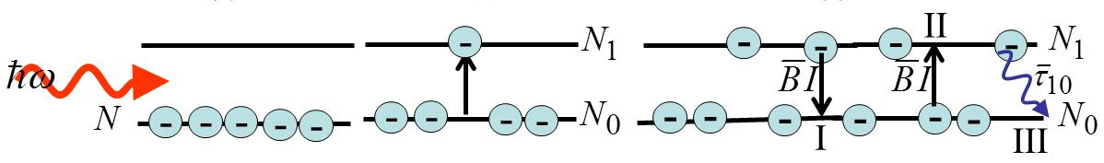
The equations deal with the local intensity and hence the Maxwell intensity is enhanced by .
Linear susceptibility, including the first order saturation term is
In the limit
In general the total polarization implied by this equation can be expanded in the usual way as

Slide 10
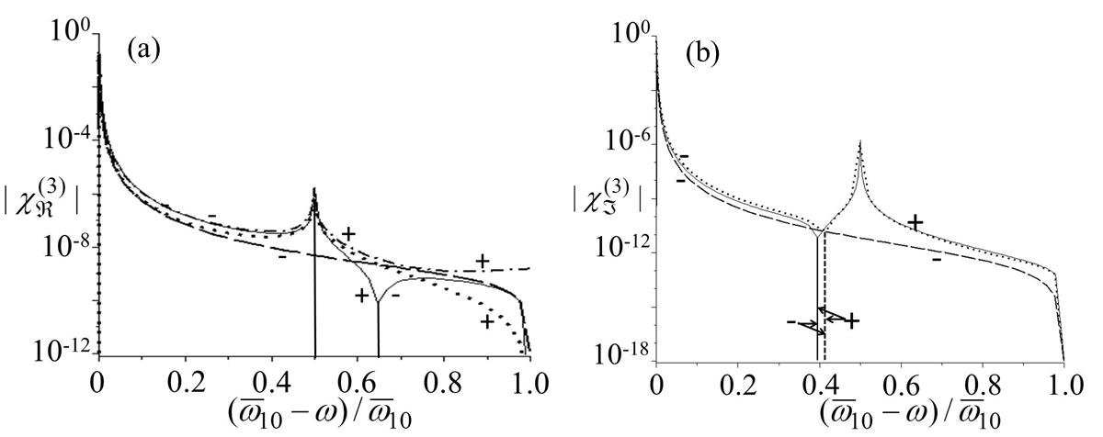
Need to express B in terms of the imaginary (absorption) part of linear susceptibility
Kerr nonlinearity (dotted line)
total nonlinearity (solid line)
saturation contribution (dashed line)
total nonlinearity
(dash-dot line)
The ± signs identify the sign of the nonlinearity. The vertical lines indicate sign changes.

Slide 11
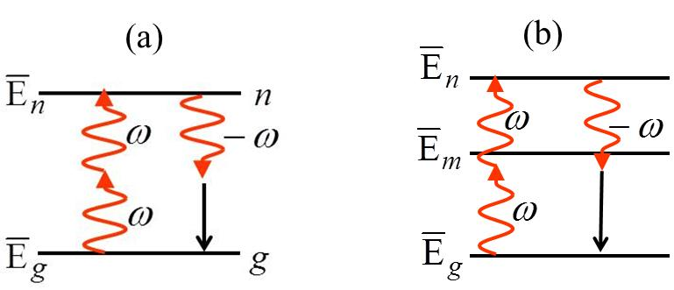
Nonlinear Absorption (NLA) and Refraction (NLR)
Single Input Beam NLA & NLR
e.g. x-polarized along a symmetry axis
Inserting into the SVEA, writing , and separating into real and imaginary
2 photon resonance term
Converting to the intensity I(z) and defining (also called β ) by
Here the first term in identifies the beam undergoing absorption and the second
the beam causing the nonlinear absorption. The identify the relative polarizations.

Slide 12
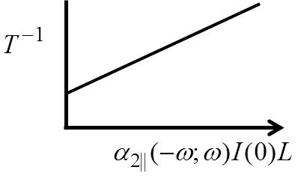
If linear loss is also present
L_{eff}
Integrating the equation for in the presence of nonlinear absorption
Defining and adopting the same notation as for

Slide 13
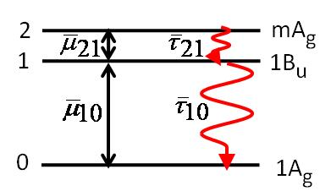
Molecular Nonlinear Optics: Three Level Model for
As discussed previously, a three level model is the minimum required to describe the third
order nonlinearity for the symmetric molecules (i.e. no permanent dipole moments).
Two photon terms
One photon terms
Convention for labeling states,
transition moments, lifetimes etc.
Due to the even symmetries of the wave functions for the
two even symmetry states mA_{g} and 1A_{g}, spontaneous decay
to the ground state is not allowed from mA_{g} and the state
mA_{g} can only decay to 1B_{u} via with subsequent decay
to the ground state via .

Slide 14
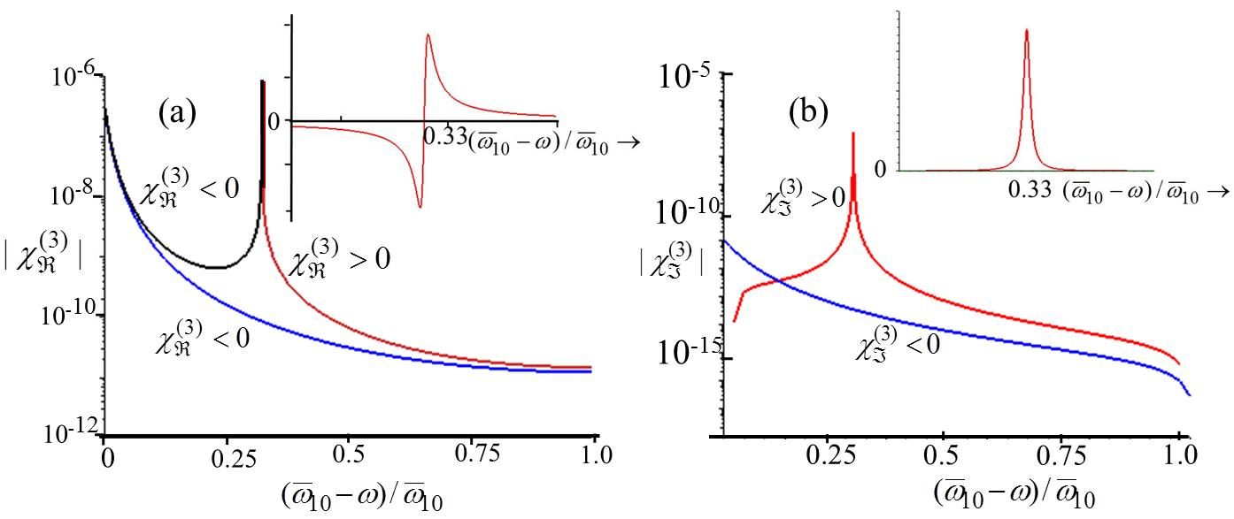
Total of the one photon terms (blue); total two photon terms (black, negative and red positive).
The upper curves show the dispersion of the two photon resonance terms on a linear scale.
Near & On-resonance
Dominant one photon terms

Slide 15
Two Photon Resonance
Dominant two photon terms
Off-resonance

Slide 16
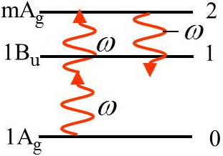
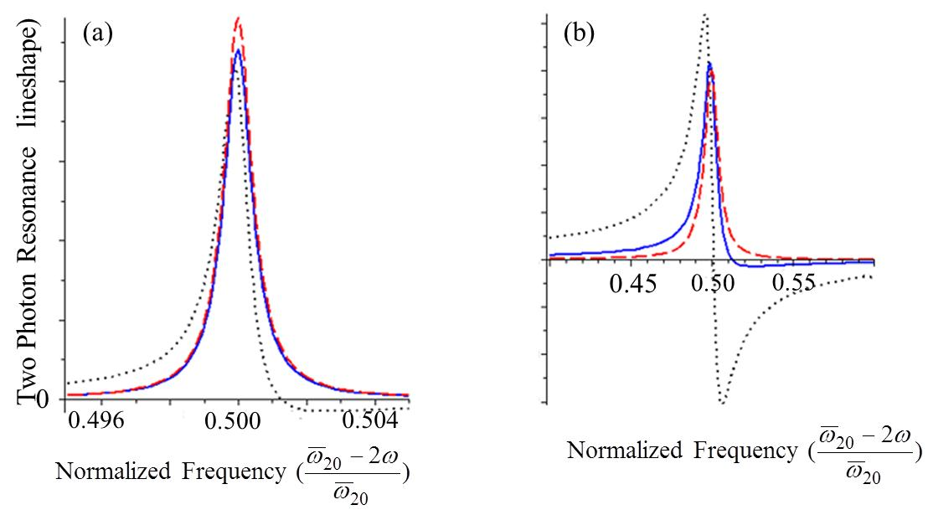
Non-resonant
Note that the sign of the non-resonant nonlinearity is determined by the sign of .
The one photon equations for NLA and NLR are the same as for the
two level case. There is an interesting consequence to the two photon
resonance absorption lineshape due to the two relaxation times needed.

Slide 17
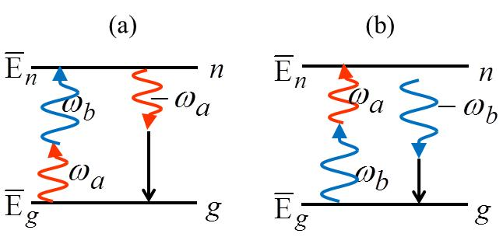
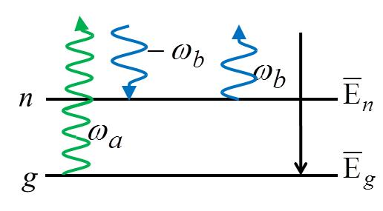
Nonlinear Absorption with Two Input Beams
Two Input Beams (Non-degenerate Case, two input frequencies: )
Proceeding as outlined for the single beam case

Slide 18
Two Input, Orthogonally Polarized Beams, Equal or Unequal Frequencies
Combining self and cross nonlinear absorption

Slide 19
Nonlinear Refraction with Two Input Beams
Two Co-polarized Input Beams (ω_{a}≠ω_{b} and ω_{a}=ω_{b}, but not co-directional) – three input “modes”
Note that in the Kleinman (non-resonant) limit all of the individual susceptibilities are the same
so that the ratios of the nonlinear index coefficients are determined by the number of nonlinear
susceptibilities (which depend on the number of unique permutations of the frequencies) that
contribute to each effect.

Slide 20
Orthogonally Polarized Beams (equal or unequal frequencies)
e.g. ω_{b}=ω_{a}

