Slide 1
Optical Parametric Generators and Oscillators
Parametric Amplifier
ω_{p} = ω_{s} + ω_{i}
Pump (ω_{p}) partially depleted
Signal (ω_{s}) amplified
Idler (ω_{i}) generated
χ⁽²⁾
Parametric Oscillator
Signal and idler generated
from noise
Tune wavelength (Δk) via
temperature or incidence angle
χ⁽²⁾
mirrors

Slide 2
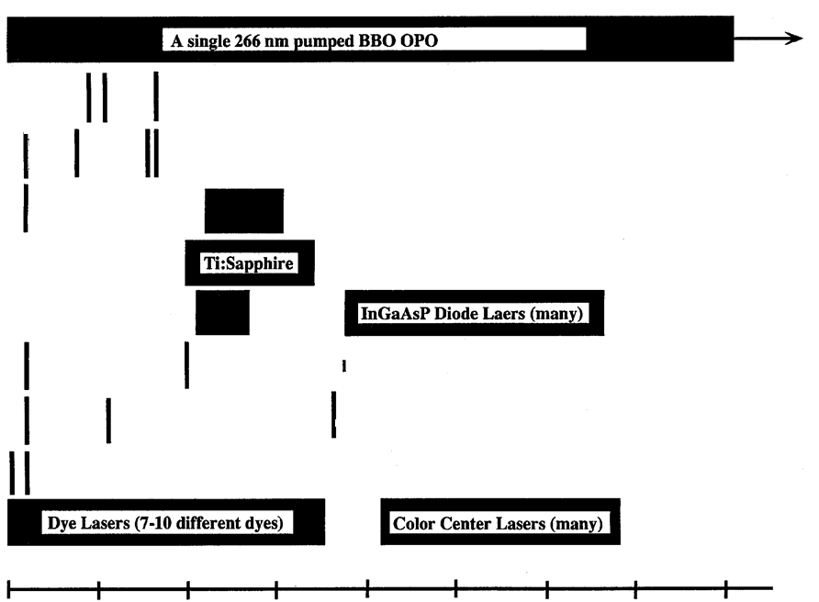
Early 1990s
A single 266 nm pumped BBO OPO
2400 nm
Ar-ion Laser
Kr-ion Laser
He-
Cd
Lasers
He-Ne Lasers
N Laser
GaAlAs Lasers
Ti:Sapphire
Alexandrite Laser
InGaAsP Diode Lasers
Ruby Laser & 2nd Harmonic
Nd YAG Laser and 2nd and 3rd Harmonics
XeCl
XeF Excimer Lasers
Dye Lasers (7-10 different dyes)
Color Center Lasers
300
700
900
1100
1300
Wavelength (nm)

Slide 3
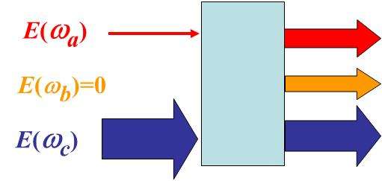
OPA: Undepleted Pump Approximation
The strong “pump” beam at ω_{c} is undepleted.
i.e.
The weak “signal beam at ω_{a} is amplified.
An “idler” beam at ω_{b} is generated
A pump beam photon breaks up into a signal photon and idler photon

Slide 4
Clearly the functional behavior depends on the sign of Γ².
The behavior near and on phase match (Γ²>0) is exponential growth
When Γ²<0, the behavior is oscillatory.
Using the boundary condition

Slide 5
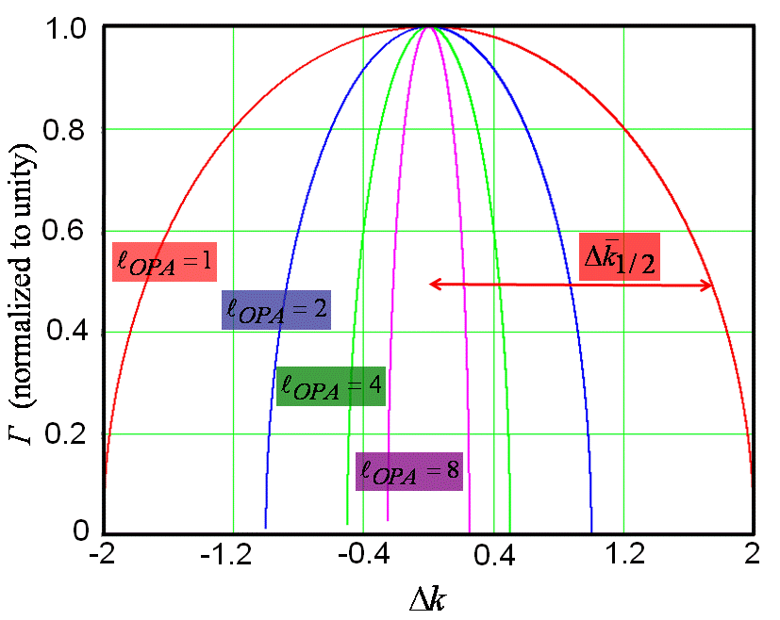
Exponential Gain Coefficient
z
For this difference frequency process,
the larger the intensity gain coefficient
2Γ, the broader the gain bandwidth!
This is contrast to SHG (i.e. sum
frequency case) in which the bandwidth
narrows with increasing intensity

Slide 6
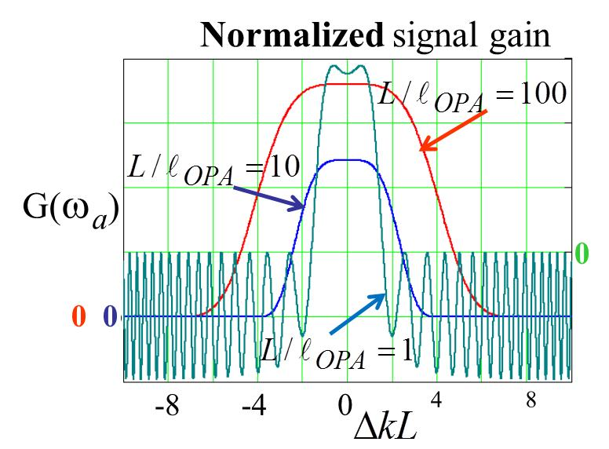
No gain!
Γz
Notes:
For large , low level oscillations still exist, but are too small to be seen
The zero level is different for .
For there is no signal gain, just
energy exchange with the idler as shown above.

Slide 7
OPA Numerical Example
Assume Δk=0
∴ Single pass gain is 34%

Slide 8
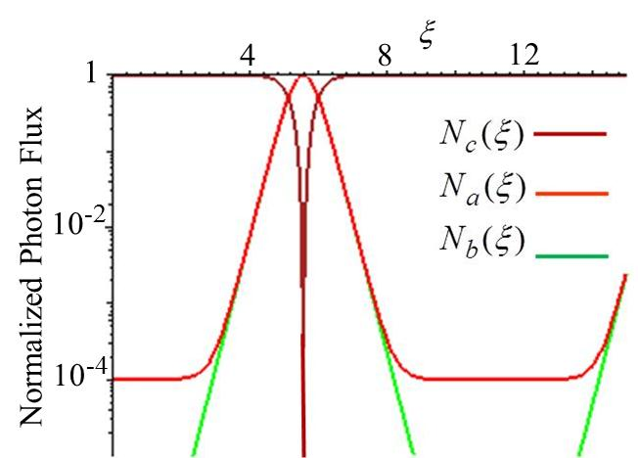
OPA Solutions with Pump Depletion
Note:
This amplifier response is periodic in
distance and pump power.
Therefore there is no saturation as with
other amplifiers.
The gain is exponential, but only over
a finite range of length.
For small distances the signal growth is
not exponential although the idler growth is!

Slide 9



Optical Parametric Oscillators (OPOs)
OPOs are the most powerful devices for generating tunable radiation efficiently.
Put a nonlinear gain medium in a cavity, “noise” at ω_{a} and ω_{b} is amplified.
By using a cavity, the pump is depleted more efficiently.
Using a doubly resonant cavity (resonant at both the idler and the signal), the threshold for net gain is reduced substantially.
Triply resonant cavities (also resonant at the pump frequency) have been reported, but their stability problems have limited their utility and commercial availability
ω_{b}
ω_{c}
χ⁽²⁾
ω_{a}
Singly Resonant Oscillator
Doubly Resonant Oscillator
Have to deal with cavity
modes at signal frequency
Cavity modes at both signal and
idler frequency need to be considered
Assume that pump is essentially undepleted on a single pass through the cavity

Slide 10
Doubly Resonant Cavity Threshold Condition
Idler (ω_{b}) and signal (ω_{a}) beams experience gain in one direction only,
i.e. interact with (ω_{c}) pump beam only in forward direction)
Forward
Backward
-Cavity “turn-on” and “turn-off” dynamics is complicated we deal only with steady state (cw)
Assume lossless χ⁽²⁾ medium
Only loss is due to transmission through mirrors
Steady state occurs when double pass loss equals single pass gain!
After interacting in forward pass with pump beam inside the cavity
χ⁽²⁾

Slide 11
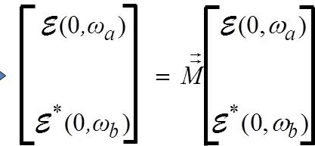
- In addition, since the mirrors are coated for high reflectivities at ω_{b} and ω_{a}, they accumulate
phase shifts of 2k_{b}L and 2k_{a}L respectively after a single round trip inside the cavity.
Reflection
Reflection
Linear phase accumulation
Linear phase accumulation
Steady state after
one round trip

Slide 12
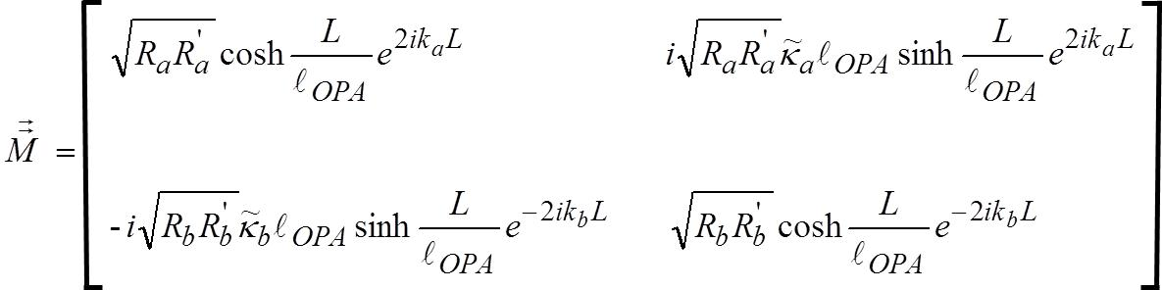
Gain threshold:
For minimum threshold, 2k_{b}L =2m_{b}π and 2k_{a}L=2m_{a}π

Slide 13
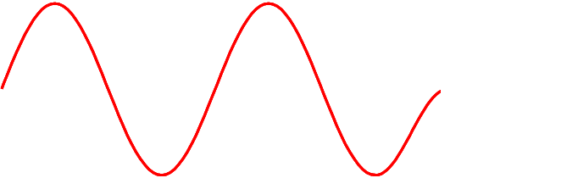
OPO Instabilities: Doubly Resonant Cavity
Mechanical instabilities (vibrations, mount creep and relaxation..) and
thermal drift cause cavity length changes and hence output frequency changes
Cavity resonances on which
threshold is minimum
Signal and idler are both
standing waves in cavity
Non-degenerate integers
→ Discrete cavity mode frequencies with separations
How many cavity modes exist within the gain bandwidth?
depends on cavity modes
fixed by pump
→Many cavity modes
within gain bandwidth

Slide 14
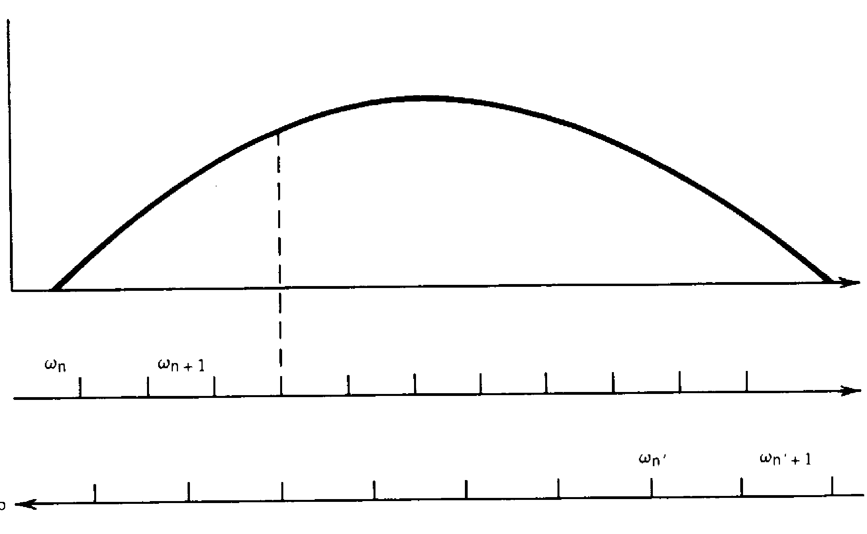
Gain Coefficient Γ
ω_{a}
Note that when
ω_{a} drifts up in
frequency, ω_{b}
drifts down in
frequency!
ω_{b}
“Mode hop”
OPO oscillates when cavity modes coincide
If length or changes, the next operating point when cavity modes coincide
can cause a large shift (called a “mode hop”) in output frequency
e.g. Type I birefringent phase matched LiNbO₃ d₃₁=5.95pm/V, L=1cm
λ_{c}=0.53μm λ_{a}=λ_{b} =1.06μm (near degeneracy) n_{a}≅n_{b}≅n_{c}≅2.24, R_{a}=R_{b}=0.98
quite a modest intensity!

Slide 15
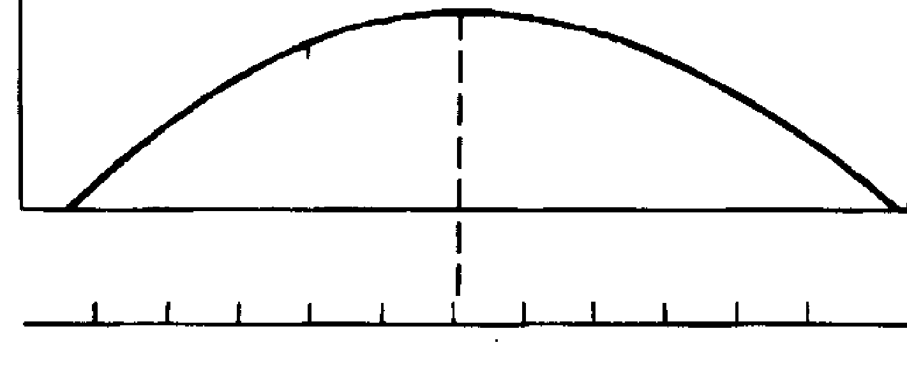
Singly Resonant OPO (SRO)
Cavity is resonant at only one frequency, usually the desired signal (ω_{a}) → R_{a} ≅1 R_{b}→0
Threshold much higher
for SRO than for DRO
e.g. The threshold for the previously discussed LiNbO₃ case is ≅1 MW/cm²
Stability of Singly Resonant OPO
If the cavity drifts, the output
frequency drifts with it, no large
mode hops occur. Frequency
hops will be just the mode
separation.
Γ

Slide 16
OPO Output
At threshold, gain=loss.
If I(ω_{c}) > I_{th}(ω_{c}), input photons in excess of threshold are converted into output
signal and idler photons
One pump photon is converted into one signal and one idler photon.
How much comes out of OPO depends on the mirror transmission coefficients
“slope efficiency”

Slide 17
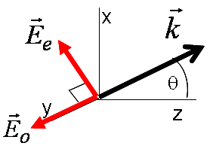
Frequency Tuning of OPO
Two approaches: (1) angle tuning
(2) temperature tuning (relatively small – useful for fine tuning
In general requires numerical calculations
Angle Tuning (uniaxial crystal)
y
e.g.
x
z

Slide 18
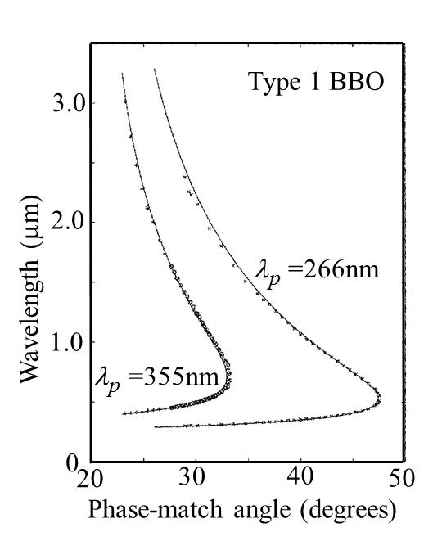
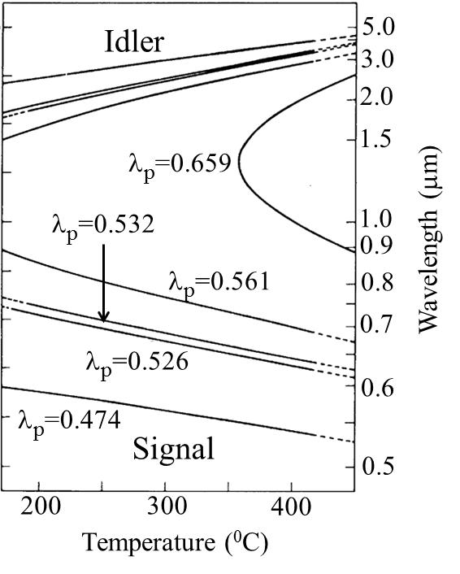
Examples of OPOs
Example of Angle Tuning
Example of Temperature Tuning
LiNbO₃ (birefringence phase-matched)

Slide 19
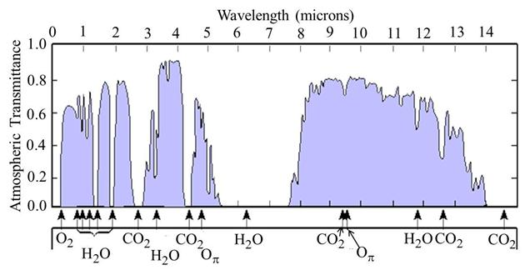
Mid-infrared OPA and OPO Parametric Devices
Atmospheric transmission and the molecules responsible for the absorption
Need broadly tunable sources for pollution sensing applications

Slide 20
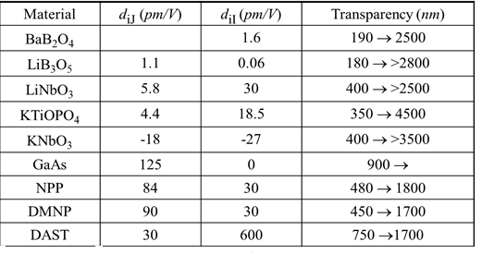
Materials
NPP: N-(4-nitrophenyl)-L-propinol
DMNP: 3,5-dimethyl-1-(4-nitrophenyl) pyrazole
DAST: Dimethyl-amino-4-N-methylstilbazolium tosylate

