Slide 1
Optimizing SHG Efficiency
Voigt notation: has 27 elements, but this can be simplified because .
in a 3x3x3 matrix → reduce to 18 elements in a 3x6 matrix
jk | J
11 | 1
22 | 2
33 | 3
23,32 | 4
13,31 | 5
12,21 | 6
d₁₁ | d₂₁ | d₃₁
d₁₂ | d₂₂ | d₃₂
d₁₃ | d₂₃ | d₃₃
d₁₄ | d₂₄ | d₃₄
d₁₅ | d₂₅ | d₃₅
d₁₆ | d₂₆ | d₃₆
Crystal symmetry
Reduces number of
independent non-zero
elements
Relationships between
non-zero elements
Note: all cubic crystal classes are isotropic for linear optics, but some are
non-centrosymmetric, have some and are not isotropic for nonlinear optics.

Slide 2
Effect of Crystal Symmetry
Number of Independent
Elements
Standard Notations
System
International
Schönflies

Slide 3
System
International
Schönflies

Slide 4
Matrix for Biaxial, Uniaxial and Optically Isotropic Classes
Small dot =
zero coefficient
Square dot= Zero
coefficient for Kleinman
symmetry only
Similar connected dots
= Equal coefficients
Open connected dots=
Opposite in sign to
closed dot
Connections via dashed line
Valid for Kleinman symmetry only

Slide 5
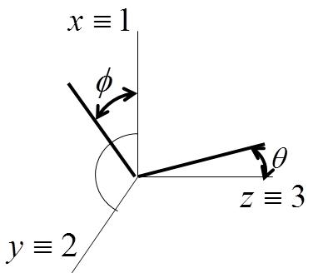
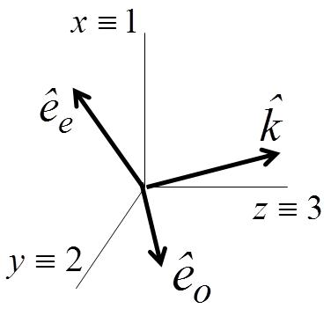
Calculation of for plane wave inputs
Define axes
Fields
Define:
Assume birefringence small → neglect difference in direction of and

Slide 6
e.g. crystal class 3,2
d₁₁ | 0 | 0
-d₁₁ | 0 | 0
0 | 0 | 0
d₁₄ | 0 | 0
0 | -d₁₄ | 0
0 | -d₁₁ | 0
θ is normally fixed by the phase-matching condition and only φ can be varied
For this example, need 3φ = 0, mπ → φ = 0, π/3 or 2π/3 for optimum conversion!

Slide 7
d₁₁ | 0 | 0
-d₁₁ | 0 | 0
0 | 0 | 0
d₁₄ | 0 | 0
0 | -d₁₄ | 0
0 | -d₁₁ | 0
This result is the same as for Type I eoo!!
General Result for Kleinman Symmetry!
Identical result for eoo and oeo, and eoe and oee!!!
That is, can interchange the order of the o and e!

Slide 8
SHG With Finite Beams
- previous results were valid for cw plane waves
much of NLO is done with pulsed lasers and finite beams
assume gaussian beams which propagate as linear “eigenmodes” when
vector effects can be neglected, i.e. for beams many wavelengths wide
x
ρ
φ
z
y
Case I L<<z₀
L

Slide 9
Calculate harmonic power in negligible depletion regime. Assume Δk=0 and a Type I interaction
2ω beam narrower than ω beam!! This is a general result in NLO. The mixing of optical beams always leads to a nonlinear polarization narrower in space (and time) than any of the mixing fields.
L
Rayleigh range the same for fundamental and harmonic

Slide 10
Case II: Optimum Conversion L≈ 2z₀(ω)
There is a trade-off between minimum beam width and crystal length L
As beam spreads, conversion efficiency goes down
Consider simplest case of Type I phase match, and negligibly small birefringence
dρ
Beam Profile
dA=2πρdρ
ρ
ρ
For detailed treatment, see G.D. Boyd and D.A. Kleinman, “Parametric Interaction of
Focused Gaussian Light Beams”, J. of Applied Physics, 39, No. 8, pp 3597-3639 (1968)

Slide 11
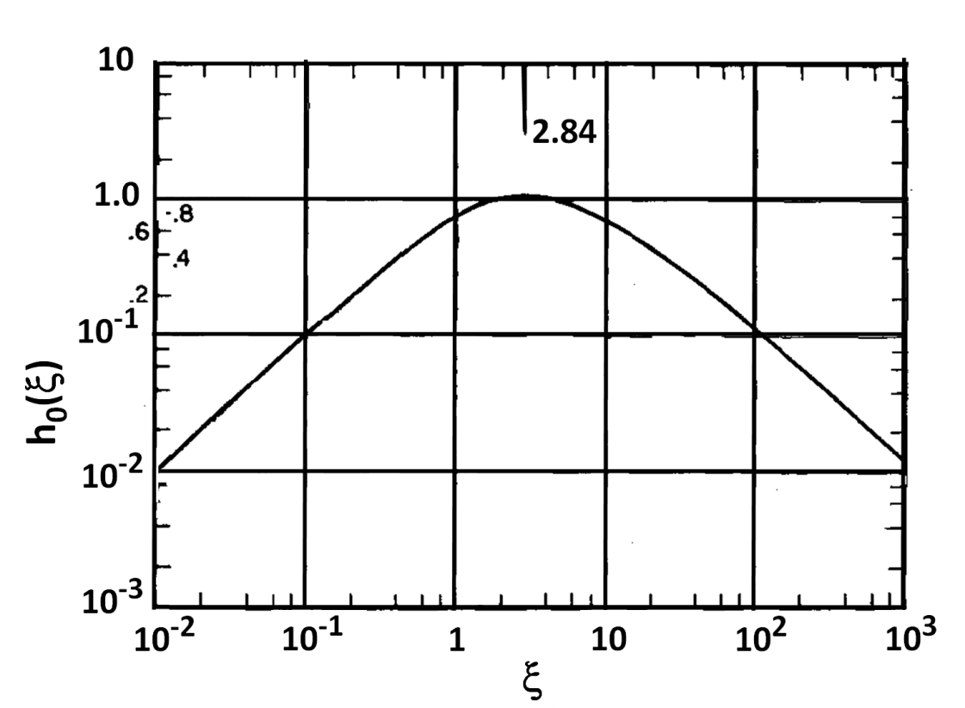
For small ξ, h₀(ξ) =ξ,
For ξ = 1, h₀(ξ) ≅ 0.8
For ξ >> 1, h₀(ξ) ∝ ξ⁻¹ (note L >> 2z₀!)
For walk-off, h₀(ξ) is reduced,
see Boyd and Kleinman paper.

Slide 12
Pulsed Fundamental Finite Beam
Beam Intensity Profile
- Assume a gaussian shaped temporal pulse
t
SH pulse is compressed in time relative to the fundamental pulse
Recall SH spatial profile was also compressed
General Property of NLO: outputs compressed in space and time!
Normally it is the pulse energy that is measured.

Slide 13
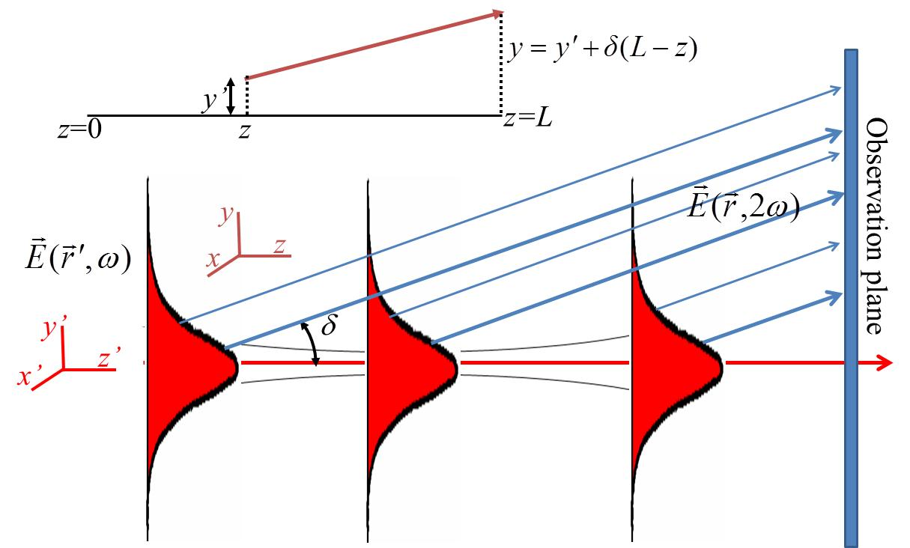
Fundamental or Harmonic Beam Walk-Off
Assume walk-off along y-axis only, small walk-off angle δ, on phase-match
Assume that w(z) ≅ w₀
Interaction distance limited conversion efficiency reduced
trade-off between walk-off angle δ, beam size and length L<2z₀

Slide 14
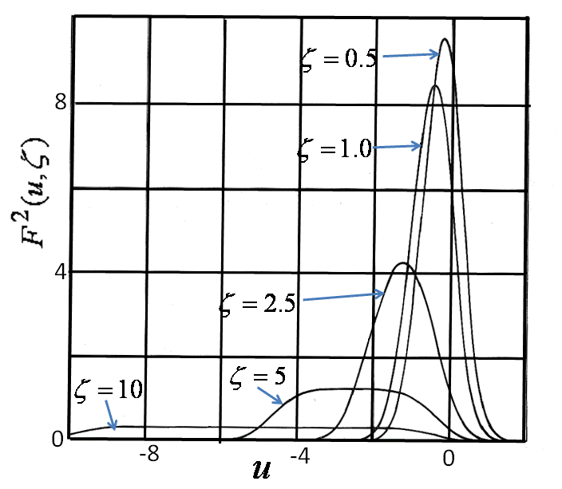
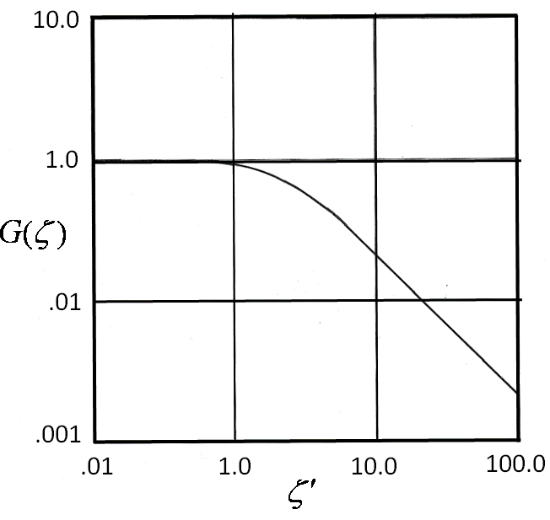

Slide 15
Example of Second Harmonic Generation
e.g. KDP is uniaxial with the point group symmetry , and a transmission range of 0.35 to
4.5 microns. The refractive indices with λ in microns are given by the general formulas
What input intensity I(ω) is needed for 58% conversion for Type 1 SHG with 1.06μm plane
wave input?
For a low conversion efficiency of 10%, what is the fundamental power required for
for a crystal of length L=2z₀? What is w₀ at the center of the crystal? What is w at the input?
For a negative uniaxial, Type I phase-match is eoo

Slide 16
For conversion efficiencies > 10% with plane waves, it is necessary to first calculate the
parametric gain length and then use to calculate the efficiency.
For 58% conversion efficiency,
(b) For L=2z₀

Slide 17
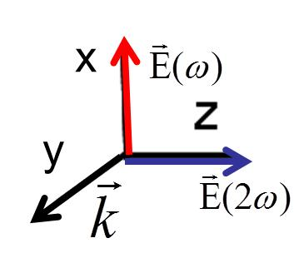
e.g. LiNbO₃ is a 3m uniaxial crystal. Consider both non-critical birefringent phase match (Type
1) and QPM wavevector-match in a L=1cm crystal with 1.06μm input;
For birefringent phase-match calculate the input intensity required for plane wave input for
58% conversion into the harmonic. Assuming a beam input with L=2z₀, find the input
power required for 10% conversion efficiency. Find the angular bandwidth.
(b) Repeat for QPM
(a) Type 1 eoo wavevector-match occurs very close to 1.06μm input.
The relevant nonlinear coefficient is

Slide 18
And of course there is no walk-off!
(b)
The large angular bandwidth, no walk-off of “non-critical” phase-match are clear.
Also, QPM allows tuning of the frequencies, a desirable feature.

Slide 19
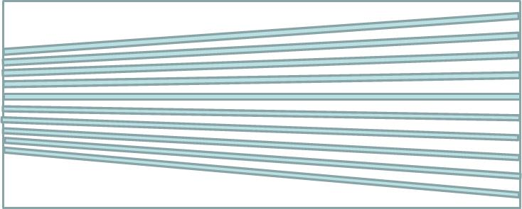
Applications of QPM Engineering
Tunable SHG
y
x
By varying the QPM period in a direction orthogonal
the wave-vector matching condition,
different frequencies can be doubled.
Δk = 2k_{e}(ω) - k_{e}(2ω) + 2pπ/Λ(y)

Slide 20
Enhanced Bandwidth
Primary periodicity is modulated by a secondary, longer period grating
Wavevector Match at Δk+K±K_{g}=0
Single Period Grating
P(2ω)
Wavelength

Slide 21
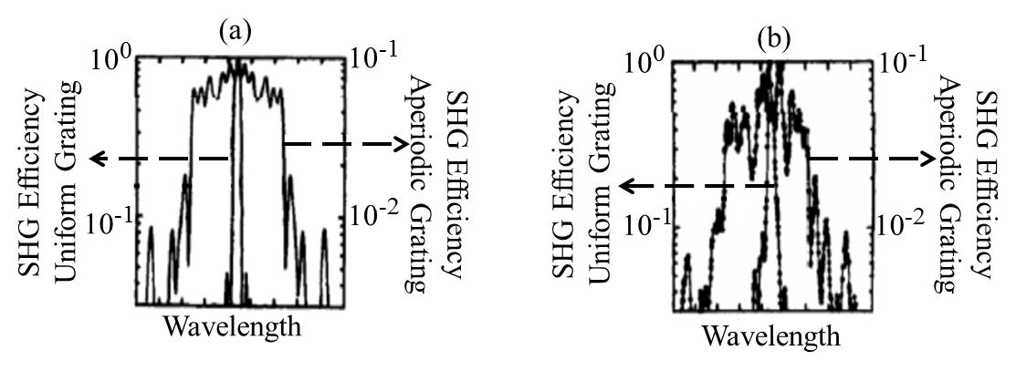
Instead of just one modulation, consider multiple, random modulation periods.
Therefore there is a quasi-continuum of .
P(2ω)
Wavelength

Slide 22
Frequency Doubling of Ultrafast Pulses
Pulse walk-off between fundamental and harmonic is issue with fs pulses
Wide bandwidths of fs pulses require short lengths
Usually, efficiency scales with pulse energy for fs pulses FOM (%/nJ)
Interaction efficiency greatly reduced when walk-off time ≥ pulse width τ
t v_{g}(ω)
t v_{g}(2ω)
L_{max} – maximum length for walk-off to maintain interaction efficiency
v_{g} – group velocity = c/n_{g} n_{g} – group index

Slide 23
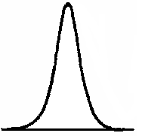
To efficiently convert all
wavelengths in the pulse requires
Material | Wavevector-Match | FOM_{uf} pm²/(V²) | Efficiency %/nJ | L (mm)
PPLN | Non-critical | 710 | 95 | 0.4
LBO | Non-critical | 42 | 6 | 5.0
KTP | Type 2 critical | 20 | 1.5 | 1.5

Slide 24
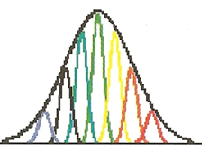
Pulse Compressed SHG
I(x)
I(x)
z
x,t
x,t

Slide 25
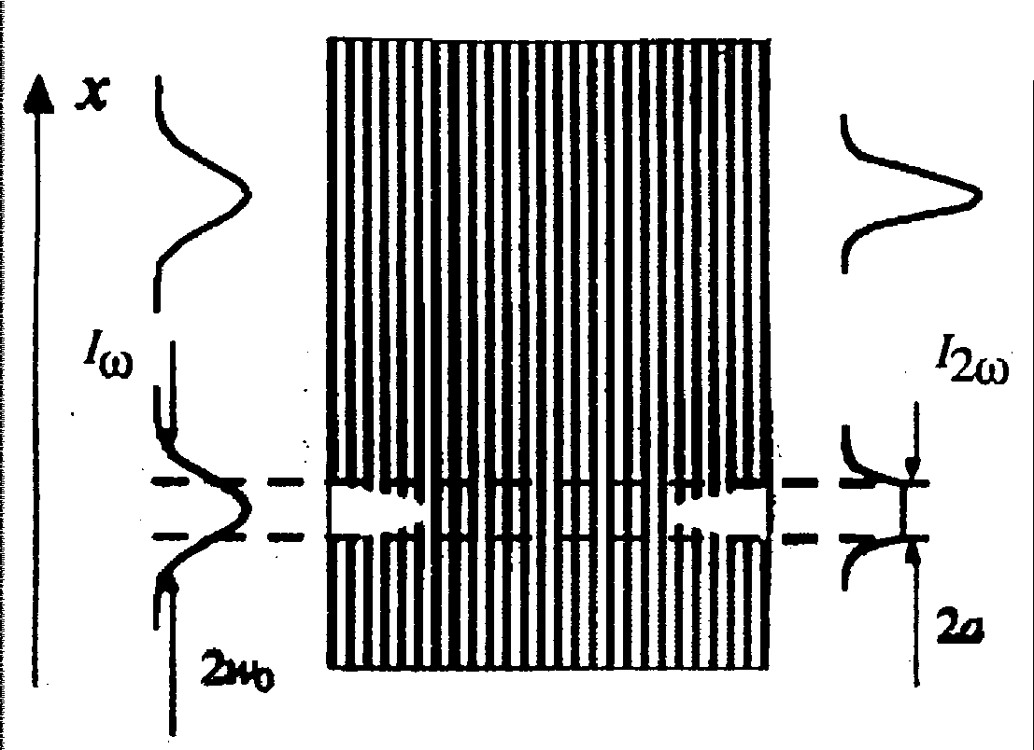
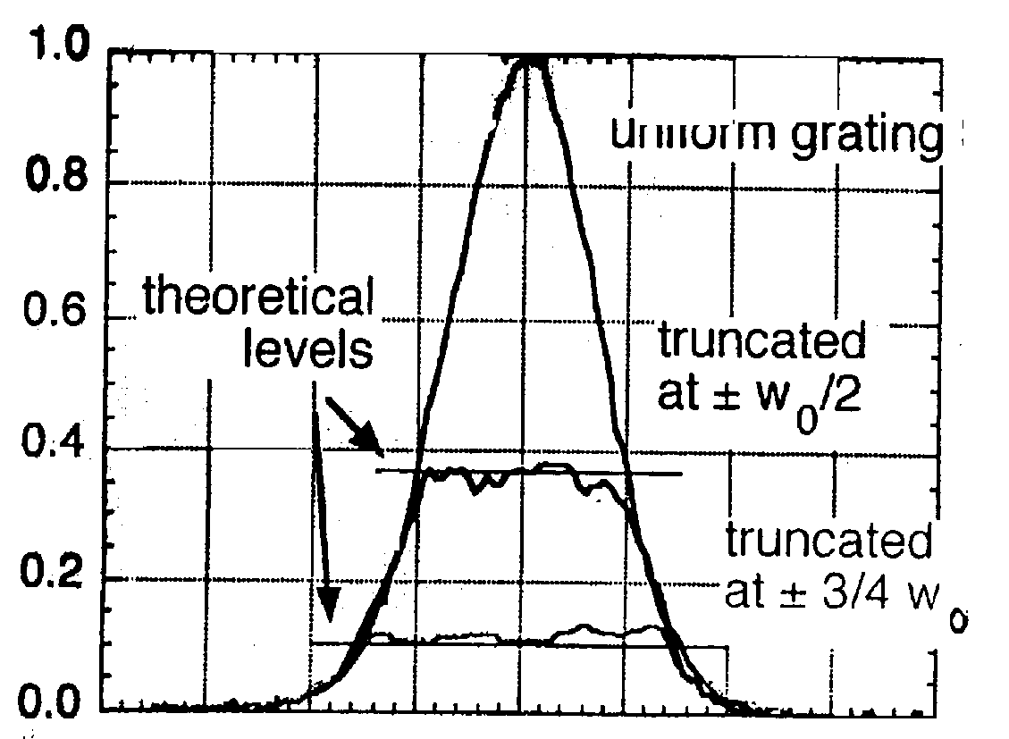
Spatially Shaped SHG Beams
- Pattern grating response in 1D (only)
y
“Flat top” beams
uniform grating
Regions of reduced SHG,
contoured for flat top beams
truncated
at
truncated
at

