Slide 1
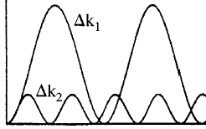
Wavevector (Phase) Matching
Δk₂ > Δk₁
I(2ω)
Need Δk small to get efficient conversion
- Problem – strong dispersion in refractive index with frequency in visible and near IR
z
Δn = [n(ω)-n(2ω)] ≠ 0 because of dispersion → linear optics problem
Solutions:
Birefringent media
Quasi-phase-matching (QPM)
Waveguide solutions
n(ω)
ω
2ω

Slide 2
Birefringent Phase-Matching: Uniaxial Crystals
Uniaxial Crystals
- optically isotropic in the x-y plane
- z-axis is the “optic axis”
- for , any two orthogonal directions
are equivalent eigenmode axes
→ cannot phase-match for
 | 0 | 0
0 |  | 0
0 | 0
= ε₀
x
“ordinary” refractive index “extraordinary” refractive index
y
z
in x-z plane, n_{e}(θ)
- Note: all orthogonal axes in x-y plane
are equivalent for linear optics
always in x-y plane
always has z component
- angle from x-axis important for
x
in x-z plane
θ
y
z
Convention:
along y-axis, n_{o}

Slide 3
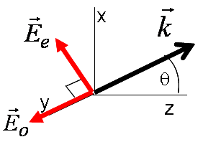
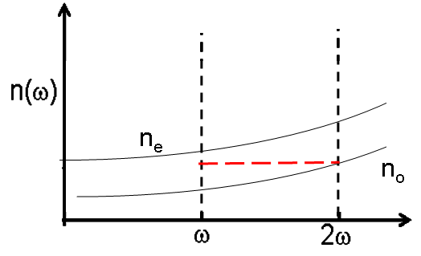
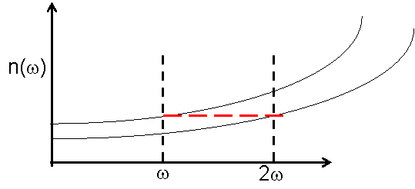
Type I Phase-Match
1 fundamental eigenmode
1 harmonic eigenmode
+ve uniaxial → n_{e}>n_{o}
+ve uniaxial oee
n_{o}(2ω) = n_{e}(θ,ω)
Harmonic (1 photon)
Fundamental (need 2 identical photons)
Δk = 2k_{e}(ω) – k_{o}(2ω) = 2k_{vac}(ω)[n_{e}(θ,ω)-n_{o}(2ω]
x
x
E
E
e
e
y
y
z
z
E
E
o
Critical phase-match 0<θ<π/2
o
Non-critical phase-match θ=π/2
n_{o}(2ω) = n_{e}(ω,θ)
n_{o}(2ω) = n_{e}(ω)
n(ω)
n(ω)
n_{e}
n_{e}
n_{o}
n_{e}(ω,θ)
n_{o}

Slide 4
Because of optical isotropy in x-y plane
for phase-matching lies on a cone
at an angle θ from the z-axis
lies in x-y plane
Note: does depend on angle φ from x-axis in x-y plane!!
Range of phase-match frequencies limited by condition n_{e}(ω) ≥ n_{o}(2ω)

Slide 5
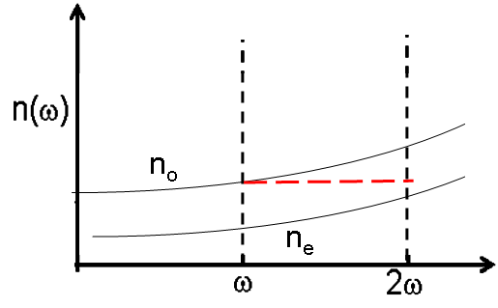
Type I -ve uniaxial → n_{o}>n_{e}
-ve uniaxial eoo
n_{o}(ω) = n_{e}(θ,2ω)
Harmonic
Fundamental
Δk = 2k_{o}(ω) – k_{e}(2ω) = 2k_{vac}(ω)[n_{o}(ω)-n_{e}(θ,2ω]
Non-critical phase-match θ=π/2
Critical phase-match 0<θ<π/2
n(ω)
n(ω)
n_{o}
n_{e}(θ)
n_{o}
n_{e}
n_{e}

Slide 6
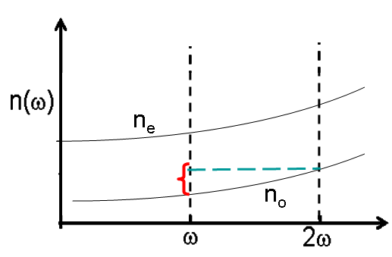
Type II Phase-Match
2 fundamental eigenmodes
1 harmonic eigenmode
+ve uniaxial → n_{e} > n_{o}
+ve uniaxial oeo
Harmonic (1 photon)
Fundamentals, need 2
(orthogonally polarized) photons
Δk = k_{e}(ω) + k_{o}(ω) – k_{o}(2ω) = k_{vac}(ω){[n_{e}(θ,ω)+n_{o}(ω)] - 2n_{o}(2ω)}
n(ω)
n_{e}
n_{o}

Slide 7
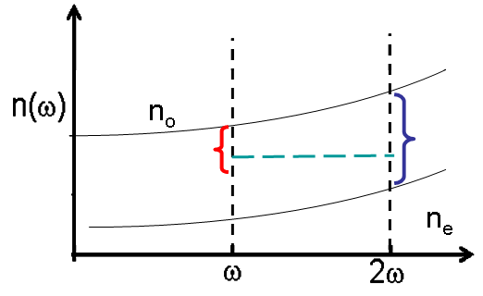
Type II -ve uniaxial → n_{o} > n_{e}
-ve uniaxial eoe
Harmonic
Fundamental
Δk = k_{e}(ω) + k_{o}(ω) – k_{e}(2ω)= k_{vac}(ω)[n_{e}(θ,ω) + n_{o}(ω)] - k_{vac}(2ω)n_{e}(θ,2ω)
= k_{vac}(ω){[n_{e}(θ,ω) + n_{o}(ω)] - 2n_{e}(θ,2ω)}
n(ω)
n_{o}
Unique θ
n_{e}

Slide 8
“Critical” Phase Match
“Non-Critical” Phase Match
Type I eoo
Z (optic) axis
θ_{PM}
n_{e}(2ω,θ)
n_{o}(2ω)
Poynting
vectors
n_{o}(ω) = n_{e}(2ω)
Curves are tangent
n_{o}(ω)
Difference between the normals to
the curves represent spatial walk-off
between fundamental and harmonic
Reduces conversion efficiency
n_{e}(ω,θ)

Slide 9
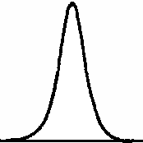
“Critical” Versus “Non-Critical” Phase Match
How precise must θ_{PM} be? I(2ω) ∝ sinc²[ΔkL/2= π/2] ≈ 4/π² ∼0.5
e.g. Type I eoo (-ve uniaxial)
0
Note key role of birefringence
I(2ω,Δθ)
Δθ_{PM} (Half width at half
maximum)
Usually quote the “full”
acceptance angle = 2Δθ_{PM}
Δθ

Slide 10
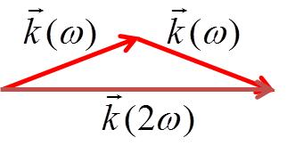
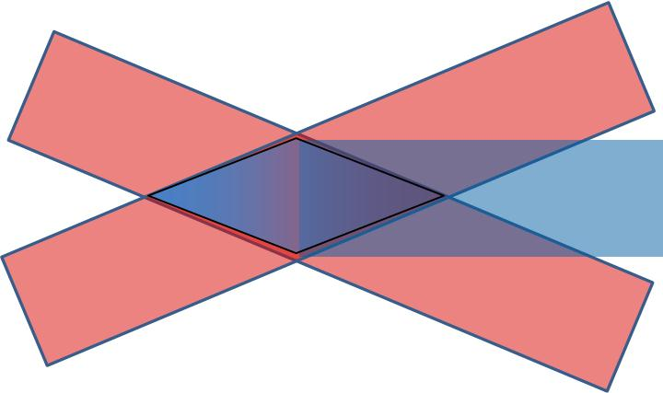
Small birefringence is an advantage in maintaining a useful angular bandwidth
Non-collinear Phase-Matching
We have discussed only collinear wavevector matching. However, clearly it is possible
to extend the wavelength range of birefringent phase-matching by tilting the beams.
Interaction limited to this region
Biggest disadvantage: Walk-off

Slide 11
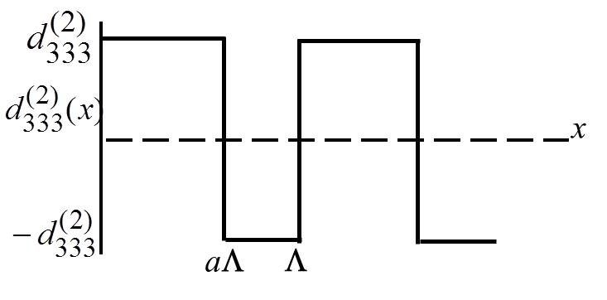
Quasi-Phase-Matching
- direction of is periodically reversed along a ferroelectric crystal
Periodically poled LiNbO₃(PPLN):
a is the “mark-space ratio”
Λ
z
1≥a>0
x
PPLN
p’th Fourier component
Δk = 2k_{e}(ω) – k_{e}(2ω) + pK
Change phase-matching condition
by manufacturing different Λ

Slide 12
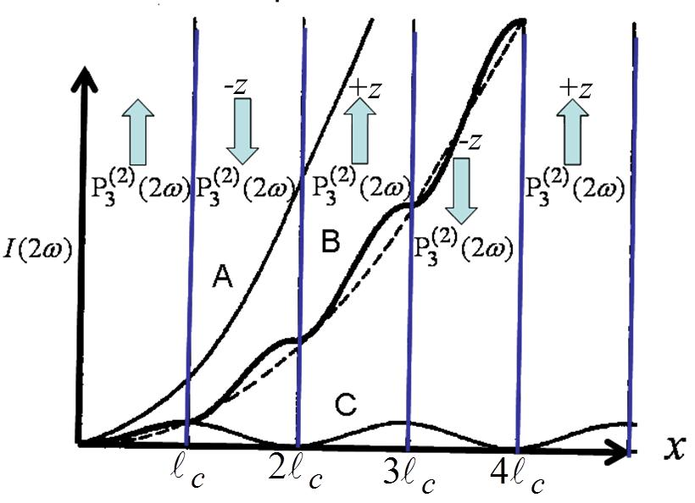
Quasi-Phase-Matching: Properties (1)
A – perfect phase match with
z
B – QPM with p=1
C -
πc/Λω

x
n(ω)
n(2ω)
A modified form of
“non-critical” phase-match

Slide 13
Quasi-Phase-Matching: Properties (2)
The relative strengths of the Fourier components depend on a.
Δk = 2k_{e}(ω) – k_{e}(2ω) + pK
Not useful since
Not useful because
Phase matching is possible
Higher order gratings can be used to extend phase-matching to
shorter wavelengths, although the nonlinearity does drop off,

Slide 14
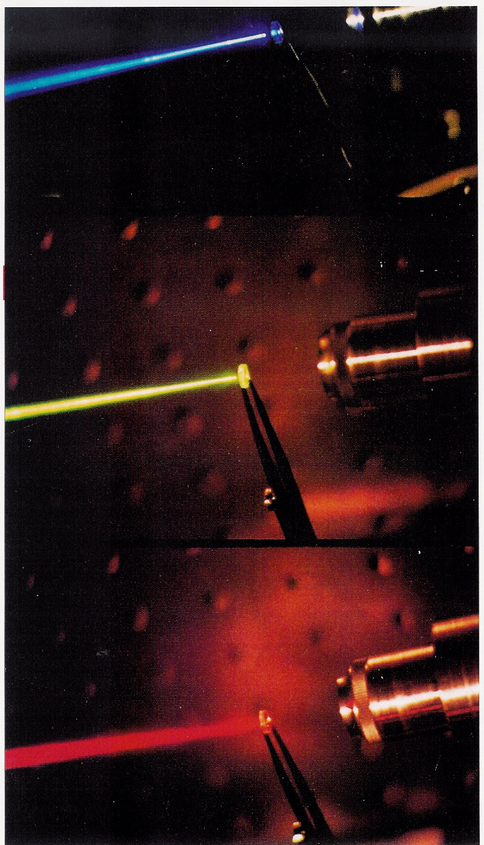
State-of-the-art QPM LiNbO₃
fundamental and harmonic co-polarized
d⁽²⁾_{eff} ≈ 16 pm/V (p=1)
samples up to 8 cms long
conversion efficiency → 1000%/W (waveguides)
commercially available from many sources
still some damage issues
Right-hand side picture shows blue,
green-yellow and red beams obtained
by doubling 0.82, 1.06 and 1.3 μm
compact lasers in QPM LiNbO₃

Slide 15
Solutions to Type 1 SHG Coupled Wave Equations
e.g. Type I
-first assume negligible fundamental depletion
valid to ∼10% conversion
ω
E(ω)
2ω
E(ω)
E(2ω)
E(2ω) and E(ω) are π/2 out of phase at L=0!!!
Large Conversion Efficiency (assume energy is conserved → Kleinman limit)
Field Normalization

Slide 16
Normalized Coupling Constant
Normalized
Propagation
Distance
Normalized
Wavevector
Detuning
“Global Phase”
Inserting into coupled wave equations and separating into real and imaginary equations
Integrated by the method of the variation of the parameters

Slide 17
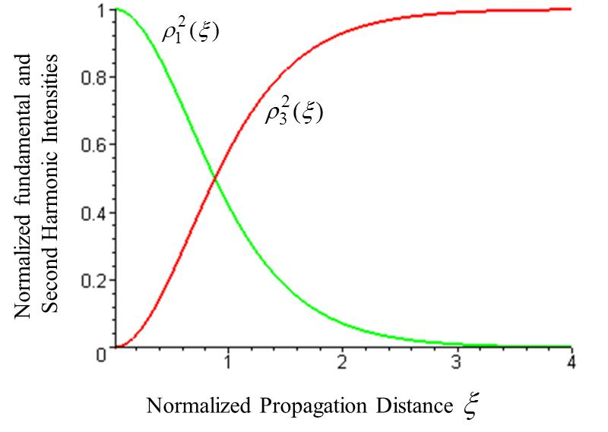
Sgn is determined by the sign of boundary (initial) condition sine( )
The general solution is given in terms of Jacobi elliptic function
Solutions simplify for Δs=0,
i.e. on phase-match
The conversion efficiency saturates at unity (as expected)

Slide 18
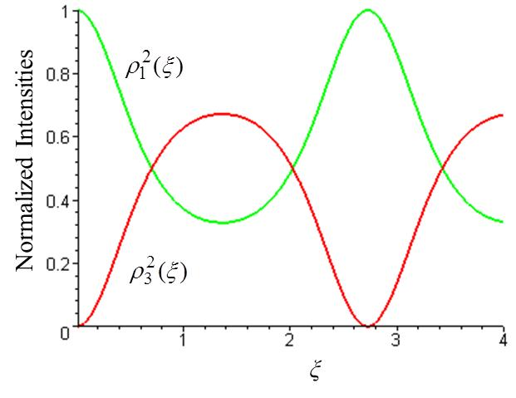
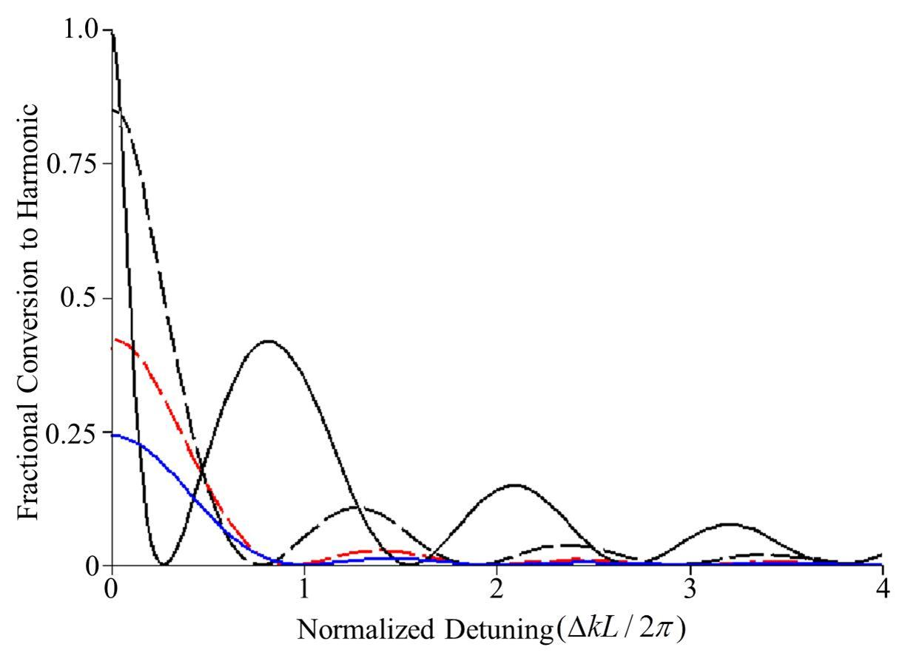
Note the different shape of the harmonic
response compared to low depletion case
Δs≠0
Δs=0.2
Δk₂ > Δk₁
I(2ω)
Δs=0.2
z
The main (Δk=0) peak with increasing
input which means that the tuning bandwidth
becomes progressively narrower.
The side-lobes become progressively narrower
and their peaks shift to smaller ΔkL.
(solid black line); (dashed black line); (red dashed line);
(solid blue line, curve multiplied by factor of 4).

Slide 19
Solutions to Type 2 SHG Coupled Wave Equations
E₁(ω)
ω
2ω
E₃(2ω)
ω
E₂(ω)
Normalizations
Physically useful solutions are given in terms of the photon fluxes N(ξ), i.e. photons/unit area
Simple analytical solutions can only be given for the case Δs=0

Slide 20
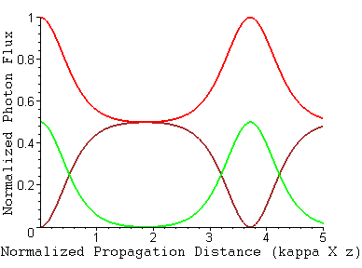
Type 2 SHG: Phase-Matched
No asymptotic final state
All intensities are periodic
with distance
Oscillation period depends
on input intensities

