Slide 1
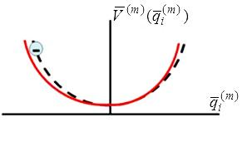
Anharmonic Oscillator Derivation of Second Order Susceptibilities
The harmonic oscillator model used for deriving the linear susceptibility can be extended to
the second order susceptibility. BUT, it does not agree in some details with the quantum
treatment. However, since it is experimentally measured coefficients that are used to calculate
expected conversion efficiencies etc., the anharmonic oscillator model is quite useful. It fails
primarily when measured values of susceptibility are used at frequencies far from the
measurement frequency.
A term cubic in the displacement is added to the potential, i.e.
Nonlinear “force constant”
Diagonalizing does not
imply is diagonalized!
Indices in are
interchangeable.
Harmonic potential
Anharmonic potential
Materials with the property are called “non-centrosymmetric”.

Slide 2
Nonlinear Displacement (Type 1)
Nonlinear “Driven” SHO Equation:
Equation cannot be solved exactly - use successive approximations
Solve for neglecting terms
Use solutions for to evaluate
Solve for etc.
χ⁽¹⁾
χ⁽²⁾
Harmonic generation
DC response

Slide 3
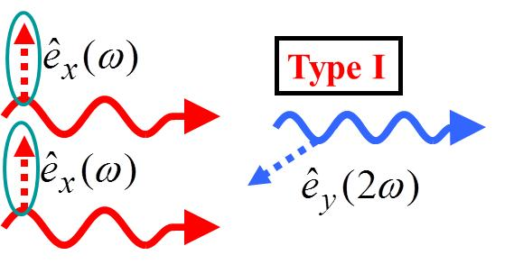
Nonlinear Second Harmonic Polarization: Type 1
Similarly for the DC term

Slide 4
Properties of χ⁽²⁾
Non-resonant

Slide 5
Nonlinear (Type 2) Displacements (1)
Type 2 refers to 2 different eigenmodes (different polarizations,
different frequencies) mixed inside a crystal. Usually refers to two
orthogonally polarized fundamental beams, or to different
frequencies of arbitrary polarization. The usual implementation
of the first case is:
E
y
45⁰
x
Most general case
ω_{c}=ω_{a}+ω_{b}
ω_{b}=ω_{c}-ω_{a}
ω_{a}=ω_{c}-ω_{b}
- Sum frequency generation
- Type 2 SHG for ω_{a}=ω_{b}
orthogonally polarized beams
Difference frequency generation

Slide 6
Nonlinear Second Harmonic Polarization: Type 2
ω_{a}=ω_{c}-ω_{b}

Slide 7
Also

Slide 8
Type 2 Second Harmonic Generatiion
e.g. 2 fundamental beams polarized along orthogonal eigenmode axes, e.g. x and y
Type II
Type I
Type II

Slide 9
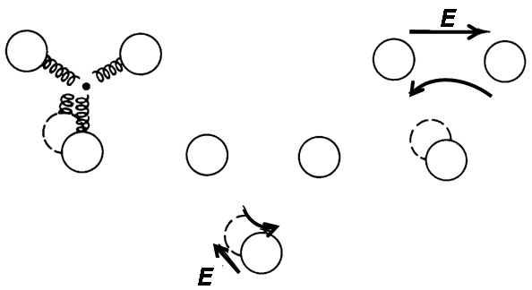
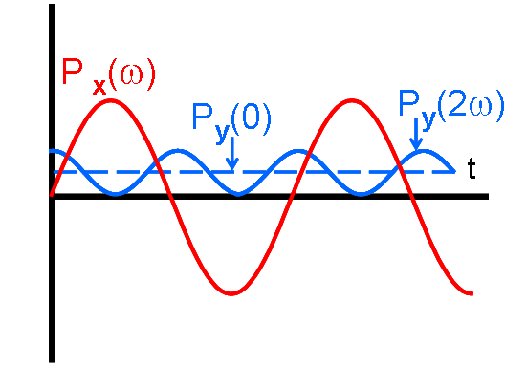
Origin of Nonlinearity in KDP (KH₂PO₄)
PO bonds give nonlinearity
Non-resonant case
PO₄ forms tetrahedron
-
-
Applied Field → Electron trajectory
→induced dipole
y
x
-
-
-
-
1 complete cycle of optical field
➔ 2 cycles of polarization ⊥ to incident field

Slide 10
Integral Formulation of Susceptibilities
Fourier component of
field in frequency domain
Identifies frequency for
expansion in time domain

Slide 11
Second Order Susceptibility
Total incident field at time
Total incident field at time

Slide 12
General Result for Total Input Fields
Ensures energy conservation,
e.g. Single Input Fundamental for SHG
Substituting:

Slide 13
Tedious but straight-forward
Smi ≡ Single
eigenmode input
Exactly the same as we assumed before!

Slide 14
Sum and Difference Susceptibilities
beams input with 2 different frequencies → 2 eigenmode input
Get SHG (2ω_{a} and 2ω_{b}) and DC like before Focus here on ω_{a} ± ω_{b}.

Slide 15
Slowly Varying Envelope Approximation (SVEA)
A simple method is needed to find the fields generated by the nonlinear polarizations
where is a weak perturbation like .
However, it is not always possible to solve the wave equation in matter with arbitrary
polarization source terms. We will now develop a formalism in which the fields generated by
perturbations can be easily calculated, provided that the perturbations are weak. It is called
the Slowly Varying Envelope Approximation SVEA, sometimes called the Slowly Varying
Phase and Amplitude Approximation. It involves performing an integral instead of solving a
differential equation which can always be done numerically.
Assume that the complex amplitude of a generated wave varies slowly with z, i.e. is small over a wavelength.
neglect
Assume CW (or long pulsed) fields,

Slide 16
This is a very useful result. It has been used for other small perturbations such as the
acousto-optic effect, electro-optic effect, scattering by molecular vibrations etc. Note that
a specific spatial Fourier component of the perturbation polarization, i.e. at k_{p} is explicitly
assumed. This approach is equivalent to first order perturbation theory in quantum mechanics.
e.g. application to linear optics, dilute gas, i.e. 1>>χ⁽¹⁾∝ρ (gas density)
Aside: In more general case (short pulses) with

Slide 17
Second Harmonic Coupled Wave Equations
Example: SHG with 1 eigenmode input
multiply both sides by
VNB: Also valid for circular polarization!

Slide 18
So far the depletion of the input beams has been neglected
ω
2ω
ω
Up-conversion
ω
Down-conversion
DFG: 2ω-ω
Both processes optimized simultaneously for wave-vector matching!

Slide 19
Recall:
Therefore in the limit of Kleinman symmetry, all d_{eff} are equivalent (equal)!! It corresponds to being far off-resonance, i.e. non-resonant.
Example: SHG with 2 eigenmode (polarization) inputs
2ω
ω
ω
ω
Up-conversion
Down-conversion

Slide 20
All 3 processes optimized simultaneously
E.g. Sum (SFG) and Difference (DFG) Frequency Generation

