Slide 1
Stimulated Scattering
Stimulated scattering is a fascinating process which requires a strong coupling between light and
vibrational and rotational modes, concentrations of different species, spin, sound waves and in
general any property which can undergo fluctuations in its population and couples to light. The
output light is shifted down in frequency from the pump beam and the interaction leads to growth
of the shifted light intensity. This leads to exponential growth of the signal before saturation
occurs due to pump beam depletion. Furthermore, the matter modes also experience gain.
The Stimulated Raman Scattering (SRS) process is initiated by noise, thermally induced
fluctuations in the optical fields and Raman active vibrational modes. An incident pump field (ω_{P})
interacts with the vibrational fluctuations, losing a photon which is down shifted in frequency by
the vibrational frequency (Ω) to produce a Stokes wave (ω_{S,}) and also an optical phonon
(quantum of vibrational energy ). These stimulate further break-up of pump photons in the
classical exponential population dynamics process in which “the more you have, the more you get”.
The pump decays with propagation distance and both the phonon population and Stokes wave
grow together. If the generation rate of Stokes light exceeds the loss, stimulated emission occurs
and the Stokes beam grows exponentially.

Slide 2
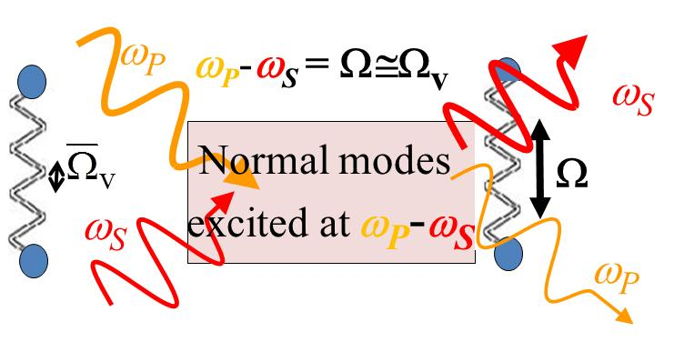
It is the product of optical fields which excites coherently the
phonon modes. Since the “noise” requires a quantum
mechanical treatment here we consider only the classical
steady state case, i.e. both the pump and Stokes are
classical fields, i.e. it is assumed that both fields are present.
Pump (laser) field
Stokes field,
drives
drives
Notes:
2

Slide 3
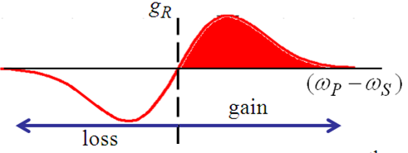
VNB: both polarizations, have exactly the correct wavevector for
phase-matching to the Stokes and pump fields respectively. Also, for simplicity in the
analysis, assume that the laser and Stokes beams are collinear. However, stimulated Raman
also occurs for non-collinear Stokes beams since is independent of .
Optical loss added
phenomenogically
→ For g_{R}I(ω_{p} )>α_{S}, exponential growth of Stokes
Phase of Raman signal independent of laser phase,
i.e. ! But if temporal coherence of
laser is very bad, δω_{P} may be larger than →
must average over δω_{P} to get net gain

Slide 4
can also have gain for Stimulated Stokes in the backward direction! Get the same but boundary conditions at z=0, L different!
In fact Stokes beam can go in any direction, however if the two beams are not collinear then the net gain is small with finite width beams
Raman Amplification
Optimum conversion:
When grows by one photon, decreases by one photon and
of energy is lost to the vibrational mode, and eventually heat

Slide 5
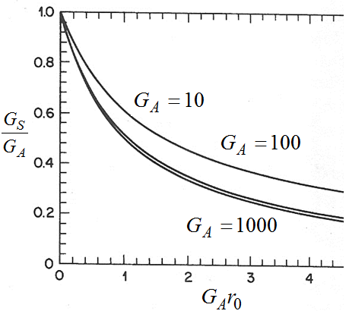
Raman Amplification – Attenuation, Saturation, Pump Depletion, Threshold
No pump depletion (small signal gain) but with attenuation loss
Assume α_{P} = α_{S} = α (reasonable approximation)
Note that the higher the input
power, the faster the saturation
occurs, as expected.
Saturation in amplifier gain occurs due to pump
depletion.

Slide 6
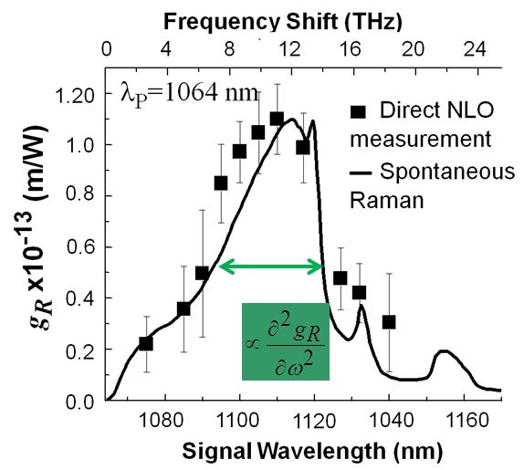
Starting from noise, the Stokes seed intensity ( ) is a single “noise” photon × the Stokes frequency bandwidth of the unsaturated gain profile, assumed to be Lorentzian.
Mathematically for the most important case of a single mode fiber:
A_{eff} is the effective nonlinear core area
The stimulated Raman “threshold” pump intensity is defined approximately as the input pump intensity for which the output pump intensity equals the Stokes output intensity, i.e.
For backwards propagating Stokes
glass
This threshold is higher than for forward
propagating Stokes. Therefore, forward
propagating Stokes goes stimulated first and
typically grows so fast that it depletes the pump
so that that backwards Stokes never really grows

Slide 7
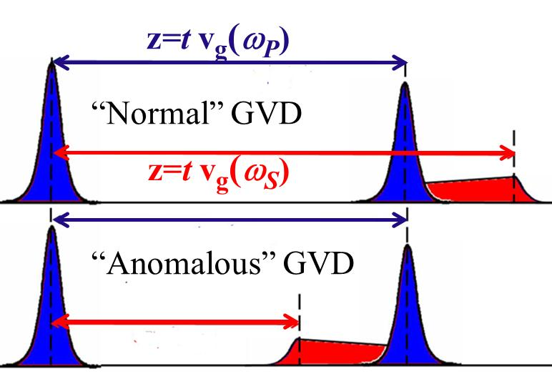
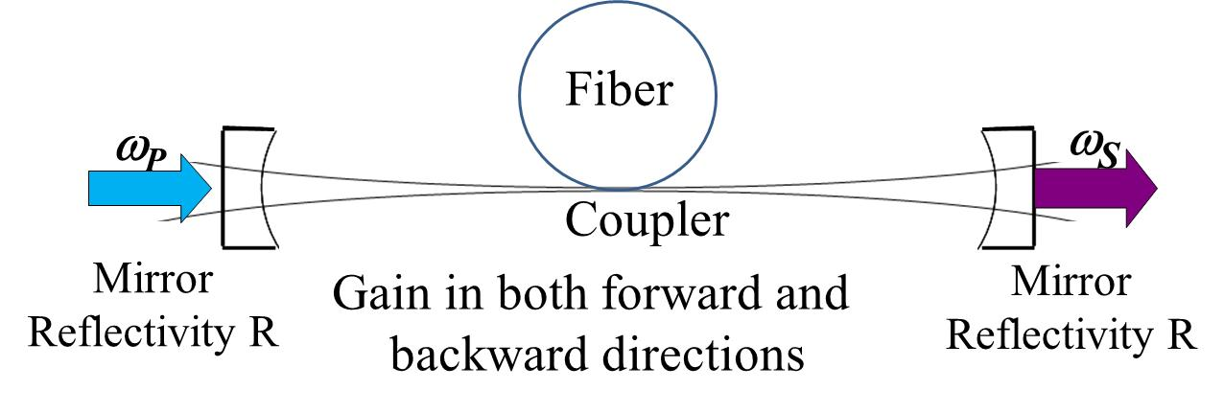
Raman Amplification – Pulse Walk-off
Stokes and pump beams propagate with different group velocities v_{g} (ω_{S}) and v_{g}(ω_{P}). The interaction efficiency is greatly reduced when
walk-off time ≥ pump pulse width Δt. As a result
the Stokes signal spreads in time and space
For backward propagating Stokes, the pulse
overlap is small and the amplification is weak.
Raman Laser
Threshold condition:
Frequently fibers used for gain. Why? Example silica has a small g_{R} but also an ultra-low loss allowing long growth distances. For L∼10m, P_{P}^{th}=1W for lasing.

Slide 8
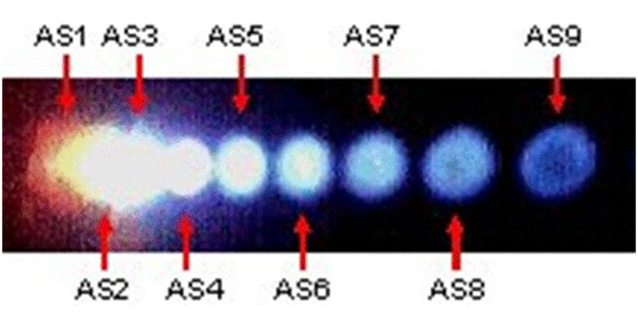
Multiple Stokes and Anti-Stokes Generation
Fused silica fiber excited
with doubled Nd:YAG laser
λ=514nm.
Spectrally resolved multiple Stokes beams
Spectrally resolved multiple Anti-Stokes beams
To this point we have focused on terms like which corresponded to
What about , i.e. Anti-Stokes generation? This requires tracking the
optical phonon population since a phonon must be destroyed to upshift the frequency. Therefore
Anti-Stokes generation follows Stokes generation which involves the generation of the phonons.
ω_{S}
ω_{P}
ω_{P}
ω_{A}

Slide 9
Coherent Anti-Stokes Generation
→ Stimulated Stokes;
→Anti-Stokes
- → dispersion in refractive index means the waves are not collinear
for the Anti-Stokes case, similar to the CARS case discussed previously
Thus Anti-Stokes process requires phase-matching (not automatic)

Slide 10
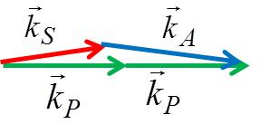
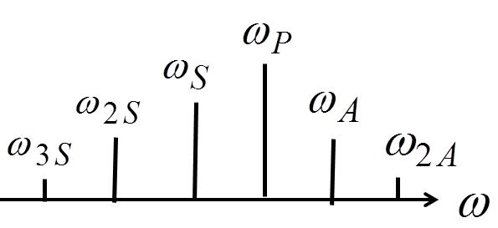
For every Stokes photon created, one pump photon is destroyed AND for every Anti-Stokes photon created another pump photon is destroyed. Also, for every Stokes photon created an optical phonon
is also created, and for every Anti-Stokes photon created an optical phonon is destroyed
What is missing in the conservation of energy is the flow of mechanical energy E_{mech} (t) into the
optical phonon modes via the nonlinear mixing interaction, and its subsequent decay (into heat).
Vibrational energy grows with the Stokes energy, and
decreases with the creation of Anti-Stokes and by
decay into heat. If Stokes strong → 2nd Stokes
→ 3rd Stokes etc.
Anti-Stokes is not automatically wavevector matched! Since
Stokes is generated in all directions, Anti-Stokes generation
“eats out” a cone in the Stokes generation (angles small).
The generation of
Anti-Stokes lags
behind the Stokes

Slide 11
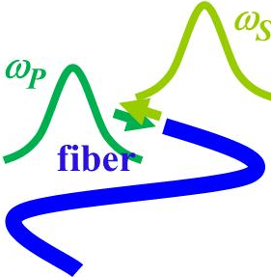
Stimulated Brillouin Scattering
The normal modes involved are acoustic phonons. In contrast to optical phonons,
acoustic waves travel at the velocity of sound.
Decays to thermal
“bath”, i.e. heat
Stimulated Brillouin
“Noise” fluctuations
in optical fields and
sound wave fields
Grow in opposite
directions but still
“drive” each other
Brillouin scattered light
Optical phonon (sound
wave) excited
Brillouin Amplification
Stokes signal injected.
Decays to thermal
“bath”, i.e. heat
Light waves
Freely propagating sound waves
Forward travelling
Backwards travelling
Notes:
11

Slide 12
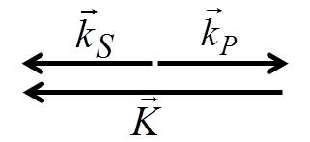
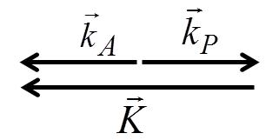
need k∼K for measurable Ω_{S}, since Ω_{S}→0 as K →0
For Stokes need
Backwards Stokes couples to
forwards travelling phonons
To get stimulated scattering, light and sound waves must be collinear → Backscattering → K ∼2k
→ phonon wave picks up energy and grows along +z. ∴ Stokes can grow along -z
For Anti- Stokes need
Backwards Anti-Stokes couples
to backwards travelling phonons
backwards phonon wave gives up energy and one phonon is lost for every
anti-Stokes photon created. But the only backwards phonons available are
due to “noise”, i.e. ∝ k_{B}T, a very small number! (Stokes process generates
sound waves in opposite direction.) Anti-Stokes NOT stimulated!

Slide 13
Comparison between Stimulated Raman and Stimulated Brillouin
Stimulated Brillouin
Acousto-optics uses bulk properties
NO local field corrections
2. Acoustic waves propagate.
Normal mode frequency Ω_{S} ∝ K
4. Backward Scattering only
Stimulated Raman
Molecular property
→ Local field corrections
2. Normal modes do NOT propagate.
Normal mode frequency is fixed at Ω_{v}
Both forwards and backwards scattering
Equation of Motion for Sound Waves
Light-sound coupling
Mass density
Force due to mixing of light beams
Acoustic damping constant
Sound velocity
Gas or Liquid
v_{s}
Only compressional wave (longitudinal acoustic
phonon) couples to backscattering of light
Notes:
13

Slide 14
Substituting into driven wave equation for q_{z}
The damping of acoustic phonons at the frequencies typical of stimulated Brillouin (10’s GHz) frequencies is large with decay lengths less than 100μm. This limits (saturates) the growth of the phonons. In this case the phonons are damped as fast as they are created , i.e. .
Mixing of optical beams drives the sound waves
Notes:
14

Slide 15
Power Flow (Manley Rowe)
Acoustic phonons modulate pump beam to produce Stokes.
Note that for , Q₊ is linked to E_{S} with
ω_{S} propagates along –z
ω_{P} travels along +z
Travels and grows along -z
Travels and depletes along +z
Pump beam supplies energy for the Stokes beam!
Notes:
15

Slide 16
Phonon Energy Flow (need acoustic SVEA)
Decay of sound waves “heats up” the lattice
Mixing of optical beams drives sound waves
Phonon beam grows in forward direction by picking up energy from the pump beam. The Stokes grows in the backwards direction because it also picks up energy from the pump.
Exponential Growth
When the growth of the acoustic phonons is limited by their attenuation constant.
Signature of exponential growth

Slide 17
This leads to exponential growth of Stokes along -z!!
The energy associated with , i.e. the sound waves, eventually goes into heat.
What is happening to acoustic phonons ?
Therefore, acoustic damping leads to saturation of the phonon flux and exponential gain of the Stokes beam!
→In the undepleted pump approximation get exponential gain for backwards Stokes

Slide 18
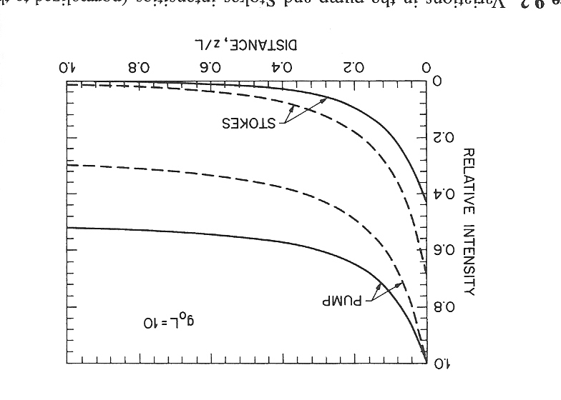
1.0
Pump signal decays exponentially in
the forward direction as the Stokes
grows exponentially in the backward
direction
0.8
Pump
0.6
For amplifying a signal I_{S}(L) inserted
at z=L, the growth of the signal is shown
for different signal intensities relative
to the pump intensity.
Relative Intensity
0.4
0.2
Stokes
Assume an isotropic solid – the pertinent
elasto-optic coefficient is p₁₂ so that
(typically 1 ≥ p₁₂ ≥ 0.1).
0.0
1.0
0.2
0.4
0.6
0.8
Distance z/L
Can add loss phenomenologically

Slide 19
Pump Depletion and Threshold
The analysis for no pump depletion, threshold and saturation effects is similar to that discussed previously for Raman gain effects Since ω_{S},ω_{P}>>Ω_{S} then α_{S}≅α_{P}=α is an excellent approximation. For no depletion of pump except for absorption
Signal output
Brillouin threshold pump intensity defined as
with unsaturated gain & with the Lorentzian line-shape for g_{B}:
To solve analytically for saturation which occurs in the presence of pump depletion, must assume α=0, ω_{P} ≅ ω_{S} and define
Notes:
19

Slide 20
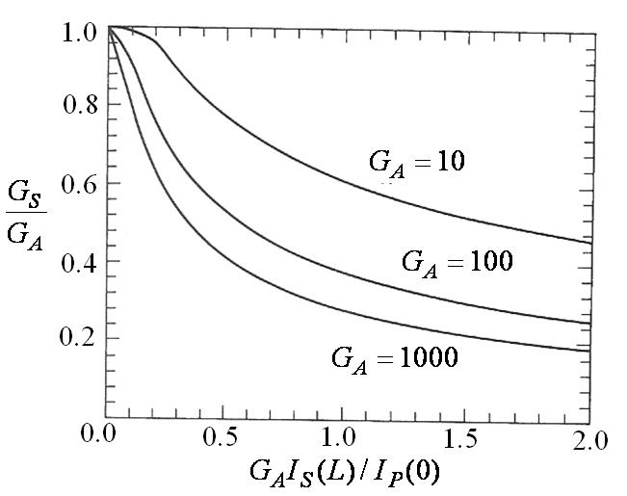
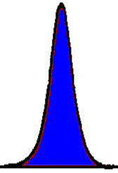
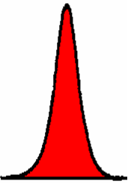
Plot of gain saturation after a propagation distance
L versus the normalized unsaturated gain G_{A}.
The higher the gain, the faster it saturates.
Stimulated Brillouin has been seen in fibers at mW
power levels for cw single frequency inputs.
It is the dominant nonlinear effect for cw beams.
e.g. fused silica : λ_{P} = 1.55μm, n=1.45, v_{S}=6km/s,
Ω_{S} /2π= 11GHz, 1/τ_{S} π ∼ 17 MHz → g_{B} ∼ 5x10⁻¹¹ m/W.
This value is ∼500x larger the g_{R}! But, 1/τ_{S} is much
smaller and requires stable single frequency input to
utilize the larger gain – hence no advantage to stimulated Brillouin for amplification.
Pulsed Pump Beam
v_{g}(ω_{P})
Stokes and pump travel in opposite directions, the overlap
with a growing Stokes is very small and hence the
Stokes amplification is very small! The shorter the pump
pulse, the less Stokes is generated, i.e. this is a very
inefficient process! Stimulated Raman dominates for
pulses when pulse width << Ln/c.
Δt_{P}
v_{g}(ω_{S})
Δt_{S}

