Slide 1
Multi-wave Mixing
In this lecture a selection of phenomena based on the mixing of two or more waves to produce a
new wave with a different frequency, direction or polarization are discussed. This includes
interactions with non-optical normal modes in matter such as molecular vibrations which under
the appropriate conditions can be excited optically via nonlinear optics.
In nonlinear optics “degenerate” means that all the beams are at the same frequency ω and
“non-degenerate” identifies interactions between waves of different frequency. Since the
interactions occur usually between coherent waves, the key issue is wavevector matching.
Because there is dispersion in refractive index with frequency, collinear wave-vector matched
non-degenerate interactions are not trivial to achieve, especially in bulk media. Of course, the
waves can be non-collinear to achieve wavevector conservation in which case beam overlap
reduces interaction efficiency.
Degenerate Four Wave Mixing (D4WM)
Beam Geometry and Nonlinear Polarization
“P1” and “p2” are counter-propagating pump waves, “s” is the input signal, “c” is the conjugate

Slide 2
General case for third order polarization, in frequency domain
Each is the total field!
Each total field is given by
Full 4-wave mixing process will contain 8x8x8 terms!
But, will need wavevector conservation in interaction → reduces # of terms
Assume beams are co-polarized along the x-axis and treat as scalar problem
E^{(p1)} and E^{(p2)} (pump beams) are strong, and E^{(s)} and E^{(c)} are weak beams
3. For the nonlinear polarization, only products containing both pump beams
and either the signal or conjugate beam are important
4. ∴Nonlinear polarization (products of 3 fields) need p1, p2 and c or s

Slide 3
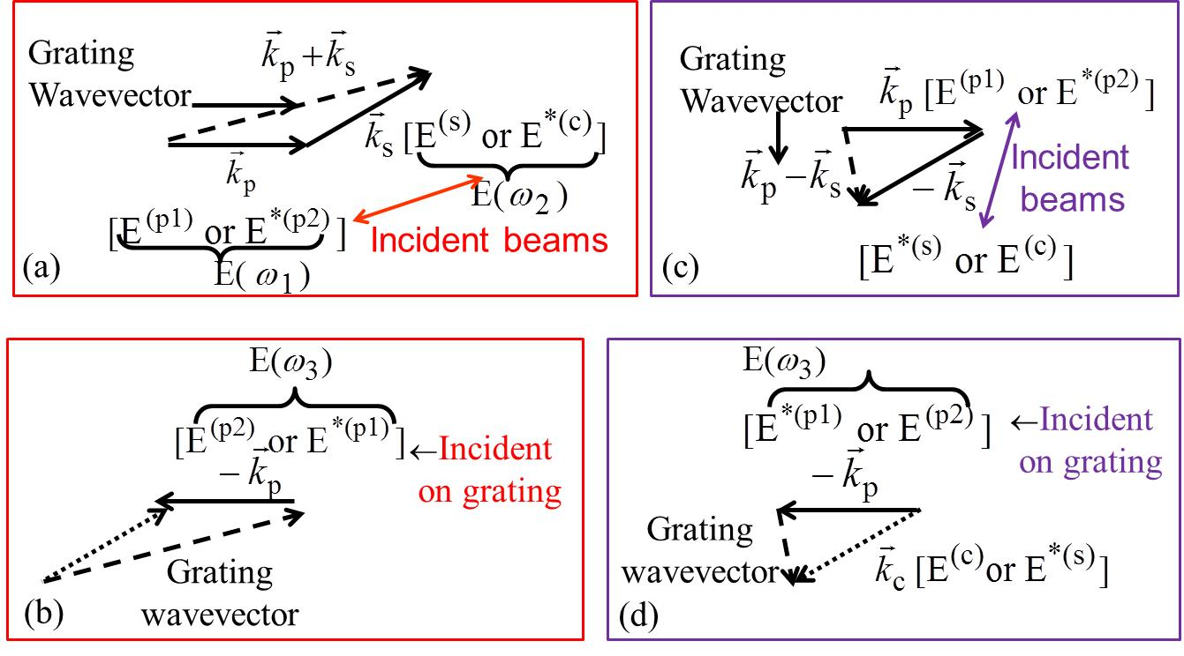
“grating model”: products of two fields create a grating
in space, and a third wave is deflected by the grating to form beams s or c. Initially the only 2 field products of interest are (p1 or p2) x (c or s).

Slide 4
There are two kinds of time dependences present here corresponding
to the first two inputs in
oscillates at 2ω (requires electronic nonlinearity)
DC in time
- Now form E(ω₁)E(ω₂) x E(ω₃) subject to the following restrictions
Terms can only multiply terms with so that the output frequency is ω
The product of three different beams is required
Because the pump beams are the “strong” beams, only products with two pump beams are kept which generate signal or conjugate beams. Assume Kleinman limit.
First term generates the conjugate and the second term the signal.
D4WM Field Solutions
Using the SVEA in undepleted
pump beams approximation

Slide 5
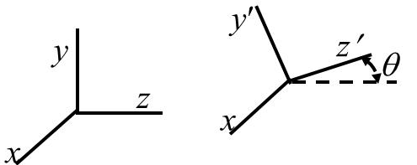
Simplifying in the undepleted pump approximation
Applying the boundary conditions:
∴ Output of conjugate beam:
R>1 ? YES! Photons come out of pump beams!
Need to include pump depletion.
∴ Can get gain on both beams!
Unphysical, need pump depletion

Slide 6
Manley Rowe Relation
Since signal travels along +z′, and the conjugate travels
along –z′, both beams grow together at expense of the
pump beams.
Can be shown easily when z ≅ z′ and allowing pump beam depletion
Note that the p1 and s, and the p2 and c beams travel in the same direction
Pump beam #1 depletes
Signal beam grows
Pump beam #2 depletes
Conjugate beam grows

Slide 7
Wavevector Mismatch
What if pump beams are misaligned, i.e. not exactly parallel?
Assume that z and z′ are essentially coincident
Form of solutions, subject to the usual boundary conditions
Linear Absorption
absorption of all 4 beams, no pump depletion approximation to signal
and conjugate used

Slide 8
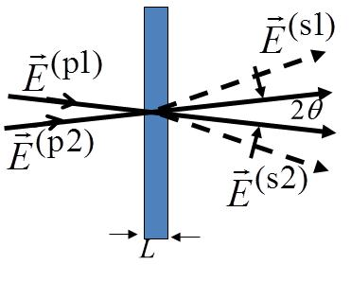
Complex
But is in general a complex quantity, i.e.
index change
absorption change
∴ Both the real (n₂) and imaginary (α₂) parts of contribute to D4WM signal
Three Wave Mixing
y
Assume a thin isotropic medium. Co-polarized beams,
x-polarized with small angles between input beams
z
x
Look at terms

Slide 9
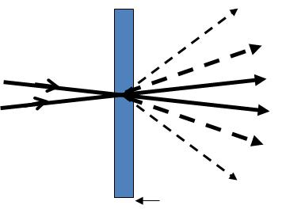
Assuming that the beams are much wider in the x-y plane than a wavelength, wavevector is
conserved in the x-y plane. For the signal field which must be a solution to the wave equation,
can interact with the pump beams
again to produce more output beams etc.
Called the Raman Nath limit of the interaction

Slide 10
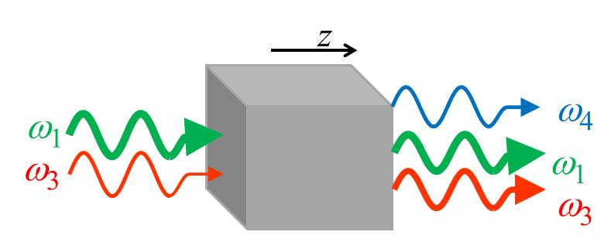
Non-degenerate Wave Mixing
In the most general non-degenerate case with frequency inputs, in which
and are the pump beams, then for frequency and wavevector conservation,
A frequent case is one pump beam from which two photons at a time are used to generate two
signal beams at frequencies above and below the pump frequency which, for efficiency, requires
The fields are written as:
Assuming
co-polarized beams,
the Kerr effect in the non-resonant regime,
cross-NLR due to the pump beam only,
and a weak signal (ω₃) input,
the signal and idler (≡conjugate) beam
nonlinear polarizations are

Slide 11
The signal and idler grow exponentially for when g is real!!
For imaginary g, the solutions are oscillatory

Slide 12
A number of simplifications can be made which give insights into the conditions for gain.
Expanding Δk around for small
. The sign of Δk is negative in the normal dispersion region and positive
in the anomalous dispersion region. The condition for gain can now be written as
After some tedious manipulations valid for small Δω, the condition for gain becomes
Gain occurs for both signs of the GVD and the nonlinearity provided that the intensity exceeds the threshold value
This means that the cross-phase nonlinear refraction due to the pump beam must exceed the
index detuning from the resonance for gain to occur.

Slide 13
Nonlinear Raman Spectroscopy
Usually refers to the nonlinear optical excitation of vibrational or rotational modes. A minimum of two unique input beams are mixed together to produce the normal mode at the sum or difference frequency. Although any Raman-active mode will work, vibrational modes typically are very active in modulating the polarizability.
Note: Must include dissipative loss of the normal modes in Manley-Rowe relations
Degenerate Two Photon Vibrational Resonance
Optical coupling between two vibrational levels (inside the vibrational
manifold of the electronic ground state)
Vibrational amplitude

Slide 14
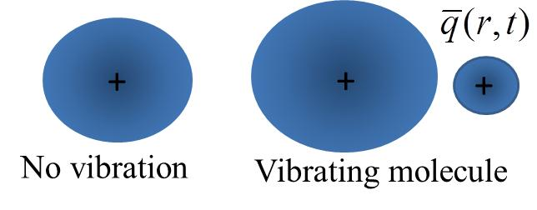
e.g. the symmetric breathing mode in a methane
molecule (CH₄)
H
H
C
H
C
H
H
H
H
H
classical mechanics
π/k_{a}
Note: The molecular vibrations are not only driven
in time due to the field mixing, but also into a
spatial pattern for the first term
q
z
Notes:
14

Slide 15
D(2ω_{a})
Real part gives 2 photon absorption; Imaginary part gives index change
Notes:
15

Slide 16
Nonlinear Raman Spectroscopy
Nonlinear process drives the vibration at the difference frequency ω_{a}-ω_{b} between input fields
I
RIKES – Raman Induced Kerr Effect Spectroscopy ( Raman Induced Birefringence)
Makes medium birefringent for beam “b” and changes
transmission of medium “b”
II
CARS – Coherent Anti-Stokes Raman Spectroscopy
New fields generated at 2ω_{a}-ω_{b} and 2ω_{b}-ω_{a}
(only one can be phase-matched at a time)
RIKES
Notes:
16

Slide 17
Index change produced at frequency ω_{b} by beam of frequency ω_{a}
Nonlinear gain or loss induced in beam “b” by beam “a”
One photon from beam “a” breaks up into a “b” photon and an optical phonon
Propagation direction of beam “a” is arbitrary, only polarization important!
Imaginary part contribution → to nonlinear refractive index coefficient

Slide 18
Real part → contribution to nonlinear gain (or loss)
Modulating the intensity of beam “a” modulates the transmission of beam “b”. Varying ω_{a} - ω_{b}
through gives a resonance in the transmission! Assumed was a crystal. If medium is random,
need to work in both lab and molecule frames of reference and then average over all orientations.
Notes:
18

Slide 19
CARS
Coherent Anti-Stokes Raman Scattering (Spectroscopy)
For simplicity, assume two input co-polarized beams, ω_{b}>ω_{a}.
Field at is written as
This process requires wavevector matching to be efficient,
Cannot get collinear wavevector matching
because of index dispersion in the visible
Notes:
19

Slide 20
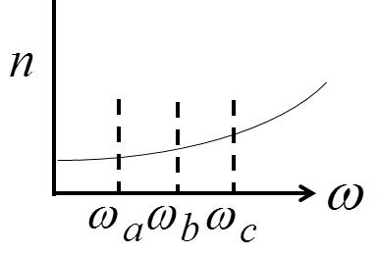
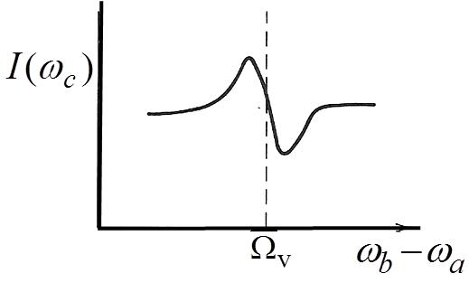
since ω_{c} >> ω_{b} - ω_{a} then angles are small relative to z-axis
When is tuned through , resonant
enhancement in the signal occurs. Monolayer
sensitivity has been demonstrated. There is also a
For comparable contributions of
background and resonance terms
“background” contribution due to electronic
transitions via:
Can also have CSRS (different
wavevector matching conditions)
Signal appears at
Differences between RIKES and CARS
Have resonance
at
Requires
wave-vector
matching
Automatically wave-vector matched in
isotropic medium. No new wave appears.

