Slide 1
Ramifications and Applications of Nonlinear Refraction
Third order nonlinear optics offers a wide range of interesting phenomena which are very different
from what is expected from linear optics. The most important are due to changes in the properties
of beams in space, time and polarization due to nonlinear refraction. If ,
beams can collapse in space or time, or both space and time. In the space domain, this leads to a
broadening of the wavevector spectrum, and in time to spectral broadening. In the worst case, this
can lead to material damage when the local intensity exceeds the damage threshold.
This beam collapse can lead to either beam instabilities or to stable wave packets. Over certain
ranges of intensity and input beam width, unstable, high local intensity filaments can form due to
the amplification of noise associated with real beams. Such instabilities are inherent to plane wave
nonlinear optics. For narrower beams, very stable wave packets whose shape is either invariant on
propagation or periodically recurring can form due to the same physics as the instabilities. These
are called solitons. They are the modes of nonlinear optics and they exhibit unique properties.
Since nonlinear refraction leads to additional nonlinear phase shifts as discussed previously, this
property can be used in interference based phenomena and devices. Signals can be manipulated
depending on their intensity, i.e. all-optical switching. The classic cases are optical bistability in
which the output transmission of light from a cavity can be either high or low for the same input
intensity and integrated optics devices such as nonlinear directional couplers which can be used
for optical logic or intensity controlled routing of signals.
Although the analysis will be for the Kerr effect, it is valid for other mechanisms that contribute
to an effective nonlinear index change, subject of course to response time considerations.

Slide 2
Self-focusing and Defocusing of Beams
This phenomenon is associated with beams of finite cross-section. An intensity dependent
change in the refractive index or a cumulative nonlinear phase shift can be created by a beam.
Hence the beam introduces an effective lens in the medium which affects the propagation of the
beam itself, and any other beam present.
Local phase velocity
- The larger the refractive index n, the slower the phase velocity
For , high intensity region travels slower than wings → curvature of phase front.
V_{p}'
Self-focusing
V_{p} > V_{p}'
For , self-defocusing occurs and beams spreads, augmenting diffraction.
V_{p}'
Self-defocusing
V_{p} > V_{p}'

Slide 3
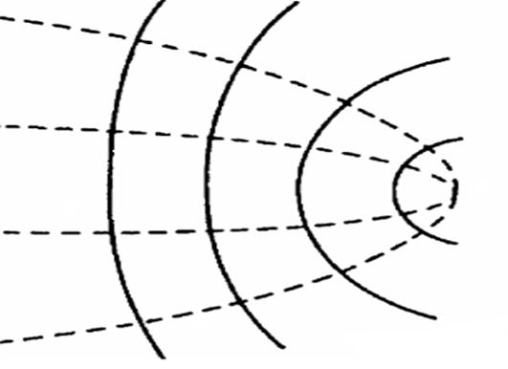
“External Self-action” (thin sample)
The shape of the beam is not significantly changed inside the sample and only the beam’s phase
front is augmented by on transmission. Assuming a lossless
gaussian beam and no diffraction inside the sample, i.e. z₀>>L,
For small phase distortion, the exponential can be expanded as where numerical
simulations have shown that C∼3.77 is a good approximation.
Compare to action of lens of focal length “f” in linear optics,
“External Self-action” (thick sample)
In this case the beam profile collapses for inside the nonlinear medium.
There is a critical power P_{c} (or intensity I_{c}) for collapse. Assume
diffraction occurs over the characteristic distance
for which and ,

Slide 4
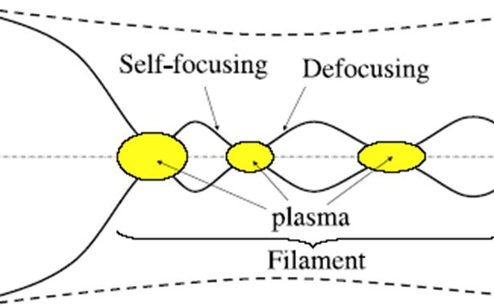
in which z_{f} is the distance to the “focus”. Typical numbers for critical power are:
CS₂, ≅ 4.5x10⁻¹⁴ cm²/W and n∼1.6 at λ_{vac} =1μm → P_{c} ≅ 30KW; fused silica, ≅ 2.5x10⁻¹⁶ cm²/W
and n∼1.5 at λ_{vac}≅1μm → P_{c} ≅ 3.5MW.
In practice, catastrophic self-focusing is arrested by other
physical nonlinear effects such as ionization, stimulated
scattering, multi-photon absorption, electron plasma
formation etc. Furthermore, the scalar and paraxial models
break down when w₀ →λ and the term ignored in
the paraxial approximation must be included. The term
also mixes all three field
components so that for a polarized input, radiation rings of both transverse polarizations are emitted. Periodically foci occur with distance, the higher the input intensity, the more frequent the focal spots. The picture illustrates what occurs in air.
The preceding discussion was based on Kerr nonlinearities. The same self-focusing phenomenon
occurs under appropriate conditions for all third order nonlinearities. However, the governing
equations can be more complex and need to be tailored to the individual nonlinear mechanisms.
Non-locality involving diffusion of the index change in space as found in liquid crystals,
photorefractive media, thermal effects, charge carrier nonlinearities in semiconductors, etc. tend
to counter-act self-focusing and raise the power required for self-focusing. Self-focusing also
occurs for the “cascading” nonlinearity.

Slide 5
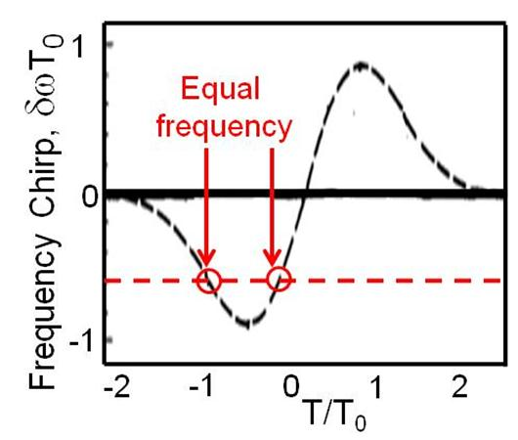
“Self-phase Modulation” and Spectral Broadening in Time
Just as in the space domain, pulse broadening occurs for and pulse narrowing
for . In the absence of nonlinearity, pulse broadening always occurs due to
Group Velocity Dispersion (GVD) which is the equivalent of diffraction in the space domain.
Note that the sign of δω^{NL} changes from the leading (T<0)
to the trailing edge (T>0) of the pulse. The spectral
broadening can be quite large. For example in fibers,
is feasible. Such large spectral broadening
is easily measurable with a spectrum analyzer. The frequency
spectrum is , i.e.
There are points on the pulse envelope for which the frequencies are equal leading to
interference in the spectral domain. As a result the spectrum is periodic in

Slide 6
Beam Instabilities in Space
Plane waves are the normal modes of linear optics, but as will be shown here they are subject to
instabilities under the appropriate conditions on intensity in nonlinear optics. The results derived
here are valid for plane waves or very wide (relative to a wavelength) beams. Recall from the
discussion on nonlinear diffraction
There is always “noise” on any real beam which can be Fourier analyzed to give a noise magnitude
at the spatial frequency κ. Therefore a real beam with nonlinearity present can be written as
A real indicates that the noise grows exponentially with distance in the small signal gain
approximation and, since the noise is amplified, the plane wave solution is unstable. The solution
field and are introduced into the nonlinear wave equation which includes diffraction
A solution exists only for a self-focusing nonlinearity, and for

Slide 7
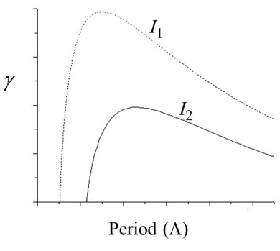
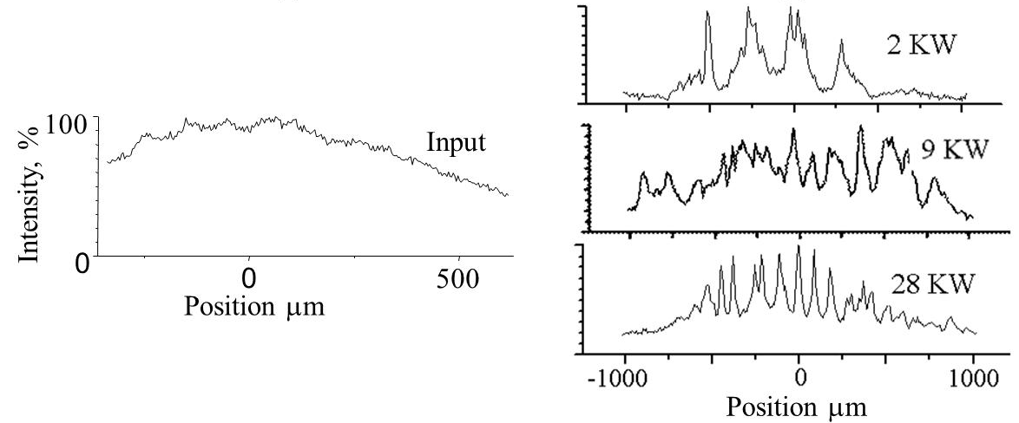
The noise with spatial κ is amplified once the intensity
crosses a threshold value which is different for every
value of κ. Note that the larger the periodicity ,
the lower the threshold for instability.
I₁>I₂
The analysis has been given for a plane wave. However, MI also occurs for wide beams as long as
their half-width is much greater than the MI period associated with their peak intensity. An
experimental example is shown for slab AlGaAs waveguides ( ) which are
effectively a 1D system since diffraction can occur only in the plane of the waveguide.
Input beam
Although the analysis above has been for Kerr nonlinearities, MI is a universal phenomenon
in nonlinear optics and occurs for all self-focusing nonlinearities.

Slide 8
Instabilities in Time
The temporal case is a complete analogue to the spatial case, with GVD replacing diffraction.
GVD and Pulse Broadening
In the frequency domain, the linear wave equation for a pulse with central frequency ω_{a} is
Expanding , again for pulses many cycles long
GVD
Fourier transform into time domain and transforming to co-ordinates travelling with pulse (T).

Slide 9
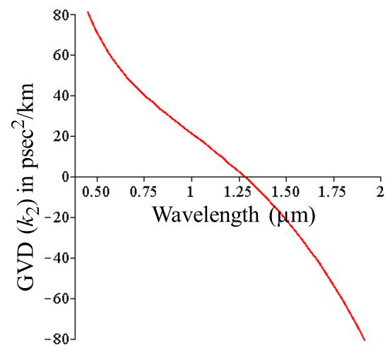
e.g.
L_{dis} is the characteristic dispersion length for pulse
broadening. Note the sign of the frequency shift
across the pulse for k₂<0 is opposite to that for
self-phase modulation. Also, the pulse width
increases on propagation for both signs of k₂.
Pulsed and cw beams can also have instabilities in
the time domain. Repeating the previous space
domain analysis modified for the time domain
Fused silica glass
In contrast to spatial diffraction which has only one sign,
both signs for GVD exist. For example, in fused silica the
sign changes from positive to negative at 1.3μm. MI can
only occur for fused silica which has for
wavelengths longer than 1.3μm .

Slide 10
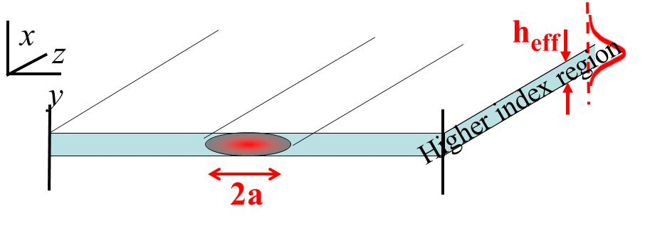
Solitons (Nonlinear Modes)
Soliton are robust solutions to the nonlinear wave equations that correspond to beams which do
not spread or collapse in space or time, or both under appropriate conditions. In the linear optics
case, solutions to Maxwell’s equations are eigenmodes, i.e. they satisfy orthogonality conditions.
This is not the case for solitons although by satisfying the nonlinear wave equation they are modes.
Solitons have some very special (unexpected from linear optics) properties. Bright solitons
exist in all media which exhibit self-focusing. There are also solitons in self-defocusing media,
called dark or grey solitons. Mathematically they consist of a notch in a plane wave. In practice
the wider the extent of the field in which the notch exists, the more stable is the dark soliton. The only nonlinearity for which realistic analytical solutions exist is the Kerr case. (Other cases need to be analyzed numerically.) The simplest (and only stable) Kerr case is for a single dimension in which light can spread in space or time, spatial solitons and temporal solitons respectively.
Bright Kerr Solitons
These solitons are only stable in 1D.
Spatial Solitons
Light is guided by a thin film of higher refractive index than
the surrounding media. The fields decay evanescently into the
surrounding media. Hence diffraction can only occur in the plane of the film. The guided wave field polarized in the plane of the surfaces has the form

Slide 11
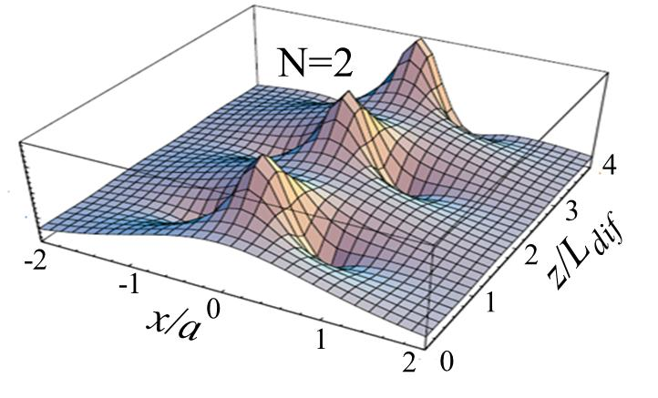
There exists a simple criterion for the existence of 1D spatial
solitons of arbitrary order in terms of diffraction length
and the nonlinear length
, namely L_{Dif}=N²L_{NL} with N=1. There
exist higher order spatial (and temporal) solitons with the
order given by N=2, 3.. which have progressively higher
power requirements. There is periodic evolution of the N>1
soliton fields with distance. The period is
In addition to the properties already discussed, solitons have other “unusual” properties.
Solitons are robust against fluctuations in width or power, i.e. aP_{sol} = constant for 1D Kerr
media. Since dP_{sol}/da < 0, P_{sol} ∝ a⁻¹ and vice-versa, any increase in the soliton power is
compensated for by a decrease in the width. This also holds for non-Kerr solitons. i.e. any
decrease in P_{sol} is still compensated by an increase in width and vice-versa.
2. Solitons have fascinating collision properties. They act like both waves and particles. In the
Kerr case, the number of output solitons=the number of input solitons. Nevertheless, in the
overlap region, obvious interference effects occur. There are attractive and repulsive forces which
depend on the relative phase angle between interacting solitons.

Slide 12
Δφ=0
Δφ=0
Δφ=π/2
Δφ=π
3. Kerr solitons are impervious to small perturbations, i.e. they are not scattered by them.
4. Solitons, with the exception of those due to cascading, can form waveguides which can trap
other weaker beams at a different frequency or polarization or both.
Temporal Solitons
The analysis of this case and hence many of the unique features of temporal solitons are analogous to the spatial case which has been discussed in some detail already. The soliton field is
Some typical numbers for silica fibers at λ=1.55μm are
k₂=-20ps²/km, P_{sol}=5W for T₀=1ps, and P_{sol}=50mW for
T₀=10ps. The original proposal for communications
was to use 10ps pulses. A property not yet discussed
is the excitation of solitons with inputs of the wrong shape
and peak power. Shown is the evoluton into a soliton of
a Gaussian input beam with N=0.75. This is a direct
consequence of the soliton robustness property.

Slide 13
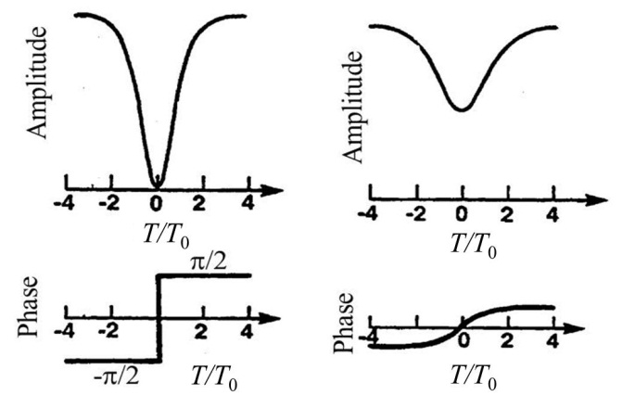
Dark Kerr Solitons
Temporal dark solitons exist for and . The starting nonlinear wave equations
are the same as for bright solitons, but the solutions for are of course different.
Note that the dark soliton is a “notch” in an
infinite broad plane wave background and
hence requires, in principle, infinite energy.
There is a π phase difference between the
background fields on opposite sides of the
notch. If this phase difference is less than π,
the notch does not go tozero (grey soliton)
and the notch has a “transverse velocity”,
i.e. it travels at an angle (slides sideways along
the time axis). It is clearly not possible to satisfy the theoretical conditions of an infinitely broad
background. However, since solitons are robust, solitonic effects are visible for finite width
beams and short propagation distances.
Dark temporal solitons require the product so in principle can occur for the
combinations as well as . However, since diffraction
has only one possible sign, namely negative, dark spatial solitons require a defocusing nonlinearity.

Slide 14
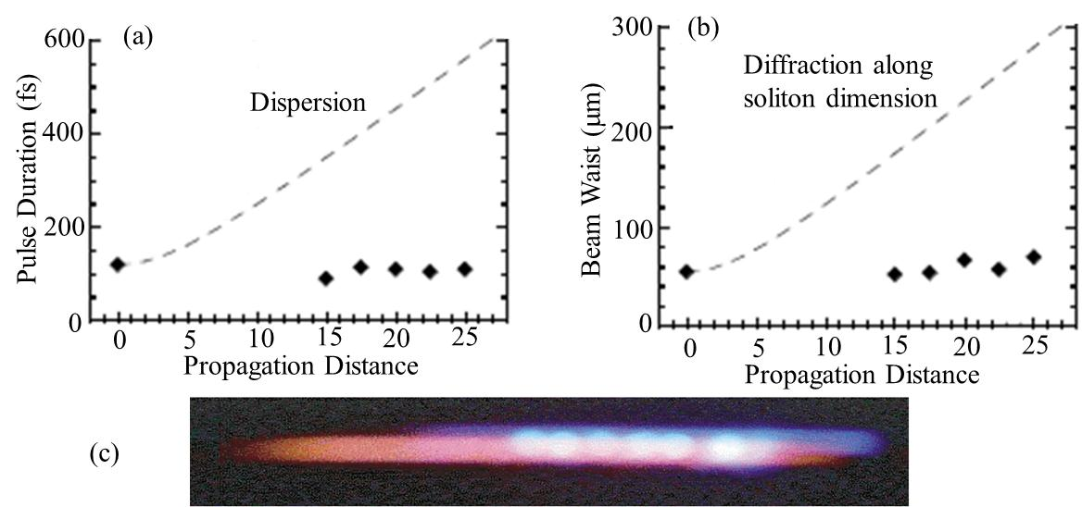
Bright Solitons in Space and Time (Optical bullets)
The condition for solitons in both space and time can be written as
y
t
Normal pulses
“Light bullet”
To date it has not proven possible to get light bullets in 2D. A light bullet in quasi-1D for which
one dimension is large and the spreading of the second (narrow) dimension is compensated by
nonlinearity was demonstrated using the cascading nonlinearity.
Experimental Results

Slide 15
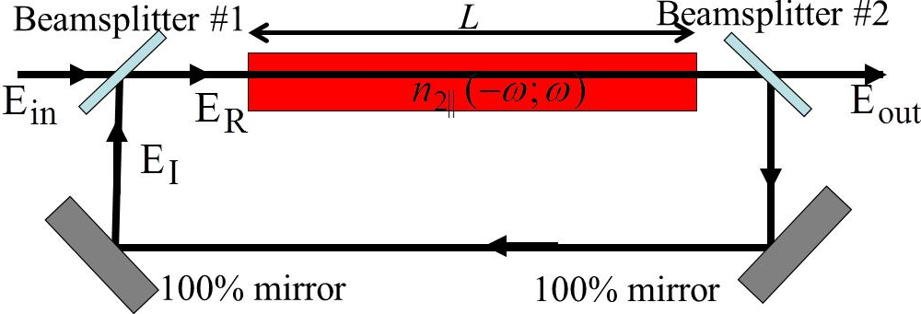
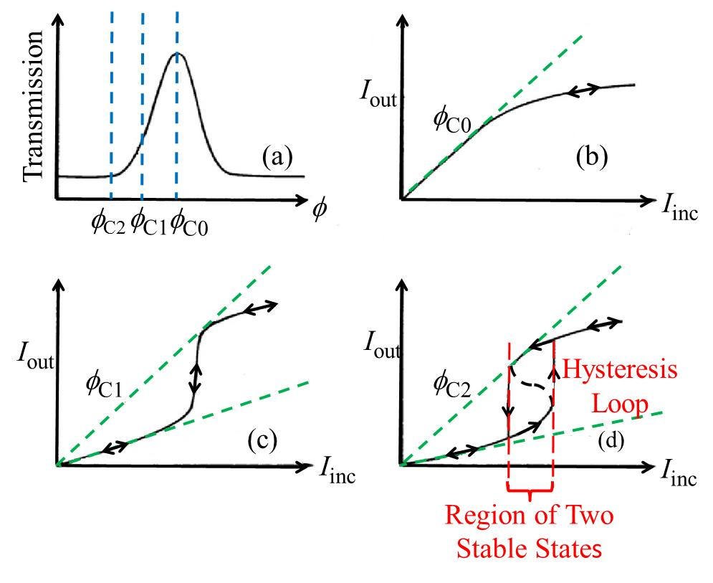
Optical Bistability
For an input into an appropriate “cavity”, for example a Fabry-Perot interferometer, and under
certain conditions of initial detuning of the cavity from one of its transmission resonances, the
output has two possible states of cavity transmission for a range of input powers. The actual
output state obtained depends on whether the input was decreasing or increasing in power when
approaching these states, i.e. the previous history
of the input beam. R and T, are intensity reflection
and transmission coefficients
Unidirectional Cavity
Total round trip phase shift is

Slide 16
This behavior can be explained as follows. Starting
on resonance, increasing the input intensity results in
a nonlinear phase shift which tunes the total phase
off the resonance peak so that the transmission
decreases and the output intensity becomes sub-linear
in the input intensity, case (b). For initially negative
detuning, the transmission increases with input
intensity as the system moves towards the resonance
due to the nonlinear phase shift, i.e. the output
increases faster than linear in the input, case (c). In
this region, . When resonance is reached, further
increases in input intensity move the system off resonance and the response is similar to case (b).
In case (d), a “run-away” effect takes place in which an increase in input intensity moves the
system further towards the resonance and reaches a point where the increase in the cavity field and
hence the nonlinear phase shift is large enough to continuously move the system to resonance
without further increase in the input intensity. This corresponds to a region (dashed black line)
where stability analysis shows the system is unstable. The system “jumps” to the high transmission
state. Subsequent increase in input intensity produces behavior similar to (b). When decreasing the
input intensity from above the hysteresis loop, the cavity field starts in the high transmission state.
The cavity field decreases but remains in the high transmission state until the system becomes
unstable and can no longer stay on resonance at which point it jumps” down to the low
transmission state. Hence a hysteresis loop is formed due to the feedback provided by the cavity!
Which state the system is in depends on the prior history of the illumination.

Slide 17
All-optical Signal Processing and Switching
Because of the importance of controlled routing of optical signals in communications, a number of
schemes have been developed for using light to control light which in principle can be achieved in
shorter times than by electronics which is limited by electron transit times across some junction.
This can be implemented by using the intensity-dependent refractive index in control-signal beam
geometries using waveguides in either fiber or channel integrated optics form.
Linear Coupler
A linear directional coupler consists
of two parallel identical channel
waveguides in which the optical field
in one waveguide overlap the second
waveguide. When one waveguide is excited, light transfers with propagation distance to the
second waveguide. The distance required for complete transfer is called the coupling length L_{C}.
Two simple coupled wave equations describe the response of the system, namely
If the two waveguides are slightly mismatched with propagation constants ,
i.e. with a characteristic beat length , the coupled wave equations become

Slide 18
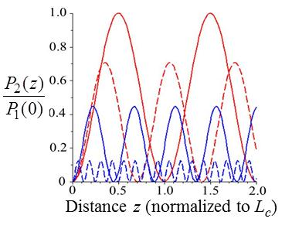
Clearly mismatching the waveguides reduces the
coupling significantly. This can be quantified by
R=2L_{C}/L_{b}.
Nonlinear Directional Coupler
If the coupler is made of a nonlinear material with
the coupler can be mismatched
by increasing the intensity. For , the coupled
equations become
Solid red – R=0. Dashed red – R=1.
Solid blue – R=2. Dashed blue – R=8.
The nonlinearity is given in terms of γ by
Analytic solutions are given by Jacobi elliptic functions in terms of a critical power .

Slide 19
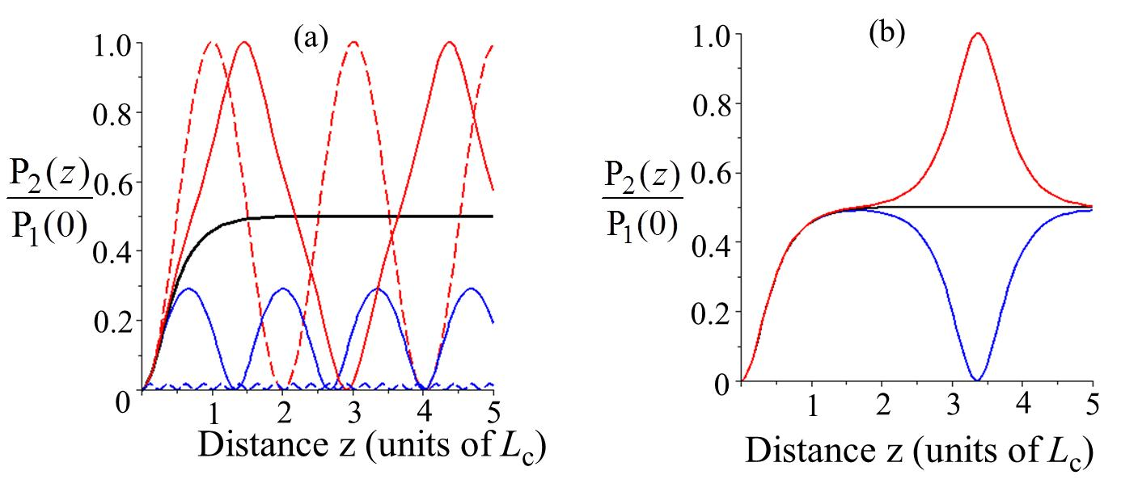
Red curves: dashed P₁(0)/P_{c}=0.4, solid P₁(0)/P_{c}=0.95. Black curve: P₁(0)/P_{c}=1.0.
Blue curve: dashed P₁(0)/P_{c}=2, solid P₁(0)/P_{c}=1.05. (b) Red curve: P₁(0)/P_{c}=0.9999.
Black curve: P₁(0)/P_{c}=1.0. Blue curve: P₁(0)/P_{c}=1.0001.
Exactly at P₁(0)=P_{c} in the asymptotic limit of a very long coupler, L>>L_{C}) the power is split 50:50
between the waveguides. This an unstable point and the slightest deviation upwards in power
leads to oscillations Far above the critical power, there is essentially no power transfer to
waveguide 2. Therefore, in going from low to high power, the signal is switched between channels.
The behavior of this device is also non-reciprocal for initially detuned devices. If and with
power incident in channel 1, the power-dependent increase in initially increases the
power transfer to channel 2 where-as if , inhibits the transfer of power to channel 2.

Slide 20
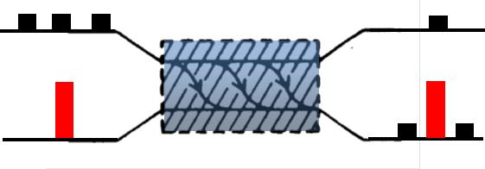
A potential application of this device to demultiplexing or routing. The strong control pulse (red)
in the lower channel detunes the coupler during its passage through the device. No signal can
cross out of the signal channel if it is coincident with the control pulse. The control pulse can be
orthogonally polarized, or even be at a different frequency.

