Slide 1
Nonlinear Optics: Phenomena, Materials and Devices
Honors senior undergraduate and graduate level course.
Approximately 24-26 lecture hours + 3 seminars.
Lectures 2-4:15 Saturday, Sunday, Tuesday and Wednesday
Designed to provide a working knowledge of Nonlinear Optics.
Requires an understanding of Maxwell’s equations and their solutions
Understanding of quantum mechanics would be useful, The quantum concepts
will be introduced when needed.
Lecture notes and schedule available on website.
Textbook “Nonlinear Optics: Phenomena, Materials and Devices”, authors George
and Robert Stegeman, will be published in early 2012 by J. Wiley and Sons.
Lecture 1 Introduction and Linear Susceptibility - optical polarization expansions, orders of
magnitude of nonlinearities, linear susceptibility, local field effects
Lecture 2 Second Order Susceptibility – coupled wave theory – nonlinear polarization and
interactions
Lecture 3 Second Harmonic Fields - coupled wave equations – wave-vector matching – solutions
Lecture 4 Practical Second Harmonic Generation - optimization – beams –QPM
Lecture 5 Tunable Frequencies – Optical parametric amplifiers and oscillators – applications
– materials
Lecture 6 Quantum Theory of Susceptibilities – 1st, 2nd and 3rd order susceptibilities

Slide 3
Lecture 7 Nonlinear Index and Absorption – simple two & three level models – frequency
dispersion – examples
Lecture 8 Third Order Nonlinearities Due to Electronic Transitions: Materials – molecules
- glasses – semiconductors
Lecture 9 Miscellaneous (Slower) Third Order Nonlinearities: Materials -vibrational,
electrostrictive, liquid crystal, electrostrictive, cascading effects
Lecture 10 Ramifications and Applications of Nonlinear Refraction - self-focusing and
defocusing - instabilities - solitons - bistability - all-optical switching
Lecture 11 Multi-Wave Mixing - degenerate and non-degenerate four wave mixing – three
wave mixing - nonlinear spectroscopy
Lecture 12 Stimulated Scattering - stimulated Raman and Brillouin scattering
Lecture 13 Extreme Nonlinear Optics - Ultra-Fast and Ultra-High Intensity
Lecture 14 “Overflow”
Terminology
Fields written as
Superscript “roof” or “hat” (example ) emphasizes a complex quantity
The unit vector is written as and has components where i=x, y, z.
The “Einstein” notation is used for summations over repeated indices.
For example,
Quantities with a “bar” on top, e.g. refers to individual properties of isolated
molecules in a single molecule’s frame of reference.
- SI (mks) units are used throughout

Slide 4
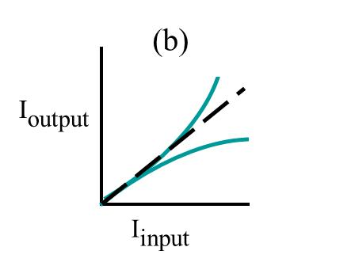
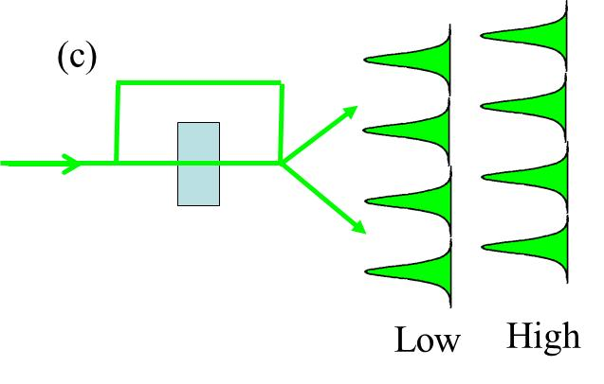
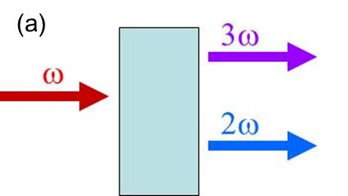
Examples of Nonlinear Optics
Examples of behavior associated with nonlinear optics
Harmonic generation
Intensity dependent
transmission
Nonlinear Interferometry
Soliton generation and modulation instability
Increasing input intensity

Slide 5
Classical Expansion of the Nonlinear Polarization
The second order polarization is created at time t and position by two separate
interactions of the total EM field with the medium at time and position , and at time and
position in a material in which χ⁽²⁾≠0. This form includes nonlocality in space and time.

Slide 6
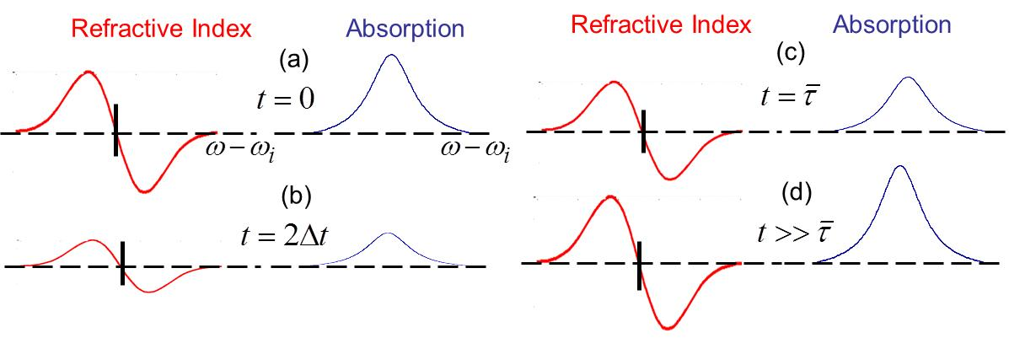
Frequency Spectrum Due to Non-Instantaneous Response
e.g. 2 level system, excited state with lifetime ; excited with pulse Δt<<
Before incidence of pulse
After passage of pulse
Evolution of frequency spectrum with time

Slide 7
Polarization Expansion: Nonlinearity Localized in Space
Summation over all of the input frequencies present
Note that all possible combinations of ω₁+ω₂ are needed!

Slide 8
Magnitudes of Nonlinear Susceptibilities
Depends on the number of electrons in an atom (or molecule), distribution of
energy levels etc.
Consider hydrogen atom with one electron
will give a minimum value
analytical solutions known for energy, levels etc.
The atomic Coulomb field binding the electron to the proton in its lowest orbit is
Assume that the perturbation expansion for the nonlinear polarization is valid up to
E ≅0.1E_{atomic}

Slide 9
Simple Model: Electron on a Spring (1)
2 ways to calculate the nonlinear susceptibilities
Electron as an anharmonic oscillator –
resonance frequencies are given by energy
difference between ground and excited
states
simple but approximate
Quantum mechanics – electric dipole
transitions between atomic (molecular )
energy levels
exact but complicated
Electron on a Spring Model
For 3D, need 3 springs with the spring displacements . The electron motion
is that of a simple harmonic oscillator along these directions. The directions are chosen
parallel to the axes which diagonalize the molecular polarizability tensor and hence .
This does not imply that the higher order susceptibilities are diagonalized along these axes!

Slide 10
Field Induced Electron Displacement
Simple Harmonic Oscillator Potential
The spring constant is given in terms of
the resonance frequencies by .
The decay of the spring motion (lifetime of excited state) means that there is damping of the
SHO and the driven SHO equation, with the electron charge, is given by
Inertial force
Spring restoring force
Electromagnetic driving force

Slide 11
Linear Susceptibility

Slide 12
Local Field Effects (1)
Maxwell’s equations in the material and the usual boundary conditions at the interface are
valid for spatial averages of the fields over volume elements small on the scale of a wavelength,
but large on the scale of a molecule. The “averaged” quantities also include the refractive index,
the Poynting vector, and the so-called Maxwell field which has been written here as . It
is the Maxwell field that satisfies the wave equation for a material with averaged refractive
index n.
At the site of a molecule the situation can be quite complex since the dipoles induced by the
Maxwell electric fields on all the molecules create their own electric fields which must be
added to the “averaged” field to get the total (“local”) field acting on a molecule.
It is very difficult to calculate the “local” field accurately because it depends on crystal
symmetry, intermolecular interactions, etc. Standard treatments like Lorenz-Lorenz are only
approximately valid even for isotropic and cubic crystal media.

Slide 13
Local Field Effects (2)
Dipole moments of the molecules induced by the Maxwell field produce a Maxwell
polarization in the material. Consider a spherical cavity around the molecule of interest to
find the local field acting on the molecule. Assuming that the effects of the induced dipoles
inside the cavity average to zero, the polarization field outside the cavity induces charges
on the walls of the cavity which produce an additional electric field on the molecule in the
cavity.
+
+
+
+
+
+
+
-
+
+
-
+
-
+
-
-
-
-
-
-
-
-

Slide 14
Linear Susceptibility with Local Field Effects

