Slide 1
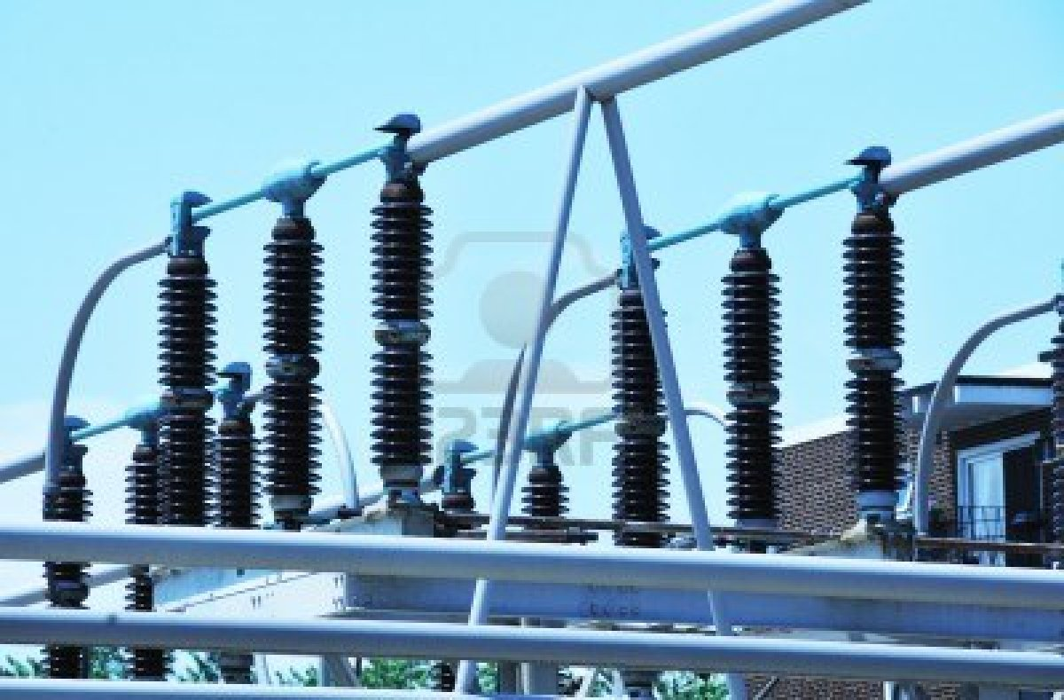
Transformers
By :
Bandar Al-Anazi
Amer Al-Khaldi

Slide 2
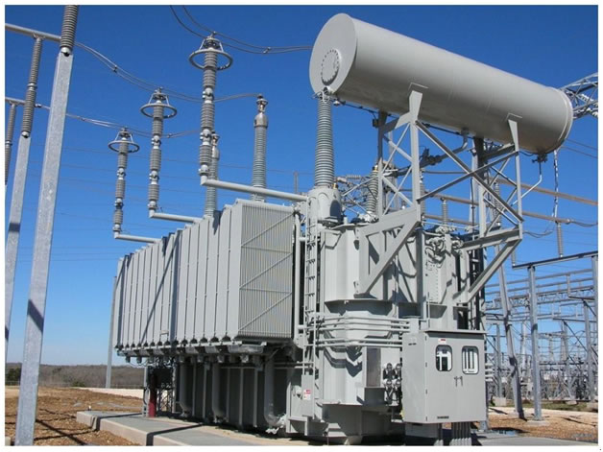
Outline
History
Definition
Manufacturing
How do they work?
Application
Conclusion

Slide 3
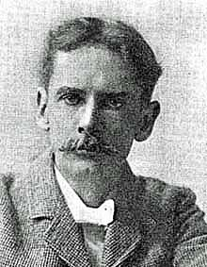
History
The Discovery of the induction property (1830 s)
More development of the property
1885 William Stanley first practical design
1886 first demonstration of a full AC
power distribution system using step up
and step down transformers.
Figure (1):
William Stanley

Slide 4
The First Trasnformer in 1885
Figure (2)

Slide 5
Deifinition
Figure (3)

Slide 6
Manufacturing
Figure (4)

Slide 7
How does it Work ?
Figure(5)
Notes:
http://www.youtube.com/watch?v=xfhuettfnE4

Slide 8
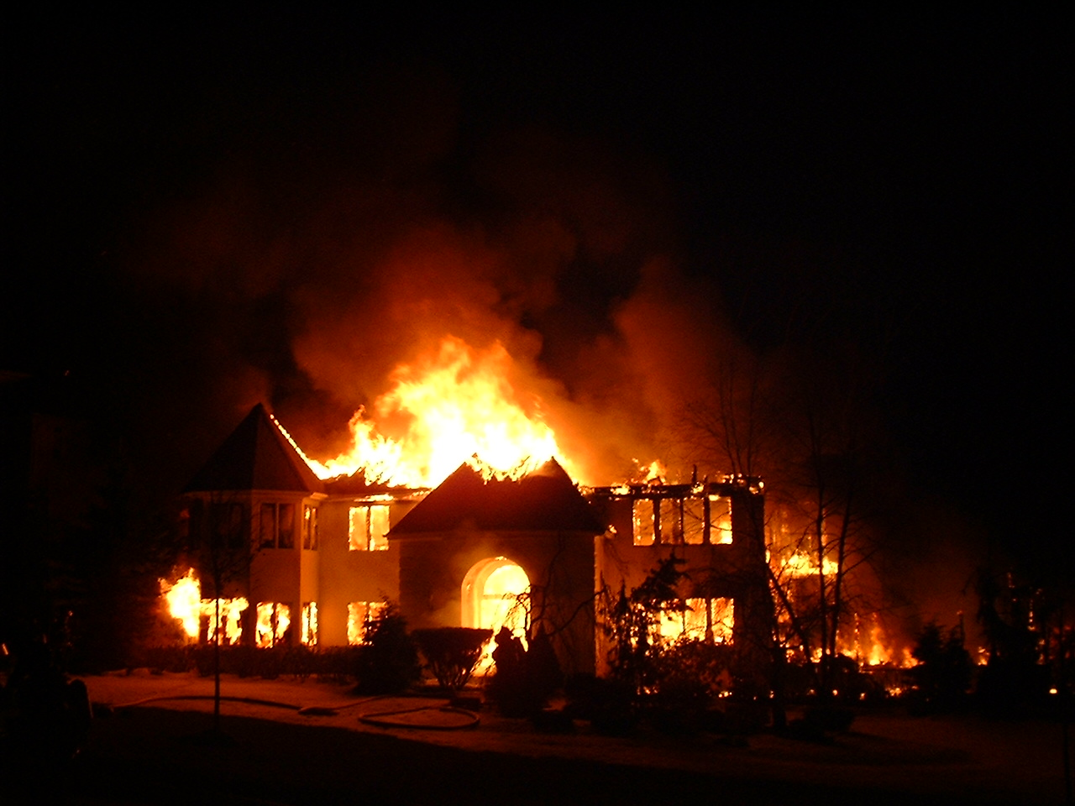
Voltage-Current Relationships
Figure (6)

Slide 9
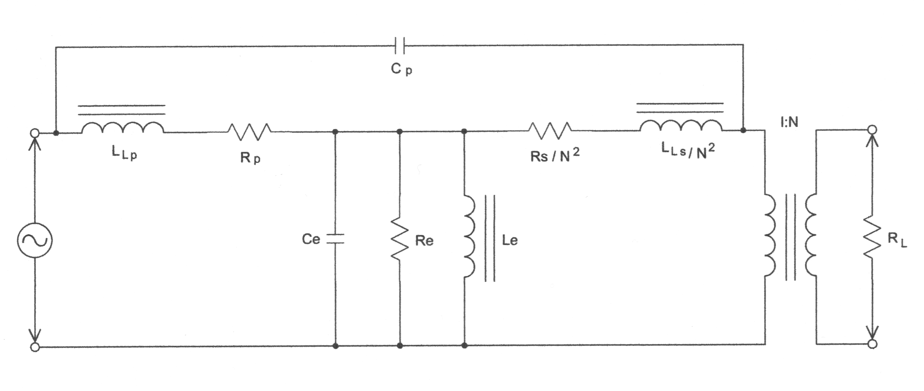
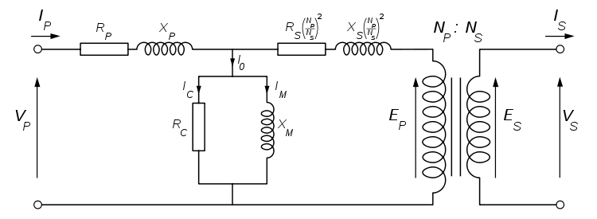
Figure (10)
Figure (11)

Slide 10
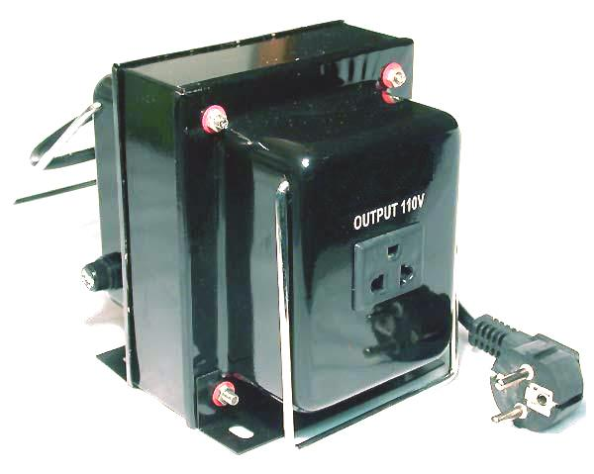
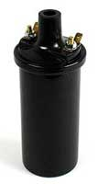
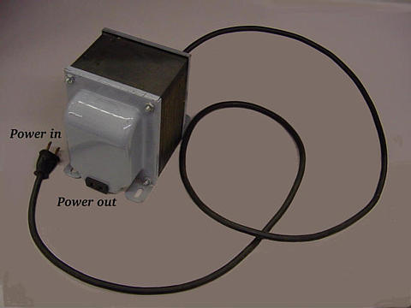
Types of Transformers
Step Down transformer
Step Up transformer
Isolation transformer
Figure (7)
Figure (8)
Figure (9)

Slide 11
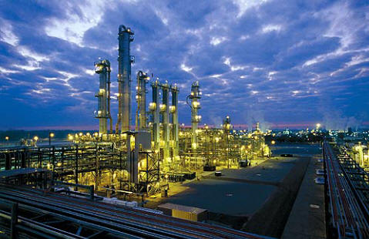
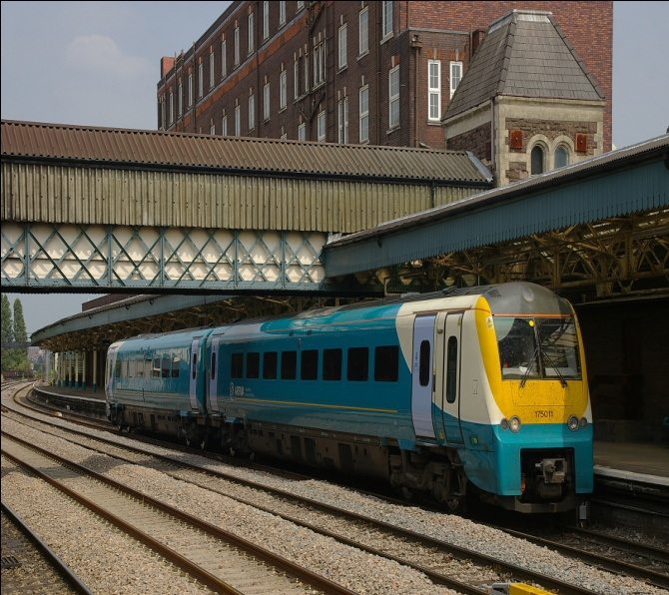
Applications
Industrial plants with high explosion risks
Many buildings (houses , hospitals , Stations …. Etc)
Railway network power supply stations

Slide 12
Conclusion
What is a Transformer ?
What are the types of the transformers ?
applications of transformers ?

Slide 13
References
1 :http://home.frognet.net/~ejcov/stanley10.html
2 :http://edisontechcenter.org/Transformers.html
3 :http://www.ndt-ed.org
4 :http://www.tpub.com/neets/book2/5b.htm
5 :http://allmaths.blogspot.com/2011_08_10_archive.html
6 :http://en.wikipedia.org/wiki/Transformer
7 :http://www.110220volts.com/1000-WATT.html
8 :http://www.oneillvintageford.co.uk/acatalog/Coil_Model_A.html
9 :http://www.allaboutcircuits.com/vol_2/chpt_9/3.html
10: http://www.magnelab.com/info/Transformer-Equivalent-Circuit
11 :http://en.wikipedia.org/wiki/Transformer

Slide 14
The End
Thank you for your time

