Slide 1










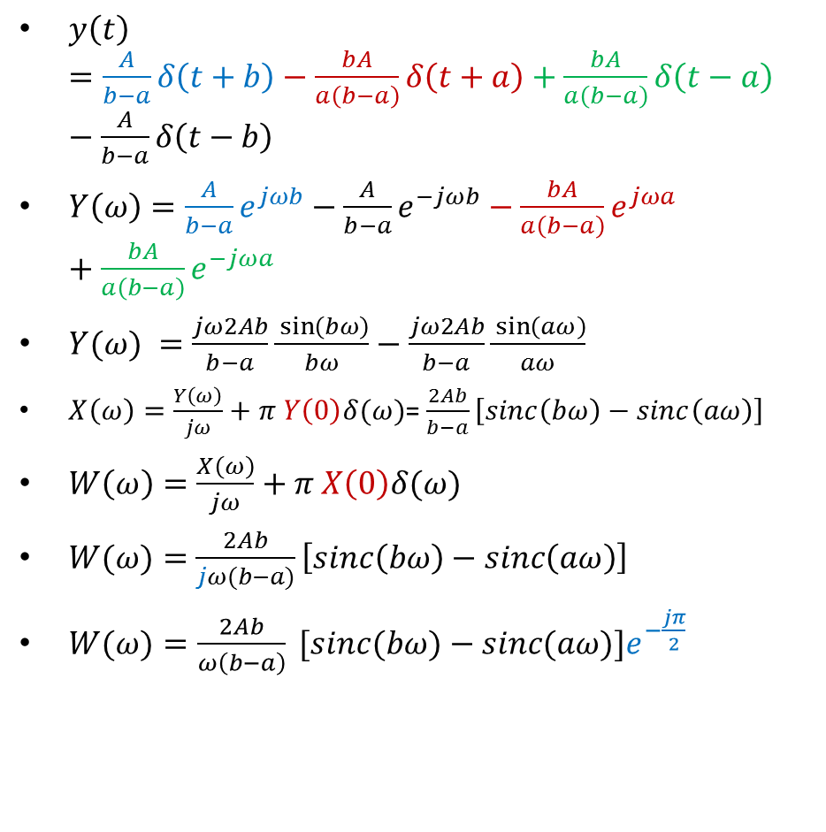


















Example I: F.T. Integration Property
$$w(t)$$
$$A$$
$$\frac{A}{b−a}$$
$$\frac{−A}{a}$$
$$a$$
$$b$$
$$t$$
$$−b$$
$$−a$$
$y\left(t\right)=\frac{A}{b−a}δ\left(t+b\right)−\frac{bA}{a\left(b−a\right)}δ\left(t+a\right)+\frac{bA}{a\left(b−a\right)}δ\left(t−a\right)−\frac{A}{b−a}δ\left(t−b\right)$
$Y\left(ω\right)=\frac{A}{b−a}e^{jωb}−\frac{A}{b−a}e^{−jωb}−\frac{bA}{a\left(b−a\right)}e^{jωa}+\frac{bA}{a\left(b−a\right)}e^{−jωa}$
$Y(ω) =\frac{jω2Ab}{b−a}\frac{\sin\left(bω\right)}{bω}−\frac{jω2Ab}{b−a}\frac{\sin\left(aω\right)}{aω}$
$X\left(ω\right)=\frac{Y\left(ω\right)}{jω}+π Y\left(0\right)δ(ω)$= $\frac{2Ab}{b−a}\left[sinc\left(bω\right)−sinc\left(aω\right)\right]$
$W\left(ω\right)=\frac{X\left(ω\right)}{jω}+π X\left(0\right)δ(ω)$
$W(ω)=$ $\frac{2Ab}{jω(b−a)}\left[sinc\left(bω\right)−sinc\left(aω\right)\right]$
$W(ω)=\frac{2Ab}{ω\left(b−a\right)} [sinc(bω)−sinc(aω)]e^{−\frac{jπ}{2}}$
$$−A$$
$$x(t)$$
$$\frac{A}{b−a}$$
$$a$$
$$t$$
$$−b$$
$$−a$$
$$b$$
$$\frac{−A}{a}$$
$$y(t)$$
$$\frac{A}{(b−a)}$$
$$\frac{bA}{a(b−a)}$$
$$−a$$
$$b$$
$$t$$
$$−b$$
$$a$$
$$\frac{−bA}{a(b−a)}$$
$$\frac{−A}{(b−a)}$$

Slide 2
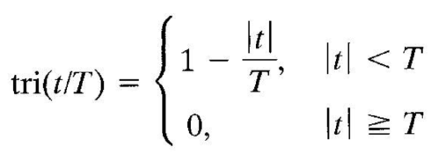
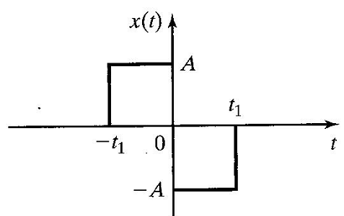
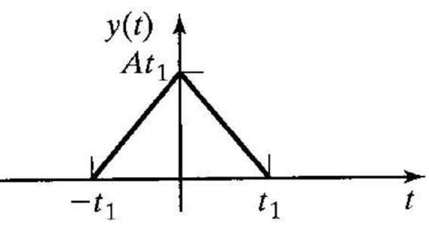
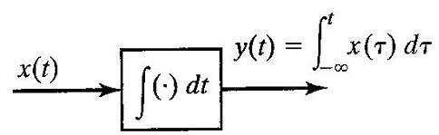
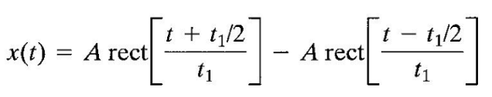
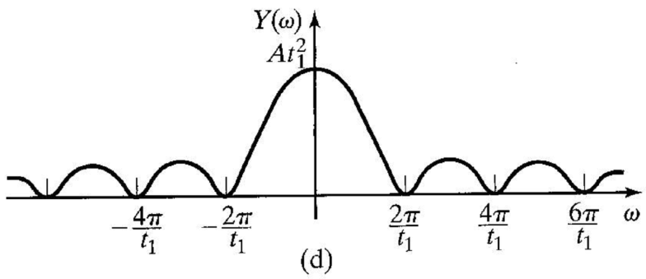

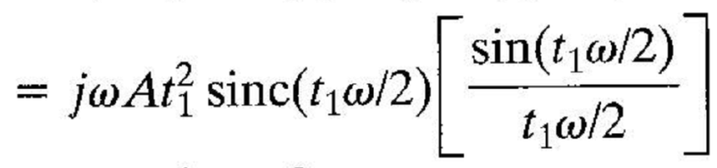
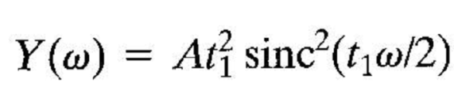

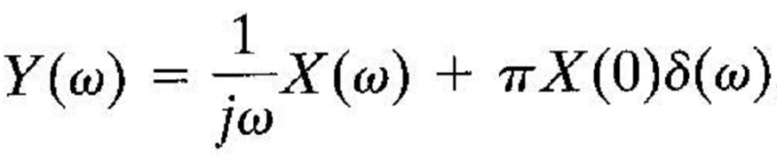
Example II: F.T. Integration Property

Slide 3
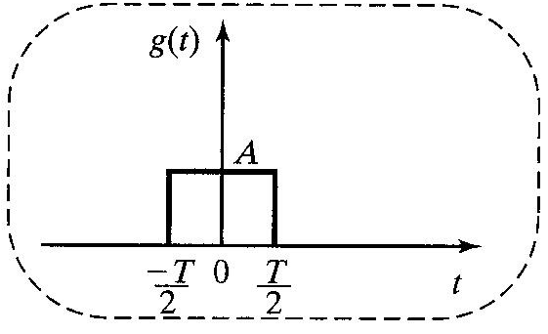
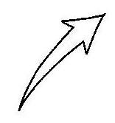
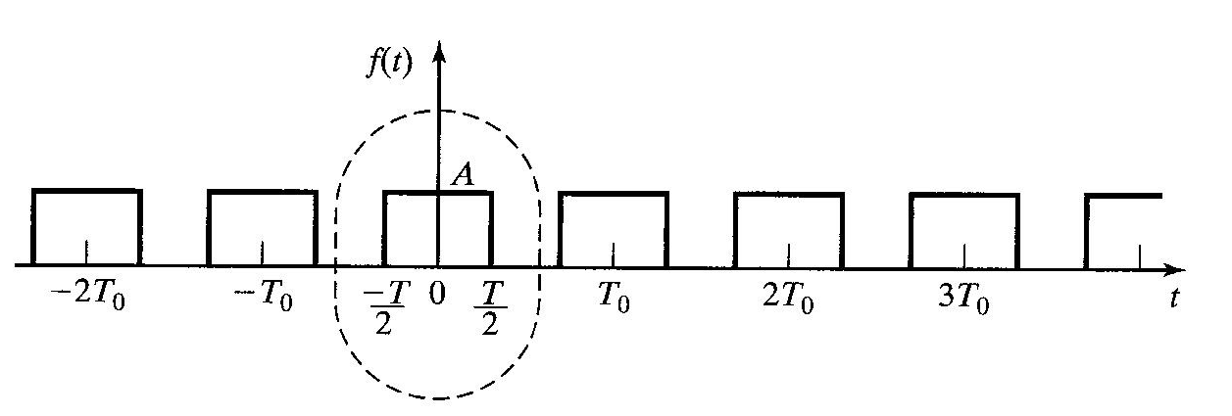
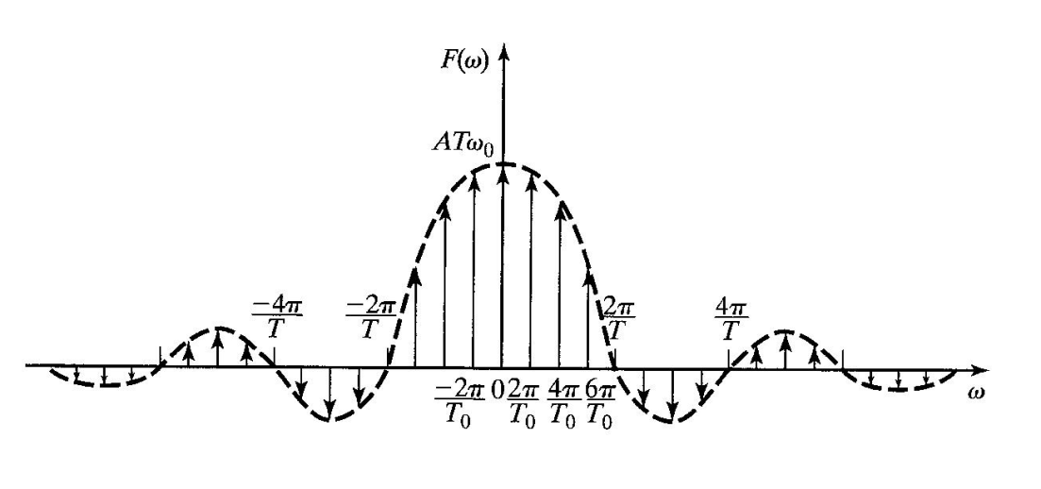

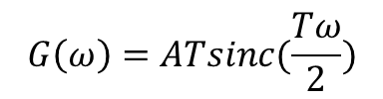

Example: The F.T. of a periodic signal
$$g\left(t\right)=Arect(\frac{t}{T})$$
$$G\left(ω\right)=ATsinc(\frac{Tω}{2})$$
$$F\left(ω\right)=\sum_{n=−∞}^{∞}{ω_{0}G\left(nω_{0}\right)δ(ω−nω_{0})}$$
$$F(ω)=\sum_{n=−∞}^{∞}{{ATω}_{0}sinc\left(\frac{nω_{0}T}{2}\right)δ(ω−nω_{0})}$$
The frequency spectra of periodic signals are made up of discrete frequency components in the form of impulses occurring at integer multiples (harmonics) of the fundamental frequency of the signal.
The weight of each impulse is found by multiplying the F.T of the generating function, evaluated at that harmonic frequency, by the fundamental frequency of the periodic signal.

