Slide 1
Applications of the Fourier Transform
Dr. Ali Muqaibel
EE207

Slide 2
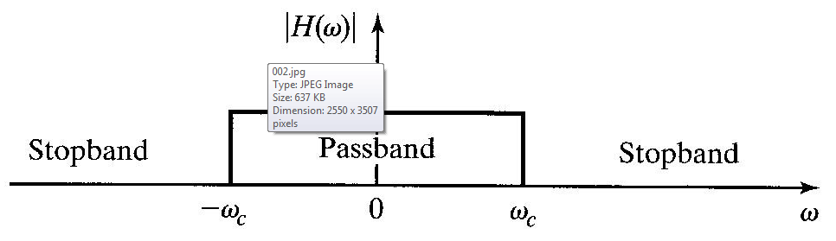
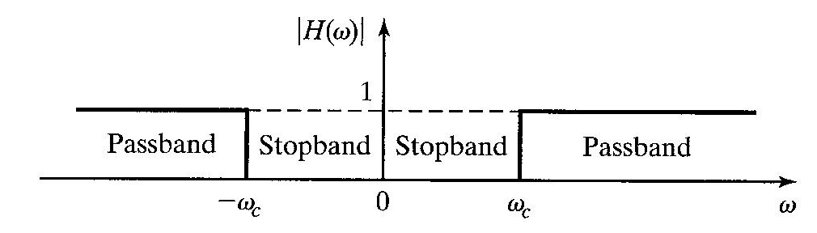
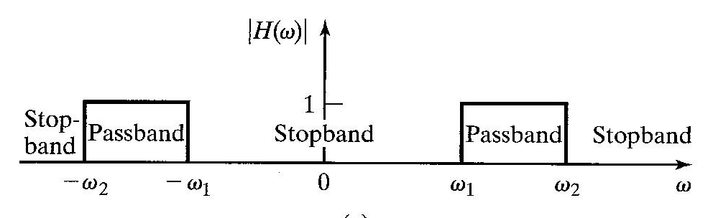
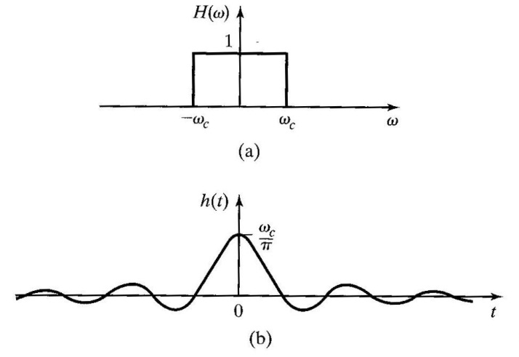
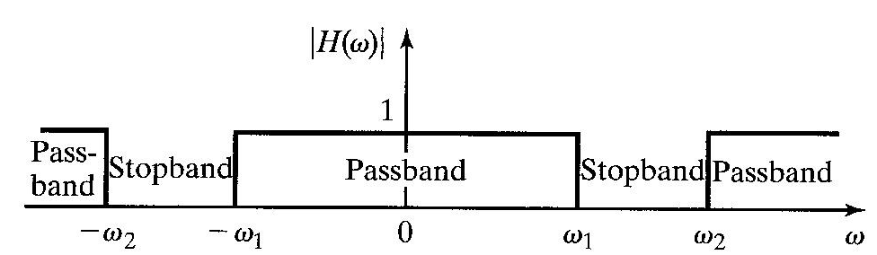
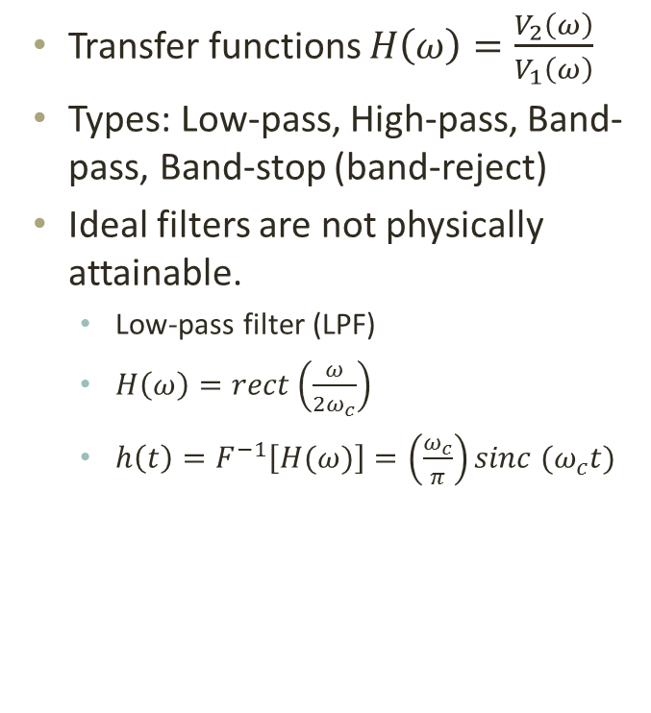
Ideal Filters
Transfer functions $H\left(ω\right)=\frac{V_{2}\left(ω\right)}{V_{1}\left(ω\right)}$
Types: Low-pass, High-pass, Band-pass, Band-stop (band-reject)
Ideal filters are not physically attainable.
  Low-pass filter (LPF)
  $H\left(ω\right)=rect\left(\frac{ω}{2ω_{c}}\right)$
  $h\left(t\right)=F^{−1}\left[H(ω)\right]=\left(\frac{ω_{c}}{π}\right)sinc (ω_{c}t)$
Non-causal

Slide 3
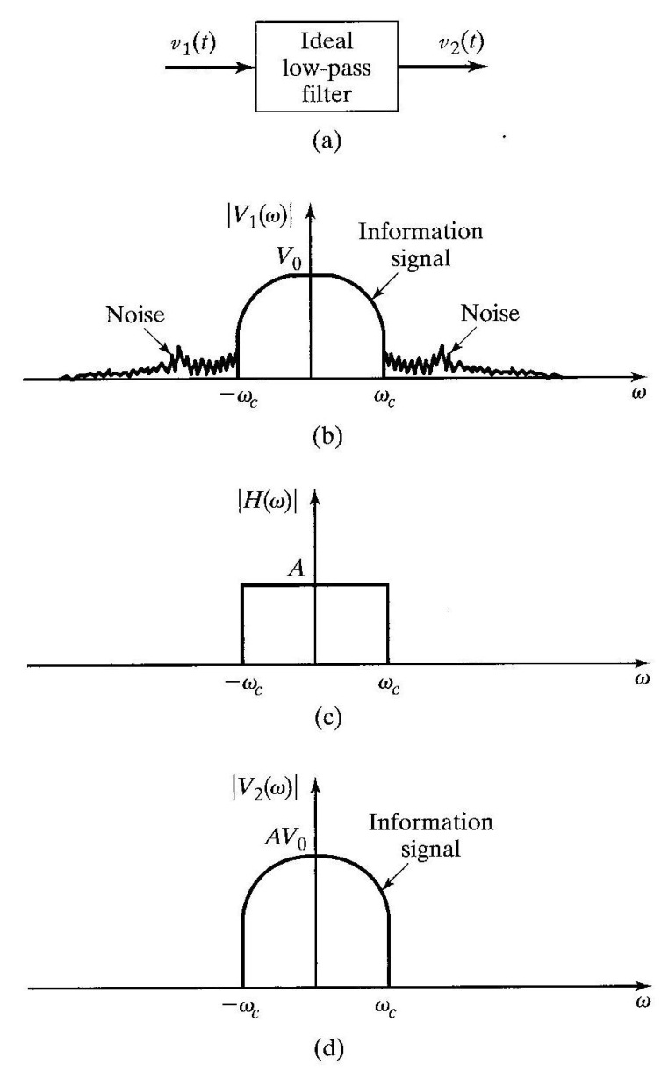
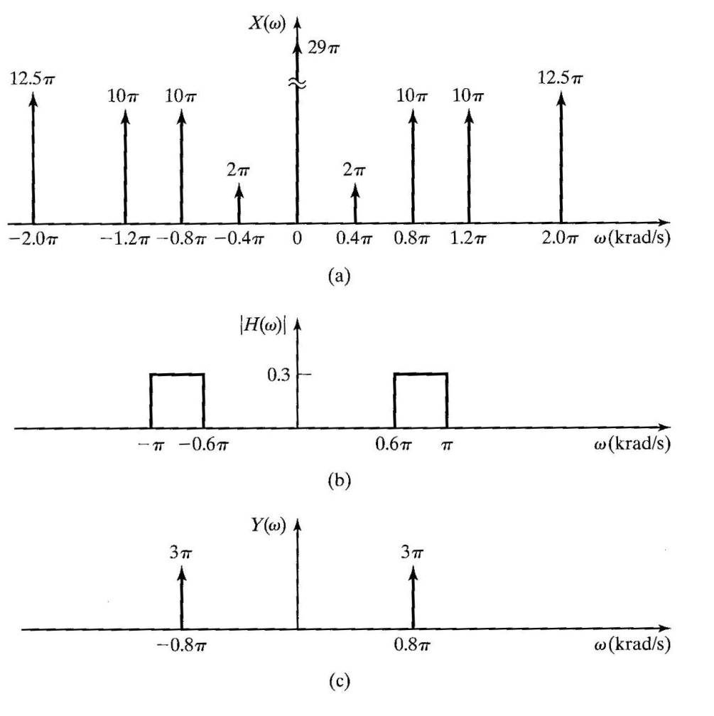
Example: Ideal Filters
Ideal band-pass filter
Ideal LPF to eliminate noise

Slide 4
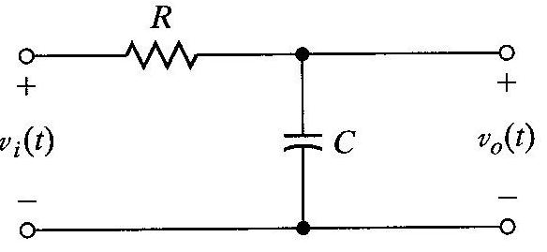
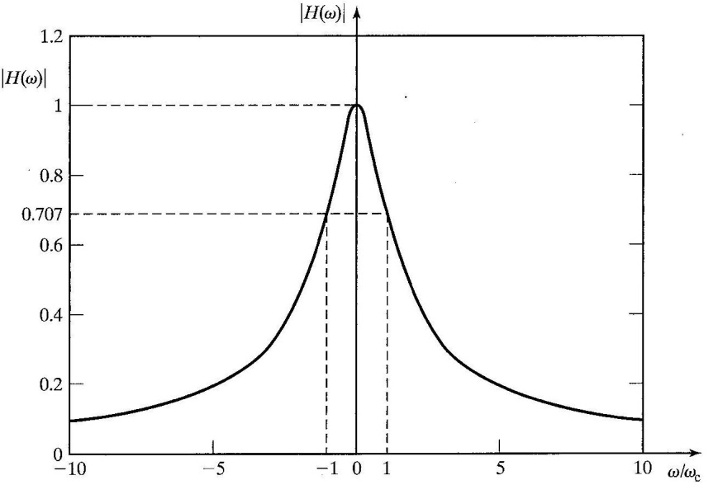
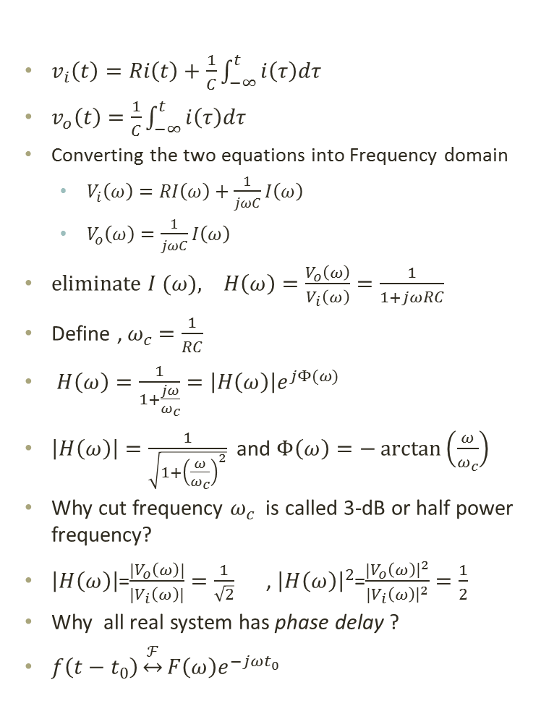
RC Low-Pass Filter
By KVL in the two loops
$v_{i}\left(t\right)=Ri\left(t\right)+\frac{1}{C}\int_{−∞}^{t}{i\left(τ\right)dτ}$
$v_{o}\left(t\right)=\frac{1}{C}\int_{−∞}^{t}{i\left(τ\right)dτ}$
Converting the two equations into Frequency domain
  $V_{i}\left(ω\right)=RI\left(ω\right)+\frac{1}{jωC}I\left(ω\right)$
  $V_{o}\left(ω\right)=\frac{1}{jωC}I\left(ω\right)$
eliminate $I (ω), H\left(ω\right)=\frac{V_{o}\left(ω\right)}{V_{i}\left(ω\right)}=\frac{1}{1+jωRC}$
Define , $ω_{c}=\frac{1}{RC}$
$H\left(ω\right)=\frac{1}{1+\frac{jω}{ω_{c}}}=\left|H\left(ω\right)\right|e^{jΦ(ω)}$
$\left|H\left(ω\right)\right|=\frac{1}{\sqrt{1+{\left(\frac{ω}{ω_{c}}\right)}^{2}}}$ and $Φ\left(ω\right)=−\arctan\left(\frac{ω}{ω_{c}}\right)$
Why cut frequency $ω_{c}$ is called 3-dB or half power frequency?
$\left|H\left(ω\right)\right|$=$\frac{{|V}_{o}\left(ω\right)|}{{|V}_{i}\left(ω\right)|}=\frac{1}{\sqrt{2}}$ , ${\left|H\left(ω\right)\right|}^{2}$=$\frac{{|V}_{o}\left(ω\right){\left.​\right|}^{2}}{{|V}_{i}\left(ω\right){\left.​\right|}^{2}}=\frac{1}{2}$
Why all real system has phase delay ?
$f\left(t−t_{0}\right)\underset{↔}{ℱ}F\left(ω\right)e^{−jωt_{0}}$

