Slide 1
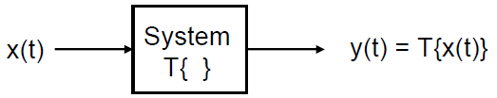
T[ ]
Output Function y(t)
Input Function x(t)

Slide 2
Consider The following Input/Output relations

Slide 3
In general we can represent the simple relation between
the input and output as:
T[ ]
y(t) = T[ x(t) ]
Were T[ ] is an operator that map the function x(t) to another function y(t) .( Function to Function mapping)

Slide 4
Example
Let the operator
Differential Operator
Let the input x(t) = 2sin(4πt) then the output y(t) be
Function 2sin(4πt)
Function 8cos(4πt)
mapped

Slide 5
Input
Input
Output

Slide 6
The operator or relation T can be defined as
- Linear / Non linear
- Time Invariant / Time Variant
- Continuous-Time / Discrete-Time
- Causal / Non Causal

Slide 7

Representation of a general system
y(t) = T[x(t)]
where the notation T[x(t)] indicates a transformation or mapping
This notation T[.] does not indicate a function
that is, T[x(t)] is not a mathematical function into which we substitute
x(t) and directly calculate y(t).
The explicit set of equations relating the input x(t) and the output y(t) is called the mathematical model, or simply, the model, of the system

Slide 8






Slide 9





Slide 10

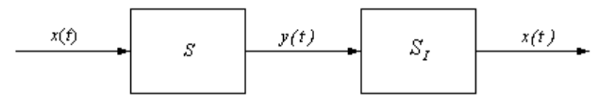
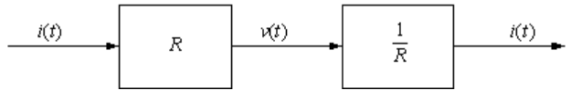

Slide 11



Slide 12



Slide 13


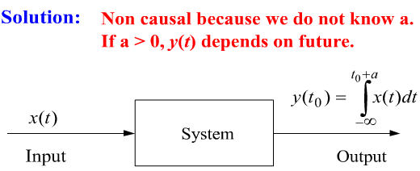

Slide 14

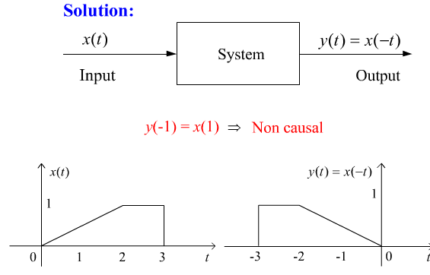

Slide 15

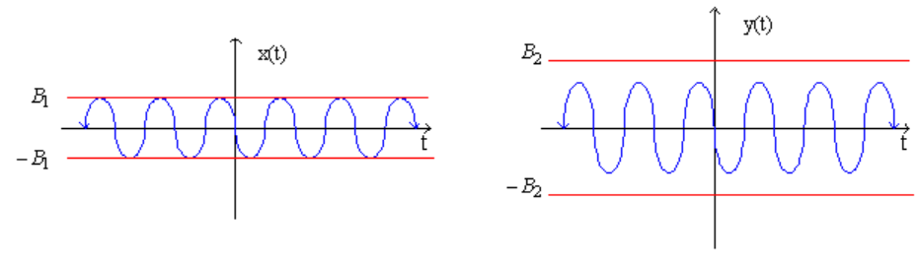

Slide 16



Slide 17




Slide 18


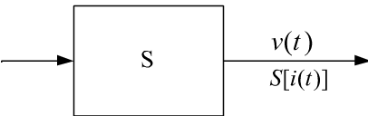
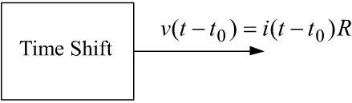
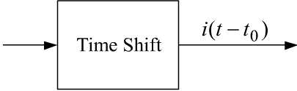
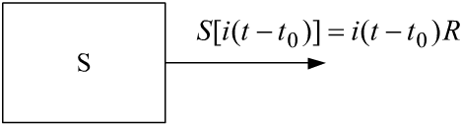

Slide 19

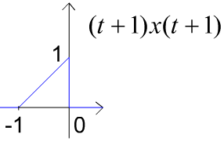
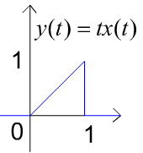
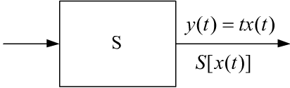
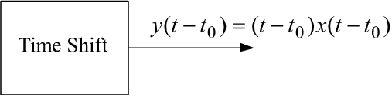
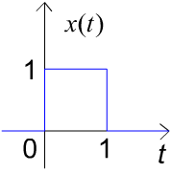
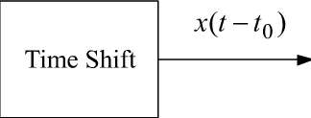
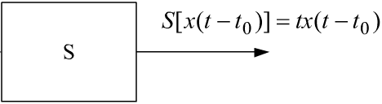
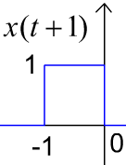
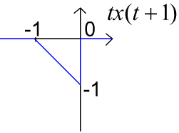

Slide 20
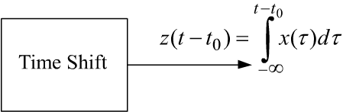
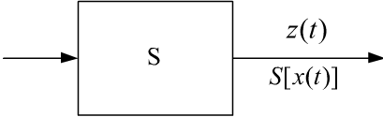
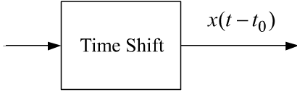
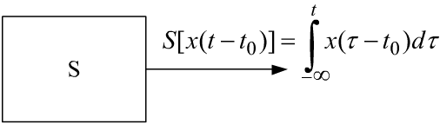

Slide 21
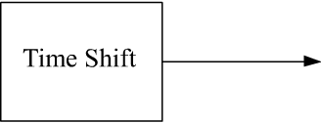
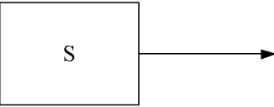

Slide 22

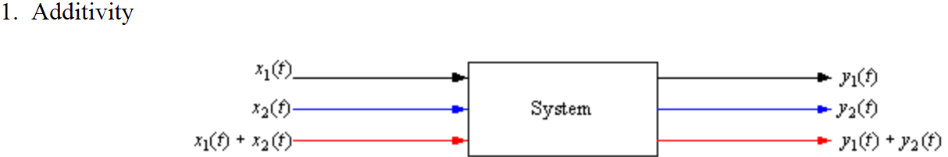
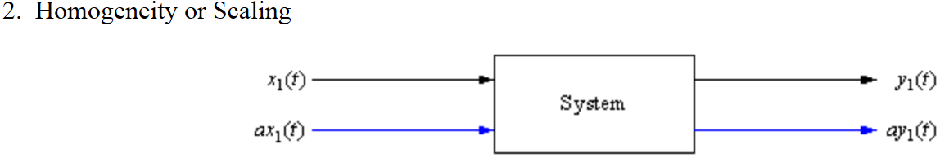

Slide 23







Slide 24


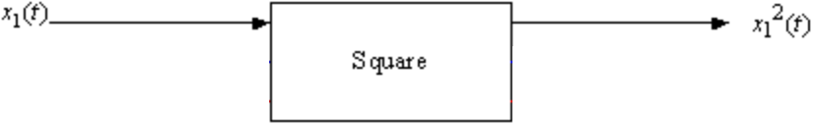





Slide 25
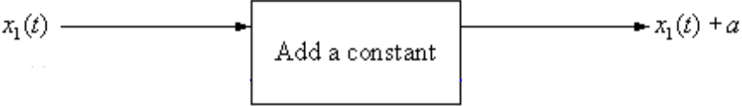



Slide 26


Slide 27








Slide 28
Linear –Time Invariant
constant with respect to t
Integration with respect to λ
Operator with respect to t

Slide 29

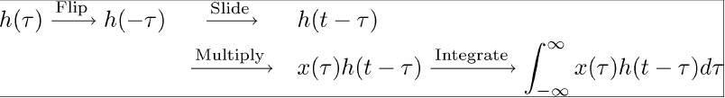

Slide 30
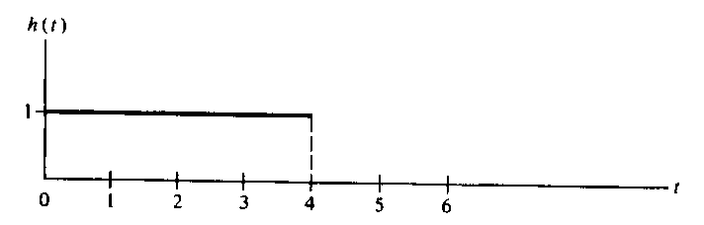
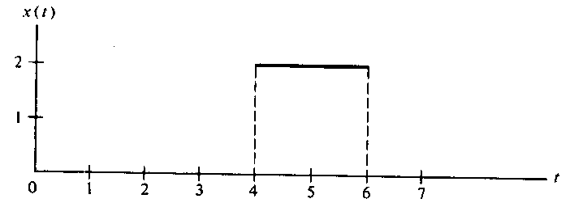
Example 2-7
Moving
Fix

Slide 31
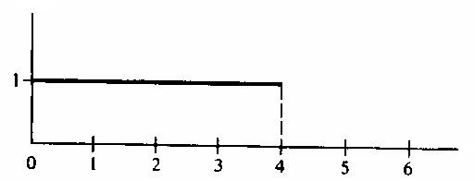
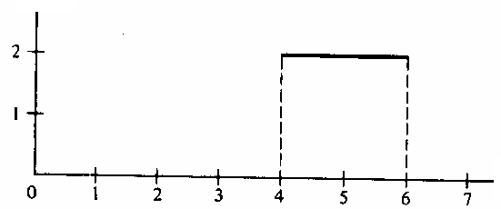
Sep 1 : make the functions or signals in terms of the variable λ

Slide 32
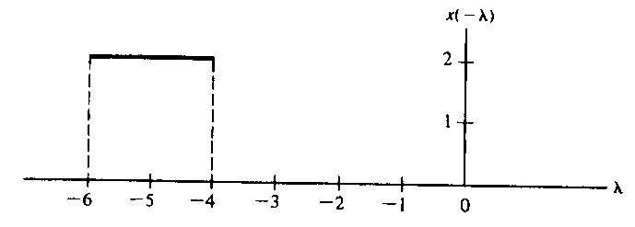
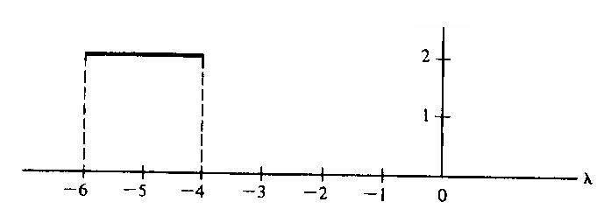
Sep 2 : make the moving function in terms of −λ
Sep 2 : add t to to form ( t− λ)
Moving to the right

Slide 33

For t ≤ 4 there is no overlapping between the functions

Slide 34
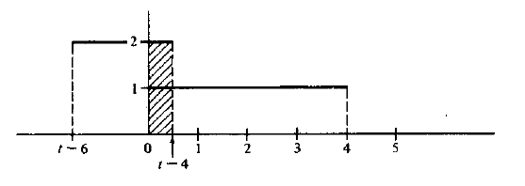

Slide 35
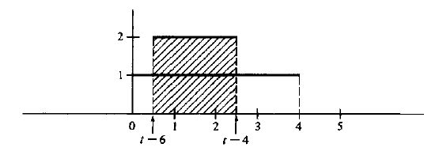


Slide 36
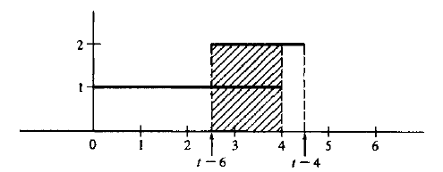


Slide 37
For t ≥ 10
For t ≥ 10 there is no overlapping between the functions

Slide 38
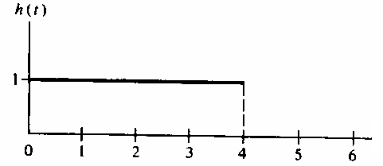

Slide 39



Slide 40





Slide 41
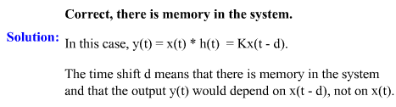

Slide 42


Slide 43
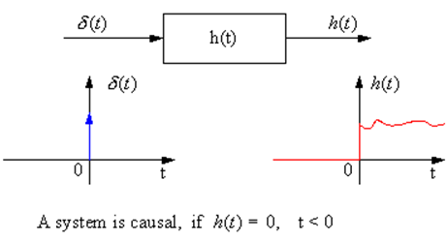

Slide 44

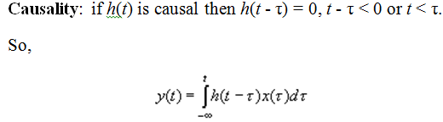

Slide 45
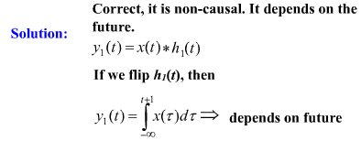
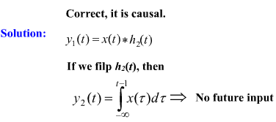

Slide 46










Slide 47



Slide 48




Slide 49





Slide 50
Chapter 3 The Fourier Series
The average of x(t)

Slide 51

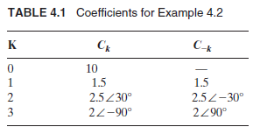

Slide 52
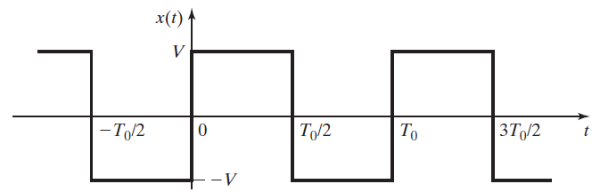







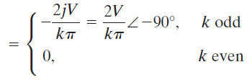


Slide 53
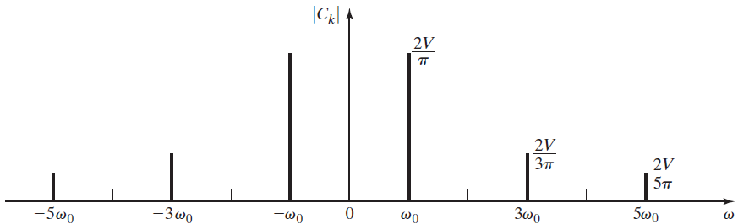
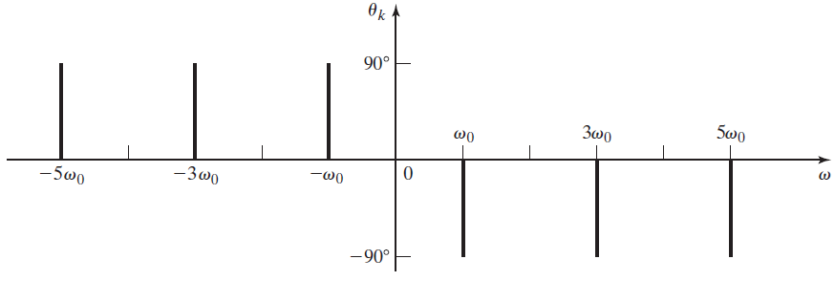

Slide 54





Slide 55




Slide 56





Slide 57
Fourier Transform Pairs

Slide 58

Finding the Fourier Transform

Slide 59


Slide 60

Example Find the Fourier Transform for the following function

Slide 61


Slide 62


Slide 63
Example

Slide 65


Slide 66
Properties of the Fourier Transform
1-Linearity

Slide 67





Slide 68
2-Time-Scaling (compressing or expanding)
Let
Then

Slide 69


Slide 70
3-Time-Shifting

Slide 71
Example Find the Fourier Transform of the pulse function
Solution
From previous Example

Slide 73
5-Duality ازدواجية

Slide 74
Step 1 from Known transform from the F.T Table
Step 2

Slide 75
6- The convolution Theorem
The multiplication Theorem

Slide 76
Find the Fourier Transform of following
Solution
Since

Slide 77
System Analysis with Fourier Transform

Slide 78
7-Differentiation
7- Integration

Slide 79











Slide 80










Slide 81











Slide 82
Find the Transfer Function for the following RC circuit
Method 1
we can find h(t) by solving differential equation as follows

Slide 83
Method 2
We will find h(t) using Fourier Transform Method rather than solving differential equation as follows

Slide 84
From Table 4-2

Slide 85
Method 3
Fourier Transform

Slide 86
Fourier Transform

Slide 87



Slide 88
Example
Find y(t) if the input x(t) is
Method 1 ( convolution method)
Using the time domain ( convolution method , Chapter 3)

Slide 89
Method 2 Fourier Transform
Sine Y(ω) is not on the Fourier Transform Table 5-2
Using partial fraction expansion (will be shown later)
From Table 5-2

Slide 90


