Slide 1
Transformations of Continuous-Time Signals
Continuous time signal:
Time is a continuous variable
The signal itself need not be continuous.
Time Reversal

Slide 2
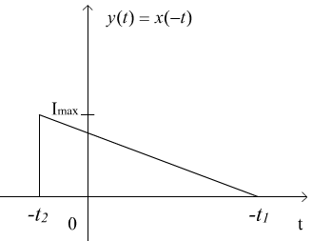
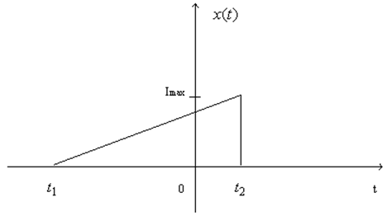
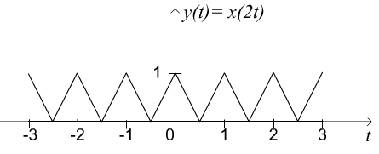
Time Reversal
compressing
Expanding

Slide 3
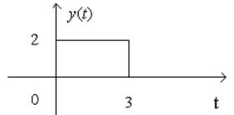
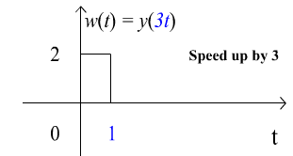
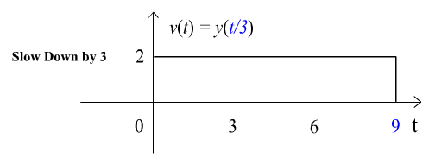

Slide 4
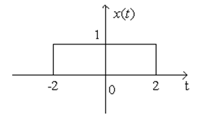
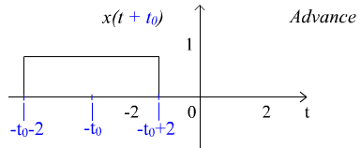
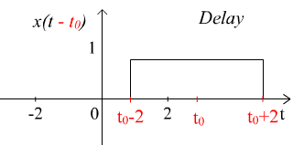

Slide 5
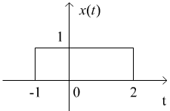
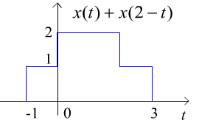
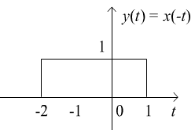
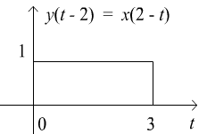
Let

Slide 6
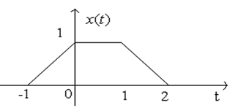
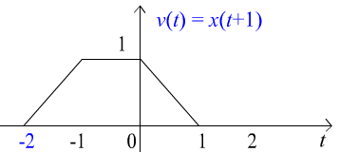
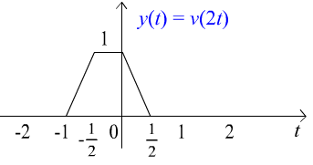
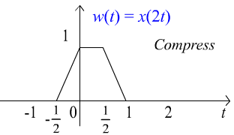
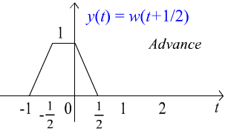

Slide 7
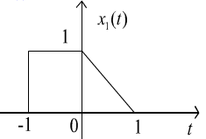
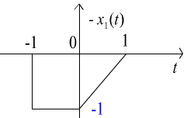
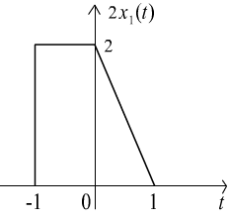
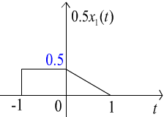

Slide 8
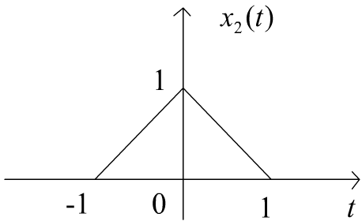
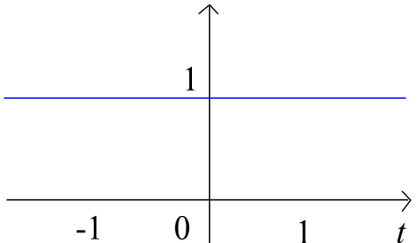
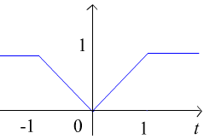

Slide 9
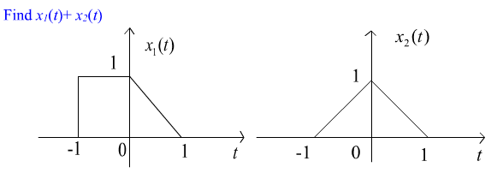
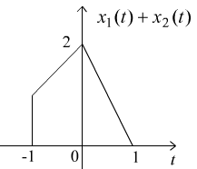

Slide 10
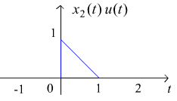

Slide 11
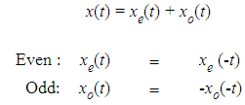
2.2

Slide 12
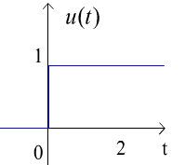
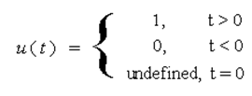
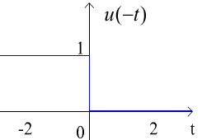
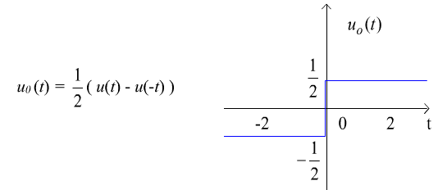

Slide 13
Periodic Functions
X(t) is periodic if given t and T, is there some period T > 0 such that

Slide 15
The common frequencies

Slide 16
You can show that the period T₀ of x(t) is (1/3) as follows
Since
Similarly

Slide 17
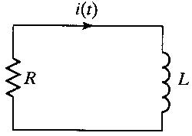
2.3 Common Signals in Engineering
RL
i(0) is the initial current
RC
In general
Exponential function

Slide 18
Exponential Signals
x(t =( C e^{at} C and a can be complex
Exponential Signals appear in the solution of many physical systems
Chapter 7 in EE 202 RL and RC
Chapter 9 in 202 Sinusoidal steady state
Sinusoidal ?
What that’s to do with the exponential ?
Euler’s identity

Slide 19
Chapter 7 in EE 201 RL and RC

Slide 20
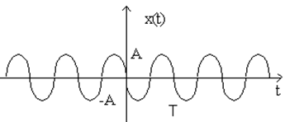

Slide 21
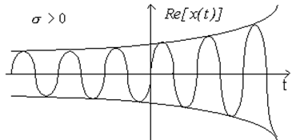
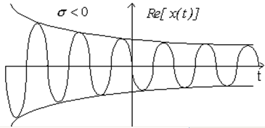
(The most general case)

Slide 22
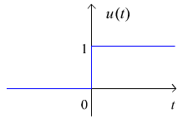
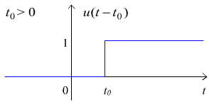
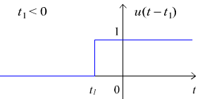
2.4

Slide 23
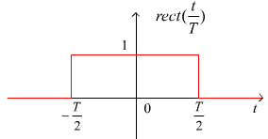
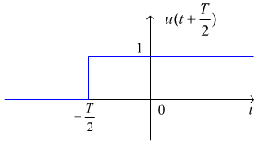
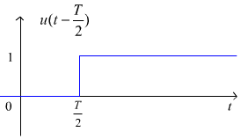
Block function (window) defined as

Slide 24
The unit step function has the property
(1)
(2)

Slide 25
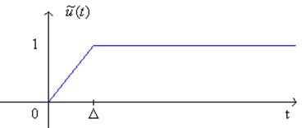
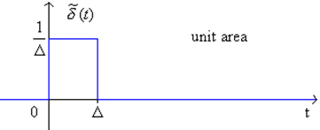
The Unit Impulse Function
let's look at a signal
What is its derivative?
Define it as:

Slide 27
Properties of Delta Function
( I )

Slide 28
( II )
Exercise

Slide 30
( II )
This property is known as “convolution” which will be useful in chapter 3

Slide 32
Step Function
Ramp Function

Slide 33
Unit Step Function
Integration
Unit Ramp Function

Slide 34
Time Shift

Slide 36
Time folding

Slide 39
Pulse Function

Slide 40
Chang of Scale
Consider the pulse function Π(t)

Slide 42
In general

Slide 43
We want to express or decompose this function to singularities functions
First we cancel the uprising ramp after t =2 with subtracting downward ramp
Which will result in horizontal line segment
However what we need is a downward ramp
Therefore we need to subtract another ramp

Slide 44
However the downward ramp will continue indefinitely
Therefore we need to cancel this part of downward ramp
To cancel this part of downward ramp
We add an upward ramp at t = 4

Slide 46
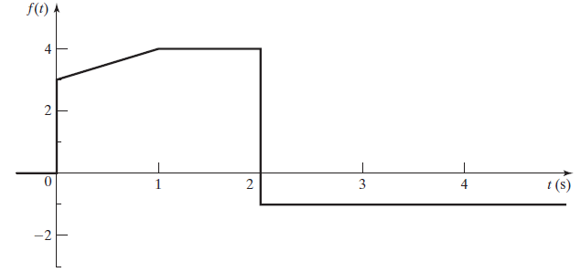

Slide 47
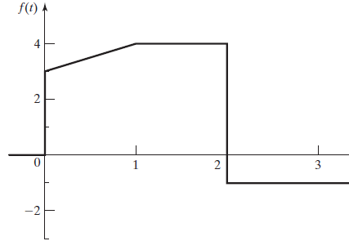

Slide 48
Input
Output
The relations between cause and effect (Input/output) are expressed as equations

Slide 49
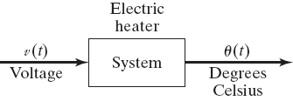
Input
Output
Examples
Electric Heater
Car
Speed
paddle
Speed

Slide 50
A another example of a physical system is a voltage amplifier such as that used
in public-address systems
amplifier
block diagram

Slide 51
Representation of a general system
y(t) = T[x(t)]
where the notation T[x(t)] indicates a transformation or mapping
This notation T[.] does not indicate a function
that is, T[x(t)] is not a mathematical function into which we substitute
x(t) and directly calculate y(t).
The explicit set of equations relating the input x(t) and the output y(t) is called the mathematical model, or simply, the model, of the system

Slide 52
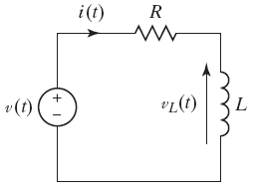

Slide 58
