Slide 1
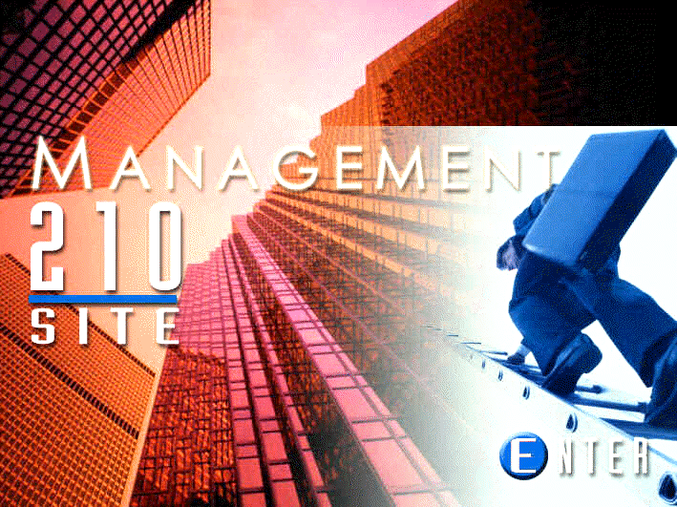
Course Information

Slide 2
Office Hours:
Sunday & Tuesday, 12:30pm to 1:30pm
Monday & Wednesday, 11:15am to 12:15pm Office #110-2
Syllabus, Homework, all course information: See the Blackboard.
Questions? Can be answered on the Blackboard 24 hours/7days.
Changing Sections? Not Allowed, unless official from chairman.

Slide 3
faculty.kfupm.edu.sa/dcc/ejoyner
www.

Slide 4
You Will Learn:
Theory of Communication and the Communication Model with its parts
    In-depth analysis and learning of the parts of the model and how to use them
Speaking Skills – Oral presentations, meeting skills
Writing Skills – Business short reports, memos, and visuals.
Other Skills – Non-verbal, cross-cultural communication, bad news, job interviews, improve your life

Slide 5

MODEL OF COMMUNICATION
Encode
Decode
Message Channel
Sender Receiver
Environment
NOTE: Barriers can happen here as a result of “Filter of the Mind” and “Monolith of Misunderstanding.”

Slide 6
Communication Barriers Cause Problems for Sender and Receiver
Encode
Decode
Message Channel
Sender Receiver
NOTE: Barriers can happen here as a result of “Filter of the Mind” and “Monolith of Misunderstanding.”

Slide 7
Sender
Facts, numbers, data, information
?
Mountain of Misunderstanding
Receiver

Slide 8
Sender
Education, Perception, Intelligence, Upbringing, Culture, Status, Skills, Personality, Interests, Likes/Dislikes, Religion, Judgment of Right and Wrong . . .
Barrier to Effective Communication
Is
FILTER
of the
MIND
?
Mountain of Misunderstanding
Receiver

Slide 9
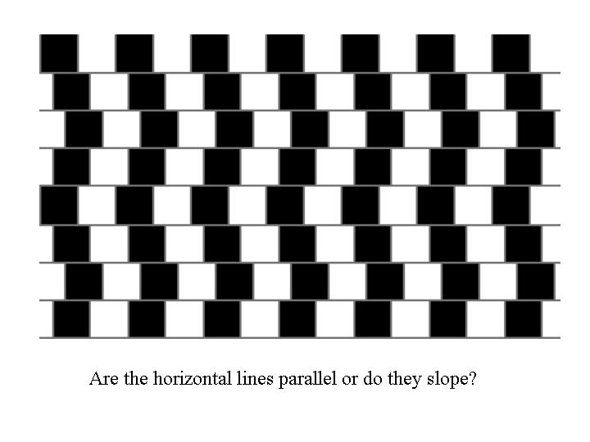

Slide 10
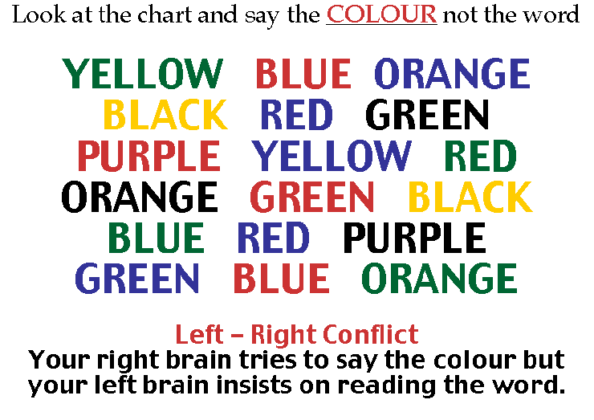
Say the colors that you see here below.

Slide 11
Did you READ the letters of the word and say the word?
Or, did you see the COLOR of the letters and say that instead?
This is Perception. The way you see, hear and understand things differently from others.

Slide 12
So, what can we do about Barriers to Communication such as the Mountain of Misunderstanding and Filter of the Mind?
First, Understand the 3 Barriers
Next, Analyze the Function of our Brain
Then, Learn about the 3 Characteristics and 4 Steps to an Effective Message
ان شاء الله Next Class

