Slide 1
Memory Hierarchy and Caches
COE 233
Logic Design and Computer Organization
Dr. Muhamed Mudawar
King Fahd University of Petroleum and Minerals

Slide 2
Presentation Outline
Memory Hierarchy and the need for Cache Memory
The Basics of Caches
Cache Performance and Memory Stall Cycles

Slide 3
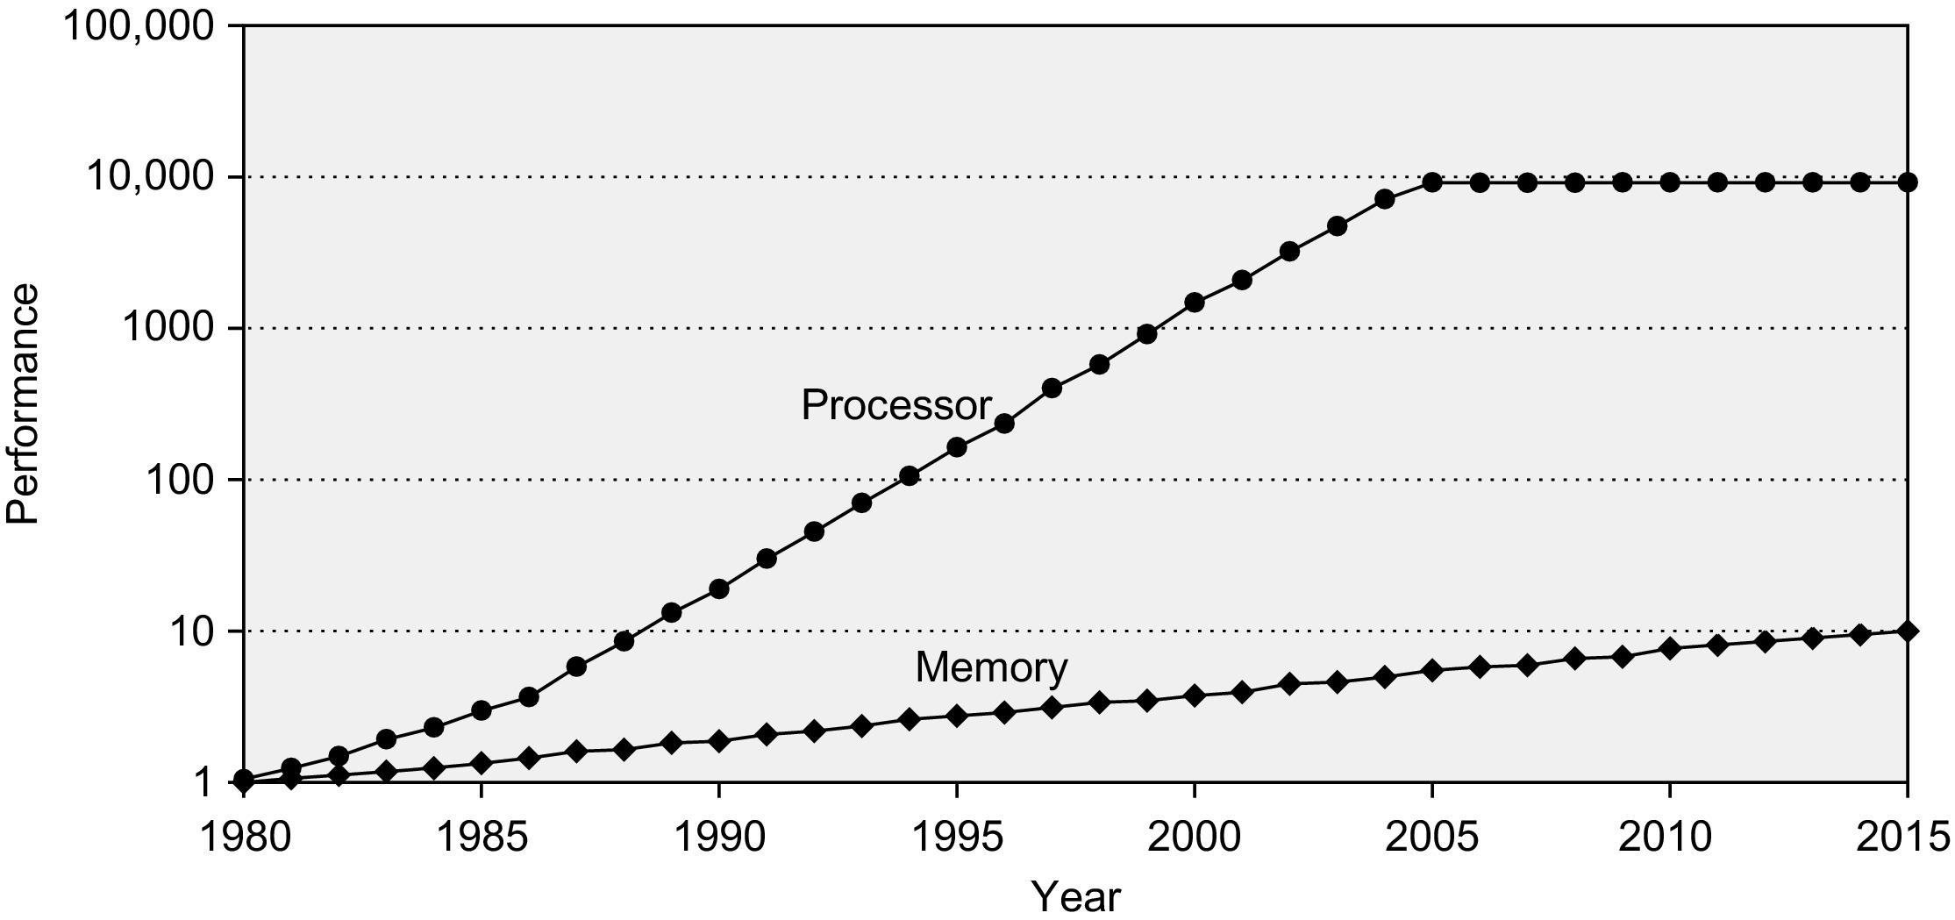
Processor-Memory Performance Gap
CPU Performance 55% per year
CPU Performance
Slowing down after 2004
Performance Gap
DRAM: 7% per year
1980 – No caches in microprocessor
1995 – Two-level caches in microprocessor

Slide 4
The Need for Cache Memory
Widening speed gap between CPU and main memory
  Processor operation takes less than 1 ns
  Main memory requires more than 50 ns to access
Each instruction involves at least one memory access
  One memory access to fetch the instruction
  A second memory access for load and store instructions
Memory bandwidth limits the instruction execution rate
Cache memory can help bridge the CPU-memory gap
Cache memory is small in size but fast

Slide 5
Typical Memory Hierarchy
Registers are at the top of the hierarchy
  Typical size < 1 KB
  Access time < 0.5 ns
Level 1 Cache (8 – 64 KiB)
  Access time: 1 ns
L2 Cache (1 MiB – 8 MiB)
  Access time: 3 – 10 ns
Main Memory (8 – 32 GiB)
  Access time: 40 – 50 ns
Disk Storage (> 200 GB)
  Access time: 5 – 10 ms
Microprocessor
Registers
L1 Cache
L2 Cache
Faster
Memory Bus
Bigger
Main Memory
I/O Bus
Magnetic or Flash Disk

Slide 6
Principle of Locality of Reference
Programs access small portion of their address space
  At any time, only a small set of instructions & data is needed
Temporal Locality (in time)
  If an item is accessed, probably it will be accessed again soon
  Same loop instructions are fetched each iteration
  Same procedure may be called and executed many times
Spatial Locality (in space)
  Tendency to access contiguous instructions/data in memory
  Sequential execution of Instructions
  Traversing arrays element by element

Slide 7
What is a Cache Memory ?
Small and fast (SRAM) memory technology
  Stores the subset of instructions & data currently being accessed
Used to reduce average access time to memory
Caches exploit temporal locality by …
  Keeping recently accessed data closer to the processor
Caches exploit spatial locality by …
  Moving blocks consisting of multiple contiguous words
Goal is to achieve
  Fast speed of cache memory access
  Balance the cost of the memory system

Slide 8
Cache Memories in the Datapath
Imm16
Ext
Imm
ALU result
32
I-Cache
0
A
32
1
D-Cache
Instruction
Rs
5
BusA
2
A
L
U
R
0
Data
RA
3
Address
0
Instruction
Rt
Register File
5
RB
BusB
0
B
Data_out
32
PC
Address
1
1
1
D
1
2
RW
BusW
2
0
Data_in
3
32
0
32
Rd2
Rd3
Rd4
Rd
1
clk
Instruction Block
I-Cache miss or D-Cache miss causes pipeline to stall
Block Address
D-Cache miss
Data Block
I-Cache miss
Block Address
Interface to L2 Cache or Main Memory

Slide 9
Next . . .
Memory Hierarchy and the need for Cache Memory
The Basics of Caches
Cache Performance and Memory Stall Cycles

Slide 10
Four Basic Questions on Caches
Q1: Where can a block be placed in a cache?
  Block placement
  Direct Mapped, Set Associative, Fully Associative
Q2: How is a block found in a cache?
  Block identification
  Block address, tag, index
Q3: Which block should be replaced on a cache miss?
  Block replacement
  FIFO, Random, LRU
Q4: What happens on a write?
  Write strategy
  Write Back or Write Through cache (with Write Buffer)

Slide 11
Inside a Cache Memory
Processor
Address
Cache
Memory
Address
Main
Memory
Data
Data
Tags identify
blocks in
the cache
Address Tag 0
Cache Block 0
Address Tag 1
Cache Block 1
N Cache Blocks
. . .
. . .
Tag N – 1
Cache Block N – 1
Cache Block (or Cache Line)
  Unit of data transfer between main memory and a cache
  Large block size ➔ Less tag overhead + Burst transfer from DRAM
  Typically, cache block size = 64 bytes in recent caches

Slide 12
Block Placement: Direct Mapped
Block: unit of data transfer between cache and memory
Direct Mapped Cache:
  A block can be placed in exactly one location in the cache
000
001
010
011
100
101
110
111
In this example:
Cache index =
least significant 3 bits of Block address
Cache
Main
Memory
00000
00001
00010
00011
00100
00101
00110
00111
01000
01001
01010
01011
01100
01101
01110
01111
10000
10001
10010
10011
10100
10101
10110
10111
11000
11001
11010
11011
11100
11101
11110
11111

Slide 13
Direct-Mapped Cache
A memory address is divided into
  Block address: identifies block in memory
  Block offset: to access bytes within a block
A block address is further divided into
  Index: used for direct cache access
  Tag: most-significant bits of block address
  Index = Block Address mod Cache Blocks
Tag must be stored also inside cache
  For block identification
A valid bit is also required to indicate
  Whether a cache block is valid or not
Block Address
Tag
Index
offset
V
Tag
Block Data
=
Data
Hit

Slide 14
Direct Mapped Cache – cont’d
Cache hit: block is stored inside cache
  Index is used to access cache block
  Address tag is compared against stored tag
  If equal and cache block is valid then hit
  Otherwise: cache miss
If number of cache blocks is 2^{n}
  n bits are used for the cache index
If number of bytes in a block is 2^{b}
  b bits are used for the block offset
If 32 bits are used for an address
  32 – n – b bits are used for the tag
Cache data size = 2^{n+b} bytes
Block Address
Tag
Index
offset
V
Tag
Block Data
=
Data
Hit

Slide 15
Mapping an Address to a Cache Block
Example
  Consider a direct-mapped cache with 256 blocks
  Block size = 16 bytes
  Compute tag, index, and byte offset of address: 0x01FFF8AC
Solution
  32-bit address is divided into:
    4-bit byte offset field, because block size = 2⁴ = 16 bytes
    8-bit cache index, because there are 2⁸ = 256 blocks in cache
    20-bit tag field
  Byte offset = 0xC = 12 (least significant 4 bits of address)
  Cache index = 0x8A = 138 (next lower 8 bits of address)
  Tag = 0x01FFF (upper 20 bits of address)
Block Address
20
8
4
Tag
Index
offset

Slide 16
Example on Cache Placement & Misses
Consider a small direct-mapped cache with 32 blocks
  Cache is initially empty, Block size = 16 bytes
  The following memory addresses (in decimal) are referenced:
  1000, 1004, 1008, 2548, 2552, 2556.
  Map addresses to cache blocks and indicate whether hit or miss
Solution:
  1000 = 0x3E8 cache index = 0x1E Miss (first access)
  1004 = 0x3EC cache index = 0x1E Hit
  1008 = 0x3F0 cache index = 0x1F Miss (first access)
  2548 = 0x9F4 cache index = 0x1F Miss (different tag)
  2552 = 0x9F8 cache index = 0x1F Hit
  2556 = 0x9FC cache index = 0x1F Hit
23
5
4
Tag
Index
offset

Slide 17
Fully Associative Cache
A block can be placed anywhere in cache ⇒ no indexing
If m blocks exist then
  m comparators are needed to match tag
  Cache data size = m × 2^{b} bytes
Address
Tag
offset
V
Tag
Block Data
V
Tag
Block Data
V
Tag
Block Data
V
Tag
Block Data
=
=
=
=
mux
m-way associative
Hit
Data

Slide 18
Set-Associative Cache
A set is a group of blocks that can be indexed
A block is first mapped onto a set
  Set index = Block address mod Number of sets in cache
If there are m blocks in a set (m-way set associative) then
  m tags are checked in parallel using m comparators
If 2^{n} sets exist then set index consists of n bits
Cache data size = m × 2^{n+b} bytes (with 2^{b} bytes per block)
  Without counting tags and valid bits
A direct-mapped cache has one block per set (m = 1)
A fully-associative cache has one set (2^{n} = 1 or n = 0)

Slide 19
Set-Associative Cache Diagram
Address
Tag
Index
offset
V
Tag
Block Data
V
Tag
Block Data
V
Tag
Block Data
V
Tag
Block Data
=
=
=
=
m-way set-associative
Hit
mux
Data

Slide 20
Write Policy
Write Through:
  Writes update cache and lower-level memory
  Cache control bit: only a Valid bit is needed
  Memory always has latest data, which simplifies data coherency
  Can always discard cached data when a block is replaced
Write Back:
  Writes update cache only
  Cache control bits: Valid and Modified bits are required
  Modified cached data is written back to memory when replaced
  Multiple writes to a cache block require only one write to memory
  Uses less memory bandwidth than write-through and less power
  However, more complex to implement than write through

Slide 21
What Happens on a Cache Miss?
Cache sends a miss signal to stall the processor
Decide which cache block to allocate/replace
  One choice only when the cache is directly mapped
  Multiple choices for set-associative or fully-associative cache
Transfer the block from lower level memory to this cache
  Set the valid bit and the tag field from the upper address bits
If block to be replaced is modified then write it back
  Modified block is written back to memory
  Otherwise, block to be replaced can be simply discarded
Restart the instruction that caused the cache miss
Miss Penalty: clock cycles to process a cache miss

Slide 22
Replacement Policy
Which block to be replaced on a cache miss?
No selection alternatives for direct-mapped caches
m blocks per set to choose from for associative caches
Random replacement
  Candidate blocks are randomly selected
  One counter for all sets (0 to m – 1): incremented on every cycle
  On a cache miss replace block specified by counter
First In First Out (FIFO) replacement
  Replace oldest block in set
  One counter per set (0 to m – 1): specifies oldest block to replace
  Counter is incremented on a cache miss

Slide 23
Replacement Policy – cont’d
Least Recently Used (LRU)
  Replace block that has been unused for the longest time
  Order blocks within a set from least to most recently used
  Update ordering of blocks on each cache hit
  With m blocks per set, there are m! possible permutations
Pure LRU is too costly to implement when m > 2
  m = 2, there are 2 permutations only (a single bit is needed)
  m = 4, there are 4! = 24 possible permutations
  LRU approximation is used in practice
For large m > 4,
Random replacement can be as effective as LRU

Slide 24
Next . . .
Memory Hierarchy and the need for Cache Memory
The Basics of Caches
Cache Performance and Memory Stall Cycles

Slide 25
Hit Rate and Miss Rate
Hit Rate = Hits / (Hits + Misses)
Miss Rate = Misses / (Hits + Misses)
I-Cache Miss Rate = Miss rate in the Instruction Cache
D-Cache Miss Rate = Miss rate in the Data Cache
Example:
  Out of 1000 instructions fetched, 150 missed in the I-Cache
  25% are load-store instructions, 50 missed in the D-Cache
  What are the I-cache and D-cache miss rates?
I-Cache Miss Rate = 150 / 1000 = 15%
D-Cache Miss Rate = 50 / (25% × 1000) = 50 / 250 = 20%

Slide 26
Memory Stall Cycles
The processor stalls on a Cache miss
  When fetching instructions from the Instruction Cache (I-cache)
  When loading or storing data into the Data Cache (D-cache)
Memory stall cycles = Combined Misses × Miss Penalty
Miss Penalty: clock cycles to process a cache miss
Combined Misses = I-Cache Misses + D-Cache Misses
I-Cache Misses = I-Count × I-Cache Miss Rate
D-Cache Misses = LS-Count × D-Cache Miss Rate
LS-Count (Load & Store) = I-Count × LS Frequency
Cache misses are often reported per thousand instructions

Slide 27
Memory Stall Cycles Per Instruction
Memory Stall Cycles Per Instruction =
Combined Misses Per Instruction × Miss Penalty
Miss Penalty is assumed equal for I-cache & D-cache
Miss Penalty is assumed equal for Load and Store
Combined Misses Per Instruction =
I-Cache Miss Rate + LS Frequency × D-Cache Miss Rate
Therefore, Memory Stall Cycles Per Instruction =
I-Cache Miss Rate × Miss Penalty +
LS Frequency × D-Cache Miss Rate × Miss Penalty

Slide 28
Example on Memory Stall Cycles
Consider a program with the given characteristics
  Instruction count (I-Count) = 10⁶ instructions
  30% of instructions are loads and stores
  D-cache miss rate is 5% and I-cache miss rate is 1%
  Miss penalty is 100 clock cycles for instruction and data caches
  Compute combined misses per instruction and memory stall cycles
Combined misses per instruction in I-Cache and D-Cache
  1% + 30% × 5% = 0.025 combined misses per instruction
  Equal to 25 misses per 1000 instructions
Memory stall cycles
  0.025 × 100 (miss penalty) = 2.5 stall cycles per instruction
  Total memory stall cycles = 10⁶ × 2.5 = 2,500,000

Slide 29
CPU Time with Memory Stall Cycles
CPU Time = I-Count × CPI_{MemoryStalls} × Clock Cycle
CPI_{MemoryStalls} = CPI_{PerfectCache} + Mem Stalls per Instruction
CPI_{PerfectCache} = CPI for ideal cache (no cache misses)
CPI_{MemoryStalls} = CPI in the presence of memory stalls
Memory stall cycles increase the CPI

Slide 30
Example on CPI with Memory Stalls
A processor has CPI of 1.5 without any memory stalls
  Cache miss rate is 2% for instruction and 5% for data
  20% of instructions are loads and stores
  Cache miss penalty is 100 clock cycles for I-cache and D-cache
What is the impact on the CPI?
Answer:
Mem Stalls per Instruction =
CPI_{MemoryStalls} =
CPI_{MemoryStalls} / CPI_{PerfectCache} =
Processor is 3 times slower due to memory stall cycles
Instruction
data
0.02×100 + 0.2×0.05×100 = 3
1.5 + 3 = 4.5 cycles per instruction
4.5 / 1.5 = 3

Slide 31
Average Memory Access Time
Average Memory Access Time (AMAT)
AMAT = Hit time + Combined Miss rate × Miss penalty
Hit Time = time to access the I-cache or D-cache (for a hit)
Hit time is assumed to be the same for I-cache and D-cache
Combined Miss Rate for Instruction Access and Data Access
Combined Miss Rate =
Memory Accesses per Instruction = 1 + %LS (%Load + %Store)
Miss penalty is assumed to be the same for I-cache and D-cache
Combined Misses per Instruction
Memory Accesses per Instruction

Slide 32
AMAT Example
Compute the overall average memory access time
  Hit time = 1 clock cycle in both I-Cache and D-Cache
  Miss penalty = 50 clock cycles for I-Cache and D-Cache
  I-Cache misses = 3.8 misses per 1000 instructions
  D-Cache misses = 41 misses per 1000 instructions
  25% of the instructions are load and store
Solution:
  Combined Misses per Instruction =
  Combined Miss rate (per access) =
  Overall AMAT =
(3.8 + 41) / 1000 = 0.0448
0.0448 / (1 + 0.25) = 0.03584
1 + 0.03584 × 50 = 2.792 cycles

Slide 33
Improving Cache Performance
Average Memory Access Time (AMAT)
AMAT = Hit time + Miss rate * Miss penalty
Used as a framework for optimizations
Reduce the Hit time
  Small and simple caches
Reduce the Miss Rate
  Larger cache size, higher associativity, and larger block size
Reduce the Miss Penalty
  Multilevel caches

Slide 34
Multilevel Caches
Top level cache is kept small to
  Reduce hit time
  Reduce energy per access
Add another cache level to
  Reduce the memory gap
  Reduce memory bus loading
Multilevel caches can help
  Reduce miss penalty
  Reduce average memory access time
Large L2 cache can capture many misses in L1 caches
  Reduce the global miss rate
Processor Core
Addr
Inst
Addr
Data
I-Cache
D-Cache
Addr
Block
Addr
Block
Unified L2 Cache
Addr
Block
Main Memory
For simplicity,
L3 cache is not shown

Slide 35
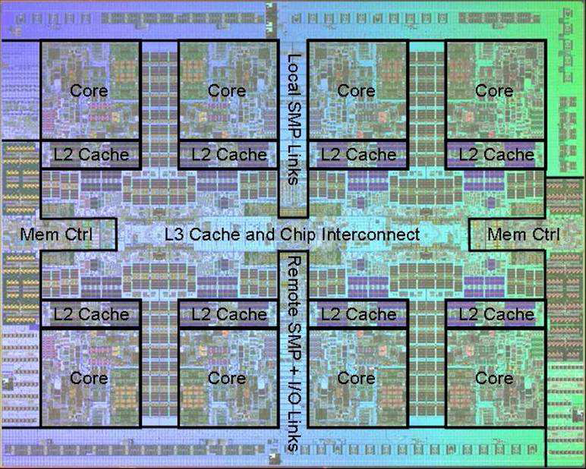
Power 7 On-Chip Caches [IBM 2010]
32KB I-Cache/core
32KB D-Cache/core
3-cycle latency
256KB Unified
L2 Cache/core
8-cycle latency
32MB Unified
Shared L3 Cache
Embedded DRAM
25-cycle latency
to local slice

