Slide 1
MIPS Architecture and Assembly Language
COE 233
Logic Design and Computer Organization
Dr. Muhamed Mudawar
King Fahd University of Petroleum and Minerals

Slide 2
Presentation Outline
Programmer's View of a Computer System
Assembly, Machine, and High-Level Languages
The MIPS Instruction Set Architecture
Introduction to Assembly Language Programming
Defining Data, Memory Alignment, and Byte Ordering
System Calls

Slide 3
Programmer’s View of a Computer System
Application Programs
High-Level Language
Increased level of abstraction
Level 5
Software
Assembly Language
Level 4
Operating System
Level 3
Interface SW & HW
Instruction Set
Architecture
Level 2
Microarchitecture
Level 1
Each level hides the details of the level below it
Hardware
Physical Design
Level 0

Slide 4
Programmer's View (cont'd)
Application Programs (Level 5)
  Written in high-level programming languages
  Such as Java, C++, Python, . . .
  Programs are compiled into assembly language level (Level 4)
Assembly Language (Level 4)
  Instruction mnemonics (symbols) are used
  Have one-to-one correspondence to machine language
  Calls functions written at the operating system level (Level 3)
  Programs are translated into machine language (Level 2)
Operating System (Level 3)
  Provides services to level 4 and 5 programs
  Translated to run at the machine instruction level (Level 2)

Slide 5
Programmer's View (cont'd)
Instruction Set Architecture (Level 2)
  Interface between software and hardware
  Specifies how a processor functions
  Machine instructions, registers, and memory are exposed
  Machine language is executed by Level 1 (microarchitecture)
Microarchitecture (Level 1)
  Controls the execution of machine instructions (Level 2)
  Implemented by digital logic
Physical Design (Level 0)
  Implements the microarchitecture at the transistor-level
  Physical layout of circuits on a chip

Slide 6
A Hierarchy of Languages
Application Programs
High-Level Languages
Machine independent
High-Level Language
Machine specific
Low-Level Language
Assembly Language
Machine Language
Hardware

Slide 7
What is Assembly Language?
Low-level programming language for a computer
One-to-one correspondence with the machine instructions
Assembly language is specific to a given processor
Assembler: converts assembly program into machine code
Assembly language uses:
  Mnemonics: to represent the names of low-level machine instructions
  Labels: to represent the names of variables or memory addresses
  Directives: to define data and constants
  Macros: to facilitate the inline expansion of text into other code

Slide 8
Translating Languages
Program (C Language):
swap(int v[], int k) {
int temp;
temp = v[k];
v[k] = v[k+1];
v[k+1] = temp;
}
A statement in a high-level language is translated typically into several machine-level instructions
Compiler
MIPS Assembly Language:
sll $2,$5, 2
add $2,$4,$2
lw $15,0($2)
lw $16,4($2)
sw $16,0($2)
sw $15,4($2)
jr $31
MIPS Machine Language:
00051080
00821020
8C620000
8CF20004
ACF20000
AC620004
03E00008
Assembler

Slide 9
Advantages of High-Level Languages
Program development is faster
  High-level statements: fewer instructions to code
Program maintenance is easier
  For the same above reasons
Programs are portable
  Contain few machine-dependent details
    Can be used with little or no modification on different machines
  Compiler translates to the target machine language
  However, Assembly language programs are not portable

Slide 10
Why Learn Assembly Language?
Many reasons:
  Accessibility to system hardware
  Writing a compiler for a high-level language
  Deep understanding of the processor architecture
Accessibility to system hardware
  Assembly Language is useful for implementing system software
  Also useful for small embedded system applications
Programming in Assembly Language is more difficult …
  Requires deep understanding of the processor architecture
  However, it is very rewarding to system software designers
  Adds a new perspective on how programs run on real processors

Slide 11
Assembly Language Programming Tools
Editor
  Allows you to create and edit assembly language source files
Assembler
  Converts assembly language programs into object files
  Object files contain the machine instructions
Linker
  Combines object files created by the assembler with link libraries
  Produces a single executable program
Debugger
  Allows you to trace the execution of a program
  Allows you to view machine instructions, memory, and registers

Slide 12
Assemble and Link Process
Source
File
Assembler
Object
File
Source
File
Assembler
Object
File
Linker
Executable
File
Source
File
Assembler
Object
File
Link
Libraries
A program may consist of multiple source files
Assembler translates each source file into an object file
Linker links all object files together and with link libraries
The result executable file can run directly on the processor

Slide 13
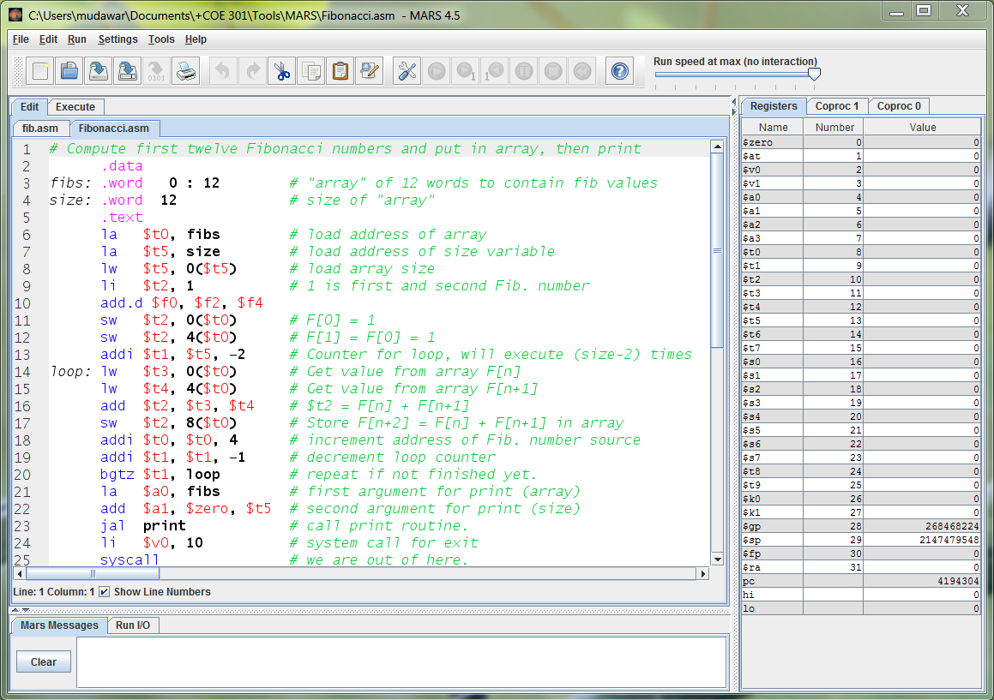
MARS Assembler and Simulator Tool

Slide 14
MARS Assembler and Simulator Tool
Simulates the execution of a MIPS program
  By running the program on the underlying Intel processor
Editor with color-coded assembly syntax
  Allows you to create and edit assembly language source files
Assembler
  Converts MIPS assembly language programs into object files
Console and file input/output using system calls
Debugger
  Allows you to trace the execution of a program and set breakpoints
  Allows you to view machine instructions, edit registers and memory
Easy to use and learn assembly language programming

Slide 15
Next . . .
Programmer's View of a Computer System
Assembly, Machine, and High-Level Languages
The MIPS Instruction Set Architecture
Introduction to Assembly Language Programming
Defining Data, Memory Alignment, and Byte Ordering
System Calls

Slide 16
Instruction Set Architecture (ISA)
Interface between software and hardware
An ISA includes the following …
  Instructions and Instruction Formats
  Data Types, Encodings, and Representations
  Programmable Storage: Registers and Memory
  Addressing Modes: to address Instructions and Data
  Handling Exceptional Conditions (like overflow)
Examples (Versions) Introduced in
  Intel (8086, 80386, Pentium, Core, ...) 1978
  MIPS (MIPS I, II, …, MIPS32, MIPS64) 1986
  ARM (version 1, 2, …) 1985

Slide 17
Instructions
Instructions are the language of the machine
We will study the MIPS instruction set architecture
  Known as Reduced Instruction Set Computer (RISC)
  Elegant and relatively simple design
  Similar to many RISC architectures, such as ARM and RISC-V
  Popular, used in many products
    Silicon Graphics, ATI, Cisco, Sony, etc.
Alternative to: Intel x86 architecture
  Known as Complex Instruction Set Computer (CISC)

Slide 18
Overview of the MIPS Architecture
. . .
4 bytes per word
Memory
Up to 2³² bytes = 2³⁰ words
. . .
EIU
$0
Execution &
Integer Unit
(Main proc)
FPU
F0
Floating
Point Unit
(Coproc 1)
32 General
Purpose
Registers
$1
F1
$2
F2
32 Floating-Point
Registers
Arithmetic &
Logic Unit
$31
Integer
FP
F31
ALU
mul/div
Arith
Floating-Point
Arithmetic Unit
Hi
Lo
TMU
BadVaddr
Trap &
Memory Unit
(Coproc 0)
Status
Integer Multiplier/Divider
Cause
EPC

Slide 19
MIPS General-Purpose Registers
32 General Purpose Registers (GPRs)
  All registers are 32-bit wide in the MIPS 32-bit architecture
  Software defines names for registers to standardize their use
  Assembler can refer to registers by name or by number ($ notation)
Name | Register | Usage
$zero | $0 | Always 0 (forced by hardware)
$at | $1 | Reserved for assembler use
$v0 – $v1 | $2 – $3 | Result values of a function
$a0 – $a3 | $4 – $7 | Arguments of a function
$t0 – $t7 | $8 – $15 | Temporary Values
$s0 – $s7 | $16 – $23 | Saved registers (preserved across call)
$t8 – $t9 | $24 – $25 | More temporaries
$k0 – $k1 | $26 – $27 | Reserved for OS kernel
$gp | $28 | Global pointer (points to global data)
$sp | $29 | Stack pointer (points to top of stack)
$fp | $30 | Frame pointer (points to stack frame)
$ra | $31 | Return address (used by jal for function call)

Slide 20
Instruction Formats
All instructions are 32-bit wide, Three instruction formats:
Register (R-Type)
  Register-to-register instructions
  Op: operation code specifies the format of the instruction
Immediate (I-Type)
  16-bit immediate constant is part in the instruction
Jump (J-Type)
  Used by jump instructions
Op⁶
Rs⁵
Rt⁵
Rd⁵
sa⁵
funct⁶
Op⁶
Rs⁵
Rt⁵
immediate¹⁶
Op⁶
immediate²⁶

Slide 21
Assembly Language Statements
Three types of statements in assembly language
  Typically, one statement should appear on a line
Executable Instructions
  Generate machine code for the processor to execute at runtime
  Instructions tell the processor what to do
Pseudo-Instructions and Macros
  Translated by the assembler into real instructions
  Simplify the programmer task
Assembler Directives
  Provide information to the assembler while translating a program
  Used to define segments, allocate memory variables, etc.
  Non-executable: directives are not part of the instruction set

Slide 22
Assembly Language Instructions
Assembly language instructions have the format:
[label:] mnemonic [operands] [#comment]
Label: (optional)
  Marks the address of a memory location, must have a colon
  Typically appear in data and text segments
Mnemonic
  Identifies the operation (e.g. add, sub, etc.)
Operands
  Specify the data required by the operation
  Operands can be registers, memory variables, or constants
  Most instructions have three operands
L1: addiu $t0, $t0, 1 #increment $t0

Slide 23
Comments
Single-line comment
  Begins with a hash symbol # and terminates at end of line
Comments are very important!
  Explain the program's purpose
  When it was written, revised, and by whom
  Explain data used in the program, input, and output
  Explain instruction sequences and algorithms used
  Comments are also required at the beginning of every procedure
    Indicate input parameters and results of a procedure
    Describe what the procedure does

Slide 24
Program Template
# Title: Filename:
# Author: Date:
# Description:
# Input:
# Output:
################# Data segment #####################
.data
. . .
################# Code segment #####################
.text
.globl main
main: # main program entry
. . .
li $v0, 10 # Exit program
syscall

Slide 25
.DATA, .TEXT, & .GLOBL Directives
.DATA directive
  Defines the data segment of a program containing data
  The program's variables should be defined under this directive
  Assembler will allocate and initialize the storage of variables
.TEXT directive
  Defines the code segment of a program containing instructions
.GLOBL directive
  Declares a symbol as global
  Global symbols can be referenced from other files
  We use this directive to declare main function of a program

Slide 26
Layout of a Program in Memory
0x7FFFFFFF
Stack Segment
Stack Grows
Downwards
Memory
Addresses
in Hex
Dynamic Area (Heap)
Data Segment
Static Area
Static data
appear here
0x10000000
Text Segment
Instructions
appear here
0x04000000
Reserved
0

Slide 27
Next . . .
Programmer's View of a Computer System
Assembly, Machine, and High-Level Languages
The MIPS Instruction Set Architecture
Introduction to Assembly Language Programming
Defining Data, Memory Alignment, and Byte Ordering
System Calls

Slide 28
Data Definition Statement
The assembler uses directives to define data
It allocates storage in the static data segment for a variable
May optionally assign a name (label) to the data
Syntax:
[name:] directive initializer [, initializer] . . .
  var1: .WORD 10
All initializers become binary data in memory

Slide 29
Data Directives
.BYTE Directive
  Stores the list of values as 8-bit bytes
.HALF Directive
  Stores the list as 16-bit values aligned on half-word boundary
.WORD Directive
  Stores the list as 32-bit values aligned on a word boundary
.ASCII and .ASCIIZ Directives
  Allocates a sequence of bytes for an ASCII string
  .ASCIIZ adds a NULL char (zero byte) at end of string
  Strings are null-terminated, as in the C programming language
.SPACE Directive
  Allocates space of n uninitialized bytes in the data segment

Slide 30
Examples of Data Definitions
.DATA
var1: .BYTE 'A', 'E', 127, -1, '\n'
var2: .HALF -10, 0xffff
var3: .WORD 0x12345678:100
var4: .FLOAT 12.3, -0.1
var5: .DOUBLE 1.5e-10
str1: .ASCII "A String\n"
str2: .ASCIIZ "NULL Terminated String"
array: .SPACE 100
Array of 100 words
Initialized with
the same value
100 bytes (not initialized)

Slide 31
Memory Alignment
Memory is viewed as an addressable array of bytes
Byte Addressing: address points to a byte in memory
However, words occupy 4 consecutive bytes in memory
  MIPS instructions and integers occupy 4 bytes
Memory Alignment:
  Address must be multiple of size
  Word address should be a multiple of 4
  Double-word address should be a multiple of 8
.ALIGN n directive
  Aligns the next data definition on a 2^{n} byte boundary
  Forces the address of next data definition to be multiple of 2^{n}
Memory
. . .
address
aligned word
12
not aligned
8
4
0
not aligned

Slide 32
Byte Ordering (Endianness)
Processors can order bytes within a word in two ways
Little Endian Byte Ordering
  Memory address = Address of least significant byte
  Example: Intel IA-32
Big Endian Byte Ordering
  Memory address = Address of most significant byte
  Example: SPARC architecture
MIPS can operate with both byte orderings
MSB
LSB
address
a
a+1
a+2
a+3
Byte 3
Byte 2
Byte 1
Byte 0
. . .
Byte 0
Byte 1
Byte 2
Byte 3
. . .
32-bit Register
Memory
MSB
LSB
address
a
a+1
a+2
a+3
Byte 3
Byte 2
Byte 1
Byte 0
. . .
Byte 3
Byte 2
Byte 1
Byte 0
. . .
32-bit Register
Memory

Slide 33
Symbol Table
Assembler builds a symbol table for labels
  Assembler computes the address of each label in data segment
Example Symbol Table
.DATA
var1: .BYTE 1, 2,'Z'
str1: .ASCIIZ "My String\n"
var2: .WORD 0x12345678
.ALIGN 3
var3: .HALF 1000
Label
var1
str1
var2
var3
Address
0x10010000
0x10010003
0x10010010
0x10010018
var1
str1
0x10010000
1
2
'Z'
'M'
'y'
' '
'S'
't'
'r'
'i'
'n'
'g'
'\n'
0
0
0
Unused
0x10010010
0x12345678
0
0
0
0
1000
var2 (aligned)
Unused
var3 (address is multiple of 8)

Slide 34
System Calls
Programs do input/output through system calls
The MIPS architecture provides a syscall instruction
  To obtain services from the operating system
  The operating system handles all system calls requested by program
Since MARS is a simulator, it simulates the syscall services
To use the syscall services:
  Load the service number in register $v0
  Load argument values, if any, in registers $a0, $a1, etc.
  Issue the syscall instruction
  Retrieve return values, if any, from result registers

Slide 35
Syscall Services
Service | $v0 | Arguments / Result
Print Integer | 1 | $a0 = integer value to print
Print Float | 2 | $f12 = float value to print
Print Double | 3 | $f12 = double value to print
Print String | 4 | $a0 = address of null-terminated string
Read Integer | 5 | Return integer value in $v0
Read Float | 6 | Return float value in $f0
Read Double | 7 | Return double value in $f0
Read String | 8 | $a0 = address of input buffer $a1 = maximum number of characters to read
Allocate Heap memory | 9 | $a0 = number of bytes to allocate Return address of allocated memory in $v0
Exit Program | 10

Slide 36
Syscall Services – Cont’d
Print Char | 11 | $a0 = character to print
Read Char | 12 | Return character read in $v0
Open File | 13 | $a0 = address of null-terminated filename string $a1 = flags (0 = read-only, 1 = write-only) $a2 = mode (ignored) Return file descriptor in $v0 (negative if error)
Read from File | 14 | $a0 = File descriptor $a1 = address of input buffer $a2 = maximum number of characters to read Return number of characters read in $v0
Write to File | 15 | $a0 = File descriptor $a1 = address of buffer $a2 = number of characters to write Return number of characters written in $v0
Close File | 16 | $a0 = File descriptor

Slide 37
Reading and Printing an Integer
################# Code segment #####################
.text
.globl main
main: # main program entry
li $v0, 5 # Read integer
syscall # $v0 = value read
move $a0, $v0 # $a0 = value to print
li $v0, 1 # Print integer
syscall
li $v0, 10 # Exit program
syscall

Slide 38
Reading and Printing a String
################# Data segment #####################
.data
str: .space 10 # array of 10 bytes
################# Code segment #####################
.text
.globl main
main: # main program entry
la $a0, str # $a0 = address of str
li $a1, 10 # $a1 = max string length
li $v0, 8 # read string
syscall
li $v0, 4 # Print string str
syscall
li $v0, 10 # Exit program
syscall

Slide 39
Sum of Three Integers
# Sum of three integers
# Objective: Computes the sum of three integers.
# Input: Requests three numbers, Output: sum
################### Data segment ###################
.data
prompt: .asciiz "Please enter three numbers: \n"
sum_msg: .asciiz "The sum is: "
################### Code segment ###################
.text
.globl main
main:
la $a0,prompt # display prompt string
li $v0,4
syscall
li $v0,5 # read 1st integer into $t0
syscall
move $t0,$v0

Slide 40
Sum of Three Integers – (cont'd)
li $v0,5 # read 2nd integer into $t1
syscall
move $t1,$v0
li $v0,5 # read 3rd integer into $t2
syscall
move $t2,$v0
addu $t0,$t0,$t1 # accumulate the sum
addu $t0,$t0,$t2
la $a0,sum_msg # write sum message
li $v0,4
syscall
move $a0,$t0 # output sum
li $v0,1
syscall
li $v0,10 # exit
syscall

