Slide 1
Memory Elements and Units
COE 233
Digital Logic and Computer Organization
Dr. Muhamed Mudawar
King Fahd University of Petroleum and Minerals

Slide 2
Presentation Outline
Introduction to Sequential Circuits
Latches
Flip-Flops and Registers
Memory Units

Slide 3
Combinational versus Sequential
Two classes of digital circuits
Combinational Circuits
Sequential Circuits
Combinational Circuit
Outputs = F(Inputs)
Function of Inputs only
NO internal memory
Sequential Circuit
Outputs is a function of Inputs and internal Memory
There is an internal memory that stores the state of the circuit
Time is very important: memory changes with time
Combinational
Circuit
Inputs
Outputs

Slide 4
Sequential Circuits
A Sequential circuit consists of:
Memory elements:
Latches or Flip-Flops
Store the Present State
Combinational Logic
Produces the Outputs
Produces the Next State
Next state = memory input (not stored yet)
Synchronous sequential circuits use a clock signal
The clock signal is an input to the memory elements
The clock determines when the memory should be updated
Inputs
Combinational
Logic
Outputs
Present
State
Next
State
Memory
Elements
Clock

Slide 5
The Clock
Positive
Pulse
Negative
Pulse
Clock cycle
Clock cycle
Time
Clock is a periodic signal = Train of pulses (1's and 0's)
The same clock cycle repeats indefinitely over time
Positive Pulse: when the level of the clock is 1
Negative Pulse: when the level of the clock is 0
Rising Edge: when the clock goes from 0 to 1
Falling Edge: when the clock goes from 1 down to 0

Slide 6
Clock Cycle versus Clock Frequency
Clock cycle
Clock cycle
Clock cycle
Time
Clock cycle (or period) is a time duration
Measured in seconds, milli-, micro-, nano-, or pico-seconds
1 ms = 10⁻³ sec, 1 µs = 10⁻⁶ sec, 1 ns = 10⁻⁹ sec, 1 ps = 10⁻¹² sec
Clock frequency = number of cycles per second (Hertz)
1 Hz = 1 cycle/sec, 1 KHz = 10³ Hz, 1 MHz = 10⁶ Hz, 1 GHz = 10⁹ Hz
Clock frequency = 1 / Clock Cycle
Example: Given the clock cycle = 0.5 ns = 0.5 ×10⁻⁹ sec
Then, the clock frequency = 1/(0.5×10⁻⁹) = 2×10⁹ Hz = 2 GHz

Slide 7
Memory Elements
Memory can store and maintain binary state (0's or 1's)
Until directed by an input signal to change state
Main difference between memory elements
Number of inputs they have
How the inputs affect the binary state
Two main types:
Latches are level-sensitive (the level of the clock)
Flip-Flops are edge-sensitive (sensitive to the edge of the clock)
Flip-Flips are used in synchronous sequential circuits
Flip-Flops are built with latches

Slide 8
Next . . .
Introduction to Sequential Circuits
Latches
Flip-Flops and Registers
Memory Units

Slide 9
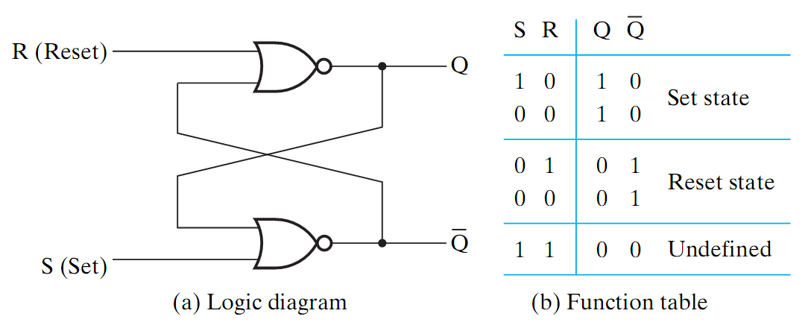
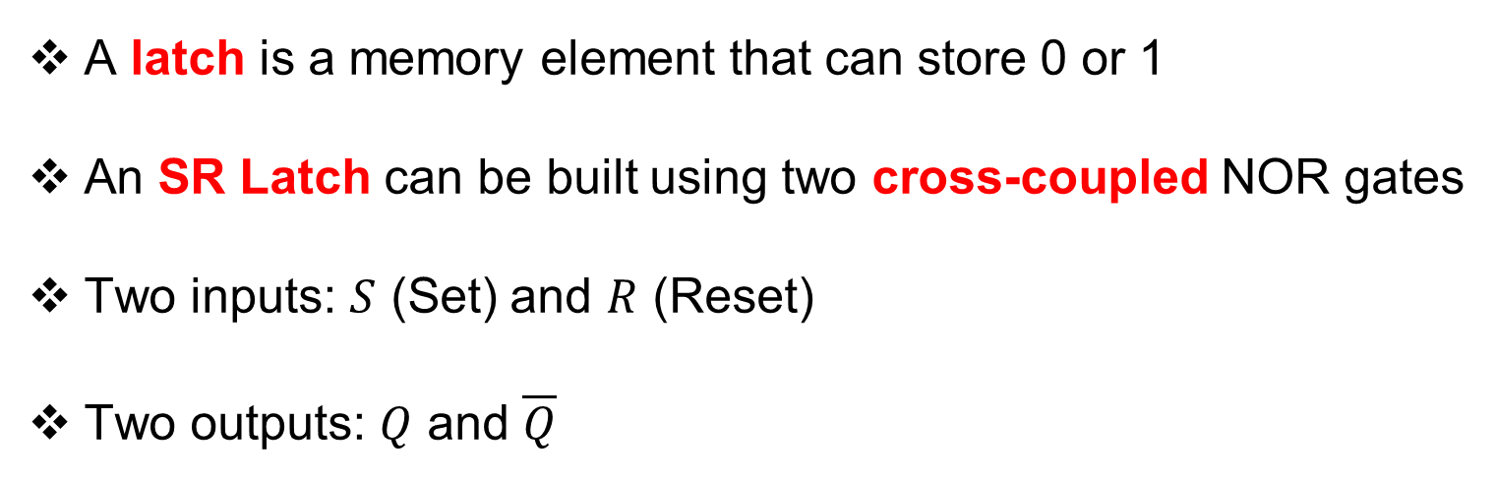
SR Latch
A latch is a memory element that can store 0 or 1
An SR Latch can be built using two cross-coupled NOR gates
Two inputs: $S$ (Set) and $R$ (Reset)
Two outputs: $Q$ and $\overline{Q}$

Slide 10
SR Latch Operation
Set Operation
Store Operation
R (Reset)
0
1
R (Reset)
0
1
Q
Q
0
Q
0
Q
S (Set)
1
S (Set)
0
Reset Operation
Store Operation
R (Reset)
1
0
R (Reset)
0
0
Q
Q
1
Q
1
Q
S (Set)
0
S (Set)
0

Slide 11
SR Latch Invalid Operation
Invalid Operation
Race Condition
R (Reset)
1
0
R (Reset)
1→0
0→1
Q
Q
0
Q
Q
S (Set)
1
S (Set)
1→0
0→1
S = R = 1 should never be used
If S and R change from 1 → 0 simultaneously then race condition (oscillation) occurs
Final Q and Q are unknown
Unknown State
R (Reset)
0
0 or 1
Q
0
Q
S (Set)
1 or 0

Slide 12
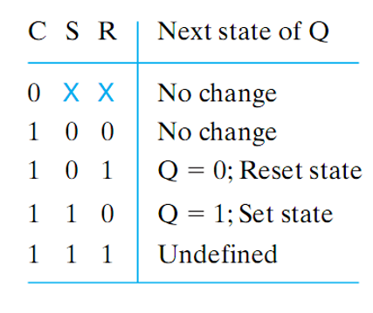
SR Latch with Clock Input
R (Reset)
CR
Q
C (Clock)
CS
Q
S (Set)
An additional Clock (enable) input signal C is used
Clock controls when the state of the latch can be changed
When C=0, the S and R inputs have no effect on the latch
The latch will remain in the same state, regardless of S and R
When C=1, then normal SR latch operation

Slide 13
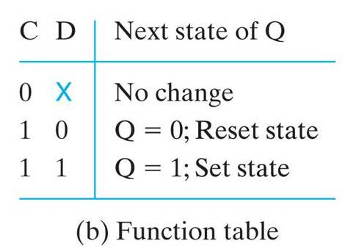
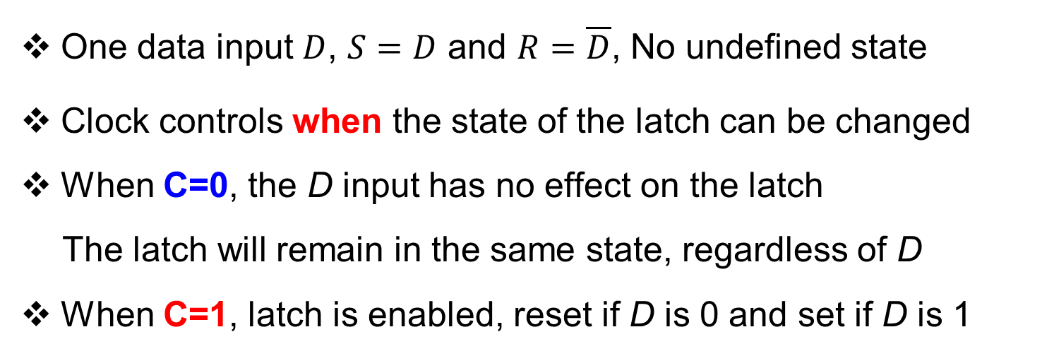
D Latch with Clock Input
R
CR
Q
C (Clock)
S
CS
Q
D (Data)
One data input $D$, $S=D$ and $R=\overline{D}$, No undefined state
Clock controls when the state of the latch can be changed
When C=0, the D input has no effect on the latch
The latch will remain in the same state, regardless of D
When C=1, latch is enabled, reset if D is 0 and set if D is 1

Slide 14




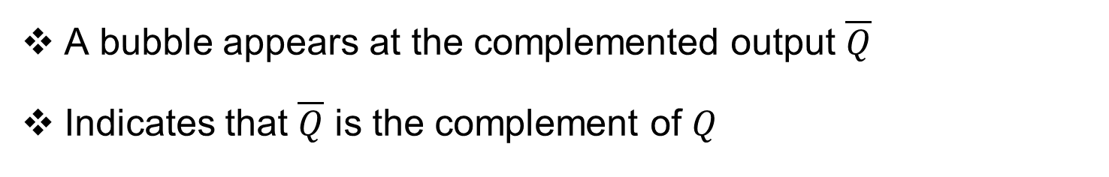







Graphic Symbols for Latches
$$S$$
$S R$
$Latch$
$$Q$$
$$D$$
$D$
$Latch$
$$Q$$
$$C$$
$$R$$
$$\overline{Q}$$
$$C$$
$$\overline{Q}$$
A bubble appears at the complemented output $\overline{Q}$
Indicates that $\overline{Q}$ is the complement of $Q$

Slide 15



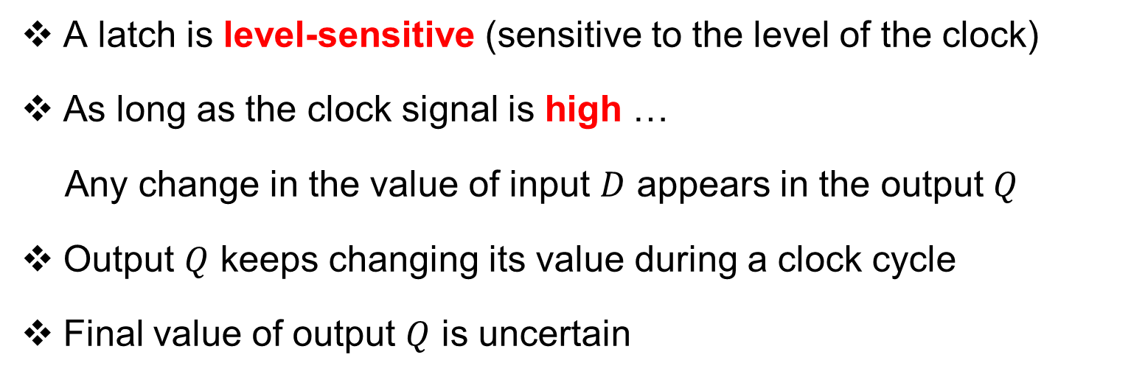





Problem with Latches
A latch is level-sensitive (sensitive to the level of the clock)
As long as the clock signal is high …
Any change in the value of input $D$ appears in the output $Q$
Output $Q$ keeps changing its value during a clock cycle
Final value of output $Q$ is uncertain
Due to this uncertainty, latches are NOT used as memory elements in sequential circuits
$Latch$
$$Q$$
$$D$$
$$Q$$
$$Clk$$
$$C$$
$$\overline{Q}$$
$$\overline{Q}$$

Slide 16
Next . . .
Introduction to Sequential Circuits
Latches
Flip-Flops and Registers
Memory Units

Slide 17
Flip-Flops
A Flip-Flop is a better memory element for sequential circuits
Solves the problem of latches in synchronous sequential circuits
A latch is sensitive to the level of the clock
However, a flip-flop is sensitive to the edge of the clock
A flip-flop is called an edge-triggered memory element
It changes it output value at the edge of the clock
High
Level
Low
Level
Rising edge
Falling edge
Rising edge
Falling edge
Time

Slide 18
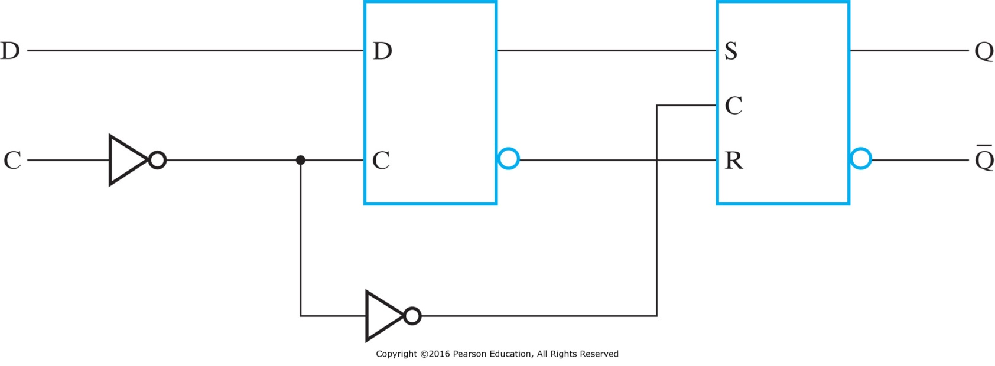


Edge-Triggered D Flip-Flop
Built using two latches in a master-slave configuration
A master latch (D-type) receives external inputs
A slave latch (SR-type) receives inputs from the master latch
Only one latch is enabled at any given time
When Clk=0, the master is enabled and the D input is latched (slave disabled)
When Clk=1, the slave is enabled to generate the outputs (master is disabled)
$$Q_{m}$$
Outputs change when Clk changes from 0 to 1
Master
Slave
Clk
$$\overline{Q_{m}}$$

Slide 19
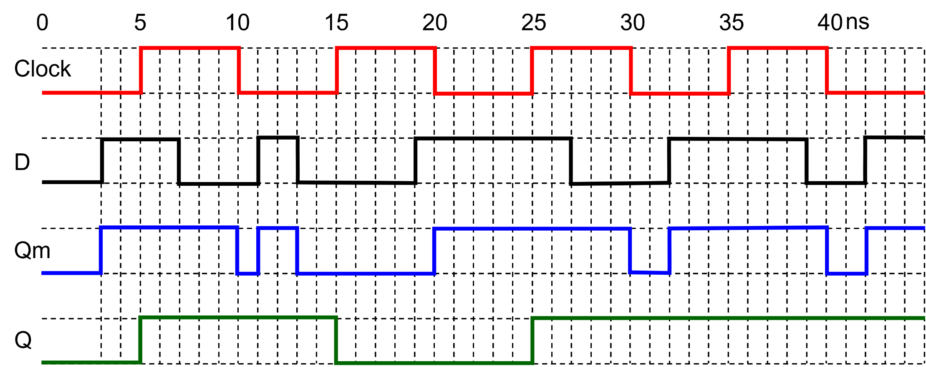
D Flip-Flop Timing Diagram
The diagram shows the timing of a positive-edge D Flip-Flop
The master latch changes its output Qm when the clock C is 0
The rising edge of the clock triggers the D Flip-Flop

Slide 20
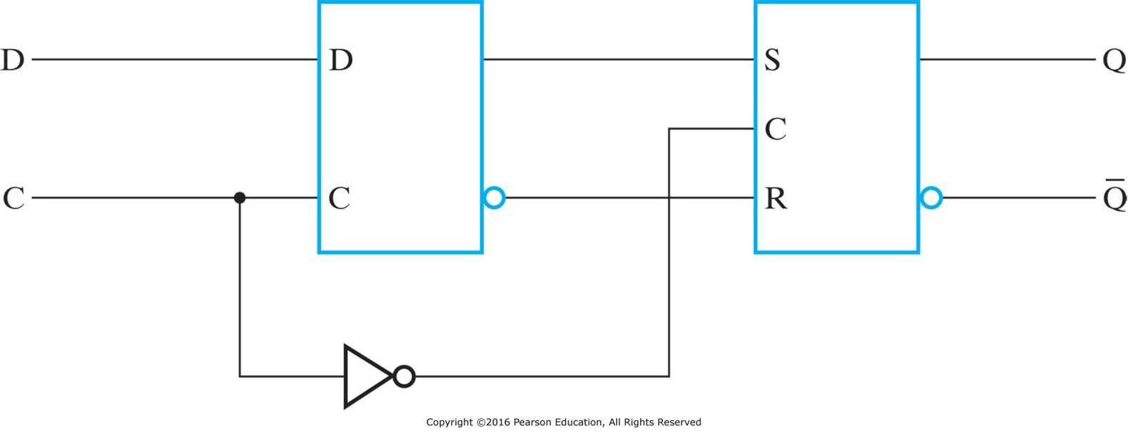


Negative Edge-Triggered D Flip-Flop
Similar to positive edge-triggered flip-flop
The first inverter at the Master C input is removed
Only one latch is enabled at any given time
When Clk=1, the master is enabled and the D input is latched (slave disabled)
When Clk=0, the slave is enabled to generate the outputs (master is disabled)
$$Q_{m}$$
Outputs change when Clk changes from 1 to 0
Master
Slave
Clk
$$\overline{Q_{m}}$$

Slide 21










Graphic Symbols for Flip-Flops
$$Data$$
Flip
Flop
$$Data$$
Flip
Flop
$$D$$
$$Q$$
$$D$$
$$Q$$
$$Clk$$
$$\overline{Q}$$
$$Clk$$
$$\overline{Q}$$
A Flip-Flop has a similar symbol to a Latch
The difference is the arrowhead at the clock input
The arrowhead indicates sensitivity to the edge of the clock
A circle at the Clk input indicates negative edge-triggered FF

Slide 22










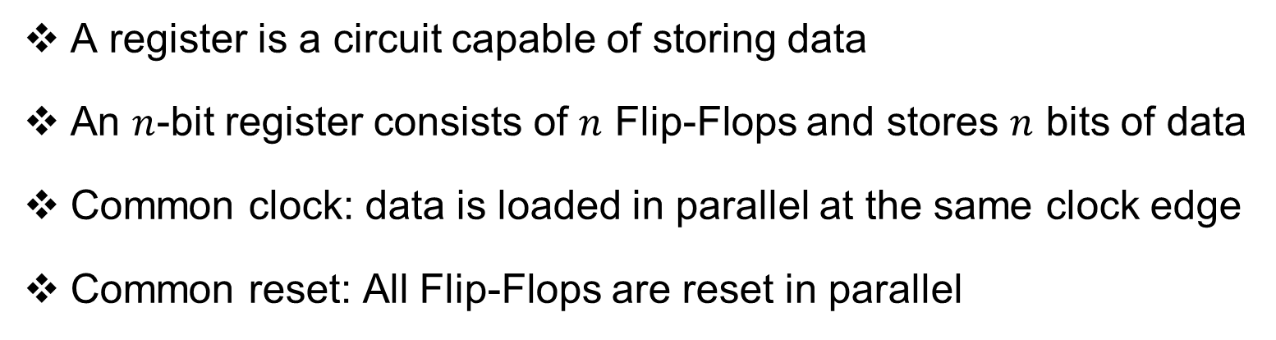





















Register
A register is a circuit capable of storing data
An $n$-bit register consists of $n$ Flip-Flops and stores $n$ bits of data
Common clock: data is loaded in parallel at the same clock edge
Common reset: All Flip-Flops are reset in parallel
4-bit
Register
$$D_{3}$$
$$D_{2}$$
$$D_{1}$$
$$D_{0}$$
$$D_{3}$$
$$Q_{3}$$
$$D_{3}$$
$$Q_{3}$$
$$D_{2}$$
$$Q_{2}$$
$$D_{1}$$
$$Q_{1}$$
$$D_{0}$$
$$Q_{0}$$
$$D_{2}$$
$$Q_{2}$$
$$D_{1}$$
$$Q_{1}$$
$$R$$
$$R$$
$$R$$
$$R$$
$$D_{0}$$
$$Q_{0}$$
$$Clock$$
$$Reset$$
$$Q_{3}$$
$$Q_{2}$$
$$Q_{1}$$
$$Q_{0}$$
$$Reset$$

Slide 23







Register Enable
Question: How to control the loading of data into a register?
Solution: Introduce an Enable control signal
If the register is enabled, load the data into the register
Otherwise, do not change the value of the register
Question: How to implement register enable?
$$I[n−1:0]$$
$$n$$
$Enable$
n-bit Register
$$Reset$$
$Clock$
$$n$$
$$Q[n−1:0]$$

Slide 24









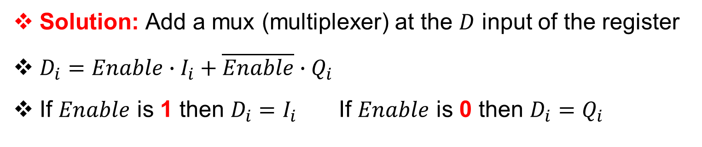














Implementing Register Enable
Solution: Add a mux (multiplexer) at the $D$ input of the register
$D_{i}=Enable∙I_{i}+\overline{Enable}∙Q_{i}$
If $Enable$ is 1 then $D_{i}=I_{i}$ If $Enable$ is 0 then $D_{i}=Q_{i}$
$$I_{3}$$
$$I_{2}$$
$$I_{1}$$
$$I_{0}$$
$$Enable$$
1
0
1
0
1
0
1
0
$$D_{3}$$
$$Q_{3}$$
$$D_{2}$$
$$Q_{2}$$
$$D_{1}$$
$$Q_{1}$$
$$D_{0}$$
$$Q_{0}$$
$$R$$
$$R$$
$$R$$
$$R$$
$$Clock$$
$$Reset$$
$$Q_{3}$$
$$Q_{2}$$
$$Q_{1}$$
$$Q_{0}$$

Slide 25
Next . . .
Introduction to Sequential Circuits
Latches
Flip-Flops and Registers
Memory Units

Slide 26
Memory Units
A memory unit is a device that can store binary information
It is a large group of cells, each capable of storing one bit
Two types of memory units: Volatile and Non-Volatile
Random-Access Memory (RAM) is volatile
ROM, Flash, and FPGA are non-volatile
Memory Unit
Does not need power supply to retain bits
Needs power supply to retain bits
Volatile
Non-Volatile
RAM
ROM
Flash
FPGA
SRAM
DRAM

Slide 27
Random-Access Memory
Large array of storage cells, capable of storing many 0's and 1's
Random Access: bits can be accessed randomly
Memory is addressable
Memory address consists of k bits
Can address 2^{k} words in memory
Each word consists of n bits
Memory capacity = 2^{k} × n bits
Two control functions: Read and Write
Read: Data_out ⬅ Memory [Address]
Write: Memory [Address] ⬅ Data_in
Data_in
n
k
Memory
Unit
2^{k} × n bits
Address
Read
Write
n
Data_out

Slide 28
Memory Capacity
Each memory location is a group of n bits, which is read/written
Byte = 8-bit data
Half-word = 16-bit data = 2 bytes
Word = 32-bit data = 4 bytes
The memory capacity is specified in bytes
1 KB (Kilo Byte) = 2¹⁰ = 1024 bytes (more than thousand = 10³)
1 MB (Mega Byte) = 2²⁰ Bytes (more than million = 10⁶)
1 GB (Giga Byte) = 2³⁰ Bytes (more than billion = 10⁹)
1 TB (Tera Byte) = 2⁴⁰ Bytes (more than trillion = 10¹²)
The memory locations can be accessed (addressed) randomly

Slide 29
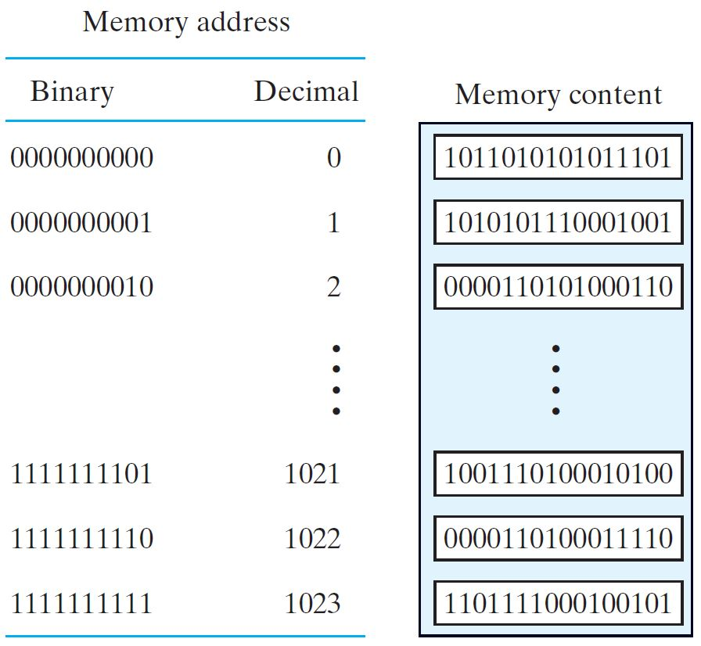
Memory Address and Content
Example of a RAM
Address = 10 bits
2¹⁰ addresses
From 0 to 1023
Data = 16 bits
Memory capacity =
2¹⁰ × 16 bits =
16 Kbits = 2 KBytes
Memory can be addressed randomly
Memory can be read and written
16-bit data

Slide 30
Example of a Small 4×3 Memory Array
2-bit Address ➔ 4 wordlines (rows), each storing 3 bits
The decoder enables one wordline (row) at a time
The data are read on the bitlines (columns)
Each wordline in the memory array can be read and written

Slide 31
Read-Only Memory (ROM)
Address consists of k bits ➔ 2^{k} memory addresses
At each memory address, there is a word consisting of n bits
The n-bit word appears at the data output of the ROM
ROM does not have data inputs or a write operation
k
ROM
2^{k} × n bits
n
Address
Data_out
ROM memory is useful for implementing Boolean Functions
Also useful for storing permanent data

Slide 32
Types of ROMs
ROM may be programmed in four different ways
Mask Programming: done by circuit manufacturer (not by user)
Programmable Read-Only Memory (PROM)
Fuses in the PROM are blown using a high-voltage pulse
Can be programmed only once (irreversible)
3. Electrically Erasable PROM (EEPROM)
Can be erased with an electric signal
Flash memory is similar to EEPROMs but has additional circuitry to erase blocks of memory

Slide 33
ROM Internal Structure (32 x 8-bit)
5-bit Input ➔ 5-to-32 binary decoder (Only one line is selected)
Each line = 8 bits ➔ 8-bit Data output
I4
I3
I2
I1
I0
0
1
2
3
.
.
.
28
29
30
31
32×8 = 256 connections
Bits are stored at the intersection
5-to-32 decoder
D7 D6 D5 D4 D3 D2 D1 D0
The 32×8 = 256 intersections are programmable

Slide 34
Implementing a Combinational Circuit
Implementing a Combinational Circuit with a ROM is easy
Store the truth table of the circuit by programming the ROM
Truth Table with Five Inputs and Eight output functions
I4 I3 I2 I1 I0 | F7 F6 F5 F4 F3 F2 F1 F0
0 0 0 0 0 | 0 0 1 1 1 0 0 0
0 0 0 0 1 | 1 0 0 0 0 1 1 0
0 0 0 1 0 | 0 1 0 1 1 0 0 1
0 0 0 1 1 | 1 0 1 1 0 0 1 0
· · · | · · ·
1 1 1 1 1 | 0 0 1 0 0 0 1 0
Inputs are used as Address lines to the ROM

Slide 35
Programming a ROM
Every 1 in the truth table ➔ X connection is logic-1
Every 0 in the truth table ➔ No X connection is logic-0
Example: At address 00011 = (decimal 3), the word 10110010 is stored
I4
I3
I2
I1
I0
0
0
1
2
3
.
.
.
28
29
30
31
x
x
x
00111000
10000110
01011001
10110010
x
x
x
0
x
x
x
x
x
x
x
x
0
5-to-32 decoder
1
x
x
01000001
11001100
10110011
00100010
1
x
x
x
x
x
x
x
x
x
x
x
1 0 1 1 0 0 1 0

Slide 36
Example: Square Function
Design a square function with a minimum size ROM
Input X = 3-bit number, Output Y = X²
Solution: Derive the Truth Table
X₂ X₁ X₀ | Square | Y₅ Y₄ Y₃ Y₂ Y₁ Y₀
0 0 0 | 0 | 0 0 0 0 0 0
0 0 1 | 1 | 0 0 0 0 0 1
0 1 0 | 4 | 0 0 0 1 0 0
0 1 1 | 9 | 0 0 1 0 0 1
1 0 0 | 16 | 0 1 0 0 0 0
1 0 1 | 25 | 0 1 1 0 0 1
1 1 0 | 36 | 1 0 0 1 0 0
1 1 1 | 49 | 1 1 0 0 0 1

Slide 37
Minimum-Sized ROM Table
Output Y₀ is identical to input X₀ ➔ No need to store in ROM
Similarly, Output Y₁ is always 0 ➔ No need to store in ROM
ROM table ➔ Only need to store Y₅, Y₄, Y₃, and Y₂ in ROM
X₂ X₁ X₀ | Y₅ Y₄ Y₃ Y₂ | Y₁ Y₀
0 0 0 | 0 0 0 0 | 0 0
0 0 1 | 0 0 0 0 | 0 1
0 1 0 | 0 0 0 1 | 0 0
0 1 1 | 0 0 1 0 | 0 1
1 0 0 | 0 1 0 0 | 0 0
1 0 1 | 0 1 1 0 | 0 1
1 1 0 | 1 0 0 1 | 0 0
1 1 1 | 1 1 0 0 | 0 1
Minimal ROM
Size = 2³ × 4 bits
8 × 4
ROM
Y₅
X₂
Y₄
X₁
Y₃
X₀
Y₂
0
Y₁
Y₀

