Slide 1
Boolean Algebra and
Logic Gates
COE 233
Digital Logic and Computer Organization
Dr. Muhamed Mudawar
King Fahd University of Petroleum and Minerals

Slide 2
Presentation Outline
Boolean Algebra, truth tables, and DeMorgan’s theorem
Algebraic manipulation and expression simplification
From truth table to logic expression: minterms and maxterms
Logic gates, logic diagrams, and standard forms
Additional gates: NAND, NOR, XOR, XNOR

Slide 3
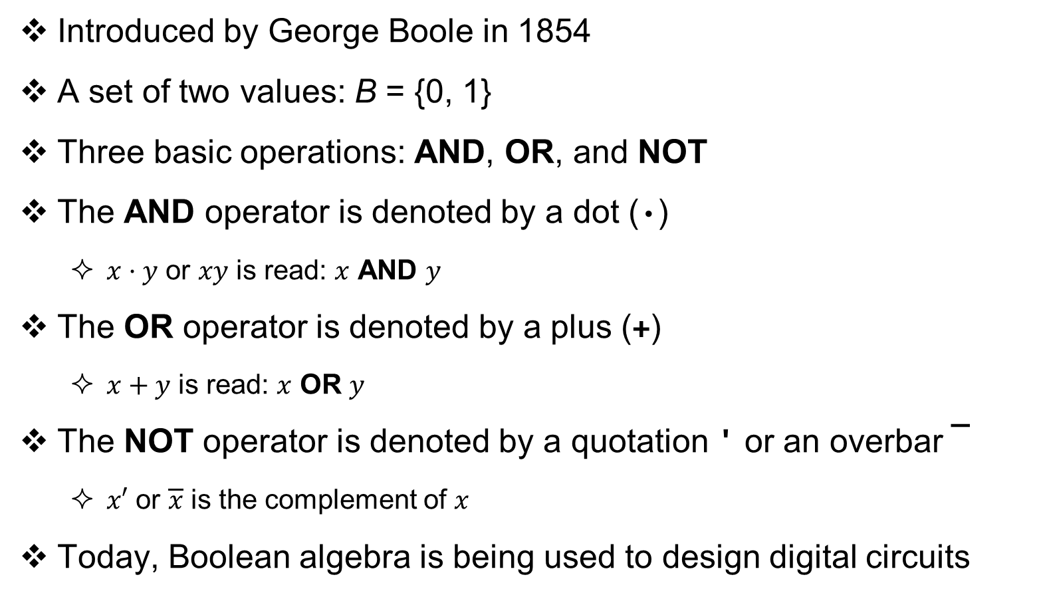
Boolean Algebra
Introduced by George Boole in 1854
A set of two values: B = {0, 1}
Three basic operations: AND, OR, and NOT
The AND operator is denoted by a dot (·)
  $x·y$ or $xy$ is read: $x$ AND $y$
The OR operator is denoted by a plus (+)
  $x+y$ is read: $x$ OR $y$
The NOT operator is denoted by a quotation ' or an overbar ¯
  $x′$ or $\overline{x}$ is the complement of $x$
Today, Boolean algebra is being used to design digital circuits

Slide 4
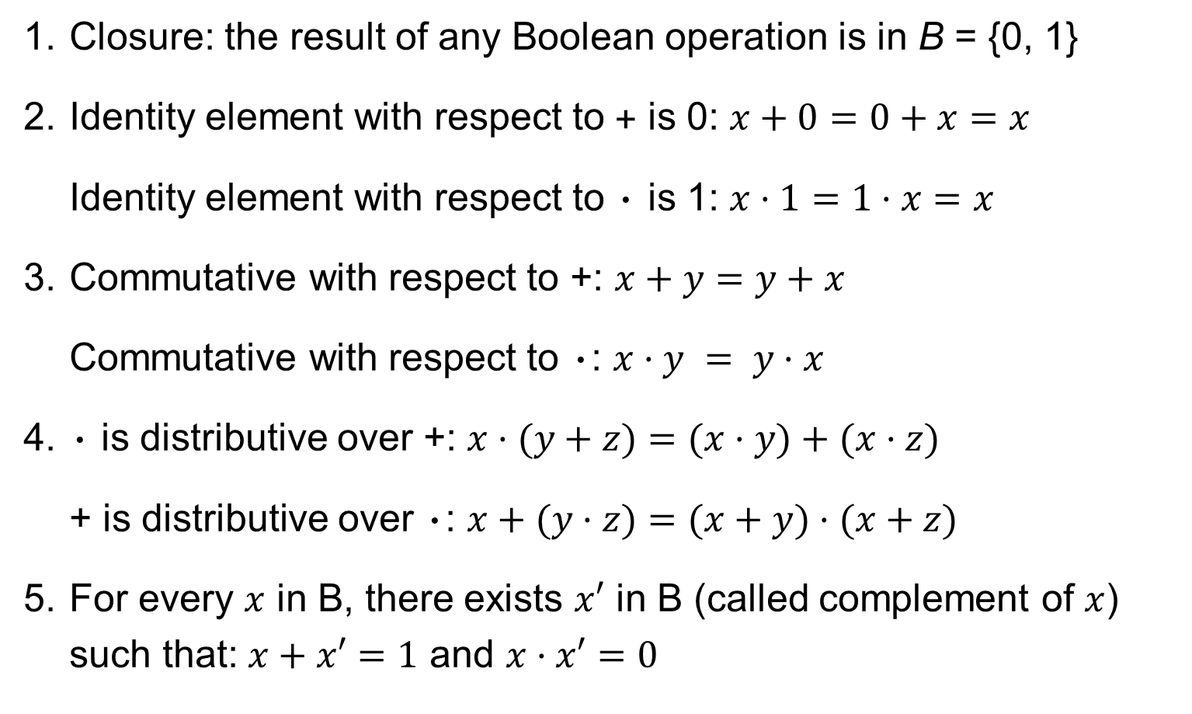
Postulates of Boolean Algebra
1. Closure: the result of any Boolean operation is in B = {0, 1}
2. Identity element with respect to + is 0: $x+0=0+x=x$
Identity element with respect to · is 1: $x·1=1·x=x$
3. Commutative with respect to +: $x+y=y+x$
Commutative with respect to ·: $x·y = y·x$
4. · is distributive over +: $x·(y+z)=(x·y)+(x·z)$
+ is distributive over ·: $x+(y·z)=(x+y)·(x+z)$
5. For every $x$ in B, there exists $x′$ in B (called complement of $x$) such that: $x+x′=1$ and $x·x′=0$

Slide 5
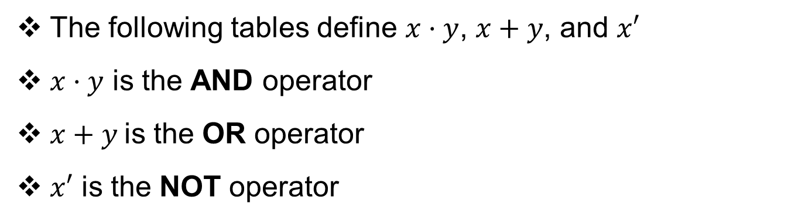
AND, OR, and NOT Operators
The following tables define $x·y$, $x+y$, and $x′$
$x·y$ is the AND operator
$x+y$is the OR operator
$x′$ is the NOT operator
x y | x·y
0 0 | 0
0 1 | 0
1 0 | 0
1 1 | 1
x y | x+y
0 0 | 0
0 1 | 1
1 0 | 1
1 1 | 1
x | x'
0 | 1
1 | 0

Slide 6
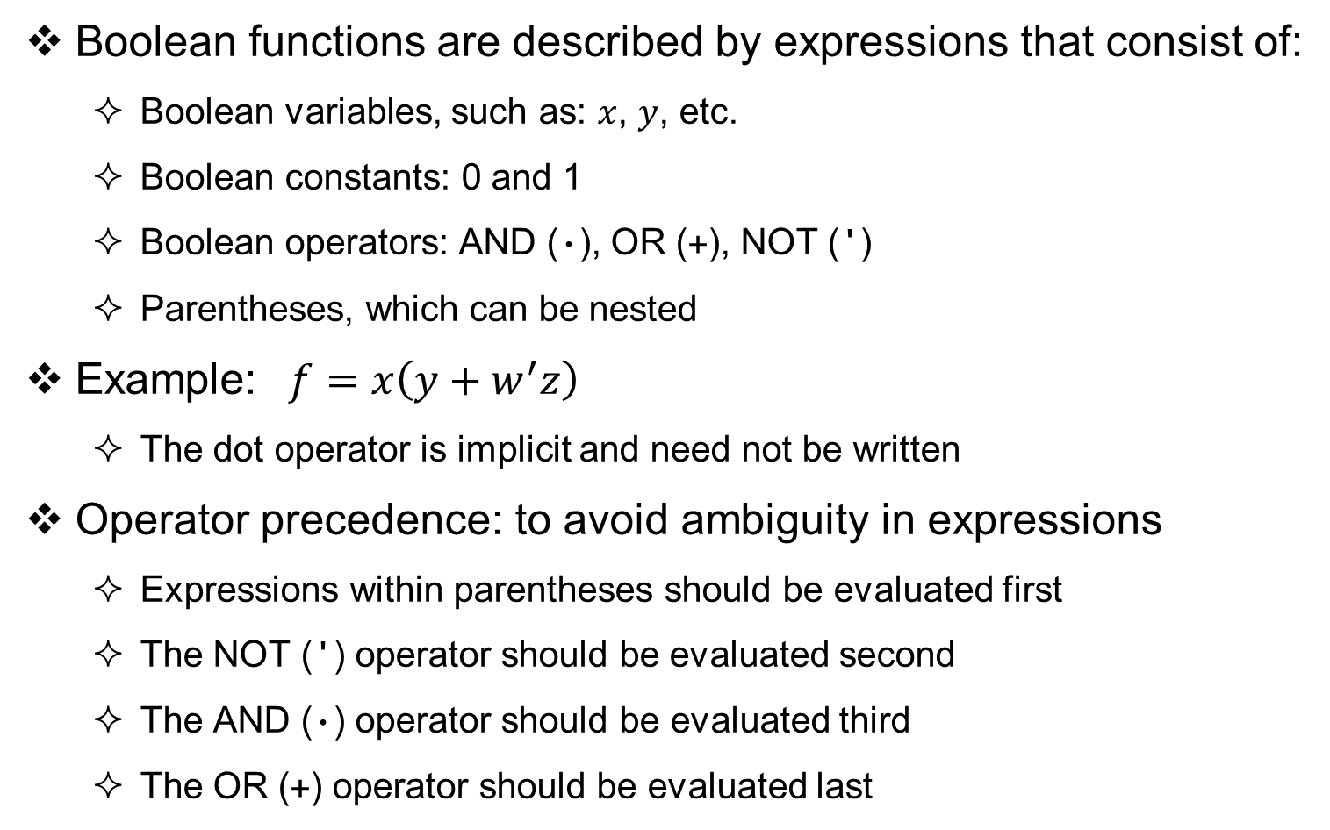
Boolean Functions
Boolean functions are described by expressions that consist of:
  Boolean variables, such as: $x$, $y$, etc.
  Boolean constants: 0 and 1
  Boolean operators: AND (·), OR (+), NOT (')
  Parentheses, which can be nested
Example: $f=x\left(y+w^{′}z\right)$
  The dot operator is implicit and need not be written
Operator precedence: to avoid ambiguity in expressions
  Expressions within parentheses should be evaluated first
  The NOT (') operator should be evaluated second
  The AND (·) operator should be evaluated third
  The OR (+) operator should be evaluated last

Slide 7
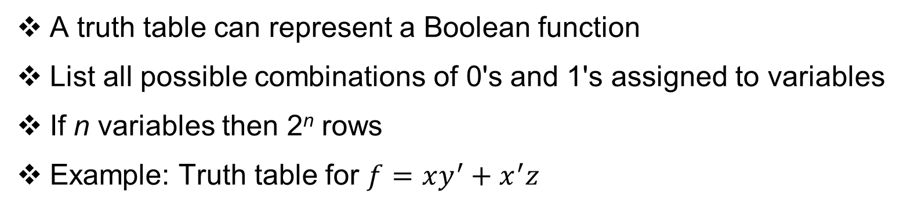
Truth Table
A truth table can represent a Boolean function
List all possible combinations of 0's and 1's assigned to variables
If n variables then 2^{n} rows
Example: Truth table for $f=xy^{′}+x^{′}z$
x y z | y' | xy' | x' | x'z | f = xy'+ x'z
0 0 0 | 1 | 0 | 1 | 0 | 0
0 0 1 | 1 | 0 | 1 | 1 | 1
0 1 0 | 0 | 0 | 1 | 0 | 0
0 1 1 | 0 | 0 | 1 | 1 | 1
1 0 0 | 1 | 1 | 0 | 0 | 1
1 0 1 | 1 | 1 | 0 | 0 | 1
1 1 0 | 0 | 0 | 0 | 0 | 0
1 1 1 | 0 | 0 | 0 | 0 | 0

Slide 8
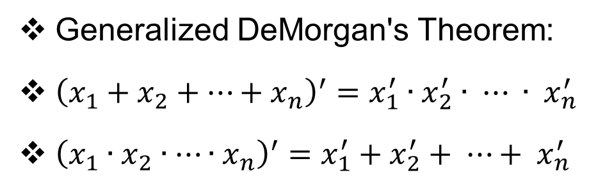
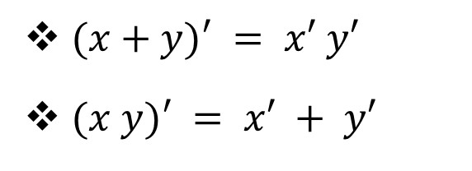
DeMorgan's Theorem
$(x+y)′ = x′ y′$
$(x y)′ = x′ + y′$
Can be verified
Using a Truth Table
x | y | x' | y' | x+y | (x+y)' | x'y' | x y | (x y)' | x'+ y'
0 | 0 | 1 | 1 | 0 | 1 | 1 | 0 | 1 | 1
0 | 1 | 1 | 0 | 1 | 0 | 0 | 0 | 1 | 1
1 | 0 | 0 | 1 | 1 | 0 | 0 | 0 | 1 | 1
1 | 1 | 0 | 0 | 1 | 0 | 0 | 1 | 0 | 0
Identical
Identical
Generalized DeMorgan's Theorem:
${\left(x_{1}+x_{2}+…+x_{n}\right)}^{′}=x_{1}^{′}∙x_{2}^{′}∙ ⋯ ∙ x_{n}^{′}$
${\left(x_{1}∙x_{2}∙…∙x_{n}\right)}^{′}=x_{1}^{′}+x_{2}^{′}+ ⋯+ x_{n}^{′}$

Slide 9
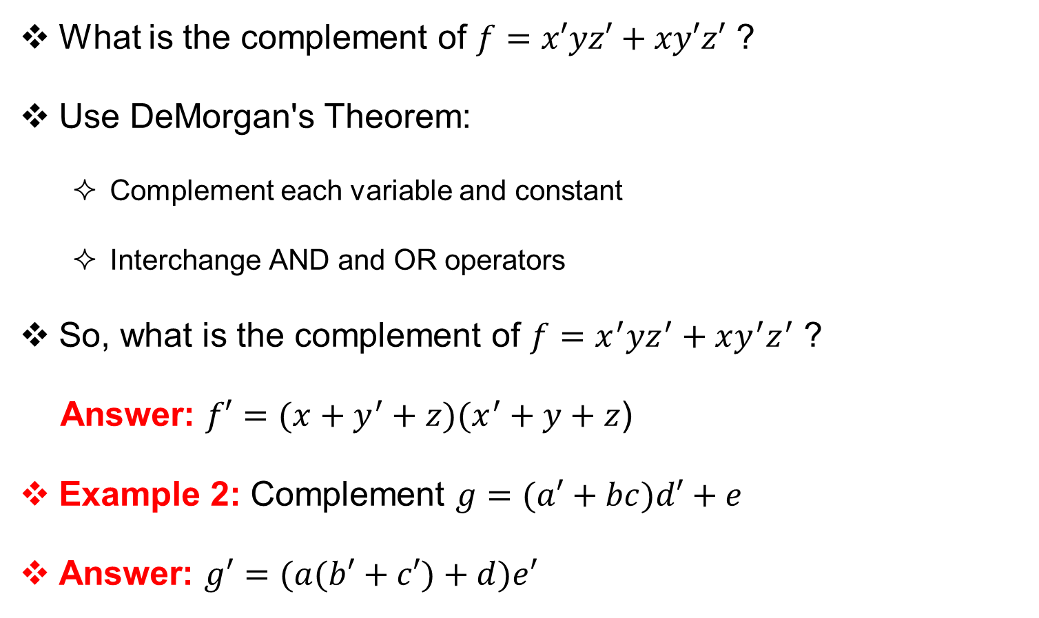
Complementing Boolean Functions
What is the complement of $f=x′yz′+xy′z′$ ?
Use DeMorgan's Theorem:
  Complement each variable and constant
  Interchange AND and OR operators
So, what is the complement of $f=x^{′}yz^{′}+xy^{′}z^{′}$ ?
Answer: $f′=(x+y^{′}+z)(x^{′}+y+z$)
Example 2: Complement $g=(a′+bc)d′+e$
Answer: $g′=(a(b′+c′)+d)e′$

Slide 10
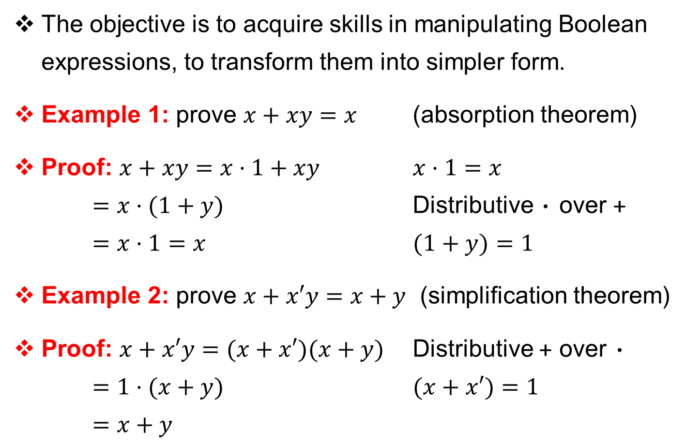
Algebraic Manipulation of Expressions
The objective is to acquire skills in manipulating Boolean expressions, to transform them into simpler form.
Example 1: prove $x+xy=x$ (absorption theorem)
Proof: $x+xy=x·1+xy$ $x·1=x$
$=x·(1+y)$ Distributive · over +
$=x·1=x$ $(1+y)=1$
Example 2: prove $x+x′y=x+y$ (simplification theorem)
Proof: $x+x′y=(x+x′)(x+y)$ Distributive + over ·
$=1·(x+y)$ $(x+x′)=1$
$=x+y$

Slide 11
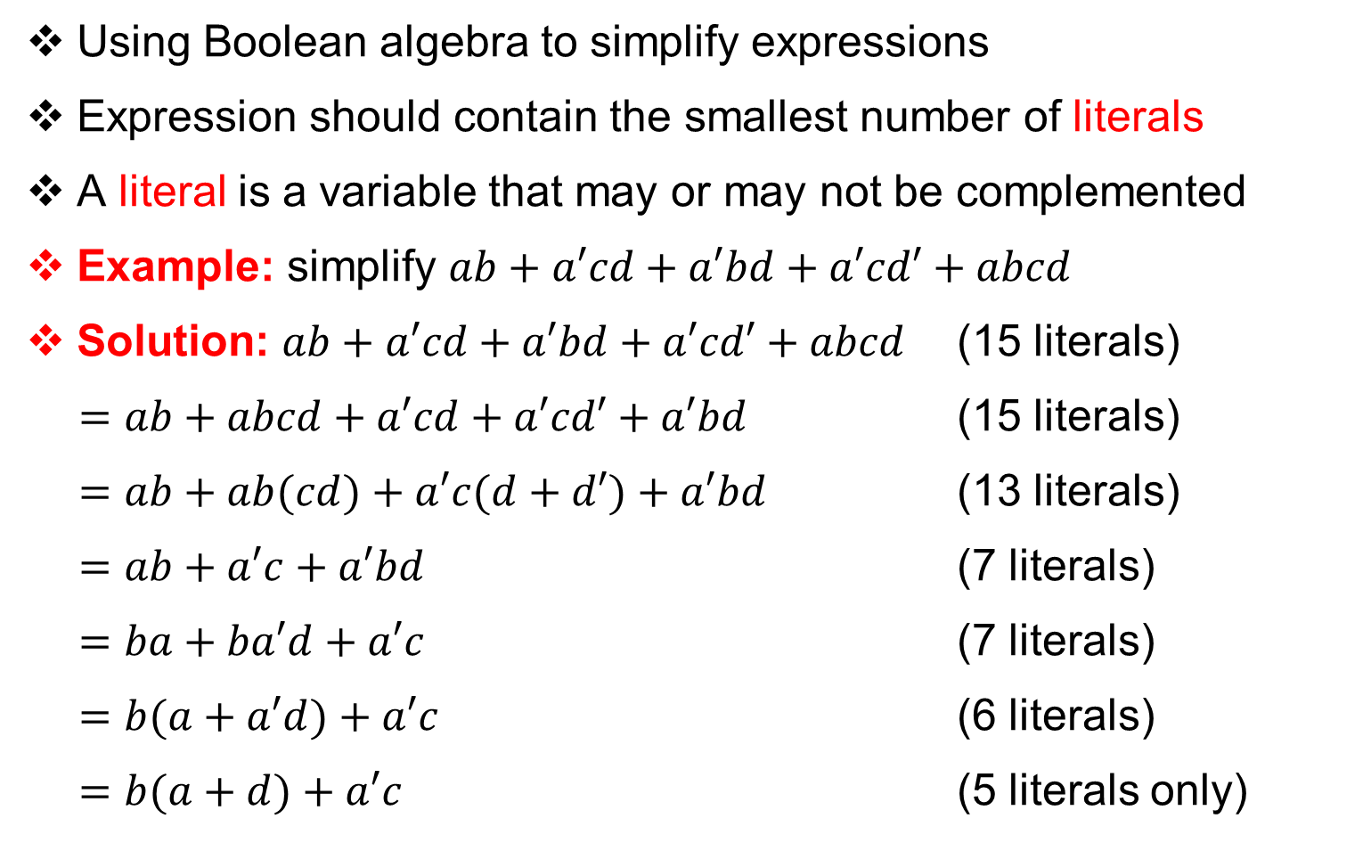
Expression Simplification
Using Boolean algebra to simplify expressions
Expression should contain the smallest number of literals
A literal is a variable that may or may not be complemented
Example: simplify $ab+a′cd+a′bd+a′cd′+abcd$
Solution: $ab+a′cd+a′bd+a′cd′+abcd$ (15 literals)
$=ab+abcd+a′cd+a′cd′+a′bd$ (15 literals)
$=ab+ab(cd)+a′c(d+d′)+a′bd$ (13 literals)
$=ab+a′c+a′bd$ (7 literals)
$=ba+ba′d+a′c$ (7 literals)
$=b(a+a′d)+a′c$ (6 literals)
$=b(a+d)+a′c$ (5 literals only)

Slide 12
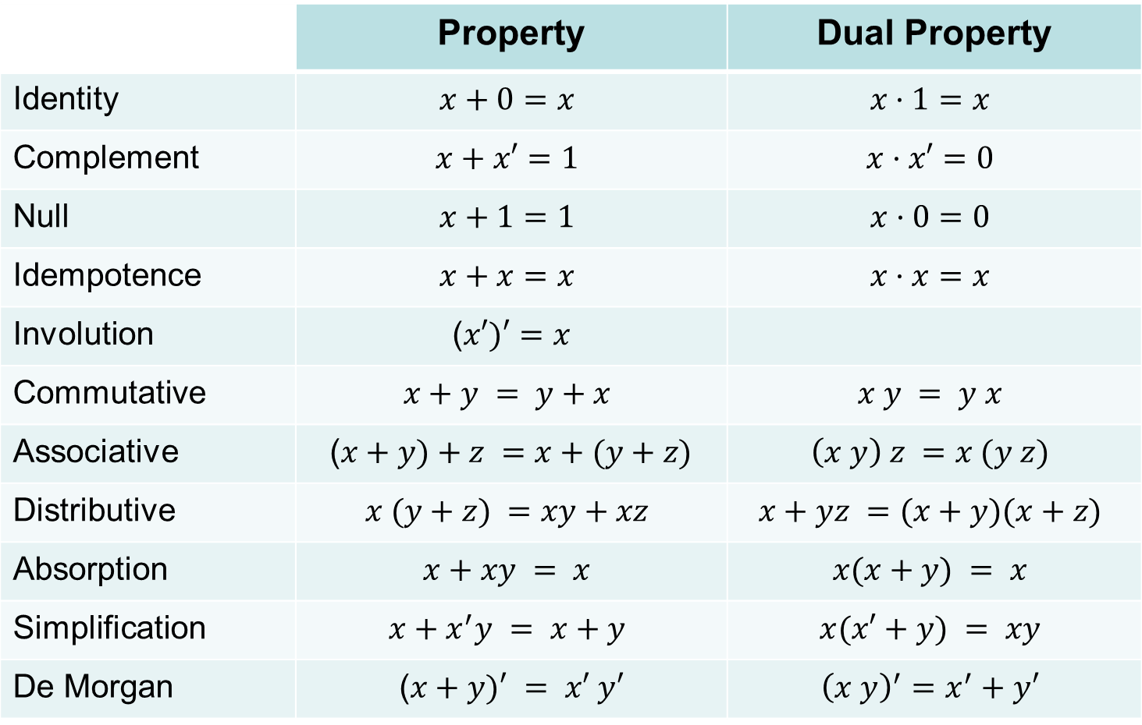
Summary of Boolean Algebra
 | Property | Dual Property
Identity | $$x+0=x$$ | $$x·1=x$$
Complement | $$x+x′=1$$ | $$x·x′=0$$
Null | $$x+1=1$$ | $$x·0=0$$
Idempotence | $$x+x=x$$ | $$x·x=x$$
Involution | ($x′)′=x$
Commutative | $$x+y = y+x$$ | $$x y = y x$$
Associative | ($x+y)+z =x+(y+z)$ | $$\left(x y\right) z =x (y z)$$
Distributive | $$x (y+z) =xy+xz$$ | $$x+yz =(x+y)(x+z)$$
Absorption | $$x+xy = x$$ | $$x(x+y) = x$$
Simplification | $$x+x^{′}y = x+y$$ | $$x(x′+y) = xy$$
De Morgan | ($x+y)′ = x′ y′$ | $${\left(x y\right)}^{′}=x^{′}+y′$$

Slide 13
Importance of Boolean Algebra
Our objective is to learn how to design digital circuits
These circuits use signals with two possible values
Logic 0 is a low voltage signal (0 volts)
Logic 1 is a high voltage signal (for example, 1.2 volts)
The physical value of a signal is the actual voltage it carries, while its logic value is either 0 (low) or 1 (high)
Having only two logic values (0 and 1) simplifies the implementation of the digital circuit

Slide 14
Next . . .
Boolean Algebra, truth tables, and DeMorgan’s theorem
Algebraic manipulation and expression simplification
From truth table to logic expression: minterms and maxterms
Logic gates, logic diagrams, and standard forms
Additional gates: NAND, NOR, XOR, XNOR

Slide 15
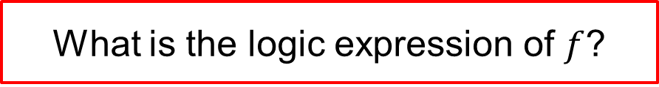
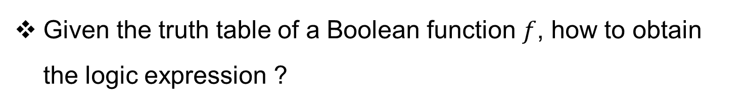
From a Truth Table to Logic Expression
Given the truth table of a Boolean function $f$, how to obtain the logic expression ?
Truth Table
x y z | f
0 0 0 | 0
0 0 1 | 0
0 1 0 | 1
0 1 1 | 1
1 0 0 | 0
1 0 1 | 1
1 1 0 | 0
1 1 1 | 1
What is the logic expression of $f$?
To answer this question, we need
to define Minterms and Maxterms

Slide 16
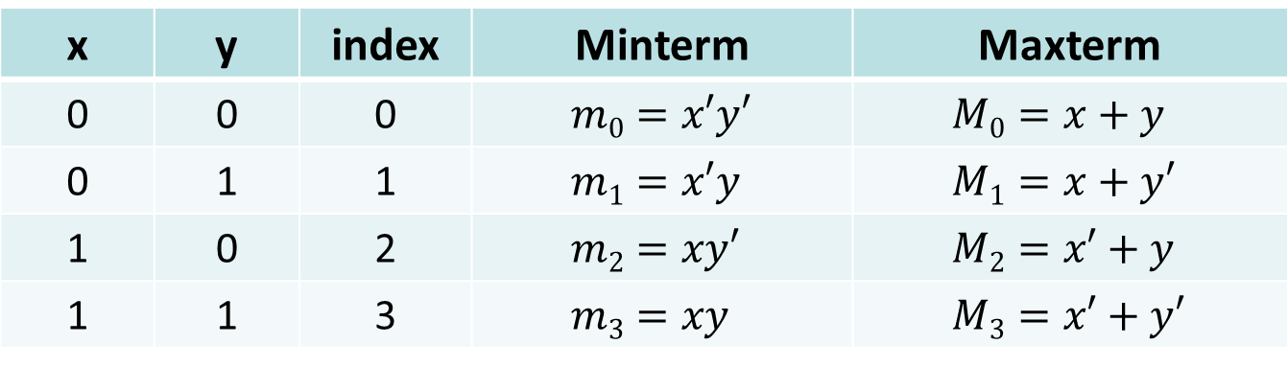
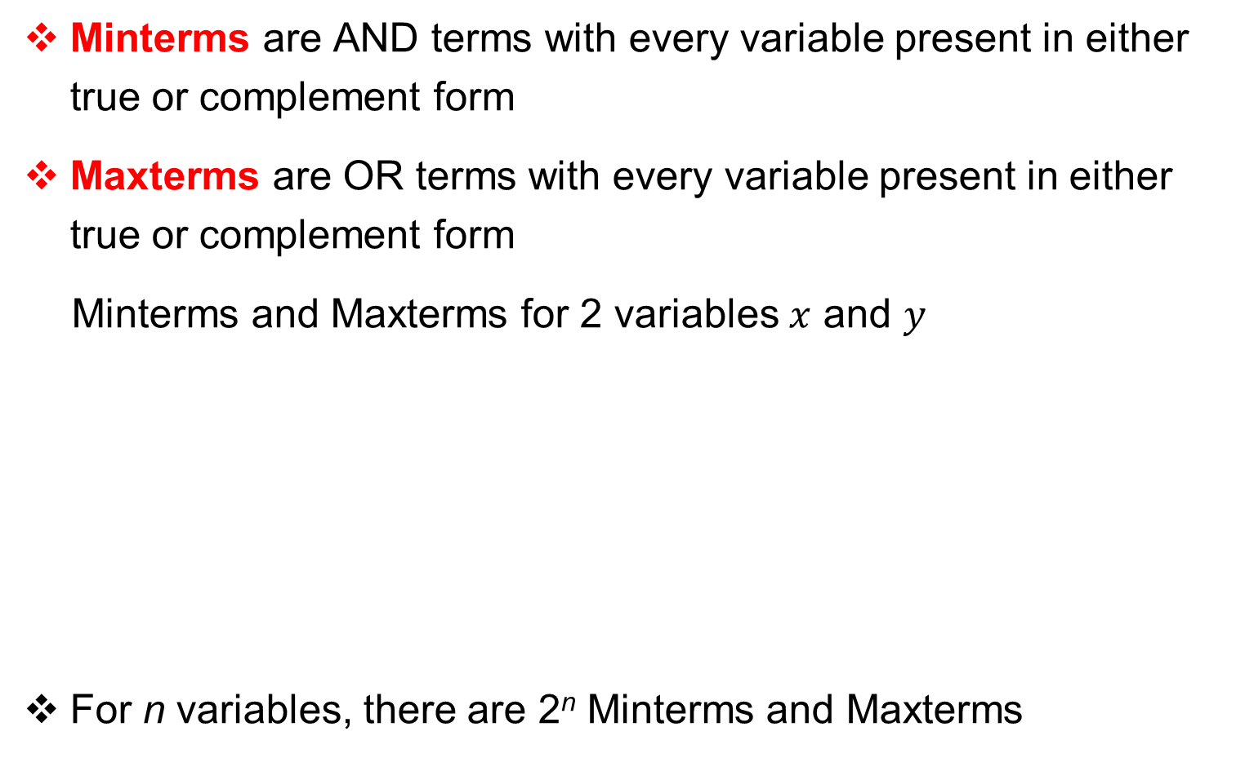
Minterms and Maxterms
Minterms are AND terms with every variable present in either true or complement form
Maxterms are OR terms with every variable present in either true or complement form
Minterms and Maxterms for 2 variables $x$ and $y$
For n variables, there are 2^{n} Minterms and Maxterms
x | y | index | Minterm | Maxterm
0 | 0 | 0 | $$m0=x′y′$$ | $$M0=x+y$$
0 | 1 | 1 | $$m1=x′y$$ | $$M1=x+y′$$
1 | 0 | 2 | $$m2=xy′$$ | $$M2=x′+y$$
1 | 1 | 3 | $$m3=xy$$ | $$M3=x′+y′$$

Slide 17
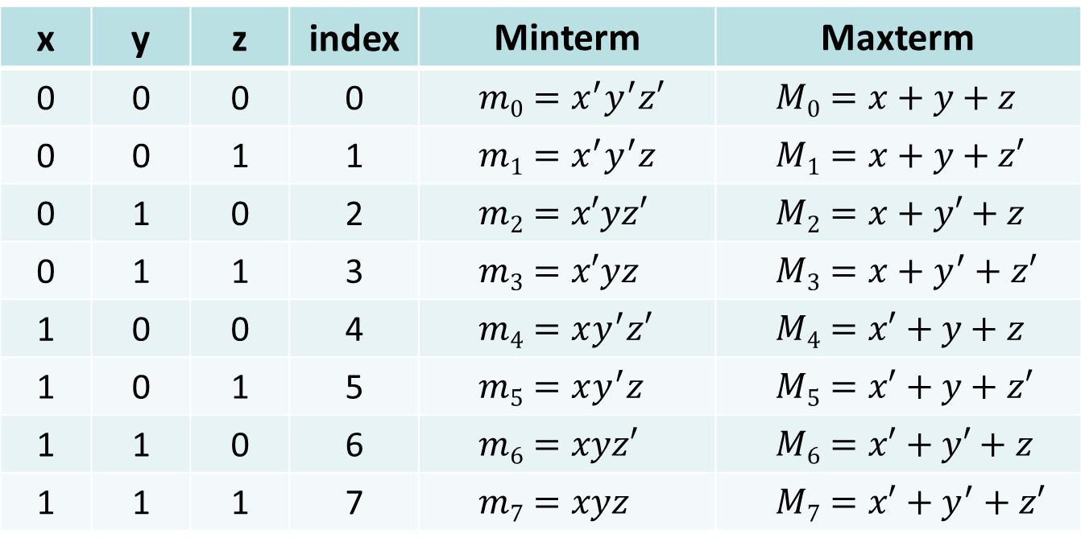
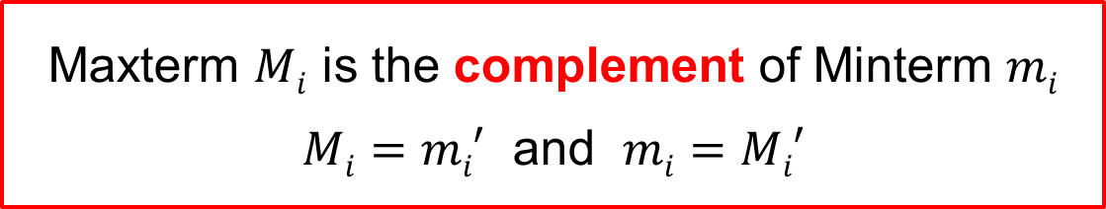
Minterms and Maxterms for 3 Variables
x | y | z | index | Minterm | Maxterm
0 | 0 | 0 | 0 | $$m0=x^{′}y^{′}z′$$ | $$M0=x+y+z$$
0 | 0 | 1 | 1 | $$m1=x^{′}y^{′}z$$ | $$M1=x+y+z′$$
0 | 1 | 0 | 2 | $$m2=x′yz′$$ | $$M2=x+y′+z$$
0 | 1 | 1 | 3 | $$m3=x′yz$$ | $$M3=x+y^{′}+z′$$
1 | 0 | 0 | 4 | $$m4=xy^{′}z′$$ | $$M4=x′+y+z$$
1 | 0 | 1 | 5 | $$m5=xy^{′}z$$ | $$M5=x′+y+z′$$
1 | 1 | 0 | 6 | $$m6=xyz′$$ | $$M6=x′+y′+z$$
1 | 1 | 1 | 7 | $$m7=xyz$$ | $$M7=x′+y^{′}+z′$$
Maxterm $Mi$ is the complement of Minterm $mi$
$Mi=mi′$ and $mi=Mi′$

Slide 18
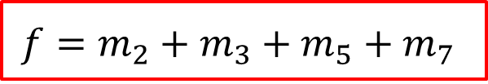
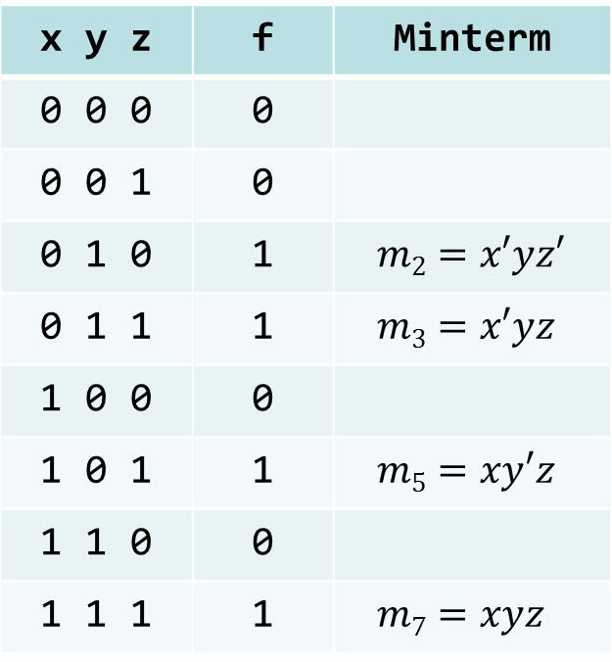
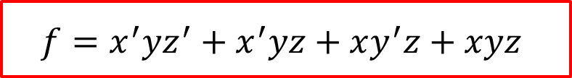
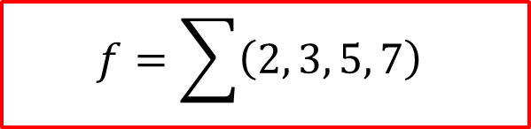
Sum-Of-Minterms (SOM) Canonical Form
Truth Table
x y z | f | Minterm
0 0 0 | 0
0 0 1 | 0
0 1 0 | 1 | $$m2=x′yz′$$
0 1 1 | 1 | $$m3=x′yz$$
1 0 0 | 0
1 0 1 | 1 | $$m5=xy′z$$
1 1 0 | 0
1 1 1 | 1 | $$m7=xyz$$
Sum of Minterm entries that evaluate to ‘1’
Focus on the ‘1’ entries
$$f=m_{2}+m_{3}+m_{5}+m_{7}$$
$$f=\sum{\left(2, 3, 5, 7\right)}$$
$$f=x^{′}yz^{′}+x^{′}yz+xy^{′}z+xyz$$

Slide 19
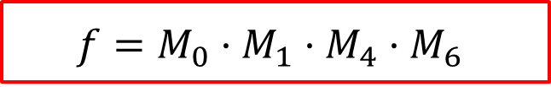
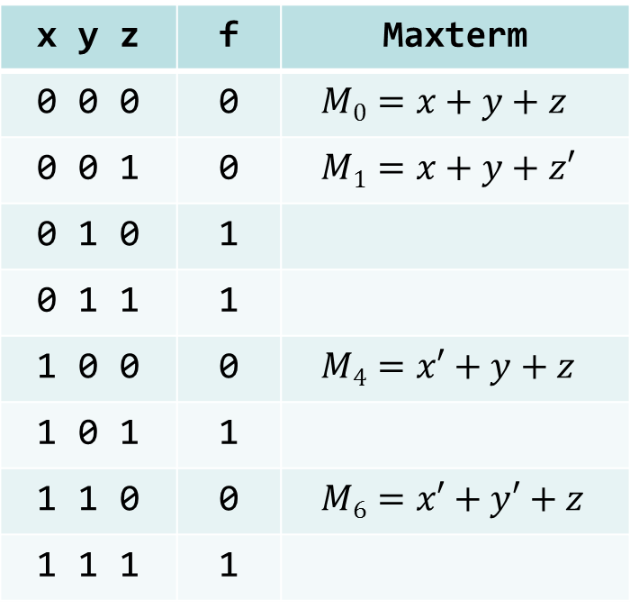

Product-Of-Maxterms (POM) Canonical Form
Truth Table
x y z | f | Maxterm
0 0 0 | 0 | $$M0=x+y+z$$
0 0 1 | 0 | $$M1=x+y+z′$$
0 1 0 | 1
0 1 1 | 1
1 0 0 | 0 | $$M4=x′+y+z$$
1 0 1 | 1
1 1 0 | 0 | $$M6=x′+y′+z$$
1 1 1 | 1
Product of Maxterm entries that evaluate to ‘0’
Focus on the ‘0’ entries
$$f=M_{0}·M_{1}·M_{4}·M_{6}$$
$$f=\prod{\left(0, 1, 4, 6\right)}$$
$$f=(x+y+z)(x+y+z^{′})(x^{′}+y+z)(x^{′}+y^{′}+z)$$

Slide 20
Purpose of the Index
Minterms and Maxterms are designated with an index
The index for the Minterm or Maxterm, expressed as a binary number, is used to determine whether the variable is shown in the true or complemented form
For Minterms:
  ‘1’ means the variable is Not Complemented
  ‘0’ means the variable is Complemented
For Maxterms:
  ‘0’ means the variable is Not Complemented
  ‘1’ means the variable is Complemented

Slide 21
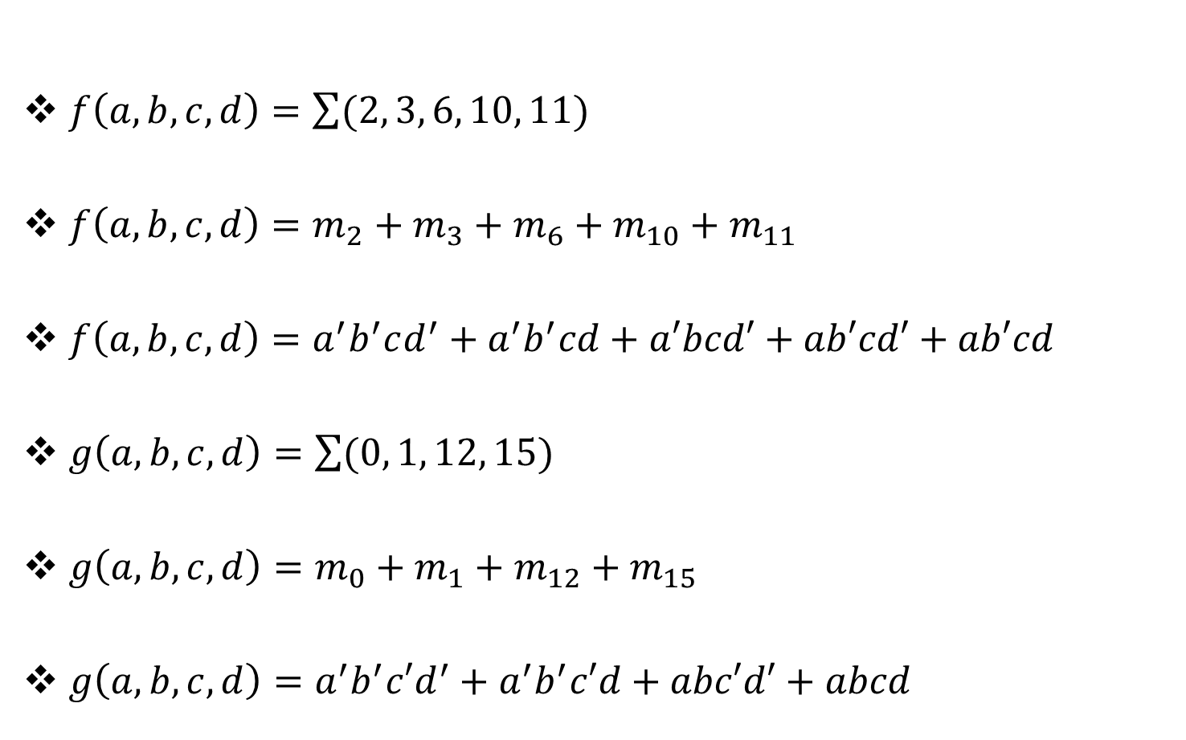
Examples of Sum-Of-Minterms
$f\left(a,b,c,d\right)=\sum{(2, 3, 6, 10, 11)}$
$f\left(a,b,c,d\right)=m_{2}+m_{3}+m_{6}+m_{10}+m_{11}$
$f\left(a,b,c,d\right)=a^{′}b^{′}cd^{′}+a^{′}b^{′}cd+a′bcd′+ab′cd′+ab′cd$
$g\left(a,b,c,d\right)=\sum{(0, 1, 12, 15)}$
$g\left(a,b,c,d\right)=m_{0}+m_{1}+m_{12}+m_{15}$
$g\left(a,b,c,d\right)=a^{′}b^{′}c′d^{′}+a^{′}b^{′}c′d+abc′d′+abcd$

Slide 22
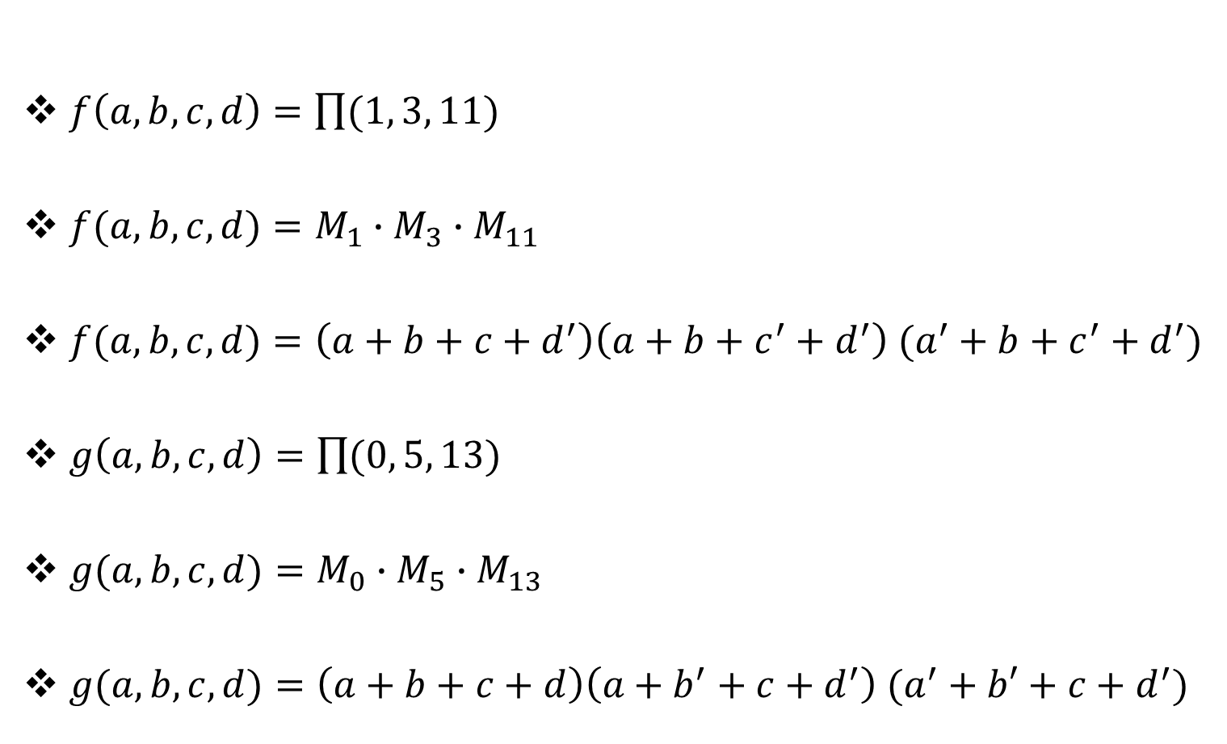
Examples of Product-Of-Maxterms
$f\left(a,b,c,d\right)=\prod{(1, 3, 11)}$
$f(a,b,c,d)=M_{1}∙M_{3}∙M_{11}$
$f(a,b,c,d)=\left(a+b+c+d^{′}\right)\left(a+b+c^{′}+d^{′}\right) (a^{′}+b+c^{′}+d^{′})$
$g\left(a,b,c,d\right)=\prod{(0, 5, 13)}$
$g(a,b,c,d)=M_{0}∙M_{5}∙M_{13}$
$g(a,b,c,d)=\left(a+b+c+d\right)\left(a+b^{′}+c+d^{′}\right) (a^{′}+b′+c+d^{′})$

Slide 23
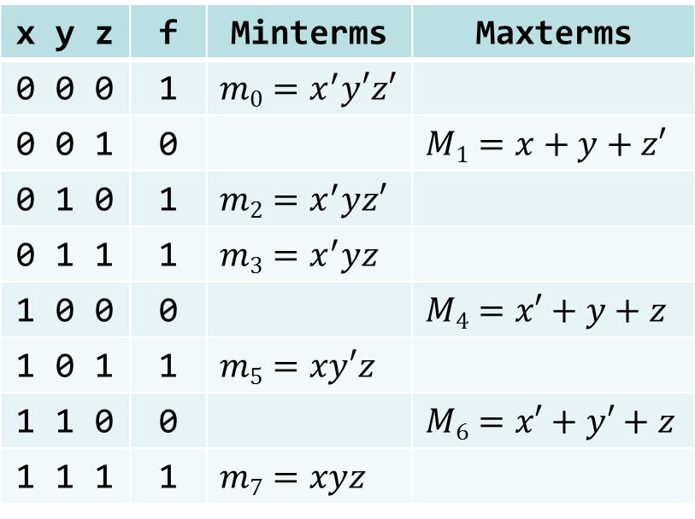
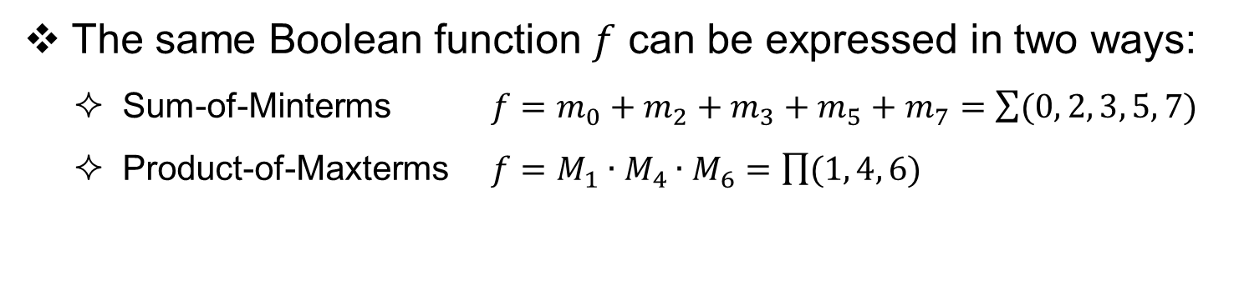
Conversions between Canonical Forms
The same Boolean function $f$ can be expressed in two ways:
  Sum-of-Minterms $f=m_{0}+m_{2}+m_{3}+m_{5}+m_{7}=\sum{(0, 2, 3, 5, 7)}$
  Product-of-Maxterms $f=M_{1}∙M_{4}∙M_{6}=\prod{(1, 4, 6)}$
Truth Table
x y z | f | Minterms | Maxterms
0 0 0 | 1 | $$m0=x^{′}y′z′$$
0 0 1 | 0 |  | $$M1=x+y+z′$$
0 1 0 | 1 | $$m2=x^{′}yz′$$
0 1 1 | 1 | $$m3=x^{′}yz$$
1 0 0 | 0 |  | $$M4=x′+y+z$$
1 0 1 | 1 | $$m5=xy′z$$
1 1 0 | 0 |  | $$M6=x′+y′+z$$
1 1 1 | 1 | $$m7=xyz$$
To convert from one canonical form to another, interchange the symbols ∑ and ∏ and list those numbers missing from the original form.

Slide 24
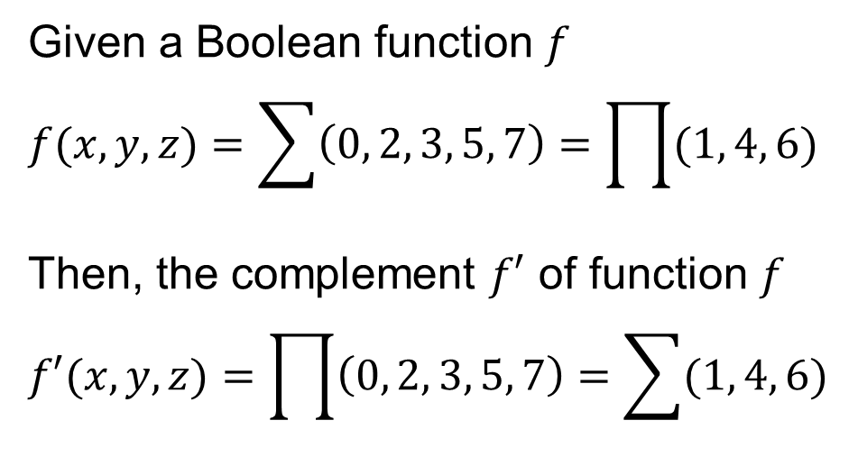
Function Complement
Truth Table
Given a Boolean function $f$
$$f(x,y,z)=\sum{\left(0, 2, 3, 5, 7\right)=\prod{(1, 4, 6)}}$$
Then, the complement $f′$ of function $f$
$$f′(x,y,z)=\prod{\left(0, 2, 3, 5, 7\right)=\sum{(1, 4, 6)}}$$
x y z | f | f'
0 0 0 | 1 | 0
0 0 1 | 0 | 1
0 1 0 | 1 | 0
0 1 1 | 1 | 0
1 0 0 | 0 | 1
1 0 1 | 1 | 0
1 1 0 | 0 | 1
1 1 1 | 1 | 0
The complement of a function expressed by a Sum of Minterms is the Product of Maxterms with the same indices. Interchange the symbols ∑ and ∏, but keep the same list of indices.

Slide 25
Summary of Minterms and Maxterms
There are 2^{n} Minterms and Maxterms for Boolean functions with n variables, indexed from 0 to 2^{n} – 1
Minterms correspond to the 1-entries of the function
Maxterms correspond to the 0-entries of the function
Any Boolean function can be expressed as a Sum-of-Minterms and as a Product-of-Maxterms
For a Boolean function, given the list of Minterm indices one can determine the list of Maxterms indices (and vice versa)
The complement of a Sum-of-Minterms is a Product-of-Maxterms with the same indices (and vice versa)

Slide 26
Next . . .
Boolean Algebra, truth tables, and DeMorgan’s theorem
Algebraic manipulation and expression simplification
From truth table to logic expression: minterms and maxterms
Logic gates, logic diagrams, and standard forms
Additional gates: NAND, NOR, XOR, XNOR

Slide 27













Logic Gates and Symbols
$$x$$
$$x$$
$$x·y$$
$$x+y$$
$$x$$
$$x′$$
$$y$$
$$y$$
AND gate
OR gate
NOT gate (inverter)
$$x$$
$$x$$
$$y$$
$$x′$$
$$y$$
AND: Switches in series
logic 0 is open switch
OR: Switches in parallel
logic 0 is open switch
NOT: Switch is normally
closed when x is 0
In the earliest days of computers, relays were used as mechanical switches controlled by electricity (coils)
Today, tiny transistors are used as electronic switches that implement the logic gates (CMOS technology)

Slide 28
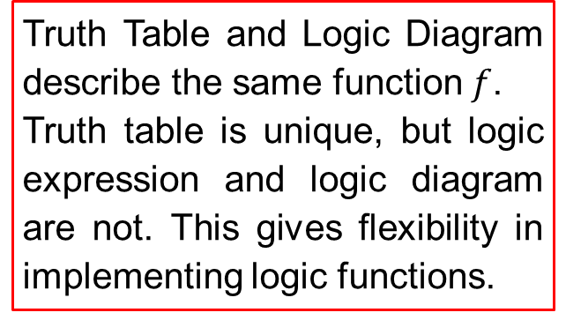





Truth Table and Logic Diagram
Given the following logic function: $f=x(y′+z)$
Draw the corresponding truth table and logic diagram
Truth Table
Logic Diagram
x y z | y'+ z | f = x(y'+ z)
0 0 0 | 1 | 0
0 0 1 | 1 | 0
0 1 0 | 0 | 0
0 1 1 | 1 | 0
1 0 0 | 1 | 1
1 0 1 | 1 | 1
1 1 0 | 0 | 0
1 1 1 | 1 | 1
$$x$$
$$f=x(y^{′}+z)$$
$$y$$
$$z$$
Truth Table and Logic Diagram describe the same function $f$.
Truth table is unique, but logic expression and logic diagram are not. This gives flexibility in implementing logic functions.

Slide 29
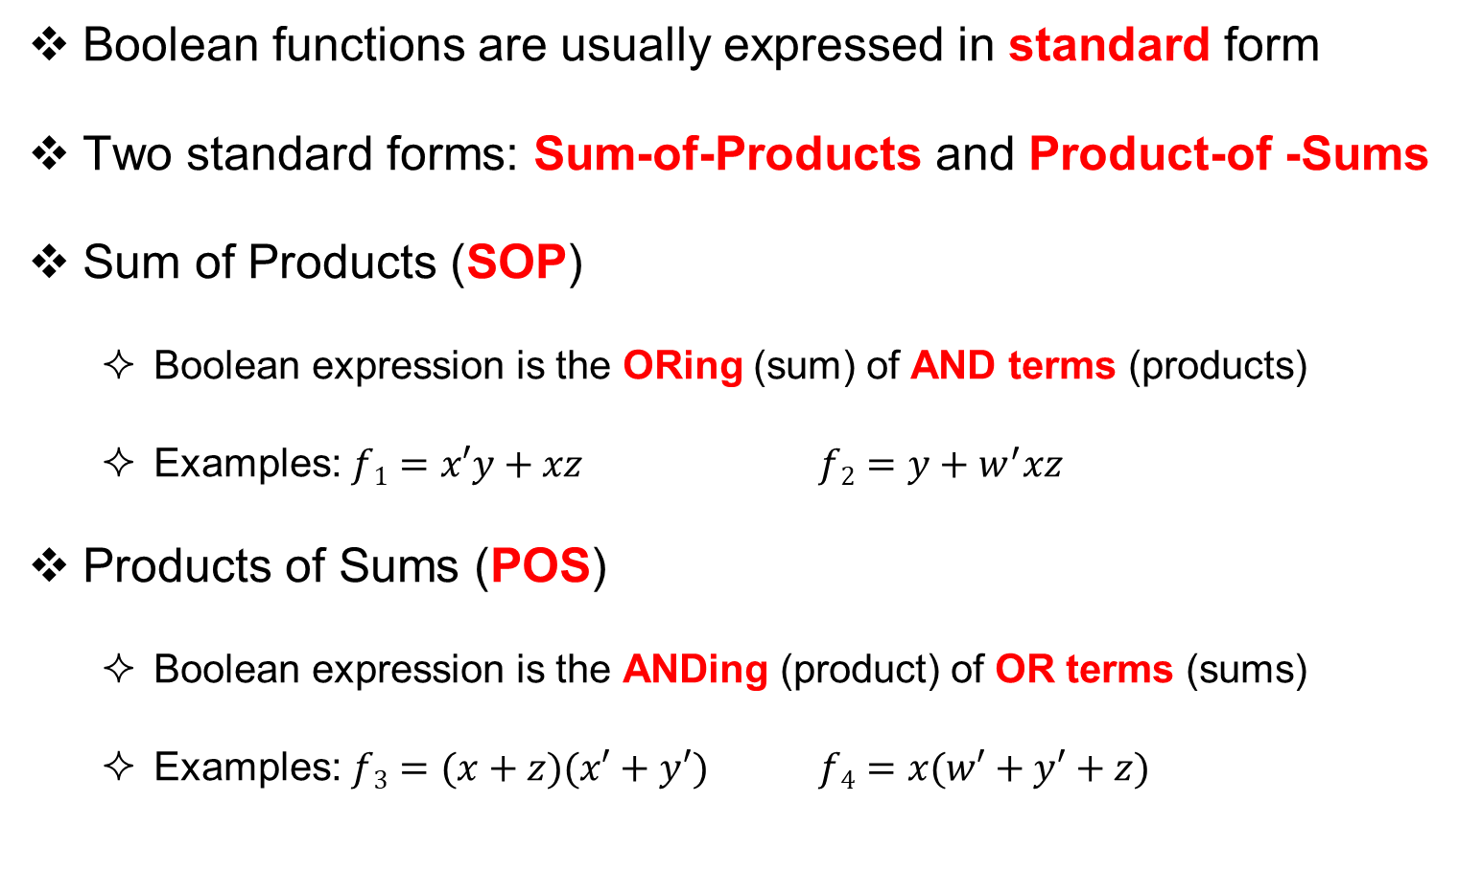
Standard Forms
Boolean functions are usually expressed in standard form
Two standard forms: Sum-of-Products and Product-of -Sums
Sum of Products (SOP)
  Boolean expression is the ORing (sum) of AND terms (products)
  Examples: $f1=x′y+xz$ $f2=y+w^{′}xz$
Products of Sums (POS)
  Boolean expression is the ANDing (product) of OR terms (sums)
  Examples: $f3=(x+z)(x′+y′)$ $f4=x(w′+y′+z)$

Slide 30
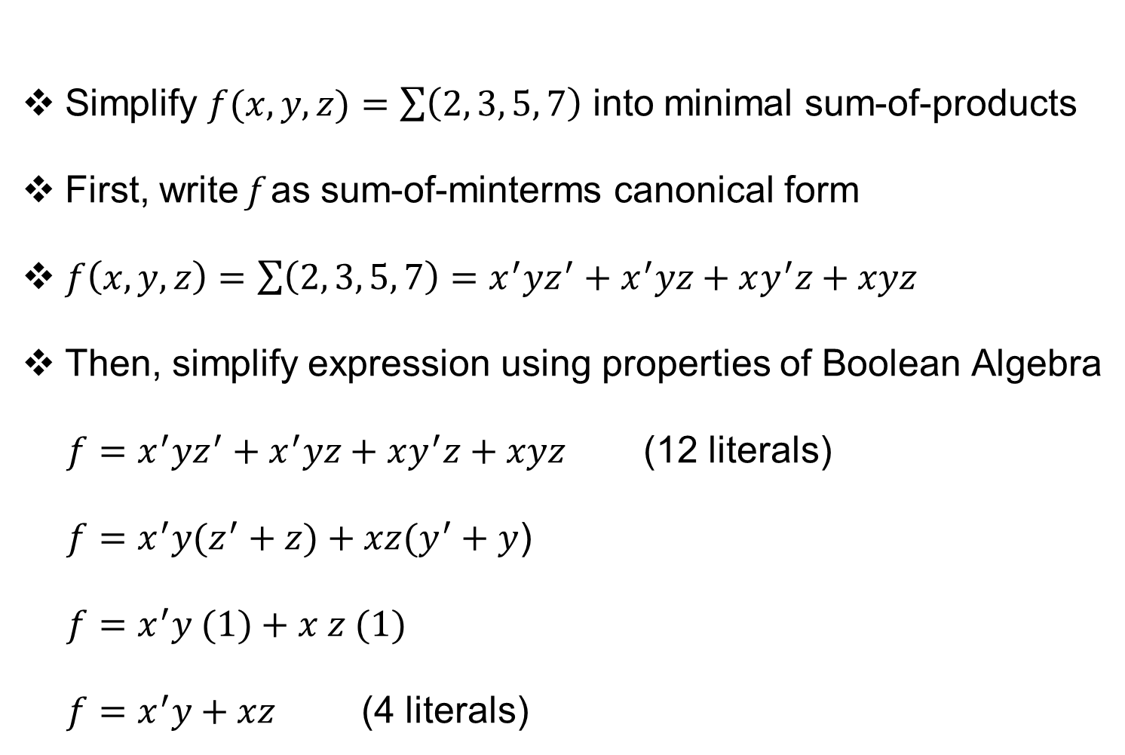
From Sum-of-Minterms to Sum-of-Products
Simplify $f(x,y,z)=\sum{\left(2, 3, 5, 7\right)}$ into minimal sum-of-products
First, write f as sum-of-minterms canonical form
$f\left(x,y,z\right)=\sum{\left(2, 3, 5, 7\right)}=x^{′}yz^{′}+x^{′}yz+xy^{′}z+xyz$
Then, simplify expression using properties of Boolean Algebra
${f=x}^{′}yz^{′}+x^{′}yz+xy^{′}z+xyz$ (12 literals)
${f=x}^{′}y(z^{′}+z)+xz(y^{′}+y$)
${f=x}^{′}y (1)+x z (1)$
${f=x}^{′}y+xz$ (4 literals)

Slide 31
























Two-Level Gate Implementation
$$f1=x′y+xz$$
$$f2=y+w^{′}xz$$
$$x′$$
$$y$$
$$y$$
$$f2$$
$$f1$$
$$w′$$
$$x$$
$$x$$
$$z$$
AND-OR
implementations
$$z$$
3-input AND gate
$$f3=(x+z)(x^{′}+y^{′})$$
$$f4=x(w^{′}+y^{′}+z)$$
$$x$$
$$x$$
$$z$$
$$f4$$
$$f3$$
$$w′$$
$$x′$$
$$y′$$
$$y′$$
OR-AND
implementations
$$z$$
3-input OR gate

Slide 32


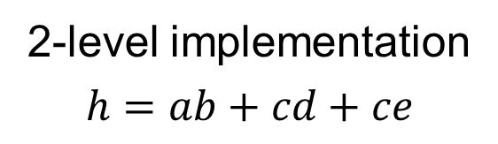



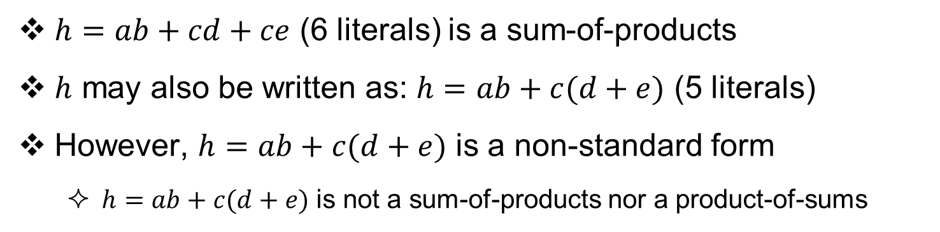






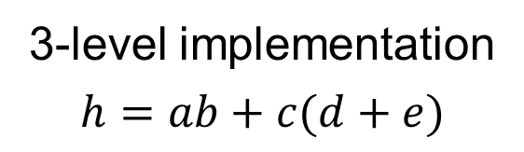


Two-Level vs. Three-Level Implementation
$h=ab+cd+ce$ (6 literals) is a sum-of-products
$h$ may also be written as: $h=ab+c(d+e)$ (5 literals)
However, $h=ab+c(d+e)$ is a non-standard form
  $h=ab+c(d+e)$ is not a sum-of-products nor a product-of-sums
2-level implementation
$$h=ab+cd+ce$$
3-level implementation
$$h=ab+c(d+e)$$
$$a$$
$$b$$
$$a$$
$$b$$
$$c$$
$$h$$
$$c$$
$$h$$
$$d$$
$$d$$
$$c$$
$$e$$
$$e$$
3-input OR gate

Slide 33
Next . . .
Boolean Algebra, truth tables, and DeMorgan’s theorem
Algebraic manipulation and expression simplification
From truth table to logic expression: minterms and maxterms
Logic gates, logic diagrams, and standard forms
Additional gates: NAND, NOR, XOR, XNOR

Slide 34
Additional Logic Gates and Symbols
Why?
  Low-cost implementation
  Useful in implementing Boolean functions
$$x$$
$$x$$
$$x·y$$
$$x+y$$
$$x$$
$$x′$$
$$y$$
$$y$$
AND gate
OR gate
NOT gate (inverter)
$$x$$
$$x$$
$${\left(x·y\right)}^{′}$$
$$(x+y)′$$
$$y$$
$$y$$
NAND gate
NOR gate
$$x$$
$$x$$
$$x⊕y$$
$$(x⊕y)′$$
$$y$$
$$y$$
XOR gate
XNOR gate

Slide 35
NAND Gate
The NAND gate has the following symbol and truth table
NAND represents NOT AND
The small bubble circle represents the invert function
NAND gate is implemented efficiently in CMOS technology
  In terms of chip area and speed
x y | NAND
0 0 | 1
0 1 | 1
1 0 | 1
1 1 | 0
$$x$$
$${\left(x·y\right)}^{′}=x^{′}+y′$$
$$y$$
NAND gate
$$x$$
$$x′+y′$$
$$y$$
Another symbol for NAND

Slide 36
NOR Gate
The NOR gate has the following symbol and truth table
NOR represents NOT OR
The small bubble circle represents the invert function
NOR gate is implemented efficiently in CMOS technology
  In terms of chip area and speed
x y | NOR
0 0 | 1
0 1 | 0
1 0 | 0
1 1 | 0
$$x$$
$${\left(x+y\right)}^{′}=x^{′}·y′$$
$$y$$
NOR gate
$$x$$
$$x′·y′$$
$$y$$
Another symbol for NOR

Slide 37
Multiple-Input NAND / NOR Gates
NAND/NOR gates can have multiple inputs, similar to AND/OR gates
$$x$$
$$w$$
$$x$$
$$y$$
$${\left(x·y·z\right)}^{′}$$
$$x$$
$${\left(w·x·y·z\right)}^{′}$$
$${\left(x·y\right)}^{′}$$
$$y$$
$$y$$
$$z$$
$$z$$
2-input NAND gate
3-input NAND gate
4-input NAND gate
$$x$$
$$w$$
$$x$$
$$y$$
$${\left(x+y+z\right)}^{′}$$
$$x$$
$${\left(w+x+y+z\right)}^{′}$$
$${\left(x+y\right)}^{′}$$
$$y$$
$$y$$
$$z$$
$$z$$
2-input NOR gate
3-input NOR gate
4-input NOR gate
Note: a 3-input NAND is a single gate, NOT a combination of two 2-input gates. The same can be said about other multiple-input NAND/NOR gates.

Slide 38
NAND – NAND Implementation
Consider the following sum-of-products expression:
$$f=bd+a′cd′$$
A 2-level AND-OR circuit can be converted easily to a 2-level NAND-NAND implementation
2-Level AND-OR
Inserting Bubbles
2-Level NAND-NAND
$$b$$
$$b$$
$$b$$
$$d$$
$$d$$
$$d$$
$$f$$
$$f$$
$$f$$
$$a′$$
$$a′$$
$$a′$$
$$c$$
$$c$$
$$c$$
$$d′$$
3-input
AND gate
$$d′$$
$$d′$$
3-input
NAND gate
Two successive bubbles on same line cancel each other

Slide 39
NOR – NOR Implementation
Consider the following product-of-sums expression:
$$g=(a+d)(b+c+d′)$$
A 2-level OR-AND circuit can be converted easily to a 2-level NOR-NOR implementation
2-Level OR-AND
Inserting Bubbles
2-Level NOR-NOR
$$a$$
$$a$$
$$a$$
$$d$$
$$d$$
$$d$$
$$g$$
$$g$$
$$g$$
$$b$$
$$b$$
$$b$$
$$c$$
$$c$$
$$c$$
$$d′$$
3-input
OR gate
$$d′$$
$$d′$$
3-input
NOR gate
Two successive bubbles on same line cancel each other

Slide 40
Exclusive OR / Exclusive NOR
Exclusive OR (XOR) is an important Boolean operation used extensively in logic circuits
Exclusive NOR (XNOR) is the complement of XOR
x y | XOR
0 0 | 0
0 1 | 1
1 0 | 1
1 1 | 0
x y | XNOR
0 0 | 1
0 1 | 0
1 0 | 0
1 1 | 1
XNOR is also known as equivalence
$$x$$
$$x$$
$$x ⨁ y$$
$$(x ⨁ y)′$$
$$y$$
$$y$$
XOR gate
XNOR gate

Slide 41
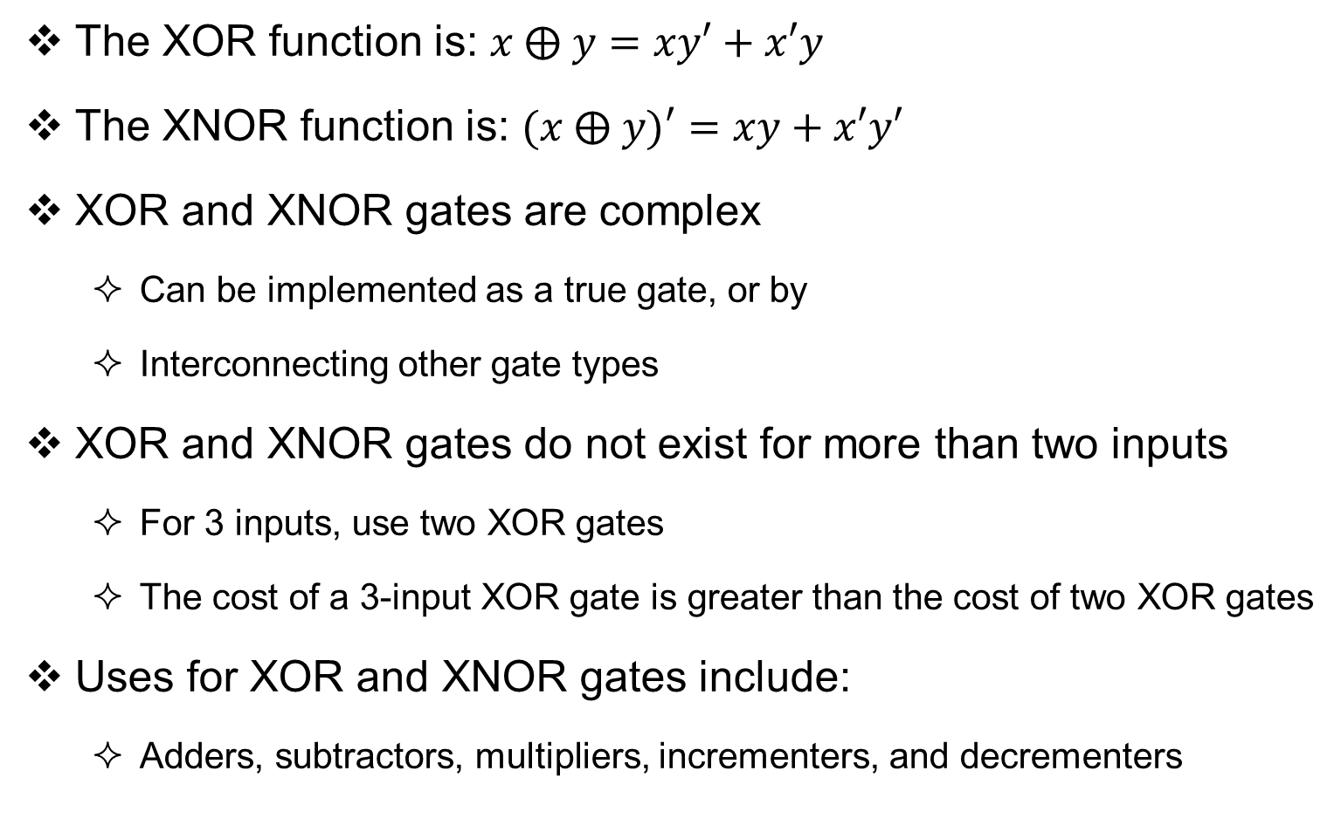
XOR / XNOR Functions
The XOR function is: $x ⨁ y=xy′+x′y$
The XNOR function is: $(x ⨁ y)′=xy+x′y′$
XOR and XNOR gates are complex
  Can be implemented as a true gate, or by
  Interconnecting other gate types
XOR and XNOR gates do not exist for more than two inputs
  For 3 inputs, use two XOR gates
  The cost of a 3-input XOR gate is greater than the cost of two XOR gates
Uses for XOR and XNOR gates include:
  Adders, subtractors, multipliers, incrementers, and decrementers

Slide 42
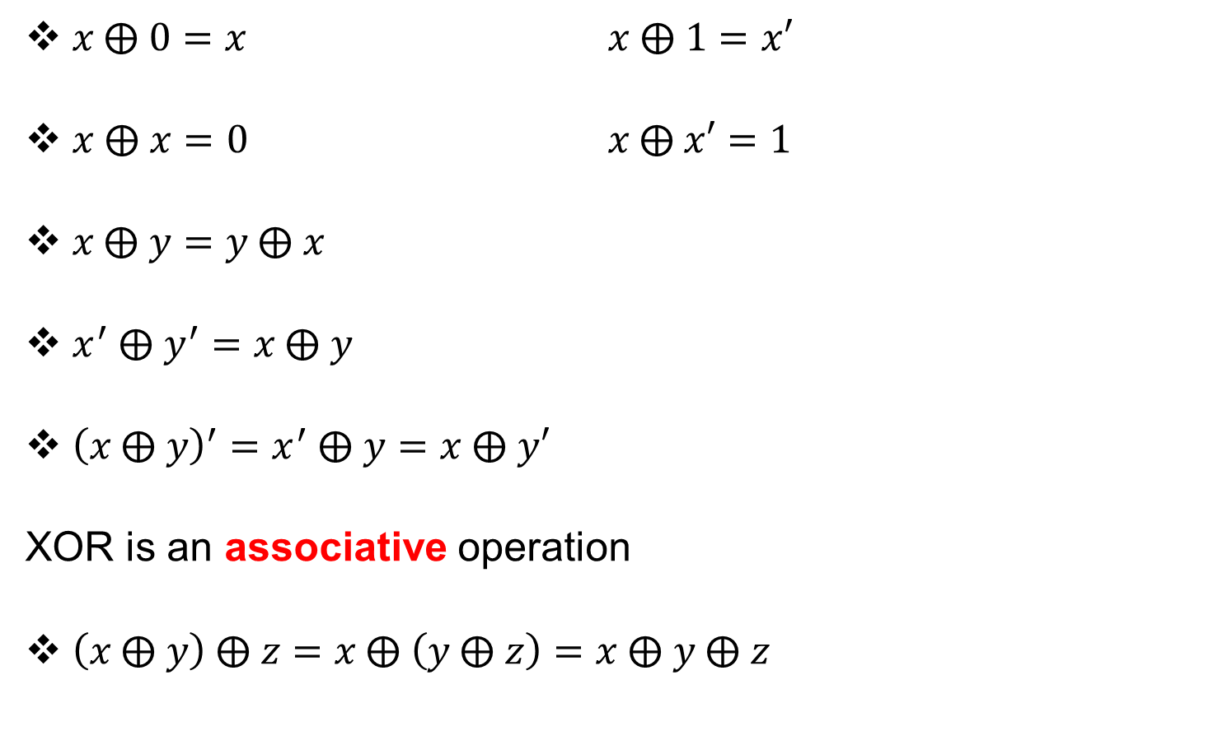
XOR and XNOR Properties
$x \text{⨁} 0=x$ $x \text{⨁} 1=x′$
$x ⨁ x=0$ $x \text{⨁} x′=1$
$x \text{⨁} y=y \text{⨁} x$
$x^{′} \text{⨁} y^{′}=x \text{⨁} y$
${\left(x \text{⨁} y\right)}^{′}=x^{′} \text{⨁} y=x \text{⨁} y′$
XOR is an associative operation
$\left(x \text{⨁} y\right) \text{⨁} z=x \text{⨁} \left(y \text{⨁} z\right)=x \text{⨁} y \text{⨁} z$

Slide 43
Odd Function
Output is 1 if the number of 1's is odd in the inputs
Output is the XOR operation on all input variables
x y z | fodd
0 0 0 | 0
0 0 1 | 1
0 1 0 | 1
0 1 1 | 0
1 0 0 | 1
1 0 1 | 0
1 1 0 | 0
1 1 1 | 1
$$fodd=\sum{(1, 2, 4, 7)}$$
$$fodd=x^{′}y^{′}z+x^{′}yz^{′}+xy^{′}z^{′}+xyz$$
$$fodd=x ⨁ y ⨁ z$$
Odd Function with 3 inputs
$$x$$
$$y$$
$$fodd$$
$$z$$
Implementation using two XOR gates

Slide 44
Even Function
w x y z | feven
0 0 0 0 | 1
0 0 0 1 | 0
0 0 1 0 | 0
0 0 1 1 | 1
0 1 0 0 | 0
0 1 0 1 | 1
0 1 1 0 | 1
0 1 1 1 | 0
1 0 0 0 | 0
1 0 0 1 | 1
1 0 1 0 | 1
1 0 1 1 | 0
1 1 0 0 | 1
1 1 0 1 | 0
1 1 1 0 | 0
1 1 1 1 | 1
Output is 1 if the number of 1's is even in the inputs (complement of odd function)
Output is the XNOR operation on all inputs
$$feven=\sum{(0, 3, 5, 6, 9, 10, 12, 15)}$$
Even Function with 4 inputs
$$feven=(w \text{⨁} x \text{⨁} y \text{⨁} z)′$$
$$w$$
$$x$$
$$feven$$
$$y$$
$$z$$
Implementation using two XOR gates and one XNOR

