Slide 1
COE 526 Data Privacy
Lecture 6: Statistical Data Privacy

Slide 2
Announcement
Quiz 2 next Tuesday 6/10/2020
Material: Lecture 5 and 6

Slide 3
Outline
Objectives of data analysis
Interactive and non-interactive data analysis
Blatant non-privacy
Data Reconstruction Attack on statistical data
Randomized Response procedure

Slide 4
Objectives of Data Analysis
Data is published and released for researchers to analyze and extract information
There are two types of data analysis problems
  "Needle in a haystack” problems: Classification and association rules problems
    Example: what causes lung cancer? which movie to watch next?
  Learn statistical trends of the whole population
    Example: percentage of low-income population in Census data, percentage of patients with certain chronic diseases
Two types of data analysis setting
  Non-interactive setting
  Interactive setting

Slide 5

Non-interactive Setting
Raw Data
x₁
…
x_{n}
Analyst
Database D
Published and maintained
by trusted curator
Example:
Census data
Health data
Network data

Slide 6
Non-interactive Setting
Anonymized Data
Sanitized
Database
D'
Raw Data
x₁
…
x_{n}
Analyst
Sanitized Database (Anonymized database)
Database D
Goals:
Accurate information (minimum changes)
Preserve individual privacy

Slide 7
Interactive Setting
What is the average salary
for employee with
age > 30?
Query f
x₁
…
x_{n}
Analyst
40K
f(D)
Database D
Data is not published/released
to analysts

Slide 8
Does Statistics Preserve Privacy?
Providing statistics about the population gives the impression of privacy
  "No one know I am in the sample … I can claim I wasn’t there"
  "This study isn’t about me”
But….
"If the release of statistics S makes it possible to determine the value [of private information] more accurately than is possible without access to S, a disclosure has taken place" [Dalenius 1977]

Slide 9
Blatant Non-Privacy
Responses of subsequent queries can
  Leak individual records
  link with public databases to re-identify individuals
  Allow adversary to reconstruct database with significant probablity
Example: COE has 1 female faculty
  What is average faculty salary?
  What is average male faculty salary?
f₁
f₁(D)
x₁
…
x_{n}
f₂
f₂(D)
f₃
Analyst
Database D
f_{3(D)}

Slide 10
Database Reconstruction Attack (DRA)
Published statistical tables are vulnerable to DRAs
The underlying microdata is recovered merely by finding another set of microdata that is consistent with the published statistical tabulations
A DRA can be performed by using the tables to create a set of mathematical constraints and then solving the resulting set of simultaneous equations

Slide 11
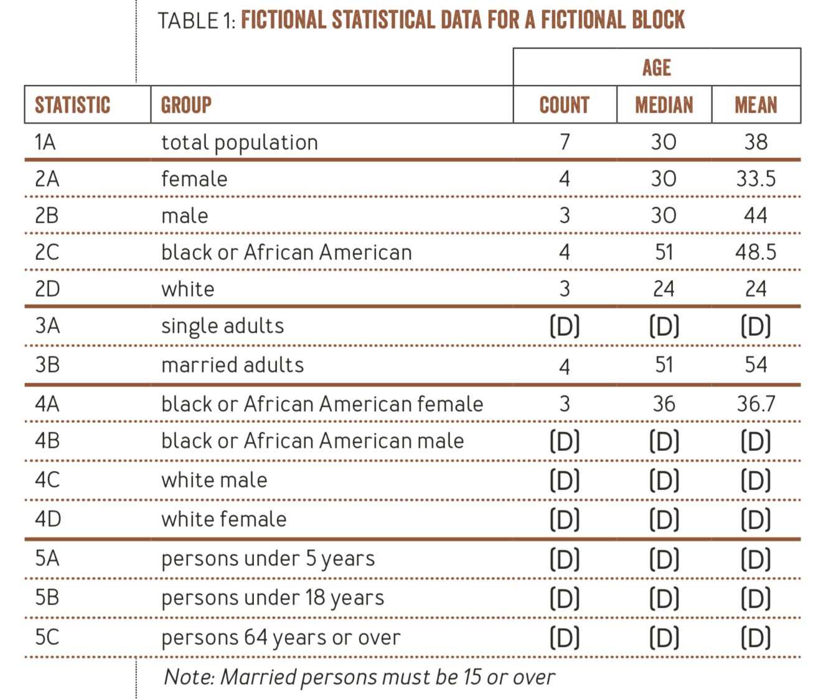
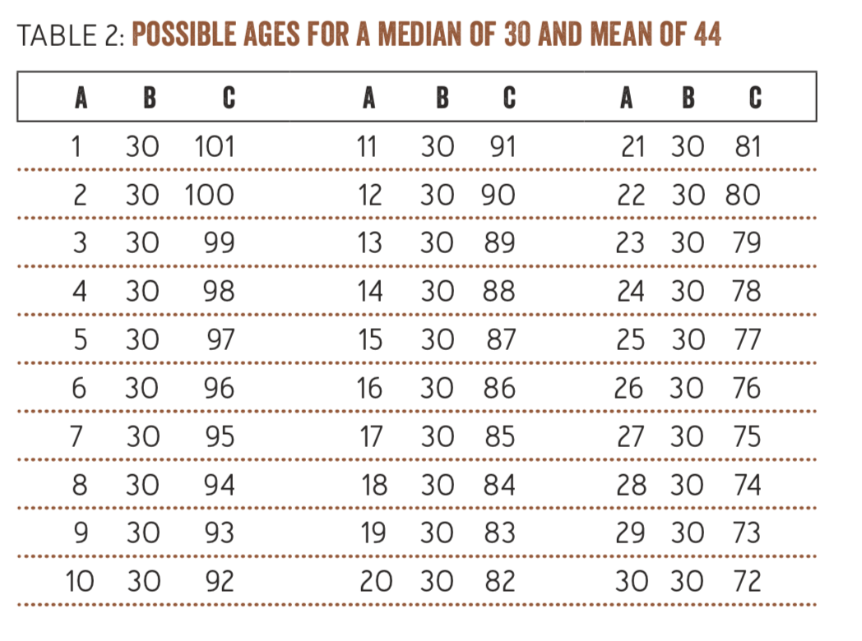
Example of DRA
(Not included in Exam)
https://digitalcommons.ilr.cornell.edu/cgi/viewcontent.cgi?article=1051&context=ldi

Slide 12
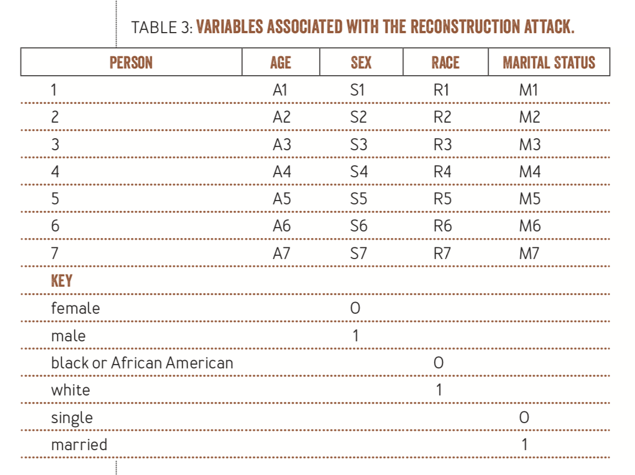
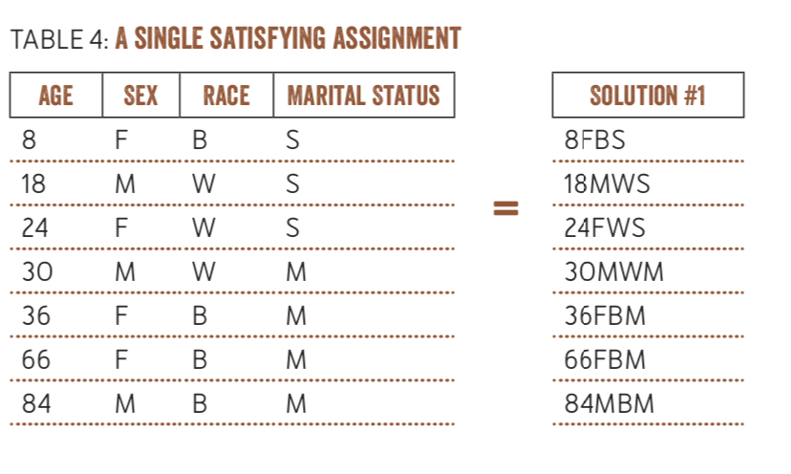
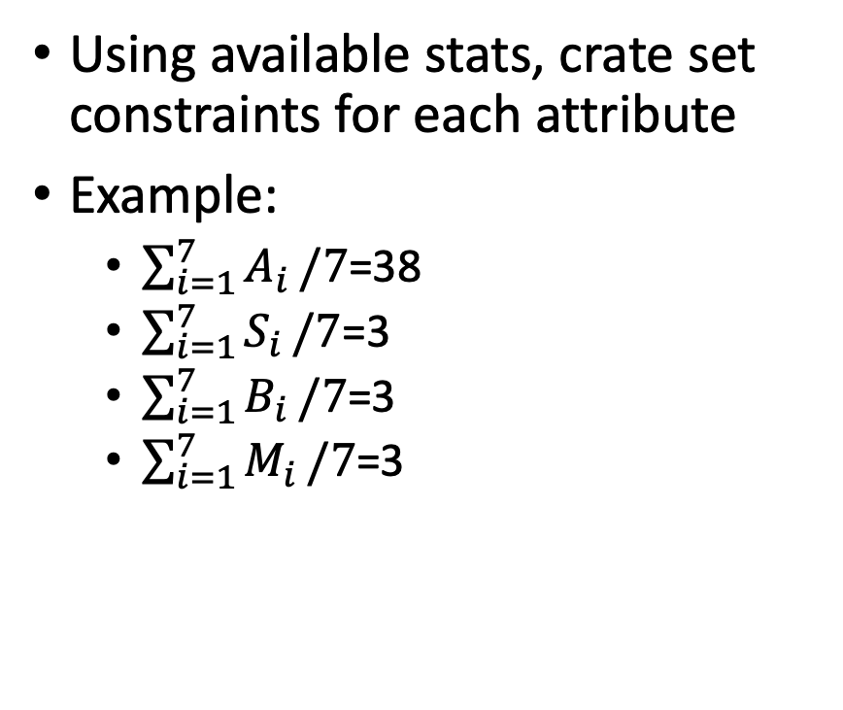
Example of DRA
(Not included in Exam)
Using available stats, crate set
constraints for each attribute
Example:
  $\sum_{i=1}^{7}{A_{i}}/7$=38
  $\sum_{i=1}^{7}{S_{i}}/7$=3
  $\sum_{i=1}^{7}{B_{i}}/7$=3
  $\sum_{i=1}^{7}{M_{i}}/7$=3

Slide 13
Statistical Disclosure Control
Query f
x₁
…
x_{n}
Statistical
Disclosure
Control
f(D)
Database D
Analyst
Goals:
Accurate statistics (low noise)
Preserve individual privacy

Slide 14
Defending Against DRA
Query set restriction: allows the query results to be displayed only if the size of the query set satisfies the condition (e.g. > k)
Data perturbation: apply noise before tabulation
Output perturbation: apply noise to the output of the query (i.e. published statistics)

Slide 15
Output Perturbation
Output perturbation can be achieved using a randomized function
Definition: A randomized function is an algorithm that uses some degree of randomness in its logic
Query f
x₁
…
x_{n}
Analyst
R(f(D)) = f(D) + noise
Database D

Slide 16
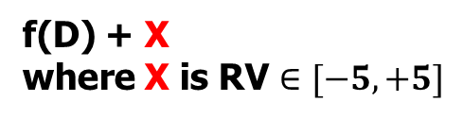
Output Perturbation
# individuals with salary > $30K
Query f
x₁
…
x_{n}
Analyst
f(D) + X
where X is RV $∈[−5,+5]$
Database D
How much noise should be added to the true answer f(D)?

Slide 17
Randomized Response
Have you ever shoplifted?
Query f
x₁
…
x_{n}
Analyst
Yes
No
Database D
With sensitive questions, people might be reluctant to answer faithfully
We are interested in statistical information only (e.g. % people who have shoplifted)

Slide 18
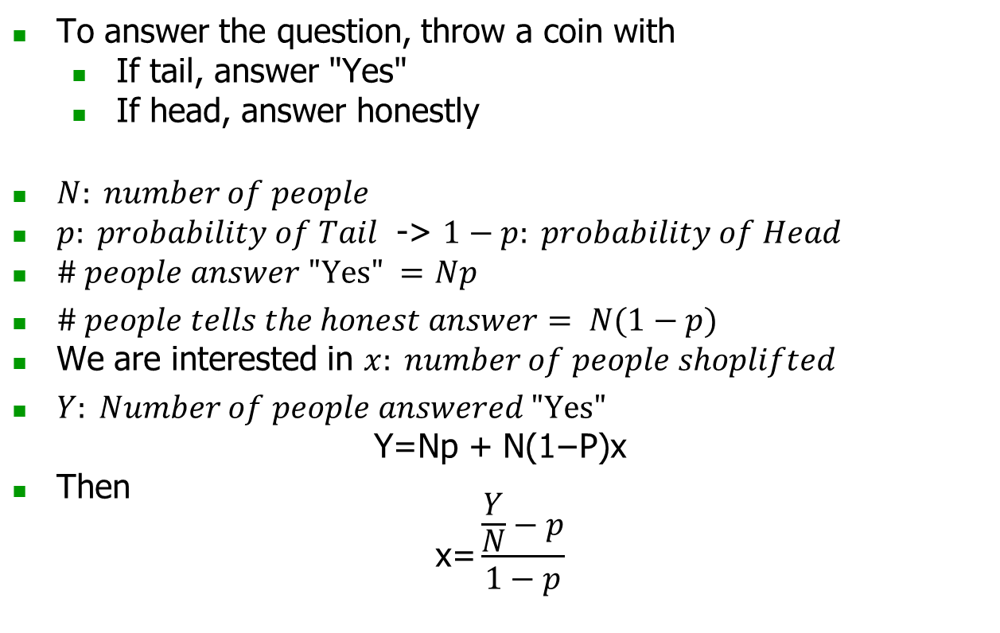
Werner's Process
To answer the question, throw a coin with
  If tail, answer "Yes"
  If head, answer honestly
$N: number of people$
$p: probability of Tail$ -> $1−p: probability of Head$
$\# people answer "Yes" =$ $Np$
$\# people tells the honest answer= N(1−p)$
We are interested in $x: number of people shoplifted$
$Y: Number of people answered "Yes"$
$\text{Y}\text{=}\text{Np}\text{ + }\text{N}\text{(1−}\text{P}\text{)}\text{x}$
Then
$\text{x}\text{=}\frac{\frac{Y}{N}−p}{1−p}$

Slide 19
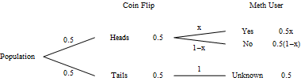
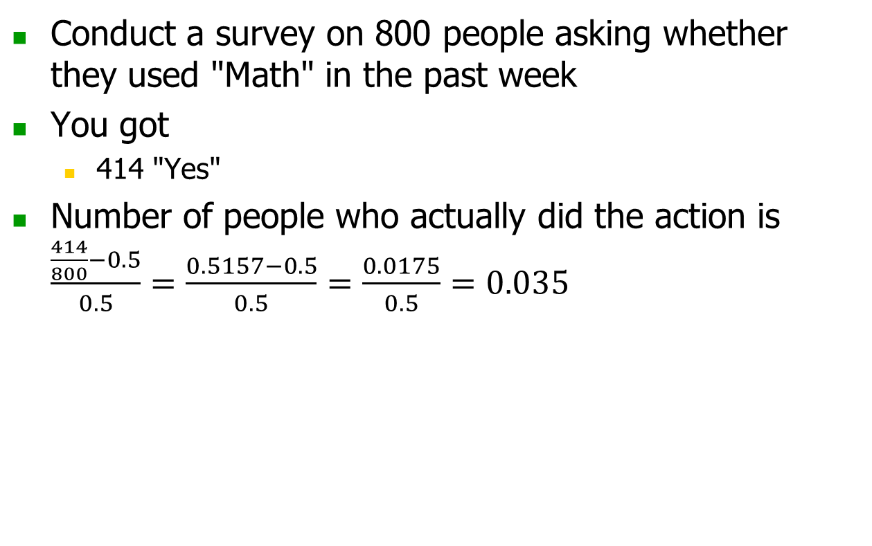
Example
Conduct a survey on 800 people asking whether they used "Math" in the past week
You got
  414 "Yes"
Number of people who actually did the action is $\frac{\frac{414}{800}−0.5}{0.5}=\frac{0.5157−0.5}{0.5}=\frac{0.0175}{0.5}=0.035$
http://www.milefoot.com/math/stat/prob-randresponse.htm

Slide 20
An Impossibility Result
A result from Delanius’s definition of privacy
“It is not possible to design any non-trivial mechanism that satisfies such strong notion of privacy.”
Result: For any reasonable definition of breach, if sanitized database contains information about database, then there exists an adversary and an auxiliary information generator that causes a breach with some nontrivial probability
Example
  Terry Gross is two inches shorter than the average Lithuanian woman
  DB allows computing average height of a Lithuanian woman
  This DB breaks Terry Gross’s privacy according to this definition…
  even if her record is not in the database!

Slide 21
No-Free-Lunch Theorem in Privacy
“it is not possible to guarantee privacy and utility without making assumptions about the data-generating mechanism.”
Result: we have to make certain assumptions about the database in order to gain provable guarantees of privacy with acceptable utility

Slide 22
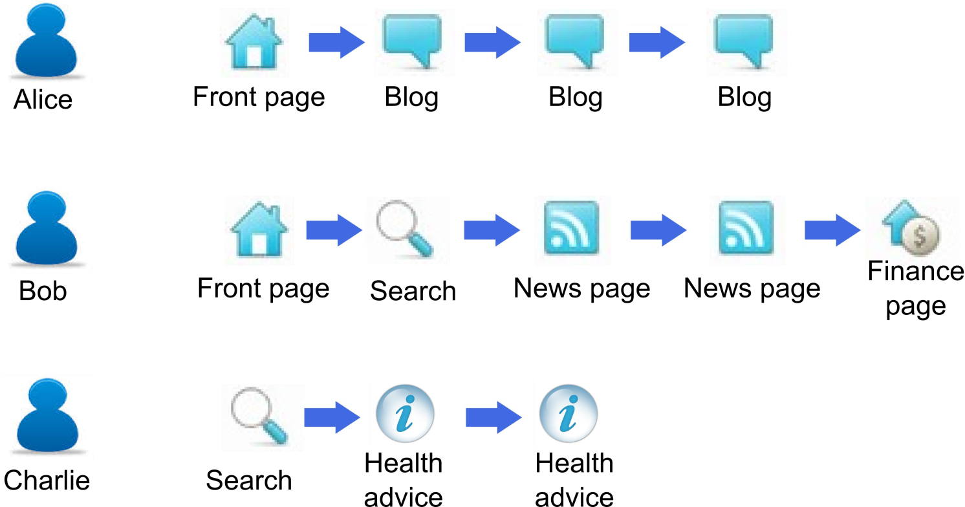


Differential Privacy
Promise: an individual will not be affected by allowing his/her data to be used in any study or analysis, no matter what other studies, datasets, or information sources, are available
Statistical outcome is indistinguishable regardless whether a particular user (record) is included in the data

Slide 23
Summary
Difference between interactive and non-interactive data analysis
Privacy requirement in interactive data analysis
Shortcoming of statistical data privacy
Randomized response procedure

