Slide 1
COE 526 Data Privacy
Lecture 5: Data Anonymization

Slide 2
Outline
Objective of data sharing (publishing)
Privacy requirement for data sharing
k-anonymization
Definition
Methods for k-anonymization
Greedy Partitioning algorithm
Attacks on k-anonymization
Data sharing beyond k-anonymization
l-diversity
t-closeness

Slide 3
Privacy Preserving Data Sharing
It is often necessary to share (publish) data
Mandated by laws and regulations
E.g., Census
For research purposes
E.g., social, medical, technological, etc.
For security/business decision making
E.g., network flow data for Internet-scale alert correlation
For system testing before deployment
Publishing data may result in privacy violations
Objective: Maximize data utility while maintaining acceptable level of data privacy

Slide 4
Data Linkage Attack
Example: In 1997, a researcher was able to re-identify the information of MA governor by linking released (anonymized) medical data with public voter list
Group Insurance Commissions (GIC, Massachusetts)
Collected data of ~135k states employees
A pseudonymized version was shared with researchers
Voter data purchased for $20
Ethnicity
Visit data
Diagnosis
Procedure
Medication
Charge
...
Name
Address
Date registered
Party affiliation
Date last voted
zip
dob
sex
Medical data
Voter list

Slide 5
Data Linkage Attack (Cont.)
Fact: 87% of the US citizens can be uniquely linked using only three attributes <Zipcode, DOB, Sex>
According to MA voter list, only six people share the BoD with state governor
3 men and 3 women
One has same Zip code
GIC data
ID | DOB | Sex | Zipcode | Disease
1 | 1/21/76 | Male | 53715 | Heart Disease
2 | 4/13/86 | Female | 53715 | Hepatitis
3 | 2/28/76 | Male | 53703 | Brochitis
4 | 1/21/76 | Male | 53703 | Broken Arm
5 | 4/13/86 | Female | 53706 | Flu
6 | 2/28/76 | Female | 53706 | Hang Nail
Voter data
Name | DOB | Sex | Zipcode
Andre | 1/21/76 | Male | 53715
Beth | 1/10/81 | Female | 55410
Carol | 10/1/44 | Female | 90210
Dan | 2/21/84 | Male | 02174
Ellen | 4/19/72 | Female | 02237

Slide 6
Data Linkage Attack (Cont.)
In 2006, Netflix launched "The Netflix Prize"
Users names were replaced with random numbers
The prize was canceled in 2009 after two researchers identified individual users by linking data with IMDB!
18k movies
100M
ratings
{?, 0,1,...,5}
480k
users

Slide 7
Main Problems
How to define privacy and utility in data sharing?
How to anonymize data to satisfy privacy while providing utility?
How to measure the utility of published data?

Slide 8
Terminologies
Attribute
Key Attribute: uniquely identifies an individual directly
Name, Address, Cell Phone
Always removed before release!
Quasi-Identifier: A set of attributes that can be potentially linked with external information to re-identify entities
ZIP code, Birth date, gender
Can be removed, but utility will degrade
Sensitive Attribute: A set of attributes that need to be released to researchers but raises privacy concerns
Medical record, wage, etc.
Record
ID | DOB | Sex | Zipcode | Disease
1 | 1/21/76 | Male | 53715 | Heart Disease
2 | 4/13/86 | Female | 53715 | Hepatitis
3 | 2/28/76 | Male | 53703 | Brochitis
4 | 1/21/76 | Male | 53703 | Broken Arm
5 | 4/13/86 | Female | 53706 | Flu
6 | 2/28/76 | Female | 53706 | Hang Nail
Table

Slide 9
Privacy Requirements in Data Sharing
Objective is to preventing the following disclosures
Membership disclosure: link a particular individual to a table (E.g. Bob is an engineer -> he is sick)
Identification disclosure: link an individual to a particular record (E.g. Alice is 30 year old -> writer)
Attribute disclosure: undiscover a new (sensitive) attribute about an individual (E.g. Writer Alice is 30 year old -> flu)
ID | Job | Sex | Age | Disease
1 | Engineer | Male | 35 | Hepatitis
2 | Engineer | Male | 38 | HIV
3 | Lawyer | Male | 38 | Flu
4 | Writer | Female | 30 | Flu
5 | Writer | Female | 31 | Hepatitis
6 | Actor | Female | 31 | Hepatitis
7 | Actor | Female | 32 | HIV

Slide 10
K-Anonymity
A table is “k-anonymized” if each record cannot be identified from other k-1 records when only “quasi-identifiers” are considered
These k records form an Equivalence Class (recall the anonymity set)
Alice who is
A writer
30 years old
How many records can we link him to?
k-Anonymity ensures that an individual cannot be linked to a record with probability > 1/k
 | ID | Job | Sex | Age | Disease
EC1 | 1 | Professional | Male | [35-40) | Hepatitis
 | 2 | Professional | Male | [35-40) | HIV
 | 3 | Professional | Male | [35-40) | Flu
EC2 | 4 | Artist | * | [30-35) | Flu
 | 5 | Artist | * | [30-35) | Hepatitis
 | 6 | Artist | * | [30-35) | Hepatitis
 | 7 | Artist | * | [30-35) | HIV

Slide 11
Generalization and Suppression
Many ways to achieve k-anonymity
Generalization
Replace with less-specific but semantically-consistent values
Suppression
Data from certain attribute is removed and replaced with *
Professional
[35-40)
*
Engineer | Lawyer | Admin
 | Job
35 | 36 | 37 | 38 | 39
Age
Male | Female
 | Sex

Slide 12
Other Anonymization Methods
Perturbation
Add noise/errors
For example, change age by $±2$years
Data generation
Generate similar "fake" data to construct ECs

Slide 13
K-Anonymization Algorithm
There are tens of k-anonymization algorithms
We will cover an algorithm called Greedy Partitioning Algorithm
Problem: find multi-dimensional partitions of the data, where each partition has two or more data points (i.e. k=2)
Optimal k-anonymous strict multi-dimensional partitioning is NP-hard
Zipcode
Age
EC1
EC3
EC2
Patient Data Single Dimensional Multi-Dimensional

Slide 14
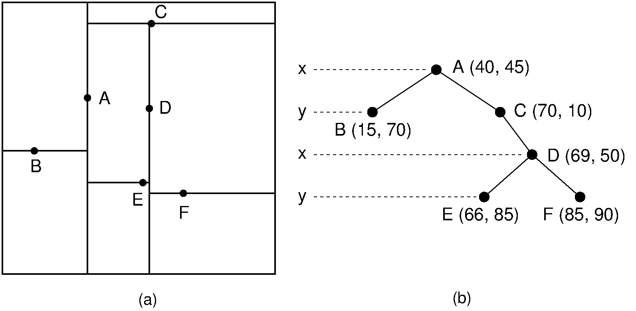
Greedy Partitioning Algorithm
Solution
Use a greedy algorithm
Based on k-d trees
Complexity O(nlogn)
Anonymize($partition$)
If (no allowable multidimensional cut for $partition$)
return $∅:partition →summary$
else
$dim<−choose_dimension()$
$fs<−frequency_set(partition, dim)$
$splitVal<−find_median(fs)$
$lhs<−\{t ∈partition :t.dim≤splitVal \}$
r$hs<−\{t ∈partition :t.dim≥splitVal \}$
return $Anonymize\left(rhs\right)∪Anonymize\left(lhs\right)$

Slide 15
Algorithm Example
k = 2
Quasi-identifiers
Zipcode
Age
ID | Age | Sex | Zip | Disease
1 | 25 | Male | 53711 | Flu
2 | 25 | Female | 53712 | Hepatitis
3 | 26 | Male | 53711 | Brochities
4 | 27 | Male | 53710 | Broken Arm
5 | 27 | Female | 53712 | HIV
6 | 28 | Male | 53711 | Hang Nail
ID | Age | Sex | Zip | Disease
1 | [25-26] | Male | 53711 | Flu
3 | [25-26] | Male | 53711 | Brochities
2 | [25-27] | Female | 53712 | Hepatitis
5 | [25-27] | Female | 53712 | HIV
4 | [27-28] | Male | [53710-53711] | Broken Arm
6 | [27-28] | Male | [53710-53711] | Hang Nail
Patient Data
Anonymized Data

Slide 16
Algorithm Example (Cont.)
Iteration # 1 (full table)
partition
`
dim = Zipcode
ID | Age | Sex | Zip | Disease
1 | 25 | Male | 53711 | Flu
2 | 25 | Female | 53712 | Hepatitis
3 | 26 | Male | 53711 | Brochities
4 | 27 | Male | 53710 | Broken Arm
5 | 27 | Female | 53712 | HIV
6 | 28 | Male | 53711 | Hang Nail
Zip | Count
53710 | 1
53711 | 3
53712 | 2
fs
LHS
splitVal = 53711
ID | Age | Sex | Zip | Disease
1 | 25 | Male | 53711 | Flu
3 | 26 | Male | 53711 | Brochities
4 | 27 | Male | 53710 | Broken Arm
6 | 28 | Male | 53711 | Hang Nail
RHS
ID | Age | Sex | Zip | Disease
2 | 25 | Female | 53712 | Hepatitis
5 | 27 | Female | 53712 | HIV

Slide 17
Algorithm Example (Cont.)
Iteration # 2 (LHS from iteration # 1)
partition
`
dim = Age
ID | Age | Sex | Zip | Disease
1 | 25 | Male | 53711 | Flu
3 | 26 | Male | 53711 | Brochities
4 | 27 | Male | 53710 | Broken Arm
6 | 28 | Male | 53711 | Hang Nail
fs
Age | Count
25 | 1
26 | 1
27 | 1
28 | 1
splitVal = 26
LHS
RHS
ID | Age | Sex | Zip | Disease
1 | 25 | Male | 53711 | Flu
3 | 26 | Male | 53711 | Brochities
ID | Age | Sex | Zip | Disease
4 | 27 | Male | 53710 | Broken Arm
6 | 28 | Male | 53711 | Hang Nail

Slide 18
Algorithm Example (Cont.)
Iteration # 3 (LHS from iteration # 2)
partition
`
No Allowable Cut
ID | Age | Sex | Zip | Disease
1 | 25 | Male | 53711 | Flu
3 | 26 | Male | 53711 | Brochities
`
Summary: Age = [25-26] Zip= [53711]
Iteration # 4 (RHS from iteration # 2)
partition
ID | Age | Sex | Zip | Disease
4 | 27 | Male | 53710 | Broken Arm
6 | 28 | Male | 53711 | Hang Nail
`
No Allowable Cut
Summary: Age = [27-28] Zip= [53710 - 53711]

Slide 19
Algorithm Example (Cont.)
Iteration # 5 (RHS from iteration # 1)
partition
`
No Allowable Cut
ID | Age | Sex | Zip | Disease
2 | 25 | Female | 53712 | Hepatitis
5 | 27 | Female | 53712 | HIV
`
Summary: Age = [25-27] Zip= [53712]
2-Anonymized table
ID | Age | Sex | Zip | Disease
1 | [25-26] | Male | 53711 | Flu
3 | [25-26] | Male | 53711 | Brochities
2 | [25-27] | Female | 53712 | Hepatitis
5 | [25-27] | Female | 53712 | HIV
4 | [27-28] | Male | [53710-53711] | Broken Arm
6 | [27-28] | Male | [53710-53711] | Hang Nail
Does it work with k=3?

Slide 20
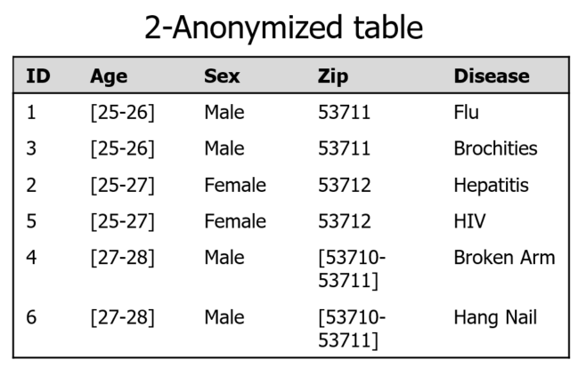
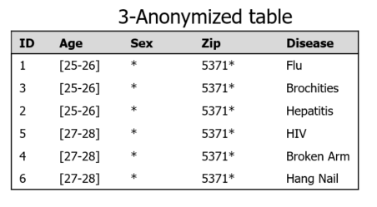
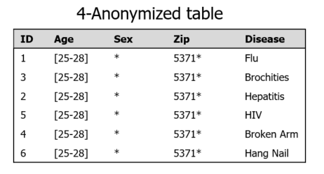
Determining the value of k
The value of k depends on
Number of records in the table
Number of quasi-identifiers
The distribution of each quasi-identifier
The relationship between quasi-identifier
Rule of thump: k increases -> privacy increases k increases -> utility decreases
What is the best value of k?

Slide 21
Utility Measures
Discernibility Metric $C_{DM}$
$$C_{DM}=\sum_{E∈EC}{{\left|E\right|}^{2}}$$
Generalized Information Loss $ILoss$
$$ILoss=\frac{1}{\left|T\right| n}× \sum_{i=1}^{n}{\sum_{j=1}^{|T|}{\frac{U_{ij}−L_{ij}}{U_{i}−L_{i}}}}$$
Utility = 1- $ILoss$
Where |E| is the size of equivalence class E, and EC is the set of all equivalence classes
Where $U_{ij}$ and $L_{ij}$ is the upper and lower value of the generalized range of attribute $i$ and record $j$, and $U_{i}$ and $L_{i}$ is the upper and lower value of attribute $i$
n is the number of attributes |T| is the number of records

Slide 22
Example
Two unequal ECs:
$C_{DM}=\sum_{E∈EC}{{\left|E\right|}^{2}}$
$={10}^{2}+6^{2}=136$
Two equal Ecs
$C_{DM}=\sum_{E∈EC}{{\left|E\right|}^{2}}$
$=8^{2}+8^{2}=128$
ID | Age | Disease
1 | [25-26] | Flu
3 | [25-26] | Cancer
2 | [25-26] | Heart disease
5 | [25-26] | Flu
4 | [25-26] | Flu
6 | [25-26] | Flu
7 | [25-26] | Flu
8 | [25-26] | Flu
9 | [25-26] | Flu
10 | [25-26] | Flu
11 | [26-30] | Flu
12 | [26-30] | Cancer
13 | [26-30] | Hepatitis
14 | [26-30] | Heart disease
15 | [26-30] | Eye
16 | [26-30] | Sore throat
EC1
EC1

Slide 23
Example
$ILoss=\frac{1}{\left|T\right| n}× \sum_{i=1}^{n}{\sum_{j=1}^{|T|}{\frac{U_{ij}−L_{ij}}{U_{i}−L_{i}}}}$
$$\frac{1}{16∗1}×\sum_{j=1}^{16}{\frac{U_{1j}−L_{1j}}{30 −25 }}$$
= $\frac{1}{16∗1}×(\frac{10∗ 1}{5 }+\frac{6∗4}{5 }$)
$=\frac{1}{16∗1}×(\frac{34}{5 }$)=0.425
Utility = 0.575
ID | Age | Disease
1 | [25-26] | Flu
3 | [25-26] | Cancer
2 | [25-26] | Heart disease
5 | [25-26] | Flu
4 | [25-26] | Flu
6 | [25-26] | Flu
7 | [25-26] | Flu
8 | [25-26] | Flu
9 | [25-26] | Flu
10 | [25-26] | Flu
11 | [26-30] | Flu
12 | [26-30] | Cancer
13 | [26-30] | Hepatitis
14 | [26-30] | Heart disease
15 | [26-30] | Eye
16 | [26-30] | Sore throat
EC1
EC1

Slide 24
Utility Vs. Privacy
100%
Accurate, not private
Decent accuracy, decent private
Utility
Inaccurate, private
0
Privacy
100%

Slide 25
Determining the value of k
4-Anonymized table
ID | Age | Sex | Zip | Disease
1 | [25-28] | * | 5371* | Flu
3 | [25-28] | * | 5371* | Brochities
2 | [25-28] | * | 5371* | Hepatitis
5 | [25-28] | * | 5371* | HIV
4 | [25-28] | * | 5371* | Broken Arm
6 | [25-28] | * | 5371* | Hang Nail
2-Anonymized table
3-Anonymized table
ID | Age | Sex | Zip | Disease
1 | [25-26] | Male | 53711 | Flu
3 | [25-26] | Male | 53711 | Brochities
2 | [25-27] | Female | 53712 | Hepatitis
5 | [25-27] | Female | 53712 | HIV
4 | [27-28] | Male | [53710-53711] | Broken Arm
6 | [27-28] | Male | [53710-53711] | Hang Nail
ID | Age | Sex | Zip | Disease
1 | [25-26] | * | 5371* | Flu
3 | [25-26] | * | 5371* | Brochities
2 | [25-26] | * | 5371* | Hepatitis
5 | [27-28] | * | 5371* | HIV
4 | [27-28] | * | 5371* | Broken Arm
6 | [27-28] | * | 5371* | Hang Nail

Slide 26
Attacks on k-Anonymity
k-anonymity does not prevent attribute disclosure if:
Sensitive values lack diversity
The attacker has background knowledge
Homogeneity Attack
A 3-anonymous patient table
Bob
Zipcode | Age
47678 | 27
Zipcode | Age | Disease
476** 476** 476** | 2* 2* 2* | Heart Disease Heart Disease Heart Disease
4790* 4790* 4790* | ≥40 ≥40 ≥40 | Flu Heart Disease Cancer
476** 476** 476** | 3* 3* 3* | Flu Cancer Cancer
Background Knowledge Attack
Carl does not have heart disease
Carl
Zipcode | Age
47673 | 36

Slide 27
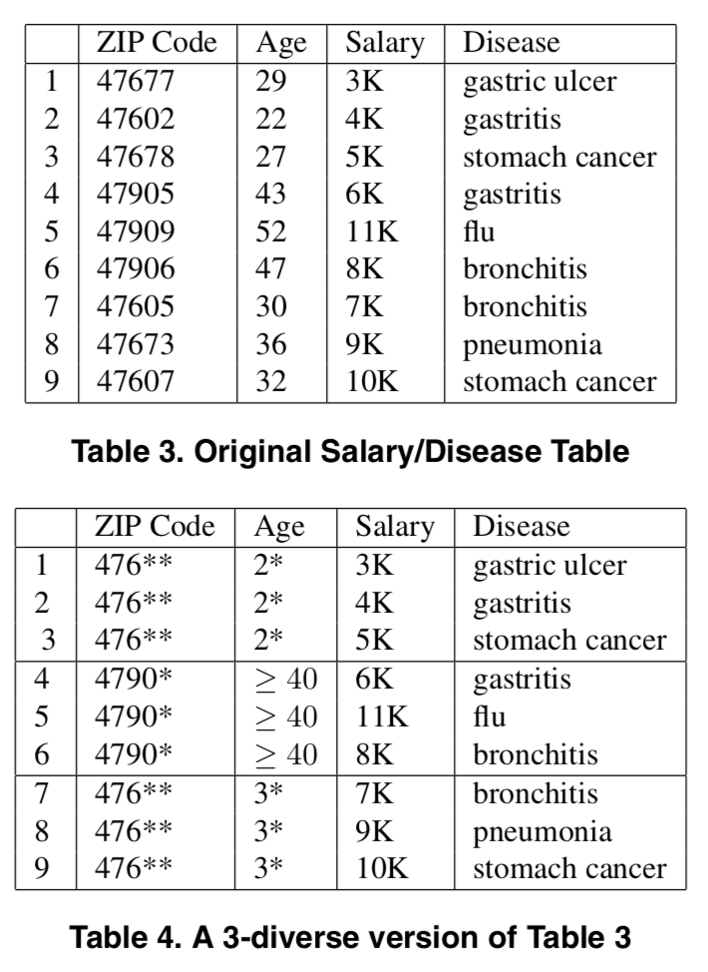
l-Diversity
The l-diversity principle
Each equivalence class should contain "at least" $l$ sensitive values
Instantiation
Distinct $l$-diversity
Entropy $l$-diversity

Slide 28
Distinct l-Diversity
Each equivalence class has at least l well-represented sensitive values
Limitation: Doesn't prevent the probabilistic inference attacks
$ILoss=\frac{1}{\left|T\right| n}× \sum_{i=1}^{n}{\sum_{j=1}^{|T|}{\frac{U_{ij}−L_{ij}}{U_{i}−L_{i}}}}$
1/16 * 34/5
3-diversity
ID | Age | Disease
1 | [25-26] | Flu
3 | [25-26] | Cancer
2 | [25-26] | Heart disease
5 | [25-26] | Flu
4 | [25-26] | Flu
6 | [25-26] | Flu
7 | [25-26] | Flu
8 | [25-26] | Flu
9 | [25-26] | Flu
10 | [25-26] | Flu
11 | [26-30] | Flu
12 | [26-30] | Cancer
13 | [26-30] | Hepatitis
14 | [26-30] | Heart disease
15 | [26-30] | Eye
16 | [26-30] | Sore throat
Notes:
To address these problems, Machanavajjhala introduced the idea of l-Diversity
This lead to two stronger notion of l-diversity

Slide 29
Entropy l-Diversity
l-distinc diversity is not enough
Different sensitive values must be distributed evenly enough
Formally, $Entropy\left(EC\right)≥log2\left(l\right)$
Where $Entropy\left(EC\right)=H\left(EC\right)=−\sum_{i=1}^{k}{p(r_{i})}\log_{2}{p(r_{i})}$
Where $r_{i}$ is a record in EC
Limitation: the entropy of the entire table may be very low because some values are very common
3-diversity
ID | Age | Disease
1 | [25-26] | Flu
3 | [25-26] | Cancer
2 | [25-26] | Heart disease
5 | [25-26] | Flu
4 | [25-26] | Flu
6 | [25-26] | Flu
7 | [25-26] | Flu
8 | [25-26] | Flu
9 | [25-26] | Flu
10 | [25-26] | Flu
11 | [26-30] | Flu
12 | [26-30] | Cancer
13 | [26-30] | Hepatitis
14 | [26-30] | Heart disease
15 | [26-30] | Eye
16 | [26-30] | Sore throat

Slide 30
Limitations of l-Diversity
$l$-diversity is difficult to achieve
Consider a single sensitive attribute with two values: HIV positive (1%) and HIV negative (99%)
One would not mind being known to be tested negative but one would not want to be known/considered to be tested positive
Suppose there are 10000 records in total, how many ECs are needed to achieve 2-diversity?
There can be at most 10000*1%=100 ECs
Each of size 100, or 100-anonymization

Slide 31
Skewness Attack
Two values for the sensitive attribute
HIV positive (1%) and HIV negative (99%)
Highest diversity still has serious privacy risk
Consider an EC that contains an equal number of positive records and negative records -> 50/50% of having HIV in one EC
Using diversity and entropy does not differentiate:
EC 1: 1 positive + 49 negative
EC 2: 49 positive + 1 negative -> l-diversity is unnecessary
The overall distribution of sensitive values matters

Slide 32
Similarity Attack
A 3-diverse patient table
Zipcode | Age | Salary | Disease
476** 476** 476** | 2* 2* 2* | 20K 30K 40K | Gastric Ulcer Gastritis Stomach Cancer
4790* 4790* 4790* | ≥40 ≥40 ≥40 | 50K 100K 70K | Gastritis Flu Bronchitis
476** 476** 476** | 3* 3* 3* | 60K 80K 90K | Bronchitis Pneumonia Stomach Cancer
Bob
Zip | Age
47678 | 27
Conclusion
Bob’s salary is in [20k,40k], which is relative low.
Bob has some stomach- related disease.
The semantic meanings of attribute values matters.

Slide 33
t-closeness
Goal is to quantify/limit amount of information leakage through data publication
Principle: Distribution of sensitive attribute value in each equivalence-class ($p_{i}$) should be close to that of the distribution in the overall dataset ($Q$)
distance between $p_{i}$ and $Q$ should be $≤$ t
${D(p}_{i},Q)≤t$ -> hence the name "t-closeness"
Challenge: How to measure distance between two distributions so that semantic relationship among sensitive attribute values is captured?
Assume distribution of income is $Q$=(10K, 20K, 30K,…, 90K)
Which range is closer? $p_{1}=$(20K,50K,80K) or $p_{1}=$(10K,20K,30K)?

Slide 34
The Earth Mover Distance
We use Earth Mover Distance

Slide 35
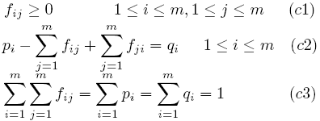
Earth Mover’s Distance (Not included in Exam)
Formulation
P=(p1,p2,…,pm), Q=(q1,q2,…,qm)
dij: the ground distance between element i of P and element j of Q.
Find a flow F=[fij] where fij is the flow of mass from element i of P to element j of Q that minimizes the overall work:
subject to the constraints:

Slide 36
Earth Mover’s Distance (Not included in Exam)
Example
With P1={3k,4k,5k} and {3k,4k,5k,6k,7k,8k,9k,10k,11k}
Move 1/9 probability for each of the following pairs
3k->6k,3k->7k cost: 1/9*(3+4)/8
4k->8k,4k->9k cost: 1/9*(4+5)/8
5k->10k,5k->11k cost: 1/9*(5+6)/8
Total cost: 1/9*27/8=0.375
With P2={6k,8k,11k} and {3k,4k,5k,6k,7k,8k,9k,10k,11k}
Total cost is 0.167 < 0.375

Slide 37
Limitation of K-anonymization, l-diversity, and t-closeness
Difficult to pin down adversary’s background knowledge
There are many adversaries when publishing data
Requires identifying which attributes are quasi-identifier or sensitive, not always possible
Syntactic in nature
Difficult to find the value of $k$, $l$, and $t$

Slide 38
Summary
Privacy requirements in data sharing (publishing)
Membership disclosure
Attribute disclosure
Identification disclosure
Difference between key attributes, quasi-identifiers, and sensitive attributes
K-anonymization
Generalization
Suppression
Attacks on k-anonymization
Homogeneity attack
Background attack
L-diversity
Distinct diversity
Entropy diversity
Attacks on l-diversity
Skewness attack
Similarity attacks
T-closeness
Limitations of syntactic privacy

Slide 39
Reading Assignment
Understanding Database Reconstruction Attacks on Public Data (on BB)

