Slide 1
COE 526 Data Privacy
Lecture 4: Privacy Design and Engineering
References:
The MITRE Corporation, August 2014, Privacy Engineering Framework. https://www.mitre.org/publications/systems-engineering-guide/enterprise-engineering/engineering-informationintensive-enterprises/privacy-systems-engineering Privacy Engineering Meets Software Engineering. On the Challenges of Engineering Privacy By Design, arxiv

Slide 2
Outline
Privacy by Design Principles
Privacy Engineering Framework
Privacy Engineering Use Case in Software Engineering

Slide 3
GDPR Article 25
GDPR Article 25 communicates requirements for data privacy by design and by default
Data privacy by design:
to embed organizational and technical privacy measures into the complete lifecycle of products, services, applications, and business and technical procedures
Data privacy by default:
only necessary personal data is collected, stored, or processed
personal data is not accessible to an indefinite number of people

Slide 4
Why Policy and Process Is Not Enough
Many organizations rely on the following activities to address privacy risks:
Policy
Privacy risk assessments and PIAs
Accounting of disclosures
Yet, privacy risks remain and privacy breaches continue to rise
Why?
Systems containing PII must be capable of preventing or minimizing the effect of human error or fallibility
Solution: implementing feasible privacy measures, a.k.a Privacy-Enhancing Technologies (PETs)

Slide 5
PETs Selection Criteria
When selecting a measure, the Data Controller must document an evaluation of the measure along four criteria:
State of the Art: An evaluation of the latest and most advanced data security and privacy enhancement tools available
Processing Profile: An evaluation of the nature, scope, and context of the data processing
Risk Profile: An evaluation of the likelihood and severity of risks to the rights and freedoms of natural person when processing personal data
Cost: An evaluation of the cost of implementation relative to the risk profile

Slide 6
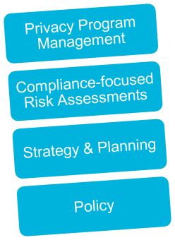
Overcoming Policy and Process Gaps
To adequately address privacy risks, systems that manage PII must behave in a privacy-sensitive manner
Privacy must be embedded into systems engineering cycle
Privacy Partially Addressed
Privacy Fully Addressed
Organizational Functions
Engineering Functions
Organizational Functions
Engineering Functions
Privacy Program Management
Privacy Testing
Compliance-focused Risk Assessments
Privacy-sensitive
Design Decisions
Strategy & Planning
Privacy Reqs.&
Controls Selection
Policy
System-focused
Risk Assessment

Slide 7
Privacy by Design Philosophical Framework
Privacy by Design (PbD) emphasizes that privacy cannot be assured solely by compliance with regulatory frameworks
Privacy assurance must become an organization’s default mode of operation
PbD applies to:
IT
Accountable business practices
Physical design
Adequate privacy requires thoughtful integration with every layer of an organization
Organization policies and governance;
Business processes;
Standard operating procedures;
System and network architectures;
IT system design and development practices

Slide 8
PbD Principles
Proactive not Reactive; Preventative not Remedial
Anticipate issues; prevent problems before they arise
Privacy as the Default Setting
Personal data protected from inception; individuals need not act to protect data
Privacy Embedded into Design
Privacy protections are core, organic functions; not bolted on after the fact
Full Functionality — Positive-Sum, not Zero-Sum
Privacy enhances, not degrades, security and functionality
End-to-End Security — Full Lifecycle Protection
Security applied to each data lifecycle stage, from creation to archiving or deletion
Visibility and Transparency — Keep it Open
Individuals understand data use; privacy practices audited
Respect for User Privacy — Keep it User-Centric
Organizational imperative = privacy is about personal control and free choice
*http://www.privacybydesign.ca/index.php/about-PbD/7-foundational-principles

Slide 9
Privacy Engineering
Focuses on providing guidance that can be used to
Decrease privacy risks
Enable organizations to make purposeful decisions about resource allocation
Effectively implement controls in information systems
Operationalizes PbD by
Segmenting PbD into activities aligned with those of the systems engineering life cycle (SELC)
Defining and implementing requirements for addressing privacy risks within the SELC
Supporting deployed systems by aligning system usage and enhancement with a broader privacy program
RESULT: Privacy is integrated into systems as part of the systems
engineering process
Notes:
Privacy requirements must be defined in terms of implementable system functionality and properties
Privacy risks, including those beyond compliance risks, are identified and adequately addressed

Slide 10
Relationship Between PbD and PE
Privacy by Design
7 foundational principles
Privacy Engineer's Manifesto
process, management, governance
Privacy Engineering
Tools, techniques, taxonomy, ontology, requirements, metrics

Slide 11
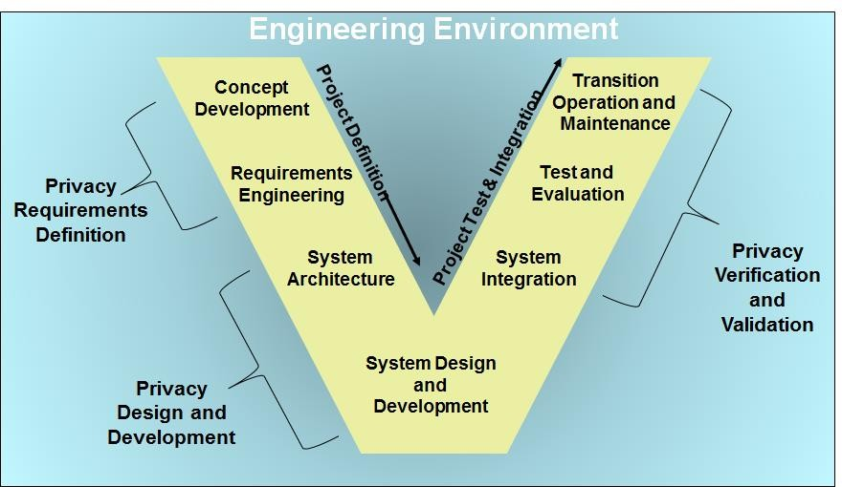
Privacy Engineering Framework
This diagram illustrates how the core privacy engineering activities map to stages of the classic systems engineering life cycle
A mapping exists for every systems engineering life cycle, including agile development

Slide 12
Privacy Engineering Activities and Methods
Life Cycle Activity | Privacy Method | Method Description
Privacy Requirements Definition: Specification of system privacy properties in a way that supports system design and development | Baseline & custom privacy system requirements | Granular technical privacy requirements derived from first principles and from risk analysis
 | Privacy empirical theories & abstract concepts | Methodological constructs based on theories of privacy and socio-technical systems
Privacy Design and Development: Representation and implementation of those elements of the system that support defined privacy requirements | Fundamental privacy design concepts | Explicit or tacit consensus understandings of how privacy works in a system
 | Privacy empirical theories and abstract concepts | Methodological constructs based on theories of privacy and socio-technical systems
 | Privacy design tools | Specific techniques for achieving privacy
 | Privacy heuristics | Experientially developed rules of thumb regarding privacy properties of artifacts
Privacy Verification and Validation: Confirmation that defined privacy requirements have been correctly implemented and reflect stakeholder expectations | Privacy testing & review | Executable tests and targeted document reviews associated with privacy requirements
 | Operational synchronization | Analysis of privacy policies & procedures and system behaviors for inconsistencies

Slide 13
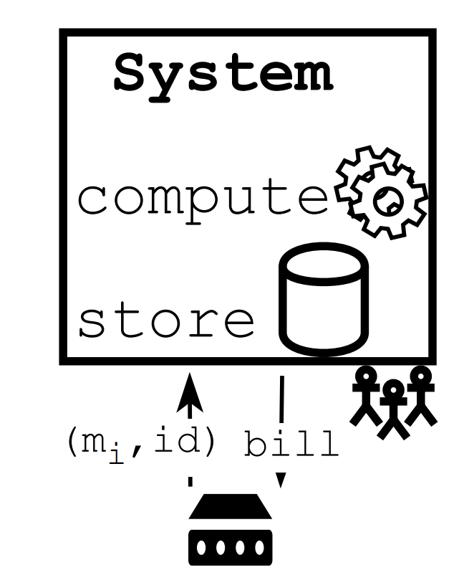
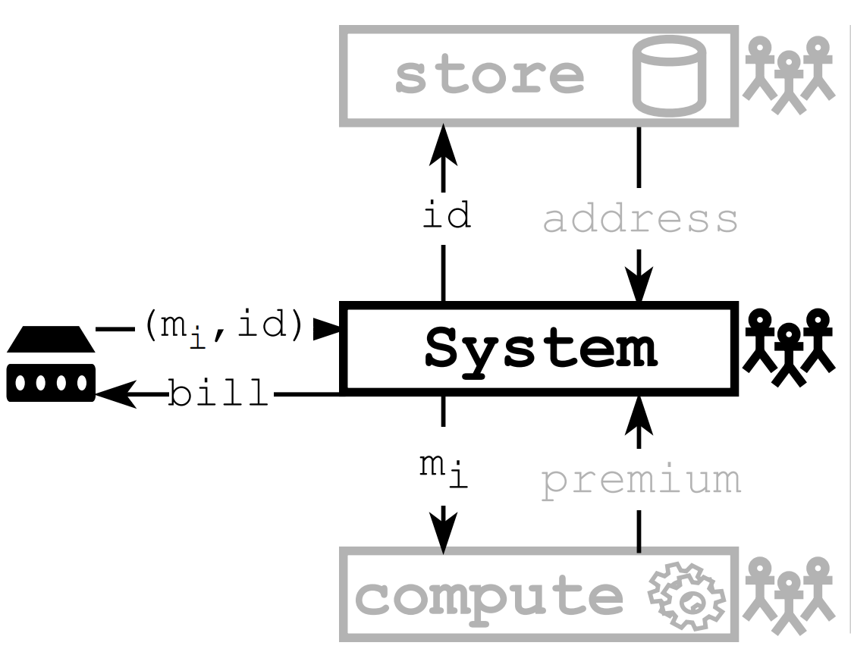
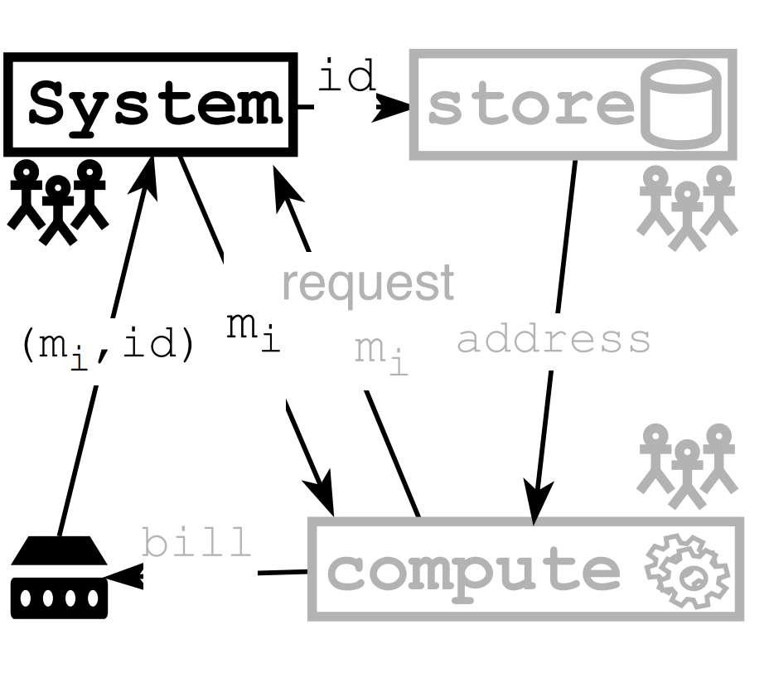
Use Case: Billing System
Software development of billing system can take different models
Monolithic
Service-oriented
Service-oriented

Slide 14
Practical Privacy Challenges
Dealing with services
Service-oriented architecture (SOA) increases the complexity of privacy
Service can be provided by untrusted third-parties
Multi-teams efforts
Minimizing trust assumption
Conflict in trust between software development requirements and privacy engineering requirements
Supporting development activities
E.g. testing and debugging on operation, sensitive data

