Slide 1
COE 526 Data Privacy
Lecture 3: Privacy Impact and Risk Assessment
References:
Sides from Prof. Bhargave (Privacy in Computing)
NIST Privacy Framework

Slide 2
Announcement
Quiz 1 is Next Sunday 20/9/2020

Slide 3
Objectives
What is privacy risk management?
Risk terminology
Risk management procedure
Privacy risk assessment
Privacy impact assessment

Slide 4
Introduction
Risk management is the on-going process of identifying, assessing, prioritizing, and addressing risks
Risk management ensures that organizations have assessed and planned for risks that are most likely to have an effect on their operations

Slide 5
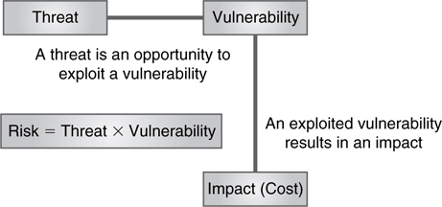
Risk Terminology
Threat: is something (generally bad) that might happen
  Natural disaster
  Cyber attack
Vulnerability: is any exposure (or weaknesses) that could allow a threat to be realized
  Lack of power backups
  Misconfiguration or software bugs

Slide 6
Risk Terminology
Risk: is the likelihood that a particular threat will be realized against a specific vulnerability
  Not all risks are inherently bad; some risks can lead to positive results
  The extent of damage (or even positive effect) from a threat determines the level of risk
Impact: refers to the amount of harm a threat exploiting a vulnerability can cause
  if a virus infects a system, the virus could affect all the data on the system.

Slide 7
Risk Terminology
Risk = Threats × Vulnerabilities
Multiplying the probability of a threat and the likelihood of a vulnerability yields the risk of that particular event
Risks apply to specific assets or resources
Multiplying the risk probability by the value of the resource, the result is the expected loss from exposure to a specific risk

Slide 8
Risk Methodology
A risk methodology is a description of how risk is managed. It should include:
  Approach to be used to carry out the steps of the risk methodology process
  Required information
  Techniques to address each risk

Slide 9
Risk Management
In ISO 27000: "Risk management is a systematic application of management policies, procedures and practices to the activities of communicating, consulting, establishing the context and identifying, analyzing, evaluating, treating, monitoring and reviewing risk"
Risk management steps:
  Establishing the context
  Risk identification
  Risk analysis
  Risk evaluation
  Risk treatment
  Risk communication and consultation
  Risk monitoring and review
Risk assessment
Notes:
https://dataprivacymanager.net/7-steps-and-elements-of-privacy-risk-management/
Risk identification, risk analysis, and risk evaluation are collectively referred to as risk assessment, a sub-process of the overall risk management process.

Slide 10
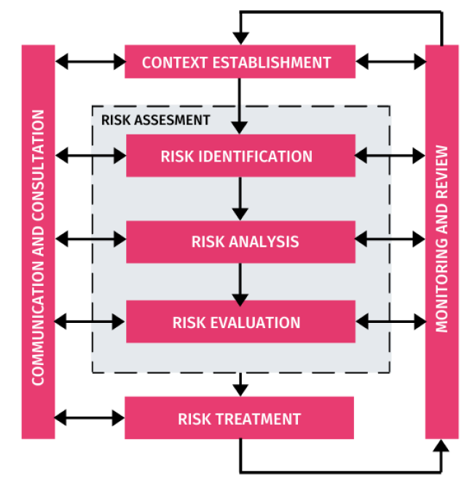
Risk Management Process

Slide 11
1- Context Establishment
In information security, this involves defining the scope and boundaries, and establishing appropriate organizational structure
In data privacy, this can be
  Defining the nature, scope, and context, and purpose of processing data
  Organization objectives for protecting data privacy
  Naming stakeholders
  Defining roles and responsibilities
  Specifications of records
  Develop risk evaluation, impact, and acceptance criteria

Slide 12
2- Risk Identification
Objectives:
  Determine what could happen to cause a potential loss to assets
  Gain insights into how, where, and why the loss might happen
Risk identification sub-steps
  Identification of assets: the only asset is PIIs
  Identification of threats:
    Application level
    Communication level
    System level
    Audit trails

Slide 13
2- Risk Identification
  Identification of existing controls
    Technical
    Organization structures
    Legal
  Identification of vulnerabilities
    Personnel
    Hardware/Software
    Policies/procedures
    System configuration
    Third parties
  Identification of consequences: damage to individual's rights and freedom
    Benign inconveniences
    Moderate disruptions
    Catastrophic events

Slide 14
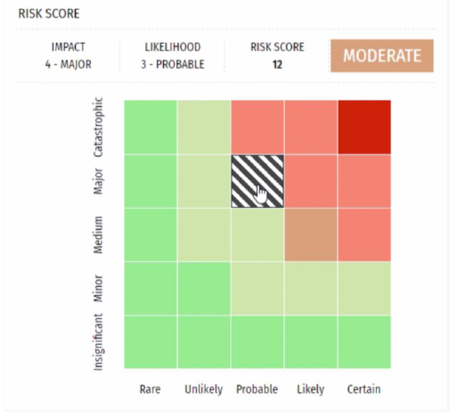
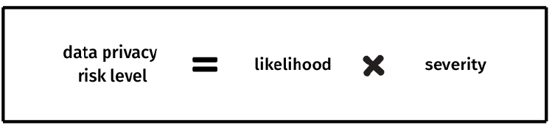
3- Risk Analysis
Risks are associated with potential damage to tangible and intangible assets
Risk analysis can qualitative or quantitative
Qualitative analysis uses a scale to describe probability and consequences.
  Consequences -> insignificant,
  minor, medium, major, catastrophic
  Probability -> rare, unlikely,
  probable, likely, certain
Quantitative uses a numerical
scale

Slide 15
4- Risk Evaluation
The output from the risk analysis phase is used as input to risk evaluation
Level of all risks need to be compared against risk evaluation criteria and risk acceptance criteria
Risk value | Evaluation criteria action
Low | Reduce risk considering the cost of prevention compared to a reduction in risk
Moderate | Action must be taken. Where the impact is major, urgent action must be taken
High | Urgent action must be taken
Risk value | Acceptance criteria action
Low | Can be accepted without documented justification
Moderate | Can be accepted provided that continual monitoring is in place. Treatment plans need to be investigated and implemented where required
High | Can be accepted by senior management with adequate documented justification and where possible mitigation treatment plans are implemented immediately

Slide 16
5- Risk Treatment
The process of selecting and implementing of measures to modify risk
Options to treat risks (ISO 27005)
  Risk acceptance (retention)
  Risk mitigation (modification)
  Risk transfer (sharing)
  Risk avoidance
Mitigation controls
  Anonymization and pseudonymization
  Encryption

Slide 17
Process Summary
Establishing the context: understanding the organization (e.g., processing of personal data, roles, responsibilities), the technical environment and the factors influencing privacy risk management (e.g., legal, contractual, business, etc)
Risk assessment: identifying, analyzing the evaluating risks to data subjects
Risk treatment: defining privacy safeguarding requirements, identifying and implementing privacy controls to avoid or reduce the risks to data subjects
Communication and consultation: getting information from interested parties, obtaining consensus on each risk management process, and informing data subjects about risks and controls
Monitoring and review: following up risks and controls and improving the process

Slide 18
Impact Assessments
One deliverable of the privacy risk assessment process is Privacy Impact Assessment (PIA) or Data Protection Impact Assessment (DPIA)
An evaluation conducted to assess how the adoption of new information policies, the procurement of new computer systems, or the initiation of new data collection programs will affect individual privacy

Slide 19
PIA and DPIA Fundamentals
The basic principles of PIA and DPIA are similar
During each stage of a PIA or DPIA, define the following
  The parties (data controllers, processors, and subjects)
  The data nature and scope
  The purposes of data processing
  The compliance requirements under GDPR and/or other legislation
PIA and DPIA are iterative cycle of four sequential stages:
  Defining the context of personal data processing
  Establishing controls to ensure compliance with the fundamental principles
  Assessing associated privacy risks
  Validating the attained data protection level

Slide 20
Case Study: Tracing Applications
Several measures have been to limit the spread of COVID-19, including
  social distancing, mass testing, quarantine and lockdown, and contact tracing
Proactively inform people who contacted an infected patient
Often performed manually; it is labor intensive
A recent study concluded that "viral spread is too fast to be contained by manual contact tracing, but could be controlled if this process was faster, more efficient and happened at scale"
Goal: a system enables a scalable approach to monitor the spread of the disease and notify potentially infected people immediately
Answer the following questions:
  What are core functionalities of contact tracing applications?
  What data need be collected? Who are the stakeholders?
  What security/privacy risks can you identify in contact tracing apps?
  What controls need to be taken to mitigate such risks?

Slide 21
Please elect someone "else" to share points of your group discussion

Slide 22
References
https://www.nist.gov/privacy-framework
https://gdpr-info.eu/issues/privacy-impact-assessment/
https://www.technologyreview.com/2020/05/07/1000961/launching-mittr-covid-tracing-tracker/
https://www.nature.com/articles/d41586-020-01264-1
https://www.nature.com/articles/d41586-020-01514-2

