Slide 1
COE 526 Data Privacy
Lecture 1B: Definition and Terminologies

Slide 2
Definition of Data Privacy
“Privacy reflects the ability of a person, organization, government, or entity to control its own space, where the concept of space (or privacy space) takes on different contexts“
Physical space
Bodily space
Computer space
Web browsing space
“Privacy is the claim of individuals, groups or institutions to determine for themselves when, how, and to what extent information about them is communicated to others”
"The right to be forgotten"

Slide 3
Private Information
Sensitive information often means Personally Identifiable Information (PII)
Name, location, phone, email, IP, SSN, medical record numbers, health plan numbers, device identifiers, account numbers
Common idea is to remove “sensitive attributes” from data to anonymize individuals
E.g. HIPAA safe harbor provision specifies such a rule for medical data

Slide 4
Non-technical Challenges of Privacy
Economics and deployment incentives
How much are people willing to pay for privacy?
How much does it cost to provide privacy?
Psychology and culture
Privacy is sensitive to individual differences
privacy is fundamentally based in social interactions
privacy is inherently contextual
Many stakeholders
Company
Record owner
Governments
Analysts
Privacy officer
Attacker (adversary)

Slide 5
Technical Challenges of Privacy
Privacy is a broad and fuzzy term
Difficult to quantify privacy
Developers have low knowledge and awareness of privacy
Wide range of privacy risks
Adversarial capabilities are rapidly growing
https://cacm.acm.org/blogs/blog-cacm/235401-why-is-privacy-so-hard/fulltext

Slide 6
Technical Challenges of Privacy
Same device, same data, different perspectives
The Burden on End-Users is Too High
AI and Machine Learning
Difficult to balance utility and privacy
https://cacm.acm.org/blogs/blog-cacm/235401-why-is-privacy-so-hard/fulltext

Slide 7
Data Linkage Attack
Data Linkage (or Re-identification) Attack is matching a user in two datasets by using some linking information (e.g., name and address, or movie mentions)
Example: In 1997, a researcher was able to re-identify the information of MA governor by linking released (anonymized) medical data with public voter list
Ethnicity
Visit data
Diagnosis
Procedure
Medication
Charge
...
Name
Address
Date registered
Party affiliation
Date last voted
zip
dob
sex
Medical data
Voter list

Slide 8
Example: The Netflix Prize
18k movies
In 2006, Netflix launched "The Netflix Prize"
Users names were replaced with random numbers
Official challenge goal: Beat Netflix's algorithm to Predict missing entries
Side note: The Netflix challenge lead to lots of interesting technical work on collaborative filtering and matrix completion.
The prize was canceled in 2009 after two researchers identified individual users by linking data with IMDB!
100M
ratings
{?, 0,1,...,5}
480k
users

Slide 9
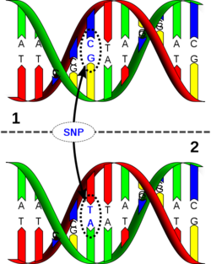
Example: Genome Wide Association Studies (GWAS)
Goal: Find association between SNPs and disease
Typical Setup:
NIH takes DNA of 1000 test candidates with common disease
NIH releases minor allele frequencies (MAF) of test population at 100,000 positions (SNPs)
Can infer membership in test group of an individual with known DNA from published data!

Slide 10
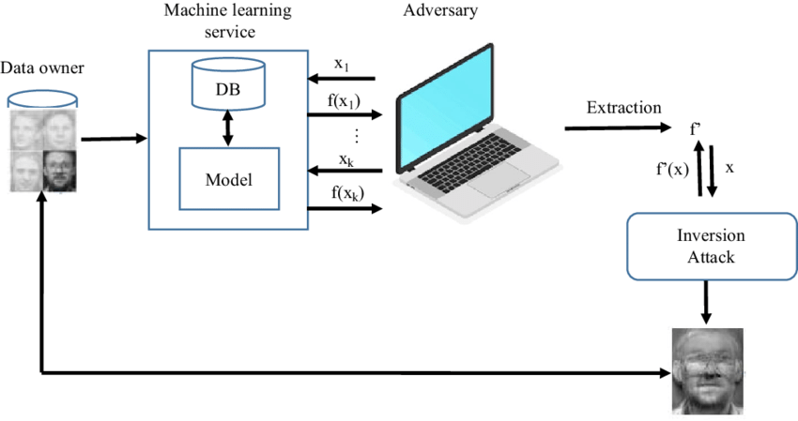
Reconstruction Attacks
Overly accurate information about too many queries to a data source allows for partial or full reconstruction of data
Also known as blatant non-privacy
What does that mean?

Slide 11
How To Achieve Privacy?
Privacy accountability
Enforcing data protection laws, policy, and effective organizational practices that preserve the privacy of users/employees/customers
Example of laws and policies
Health Insurance Portability and Accountability Act (HIPAA)
General Data Protection Regulation (GDPR)
Children's Online Privacy Protection Act (COPPA)
California Online Privacy Protection Act
Maintaining the compliance of such laws
Demonstrating that the privacy is being preserved
We will talk more about the privacy laws and regulations next class

Slide 12
How To Achieve Privacy?
Technical solutions, add-ons and stand-alone, with provable guarantees of privacy protection
Examples
Statistical privacy
Differential privacy
Cryptographic privacy
E.g., Zero-knowledge proof, anonymous credential, anonymous cash
Anonymous communications
E.g., TOR
Data protection in AI and ML
Trusted execution environment

Slide 13
Privacy Terminologies
Some important terminologies in privacy literature
Anonymity
Unlinkability
Undetectability
Unobservability
Pseudonymity

Slide 14
Setting
Universe
System
Outsiders
Insiders

Slide 15
Adversary? Attacker? Bad Guy?
An attacker may be Interested in
What communication is occurring (passive)
What patterns of communications exist (passive)
Manipulate the communications (active)
All statements are based on the “perspective” of the attacker
Perspective defines the set of all possible observations
Attacker may also have limited computation capabilities
Both the above define the information available to the attacker
An attacker uses all facts available to him to infer “Items of Interest (IOI)” in the system
An IOI can be a subject, a message, an action
E.g. who did send or receive which messages

Slide 16
Implicit Assumptions
Adversary never has access to message content to get information about senders/receivers
Why is this a reasonable assumption?
It is unreasonable to assume that an adversary “forgets” any information
Information once known cannot be assumed to be suddenly lost!
If anything, knowledge only increases!

Slide 17
Attacker Scope: Insider
Universe
System

Slide 18
Attacker Scope: Outsider
Universe
System

Slide 19
Anonymity
Anonymity is the state of being not identifiable within a set of subjects, called the anonymity set
Anonymity Set: Set of similar subjects or subjects with similar attributes, for example,
Set of senders
Set of receivers
A sender/receiver can be anonymous only within an anonymity set of senders/receivers
Anonymity of a set of subjects within an (potentially larger) anonymity set means that all these individual subjects are not identifiable within this anonymity set

Slide 20
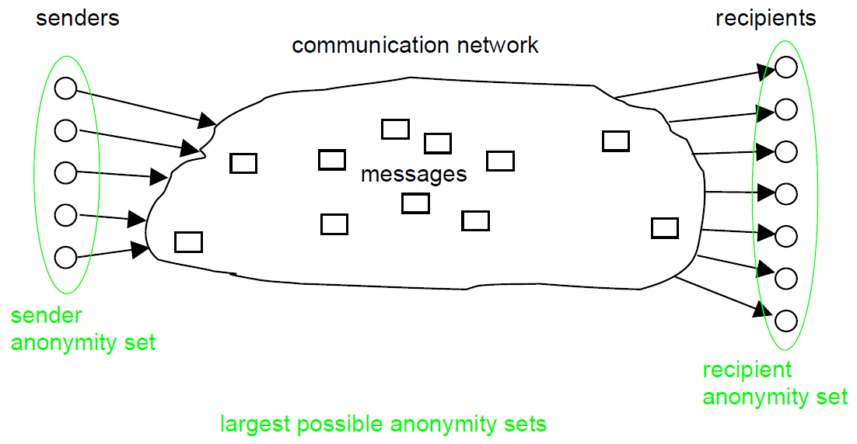
Anonymity

Slide 21
Anonymity
Recall: Anonymity is the state of being not identifiable within a set of subjects, called the anonymity set
How to quantify the anonymity of a subject?
What is the problem with this definition of anonymity?
Note: Anonymity set cannot increase w.r.t. a particular IOI

Slide 22
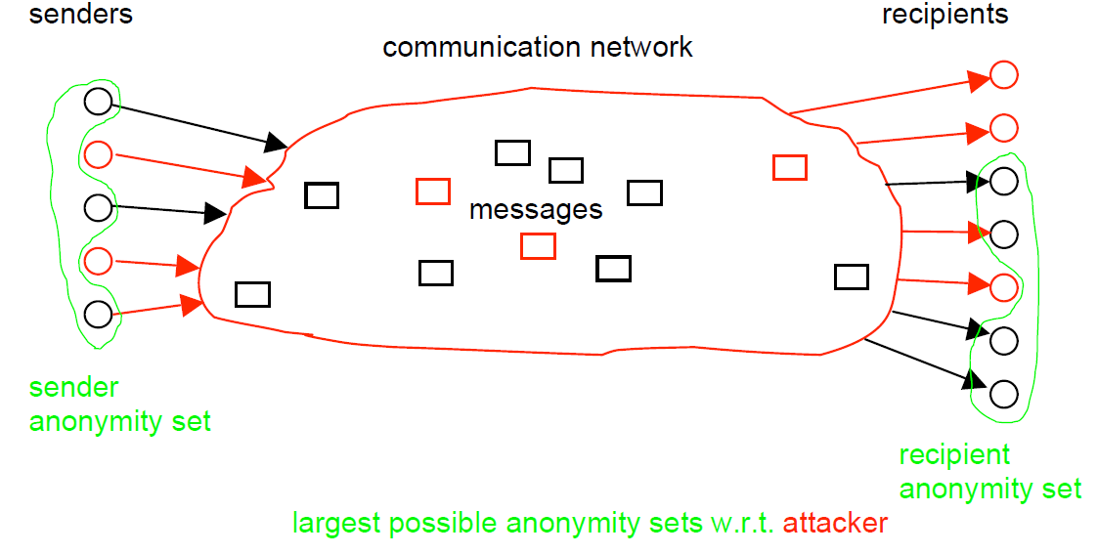
Anonymity

Slide 23
Anonymity Properties
Quantification of Anonymity
Detailed description of the system needed?
May not be always possible
Robustness of Anonymity
How stable the quantification is with changes, e.g., change in adversary strength
Quality of Anonymity = Quantification + Robustness

Slide 24
Unlinkability
Unlinkability of two or more items of interest (IOIs, e.g., subjects, messages, actions) from an attacker’s perspective means that within the system, these IOIs are no more and no less related after his observations that they are related concerning his a-priori knowledge

Slide 25
Unlinkability Example
Size of sender anonymity set = 5
Example:
What is the probability that two (independent) messages are sent by the same sender?
After observation, what is the probability?

Slide 26
Anonymity in terms of Unlinkability
Recall anonymity
A sender S sends a message M anonymously, iff S is anonymous within the set of potential senders of M
A message M is sent anonymously, iff M can have been sent by each potential sender
Sender/recipient anonymity means message is unlinkable to the potentially sending/receiving subjects

Slide 27
Relationship Anonymity
Relationship anonymity of a pair of subjects, means that to this sender and receiver are unlinkable
Relationship anonymity is a weaker property than each of Sender anonymity and Recipient anonymity!
Sender anonymity → Relationship anonymity
Receiver anonymity → Relationship anonymity
Relationship anonymity ->? Sender anonymity, Receiver anonymity

Slide 28
Undetectability
Undetectability of an item of interest (IOI) from an attacker’s perspective means that the attacker cannot sufficiently distinguish whether it exists or not.
For example, if the IOI under consideration is a message, then it means that a message is not sufficiently distinguishable from random noise
Perfect or Maximal Undetectability: If the attacker can never distinguish (or distinguish with zero probability) whether an IOI exists or not.
Example
steganography

Slide 29
Unobservability
Unobservability of an IOI means
Undetectability of the IOI against all subjects uninvolved in it, and
Anonymity of the subject(s) involved in the IOI
Sender unobservability: means that it is sufficiently undetectable whether any sender within the unobservability set sends
Sender unobservability is perfect iff it is completely undetectable whether any sender within the unobservability set sends
Similarly, Recipient unobservability and Relationship unobservability are defined!

Slide 30
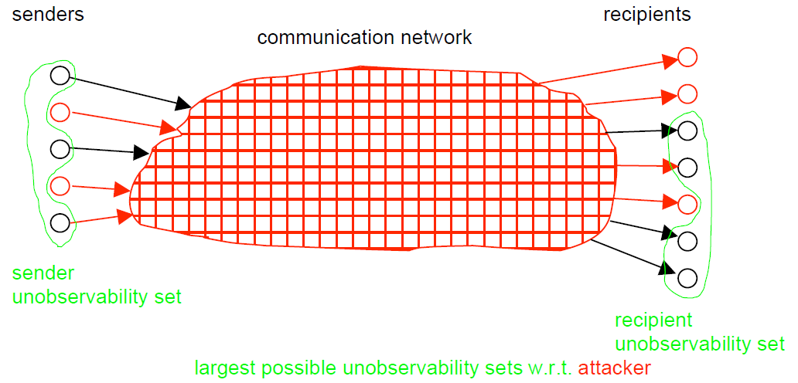
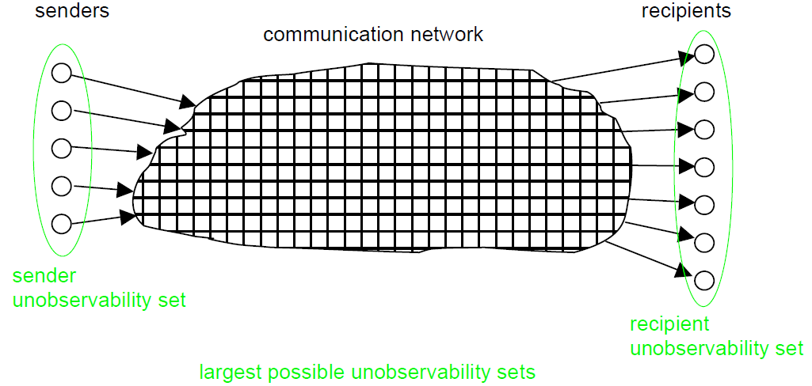
Unobservability

Slide 31
Relationships
Unobservability ➔ Anonymity
Sender Unobservability ➔ Sender Anonymity
Recipient Unobservability ➔ Recipient Anonymity
Relationship Unobservability ➔ Relationship Anonymity
Sender anonymity ➔ Relationship anonymity
Recipient anonymity ➔ Relationship anonymity
Sender unobservability ➔ Relationship unobservability
Recipient unobservability ➔ Relationship unobservability
Unobservability ➔ Undetectability

Slide 32
Pseudonymity
Any two-way communication still requires appropriate identifiers
Pseudonym is an identifier of a subject other than one of the subject’s real name(s)
Holder: The subject to which the pseudonym belongs to
The subject is pseudonymous if a pseudonym is used instead of the real name(s)
Pseudonymity: Use of pseudonyms as identifiers in communications

Slide 33
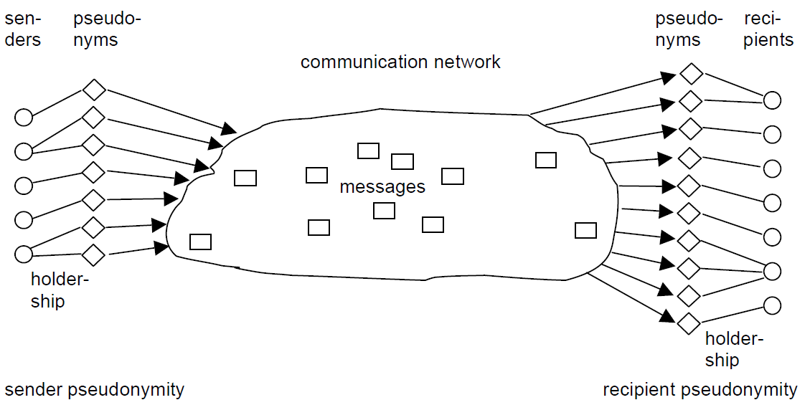
Pseudonymity

Slide 34
Reading Material for Next Class
Read the Fair Information Practices Principles
https://www.privacyfirst.nl/acties-3/item/154-the-fair-information-principles-canada.html
Read the HIPAA Privacy Rule
https://www.hhs.gov/sites/default/files/privacysummary.pdf
Read the GDPR principles
https://gdpr.eu/what-is-gdpr/
Think about these questions:
What are the common concepts and principles these privacy laws and regulations?
Are there parts of the policy that are too vague? If so, suggest alternatives
Identify any data privacy laws and regulations in Saudi Arabia

Slide 35
References
https://dud.inf.tu-dresden.de/literatur/Anon_Terminology_v0.31.pdf
https://cacm.acm.org/blogs/blog-cacm/235401-why-is-privacy-so-hard/fulltext
https://onlinelibrary.wiley.com/doi/10.1111/spc3.12507

