Slide 1
COE526: Data Privacy
Lecture 11: Secure Multiparty Computation

Slide 2
Computing on Encrypted Data
Basic idea
Client encrypts his data 𝑥 and sends encryption 𝐸(𝑥) to the server
The server performs some computation (evaluate function 𝑓) and returns the encrypted result to the client
The client decrypts the result to find out the answer, but the server learns nothing about the data
Homomorphic encryption

Slide 3
E-Voting Example using Homeomorphic Encryption
We have three candidates: Don, Joe, and West
We want to construct a "fast" and secure voting system
We can assign certain number of bits for each candidate
Don: 010000, Joe: 000100, West: 000001
Assume we have 6 people voting and results are as follows
Voter | Don | Joe | West | Bit Score
1 |  |  | X | 00 00 01=1
2 |  | X |  | 00 01 00=4
3 |  | X |  | 00 01 00=4
4 |  |  | X | 00 00 01=1
5 | X |  |  | 01 00 00=16
6 |  |  | X | 00 00 01=1

Slide 4
E-Voting Example using Homeomorphic Encryption
Votes need to be added -> use Paillier Cryptosystem
Use p =5, q=7, n = 35, n²⁼1225, $λ=12, g=141$
X | r | Enc(x, r)
1 | 4 | 359
4 | 17 | 173
4 | 26 | 486
1 | 12 | 1088
16 | 11 | 541
1 | 32 | 163
$359 ⋅173⋅486⋅$1088 $⋅$541 $⋅$163=983 mod 1225 $$D_{SK} \left(983 mod 1225\right)=27$$
27 = 01 10 11
Don received 1 vote (01)
Joe received 2 votes (10)
West received 3 votes (11)

Slide 5
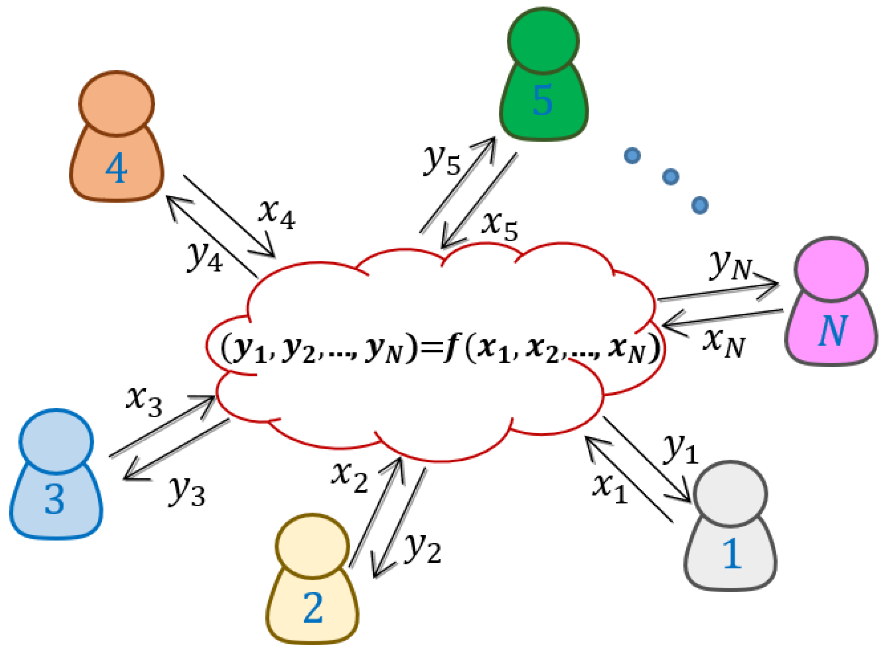
Secure Multiparty Computation (SMC)
General framework for describing computation between parties who do not trust each other
A set of parties with private inputs wish to compute some joint function of their inputs
Parties wish to preserve some security properties. e.g., privacy and correctness
Security must be preserved in the face of adversarial behavior by
some of the participants, or
an external party

Slide 6
SMC Examples
Elections
N parties, each one has a “Yes” or “No” vote
Goal: determine whether the majority voted “Yes”, but no voter should learn how other people voted
Auctions
Each bidder makes an offer
Offer should be committing! (can’t change it later)
Goal: determine whose offer won without revealing losing offers
Distributed data mining
Two companies want to compare their datasets without revealing them
For example, compute the intersection of two lists of names
Database privacy
Evaluate a query on the database without revealing the query to the database owner
Evaluate a statistical query on the database without revealing the values of individual entries
Many variations

Slide 7
A Couple of Observations
In all cases, we are dealing with distributed multi-party protocols
A protocol describes how parties are supposed to exchange messages on the network
All of these tasks can be easily computed by a trusted third party
The goal of secure multi-party computation is to achieve the same result without involving a trusted third party

Slide 8
Security Requirements
Privacy: only the output is revealed
Correctness: the function is computed correctly
Independence of inputs: parties cannot choose inputs based on others’ inputs
Fairness: if one party receives output, all receive output
Guaranteed output delivery

Slide 9
Security Requirements: Example
Consider a secure auction (with secret bids):
An adversary may wish to learn the bids of all parties – to prevent this, require PRIVACY
An adversary may wish to win with a lower bid than the highest – to prevent this, require CORRECTNESS
The adversary may also wish to ensure that it always gives the highest bid – to prevent this, require INDEPENDENCE OF INPUTS
An adversary may try to abort the execution if its bid is not the highest – require FAIRNESS

Slide 10
How to Define Security?
Must be mathematically rigorous
Must capture all realistic attacks that a malicious participant may try to stage
Should be "abstract"
Based on the desired "functionality" of the protocol, not a specific protocol
Goal: define security for an entire class of protocols
slide 20

Slide 11
Heuristic Approach to Security
Approach 1
Build a protocol
Try to break the protocol
Fix the break
Return to (2)
Problems
Real adversaries won’t tell you that they have broken the protocol
You can never be really sure that the protocol is secure
Approach 2
Design a protocol
Provide a list of attacks that (provably) cannot be carried out on the protocol
Reason that the list is complete
Problem: often, the list of attacks is not complete
Zero-day attacks!!

Slide 12
A Rigorous Approach
Provide an exact problem definition
Meaning of security
Network model
Adversarial power
Prove that the protocol is secure
Often by reduction to an assumed hard problem, like factoring large composites

Slide 13
SMC Functionality
$K$ mutually distrustful parties want to jointly carry out some task
The input to the function is $K$ (private) input, the output is $K$ outputs
$F$ can be either a probabilistic or a deterministic map function from inputs to outputs
In general, we can model $F$as $F:{\left({\left\{0,1\right\}}^{∗}\right)}^{K}→({\left\{0,1\right\}}^{∗})K$
Assume that $F$ is computable in polynomial time, for example,
$$F\left(A,B\right)=(\left(A≥B\right),(A≥B))$$
K inputs (one per party);
each input is a bitstring
K outputs

Slide 14
Defining Security
The real/ideal (simulation) model paradigm for defining security
Ideal model: parties send inputs to a trusted party, who computes the function for them
Real model: parties run a real protocol with no trusted help
The security of a protocol can be checked by comparing what an adversary can do in a real protocol execution to what it can do in an ideal scenario (simulation)
A protocol is secure if any adversary in the real model can do no more harm than if it was involved in the ideal model
In other words, an adversary should have an indistinguishable view of the protocols
Notes:
In other words, A protocol $P$ securely computes a functionality $F_{P}$ if for every adversary $A$ in the real model, there exists an adversary $S$in the ideal model, such that the view of the adversary from a real execution of $P$with $A$is indistinguishable from the view of the adversary from an ideal execution with $S$

Slide 15
Ideal Model
Intuitively, we want the protocol to behave "as if" a trusted third party collected the parties’ inputs and computed the desired functionality
Computation in the ideal model is secure by definition!
x₁
f₁(x₁,x₂)
x₂
f₂(x₁,x₂)
A
B

Slide 16
More Formally
A protocol is secure if it emulates an ideal setting where the parties hand their inputs to a "trusted party," who locally computes the desired outputs and hands them back to the parties [Goldreich-Micali-Wigderson 1987]
x₁
f₁(x₁,x₂)
x₂
f₂(x₁,x₂)
A
B

Slide 17
Real world
No trusted third party
Participants run some protocol amongst themselves without any help
Despite that, secure protocol should emulate an ideal setting
Real protocol that is run by the participants is secure if no adversary can do more harm in real execution than an execution that takes place in the ideal world

Slide 18
Adversary Models
Some participants may be dishonest (corrupt)
If all were honest, we would not need secure multi-party computation
Semi-honest (aka passive; honest-but-curious)
Follows protocol, but tries to learn more from received messages than he would learn in the ideal model
Malicious
Deviates from the protocol in arbitrary ways, lies about his inputs, may quit at any point
For now, focus on semi-honest adversaries and two-party protocols

Slide 19
Properties of the Definition
How do we argue that the real protocol "emulates" the ideal protocol?
Correctness
All honest participants should receive the correct result of evaluating function $F$
Because a trusted third party would compute f correctly
Privacy
All corrupt participants should learn no more from the protocol than what they would learn in ideal model
slide 28

Slide 20
Yao’s Millionaire Problem
I am more rich
I am rich
Two millionaires, Alice and Bob want to know which of them is richer without revealing their actual wealth
This problem is analogous to a more general problem where there are two numbers A and B and the goal is to solve the inequality without revealing the actual values of A and B

Slide 21
HE-based Solution: Setup
Assume Alice has $X=\$7$and Bob has $Y=\$2$
We need to represent $X$ and $Y$ using binary numbers of length n
Let $X=x_{n}x_{n−1}… x_{i+1}x_{1}, x_{i}∈{\left\{0,1\right\}}^{n}$
X=7=111₂, Y=2=010₂
We define two types of encoding
0-encoding of $X$ is a set $S_{X}^{0}=\left\{x_{n}x_{n−1}…x_{i+1}1 | x_{i}=0 ∀ 1≤i≤n\right\}$
Invert the least significant bit of all prefixes of $X$ tailing 0
$S_{X}^{0}$ = {}, $S_{Y}^{0}=\{1,011\}$
1-encoding of $X$ is a set $S_{X}^{1}=\left\{x_{n}x_{n−1}…x_{i+1}x_{i} | x_{i}=1 ∀ 1≤i≤n\right\}$
All prefix of $X$ tailing 1
$S_{X}^{1}$ = {1,11,111}, $S_{Y}^{1}=\{01\}$
$X>Y$ if and only if $S_{X}^{1}$ and $S_{Y}^{0}$has a common element, i.e., $S_{X}^{1}\text{∩}S_{Y}^{0}≠∅$
$\text{\{1,11,111\}∩}\{1,011\}$={1}
X=7=111 has three prefixes
1
11
111
Y=2=010 has three prefixes
0
01
010

Slide 22
HE-based Solution: Protocol
Alice (X=7=111)
Bob (Y=2=010)
Alice sends a matrix $T_{2×n}$ to Bob, where $T\left[x_{i},i\right]=E\left(1\right),$ $T\left[x_{i},i\right]=E\left(r_{i}\right), r_{i}$ is random
Bob does the following
Finds $S_{y}^{0}$
Computes $c_{t}=T\left[t_{n},n\right]∙T\left[t_{n−1},n−1\right]∙$ $…∙T\left[t_{i},i\right]$ for each $t=t_{n}t_{n−1}…t_{i}∈S_{y}^{0}$
Chooses another $n−|S_{y}^{0}|$ random ciphertexts forming a new set {$c_{1},c_{2},…, c_{n}$} and sends them back to Alice after random permutation
Alice decrypts all $c_{i}$, check whether some of them are 1 which indicates x>y
$$\begin{matrix}E(r_{2}) & E(r_{1}) & E(r_{0}) \\ E(1) & E(1) & E(1)\end{matrix}$$
$$\begin{matrix}E(r_{2}) & E(r_{1}) & E(0) \\ E(1) & E(1) & E(1)\end{matrix}$$
$$S_{y}^{0}=\{1,011\}$$
$c_{\{1\}}=T[1,0]$= $E\left(1\right)$
$$c_{\{011\}}=T\left[0,2\right]T\left[0,1\right]T[1,0] \\ \text{= }E\left(r_{2}\right)E\left(r_{1}\right)E\left(1\right)$$
{$E\left(r_{2}\right)E\left(r_{1}\right)E\left(1\right),E\left(1\right), c_{1}$}
{$E\left(r_{2}\right)E\left(r_{1}\right)E\left(r_{1}\right),E\left(1\right), c_{1}$}
$$D(E\left(1\right))=1$$

Slide 23
Another Example
Alice (X=7=111)
Bob (Y=6=110)
$S_{Y}^{0}$ = {??????}
$S_{X}^{1}$ = {1,11,111}
$$\begin{matrix}E(r_{2}) & E(r_{1}) & E(r_{0}) \\ E(1) & E(1) & E(1)\end{matrix}$$
$$\begin{matrix}E(r_{2}) & E(r_{1}) & E(0) \\ E(1) & E(1) & E(1)\end{matrix}$$
$$S_{y}^{0}=\{111\}$$
$$c_{\{111\}}=T\left[1,2\right]T\left[1,1\right]T[1,0] \\ \text{= }E\left(1\right)E\left(1\right)E\left(1\right)$$
{$c_{3},E\left(1\right)E\left(1\right)E\left(1\right), c_{2}$}
{$c_{3},E\left(1\right)E\left(1\right)E\left(1\right), c_{2}$}
$$D(E\left(1\right)E\left(1\right)E\left(1\right))=D(E\left(1.1.1\right))=1$$

Slide 24
Summary
Secure multiparty computation is a framework for secure distributed computing
If a trusted third-party exists, no need for SMC
Security and privacy of SMC can be proven using simulation of real/ideal model
Example of SMC: Yao's Millionaire problem
Solution to Yao's Millionaire problem using Homeomorphic encryption
Next, a solution for general Yao's millionaire problem
K parties
Any arbitrary function

