Slide 1
Random Access Networks
CSMA Families

Slide 2
References
Chapter 9 of the book.
Throughput Analysis for Persistent CSMA Systems, HIDEAKI TAKAGI AND LEONARD KLEINROCK. IEEE TRANSACTIONS ON COMMUNICATIONS, VOL. COM-33, NO. 7, JULY 1985
Performance Analysis and Enhancement of MAC Protocols, Chuan Heng Foh, A Thesis submitted in total fulfillment of the requirements of the degree of Doctor of Philosophy. Department of Electrical and Electronic Engineering, The University of Melbourne, 2002.

Slide 3
CSMA Motivation
In Aloha and slotted Aloha: a station initiates a transmission without making sure that the broadcast channel is clear for transmission.
Therefore,
During a data frame transmission, there is a chance of collision.
Carrier Sense Multiple Access (CSMA) protocol was proposed as a refinement over SLOTTED ALLOHA by providing Carrier Sensing.
The main Objective of this added functionality is to minimize the length of the collision period.

Slide 4
CSMA Motivation
If all stations initiate transmissions only when the broadcast channel is sensed idle, the chances of collisions can be reduced.
“listen before transmit”.
NOTE:
Due to signal propagation delay, tow or more stations may not be aware of other transmissions even after the channel is sensed idle.
Therefore,
If two or more stations start their transmissions at the same time,
Collisions are still possible !!

Slide 5


CSMA Motivation
In the case that a ready station senses a busy channel, the transmission may defer based on various schemes described in the following:

Slide 6
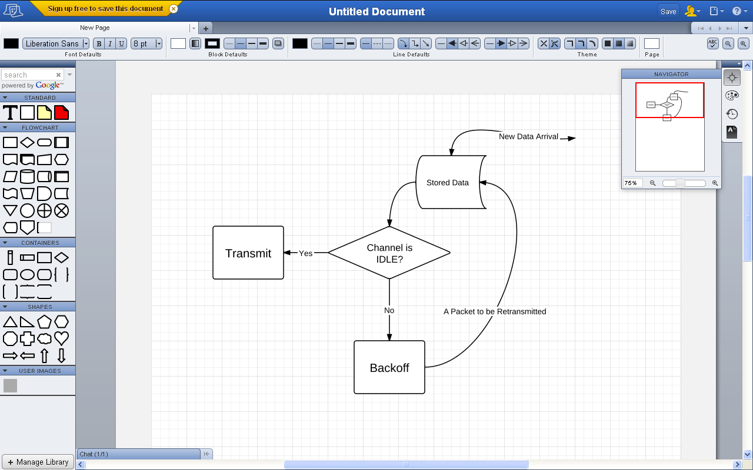
CSMA Transmission Modes
1) Non-persistent CSMA (NP):
  If channel is sensed idle then transmit packet
  Else (channel busy) use backoff algorithm to delay transmission.

Slide 7
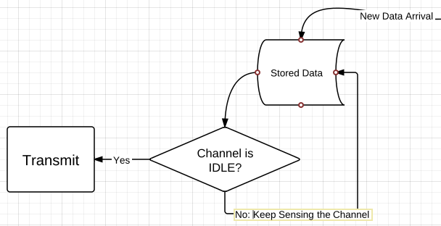
CSMA Transmission Modes
1-persistent CSMA (p-persistent and P=1):
If the channel is sensed busy, a ready station will keep sensing the busy channel until the channel turns idle. As soon as the channel is sensed idle, the station starts its transmission immediately, that is, with probability one.

Slide 8
CSMA Transmission Modes
p-persistent CSMA (NP):
If the broadcast channel is sensed busy by a ready station, it will persist in sensing the channel until the channel becomes idle. As soon as the channel is sensed idle, with probability p, the station transmits the data frame, or with probability (1-p), it waits for a predefined time period before sensing the channel again. The same process is repeated then.
  If channel is sensed idle then Transmit packet with probability of p.
  Else Wait for end to end delay (time slot) with probability
  (1-p) & repeat.
  Else (channel busy) keep spin sensing until channel is idle in which case repeat the algorithm.

Slide 9
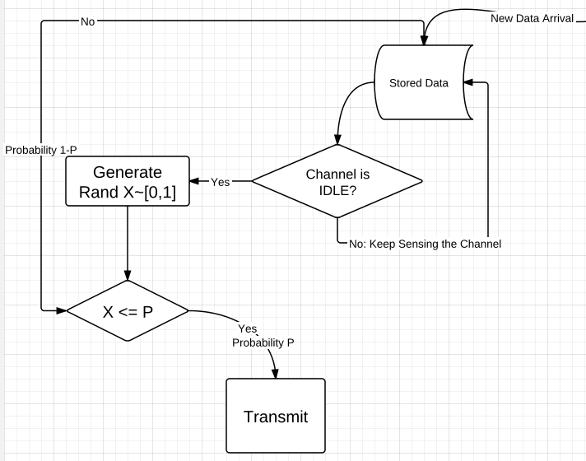
CSMA Transmission Modes
p-persistent CSMA (NP):
wait

Slide 10
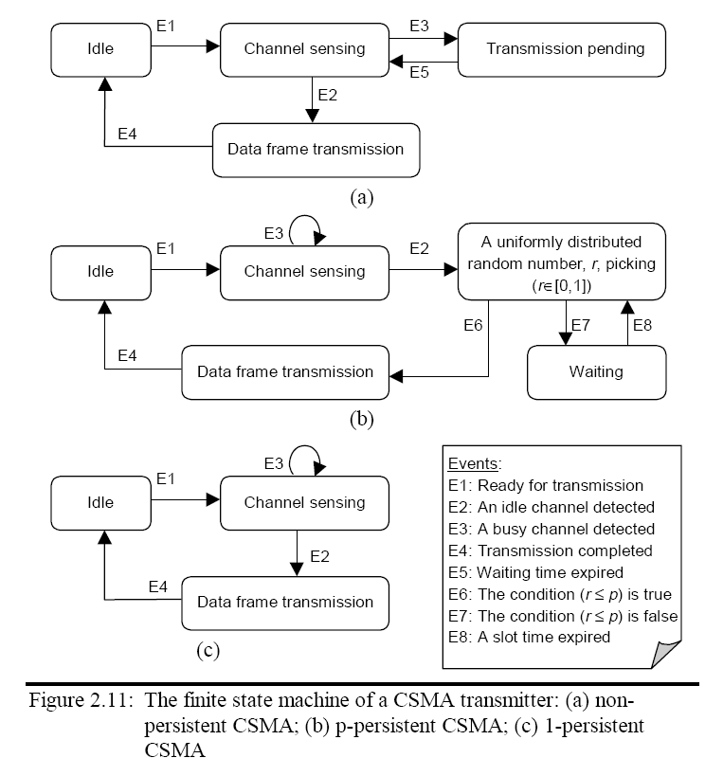

Slide 11
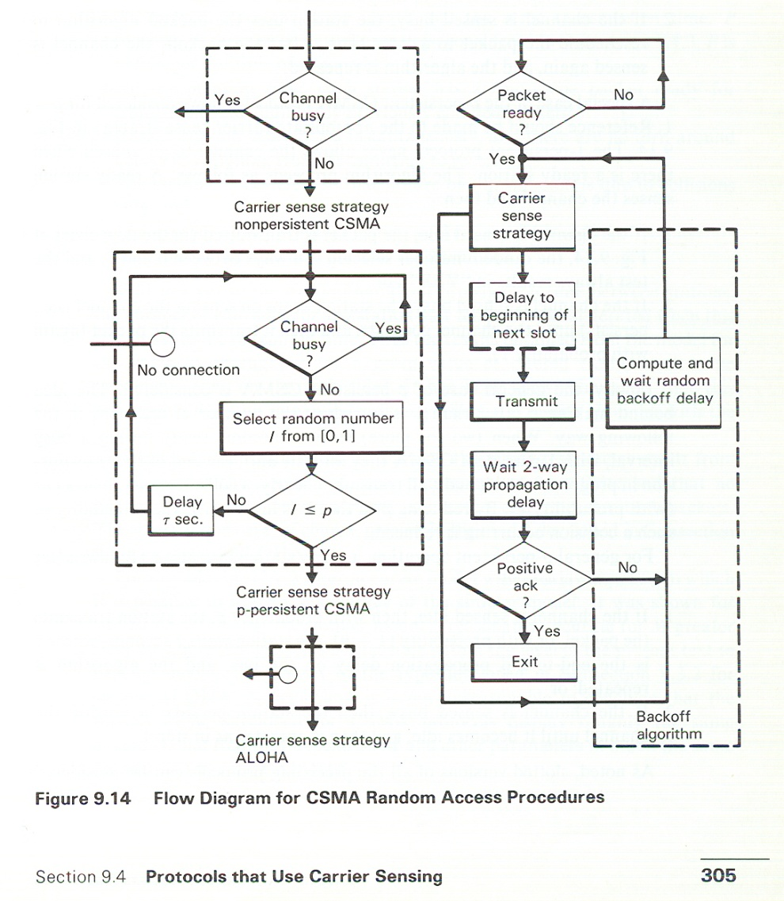
Flow diagram of CSMA

Slide 12
Throughput Analysis CSMA
Assumption for throughput analysis:
Infinite # of stations, arrivals are following Poisson distribution.
Propagation delay between stations is τ. That is the one –way propagation delay for bus.
Fixed packet length and transmission time is Δt.
Each ST has at most one packet ready for transmission
In the case of slotted protocols Δt = k τ. Where k is integer.
No overhead for sensing, channel is noiseless.
Any packet time overlap is destructive.

Slide 13
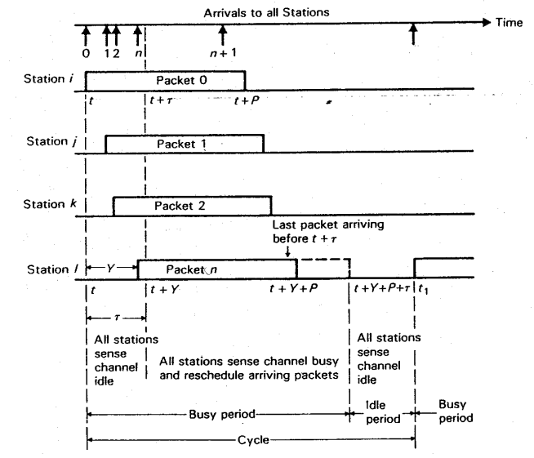
Throughput Analysis CSMA

Slide 14
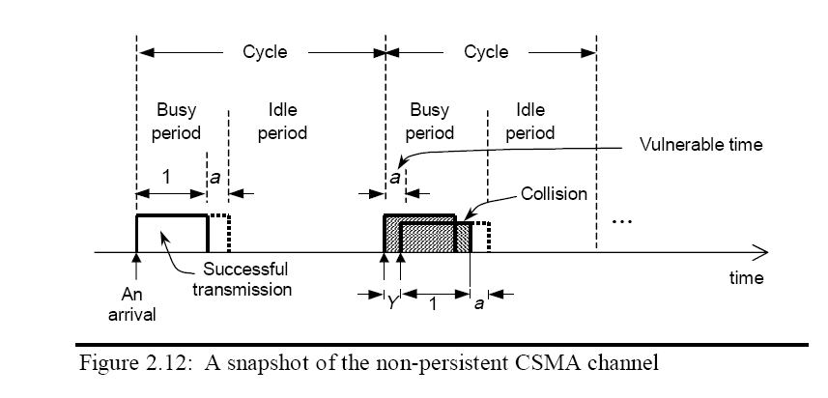
Throughput Analysis CSMA
Let the arrival rate of the combined load and retransmission traffic
be G data frames per data frame transmission time
In non-persistent CSMA protocol, the broadcast channel is repeating two periods: an idle period and a busy period

Slide 15
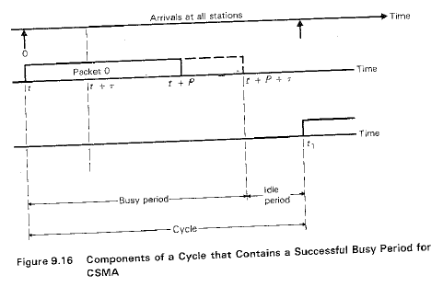
Throughput Analysis

Slide 16
Throughput Analysis CSMA
Busy Period: (B)
  During this there are no attempts to access the network
  May contain busy packets and or not colliding packets
Idle Period: (I)
Depends on the load of the network, it maybe empty and maybe start of transmission
B and I variables are two independent random variables.
Duration of a cycle: (B+I) :
Useful period (U)
The duration that the channel carries useful information within a cycle. It is the average time in Busy period during which there is a successful transmission

Slide 17

Throughput Analysis
Using the results from the renewal theory:
The throughput can be expressed as

Slide 18



Throughput Analysis CSMA, E[U]
  When a transmission occurs, it takes a units of time to reach all other stations.
  To get a successful transmission, it is required to have no other stations initiating transmissions during vulnerable period, a, when a transmission is started.
  Since the arrival process is a Poisson process
Therefore,

Slide 19

Throughput Analysis CSMA, E[I]
The idle period, I,
is the duration from the end of a transmission to the arrival of the next transmission.
In other words, I is the inter-arrival time of the arrival process.
Since the arrival process is a Poisson process
Thus the
idle period is exponentially distributed, and its mean value is given by

Slide 20

Throughput Analysis CSMA, E[B]
The busy period, B
Is the sum of
the time difference between the first and the last arrivals within a vulnerable period, denoted Y,
plus
The data frame transmission time and the signal propagation time.
How to find Y ???

Slide 21




Throughput Analysis CSMA, E[B]
0
y
0 arrival in -y

Slide 22
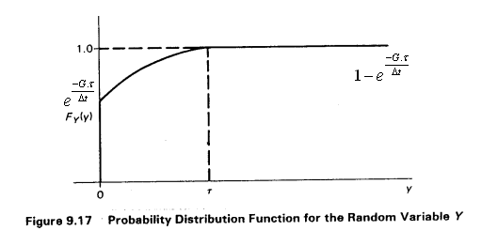
Throughput Analysis CSMA, E[B]

Slide 23

Throughput Analysis CSMA
By substituting the expressions for E[U], E[I], E[B]
the throughput for the non-persistent CSMA protocol is thus
a : The normalized propagation delay.
It is clear that non-persistent CSMA performs better for small values of a.

Slide 24
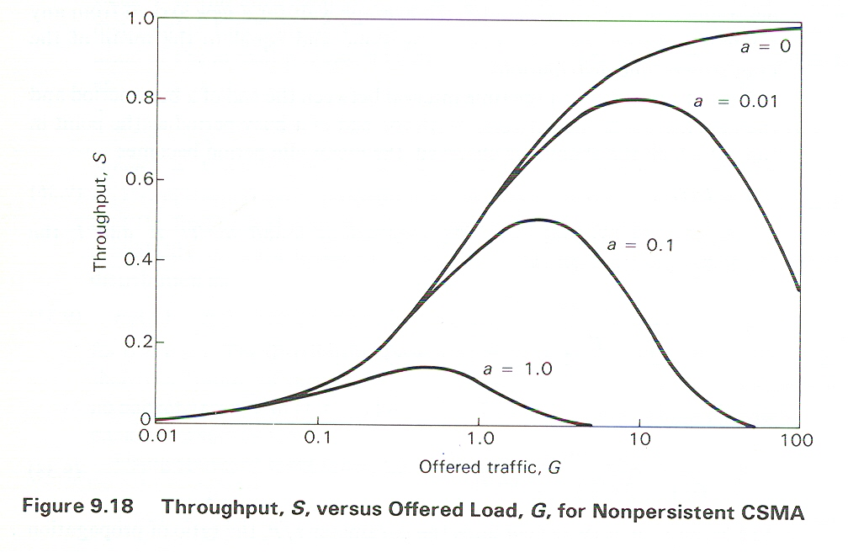

As (a) approaches 0 == > S = G/G+1
As (a) approaches 0 & G >>1 == > S=1
For (a) = 1: S is the lowest, this is because time & are equal, and by the time we get information about the status of channel, the actual status may have changed.

Slide 25
Slotted CSMA

Slide 26




Slotted CSMA
Since
Therefore

Slide 27



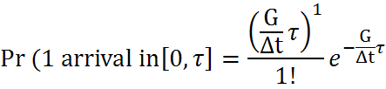

Slotted CSMA

Slide 28




Slotted CSMA
Similarly:
Therefore:

Slide 29





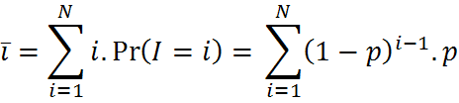


Slotted CSMA

Slide 30


Slotted CSMA
Substituting all the previous terms back in S:

Slide 31
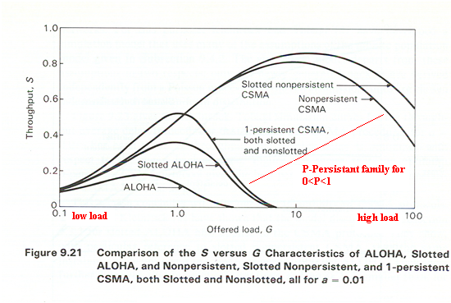
Throughput Analysis CSMA
Notes:
For small G the persistent CSMA is the best.
For large G the non persistent CSMA is the best.

Slide 32
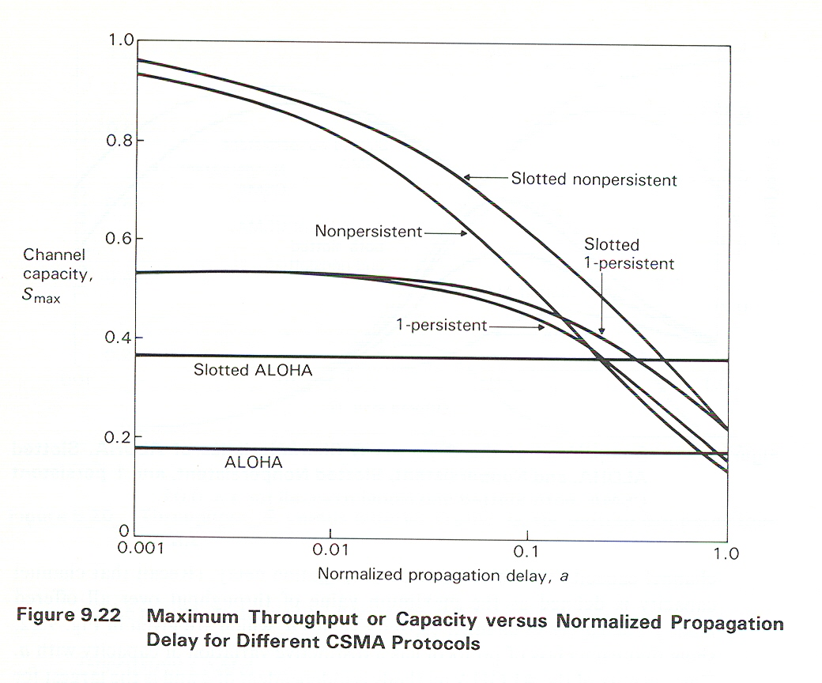
Throughput Analysis CSMA

Slide 33
Throughput Analysis CSMA
Notes:
ALOHA protocols are not sensitive to varying (a) since it does not depend on it (constant).
1-persistant (slotted/un-slotted) are not sensitive to varying (a) for small (a). however, as (a) increases the sensitivity increases as well-this goes for non-persistent also-.
For large (a) ALOHA gives highest S because sensing became useless as 2τ is very large.
p-persistent performance is between S-NP & NP. p-persistent is optimized for a given (a)

Slide 34
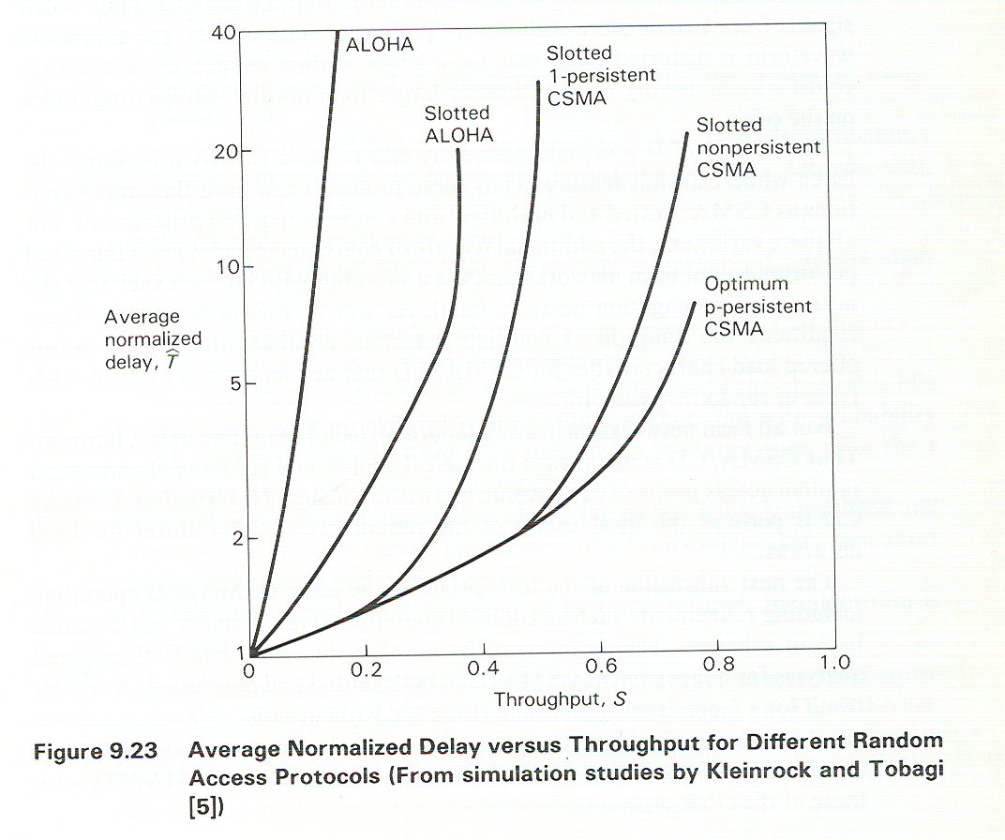
Avg. Normalized Delay VS Throughput

Slide 35
NOTES
The Previous figure was a result of simulation for the throughput average delay tradeoffs for the ALOHA and CSMA procedures for a = 0.01
For each value of S, the average delay was optimized with respect to the mean backoff time.

Slide 36
CSMA/CD

Slide 37

CSMA/CD
Collision Detection: Listen while transmitting the Packet
A Timer is used to broadcast t jamming signal in case a collision is detected. This will take J seconds
If the Jamming is heard, other transmitting stations back-off.

Slide 38
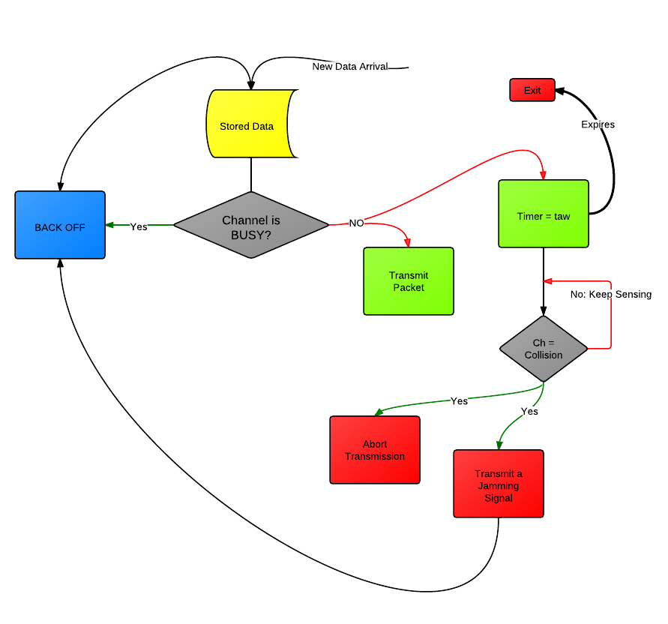
CSMA/DC Flow Chart

Slide 39

CSMA/CD: Back off
Truncated binary Exponential Back off:
Initial Transmission + 15 attempts:
If this happens == > give up ( report a failure network)
i=1
Step i: k = min(10,i)
  r = rand[0, ]
  wait for: r * 2
  Exit

Slide 40
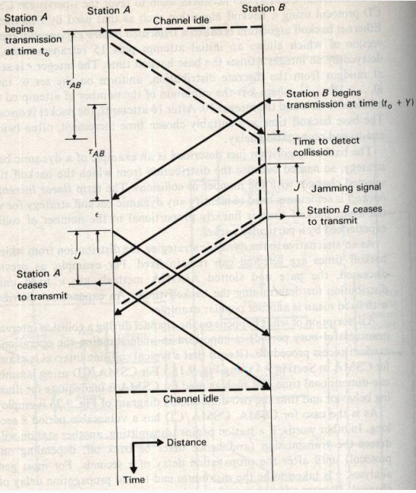

Timing diagram of CSMA /CD:
Notes:
Time during which channel is idle as seen by each station is :
Where J is jamming time
WHY ??

Slide 41
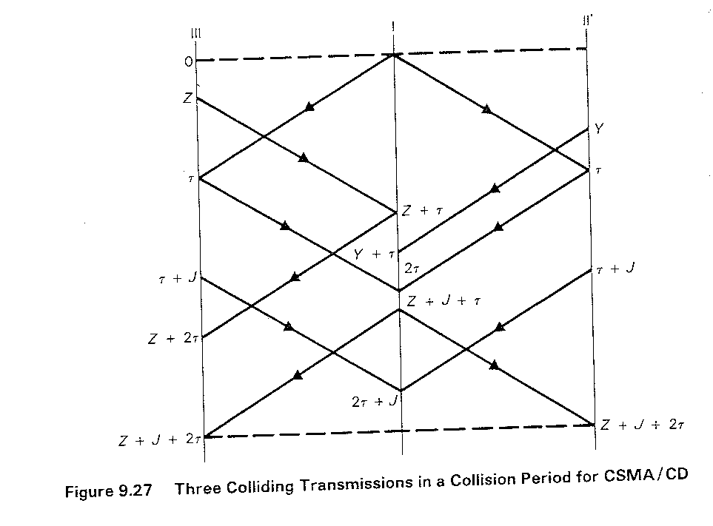

Slide 42
Throughput Analysis

Slide 43
Throughput Analysis

Slide 44
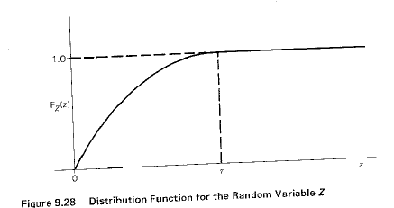

Slide 45
Throughput Analysis

Slide 46
Throughput Analysis

Slide 47
Throughput Analysis

Slide 48
Slotted CSMA/CD

Slide 49
Performance Analysis CSMA/CD
Notes:
  γ is normalized Jamming time (in plot γ=1).
  SNP is better for low value of (a) (slotted is good for high G).
  Slotting time has negligible effect for low G.

Slide 50
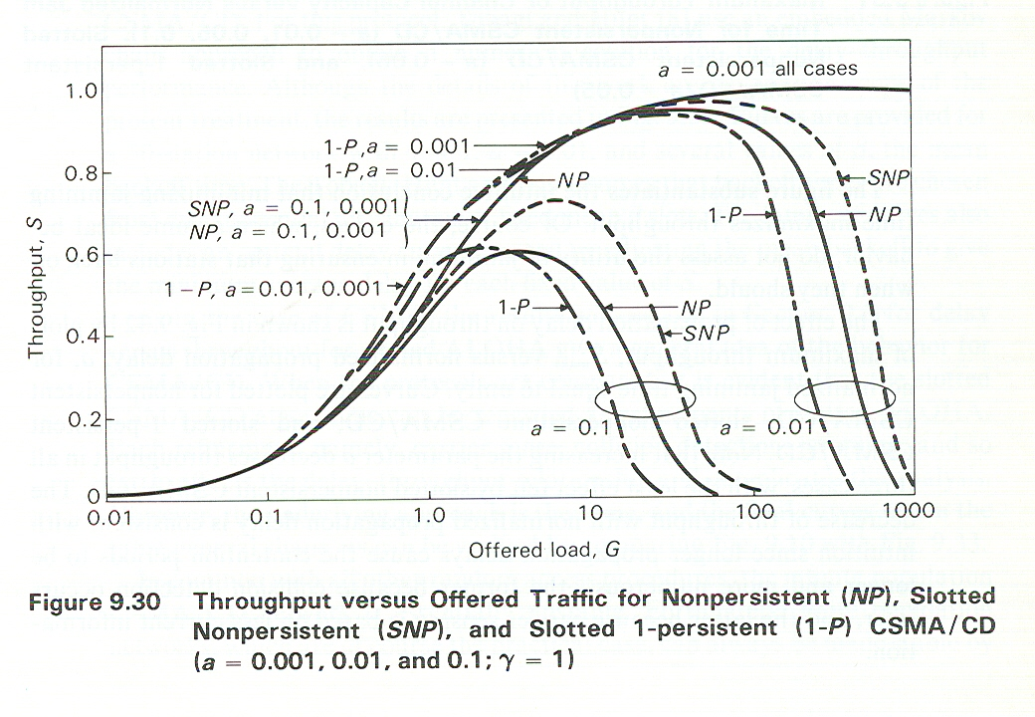
Performance Analysis CSMA/CD

Slide 51
NOTES
The previous figure plots the throughput S versus offered Traffic G, for various schemes. The normalized jamming time is unity in all cases, and a takes several shown values.
Non-persistence CSMA/CD both slotted and un-slotted give for small a greater maximum throughput than 1-persistence CSMA/CD
Slotting the time access tend to increase throughput at higher values of G but has negligible effects for small values.

Slide 52
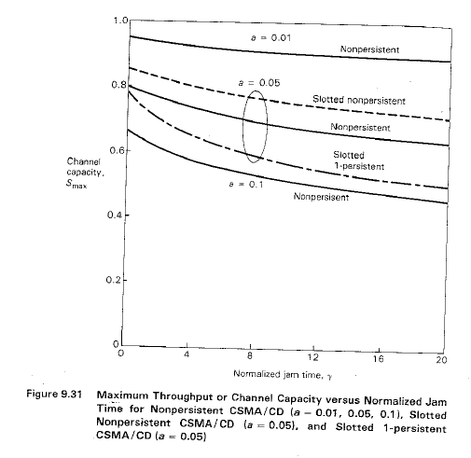

Slide 53
NOTES
The previous figure shows the sensitivity of throughput S for the jamming time γ for 3 values of normalized propagation delay.
minimizing the jamming time, maximizes S.

Slide 54
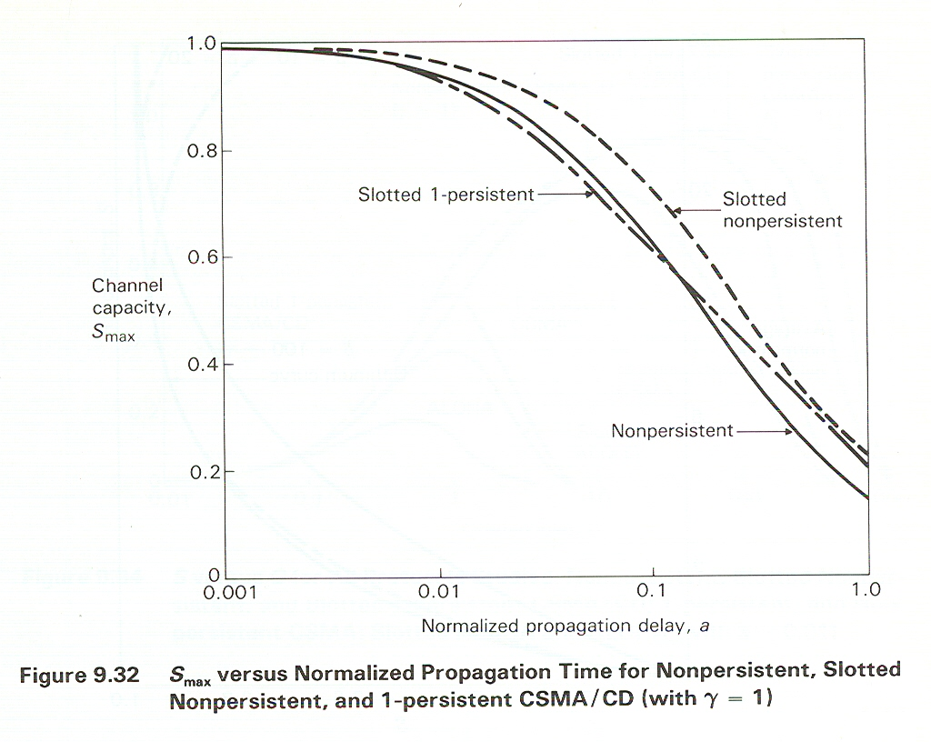
Performance Analysis CSMA/CD

Slide 55
NOTES
The previous figure shows the effect of propagation delay on throughput S, by plotting max throughput versus normalized propagation delay a, for normalized jamming time equal to unity.
Increasing a decreases S for all cases, with the least effect felt by slotted non-persistence CSMA/CD.
That is due to the fact that:
  longer propagation delays cause the contention period to become:
  A) larger because collision detection occurs later.
  B) more numerous. because carrier sensing is based on less current information.

Slide 56
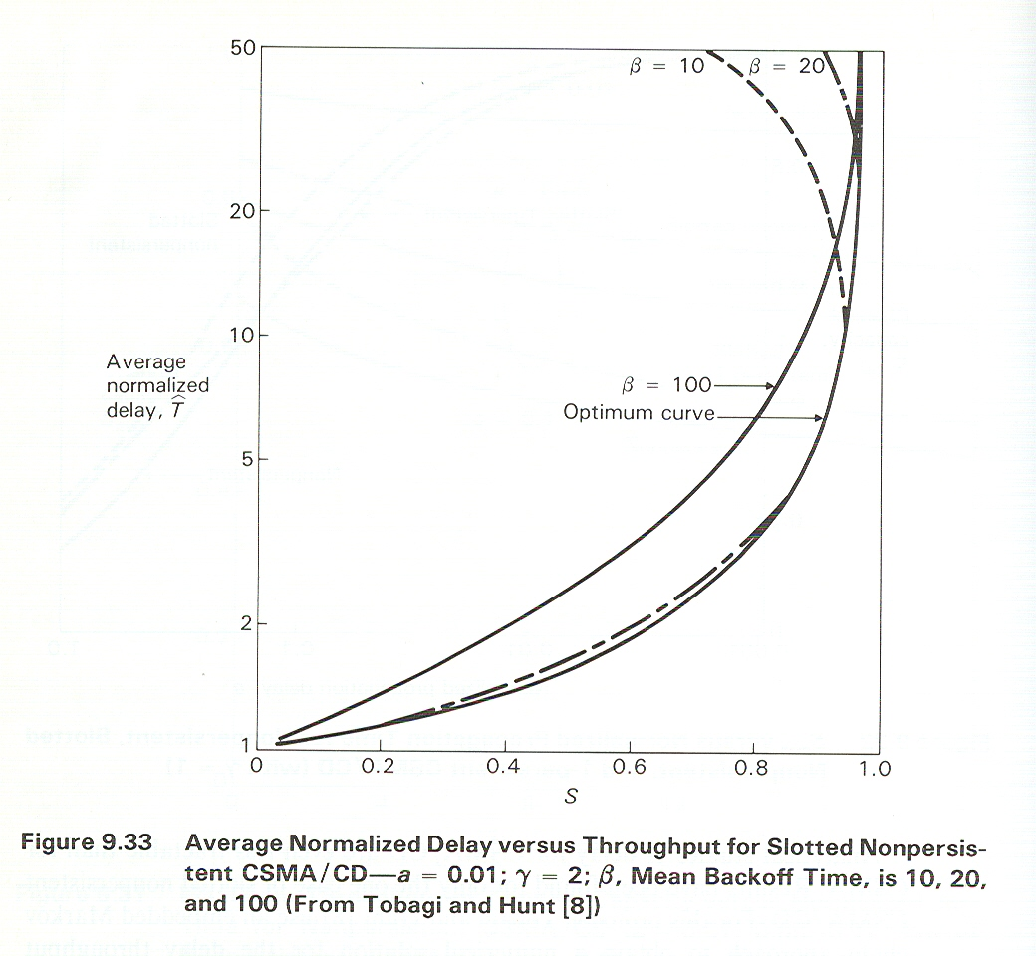
Performance Analysis CSMA/CD

Slide 57
NOTES
The previous figure assumes the backoff times are drown from exponential distribution.
The infinite population of CSMA/CD is unstable.
The finite population networks, practical, can be made stable by increasing the mean backoff time to sufficiently very large value.

Slide 58
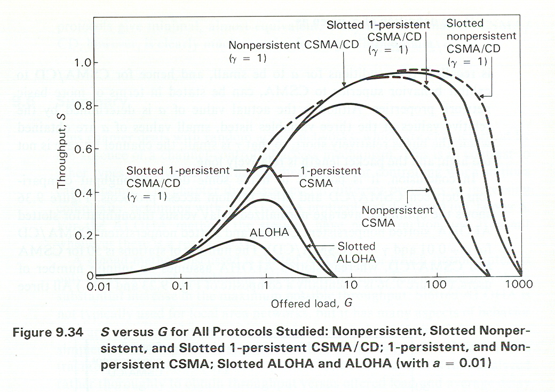
Performance Analysis CSMA/CD

Slide 59
NOTES
In the previous figure, a = 0.01 and γ =1
For CD protocols, the figure shows the improvement in maximum throughput achieved by CSMA/CD over all others.
Since CSMA/CD maintain a throughput relatively high and close to the maximum over a large range of offered Load suggests that CSMA/CD is probably more stable than other random access protocols
Notice that: this improvement is to a large extent depend on a. this is shown in the next figure.

Slide 60
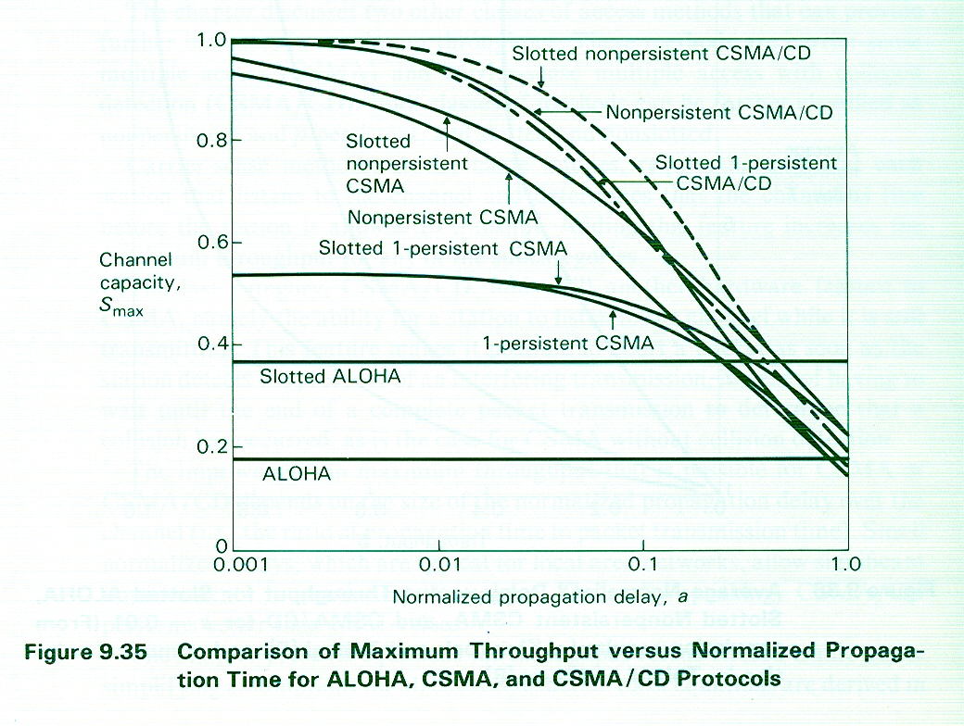
Performance Analysis CSMA/CD

