Slide 1
ICS103 Programming in C Ch1: Overview of Computers & Programming

Slide 2
Outline
Overview of Computers
Hardware
Software
Computer Languages
Software Development Method
Pseudo Code and Flowcharts

Slide 3
Computers
Computers receive, store, process, and output information.
Computer can deal with numbers, text, images, graphics, and sound.
Computers are worthless without programming.
Programming Languages allow us to write programs that tell the computer what to do and thus provide a way to communicate with computers.
Programs are then converted to machine language (0 and 1) so the computer can understand it.

Slide 4
Hardware & Software
Hardware is the equipment used to perform the necessary computations.
i.e. CPU, monitor, keyboard, mouse, printer, speakers etc.
Software consists of the programs that enable us to solve problems with a computer by providing it with a list of instructions to follow
i.e. Word, Internet Explorer, Linux, Windows etc.

Slide 5
Computer Hardware
Main Memory
RAM - Random Access Memory - Memory that can be accessed in any order (as opposed to sequential access memory), volatile.
ROM - Read Only Memory - Memory that cannot be written to, non-volatile.
Secondary Memory - Hard disks, floppy disks, zip disks, CDs and DVDs.
Central Processing Unit - Coordinates all computer operations and perform arithmetic and logical operations on data.
Input/Output Devices - Monitor, printer, keyboard and mouse.
Computer Networks – Computers that are linked together can communicate with each other. WAN, LAN, MAN, Wireless-LAN.

Slide 6
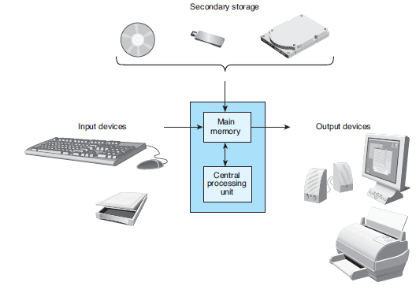
Figure 1.3 Components of a Computer

Slide 7
Memory
Memory Cell (MC) – An individual storage location in memory.
Address of a MC- the relative position of a memory cell in the main memory.
Content of a MC – Information stored in the memory cell. e.g Program instructions or data.
Every memory cell has content, whether we know it or not.
Bit – The name comes from binary digit. It is either a 0 or 1.
Byte - A memory cell is actually a grouping of smaller units called bytes. A byte is made up of 8 bits.
This is about the amount of storage required to store a single character, such as the letter H.

Slide 8
Computer Software
Operating System - controls the interaction between machine and user. Example: Windows, Unix, Dos etc.
Communicate with computer user.
Manage memory.
Collect input/Display output.
Read/Write data.
Application Software - developed to assist a computer user in accomplishing specific tasks. Example: Word, Excel, Internet Explorer.

Slide 9
Computer Languages
Machine Language – A collection of binary numbers
Not standardized. There is a different machine language for every processor family.
Assembly Language - mnemonic codes that corresponds to machine language instructions.
Low level: Very close to the actual machine language.
High-level Languages - Combine algebraic expressions and symbols from English
High Level : Very far away from the actual machine language
For example: Fortran, Cobol, C, Prolog, Pascal, C#, Perl, Java.

Slide 10
Compiler
Compilation is the process of translating the source code (high-level) into executable code (machine level).
Source file - A file containing the program code
A Compiler turns the Source File into an Object File
Object file - a file containing machine language instructions
A Linker turns the Object File into an Executable
Integrated Development Environment (IDE) - a program that combines simple word processing with a compiler, linker, loader, and often other development tools
For example, Eclipse or Visual Studio

Slide 11
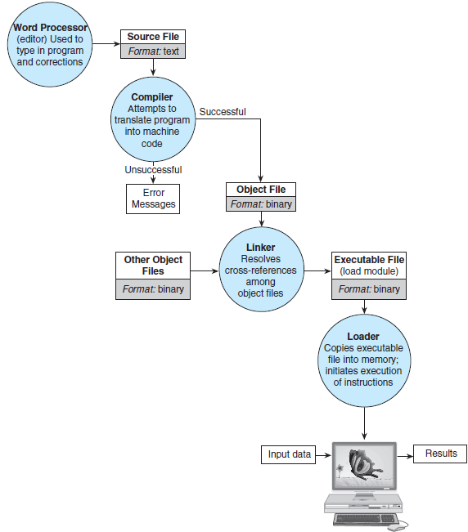
Figure 1.11 Entering, Translating, and Running a High-Level Language Program

Slide 12
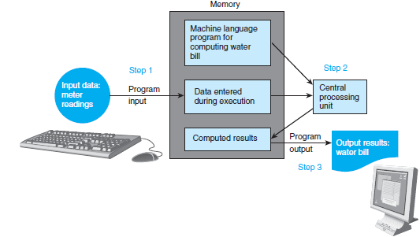
Figure 1.12 Flow of Information During Program Execution

Slide 13
Software Development Method
Specify problem requirements
Analyze the problem
Design the algorithm to solve the problem
Implement the algorithm
Test and verify the completed program
Maintain and update the program

Slide 14
Steps Defined
Problem - Specifying the problem requirements forces you to understand the problem more clearly.
Analysis - Analyzing the problem involves identifying the problem’s inputs, outputs, and additional requirements.
Design - Designing the algorithm to solve the problem requires you to develop a list of steps called an algorithm that solves the problem and then to verify the steps.
Implementation - Implementing is writing the algorithm as a program.
Testing - Testing requires verifying that the program actually works as desired.
Maintenance - Maintaining involves finding previously undetected errors and keep it up-to-date.

Slide 15
Converting Miles to Kilometers
Problem: Your boss wants you to convert a list of miles to kilometers. Since you like programming, so you decide to write a program to do the job.
Analysis
We need to get miles as input
We need to output kilometers
We know 1 mile = 1.609 kilometers
Design
Get distance in miles
Convert to kilometers
Display kilometers

Slide 16
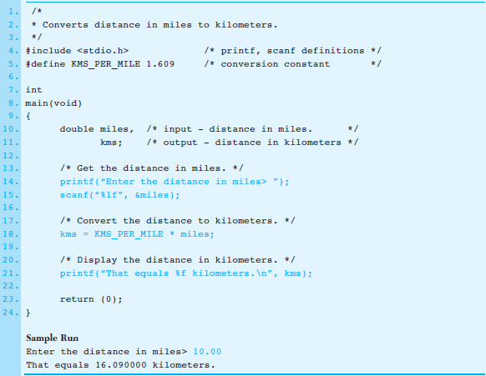
4. Implementation

Slide 17
Miles to Kilometers cont’d
5. Test
We need to test the previous program to make sure it works. To test we run our program and enter different values and make sure the output is correct.

Slide 18
Pseudo code & Flowchart
Algorithm - A list of steps for solving a problem.
Pseudo code - A combination of English phrases and language constructs to describe algorithm steps.
Flowchart - A diagram that shows the step-by-step execution of a program.

Slide 19
Why use pseudo code?
Pseudo code cannot be compiled nor executed, and there are no real formatting or syntax rules.
It is simply one step - an important one - in producing the final code.
The benefit of pseudo code is that it enables the programmer to concentrate on the algorithms without worrying about all the syntactic details of a particular programming language.
In fact, you can write pseudo code without even knowing what programming language you will use for the final implementation.
Example:
Input Miles
Kilometers = Miles * 1.609
Output Kilometers

Slide 20
Another Example of Pseudo code
Problem: Calculate your final grade for ICS 103
Specify the problem - Get different grades and then compute the final grade.
Analyze the problem - We need to input grades for exams, labs, quizzes and the percentage each part counts for. Then we need to output the final grade.
Design
Get the grades: quizzes, exams, and labs.
Grade = .30 * 2 regular exams & quizzes + .20 * Final exam + .50 * labs
Output the Grade
Implement – Try to put some imaginary number and calculate the final grade after you learn how to program.

Slide 21
Flowcharts
Flowchart uses boxes and arrows to show step by step execution of a program.
Process
Start or Terminal
Decision
Document
Display
Manual Input

Slide 22
Example of a Flowchart
Start
Get Grades and
percentages
Calculate
Final grade
Display
Grade
End

