Slide 1
Embedded Computing Chapter 1
COE 306: Introduction to Embedded Systems
Dr. Aiman El-Maleh
Computer Engineering Department
College of Computer Sciences and Engineering
King Fahd University of Petroleum and Minerals

Slide 2
Next . . .
What are Embedded Computing Systems?
Challenges in Embedded Computing System Design
Design Methodology
Formal System Description: UML

Slide 3
What is an Embedded System?
Embedded computing system: any device that includes a programmable computer but is not itself a general-purpose computer.
Take advantage of application characteristics to optimize the design:
don’t need all the general-purpose bells and whistles.
Examples: calculator, fax, clock, coffee maker, cell phone, printer, TV, microwave, camera, car (40–100 microcontrollers)
It all started from a calculator: using Intel 4004 microprocessor

Slide 4
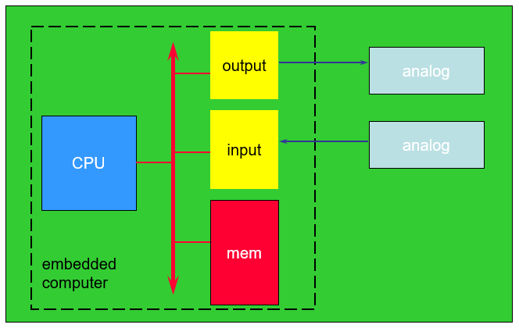
Embedding a Computer
Microcontroller: includes CPU, I/O devices, on-board memory.

Slide 5
Application Examples
Simple control: front panel of microwave oven, etc.
Canon EOS 3 has three microprocessors.
32-bit RISC CPU runs autofocus and eye control systems.
Digital TV: programmable CPUs + hardwired logic.
Today’s high-end automobile may have 100 microprocessors:
4-bit microcontroller checks seat belt;
microcontrollers run dashboard devices;
16/32-bit microprocessor controls engine: determining when spark plugs fire, controlling the fuel/air mixture, etc.
Low-end cars use 20+ microprocessors.

Slide 6
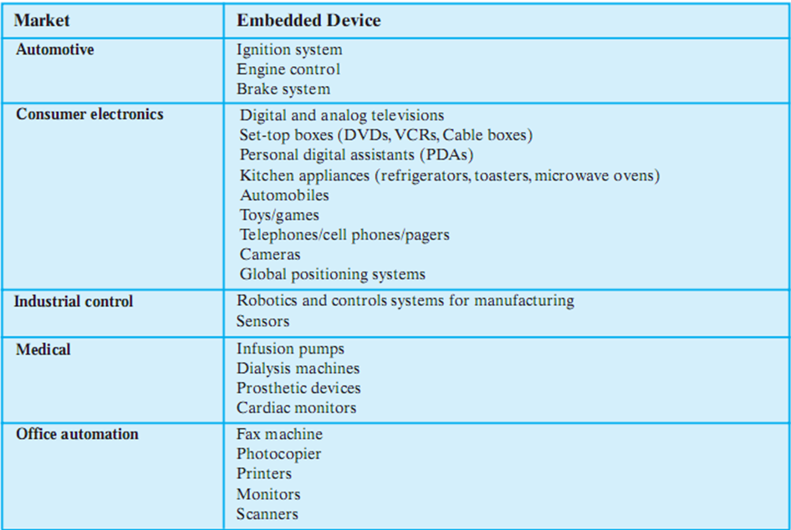
Examples of Embedded Systems

Slide 7
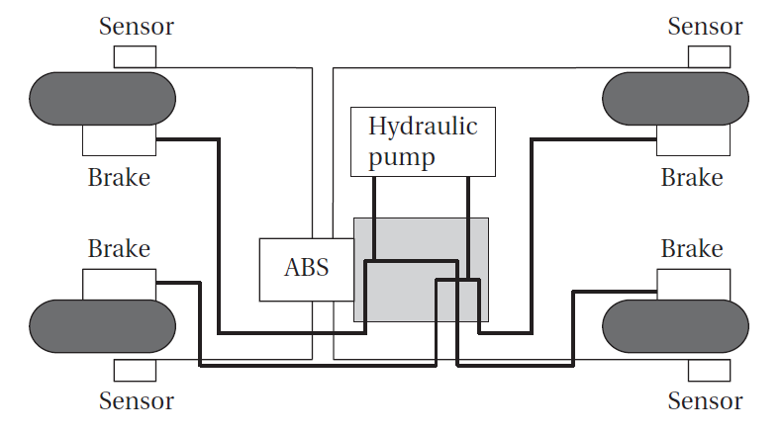
BMW 850i Antilock Brake System
An antilock brake system (ABS) reduces skidding by pumping the brakes.
The purpose of an ABS is to temporarily release the brake on a wheel when it rotates too slowly.

Slide 8
Cyber-Physical Systems
A physical system that tightly interacts with a computer system.
The embedded computer is the cyber-part of the cyber-physical system.
Computers replace mechanical controllers:
More accurate.
More sophisticated control.
Engine controllers replace distributor, carburetor, etc.
Complex algorithms allow both greater fuel efficiency and lower emissions.

Slide 9
Characteristics of Embedded Systems
Sophisticated functionality
Often have to run sophisticated algorithms or multiple algorithms: e.g., a microprocessor controlling automobile engine
Often provide sophisticated user interfaces: e.g. moving maps in Global Positioning System (GPS)
Real-time operation
Must finish operations by deadlines.
Hard real time: missing deadline causes failure; e.g., missed deadlines in printers can result in scrambled pages
Soft real time: missing deadline results in degraded performance; e.g., Streaming audio-video
Many systems are multi-rate: must handle operations at widely varying rates; audio and video of a multimedia stream run at very different rates, but they must remain closely synchronized.

Slide 10
Characteristics of Embedded Systems
Low manufacturing cost
Many embedded systems are mass-market items that must have low manufacturing costs. Cost is determined by type of microprocessor, amount of memory, type of I/O devices.
Low power
Power consumption is critical in battery-powered devices.
Excessive power consumption increases system cost even in wall-powered devices.
Designed to tight deadlines by small teams
Often designed by a small team of designers.
Often must meet tight deadlines: 6 month market window is common; Can’t miss back-to-school window for calculator.

Slide 11
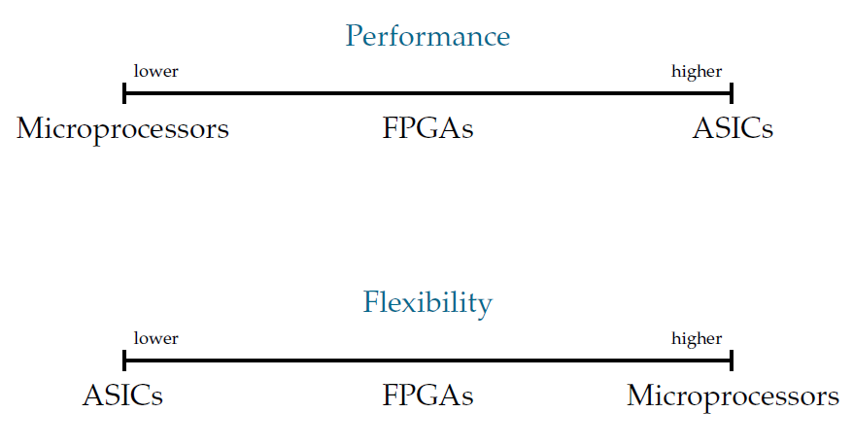
Implementation Alternatives
Microprocessor, custom hardware (ASICs), FPGAs

Slide 12
Why Use Microprocessors?
Efficient
1+ IPC for modern RISC processors
Large design teams / mass production
Highly optimized (speed, power)
Latest manufacturing technology (fabrication)
Single-design for multiple functions / general-purpose
Implementing several functions on a single processor often makes much better use of the available hardware budget
Flexible
Separate hardware/software design by different teams
Easier to design cost-effective families/generations of products

Slide 13
Embedded Computing Platform
Embedded computing platform: hardware architecture + associated software.
Why not use PCs for all embedded computing?
real-time performance requirements often drive us to different architectures
low power and low cost also drive us away from PC architectures and toward multiprocessors
Custom embedded systems that are designed for an application, such as a cell phone
burn several orders of magnitude less power than do PCs with equivalent computational performance,
they are considerably less expensive as well.

Slide 14
Challenges in Embedded System Design
How much hardware do we need?
type of microprocessor, amount of memory, peripheral devices— performance-cost tradeoff
How do we meet deadlines?
Faster hardware or cleverer software?
Faster hardware increases cost and power consumption
How do we minimize power?
Turn off unnecessary logic? Reduce memory accesses?
Careful design is required to slow down noncritical parts of the machine while still meeting necessary performance goals
Excessive power consumption reduces battery life and increases heat dissipation

Slide 15
Challenges in Embedded System Design
How do we design for upgradeability?
Support multiple versions/generations using the same hardware
How can we design a machine that will provide the required performance for software that we haven’t yet written?
Does it really work?
Is the specification correct?
Does the implementation meet the spec?
How do we test for real-time characteristics?
How do we test on real data?
How do we work on the system?
Limited observability and controllability; no keyboard and screen
Restricted development environments

Slide 16
Performance of Embedded Computing Systems
In general-purpose computing, performance often means average-case, may not be well-defined.
In real-time systems, performance means meeting deadlines: Missing the deadline by even a little is bad.
We need to analyze the system at several levels of abstraction to understand performance:
CPU: pipelined CPU with a cache
Platform: bus and I/O devices
Program: structure and overall behavior
Task: multitasking system with tasks interaction
Multiprocessor: interaction between processors

Slide 17
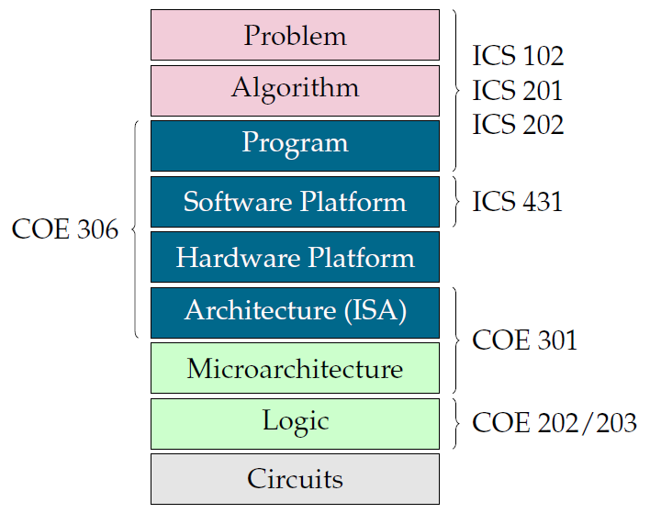
The Computing Stack
EE 202, EE 203

Slide 18
Importance of Design Methodology
Design methodology is a procedure for designing a system.
Helps in tracking design objectives and keeps a scorecard on design to ensure nothing is skipped.
Compilers, software engineering tools, computer-aided design (CAD) tools, etc., can be used to:
help automate methodology steps;
keep track of the methodology itself.
Team communication and coordination
a design methodology makes it much easier for members of a design team to communicate.

Slide 19
Design Goals
Functionality and user interface
Performance
Overall speed, deadlines
Manufacturing cost
Power consumption
Other requirements (physical size, weight, etc.)

Slide 20
Embedded System Design Process
Top-down design:
start from most abstract description;
work to most detailed.
Bottom-up design:
work from small components to big system.
Real design uses both techniques.
At each level of abstraction, we must:
analyze the design to determine how to meet specifications;
refine the design to add detail.
Requirements
Specification
Architecture
Component
Design
System
Integration

Slide 21
Requirements
Plain language description of what the user wants and expects to get.
Functional requirements
Output as a function of input.
Non-functional requirements
Performance: time required to compute output;
Cost: includes manufacturing and nonrecurring engineering (NRE) costs
Physical size and weight
Power consumption, reliability; etc.
Validating requirements: mock-ups, physical non-functional models.

Slide 22
Requirements Analysis
Requirements analysis
Check for requirements consistency;
Requirements form (summary)
Types of data: Analog? Digital?
Data Characteristics: Periodically arriving data?
Occasional user inputs? #bits per data element?
Types of I/O devices: Buttons? Analog/Digital Conv.?
Video displays?

Slide 23
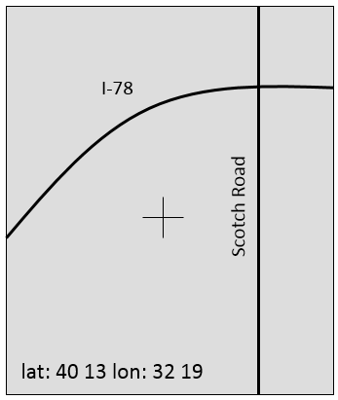
Example: GPS Moving Map Requirements
Moving map obtains position from GPS, paints map from local database.
Functionality: For automotive use. Show major roads and landmarks.
User interface: At least 400 x 600 pixel screen. Three buttons max. Pop-up menu.
Performance: Map should scroll smoothly. No more than 1 sec power-up. Lock onto GPS within 15 seconds.
Cost: $120 street price = approx. $40 cost of goods sold.
Physical size/weight: Should fit in hand.
Power consumption: Should run for 8 hours on four AA batteries.

Slide 24
GPS Moving Map Requirements Form

Slide 25
Specification
A formal more precise description of the system that reflects the customer’s requirements in a way that can be clearly followed during design.
should not imply a particular architecture;
provides input to the architecture design process.
A contract between the customer and the architects
Clarifies design objectives and prevents faulty assumptions
Should be:
Understandable: so it can be verified against requirements
Unambiguous: so designers are clear about what to build

Slide 26
Specification
Unclear specifications can result in design problems.
If the behavior of some feature in a particular situation is unclear from the specification, the designer may implement the wrong functionality.
If global characteristics of the specification are wrong or incomplete, the overall system architecture derived from the specification may be inadequate to meet the needs of implementation.

Slide 27
GPS Specification
Should include:
data received from the GPS satellite constellation;
map data;
user interface;
operations required to satisfy user requests;
background operations needed to keep the system running.
Unified Modeling Language (UML) is a language used for describing specifications.

Slide 28
Architecture Design
Purpose of architecture is to describe how the system implements required functions
Plan for overall structure of the system
What major components are needed for satisfying the specification?
Hardware components: CPUs, peripherals, etc.
Software components: major programs and their operations.
Block diagrams: General architecture, Hardware architecture, Software architecture
Must satisfy functional and non-functional requirements

Slide 29
GPS Moving Map Block Diagram
Shows major operations and data flows among them
GPS
receiver
search
engine
renderer
display
database
user
interface
General Architecture

Slide 30
GPS Moving Map Hardware Architecture
display
frame
buffer
CPU
GPS
receiver
memory
panel I/O

Slide 31
GPS Moving Map Software Architecture
Timer used to control when we read the buttons on the user interface and render data onto the screen
position
database
search
renderer
pixels
user
interface
timer

Slide 32
Designing Hardware and Software Components
Building system components in conformance to the architecture and specification.
Some components are ready-made, some are modified from existing designs, others designed from scratch.
Ready-made, standard components
CPU, memory, GPS receiver
Software library, topographic data databases
Custom components
PCB, FPGA
Custom software modules

Slide 33
System Integration
Putting the system components together
Many bugs appear only at this stage
Have a plan for integrating components to uncover bugs quickly, test as much functionality as early as possible
Bug discovery
Building the system in phases
Testing
Inserting appropriate debugging facilities during design can help ease system integration problems.
Debugging facilities for embedded systems are usually much more limited than what you would find on desktop systems; always a challenge.

Slide 34
Formal System Description
Unified Modeling Language (UML): A visual, object-oriented modeling language used to capture design tasks
Designed to be useful at many levels of abstraction in the design process
described as a number of interacting objects
some of those objects correspond to real pieces of software or hardware in system; others correspond to people or machines
Structural Description: the system components
Behavioral Description: how the system components act

Slide 35
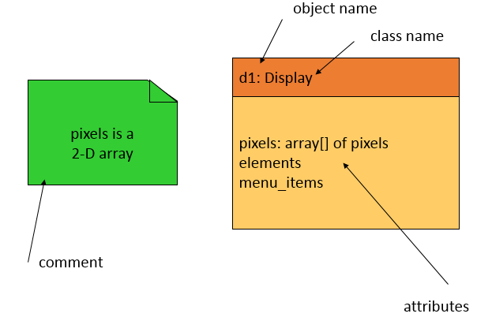
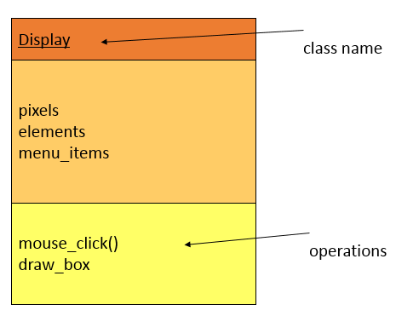
Structural Description
Classes, interfaces, and objects
A class is a form of type definition. It defines attributes that an object may have and operations that determine how the object interacts with the rest of the world.

Slide 36
The Class Interface
The operations provide the abstract interface between the class’s implementation and other classes.
Operations may have arguments, return values.
An operation can examine and/or modify object’s state.
Choose your interface properly
If the interface is too small/specialized:
object is hard to use and reuse.
If the interface is too large:
class becomes too cumbersome for designers to understand;
implementation may be too slow; spec and implementation are probably buggy.

Slide 37
Structural Description
A conceptual model, not tied to implementation
Relationships between classes:
Association: classes communicate but one does not own other. One class uses the functionalities provided by another class.
Aggregation: a complex class is made of several smaller classes. The child can exist independently of the parent.
Composition: aggregation in which owner does not allow access to its components. The child cannot exist independent of the parent.
Generalization: define one class in terms of another. A superclass has the most general attributes, operations, and relationships that may be shared with subclasses. A subclass may have more specialized attributes and operations.

Slide 38
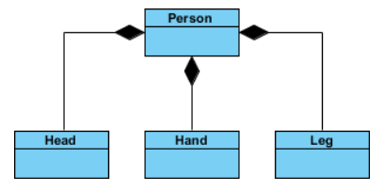
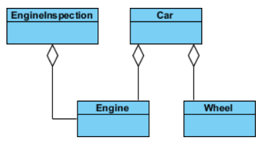
Relations Examples
Association
Composition
Aggregation

Slide 39
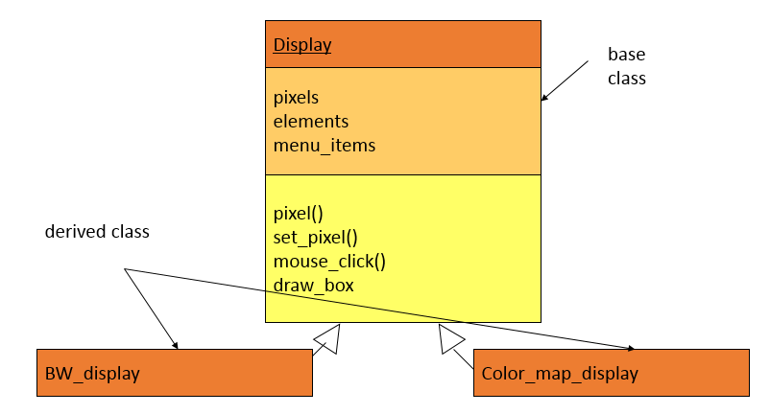
Class Derivation: UML Generalization
May want to define one class in terms of another.
Derived class inherits attributes, operations of base class

Slide 40
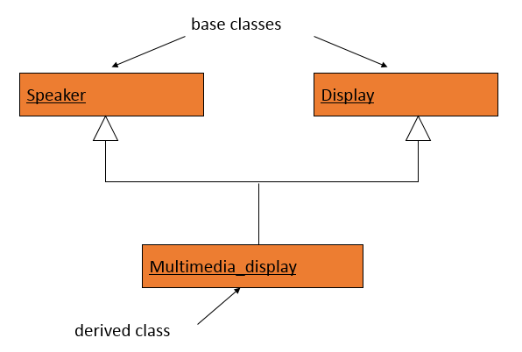
Multiple Inheritance

Slide 41
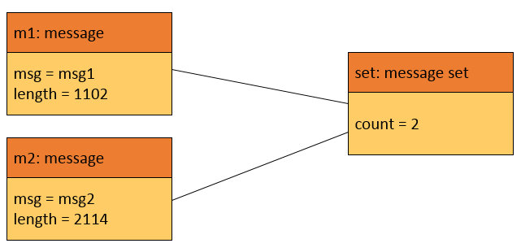
Links and Associations
Link: describes relationships between objects.
Association: describes relationship between classes.
Links between
objects
Association between
classes

Slide 42
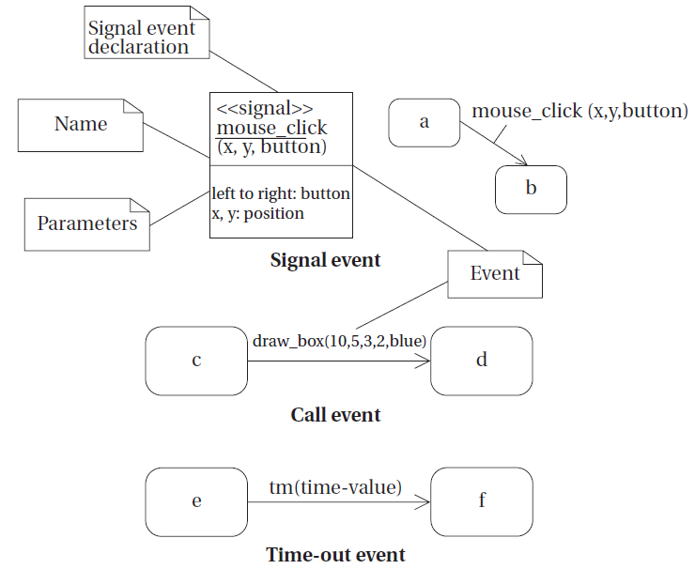
Behavioral Description: State Machine
Event-driven: An event is some type of action.
It may originate outside the system or inside it.
Types of events
A signal is an asynchronous occurrence. It is defined in UML by an object that is labeled as a «signal».
A call event follows the model of a procedure call in a programming language.
A time-out event causes machine to leave state after certain amount of time.

Slide 43
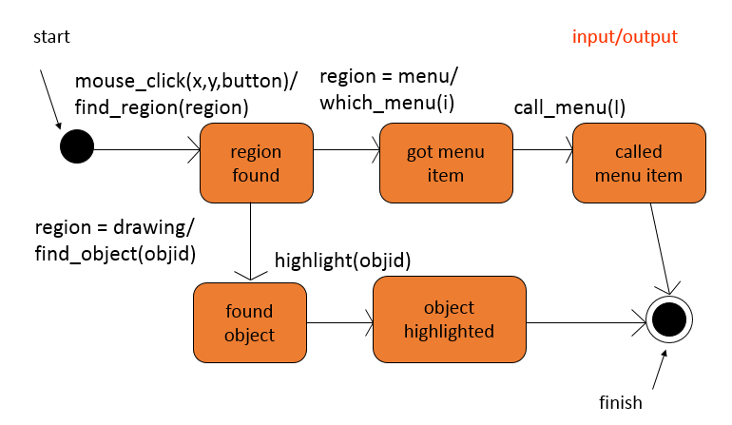
Behavioral Description: State Machine

Slide 44
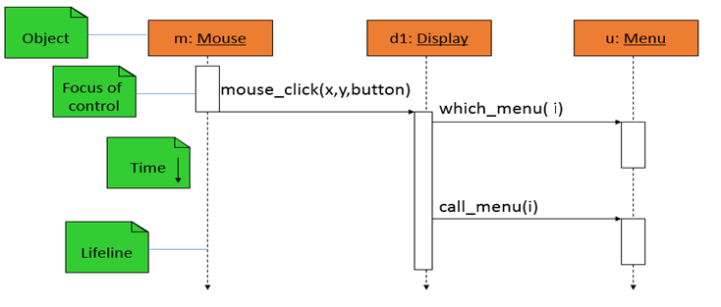
Behavioral Description: Sequence Diagram
Shows sequence of operations over time
Describes how—and in what order—a group of objects work together
Shows a particular scenario

Slide 45
Summary
Embedded computers are all around us
Many systems have complex embedded hardware and software.
Embedded systems pose many design challenges: design time, deadlines, power, etc.
Design methodologies help us manage the design process.
Object-oriented design helps us organize a design.
UML is a transportable system design language
Provides structural and behavioral description primitives.

