Slide 1
Combinational Circuit Design
COE 202
Digital Logic Design
Dr. Aiman El-Maleh
College of Computer Sciences and Engineering
King Fahd University of Petroleum and Minerals

Slide 2
Outline
Combinational Logic Circuits
Combinational Circuits Design Procedure
Design Examples
BCD to Excess 3 Code Converter
BCD to 7-Segment Decoder for LED

Slide 3
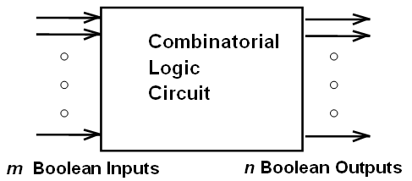
Combinational Logic Circuits
A combinational logic circuit has:
A set of m Boolean inputs,
A set of n Boolean outputs, and
n logic functions, each mapping the 2^{m} input combinations to an output
Outputs are determined only by present inputs
Each Output = F (the m inputs)

Slide 4
Combinational Circuits Design Procedure
1. Specification (Requirement)
Write a specification for what the circuit should do e.g. add two 4-bit binary numbers
Specify names for the inputs and outputs
2. Formulation
Convert the Specification into a form that can be Optimized
Usually as a truth table or a set of Boolean equations that define the required relationships between the inputs and outputs
3. Logic Optimization
Apply logic optimization (2-level & multi-level) to minimize the logic circuit
Provide a logic diagram or a netlist for the resulting circuit using ANDs, ORs, and inverters

Slide 5
Combinational Circuits Design Procedure
4. Technology Mapping and Design Optimization
Map the logic diagram or netlist to the implementation technology and gate type selected, e.g. CMOS NANDs
Perform design optimizations of gate costs, gate delays, fan-outs, power consumption, etc.
Sometimes this stage is merged with stage 3
5. Verification
Verify that the final design satisfies the original specification- Two methods:
Manual: Ensure that the truth table for the final technology-mapped circuit is identical to the truth table derived from specifications
By Simulation: Simulate the final technology-mapped circuit on a CAD tool and test it to verify that it gives the desired outputs at the specified inputs and meets delay specs etc.

Slide 6
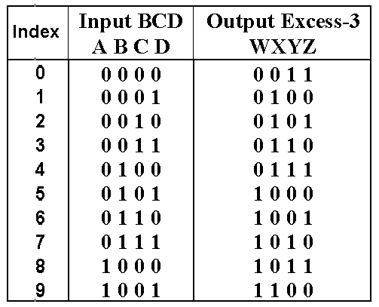
BCD to Excess 3 Code Converter
1. Specification
Transforms BCD code for the decimal digits (0-9) to the corresponding Excess-3 code
BCD code words for digits 0 through 9: 4-bit patterns 0000 to 1001, respectively
Excess-3 code words for digits 0 through 9: 4-bit patterns obtained by adding 3 (binary 0011) to each BCD code input
2. Formulation
In the form of a truth table: Variables
BCD: A,B,C,D Excess-3: W,X,Y,Z
Don’t Cares: BCD 1010 to 1111

Slide 7
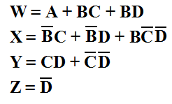
BCD to Excess 3 Code Converter
Z map
Y map
3. Optimization
2-level using K-maps
z
C
C
1
1
1
1
0
1
3
2
0
1
3
2
1
1
1
1
4
5
7
6
B
4
5
7
6
B
X
X
X
X
X
X
X
X
A
12
13
15
14
A
12
13
15
14
1
X
X
1
X
X
8
9
11
10
8
9
11
10
D
D
X map
W map
C
C
1
1
1
0
1
3
2
0
1
3
2
1
1
1
1
4
5
7
6
B
4
5
7
6
B
X
X
X
X
X
X
X
X
A
12
13
15
14
A
12
13
15
14
1
X
X
1
1
X
X
8
9
11
10
8
9
11
10
D
D

Slide 8
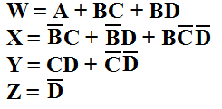
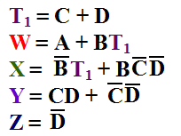
BCD to Excess 3 Code Converter
3. Logic Optimization (continued)
Start with SOPs (2-level) from the K-maps:
Extracting a common factor:

Slide 9
BCD to Excess 3 Code Converter
4. Technology Mapping
Use a library containing inverters, 2-input NAND, 2-input NOR, and 2-2 AOI gates
A
W
T1
T1
B
X
C
Y
D
Z

Slide 10
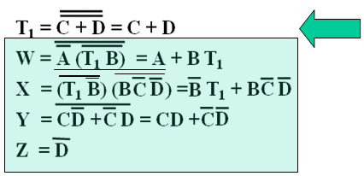
BCD to Excess 3 Code Converter
5. Verification
Find the SOP Boolean equations from the final technology mapped circuit
Find the truth table from these equations
Compare it with the specification truth table
Finding the Boolean Equations
T1

Slide 11
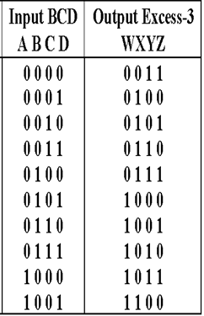
BCD to Excess 3 Code Converter
5. Verification- Manual, Continued: The circuit truth table from the equations - Compare it with the specification truth table:
The tables match!

Slide 12
BCD to Excess 3 Code Converter
5. Verification- by Simulation: Procedure
Use a schematic editor or text editor to enter a gate level representation of the final circuit
Use a waveform editor or text editor to enter a test consisting of a sequence of input combinations to be applied to the circuit
This test should guarantee the correctness of the circuit if the simulated responses to it are correct
Generation of such a test can be difficult, and sometimes people apply all possible “care” input combinations

Slide 13
BCD to Excess 3 Code Converter
5. Verification- by Simulation: Final Circuit Schematic

Slide 14
BCD to Excess 3 Code Converter
Run the simulation of the circuit for 120 ns
Do the simulation output combinations match the original specification truth table?

Slide 15
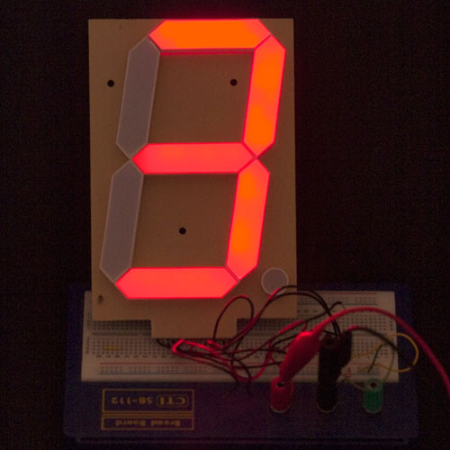
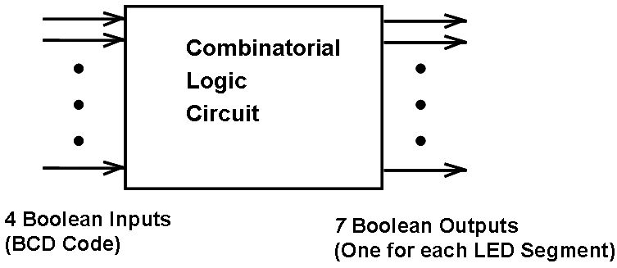
BCD to 7-Segment Decoder for LED
1. Specification
Transforms a BCD input code for the decimal digits (0 to 9) to 7 outputs (one for each of the seven LED segments) used to drive the display
Each output indicates whether the corresponding segment is ON (1) or OFF (0) for the input BCD code

Slide 16
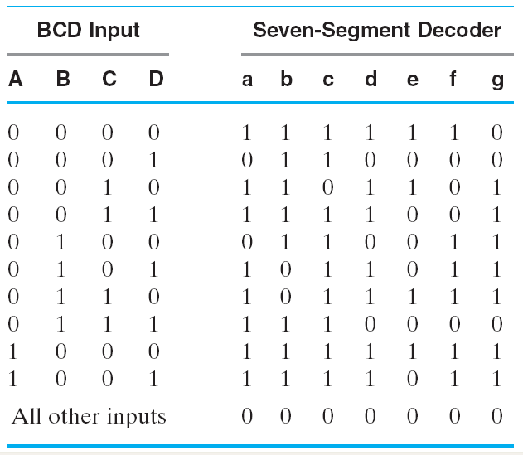
BCD to 7-Segment Decoder for LED
2. Formulation
4 Input Variables
BCD: A,B,C,D (LSB)
7 Output Variables
Drivers for the 7 Segments:
a,b,c,d,e,f,g
(1 = segment lit,
i.e. active high)
Don’t Cares
None!
Display is OFF for
non BCD codes

Slide 17
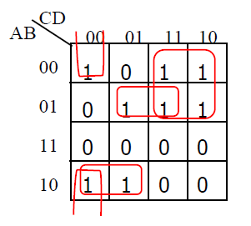
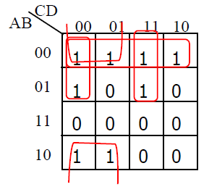
BCD to 7-Segment Decoder for LED
3. Optimization: Using Seven 4-Variable K-maps we get:

Slide 18
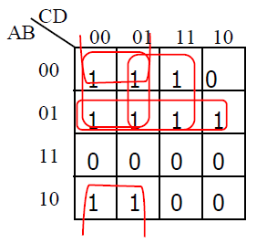
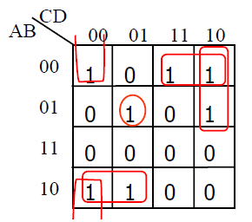
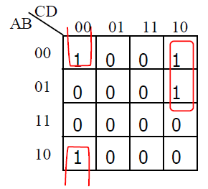
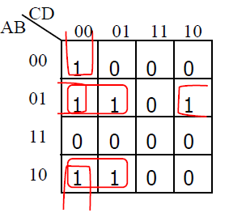
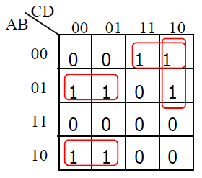
BCD to 7-Segment Decoder for LED

