Slide 1
Other Gate Types
COE 202
Digital Logic Design
Dr. Aiman El-Maleh
College of Computer Sciences and Engineering
King Fahd University of Petroleum and Minerals

Slide 2
Outline
Gate Classifications: Primitive & Complex gates
Buffer
Nand Gate
Nor Gate
Two-level implementation using Nand gates
Two-level implementation using Nor gates
XOR gate
XNOR gate
Parity Generation and Checking

Slide 3
Gate classifications
Gate classifications
Primitive gate - a gate that can be described using a single primitive operation type (AND or OR) plus optional inversion(s), e.g. NAND
Complex gate - a gate that requires more than one primitive operation to describe it, e.g. XOR
Complex gates can implement Boolean functions with less area and delay than primitive gates.

Slide 4
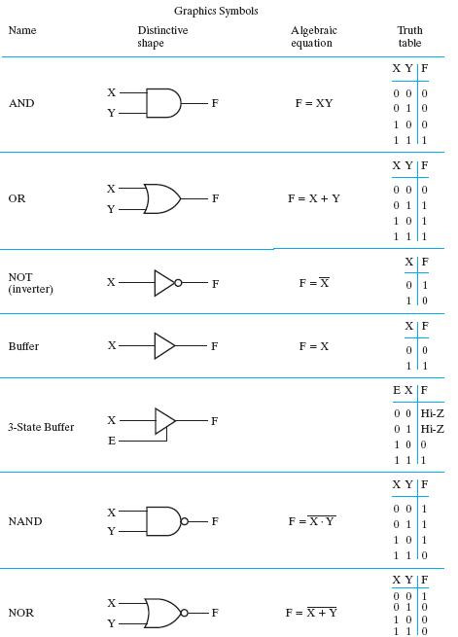
Primitive Gates

Slide 5
Buffer
A buffer is a gate with the function F = X:
In terms of Boolean logic, a buffer is the same as a direct connection!
So why use it?
A buffer is an electronic amplifier that can be used to:
Improve circuit voltage levels e.g. of a received signal
Increase current drive capability (i.e. get a larger fan out)
Introduce desirable circuit delay
X
F

Slide 6
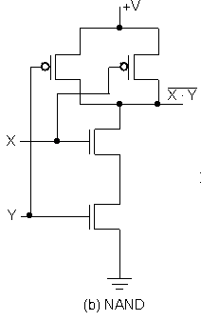
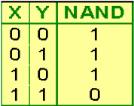
NAND Gate [NOT (AND)]
The basic NAND gate has the following symbol,
AND-Invert (NAND)
NAND represents AND NOT, i. e., an AND function followed by an inverter (NOT). The symbol shown is an AND-Invert. The small circle (“bubble”) represents the invert function.

Slide 7
NAND Gates (continued)
Applying DeMorgan's Law gives Invert-OR (NAND)
This NAND symbol is called Invert-OR, since inputs are inverted and then ORed together
Note the above symbol is still for a NAND
So a NAND gate can be represented in two different but equivalent forms: → AND-then-Invert form
→ Invert-then-OR form

Slide 8
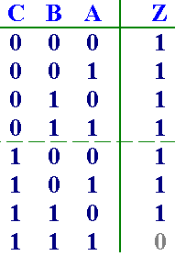
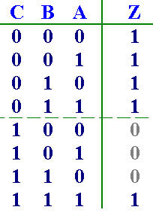
Observations on the NAND Gate
The NAND is not Associative.
NAND usually does not have an operation symbol defined like the “.” for the AND and the “+” for the OR
This is because NAND is not associative and we have difficulty dealing with non-associative arithmetic!:
≠
≠

Slide 9
Observations on the NAND Gate
i.e. the n-input NAND function can not be derived from a sequence of 2-input NAND operations
But it can be derived as a sequence 2-input AND operation (which is associative) followed by a single final inversion.
The NAND is a Universal Gate.
Universal gate – is a gate that can be used to implement any Boolean function through implementing the 3 basic logic operations: (AND, OR, and NOT)
The NAND gate is the natural implementation for the simplest and fastest electronic circuits.

Slide 10
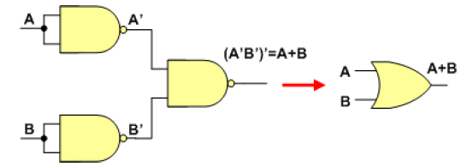
Observations on the NAND Gate

Slide 11
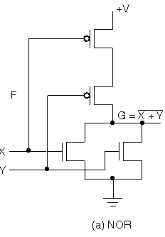
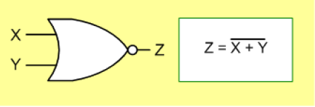
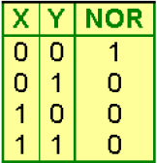
NOR Gate [NOT (OR)]
The basic NOR gate has the following symbol,
OR-Invert (NOR)
NOR represents OR NOT, i. e., the OR function followed by a NOT. The symbol shown is an OR-Invert. The small circle (“bubble”) represents the invert function.

Slide 12
NOR Gate (continued)
Applying DeMorgan's Law gives Invert-AND (NOR)
This NOR symbol is called Invert-AND, since inputs are inverted and then ANDed together.
Note the above symbol is still for a NOR.
So a NOR gate can be represented in two different but equivalent forms: OR-then-Invert & Invert-then-AND.
OR-Invert
Invert-AND
X
=
⋅
⋅
Y
F
(
X
,
Y
,
Z
)
X
Y
Z
Z

Slide 13
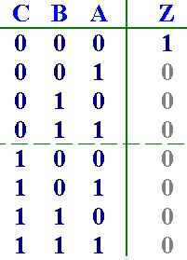
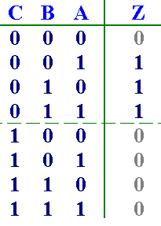
Observations on the NOR Gate
The NOR gate is not Associative.
NOR usually does not have an operation symbol defined like the “.” for the AND and the “+” for the OR
This is because NOR is not associative and we have difficulty dealing with non-associative arithmetic!:
≠
≠

Slide 14
Observations on the NOR Gate
i.e. the n-input NOR function can not be derived from a sequence of 2-input NOR operations.
But it can be derived as a sequence 2-input OR operation (which is associative) followed by a single final inversion.
The NOR gate is a universal gate.
The NOR gate is another natural implementation for the simplest and fastest electronic circuits.

Slide 15
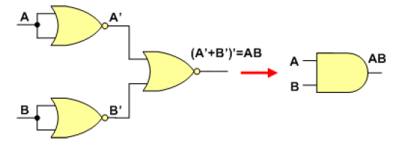
Observations on the NOR Gate

Slide 16
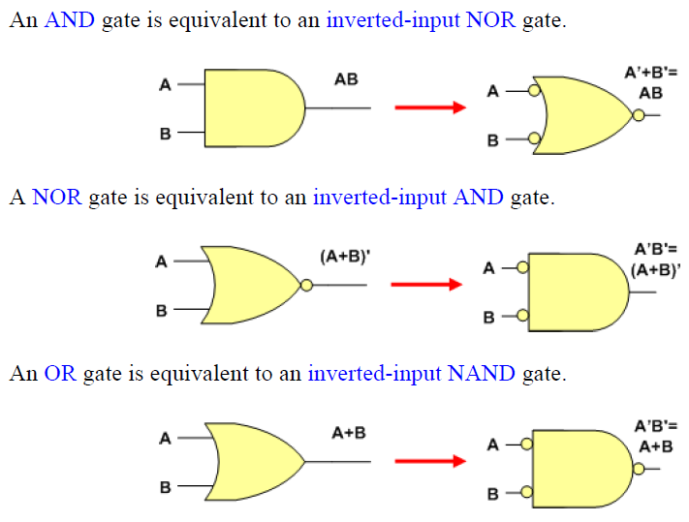
Equivalent Gates

Slide 17
Two-Level Implementation using Nand/Nor
We have seen before that Boolean functions in either SOP or POS forms can be implemented using 2-Level implementations.
For SOP forms AND gates will be in the first level and a single OR gate will be in the second level.
For POS forms OR gates will be in the first level and a single AND gate will be in the second level.
Note that using inverters to complement input variables is not counted as a level.
We will show that SOP forms can be implemented using only NAND gates, while POS forms can be implemented using only NOR gates.

Slide 18
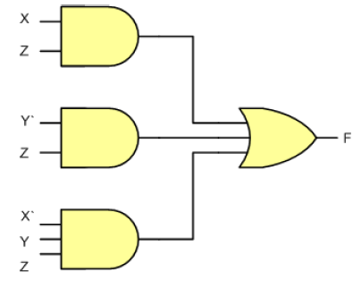
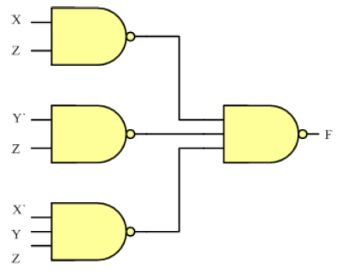
Two-Level Implementation using Nand Gates
Example 1: Implement the following SOP function
F = XZ + Y’Z + X’YZ
Introducing two successive inverters at the inputs of the OR gate results in the shown equivalent implementation.
Two successive inverters on the same line will not have an overall effect on the logic.

Slide 19
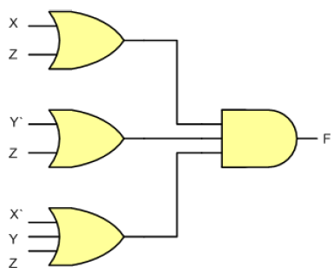
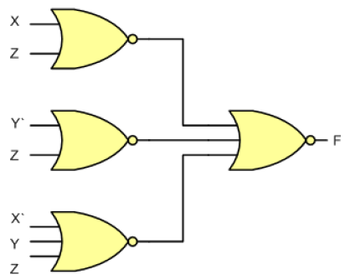
Two-Level Implementation using Nor
Example 2: Implement the following POS function
F = (X+Z) (Y’+Z) (X’+Y+Z)
Introducing two successive inverters at the inputs of the AND gate results in the shown equivalent implementation.
Two successive inverters on the same line will not have an overall effect on the logic.

Slide 20
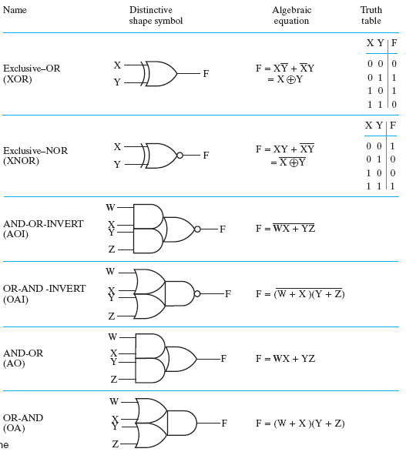
Complex Gates

Slide 21
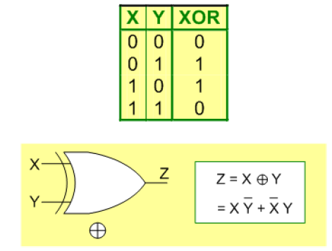
Exclusive OR (XOR) Gate
The exclusive-OR (XOR), operator uses the symbol ⊕, and it performs the following logic operation:
X ⊕ Y = X Y’ + X’ Y
The graphic symbol and truth table of XOR gate is:
The result is 1 only when either X is equal to 1 or Y is equal to 1, but not when both X and Y are equal to 1.

Slide 22
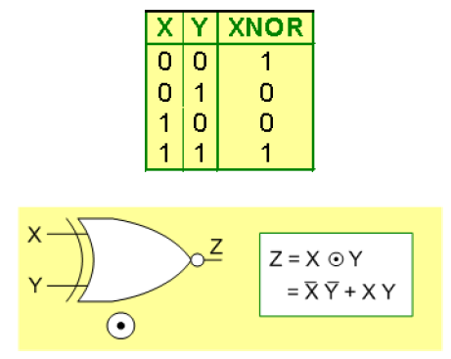
Exclusive NOR (XNOR) Gate
The exclusive-NOR (XNOR), operator uses the symbol , and it performs the following logic operation
The graphic symbol and truth table of XNOR (Equivalence) gate is shown:
The result is 1 when either both X and Y are 0’s or when both are 1’s. That is why this gate is often referred to as the Equivalence gate.

Slide 23
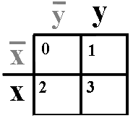
2-input XOR / XNOR Gates
Sum
Parity
The XOR function means: X OR Y, but NOT BOTH
XNOR is called the equivalence function, operator (≡).
From the K-maps:
From eqns above, note that
X
Y
X
⊕
Y
X
Y
(X
⊕
Y)
or X
≡
Y
0
0
0
1 for different
inputs
1 for equal
inputs
0
0
0
1
1
0
1
1
0
1
0
1
1
0
1
1
2
1
0
0
1
3
1
1
0
1
1
1
1
X
⊕
Y
=
X
Y
+
X
Y
X
⊕
Y
=
X
Y
+
X
Y

Slide 24
XOR Implementations
The simple SOP implementation uses the following structure:
A NAND only implementation:
X
AND
X
Y
X
⊕
Y
=
X
Y
+
X
Y
OR
X
Y
X
Y
Y
AND
Invert-then-AND
= OR-Invert
X
OR
AND
X
Y
as above
AND
Y

Slide 25
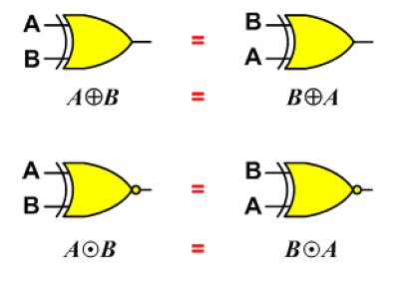
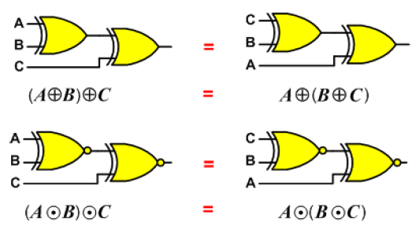
Properties of XOR/XNOR Operations
Commutativity
Associativity

Slide 26
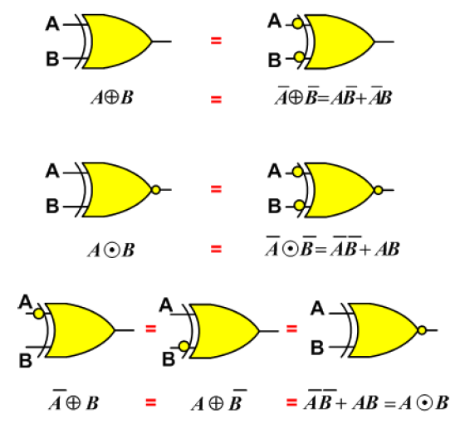
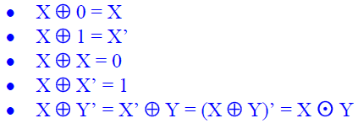
Basic Identities of XOR Operation

Slide 27
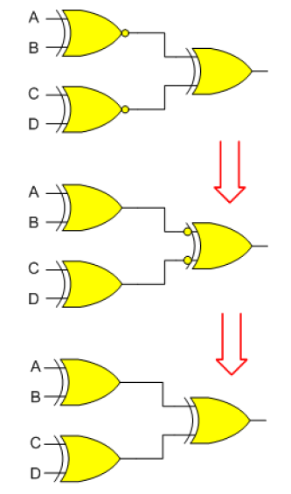
Basic Identities of XOR Operation
Proving the above identity is easier done using graphical equivalence between gates

Slide 28
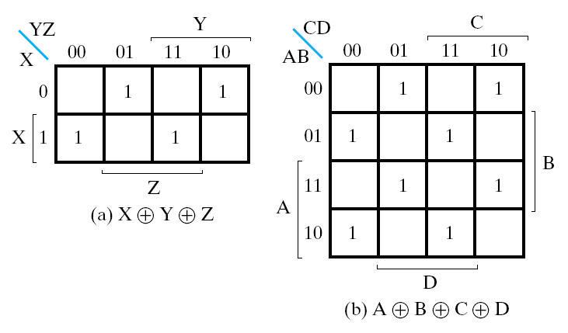
XOR for >2 Variables: The Odd Function
The XOR function can be extended to 3 or more literals. For more than 2 literals, it is called: Odd function, or modulo 2 sum.
Distance 2
The odd function for
3 inputs and 4 inputs
X
⊕
Y
⊕
Z
=
X
Y
Z
+
X
Y
Z
+
X
Y
Z
+
X
Y
Z
1s in the K-map correspond to minterms with indices having an odd number of 1s in binary, hence the name. Use to generate even parity bit and to check even parity (output = 1 for parity error)

Slide 29
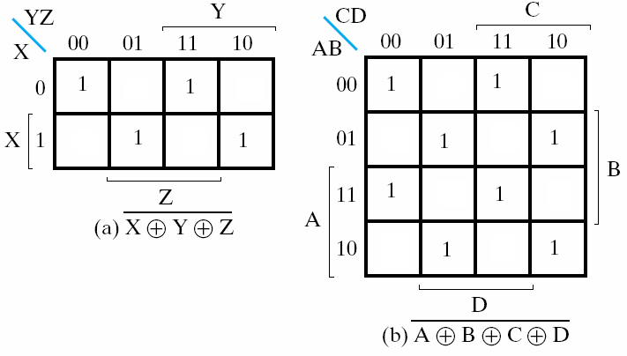
XNOR for >2 Variables:The Even Function
The XONR function can be extended to 3 or more literals. For more than 2 literals, it is called: Even function.
Distance 2
The odd function for
3 inputs and 4 inputs
X
⊕
Y
⊕
Z
=
X
Y
Z
+
X
Y
Z
+
X
Y
Z
+
X
Y
Z
1s in the K-map correspond to minterms with indices having an even number of 1s in binary, hence the name. Use to generate odd parity bit and to check odd parity (output = 1 for parity error)

Slide 30
Parity Generation and Checking
Exclusive-OR functions are very useful in systems using parity bits for error-detection.
A parity bit is used for the purpose of detecting errors during transmission of binary information.
A parity bit is an extra bit included with a binary message to make the total number of 1’s in this message (including the parity bit) either odd or even.
The message, including the parity bit, is transmitted and then checked at the receiving end for errors.
An error is detected if the checked parity does not correspond with the one transmitted.

Slide 31
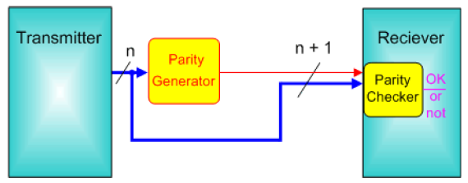
Parity Generation and Checking
The circuit that generates the parity bit at the transmitter side is called a parity generator.
The circuit that checks the parity at the receiver side is called a parity checker.

Slide 32
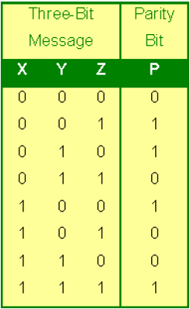
Parity Generation and Checking
As an example, consider a 3-bit message to be transmitted together with an even parity bit.
The three bits, X, Y, and Z, constitute the message and are the inputs to the even parity generator circuit whose output is the parity bit P.
The 4 bits (X, Y, Z & P) are transmitted to their destination, where they are applied to a parity-checker circuit to check for possible errors in the transmission.

Slide 33
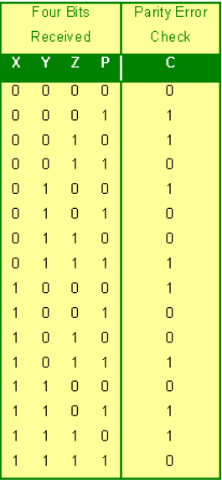
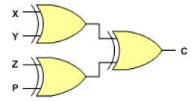
Parity Generation and Checking
Since the information was transmitted with even parity, the received four bits must have an even number of 1’s.
The parity checker generates an error signal (C = 1), whenever the received four bits have an odd number of 1’s.

