Slide 1
COE 202: Digital Logic Design
Courtesy of Dr Radwan E Abdel-Aal
Unit 11
Sequential Circuits

Slide 2
Unit 11: Sequential Circuits
1. Sequential Circuit Definitions, Types of Latches: SR, Clocked SR, and D Latches
Flip-Flops: SR, D, JK, and T Flip-Flops
Flip-Flop Timing Parameters: Setup, hold, propagation, clocking
Flip-Flops: Characteristic and Excitation Tables
Analysis of Sequential Circuits with D flip-flops: Deriving the input equations, state table, and state diagram. Timing.
Design of Sequential Circuits with D flip-flops: Determining the state diagrams and tables, State assignment, Combinational Logic

Slide 3
Chapter 5 - Sequential Circuits

Slide 4
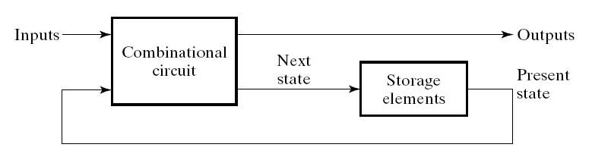
Introduction to Sequential Circuits
State
Variables
A Sequential circuit consists of:
  Data Storage elements:
  (Latches / Flip-Flops)
  Combinatorial Logic:
    Implements a multiple-output function
    Inputs are signals from the outside
    Outputs are signals to the outside
    State inputs (Internal): Present State from storage elements
    State outputs, Next State are inputs to storage elements
The storage elements isolate
The next state from the present state, So that the change occurs only when required

Slide 5
Introduction to Sequential Circuits
(State)
(State)
Combinatorial Logic
  Next state function
  Next State = f(Inputs, State)
  2 output function types : Mealy &Moore
  Output function: Mealy Circuits
  Outputs = g(Inputs, State)
  Output function: Moore Circuits
  Outputs = h(State)
Output function type depends on specification and affects the design significantly

Slide 6
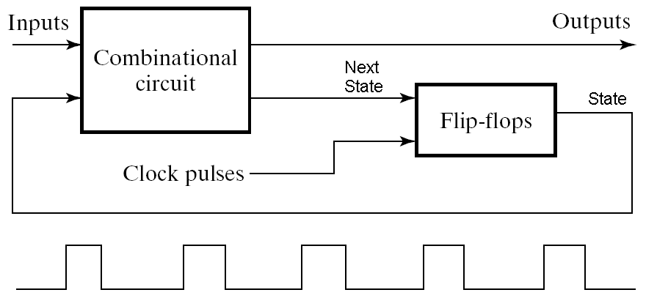
Timing of Sequential Circuits
Two Approaches
Behavior depends on the times at which storage elements ‘see’ their inputs and change their outputs (next state → present state)
Asynchronous
  Behavior defined from knowledge of inputs at any instant of time and the order in continuous time in which inputs change
Synchronous
  Behavior defined from knowledge of signals at discrete instances of time
  Storage elements see their inputs and change state only in relation to a timing signal (clock pulses from a clock)
  The synchronous abstraction allows handling complex designs!
Storage Elements

Slide 7
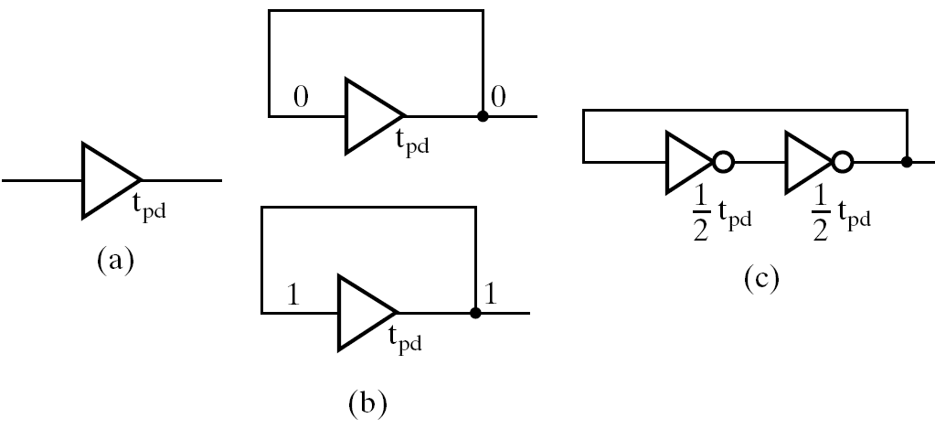
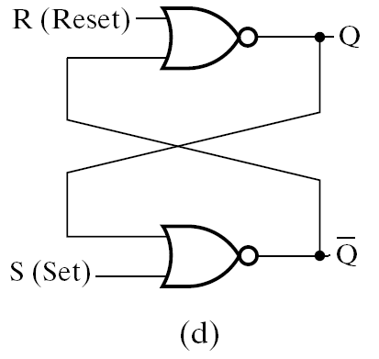
Data Storage Logic Structures
t_{pd}
Data In (Change data stored)
Output-Supporting
feedback
Delay in
A non-inverting
Buffer
Problem:
Data stored only
for short time, i.e.
Propagation delay t_{pd}
Feedback across
Two inverting buffers
Connected in series
Non-inverting buffer
With feedback- indefinite
Set-Reset
NOR Latch
Separate inputs for
Data in and for
feedback
Problem: No separate input for data.
Difficult to change data stored

Slide 8
Basic NOR Set–Reset (SR) Latch
Cross-coupling two
NOR gates gives the
S – R Latch:
Which has the time sequence
behavior:
R (reset)
Q
S (set)
Q
Time
R
S
Q
Q
Comment
0
0
?
?
Stored state unknown
00 = Normal input condition
No input change
0
1
1
0
“Set” Q to 1 (change data)
0
0
1
0
Now Q “remembers” 1
1
0
0
1
“Reset” Q to 0 (change data)
Input R S stored in Q Q
(remains at O/P after input
is removed)
0
0
0
1
Now Q “remembers” 0
1
1
0
0
Both Q and Q go low (Avoid)
0
0
?
?
Undefined!
S = 1, R = 1 is a forbidden input pattern

Slide 9
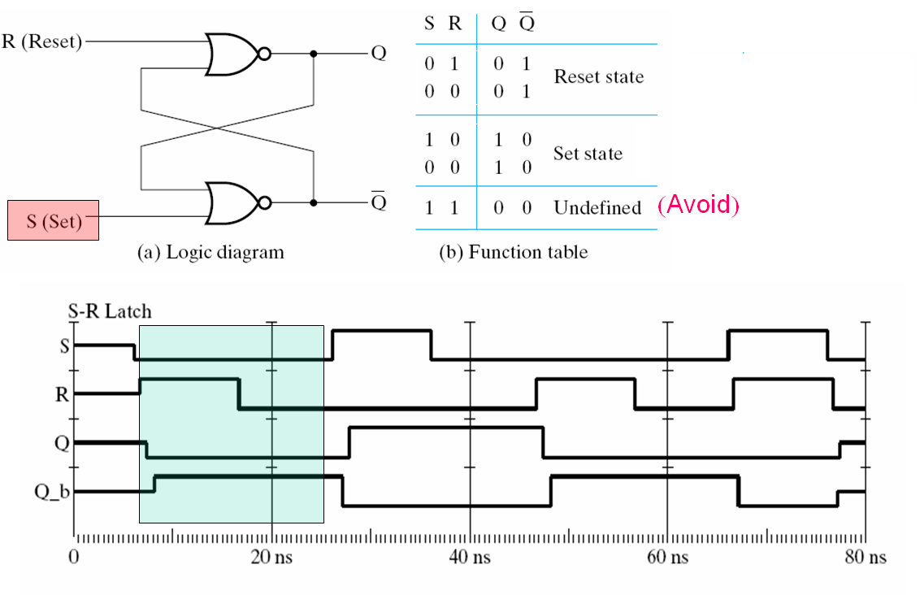
Basic NOR Set–Reset (SR) Latch
Should not try to Set
and Reset at the same time!
Reset then 00
Set then 00
Forbidden I/Ps
0
Which
Changes
First?
0
Unpredictable
Q_b = Q

Slide 10
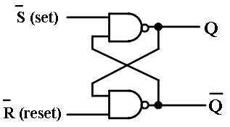
Basic NAND Set–Reset (SR) Latch
Cross-coupling two
NAND gates gives the
S – R Latch:
Which has the time sequence
behavior:
R (reset)
Q
S (set)
Q
Time
S
R
Q
Q
Comment
1
1
?
?
Stored state unknown
11 = Normal input condition
No input change
0
1
1
0
“Set” Q to 1 (change data)
1
1
1
0
Now Q “remembers” 1
1
0
0
1
“Reset” Q to 0 (change data)
Input S R stored in Q Q
(remains at O/P after input
is removed)
1
1
0
1
Now Q “remembers” 0
0
0
1
1
Both Q and Q go high (Avoid)
1
1
?
?
Undefined!
S = 0, R = 0 is a forbidden input pattern

Slide 11
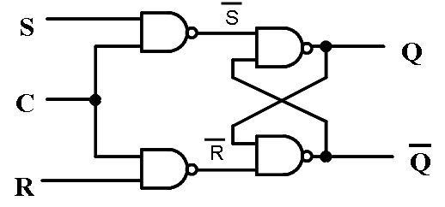
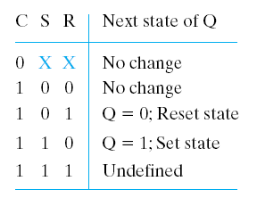
Clocked (or controlled) SR NAND Latch
Adding two NAND
gates to the basic
S - R NAND latch
gives the clocked
S – R latch:
C = normally 0 → S R inputs to the latch = normally 1 1
(No output change)
i.e. this prevents the forbidden conditions S R = 0 0 with C = 0
C = 1 Opens the two input NANDs
for the S R, inverting them.
This gives normal S R (not S R)
latch operation → Allow changes in latch state
But here S R = 1 1 during C = 1 still a problem
C means “control” or “clock”. Changes
This latch is also
Transparent:
O/P changes directly
With the I/P at C = 1
introduced by SR only during the clock pulse

Slide 12
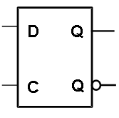
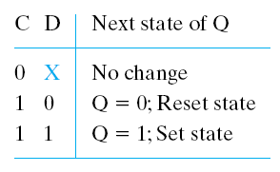
The D Latch
S
Adding an inverter
to the S-R Latch,
gives the D Latch
Now S R can not become 1 1
So we got rid of the remaining
unwanted condition
(SR =11 with C = 1)
D
Q
C
Q
R
To get ‘no change’:
block the clock pulse
This latch
is transparent:
With C = 1,
Input D is
‘connected’
to output Q
C = 1
C = 0:
Freeze Output at last value
entered when C was 1,
(store it till next time C becomes 1)
Function Table

Slide 13
Flip-Flops
The latch timing problem
Solution: Flip-Flop
  Master-slave flip-flop
  Edge-triggered flip-flop
Standard symbols for storage elements
Direct inputs to flip-flops
Flip-flop timing

Slide 14
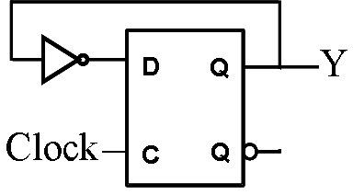
The Transparent Latch as a Storage Element:
Timing Problem of the transparent Latch
Consider the following circuit:
Transparent latch
is problematic!
Suppose that initially Y = 0.
As long as C = 1, the value of Y keeps changing!
Changes occur based on the delay in the Y-to-Y loop
If t_{Y-Y} < t_{CW} this causes unwanted multiple state changes to occur during one clock pulse- unacceptable!
Desired behavior: Y changes only once per clock pulse, i.e. one state transition per clock pulse
t _{Y-Y}
Represents
The Combinational
Circuit part
Clock Pulse Width
t_{CW}
Clock
t _{Y-Y}
Y
The latch was supposed
to isolate outputs of
Combinational circuit
from its inputs

Slide 15
Solving the Latch Timing Problem
Flip flops instead of latches
Two approaches:
  Break the closed path from Y to Y within the storage element into 2 successive (mutually exclusive) steps in time:
  - 1. Sense the change in the input D (then stop)
  - 2. Apply that change to the output Y (then stop)
  This uses a master-slave (Pulse Triggered) flip-flop
  Use an edge-triggered flip-flop:
  Change in D is sensed and applied to the Q output in one go at the clock pulse edge (+ ive or – ive)
  This is similar to effectively having a 0 width of the clock pulse which solves the problem

Slide 16

S-R Master-Slave (Pulse-Triggered) Flip-Flop
X
C=1
C=0
Consists of two clocked
S-R latches in series
with the clock to the
second latch inverted
C = 1: - Master is open
- Slave is blocked
Only “input is sensed” by master for this pulse duration (pulse-triggered) while output is unchanged by slave
C = 0: - Master is Blocked
- Slave is open → “output is changed”
The path from input to output is thus broken by the difference in clocking values for the two latches (C = 1 and C = 0)
Sensing I/P and changing O/P are now two separate steps - not one transparent step as with the transparent D latch
X
S
S
Q
S
Q
Q
C
C
Master
C
Slave
R
R
Q
R
Q
Q
C =1
C =0

Slide 17
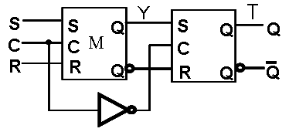
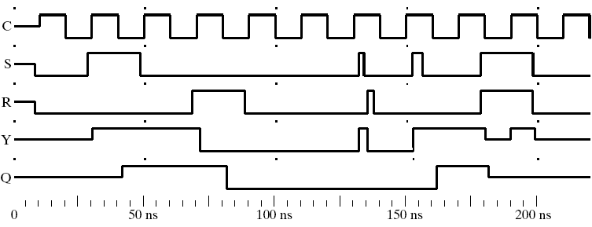

S-R Master-Slave
Flip-Flop: Simulation
Z
S
Ideally, changes in S, R inputs from combinational circuit
Should arrive before the next clock interval
(C=1 pulse) arrives.
2 pulses
On S, R inputs arrive late
during + ive Clk
→ But no problem
Data appears
at slave O/P
1 pulse
On S input
arrives late
during + ive Clk
→ Problem
Clock
Interval T
Set
Reset
M
S
X
Forbidden
Condition
S = 1, R = 1
Still
possible
0
0
0
0
X
X
In→ Out
Delay = T/2
X
T/2
X
Z
0
0
1
Consider
Performance of the
Latch as a whole
O/P Error due to the pulse on S
Delay in Combinational Circuit

Slide 18
Problems with the S-R Master-Slave Flip-Flop
The undesirable condition of S = 1 and R = 1 simultaneously is still possible (latches are S-R not D) → Master-Slave D type is possible
T/2 input-to-output delay (width of the C = 1 pulse), which may slow down the sequential circuit
While C = 1, master stage is open, and any changes in the input S, R affect FF operation → The 1s catching behavior
  Suppose Q = 0 and S goes to 1 and back to 0 and R goes to 1 and back to 0 (all within C = 1 pulse)
    The master latch sets and then resets so slave not affected
    A 0 is transferred to the slave (correct)
  Suppose Q = 0 and S goes to 1 and then back to 0 with R remaining at 0 (all within C = 1 pulse)
    The master latch sets to 1
    A 1 is transferred to the slave (wrong)
Solution:
Ensure data input to FF (to master) is valid before start of + ive clock pulse

Slide 19
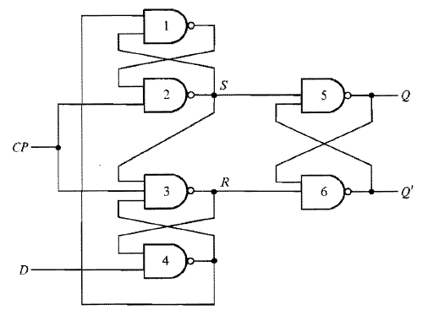

Edge-Triggered D-type Flip-Flop
This is a Positive
Edge-triggered D flip-flop
This is the preferred FF
used nowadays to build
most sequential
circuits
The D data input is transferred to the Q output only at the rising edge of the clock, subject to timing constraints on the D input must relative to effective clock edge: Setup time before edge and Hold time after edge
D → Q

Slide 20
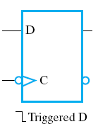
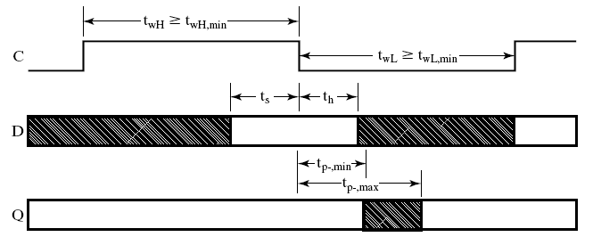
Flip-Flop Timing Parameters:
Edge Triggered FF
Q
Requirements:
t_{w} - clock
pulse width
(for both low & high)
t_{s} : setup time
t_{h} : hold time
(usually 0 ns)
Outcomes:
t_{p}: propagation delay
  t_{PHL} :High-to-Low
  t_{PLH} :Low-to-High
  t_{p} :max (t_{PHL}, t_{PLH})
Negative Edge-Triggered
D Flip Flop
Input transitions allowed
Valid, Stable
Old Data on Q
New Data on Q
Output transitions occur
D input can still change up to here!
Better utilization of time
→ faster design compared to Master-Slave FF, see next

Slide 21
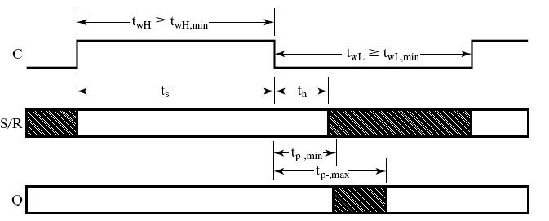
Flip-Flop Timing Parameters:
S-R Master Slave FF
Requirements:
t_{w} : clock
pulse width
(for both low & high)
t_{s} : setup time
t_{h} : hold time
(usually 0 ns)
Outcomes:
t_{pd} : propagation delay
  t_{PHL} : High-to-Low
  t_{PLH} : Low-to-High
  t_{pd} : max (t_{PHL}, t_{PLH})
M-S, S-R Flip Flop
(Positive Pulse Triggered)
Data from master appears on
slave (i.e. FF) output here
Master is open here
Input transitions allowed
Output transitions occur
Why tsetup = tw here?
We want to avoid things like 1’s catching - so S,R should be valid and stable before Master Pulse begins (see slide 17)
D input should be stable here!
More time wasted compared to Edge-triggered and slower design compared to the edge triggered FF

Slide 22
Standard Symbols for Storage Elements
In a sequential that uses different
Type of FFs, Ensure all FFs
circuit change their outputs
at the same clock edge. Invert
Signal to FF clock if needed
Master-Slave:
Postponed output
indicators
Edge-Triggered:
Dynamic
indicator
Transparent
Latches,
No
I-O isolation
S
S
D
D
R
R
C
C
SR
SR
D, Active high Clk
D, Active low Clk
(a) Clocked Latches
M-S (Pulse
Triggered) FF
I-O Isolation,
But caution!
S
S
D
D
C
C
M-S D-type
O/P affected during width of the
given pulse and changed at its end
R
R
C
C
Triggered SR
Triggered SR
Triggered D
Triggered D
(b) Master-Slave Flip-Flops
D
D
One problem with D type FF
is that no D inputs produce “no change” at output
Solution:
Gate out the clock pulses
Feed back the O/P to the D
input when no change is required
C
C
O/P affected and changed
on the given one clock edge
Triggered D
Triggered D
(c) Edge-Triggered Flip-Flops

Slide 23
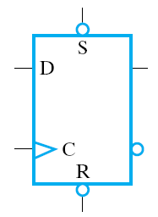
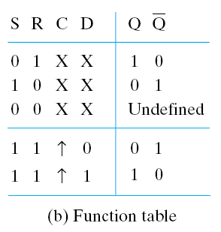
Direct Inputs
At power up the state of a sequential circuit could be anything!
We usually need to initialize it to a known state before operation begins
This initialization is often done
directly outside of the clocked behavior
of the circuit, i.e., asynchronously.
Direct R and/or S inputs that control the state of the latches within the flip-flops are added to FFs for this initialization.
For the example flip-flop shown
  0 applied to R directly resets the flip-flop to the 0 state regardless of the clock
  0 applied to S directly sets the flip-flop to the 1 state regardless of the clock
Bubble =
I/P active low
Asynchronous
(Direct) S,R → Q
Q
Synchronous
(clocked) D→Q
Q
Edge-
Triggered
Asynchronous
Action- Regardless of clock
Synchronous
Action

Slide 24
Other Types of Flip-Flops
We know about the master-slave S-R and D flip-flops
We will briefly introduce J-K and T flip-flops
  Implementation
  Behavior

Slide 25
Basic Flip-Flop Descriptors
For use in analysis: Circuit, given state → Next state?
(FF: present output, inputs → next output?)
  Characteristic table - defines the next state of the flip-flop in terms of flip-flop inputs and current state
  Characteristic equation - defines the next state of the flip-flop as a Boolean function of the flip-flop inputs and the current state
For use in design: Specified state transitions → Circuit?
(FF: Present, Next states → inputs that give this state transition?)
  Excitation table - defines the flip-flop inputs that give a specified present to next output transition

Slide 26

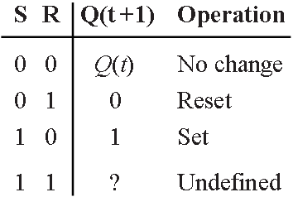

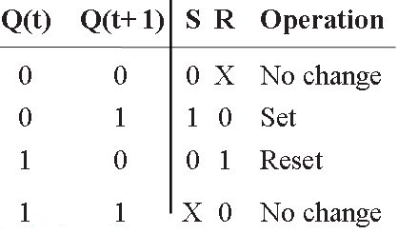
S-R Flip-Flop
Characteristic Table
Characteristic Equation
Excitation Table
Given FF inputs → Present to Next ?
Input-
Driven
Analysis
Given Present to next → Inputs = ?
Output-
Driven
Design
Change

Slide 27

D Flip-Flop
Characteristic Table
Characteristic Equation
Q(t+1) = D(t)
Excitation Table
D(t)
Q(t
+
1)
Operation
0
0
Reset
1
1
Set
Q(t
+1)
D(t)
Operation
0
0
Reset
1
1
Set

Slide 28

J-K Flip-Flop- Improvement on SR
Avoids SR = 11 problem, JK = 11 → Toggle, i.e. Q(t+1) = Q(t)
Characteristic Table
Characteristic Equation
Excitation Table
J
K
Q(t
+
1)
Operation
0
0
Q
(
t
)
No change
0
1
0
Reset
1
0
1
Set
1
1
Q
(
t
)
Complement
(Toggle)
J
D
Q(t)
Q(t
+
1)
J
K
Operation
K
C
0
0
0
X
No change
0
1
1
X
Set
Change
1
0
X
1
Reset
1
1
X
0
No Change

Slide 29
T (Toggle) Flip-Flop
D FF with “No change” & “toggling: capabilities
Characteristic Table
Characteristic Equation
Q(t+1) = D(t) = T ⊕ Q(t)
Excitation Table
T
Q(t
+
1)
Operation
D
T
0
Q
(
t
)
No change
1
Q
(
t
)
Complement (Toggle)
C
Q(t
₊
1)
T
Operation
Q
(
t
)
0
No change
Q
(
t
)
1
Complement

Slide 30
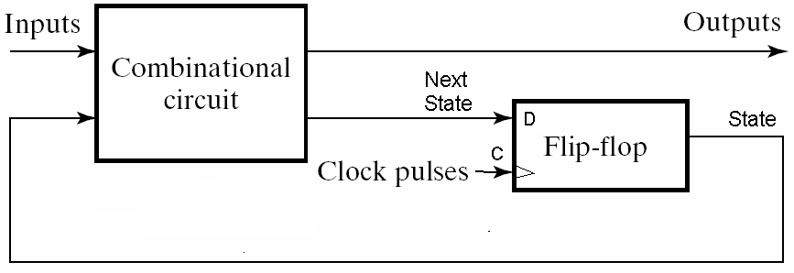
Sequential Circuit Analysis
General Model
  Current State (state) at time (t) is stored in an array of flip-flops
  Next State at (t+1) is a combinational function of State & Inputs
  Outputs at time (t) are a combinational function of State (t) and (sometimes) Inputs (t)
(t)
(t)
O’ (t)
(t)
State (t)
•
State Bits
(one FF per bit)
FF Provides isolation between in and out:
State (t) is not affected by Q’(t) until…..
•
…. the next clock pulse comes:
t becomes t+1,
O’(t) is moved to FF output, thus
becoming State (t+1)
How many states does the Circuit above have?
How many FFs needed for a circuit with 5 states?

Slide 31
Analysis:
Given a Sequential Circuit determine the way it behaves
External
Inputs
Feedback
Input: x(t)
Output: y(t)
State: (A(t), B(t))
Analysis answers questions:
What is the function(s) for the External Output(s) ?
(what is the output given a present state and inputs?)
What is the function for the Next State?
(what is the next state given a present state and inputs)
x
D
Q
A
Combinational
Logic
C
Q
A
Flip Flops
State
D
Q
B
Clock
CP
Q
C
y
External
Output(s)
→ Synchronous or asynchronous?
→ Mealy or Moore?

Slide 32
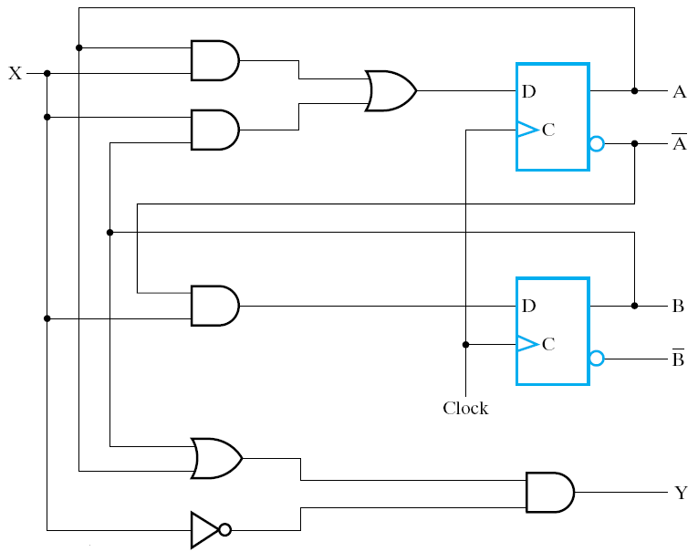
Analysis Example 1: A Mealy Circuit, Output = F (states, inputs)
Deriving flip flop input equations
Right at the outset, there are things we can do:
Derive Boolean expressions for all outputs of the combinational logic (CL) circuits
These CL outputs are:
→ Inputs to the flip flops
(Will form the next state)
D_{A} = AX + BX
D_{B} = AX
→ Output(s) to the outside world
Y = (A+B) X
+ ive Edge
Triggered D FFs
Note: Flip flop input equations required
depend on the flip flop type used, e.g. D, SR, etc.

Slide 33




Determine FF D’s
Combinationally
here just before clk
Then transfer FF D’s to FF Q’s on the effective clock edge
1
0
1
0
0
X
0
1
State variables change only at clock edges
X
0
Output in Mealy can change asynchronous
To clock (with changes in external input X)
Reset state to all to 0
(asynchronously?)

Slide 34
Sequential Circuit Analysis
Given a sequential Circuit
Objective: Derive outputs & state behavior (outputs and next state) from (present states and inputs)
Two equivalent approaches to represent the results:
  State table: A truth table-like approach
  State diagram: A graphical, more intuitive way of representing the state table and expressing the sequential circuit operation

Slide 35
State Table Characteristics
State table – a multiple variable table with the following four sections:
  → CL Inputs:
  Present State – the values of the state variables for each allowed state (FF outputs)
  External Inputs
  → CL Outputs:
  Next-state – the value of the state (FF outputs) at time (t+1) based on the present state and the inputs. Determined by FF inputs & FF characteristics
  Outputs – the value of the outputs as a function of the present state and (sometimes- Mealy) the inputs.

Slide 36
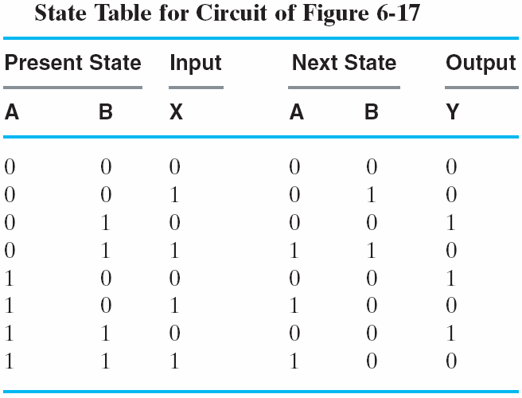
One-Dimensional State Table
FF Input Equations:
# of rows in Table = 2^{(# of FFs+ # of inputs)}
Get from:
- Equations for FF input (CL)
- Then FF Characteristics.
x
D
Q
A
Two State Variables:
A, B: → 4 states
Purely
Combinational
C
Q
A
D
Q
B
CP
C
Q
y
4 states, 1 input
inputs
outputs
check

Slide 37
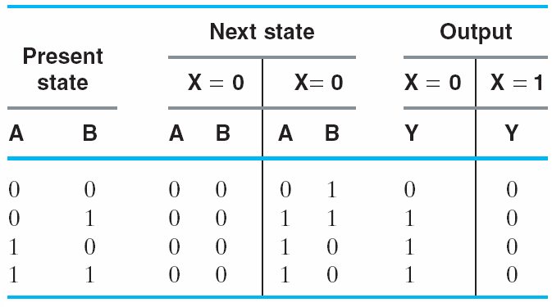

Two-Dimensional State Table a step closer to Sate Diagrams
# of rows in Table = 2^{(# of FFs)}
and I/P conditions considered with O/Ps
For Moore type
O/P = f (state) &
only one column
x
1. FF input Equations (CL)
2. Then FF Characteristics.
D
Q
A
Two State Variables A, B
→ 4 states
Purely
Combinational
C
Q
A
(Mealy)
D
Q
B
CP
C
Q
y
4 states. As many rows as states
Next State
= f (State, I/P)
Output
= f (State, I/P)

Slide 38
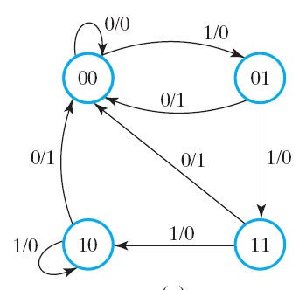
Sate Diagram,
Mealy Circuits
Input/output
Directed arc
To next state
State Transition
For a given input value,
Corresponding O/P is also marked
x
D
Q
A
State
C
Q
A
Number of transition combinations exiting a state
= Number of input combinations = 2 here
D
Q
B
CP
C
Q
y

Slide 39
Moore and Mealy Models
Sequential Circuits or Sequential Machines are also called Finite State Machines (FSMs). Two formal models exist:
In contemporary design, models are sometimes mixed Moore and Mealy
Moore Model
  Named after E.F. Moore.
  Outputs are a function of states ONLY
  O/Ps are usually specified on the states (in the circles)
Mealy Model
  Named after G. Mealy
  Outputs are a function of external inputs AND states
  Usually specified on the state transition arcs

Slide 40
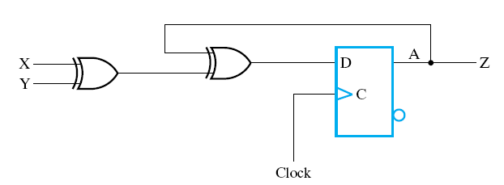
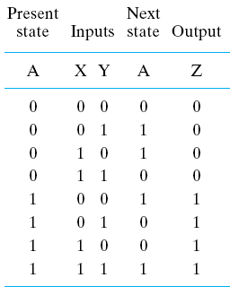
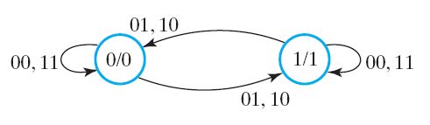
Analysis Example 2: A Moore Circuit
Output = F (States only)
Right at the outset, there are thing we can do:
Derive Boolean expressions for all outputs of the combinational logic (CL) circuits
These CL outputs are:
→ Inputs to the flip flops
D_{A} = X⊕Y ⊕A
→ Output to the outside world
Z = A
Does not depend on inputs, only on state → Moore model
One + ive Edge
Triggered D FF,
2¹ = 2 states
= D_{A}
O/P Determined only by state
Output associated with the
State only (inside the circle)
State, Output
I/P combinations
Affect state transitions only
How many I/P combinations
Emanate from a state?

Slide 41
Sequential Circuit Design:
The Design Procedure
1. Specification – e.g. Verbal description
2. Formulation – Interpret the specification to obtain a state diagram and a state table
3. State Assignment - Assign binary codes to symbolic states
4. Flip-Flop Input Equation Determination - Select flip-flop types and derive flip-flop input equations from next state entries in the state table
5. Output Equation Determination - Derive output equations from output entries in the state table
6. Optimization - Optimize the combinational logic equations in 4, 5 above, e.g. using K-maps
7. Technology Mapping - Find circuit from equations and map to a given gate & flip-flop technology
8. Verification - Verify correctness of final design
CAD Help Available

Slide 42
Specification
Specification can be through:
  Written description
  Mathematical description
  Hardware description language*
  Tabular description*
  Logic equation description*
  Diagram that describes operation*
Relation to Formulation
  If a specification is rigorous at the binary level (marked with * above), then all or part of formulation would have been completed

Slide 43
Formulation:
Get a State Diagram/Table from the Specifications
A state is an abstraction of the history of the past applied inputs to the circuit (including power-up reset or system reset).
  The interpretation of “past inputs” is tied to the synchronous operation of the circuit. e. g., an input value (other than an asynchronous reset) is measured only during the setup-hold time interval for an edge-triggered flip-flop.
Examples:
  State A may represent the fact that three successive 1’s have occurred at the input
  State B may represent the fact that a 0 followed by a 1 have occurred as the most recent past two inputs
  0001100011011100
  Machine enters State A here
  Machine enters State B here
  Machine can only be in one state at any given time

Slide 44
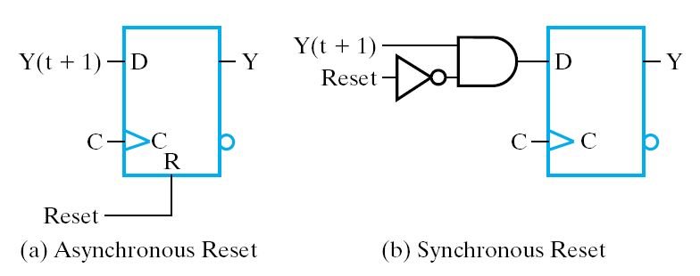
State Initialization
When a sequential circuit is turned on, the state of the flip flops is unknown (Q could be 1 or 0)
Before meaningful operation, we usually bring the circuit to an initial known state, e.g. by resetting all flip flops to 0’s
This is often done asynchronously through dedicated direct S/R inputs to the FFs
It can also be done synchronously by going through the clocked FF inputs

Slide 45
Example: Bit Sequence Recognizer: 1101 1. Specifications- Verbal
Verbal Specifications:
Detect the occurrence of bit sequence 1101 whenever it occurs on input X and indicate this detection by raising an output Z high
i.e. normally output Z = 0 until sequence 1101 occurs
i.e. until input X = 1 and 110 was the last sub-sequence received i.e. system was in the state ‘110 received’
Is this a Mealy or a Moore model?
X
Input
1101
Recognizer
Z
Output

Slide 46
Example: Bit Sequence Recognizer: 1101
2. Formulation: State Diagram Strategy
Begin in an initial state in which NONE of the initial portion of the sequence has occurred (typically “reset” state)
Add a state which recognizes that the first symbol in the target sequence (1) has occurred
Add states that recognize each successive symbol occurring
The final state represents:
  Occurrence of the required input sequence (Moore)
  Occurrence of the required input sequence less the last input (Mealy)
Add state transition arcs which specify what happens when a symbol not contributing to the target sequence has occurred

Slide 47
Recognizer for Sequence 1101
Has sub-sequences: 1, 11, 110
1/0
1/0
0/0
A
B
C
D
Initial or
No Progress State
1/1
Input/output = X/Z
When does Z become 1?
The states have the following abstract meanings:
  A: No proper sub-sequence of the sequence has occurred. Could be also the initialization (Reset) state
  B: Remembers the occurrence of sub-sequence ‘1’
  C: Remembers the occurrence of sub-sequence ‘11’
  D: Remembers the occurrence of sub-sequence ‘110’
  The 1/1 arc from D means full sequence is detected & Z = 1. But why does it go to B? Since this ‘1’ could be the first 1 in a new sequence and thus needs to be remembered as ‘1’!

Slide 48
Is this the complete state diagram?
What is missing?
1101
At each state, the input X could have any of two values, so 2 arcs must emanate from each state (X = 0 and X = 1)
Also A is not entered!
1/0
1/0
0/0
A
B
C
D
Initial or
No Progress State
Transitions that help build
the target sequence:
Go to B (1) or C (11)
Transitions that
do not help build
the required
sequence:
go to A
1/1
0/0
1/0
11101
111
1/0
1/0
0/0
A
B
C
D
1
11
110
0/0
1/1
A 0 after only one 1 is not a help!
1101101
1101
0/0
Each state must have 2 arcs exiting

Slide 49
“Symbolic” State Table (Mealy Model)
From the State Diagram, we can fill in the 2-D State Table
There are 4 states, one input, and one output.
Two dimensional table
with four rows, one for
each current state
0/0
0/0
1/0
1/0
1/0
0/0
1/0
A
B
C
D
0/0
1/1
0/0
O/P depends on I/P,
→ Mealy
Present
Next State
Output
From “symbolic” state table
To binary State Table:
What is needed?
→ State Assignment Issues
State
x=0 x=1
x=0 x=1
A
A
B
0
0
B
A C
0 0
C
D C
0 0
D
A B
0 1

Slide 50
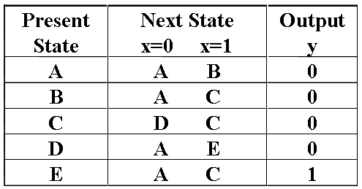
Formulation Example: State Diagram (Moore Model)
With the Moore model, output is associated with only a state not a state and an input as seen with the Mealy model
This means we need a fifth state (remembers the full target sequence (1101)) and produces the required Z = 1 output
0
1
0/0
1/0
O/P tied to state
1
1
0
1/0
1/0
0/0
A/0
B/0
C/0
D/0
A
B
C
D
0
1
0/0
1/1
1
Moore
Mealy
0
E/1
0/0
New State
Produces the Z O/P
0
Now 5 states needed
An extra FF!
Note: O/P does not
depend on I/P (only 1 column)

Slide 51
3. State Assignment: From abstract symbols to binary bit representation of states
Need to represent m states → ? FFs
Each of the m symbolic states must be assigned a unique binary code
Minimum number of state bits (state variables) (FFs) required is n, such that 2^{n} ≥ m
i.e. n ≥ log₂ m
where x is the smallest integer ≥ x
If 2^{n} > m, this leaves (2^{n} – m) unused states
Utilize them as don’t care conditions to simplify CL design
But may need caution: e.g. what if the circuit enters an unused state by mistake
Also which code is given to which state? → different CL implementations → may influence optimization, e.g.
(with 2 FFs) State A is assigned 00 or 01 or 10 or 11?

Slide 52
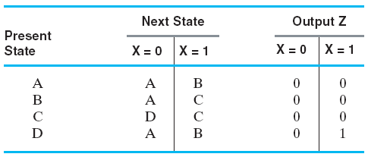
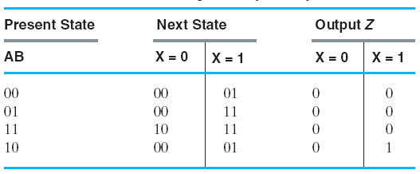
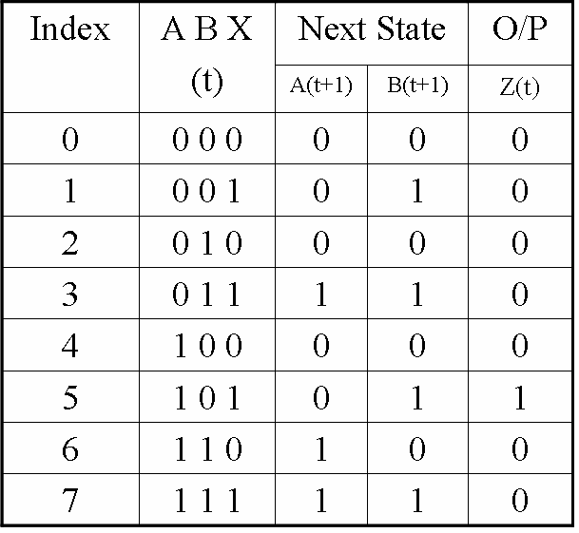
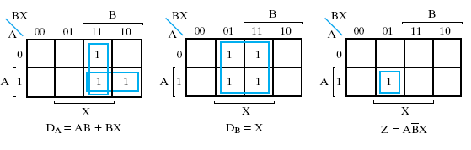
4, 5, 6: Determination and Optimization: The Mealy Model
4 states (A, B, C, D) → 2 FFs, No unused states
Let A = 00 (to suit being a Reset state), B = 01, C = 11, D = 10
Symbolic State Table
Binary State Table
(t)
(t+1)
(t)
(The 2 FFs)
AB
AB
Assign
States
For optimization of FF input equations we express A(t+1), B(t+1), Z(t) in terms of
A(t), B(t) and X(t) (using one dimensional state table)
= D_{A}(t)
= D_{B}(t)
Using D flip flops:
D_{A} (t) = A (t+1)
D_{B} (t) = B (t+1)
Optimized
Results
Use standard order to
Simplify entering
Data into the K-maps

Slide 53
Sequential Circuit
SOP: AND-OR
D
A
C
R
Z
B
X
D
Clock
C
R
Reset
Asynchronous Reset
To Initial State A (AB = 00)

Slide 54
7. Technology-Mapped Circuit –
Final Result
Design Library contains:
  D Flip-flops
  with Reset
  (Active High)
  NAND gates
  with up to 4
  inputs and
  inverters
SOP using NANDs only
A
D
OR-AND
C
R
Z
B
AND
X
D
Clock
C
R
Reset

Slide 55
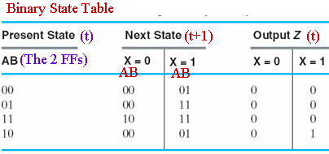
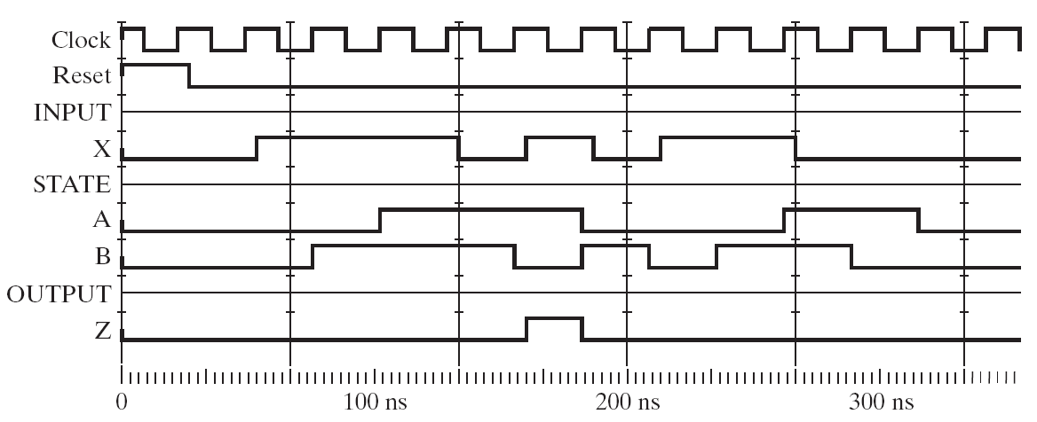
8. Verification
Manual or Using CAD Simulation
1/0
0/0
1/0
1/0
0/0
A
B
C
D
A
B
C
D
Reset State
0/0
1/1
0/0
+ive
Edges
Asynch.
1
1
1
1
0
1
0 0
0 0
1 0
1 1
1 1
0 1
1 0
Async. Reset
(A)
(B)
(C)
(C)
(D)
(B)
Changes directly
with input (Mealy)

Slide 56
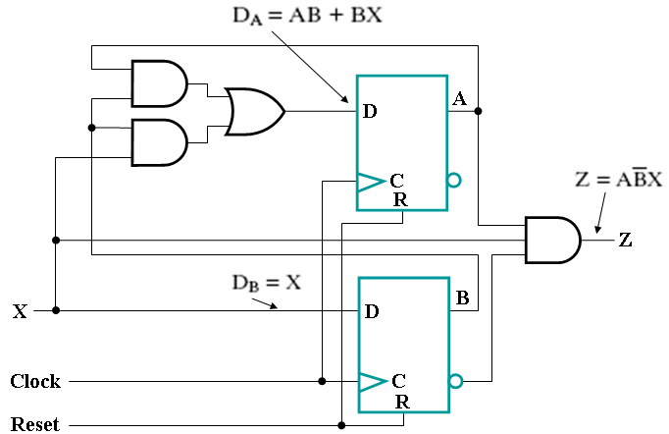
Sequential Circuits
Analysis Versus Design
0/0
1/0
A
1/0
B
1/0
C
0/0
D
0/0
1/1
Analysis
0/0
1-D
2-D
Design
  For Analysis of a given circuit:
  Given circuit, get its behavior [state table (state diagram)]:
  {Present state, inputs} → Next state?
  Flip Flop Consideration: (inputs→ outputs?)
  → We use FF Characteristic tables/equations
  For Design to achieve a specified circuit performance
  Given desired behavior [(state diagram (State table)], get circuit
  (behavior: Present to next changes → FF Inputs?→ CL circuit)
  Flip Flop Considerations: (O/P behavior → inputs to give this behavior?)
  → We use FF Excitation tables

Slide 57
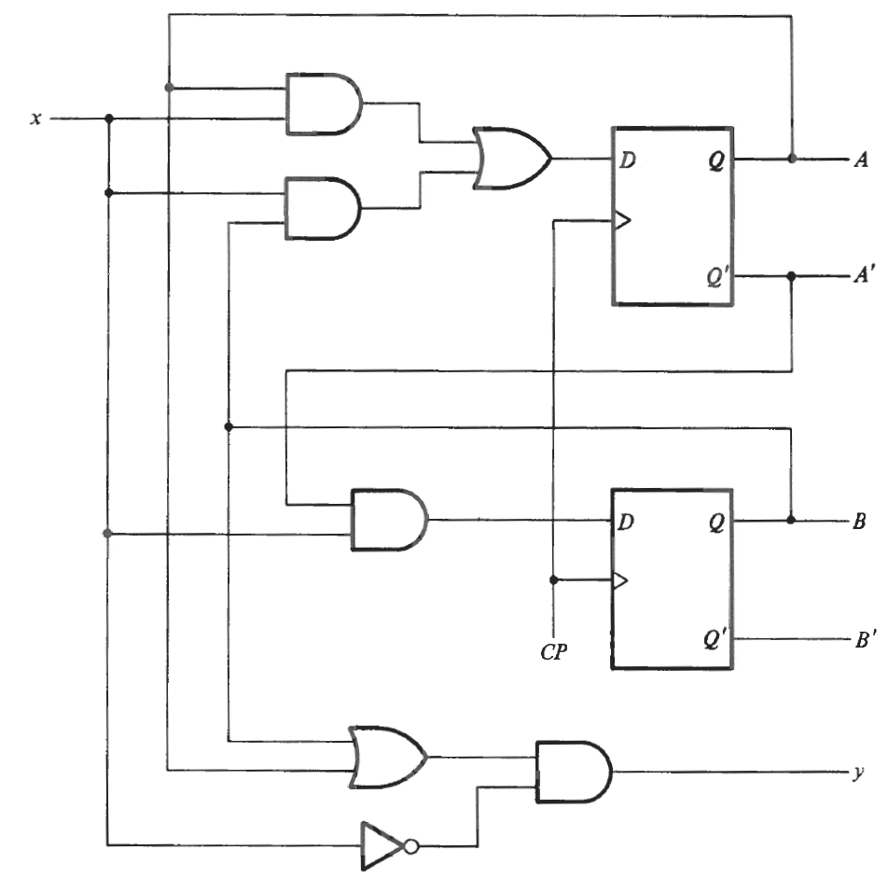



Another Analysis Example:
Circuit → Behavior in a State Diagram form
2 D-type Flip Flops
+ive edge triggered
2² = 4 states
AB = 00, 01, 10, 11
→1 input x
1 output y
State Variables are?
Mealy or Moore?

Slide 58
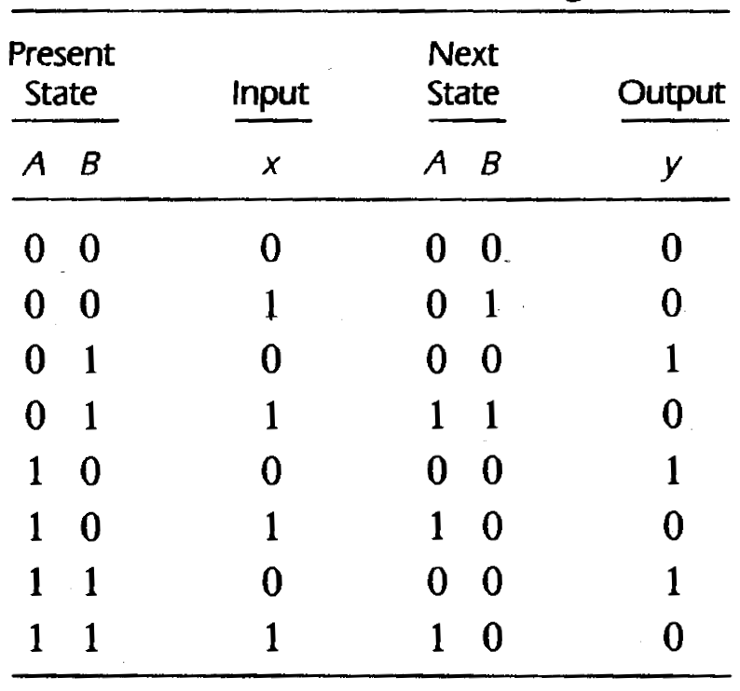
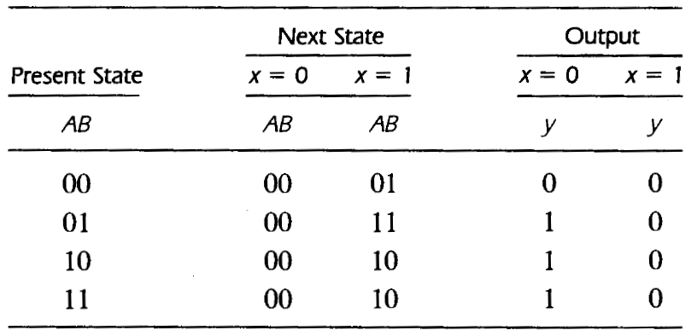
Analysis Example, Contd.
1-D State Table
Comb → Seq Link
(Ds)
Lower
2-D State Table (closer to state diagram)

Slide 59
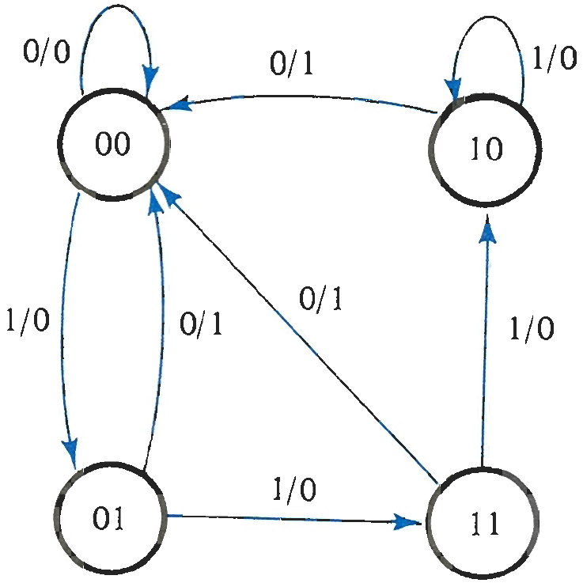
Analysis Example, Contd.
2-D Truth Table (closer to state diagram)
Input/Output

Slide 60
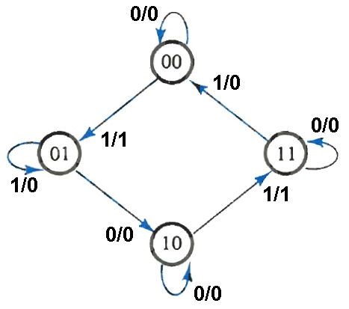
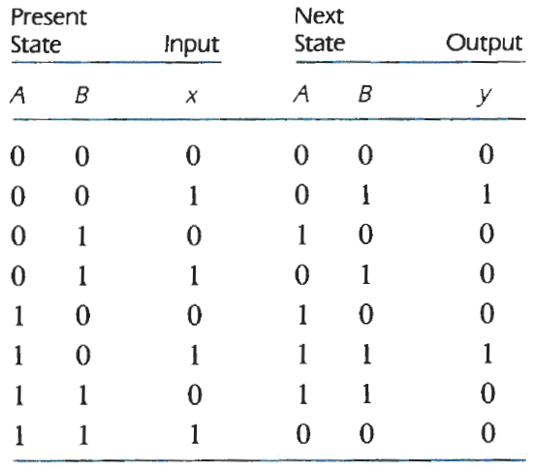
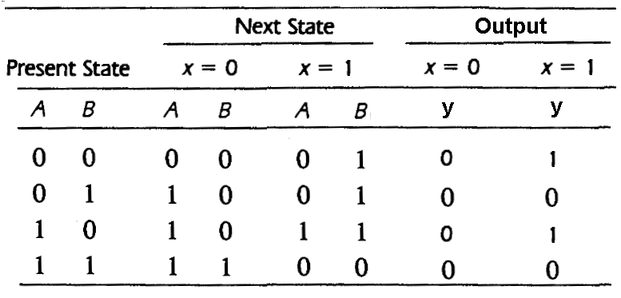
Another Design Example
Behavior in a State Diagram form → Circuit
4 states
00, 01, 10, 11
2 flip-flops A,B
1 input, x
1 output, y
Mealy or Moore?
Seq → Comb Link
Inputs
Outputs
1-D
State Table
(Ds)
2-D State Table

Slide 61
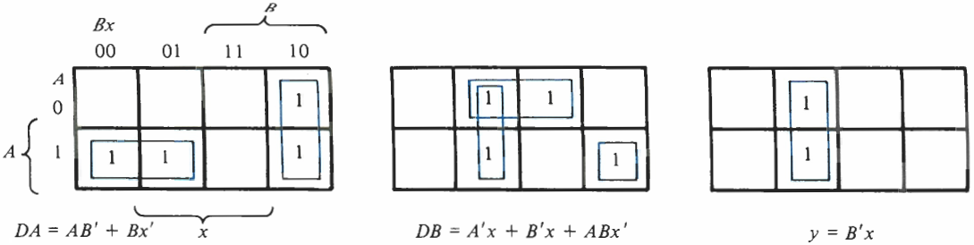
Design Example, Contd.
Inputs
Outputs
Straight forward Combinational Logic design problem:
3 inputs: {A, B, x}
3 Outputs: {DA, DB, y}
Index
DA
DB
0
1
2
3
4
5
6
7
The D type flip flop data inputs,
Will be the next state on the next + ive clock edge

Slide 62
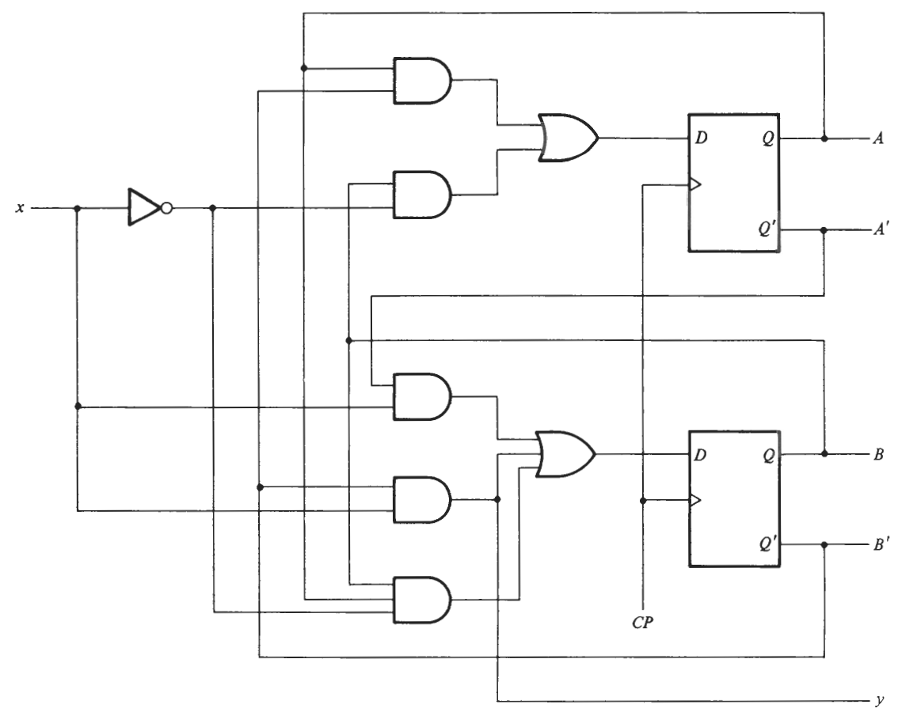


Design Example, Contd.
State
Input
Output

Slide 63
Unit 11: Sequential Circuits
Chapters 5 & 6: Sequential Circuits
1. Sequential Circuit Definitions, Types of Latches: SR, Clocked SR, and D Latches
Flip-Flops: SR, D, JK, and T Flip-Flops
Flip-Flop Timing Parameters: Setup, hold, propagation, clocking
Flip-Flops: Characteristic and Excitation Tables
Analysis of Sequential Circuits with D flip-flops: Deriving the input equations, state table, and state diagram. Timing
Design of Sequential Circuits with D flip-flops: Determining the state diagrams and tables, State assignment, Combinational Logic

