Slide 1
COE 202: Digital Logic Design
Courtesy of Dr. Radwan E Abdel-Aal
Unit 13
Programmable Logic
(Section 6-8)
Memory Devices: RAM and ROM
(Supplementary notes: lesson 6_2)

Slide 2
Programmable Implementation Technologies: Overview
Why programmable logic?
Programmable logic techniques and technologies
Programmable Logic Devices:
Read-Only Memory (ROM)
Programmable Array Logic (PAL)
Programmable Logic Array (PLA)
VLSI Programmable Logic Devices (Field Programmable Gate Arrays- FPGA)

Slide 3
Why Programmable Logic?
Facts:
It is most economical to produce an IC in large volumes
But:
Many situations require only small volumes of ICs
Many situations require changes to be done in the field, e.g. Firmware of a product under development
A programmable logic device can be:
Produced in large volumes
Programmed to implement many different low-volume designs

Slide 4
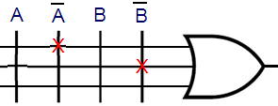
Programmable Logic - Additional Advantages
Many programmable logic devices are field-programmable, i. e., can be programmed in the field by the user - outside of the manufacturer’s environment
Nowadays, most programmable logic devices are erasable and reprogrammable (i.e. can programmed many times)
Allows “updating” a device or firmware, correction of errors
Allows reuse the device for a different design - re-usability!
Concept of
Logic Programming
Locations of connections
determine the logic function implemented

Slide 5
Hardware Programming Technologies
In the Factory - Cannot be erased/reprogrammed by user
Mask programming (changing the VLSI mask) during manufacturing
Programmable only once
Fuse
Anti-fuse
Reprogrammable (Erased & Programmed many times)
Volatile - Programming lost if chip power lost
Single-bit storage element
Non-Volatile - Programming survives power loss
UV Erasable
Electrically Erasable
Flash (as in Flash Memory)

Slide 6
Programmable Logic Configurations: All use AND-OR structure- differ in which is programmable
Programmable Read Only Memory (PROM) - fixed array of AND gates and a programmable array of OR gates
Programmable Array Logic (PAL) - programmable array of AND gates feeding a fixed array of OR gates.
Programmable Logic Array (PLA) - programmable array of AND gates feeding a programmable array of OR gates.
How many
Possibilities?
Fixed or Programmable
Connections
Fixed or Programmable
Connections

Slide 7
ROM, PAL and PLA Configurations
Fixed
Fixed
Programmable
Programmable
Inputs
Connections
AND array
Connections
OR array
Outputs
PROM
(decoder)
(a) Programmable read-only memory (PROM)
Inputs
Programmable
Programmable
Fixed
Fixed
Connections
AND array
Connections
OR array
Outputs
PAL
(b) Programmable array logic (PAL) device
Programmable
Programmable
Programmable
Programmable
Inputs
Connections
AND array
Connections
OR array
Outputs
PLA
(c) Programmable logic array (PLA) device

Slide 8
Wiring Conventions for Programmable Logic
We deal with a large number of gates and gate inputs
Need a more concise way of expressing gate circuits
graphically
Inputs (literals)
A
A
B
B
Inputs
1 wire
X
X
X marks a connection, i.e. an input to the OR
Output = ?

Slide 9
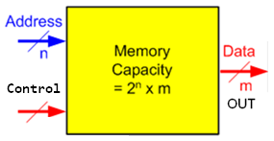
Read Only Memory (ROM)
Data stored in a ROM is non-volatile
i.e. Once written, this data is permanently stored until erased or changed through re-programming (if applicable)
The ROM has n input lines for the address and m output data lines
So, Total memory capacity of a ROM is 2^{n} x m bits
ROMs do not have input lines as a write operation does not exist in them
Programmable ROMs receive data to be programmed on the output lines
Generally, system-level programs that need to be accessed frequently and at power up access are stored in the computer’s ROM, e.g. the BIOS firmware

Slide 10
1. Read Only Memory (ROM) Programmable sum of (fixed) minterms
Example: 8 X 4 PROM (n = 3 input lines, m = 4 output lines)
The fixed "AND" array is a “decoder” with 3 inputs and 8 outputs implementing minterms
The programmable "OR“ array uses a single line to represent all inputs to an OR gate. An “X” in the array corresponds to attaching the minterm to the OR
Read Example: For input (A₂,A₁,A₀) = 010, output is (F₃,F₂,F₁,F₀ ) = 1001.
What are functions F₃, F₂ , F₁ and F₀ in terms of (A₂, A₁, A₀)?
8 X 3-input fixed ANDs give all 8 minterms
m0
D0
X
X
X
D1
D2
X
X
D3
X
8 Minterms
A
A2
D4
X
D5
X
X
B
A1
D6
LSB
A0
D7
X
C
m7
n I/Ps
m O/Ps
F3
F2
F1
F0
2^{n} x m Programmable
Connections
Notes:
F3 = D7 + D5 + D2 = A2 A0 + A2’ A1 A0’
F2 = D7 + D0 = A2 A1 A0 + A2’ A1’ A0’
F1 = D4 + D1 = A1 A1’ A0’ + A2’ A1’ A0
F0 = D7 + D5 + D1 = A2 A0 + A1’ A0

Slide 11
Read Only Memory (ROM): n i/ps to m o/ps 2^{n} locations x m bits each
Read Only Memories (ROM) have:
n input (address) lines → 2^{n} locations → 2^{n} decoded minterms
m output lines (word width)
Fixed array of 2^{n} AND gates implementing all the N-literal minterms.
Programmable OR Array with m outputs lines to form up to m expressions, each being a sum of selected minterm.
The program for a PROM is simply the multiple-output truth table to be implemented
If a 1 entry, a connection is made to the corresponding minterm for the corresponding output
If a 0, no connection is made
Can be viewed as a memory with the inputs as addresses of data (output values), hence ROM or PROM names! Device on previous slide is an 8 x 4 memory (8 locations, each 4 bits)
Truth table is a listing of the memory contents

Slide 12
Read Only Memory (ROM) Advantages/Limitations
Advantages:
Can implement any function (all the minterms are available)
Program is derived directly from the truth table (uses the canonical form)
Disadvantages:
Becomes complex for a large number of inputs n (# of ANDs = 2^{n}, each n-input wide)
Does not support multi-level circuits (no outputs brought back as inputs)

Slide 13
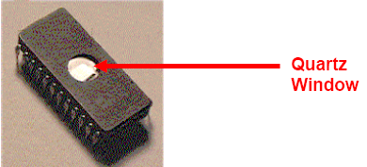
Types of ROM Devices
Simply ROM: Programmed only once and by the manufacturer (in factory), based on the client’s truth table
PROM: A ROM programmable only once by the user (in the field). The user blows fuses to remove unwanted connections. This process is irreversible and hence device is programmed only once
EPROM: Erasable, Programmable ROMs. Can have their data erased using Ultraviolet light and reprogrammed. The user can then reprogram the ROM many times using special programmers Off- situ.
Off-situ: Remove from
computer to erase/program
An
EPROM

Slide 14
Types of ROM, Contd.
EEPROMs: Electrically Erasable Programmable ROMs. Have memory cells that can be erased and reprogrammed by exposure to electrical signals.
Erasure/Programming is now much easier and in-situ. The processor can now “write” into the EEPROM.
Flash memory devices:
Memory cells are erased in blocks not one-by-one as in EEPROMs → Shorter life but faster operation

Slide 15
Read Only Memory (ROM) Naming Conventions determined by Programming Technology
Programming Technology | ROM Name | Remarks
Mask | ROM | Programmed at manufacturing only
Fuse/Antifuse | PROM | Programmed (only once) by the user
Floating Gate (UV Erasable) | EPROM | Erased and Programmed by user many times- off situ
Electrically Erasable | EEPROM | Erased and Programmed by user many times- in situ

Slide 16
ROM-based Designs
Combinational Circuits:
ROMs can be used to implement combinational circuits from their truth tables
(i.e. SOm form, without the need for minimization to SOP)
Sequential Circuits:
Use ROMs to design the combinational part of the sequential circuit

Slide 17
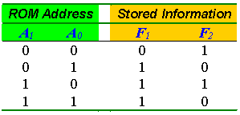
ROM-based Designs: Combinational Circuits
Example 1: Implement the following two combinational functions using a ROM
F1 (X,Y) = ∑ m (1,2,3)
F2 (X,Y) = ∑ m (0,2)
Solution:
Specifying the ROM required:
ROM has n = 2 inputs (→ 2² = 4 locations)
and m = 2 outputs (→ Each location has 2 bits) … 4 x 2 bit ROM
Specifying the ROM data content (to be programmed into the ROM):
Directly from the truth table of the two functions
Index
0
1
2
3

Slide 18
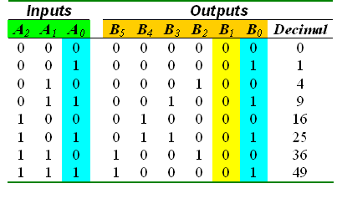
ROM-based Designs: Combinational Circuits
Example 2: X² look-up table, X is 3-bit binary number
→ Specification: Use a ROM to implement a combinational circuit that accepts a 3-bit binary number at the input and generates its square at the output.
Formulation:
8 x 6 bits ROM, Truth Table →
→ Observations on the truth table:
1. Output B₀ = Input A₀
2. Output B₁ = Always 0
No need to ‘store’ data for B0 and B1
This reduces the size of the ROM required from 8 x 6 bits to 8 x 4 bits
8
Locations
6 bits

Slide 19
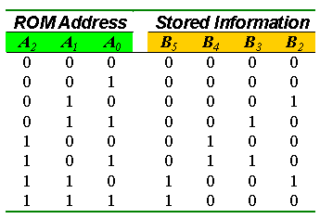
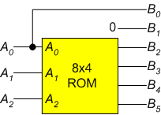
ROM-based Designs: Combinational Circuits
Example 2, Continued
Truth Table for Reduced ROM
Implementations of the X² Look-up Table:
8
Locations
4 bits

Slide 20
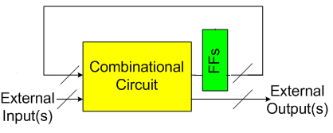
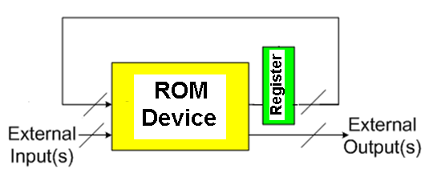
ROM-based Designs: Sequential Circuits
:
Conventional Design
Individual FFs
ROM-Register
Based Design

Slide 21
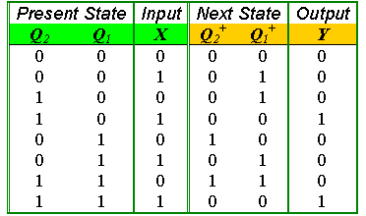
ROM-based Designs: Sequential Circuits
:
Example: Design a sequential circuit that has the following
State Transition Table Using a ROM and a Register
Q₁⁺ = Σm (1, 2, 5, 6)
Q₂⁺ = Σm (4, 6)
Y (Q₁, Q₂, X) = Σm (3, 7)
8
Locations
ROM inputs
(Address)
ROM Outputs
(Data)
3 bits
3 bits

Slide 22
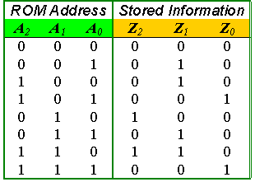
ROM-based Designs: Sequential Circuits
:
The ROM Required
Organization
Truth Table

Slide 23
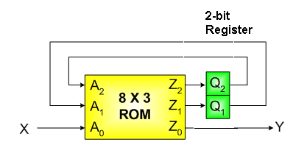
ROM-based Designs: Sequential Circuits
:
Implementation

Slide 24
2. Programmable Array Logic (PAL) Sum of a fixed number of products
AND gates inputs
Programmable
4-input, 4-output PAL with fixed, 3-input OR terms
What are the equations for F1 through F4?
F1 = +
F2 = B + AC + AB
F3 =
F4 =
What if a function uses more than 3 products?
Implement as multi-level
0
1
2
3
4
5
6
7
8
9
Product
1
X
Fixed
term
2
X
X
F
1
3
I
1
A
X
X
X
O/P made available
as I/P → support
multilevel circuits
4
A
B
C
5
X
X
F
2
A
C
6
X
X
I
2
B
7
X
X
8
X
X
F
3
9
X
I
3
C
10
X
X
11
X
X
F
4
12
X
I
4
0
1
2
3
4
5
6
7
8
9
Notes:
F3 = AD + BD + F1 = AD + BD + A’B+ C’ = AD + BD + A’B’ + C’
F4 = AB + CD + F1’ = AB + CD + (A’B’ + C’)’ = AB + CD + AC + BC

Slide 25
Programmable Array Logic (PAL)
PAL is the opposite of the ROM, having a set of programmable ANDs combined with a set of fixed ORs- Here programmable means selectable I/Ps
Advantages
For given internal complexity, a PAL can support larger N and M than a PROM
PAL has outputs from OR terms fed as internal inputs to all AND terms, allowing implementation of multi-level circuits
Some PALs have outputs that can be complemented, allowing expressions in terms of a POS: F = F
Disadvantages
Has only a limited number of products (= # of ANDs = # of inputs to an OR). If function needs more product terms it can not be implemented directly in 2-level logic
SOP

Slide 26
Programmable Array Logic (PAL), Contd.
There is no sharing of the AND gates as in the ROM and PLA. i.e. AND gate outputs (product terms) are not available for connecting to all the ORs (Sums)
Design requires fitting functions within the limited number of ANDs per output (i.e. per OR gate)
We start by single function optimization, trying to fit the function into one section (one SOP)
If the number of terms in a function is greater than the number of ANDs per OR gate (products/section), then we use more than one section to implement an output (multilevel)
If several outputs use the same product, this reduces circuit cost
Here: Max of 3 products/section
Product
AND gates inputs
term
A
A
B
B
C
C
D
D
W
W
1
2
W
3
X
A
4
All fuses intact
(always
5
0)
5
F1
6
B
7
8
F2
9
C
10
11
12
D
X
Fuse intact
1
Fuse blown
A
A
B
B
C
C
D
D
W
W

Slide 27
Programmable Array Logic (PAL) Example
Equations: F1 = A + B + C + ABC F2 = AB + BC + AC
F1 must be factored since four terms (> 3)
Factor out last two terms as W
= W
B
C
A
C
A
B
AND
Inputs
PAL Programming Table
Pr
od
uc
t
term
A B C D
W
Outputs
Take Compl.
Remove both connections
A
B
1
Take True.
0
0
1
—
—
W = C
2
1
1
1
—
—
+ ABC
3
Full gate not used.
See next slide
—
—
—
—
—
4
1
0
0
—
—
B
C
F1 = X = A
+ B + W
5
0
1
0
—
—
A
C
6
—
—
—
—
1
7
1
1
—
—
—
F2 = Y
= AB + BC +AC
8
—
1
1
—
—
PAL comes with all
Connections made.
Connections that are not needed must be removed
9
1
—
1
—
—
10
—
—
—
—
—
11
—
—
—
—
—
12
—
—
—
—
—
How many connections are removed for product 1?, for product 3?

Slide 28
Programmable Array Logic Example
AND gates inputs
Product
A
A
B
B
C
C
D
D
W
W
term
1
X
X
X
For an unused product,
Leave all connections intact
Why?
2
W
X
X
X
3
X
A
4
X
X
X
All fuses intact
(always
=
0)
5
5
X
X
X
F1
6
X
Opposite of ROM:
ANDs: programmable
ORs: not
B
7
X
X
8
X
X
F2
9
X
X
C
10
11
12
D
X
Fuse intact
1
Fuse blown
A
A
B
B
C
C
D
D
W
W

Slide 29
3. Programmable Logic Array (PLA) Programming at both the product and the sum levels
A
What are the equations for F₁ and F₂?
Could the PLA implement the functions without the XOR gates?
n inputs
(3)
B
C
X
X
1
X
X
A B
k products
(4)
Programmable
Connections,
Get expressions
for each group for
a PLA with:
n inputs, k products,
m outputs
B C
X
X
2
X
Fuse intact
X
A C
Fuse blown
X
X
3
X
Programming
the Output inversions
X
X
4
X
A B
C
C
B
B
A
A
X
0
X
1
PLA with 3-inputs, 4 product terms, 2-outputs, + programmable output inversions
F
1
m outputs
(2)
F
2
Express F2 as a SOP and POS
Notes:
F1 = AB +BC + AC
F2 = (AB + A’B’)’ = (A’ + B’) (A + B) = A’B + AB’
No. If only SOP functions used, requires at least 5 AND gates.

Slide 30
Programmable Logic Array (PLA)
Compared to ROMs and PALs, PLA is the most flexible economical device: having programmable ANDs, programmable ORs, and programmable output inversions
Advantages
PLA can have large numbers of inputs N and outputs M, permitting implementation of optimized functions that are impractical for a ROM (because of the large number of inputs N required)
A PLA has all of its product terms available for connecting to all outputs, overcoming the problem of the limited number of inputs to each PAL OR
Any product can be shared by all output functions (sums)
Some PLAs have outputs that can be complemented, to give F expressions in terms of product of sum (POS) (inverted SOP of F)
Disadvantage
Often the # of product terms limits the application of a PLA. Solution: → Use two-level multiple-output optimization to reduce the number of product terms required, thus fitting it into the PLA.

Slide 31
Using Programmable Logic Array (PLA)
The set of functions to be implemented must fit the available number of product terms
Any product is available for use by any output, so we try to maximize sharing of products among various outputs
The best approach to fitting is multiple-output, two-level optimization
Since output inversion is available, terms can implement either a function or its complement if this reduces the number of products needed and/or increases sharing of products
For small circuits, use K-maps to optimize individual functions and maximize product term sharing including use of output complementing
For larger circuits, CAD software is used to do this optimization
A
B
C
X
X
1
X
X
X
X
2
X
X
X
Fuse intact
1
Fuse blown
X
X
3
X
X
X
X
X
4
X
C
C
B
B
A
A
X
0
X
1
F
1
F
2
Implement F or F to maximize sharing
Of products- easy to invert to get F

Slide 32
Programmable Logic Array (PLA) Example F1(A,B,C), F2(A,B,C), PLA: (3 inputs, 4 products, 2 outputs with programmable inversion)
B
B
K-map specifications
How can this be implemented with only four products?
Complete the programming table
Choose implementations
(F or F) that use the largest
# of shared products!
How many products
needed if we implement
F1 and F2?
BC
BC
A
00
01
11
10
A
00
01
11
10
0
0
1
0
1
0
0
0
1
0
A
1
1
0
0
0
A
1
0
1
1
1
F1 map
F2 map
C
C
F
1
=
A
BC + A B C + A B C
F
2
=
AB
+
AC
+ BC
F
1
=
AB + AC + BC + A B C
F
2
=
AC
+
AB
+
B
C
PLA programming table
Outputs
SUM (OR)
Programming
Product
Inputs
(C)
(T)
term
A
B
C
F
1
F
2
AB
1
1
1
–
1
1
AC
2
1
–
1
1
1
Product (AND)
Programming
BC
3
–
1
1
1
1
ABC
4
0
0
0
1
–

Slide 33
Programmable Logic Array (PLA) Example, Contd.
A
B
Good sharing
of products!
The 4 products
C
X
X
1
X
X
AB
X
X
2
X
X
AC
X
Fuse intact
1
Fuse blown
X
X
3
X
X
BC
But we actually
need F1 as an O/P,
not F1- So invert F1
With the XOR
X
X
X
4
X
ABC
Give algebraic expressions
of F1 and F2
C
C
B
B
A
A
X
0
X
1
F
1
F2
F1
We inclement F1
Using the PLA then invert it
, as this is more economical
F
2

Slide 34
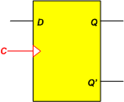
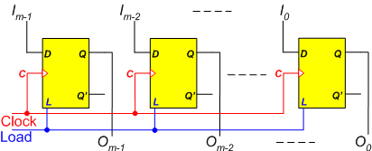
2. Memory Devices: Introduction
Storage element → Memory device for data storage
One flip flop stores a bit
A set of m flip flops make a register that stores m bits
m = 8: Byte, m = 16: Word,
m = 32: double words, m = 64: Quad words, etc.
Over the years, Processors have used larger and larger registers to process data: m = 4, 8, 16, 32, 64, 128 bits

Slide 35
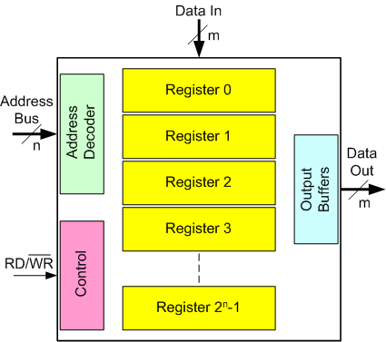
Memory Devices
A memory device consists of a set of registers (memory locations) that share a common set of input lines (input bus) and a common set of output lines (output bus)
With Read/Write memory devices we can store (write) into or read from any memory location
We select which location to access by specifying its address on the address bus
We select a specific memory chip and specify a READ or a WRITE operation using control signals (e.g. RD/WR) on the control bus
Time taken for the read data to appear at the device output after specifying the location address is access time (ns)
Chip
Select
A memory device that we can write
into and read from is a Read/Write
(RAM) device

Slide 36
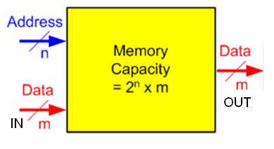
Capacity of a Memory Device
Storage Capacity: Number of storage locations x width of data in each location
With Address = n bits
Number of registers (storage locations) = 2^{n} locations
If each location is m-bit wide
then memory capacity is
2^{n} x m bits
Example: n = 10, m = 8
→ 2¹⁰ x 8 bits
→ 1K Bytes of storage
= 1 KB = 8 K bits
What is n, m for a 64 K locations,
each being 1 Byte?

Slide 37
Basic Types of Memory Devices
Two Basic Types:
Random Access Memory (RAM): Can be Read or written into
Read Only Memory (ROM): Can be read only. Writing requires programming

Slide 38
RAM Memory
The contents of a RAM can be accessed in random order
(so is ROM by the way- a misnomer!)
A better name is Read-Write memory: i.e. Can be read or written into
→ Has both input and output data lines
Time taken to transfer data to or from any register (storage location) is the same regardless of address
This is different from sequential storage e.g. on tape or disc
Data held in a RAM memory is volatile (not permanent) – Disappears when power is removed
Will not survive a power down → Use ROM for this purpose

Slide 39
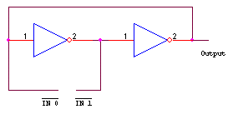
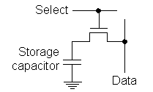
Two main types of RAM Memory
Static Memory (SRAM): Each bit is stored in a latch
→ Once data is written, it remains as long as power is ON
→ More costly, requires a larger number of transistors, lower storage capacity, faster access times
Dynamic memory (DRAM): Each bit is stored as a chage on a capacitor
→ The charge leaks, and data needs to be refreshed to prevent data loss (snag)
→ Simpler circuit, larger storage capacity, lower cost, slower access time
Write
Read

Slide 40
Overview
Unit 13
Programmable Logic
Memory Devices: RAM and ROM

