Slide 1
Sequential Circuit Analysis & Design
Dr. Aiman H. El-Maleh
Computer Engineering Department
King Fahd University of Petroleum & Minerals

Slide 2
Outline
Sequential Circuit Model
Timing of Sequential Circuits
Latches and Flip flops
Sequential Circuit Timing Constraints
Sequential Circuit Analysis
Sequential Circuit Design Procedure
Sequential Circuit Design Examples

Slide 3
Sequential Circuit Model
A Sequential circuit consists of:
Data Storage elements: (Latches / Flip-Flops)
Combinatorial Logic:
Implements a multiple-output function
Inputs are signals from the outside
Outputs are signals to the outside
State inputs (Internal): Present State from storage elements
State outputs, Next State are inputs to storage elements

Slide 4
Sequential Circuit Model
Combinatorial Logic
Next state function: Next State = f(Inputs, State)
2 output function types : Mealy & Moore
Output function: Mealy Circuits Outputs = g(Inputs, State)
Output function: Moore Circuits Outputs = h(State)
Output function type depends on specification and affects the design significantly

Slide 5
Sequential Circuit Model
Mealy Circuit
Moore Circuit

Slide 6
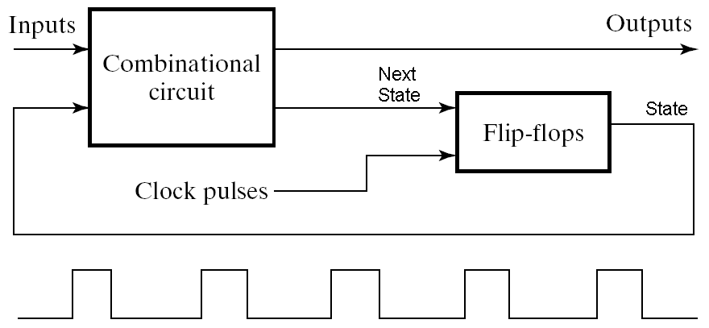
Timing of Sequential Circuits Two Approaches
Behavior depends on the times at which storage elements ‘see’ their inputs and change their outputs (next state → present state)
Asynchronous
Behavior defined from knowledge of inputs at any instant of time and the order in continuous time in which inputs change
Synchronous
Behavior defined from knowledge of signals at discrete instances of time
Storage elements see their inputs and change state only in relation to a timing signal (clock pulses from a clock)
The synchronous abstraction allows handling complex designs!

Slide 7
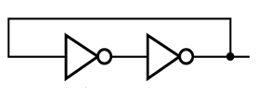
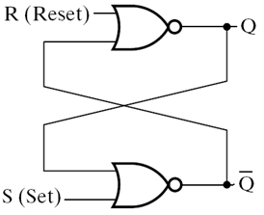
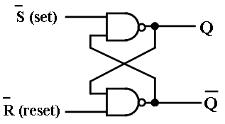
Data Storage Logic Structures
Feedback across Two inverting buffers Connected in series
Problem: No separate input to change data stored
Set-Reset Latch (SR-Latch)

Slide 8
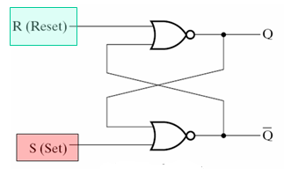
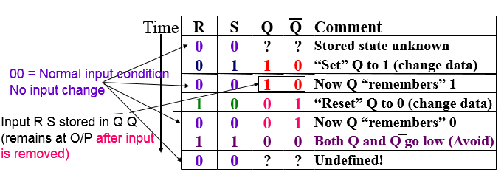
Basic NOR-NOR Set–Reset (SR) Latch
S = 1, R = 1 is a forbidden
input pattern

Slide 9
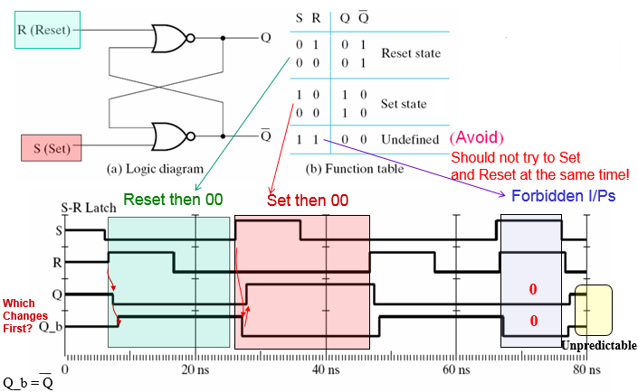
Basic NOR-NOR Set–Reset (SR) Latch

Slide 10
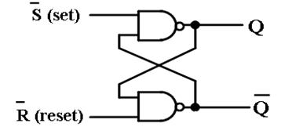
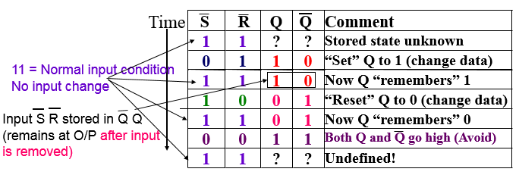
Basic NAND-NAND Set–Reset (SR) Latch
S = 1 (S’=0), R = 1 (R’=0) is a forbidden input pattern

Slide 11
Clocked SR Latch

Slide 12
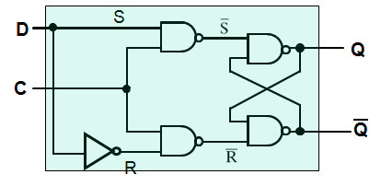
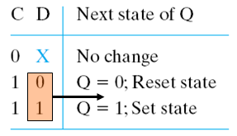
D Latch
D Latch
Now S R can not become 1 1
So we got rid of the remaining unwanted condition (SR =11 with C = 1)
This latch is transparent: with C = 1, Input D is ‘connected’ to output Q

Slide 13
The Transparent Latch as a Storage Element

Slide 14
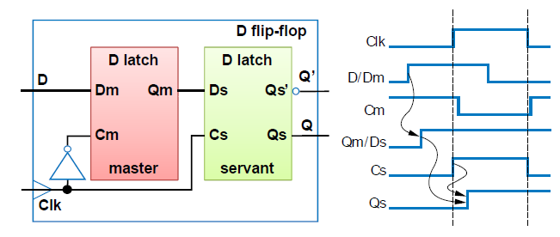
Master Slave D Flip Flop (Rising-Edge Trigerred)
When CLK=0, the master is activated and the value on D is copied to Qm. The slave is unactivated and keeps its previous value.
When CLK=1, the master is unactivated and its hold the last value stored at Qm while the slave is activated and copies the value of Qm.

Slide 15
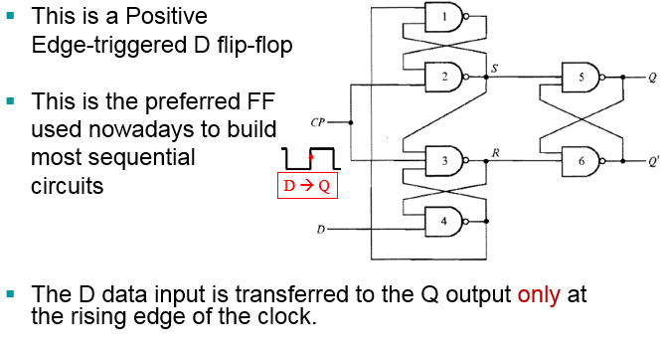
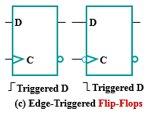
Another Rising Edge-Triggered D-type Flip-Flop

Slide 16
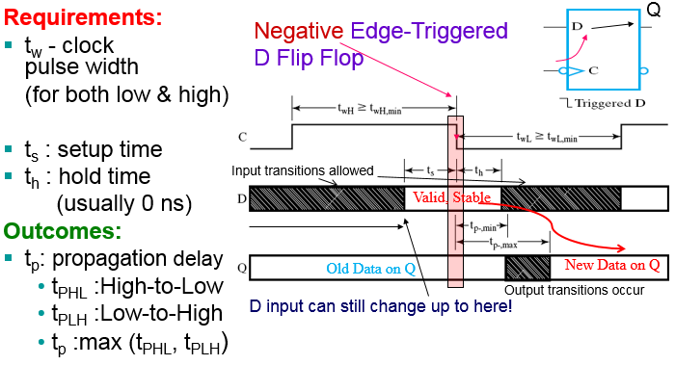
D Flip-Flop Timing Parameters

Slide 17
Sequential Circuit Timing Constraints
T_{D} = worst case delay through combinational logic
T_{SU} = FF set up time – Minimum time before the clock edge where the input data must be ready and stable
T_{clk→Q} = Clock to Q delay – Time between clock edge and data appearing at the output of the FF
T_{Hold} = FF hold time – Minimum time after the clock edge where data has to remain stable (held stable)
Based on the FF & combinational logic timing parameters, the following timing constraints are obtained for correct operation of the circuit: T_{clk} ≥ T_{clk→q1} + T_{D} + T_{su}

Slide 18
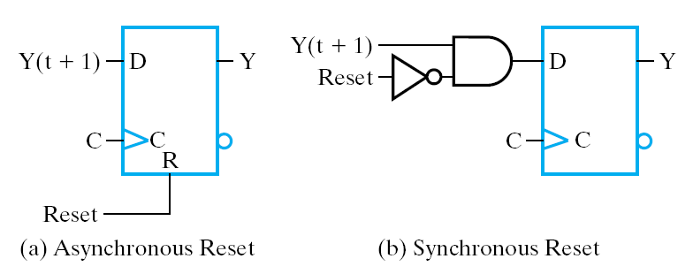
State Initialization
When a sequential circuit is turned on, the state of the flip flops is unknown (Q could be 1 or 0)
Before meaningful operation, we usually bring the circuit to an initial known state, e.g. by resetting all flip flops to 0’s
This is often done asynchronously through dedicated direct S/R inputs to the FFs
It can also be done synchronously by going through the clocked FF inputs

Slide 19
Sequential Circuit Analysis

Slide 20
Sequential Circuit Analysis
Given a sequential Circuit
Objective: Derive outputs & state behavior (outputs and next state) from (present states and inputs)
Two equivalent approaches to represent the results:
State table: A truth table-like approach
State diagram: A graphical, more intuitive way of representing the state table and expressing the sequential circuit operation

Slide 21
State Table Characteristics
State table – a multiple variable table with the following four sections:
→ CL Inputs:
Present State – the values of the state variables for each allowed state (FF outputs)
External Inputs
→ CL Outputs:
Next-state – the value of the state (FF outputs) at time (t+1) based on the present state and the inputs. Determined by FF inputs
Outputs – the value of the outputs as a function of the present state and (sometimes- Mealy) the inputs.

Slide 22
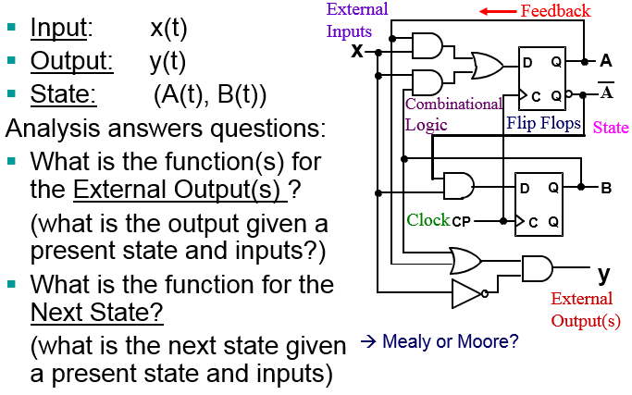
Sequential Circuit Analysis Example

Slide 23
Sequential Circuit Analysis Example

Slide 24
Sequential Circuit Analysis Example

Slide 25
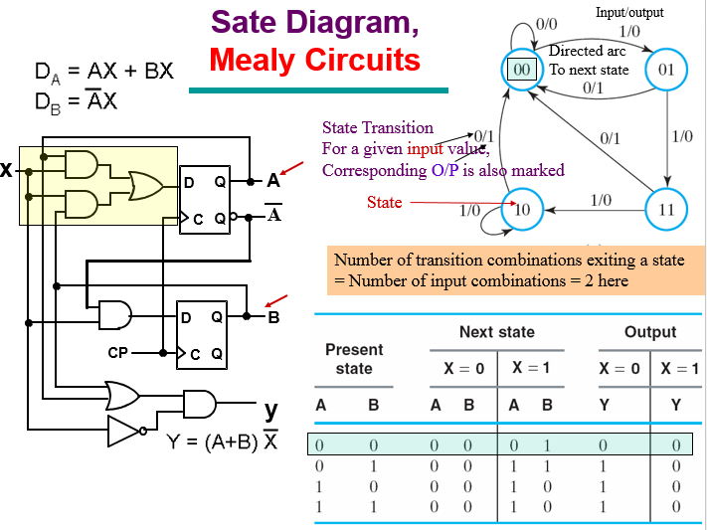
Sequential Circuit Analysis Example

Slide 26
Moore and Mealy Models

Slide 27
Moore Sequential Circuit Analysis Example

Slide 28
Sequential Circuit Design Procedure
1. Specification – e.g. Verbal description
2. Formulation – Interpret the specification to obtain a state diagram and a state table
3. State Assignment - Assign binary codes to symbolic states
4. Flip-Flop Input Equation Determination - Select flip-flop types and derive flip-flop input equations from next state entries in the state table
5. Output Equation Determination - Derive output equations from output entries in the state table
6. Verification - Verify correctness of final design

Slide 29
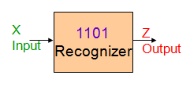
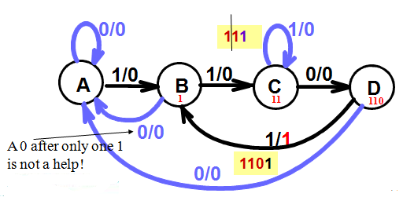
Example: Bit Sequence Recognizer 1101
1. Specifications: Detect the occurrence of bit sequence 1101 whenever it occurs on input X and indicate this detection by raising an output Z high
2. Formulation: State Diagram

Slide 30
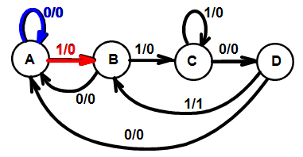
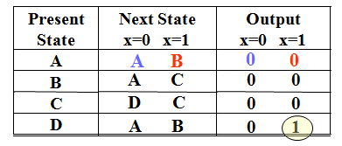
Example: Bit Sequence Recognizer 1101
From the State Diagram, we can fill in the 2-D State Table
There are 4 states, one input, and one output.
Two dimensional table with four rows, one for each current state.
State Diagram
State Table

Slide 31
Example: Bit Sequence Recognizer 1101
3. State Assignment: From abstract symbols to binary bit representation of states
Each of the m symbolic states must be assigned a unique binary code
Minimum number of state bits (state variables) (FFs) required is n_{b}, such that 2^{nb} ≥ n_{s}
If 2^{nb} > n_{s}, this leaves (2^{nb} – n_{s}) unused states
Utilize them as don’t care conditions to simplify CL design
But may need caution: e.g. what if the circuit enters an unused state by mistake
n_{b}= ⎡log₂ n_{s}⎤.

Slide 32
Example: Bit Sequence Recognizer 1101
Also which code is given to which state? → different CL implementations → may influence optimization, e.g. (with 2 FFs) State A is assigned 00 or 01 or 10 or 11?
There are possible encodings = 16
Let A = 00 (to suit being a Reset state), B = 01, C = 11, D = 10

Slide 33
Example: Bit Sequence Recognizer 1101
For optimization of FF input equations we express A(t+1), B(t+1), Z(t) in terms of A(t), B(t) and X(t) (using one dimensional state table)

Slide 34
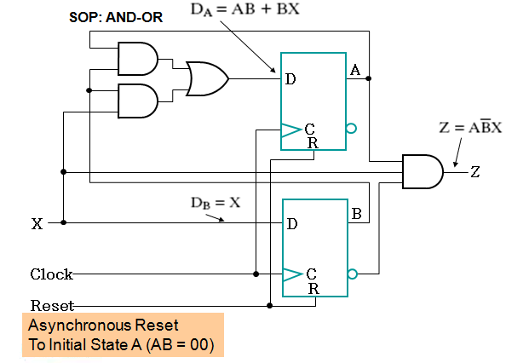
Example: Bit Sequence Recognizer 1101

Slide 35
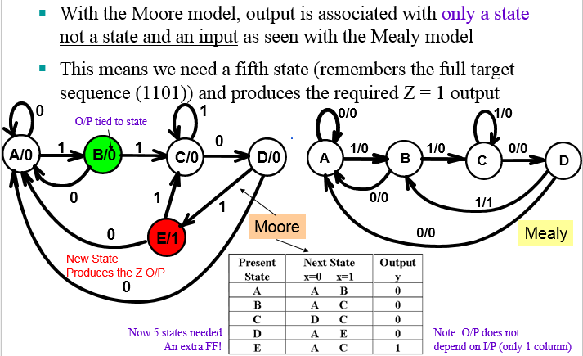
State Diagram (Moore Model)

Slide 36
Sequential Circuit Design: Serial Comparator
It is required to design a sequential circuit that compares two n-bit numbers A=A_{n-1}A₂A₁A₀ and B=B_{n-1}B₂B₁B₀, applied to the sequential circuit serially from the least significant bits to the most significant bits.
The circuit produces two outputs GT and LT.
If A>B, then output signal GT is set to 1 and LT is set to 0.
If A<B, then output signal LT is set to 1, and GT is set to 0.
Otherwise, both signals will be set to 0, which indicates that the two numbers are equal (i.e. A=B).

Slide 37
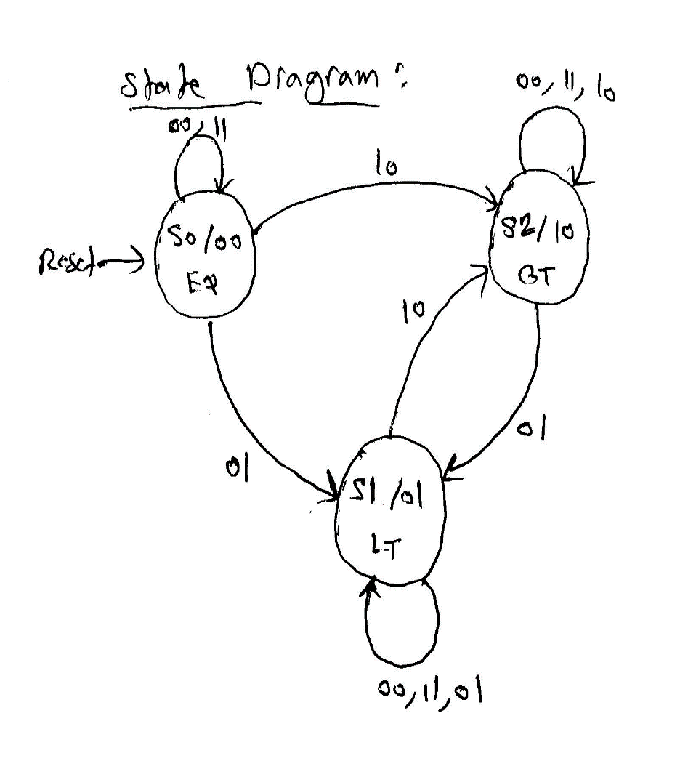
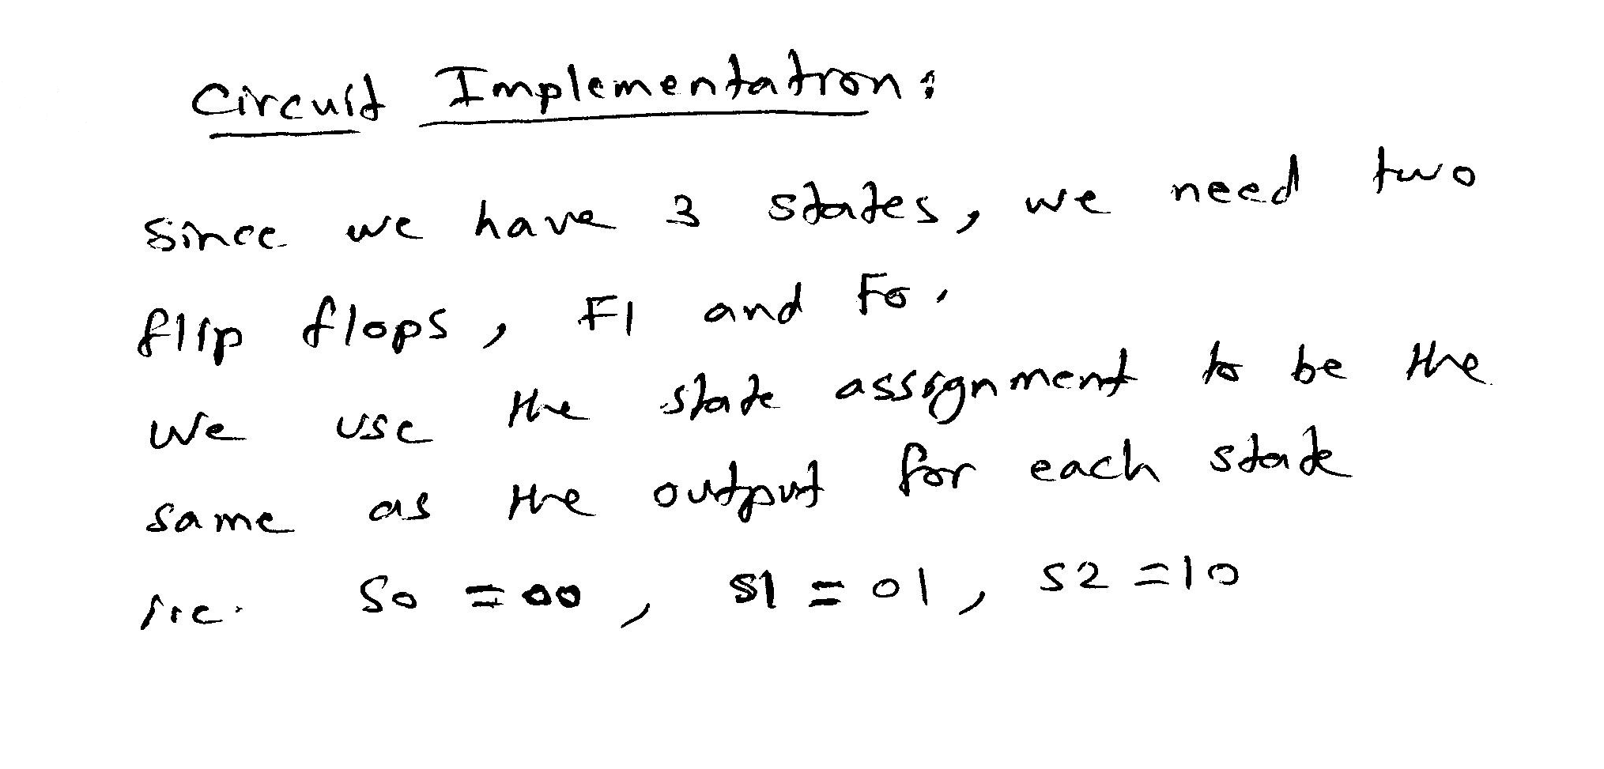
Sequential Circuit Design: Serial Comparator

Slide 38
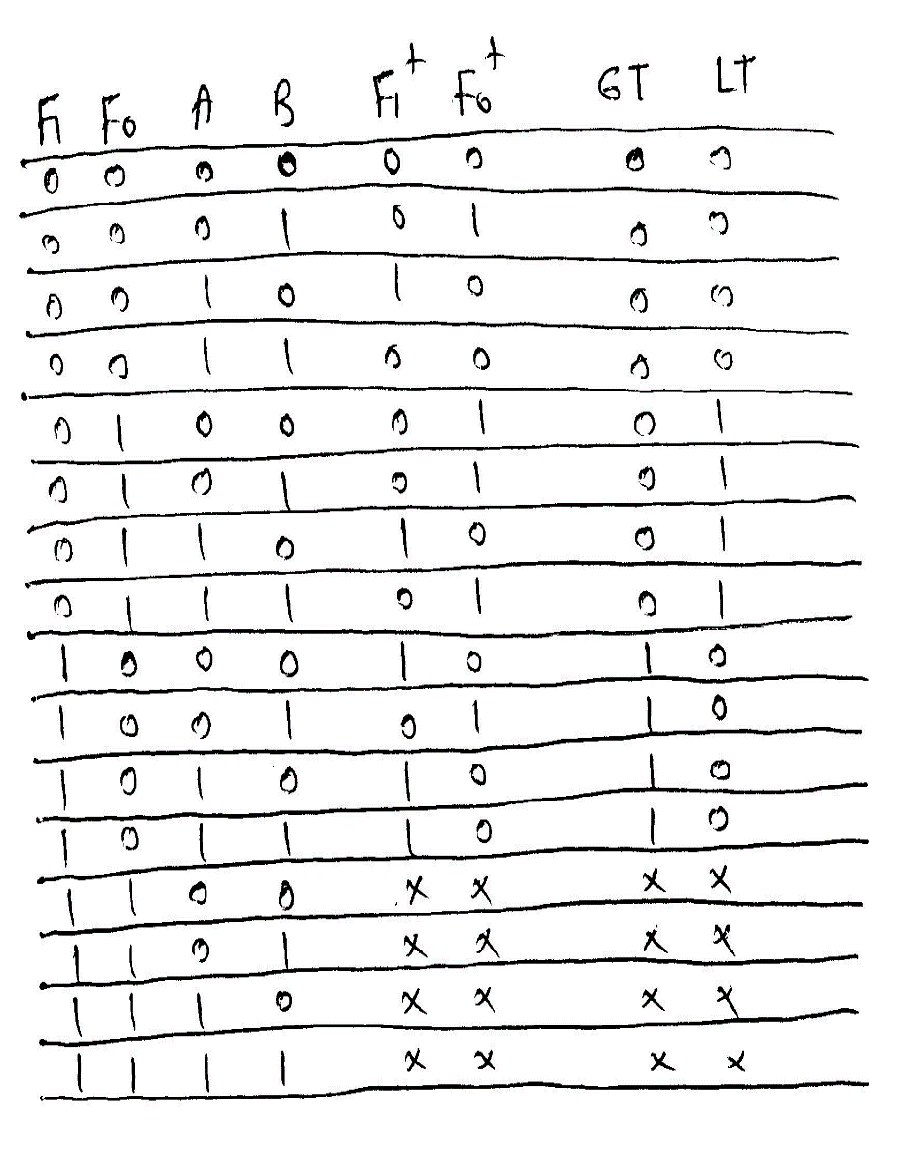
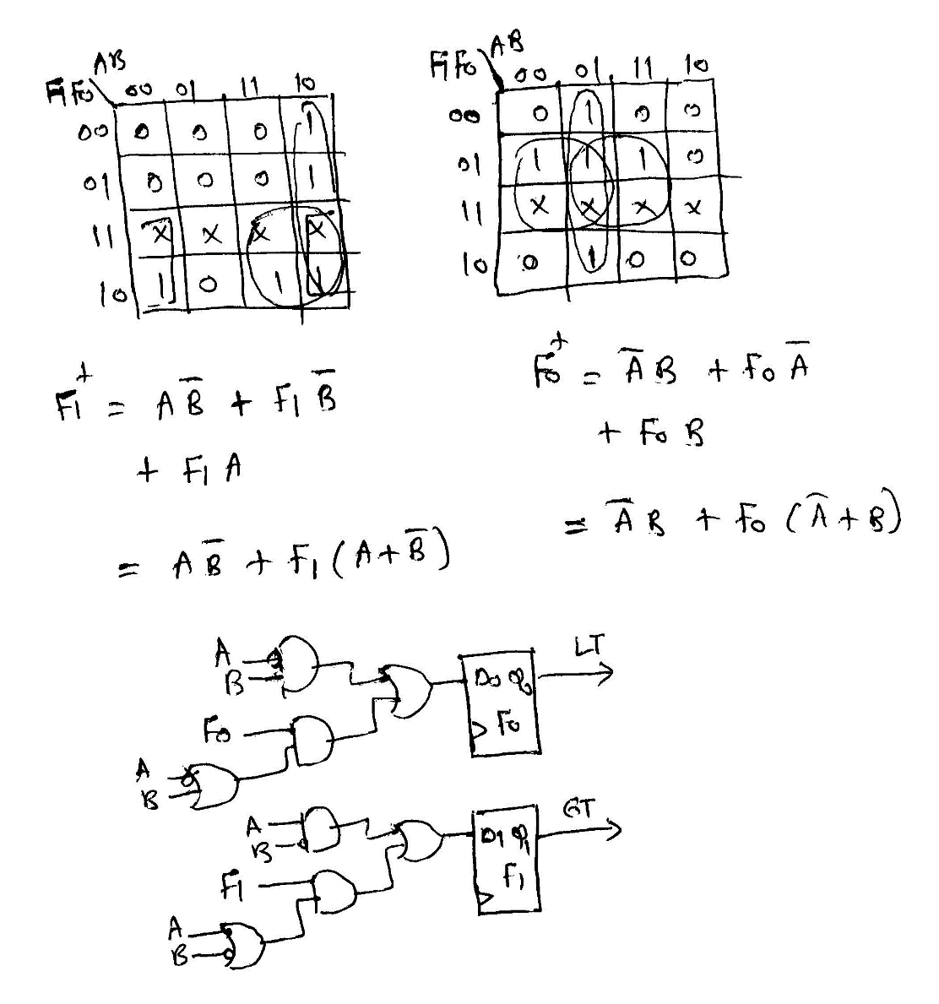
Sequential Circuit Design: Serial Comparator

Slide 39
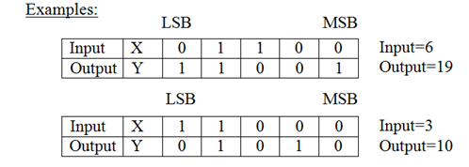
Sequential Circuit Design: Y = 3*x + 1
It is required to design a sequential circuit that has a single input X and a single output Y.
The circuit receives an unsigned number serially through the input X from the least significant bit (LSB) to the most significant bit (MSB), and computes the equation Y=3*X+1 and generates the output serially from the least significant bit to the most significant bit.

Slide 40
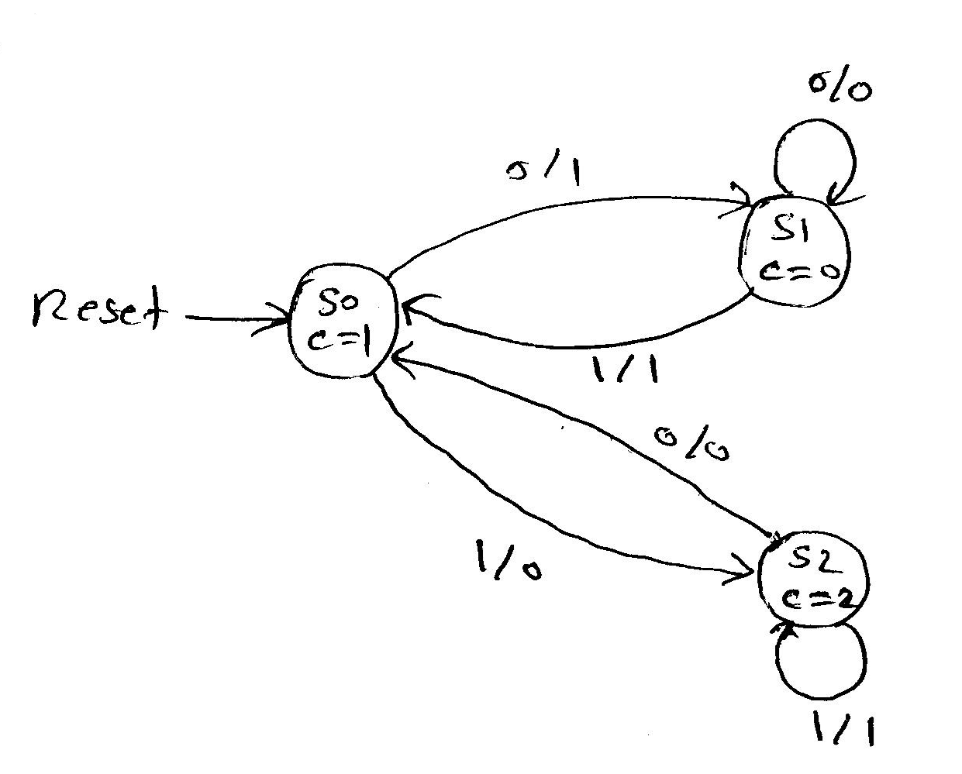
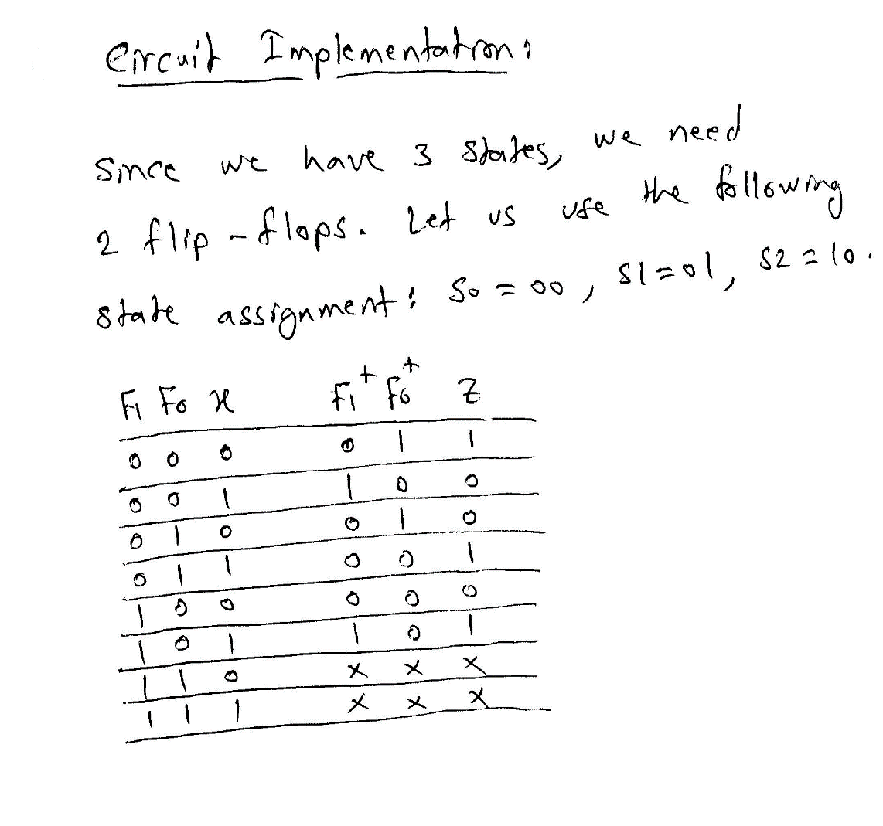
Sequential Circuit Design: Y = 3*x + 1
State Diagram

Slide 41
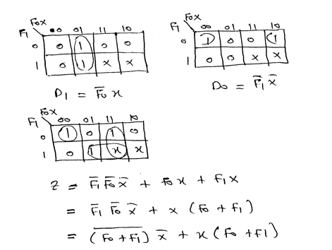
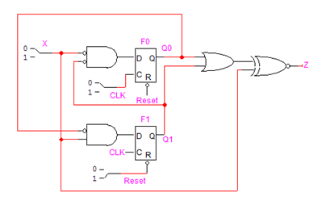
Sequential Circuit Design: Y = 3*x + 1

Slide 42
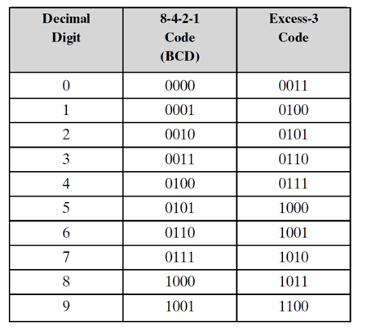
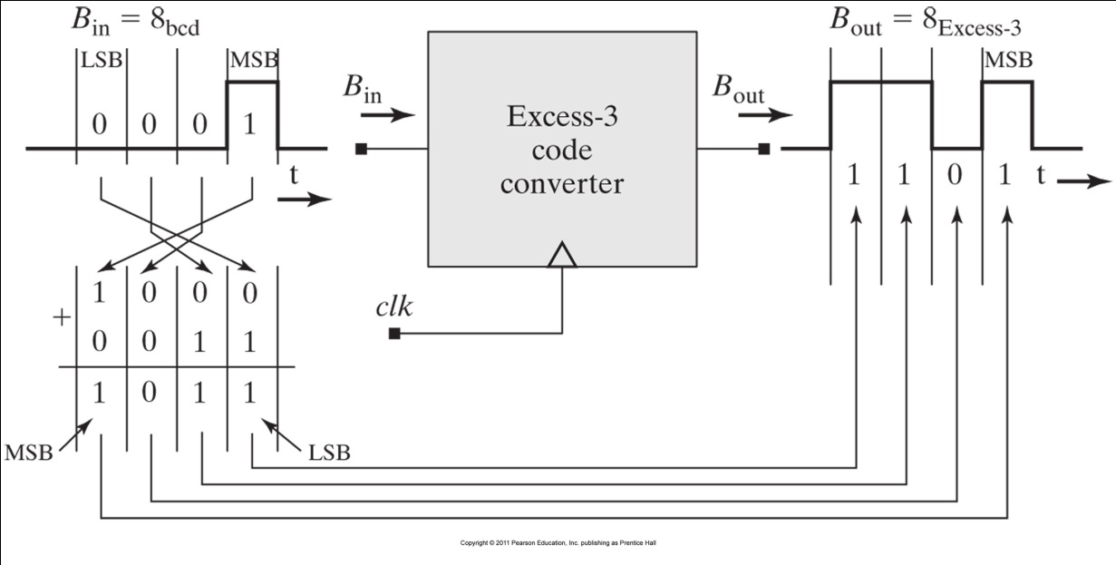
BCD to Excess-3 Serial Code Converter
Assume that once the machine is reset, a continues stream of BCD digits will be transmitted serially and converted to Excess-3 digits.

Slide 43
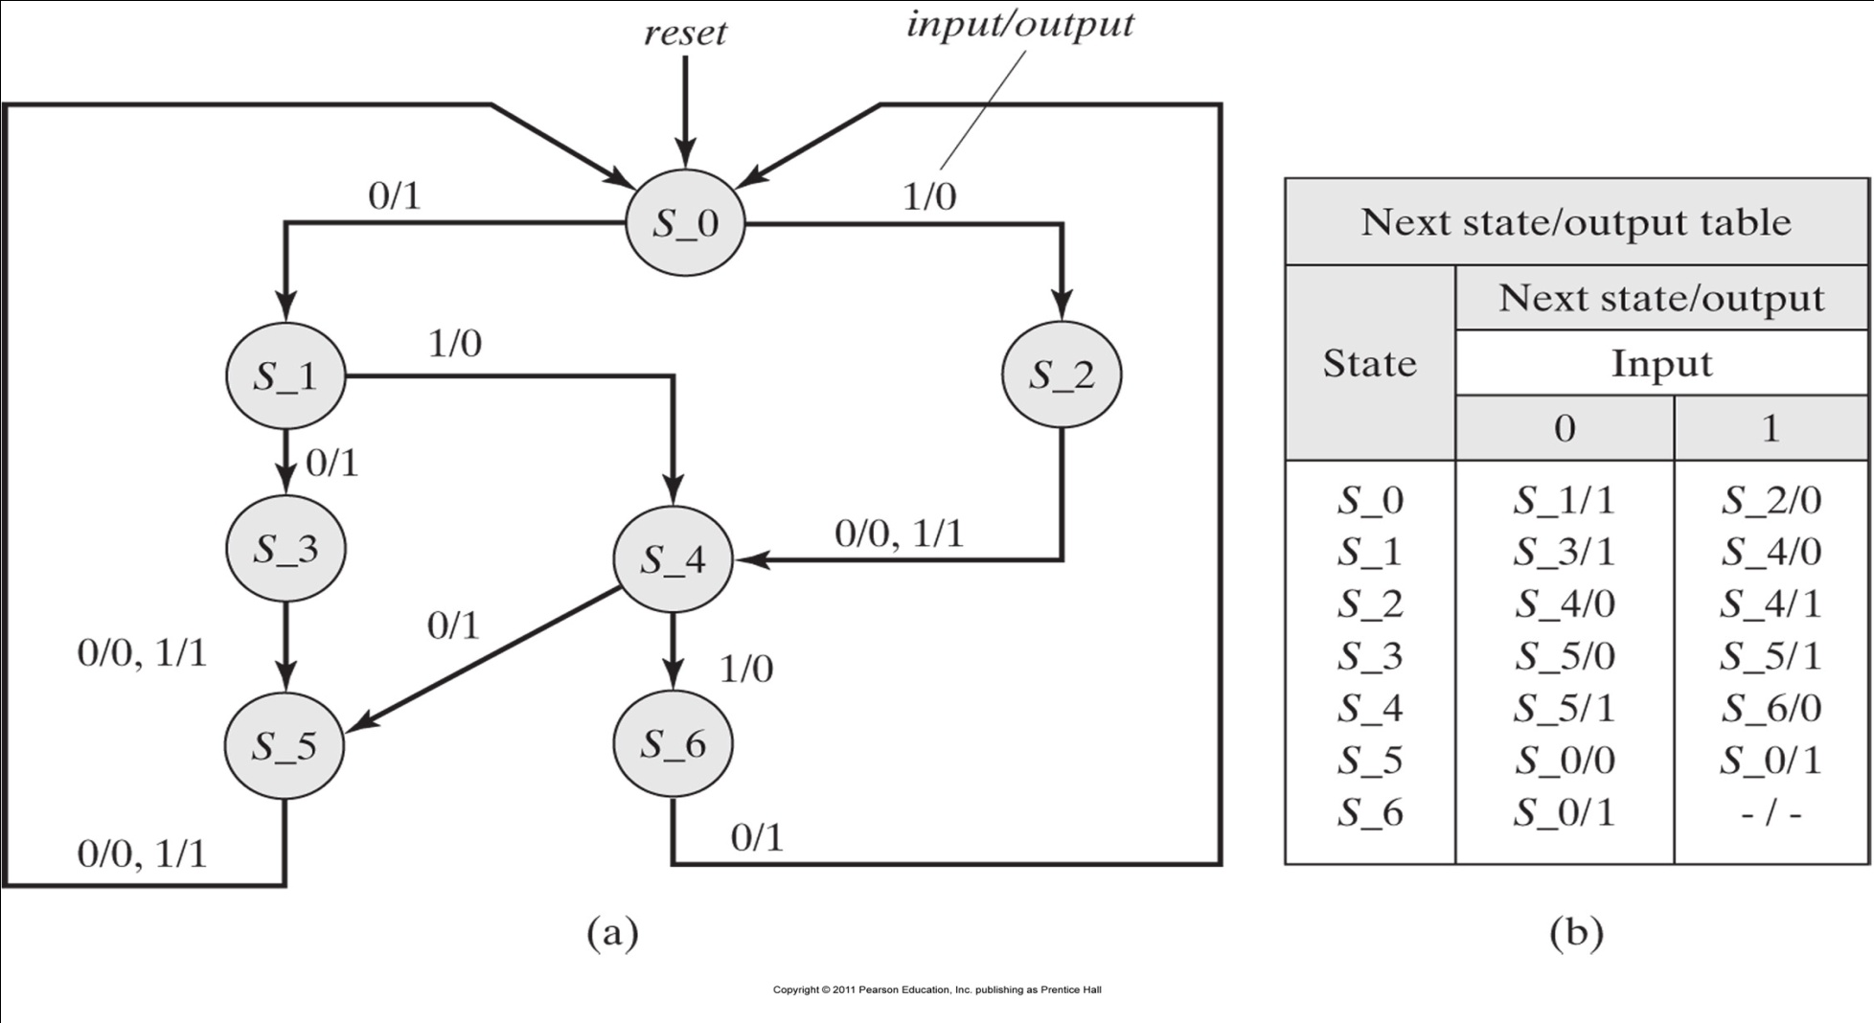
BCD to Excess-3 Serial Code Converter
State Diagram
State Table

Slide 44
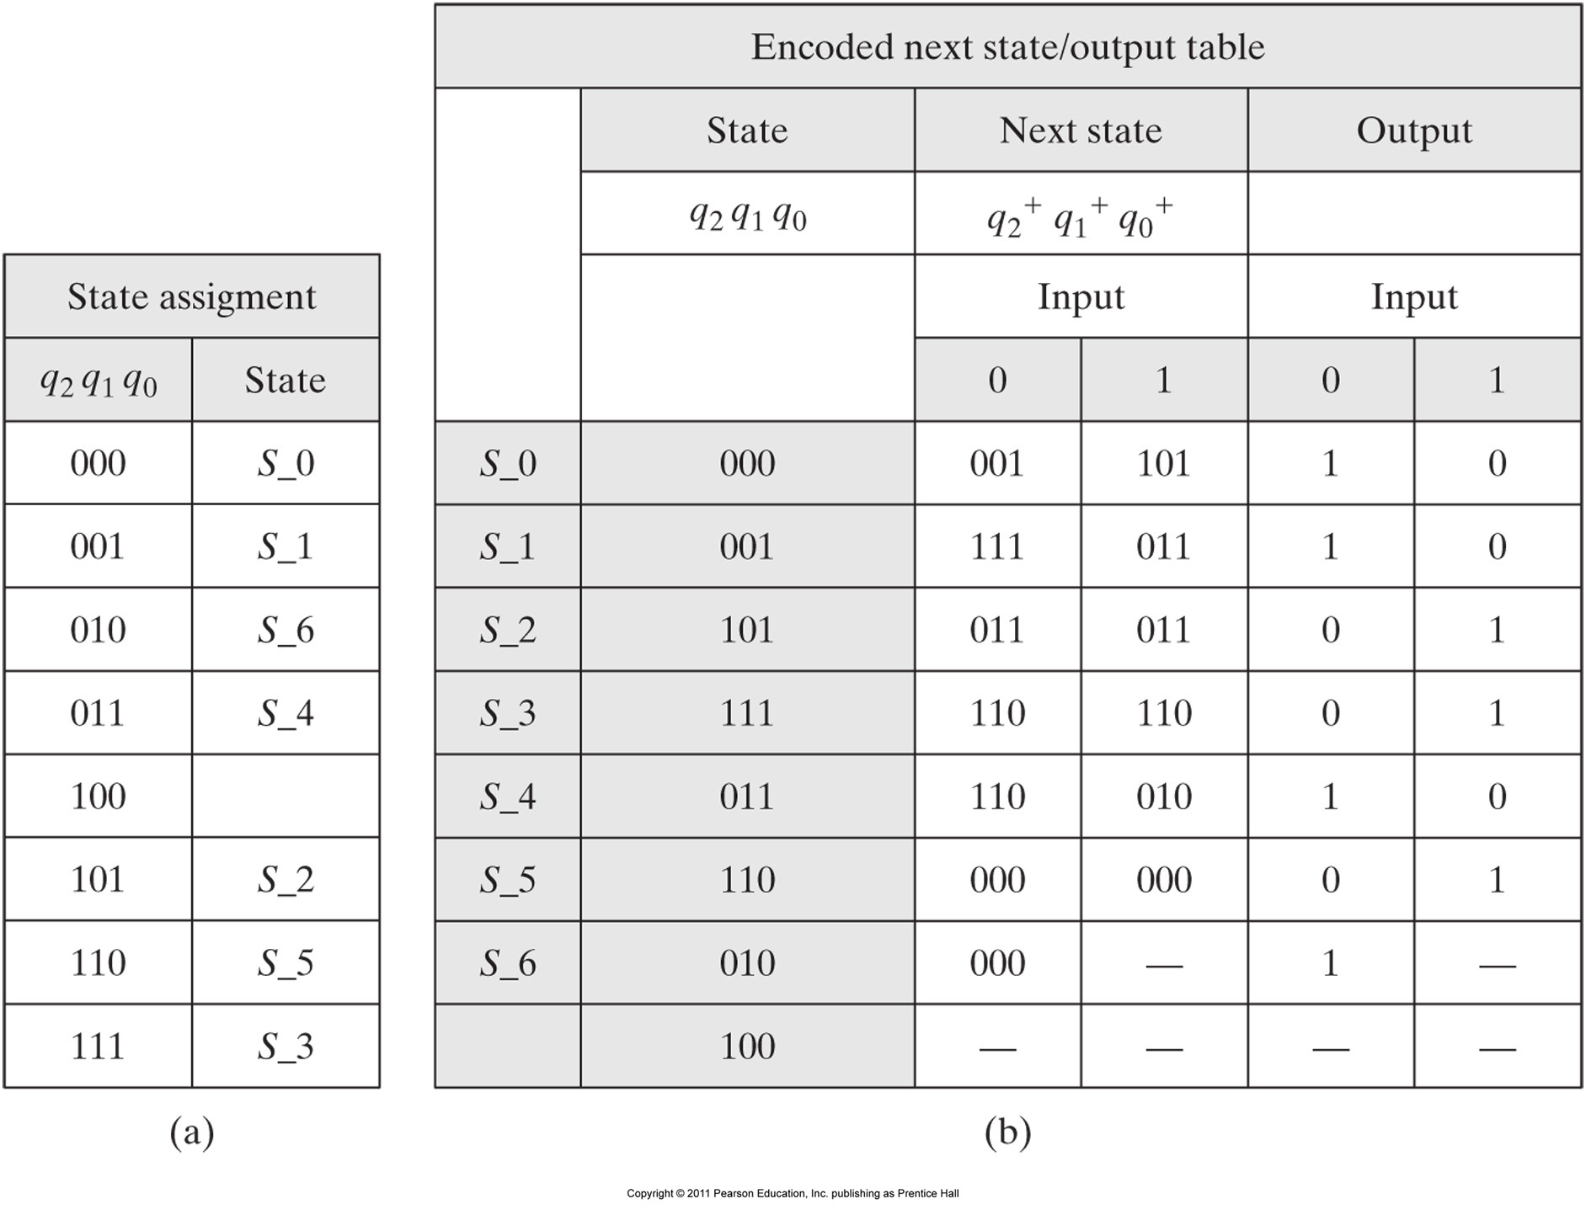
BCD to Excess-3 Serial Code Converter

Slide 45
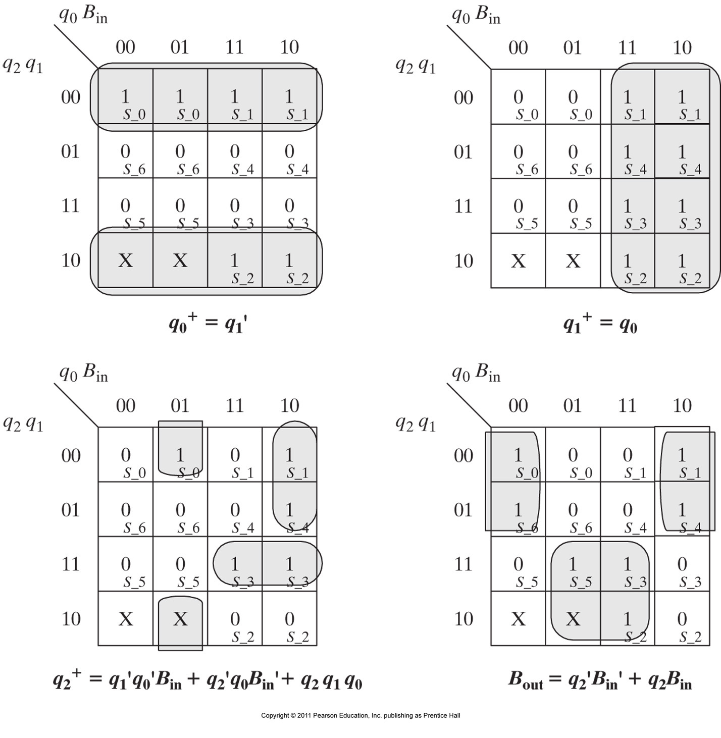
BCD to Excess-3 Serial Code Converter
Karnaugh maps for the encoded state bits and output bit (B_{out})

Slide 46
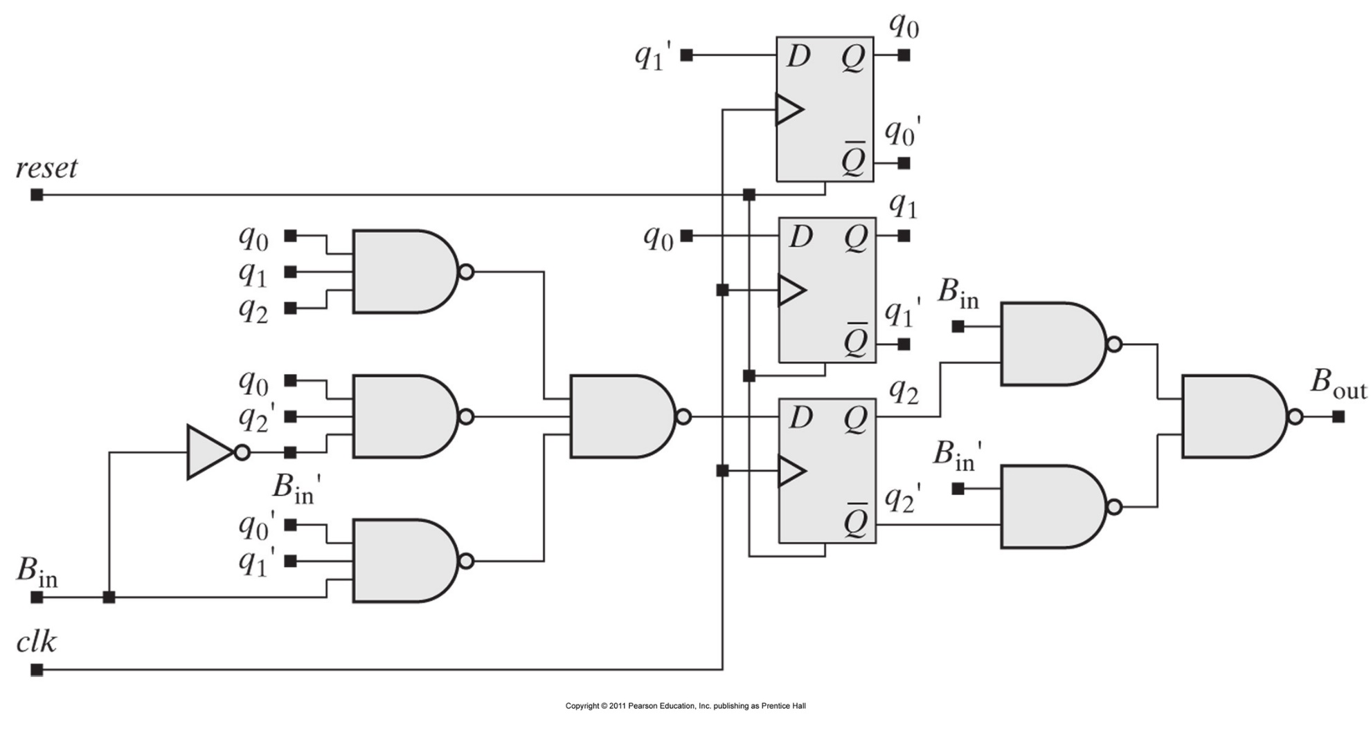
BCD to Excess-3 Serial Code Converter

