Slide 1
Functions and Functional Blocks
COE 202
Digital Logic Design
Dr. Aiman El-Maleh
College of Computer Sciences and Engineering
King Fahd University of Petroleum and Minerals

Slide 2
Outline
Enabling function
Decoders
Implementing Functions using Decoders
Encoders
Multiplexers
Implementing Functions using Multiplexers
DeMultiplexers
Design Examples using MSI Functional Blocks

Slide 3
Functions and Functional Blocks
Will consider functions that are useful in designing other combinational and sequential circuits
Such circuits can be implemented using a set of functional blocks
In the past, many functional blocks were implemented as separate SSI (small scale integration), MSI, and LSI integrated circuits (ICs)
Today, they are often used as parts in a design library for use within larger VLSI circuits
10s 100s 1000s millions gates/chip
SS → MS → LS → VLS
(Small Scale) (Medium Scale) (Large Scale) (Very Large Scale)

Slide 4
Enabling Function
Enable: Allow an input signal to pass through to an output
Disable: block an input signal from passing through to an output, replacing it with a fixed state (1, 0, or HiZ)
Disable: EN = 0 in both cases
When disabled, output = 0
When disabled, output = 1

Slide 5
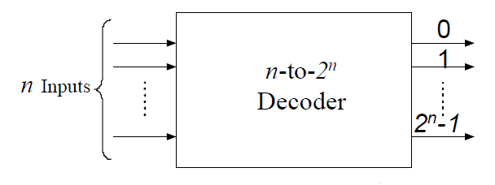
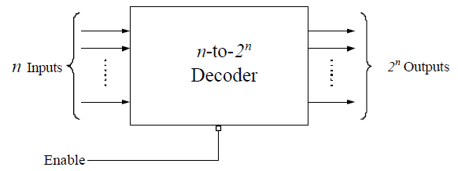
Decoders
A decoder is a circuit that decodes an input code. Given a binary code of n-bits, a decoder will tell which code is this out of the 2^{n} possible codes.
A decoder may have enable line
  In general, output i equals 1 if and only if the input binary code has a value of i.
  Thus, each output line equals 1 at only one input combination but is equal to 0 at all other combinations.
  Thus, the decoder generates all of the 2^{n} minterms of n input variables.

Slide 6
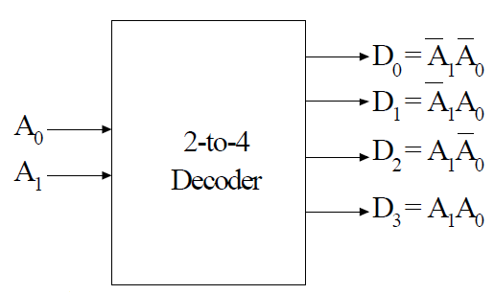
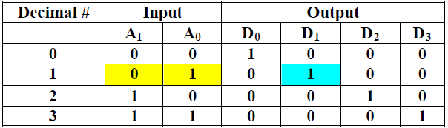
2-to-4 Decoder
A 2-to-4 decoder contains two inputs denoted by A1 and A0 and four outputs denoted by D0, D1, D2, and D3.
For each input combination, one output line is activated, that is, the output line corresponding to the input combination becomes 1, while other lines remain inactive.
For example, an input of 00 at the input will activate line D0. 01 at the input will activate line D1, and so on.

Slide 7
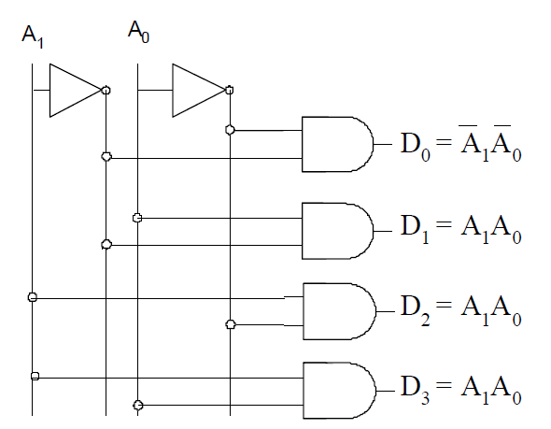
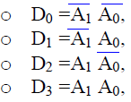
2-to-4 Decoder
Notice that, each output of the decoder is actually a minterm resulting from a certain combination of the inputs, that is:
( minterm m₀)
( minterm m₁)
( minterm m₂)
( minterm m₃)

Slide 8
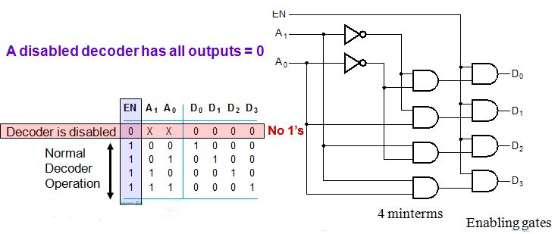
2-to-4 Decoder with Enable
Attach m output-enabling gates opened by the EN input
  Note use of X’s to denote both 0 and 1 at the inputs
  Combination containing two X’s represent four input binary combinations

Slide 9
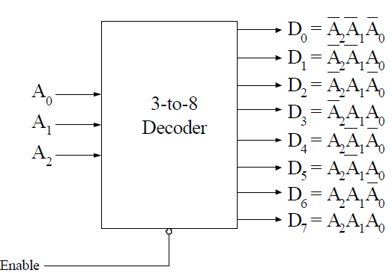
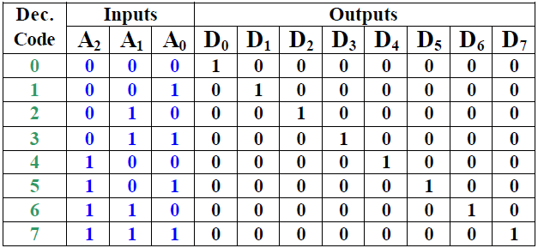
3-to-8 Decoder
In a three to eight decoder, there are three inputs and eight outputs, A0 is the least significant variable, while A2 is the most significant variable.
Each output represents one minterm
  For example, for input combination A2A1A0 = 001, output line D1 equals 1 while all other output lines equal 0’s
  It should be noted that at any given instance of time, one and only one output line can be activated.

Slide 10
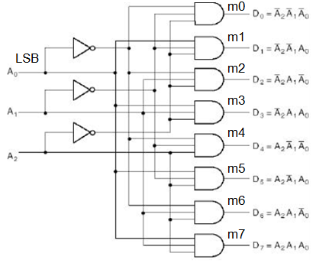
3-to-8 Decoder Implementation
Notice that each output line
is the minterm corresponding to
the input code, i.e. D₅ is m₅

Slide 11
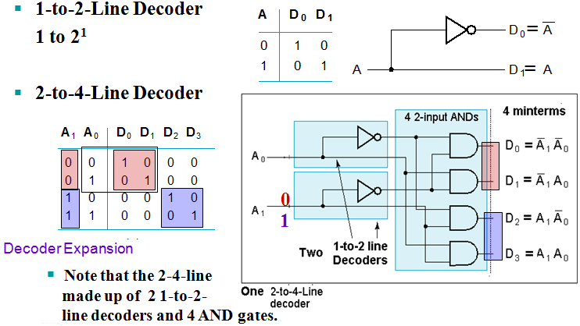
Hierarchical 2-to-4 Decoder Design

Slide 12
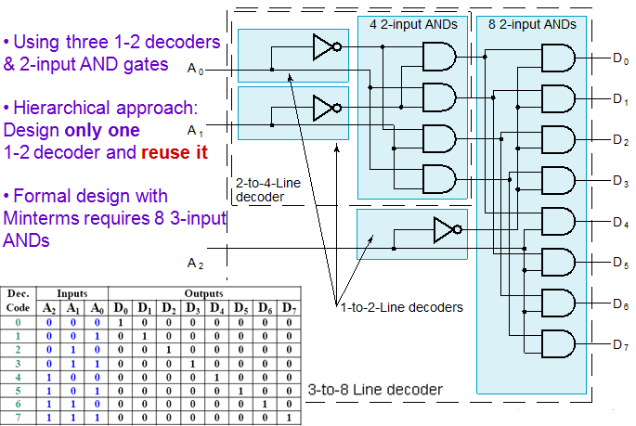
Hierarchical 3-to-8 Decoder Design

Slide 13
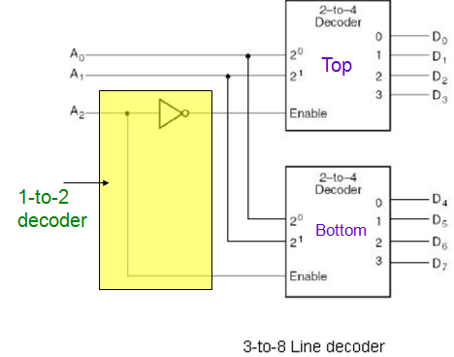
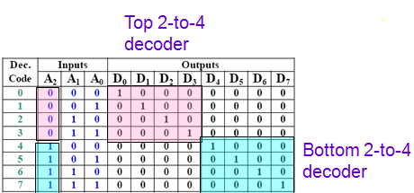
Decoder Expansion
Example: 3-to-8 from two 2-to-4 with EN
  Using two 2-to-4 decoders
  & one 1-to-2 decoder

Slide 14
Implementing Functions using Decoders
Implementing functions of n inputs and m requires:
  Specification:
  → As a Truth Table (has n input columns and m output columns) or m sum of minterms (SOm) expressions
  Implementation requires:
  → One n-to-2^{n}-line decoder
  → m OR gates, one for each output
  Procedure:
  → From the truth table: For each ‘1’ in the truth table of an output, connect the corresponding D_{i} of the decoder to the OR of that output
  → From the m minterm expressions: Connect the decoder D_{i}’s corresponding to the minterms of each output to the OR of that output

Slide 15
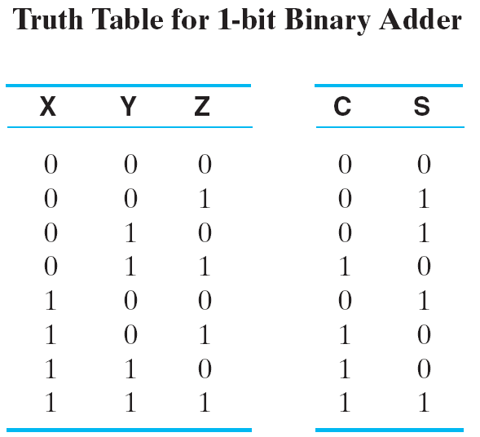

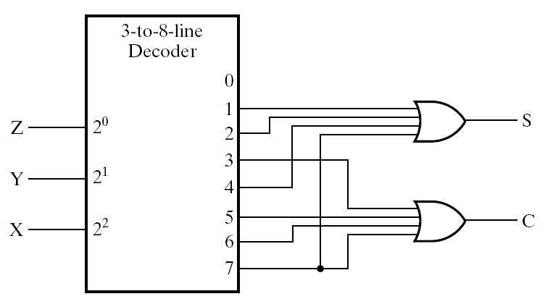
Implementing Functions using Decoders
Example:1-bit adder (Full Adder)
We need:
2 SOm expressions
3-to-2³ Decoder
2 OR gates of appropriate # of inputs
Larger # of 1’s require larger ORs. If so, Consider expressing F and using a NOR instead!
LSB

Slide 16
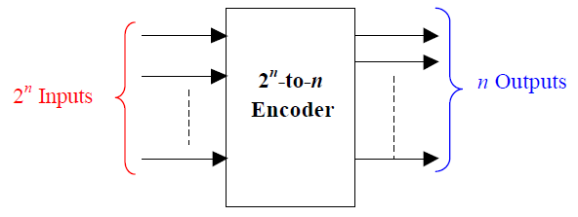
Encoders
An encoder performs the inverse operation of a decoder.
It has 2^{n} inputs, and n output lines.
Only one input can be logic 1 at any given time (active input). All other inputs must be 0’s.
Output lines generate the binary code corresponding to the active input.

Slide 17
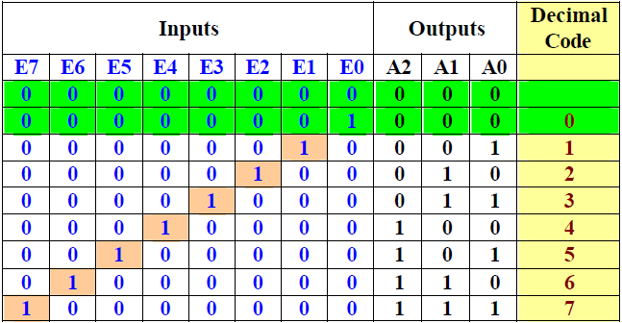
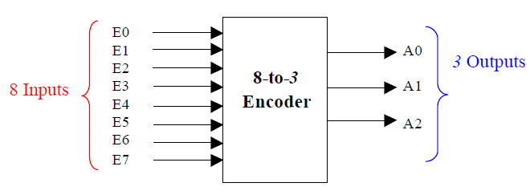
Octal-to-Binary Encoder
Assuming
only 1 (and at least 1)
Input line being
active at a time
Only 8 rows are
relevant, out of the 2^8 = 256 rows

Slide 18
Octal-to-Binary Encoder
Note that not all input combinations are valid.
Valid combinations are those which have exactly one input equal to logic 1 while all other inputs are logic 0’s.
Since, the number of inputs = 8, K-maps cannot be used to derive the output Boolean expressions. The encoder implementation, however, can be directly derived from the truth table:
  Since A0 = 1 if the input octal digit is 1 or 3 or 5 or 7, then we can write: A0 = E1 + E3 + E5+ E7
  Likewise, A1 = E2 + E3 + E6+ E7, and similarly
  A2 = E4 + E5 + E6+ E7
  Thus, the encoder can be implemented using three 4- input OR gates.

Slide 19
Major Limitation of Encoders
Exactly one input must be active at any given time.
If the number of active inputs is less than one or more than one, the output will be incorrect.
For example, if E₃ = E₆ = 1, the output of the encoder A₂A₁A₀ = 111, which implies incorrect output.
Two Problems to Resolve:
  1. If two or more inputs are active at the same time, what should the output be?
  2. An output of all 0's is generated in 2 cases:
    when all inputs are 0
    when E0 is equal to 1.
    How can this ambiguity be resolved?

Slide 20
Major Limitation of Encoders
Solution To Problem 1:
  Use a Priority Encoder which produces the output corresponding to the input with higher priority.
  Inputs are assigned priorities according to their subscript value; e.g. higher subscript inputs are assigned higher priority.
  In the previous example, if E₃ = E₆ = 1, the output corresponding to E₆ will be produced (A₂A₁A₀ = 110) since E₆ has higher priority than E₃.
Solution To Problem 2:
  Provide one more output signal V to indicate validity of input data.
  V = 0 if none of the inputs equals 1, otherwise it is 1

Slide 21
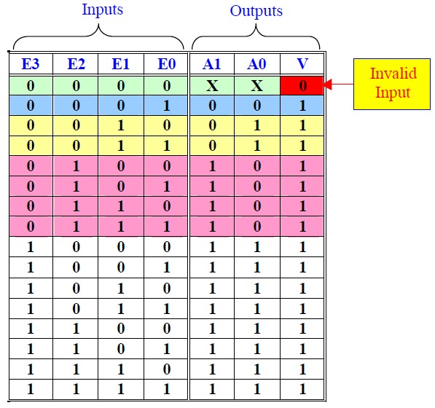
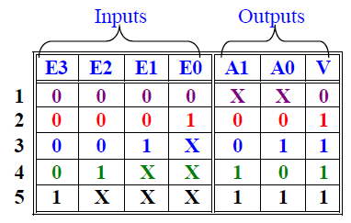
4-to-2 Priority Encoders
Sixteen input combinations.
Three output variables A1, A0, and V.
V is needed to take care of situation when all inputs are equal to zero.

Slide 22
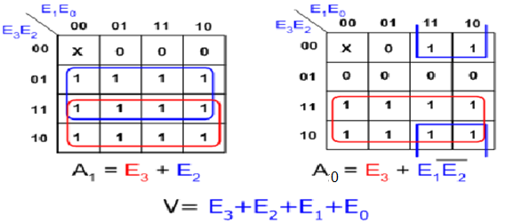
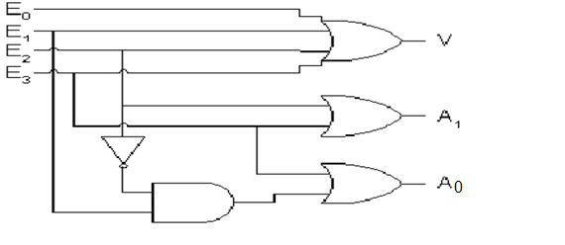
4-to-2 Priority Encoders

Slide 23
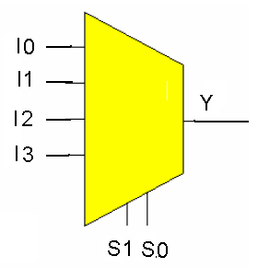
Multiplexers: 2^{n}-to-1
A multiplexer (MUX) selects information from one of 2^{n} input line and directs it toward a single output line.
A typical multiplexer has:
  2^{n} information inputs (I₍₂^{n} _{– 1)}, … I₀) (to select from)
  1 Output Y (to select to)
  n select control (address) inputs (S_{n - 1}, … S₀) (to select with)
Implemented using decoders
MUX selection circuits can be duplicated m times (with the same selection controls in parallel) to provide m-wide data widths

Slide 24
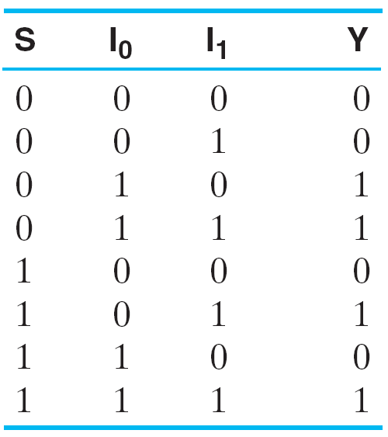

2-to-1 MUX
The single selection variable S
has two values:
  S = 0 selects input I₀
  S = 1 selects input I₁
3-input K-map optimization gives
the output equation:
The circuit:
Can be seen As:
1-to-2 decoder
+ Enabling
+ Selection
Truth Table
2^{n} Minterms
2^{n} I Inputs

Slide 25
4-to-1 MUX
Using 2-to-4 decoder +4 2-input AND + 4-input OR for Enabling/Selection
# of the
ANDs
2-to-4
Size of the Select
Inputs = Log₂ (4)
X

Slide 26
4-to-1 MUX
A 4-to-1 MUX can be implemented using three 2-to-1 MUXs.
F = s₁’s₀’ I₀ + s₁’s₀ I₁ + s₁s₀’ I₂ + s₁s₀ I₃
= s₁’ (s₀’ I₀ + s₀ I₁)+ s₁ (s₀’ I₂ + s₀ I₃)
I₀
2x1
MUX
I₁
2x1
MUX
S₀
F
I₂
2x1
MUX
I₃
S₁
S₀

Slide 27
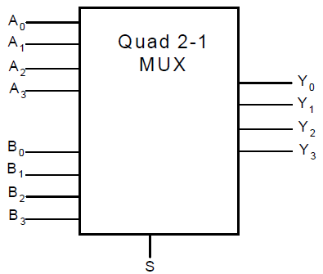
Quad 2-to-1 MUX
Given two 4-bit numbers A and B, design a multiplexer that selects one of these 2 numbers based on some select signal S. Obviously, the output (Y) is a 4-bit number.
The 4-bit output number Y is defined as follows:
  Y = A IF S=0, otherwise Y = B
The circuit is implemented using four 2x1 Muxes, where the output of each of the Muxes gives one of the outputs (Y_{i}).

Slide 28
Quad 2-to-1 MUX
A₀
2x1
MUX
Y₀
B₀
S
A₁
2x1
MUX
Y₁
B₁
S
A₂
2x1
MUX
Y₂
B₂
S
A₃
2x1
MUX
Y₃
B₃
S

Slide 29
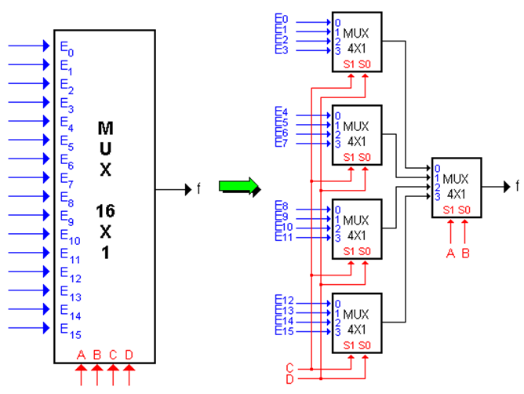
16-to-1 MUX

Slide 30
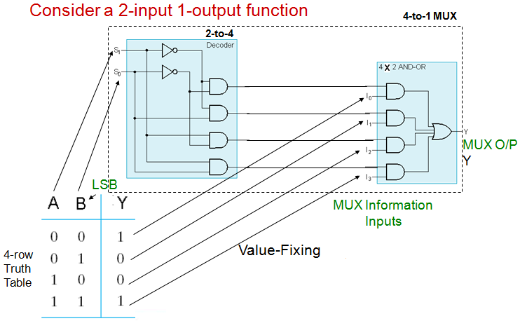
Implementing Functions using Multiplexers

Slide 31
Implementing Functions using Multiplexers
Implementing a function of n inputs and m outputs (n to m) requires:
  Truth table, or m Sum-of-minterms expressions
  m-wide 2^{n}-to-1 multiplexer
Design:
  In the order they appear in the truth table:
    Apply the function inputs to the multiplexer select inputs S_{n -1}, … , S₀
    Label the outputs of the multiplexer with the output variables
  Value-fix the information inputs to the multiplexer using the values from the truth table. For don’t cares, use either 0 or 1.

Slide 32
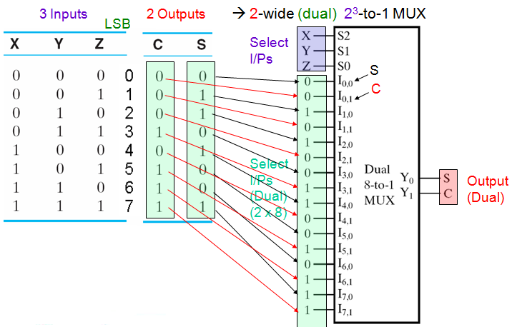
Implementing Functions using Multiplexers
Example: 1-bit adder

Slide 33
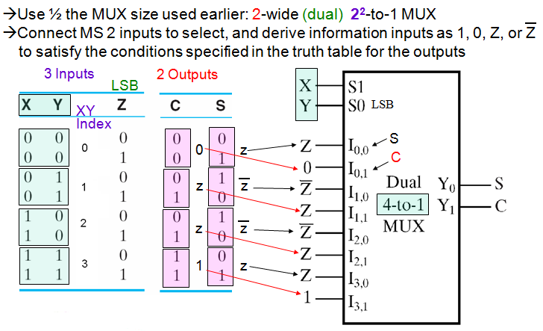
Implementing Functions using Multiplexers
Example: 1-bit adder, a more efficient approach

Slide 34
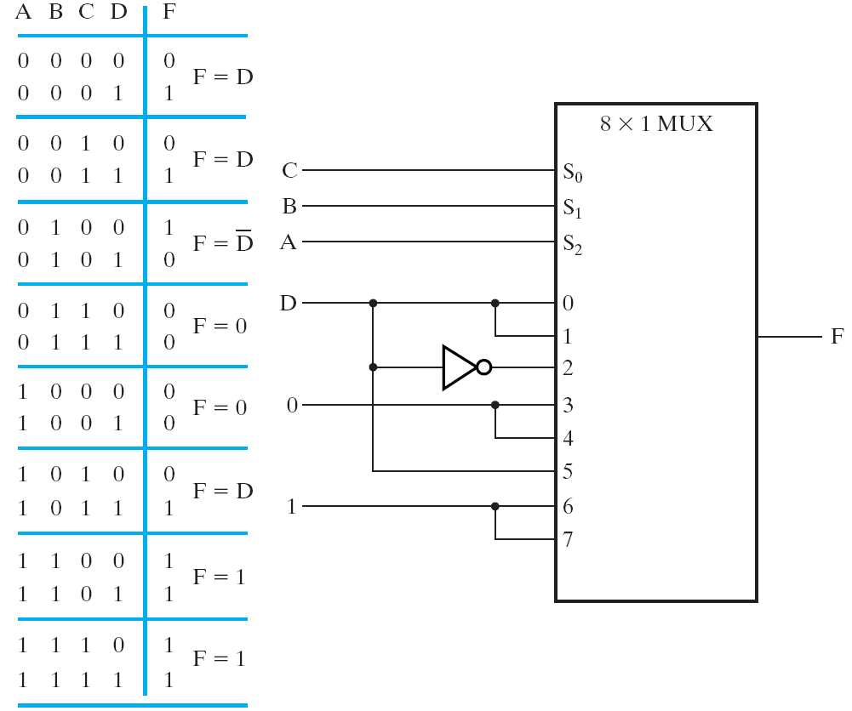
Implementing Functions using Multiplexers
Example: F (A,B,C,D) = Σm(1,3,4,11,12,13,14,15)
16 rows in truth table
→ 16-to-1 MUX
(conventional
approach)
But using the efficient
approach … will use
only an 8-to-1 MUX
+ 1 inverter

Slide 35
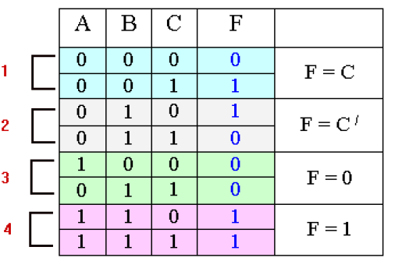
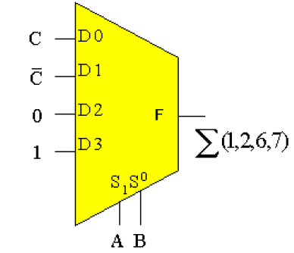
Implementing Functions using Multiplexers
Example: F (A,B,C,D) = Σm(1,2,6,7)

Slide 36
Shannon's Expansion
The cofactor of f(x₁,x₂,…,x_{i},…,x_{n}) with respect to variable x_{i} is f_{xi} = f(x₁,x₂,…,x_{i}=1,…,x_{n})
The cofactor of f(x₁,x₂,…,x_{i},…,x_{n}) with respect to variable x_{i}’ is f_{xi’} = f(x₁,x₂,…,x_{i}=0,…,x_{n})
Theorem: Shannon's Expansion
Any function can be expressed as sum of products (product of sums) of n literals, minterms (maxterms), by recursive expansion.

Slide 37
Shannon's Expansion
Example: f = ab + ac + bc
  f_{a} = b + c
  f_{a’} = bc
  F = a f_{a} + a’ f_{a’} = a (b + c) + a’ (bc)
Using Shanon’s Expansion we can implement any function using any sizes of multiplexers
2x1 MUX: f = a [ b (1) + b’ (c) ] + a’ [ b (c) + b’ (0) ]
  Three 2x1 Muxs
4x1 MUX: f = a b (1) + a b’ (c) + a’ b ( c) + a’ b’ (0)

Slide 38
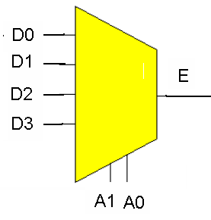
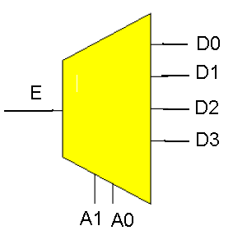
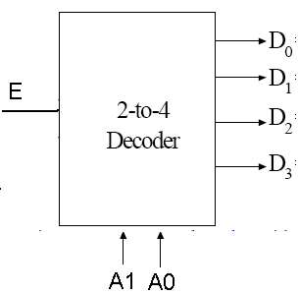
Demultiplexer
Many-to-One
One-to-Many
De
MUX
MUX
≡
Multiplexer
Demultiplexer
A device that moves data arriving on a single input (E) to one of m outputs (Ds)
Determined by the value of log₂ address inputs (As)
A decoder with Enable is
Referred to as:
Decoder/Demultiplexer
DeMUX

Slide 39
Decoder with Enable = DeMultiplexer
Alternatively, can be viewed as distributing the value of the signal EN to 1 of 4 outputs
In this case, called a
Demultiplexer
Data Input
Address
Outputs
Decoder is disabled
No 1’s
Normal
Decoder
Operation

Slide 40
Design Examples using MSI Functional Blocks
1. Adding Three 4-bit numbers
2. Adding two 16-bit numbers using 4-bit adders
3. Building 4-to-16 Decoders using 2-to-4 Decoders with Enable
4. Selecting the larger of two 4-bit numbers
5. BCD to Excess-3 Code Converter using a decoder and straight binary encoder

Slide 41
Adding Three 4-bit Numbers
Problem: Add three 4-bit numbers (X, Y, Z) using standard MSI combinational components
Solution:
Let the numbers be X₃X₂X₁X₀, Y₃Y₂Y₁Y₀, Z₃Z₂Z₁Z₀
X₃X₂X₁X₀
+ Y₃Y₂Y₁Y₀
-------------------
C₄ S₃S₂S₁S₀
S₃S₂S₁S₀
+ Z₃Z₂Z₁Z₀
-------------------
D₄ F₃F₂F₁F₀
Note: C₄ and D₄ are generated in position 4. They must be added to generate the most significant bits of the result

Slide 42
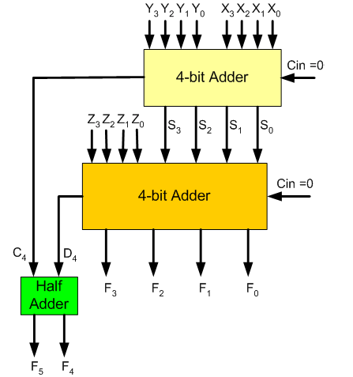
Adding Three 4-bit Numbers
64
59 +
123
89 +
212
1

Slide 43
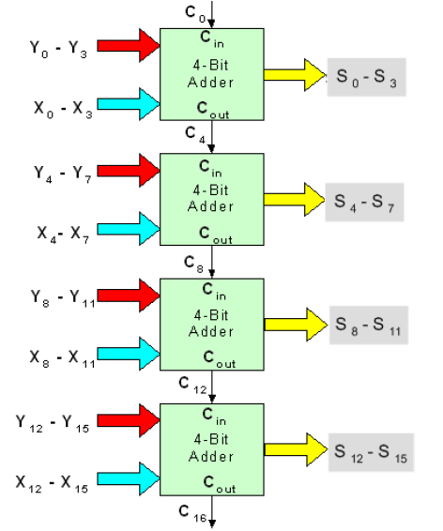
Adding Two 16-bit Numbers using 4-bit Adders
Solution:
Four 4-bit adder blocks are connected in cascade, with carries rippling in between

Slide 44
Design a 4-to-16 Decoder
Using 2-to-4 Decoders with Enable
Problem: Design a 4x16 Decoder using 2x4 Decoders
Solution:
Each group combination holds a unique value for A₃A₂
  One Decoder can be therefore used with inputs: A₃A₂
  Four more decoders are needed for representing each individual color combination
Select 1 of the 4
2-to-4 decoders
Common to all 4
3-to-4 decoders
A₃ | A₂ | A₁ | A₀ | Active Output
0 | 0 | 0 | 0 | D₀
0 | 0 | 0 | 1 | D₁
0 | 0 | 1 | 0 | D₂
0 | 0 | 1 | 1 | D₃
0 | 1 | 0 | 0 | D₄
0 | 1 | 0 | 1 | D₅
0 | 1 | 1 | 0 | D₆
0 | 1 | 1 | 1 | D₇
1 | 0 | 0 | 0 | D₈
1 | 0 | 0 | 1 | D₉
1 | 0 | 1 | 0 | D₁₀
1 | 0 | 1 | 1 | D₁₁
1 | 1 | 0 | 0 | D₁₂
1 | 1 | 0 | 1 | D₁₃
1 | 1 | 1 | 0 | D₁₄
1 | 1 | 1 | 1 | D₁₅
A₃A₂ = 00
A₃A₂ = 01
A₃A₂ = 10
A₃A₂ = 11

Slide 45
Design a 4-to-16 Decoder
Using 2-to-4 Decoders with Enable
A₀
A₁
D₀
D₁
D₂
D₃
2x4
Decoder
E
A₀
A₁
D₄
D₅
D₆
D₇
2x4
Decoder
D₀
D₁
D₂
D₃
A₂
A₃
2x4
Decoder
A₀
A₁
D₈
D₉
D₁₀
D₁₁
Enable for the
full 4-to16 decoder
2x4
Decoder
E
A₀
A₁
D₁₂
D₁₃
D₁₄
D₁₅
2x4
Decoder

Slide 46
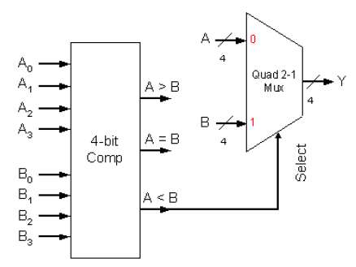
Hardware that Compares Two Unsigned 4-bit Numbers and Passes the Larger of the Two
Solution: We will use a magnitude comparator and a Quad 2-to-1 MUX. How?

Slide 47
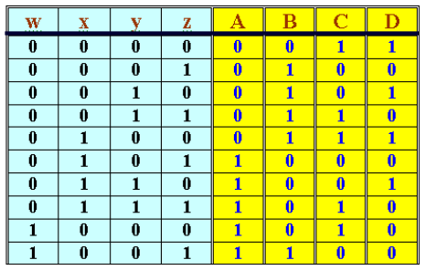
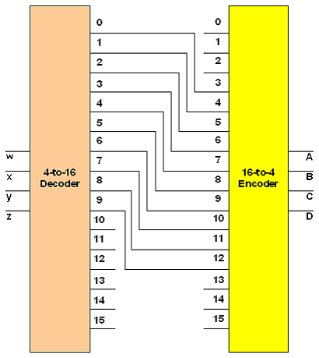
BCD to Excess-3 Code Converter using a Decoder and Straight Binary Encoder
BCD
Excess-3
Index
0
1
2
3
4
5
6
7
8
9
BCD: 0 - 9
Excess-3: 3 - 12

