Slide 1
Chemistry
Third Edition
Julia Burdge
Lecture PowerPoints
Chapter 15
Chemical Equilibrium
Copyright © 2012, The McGraw-Hill Compaies, Inc. Permission required for reproduction or display.
1

Slide 2
15
Chemical Equilibrium
15.1 | The Concept of Equilibrium
15.2 | The Equilibrium Constant
15.3 | Equilibrium Expressions
15.4 | Using Equilibrium Expressions to Solve Problems
15.5 | Factors That Affect Chemical Equilibrium
Copyright © 2012, The McGraw-Hill Compaies, Inc. Permission required for reproduction or display.
2

Slide 3
15.1
The Concept of Equilibrium
The Concept of Equilibrium
Copyright © 2012, The McGraw-Hill Compaies, Inc. Permission required for reproduction or display.
3

Slide 4
15.1
The Concept of Equilibrium
The Concept of Equilibrium
A system in which both forward and reverse processes are occurring at the same rate is at equilibrium.
Copyright © 2012, The McGraw-Hill Compaies, Inc. Permission required for reproduction or display.
4

Slide 5
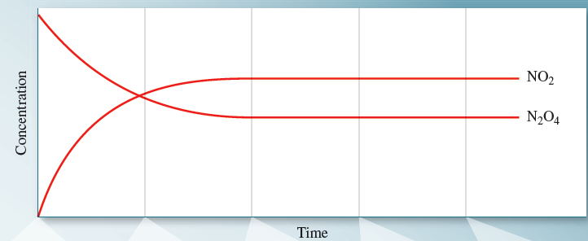
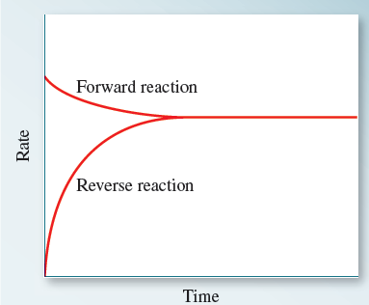
15.1
The Concept of Equilibrium
The Concept of Equilibrium
Copyright © 2012, The McGraw-Hill Compaies, Inc. Permission required for reproduction or display.
5

Slide 6
15.1
The Concept of Equilibrium
The Concept of Equilibrium
Some important things to remember about equilibrium are:
Equilibrium is a dynamic state—both forward and reverse reactions continue to occur, although there is no net change in reactant and product concentrations over time.
At equilibrium, the rates of the forward and reverse reactions are equal.
Equilibrium can be established starting with only reactants, with only products, or with any mixture of reactants and products.
Copyright © 2012, The McGraw-Hill Compaies, Inc. Permission required for reproduction or display.
6

Slide 7
15.2
The Equilibrium Constant
Calculating Equilibrium Constants
Magnitude of the Equilibrium Constant
Copyright © 2012, The McGraw-Hill Compaies, Inc. Permission required for reproduction or display.
7

Slide 8
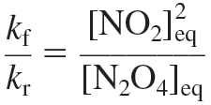
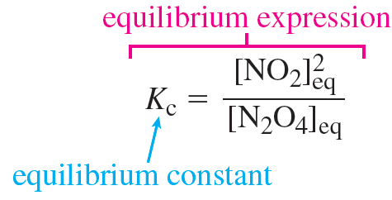
15.2
The Equilibrium Constant
Calculating Equilibrium Constants
Copyright © 2012, The McGraw-Hill Compaies, Inc. Permission required for reproduction or display.
8

Slide 9
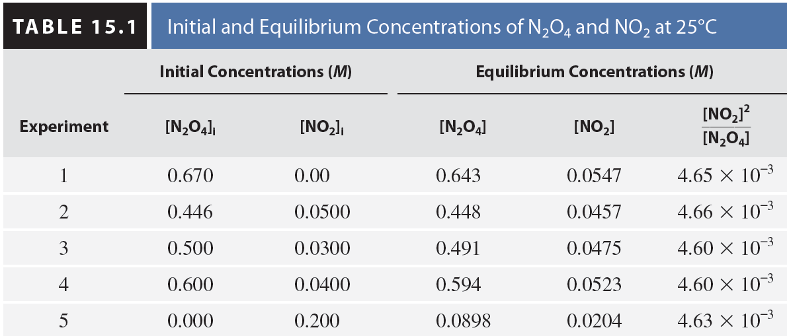
15.2
The Equilibrium Constant
Calculating Equilibrium Constants
Copyright © 2012, The McGraw-Hill Compaies, Inc. Permission required for reproduction or display.
9

Slide 10
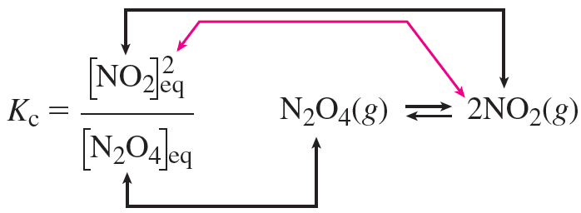
15.2
The Equilibrium Constant
Calculating Equilibrium Constants
Copyright © 2012, The McGraw-Hill Compaies, Inc. Permission required for reproduction or display.
10

Slide 11
15.2
The Equilibrium Constant
Calculating Equilibrium Constants
The reaction quotient (Q_{c} ) is a fraction with product concentrations in the numerator and reactant concentrations in the denominator—with each concentration raised to a power equal to the corresponding stoichiometric coefficient in the balanced chemical equation.
Copyright © 2012, The McGraw-Hill Compaies, Inc. Permission required for reproduction or display.
11

Slide 12
15.1
Carbonyl chloride (COCl₂), also called phosgene, is a highly poisonous gas that was used on the battlefield in World War I. It is produced by the reaction of carbon monoxide with chlorine gas:
In an experiment conducted at 74°C, the equilibrium concentrations of the species involved in the reaction were as follows: [CO] = 1.2 × 10^{–2} M, [Cl₂] = 0.054 M, and [COCl₂] = 0.14 M.
Write the equilibrium expression, and
determine the value of the equilibrium constant for this reaction at 74°C.
Copyright © 2012, The McGraw-Hill Compaies, Inc. Permission required for reproduction or display.
12

Slide 13
15.1
Setup
The equilibrium expression has the form of concentrations of products over concentrations of reactants, each raised to the appropriate power— in the case of this reaction, all the coefficients are 1, so all the powers will be 1.
Solution
Copyright © 2012, The McGraw-Hill Compaies, Inc. Permission required for reproduction or display.
13

Slide 14
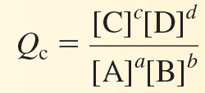
15.2
The Equilibrium Constant
Calculating Equilibrium Constants
We often find it useful to calculate the value of Q_{c} for a system that is not at equilibrium.
At any point during the progress of a reaction, therefore,
Copyright © 2012, The McGraw-Hill Compaies, Inc. Permission required for reproduction or display.
14

Slide 15
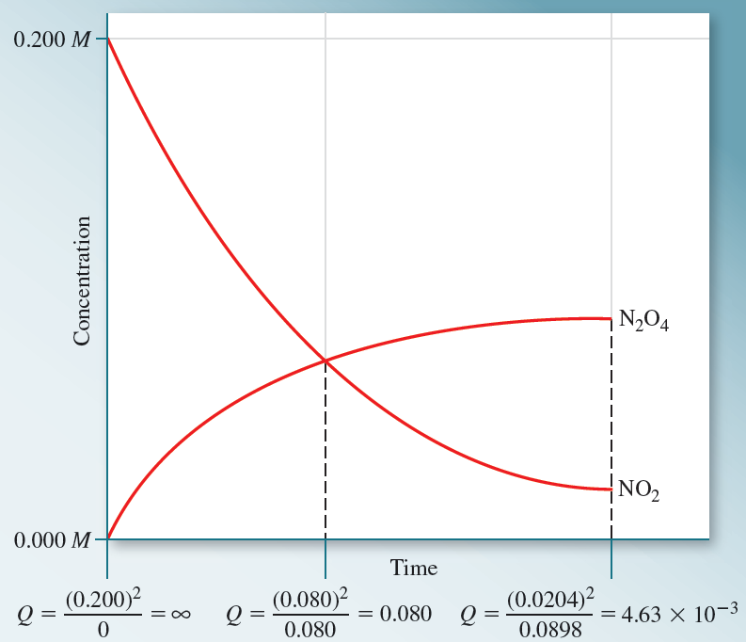
15.2
The Equilibrium Constant
Calculating Equilibrium Constants
Copyright © 2012, The McGraw-Hill Compaies, Inc. Permission required for reproduction or display.
15

Slide 16
15.2
Write reaction quotients for the following reactions:
Copyright © 2012, The McGraw-Hill Compaies, Inc. Permission required for reproduction or display.
16

Slide 17
15.2
Solution
Copyright © 2012, The McGraw-Hill Compaies, Inc. Permission required for reproduction or display.
17

Slide 18
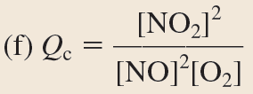
15.2
Solution
Copyright © 2012, The McGraw-Hill Compaies, Inc. Permission required for reproduction or display.
18

Slide 19
15.2
The Equilibrium Constant
Magnitude of the Equilibrium Constant
One of the things the equilibrium constant tells us is the extent to which a reaction proceeds at a particular temperature.
If we combine stoichiometric amounts of the reactants in a reaction, three outcomes are possible:
The reaction will go essentially to completion, and the equilibrium mixture will consist predominantly of products.
Copyright © 2012, The McGraw-Hill Compaies, Inc. Permission required for reproduction or display.
19

Slide 20
15.2
The Equilibrium Constant
Magnitude of the Equilibrium Constant
The reaction will not occur to any significant degree, and the equilibrium mixture will consist predominantly of reactants.
The reaction will proceed to a significant degree but will not go to completion, and the equilibrium mixture will contain comparable amounts of both reactants and products.
Copyright © 2012, The McGraw-Hill Compaies, Inc. Permission required for reproduction or display.
20

Slide 21
15.2
The Equilibrium Constant
Magnitude of the Equilibrium Constant
When the magnitude of K_{c} is very large, we expect the first outcome.
Copyright © 2012, The McGraw-Hill Compaies, Inc. Permission required for reproduction or display.
21

Slide 22
15.2
The Equilibrium Constant
Magnitude of the Equilibrium Constant
When the magnitude of K_{c} is very small, we expect the second outcome.
An equilibrium constant that falls between 1 × 10² and
1 × 10^{–2} indicates that neither products nor reactants are strongly favored.
In this case, a system at equilibrium will contain a mixture of reactants and products, the exact composition of which will depend on the stoichiometry of the reaction.
Copyright © 2012, The McGraw-Hill Compaies, Inc. Permission required for reproduction or display.
22

Slide 23
15.3
Equilibrium Expressions
Heterogeneous Equilibria
Manipulating Equilibrium Expressions
Equilibrium Expressions Containing Only Gases
Copyright © 2012, The McGraw-Hill Compaies, Inc. Permission required for reproduction or display.
23

Slide 24
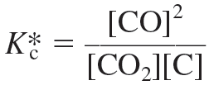
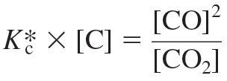
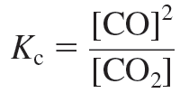
15.3
Equilibrium Expressions
Heterogeneous Equilibria
Copyright © 2012, The McGraw-Hill Compaies, Inc. Permission required for reproduction or display.
24

Slide 25
15.3
Write equilibrium expressions for each of the following reactions:
Copyright © 2012, The McGraw-Hill Compaies, Inc. Permission required for reproduction or display.
25

Slide 26
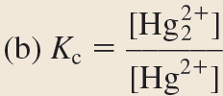
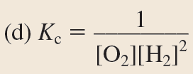
15.3
Solution
Copyright © 2012, The McGraw-Hill Compaies, Inc. Permission required for reproduction or display.
26

Slide 27
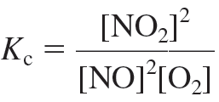
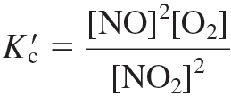
15.3
Equilibrium Expressions
Manipulating Equilibrium Expressions
Copyright © 2012, The McGraw-Hill Compaies, Inc. Permission required for reproduction or display.
27

Slide 28
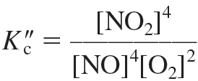
15.3
Equilibrium Expressions
Manipulating Equilibrium Expressions
Copyright © 2012, The McGraw-Hill Compaies, Inc. Permission required for reproduction or display.
28

Slide 29
15.3
Equilibrium Expressions
Manipulating Equilibrium Expressions
This is the product of the two corresponding equilibrium expressions.
Copyright © 2012, The McGraw-Hill Compaies, Inc. Permission required for reproduction or display.
29

Slide 30
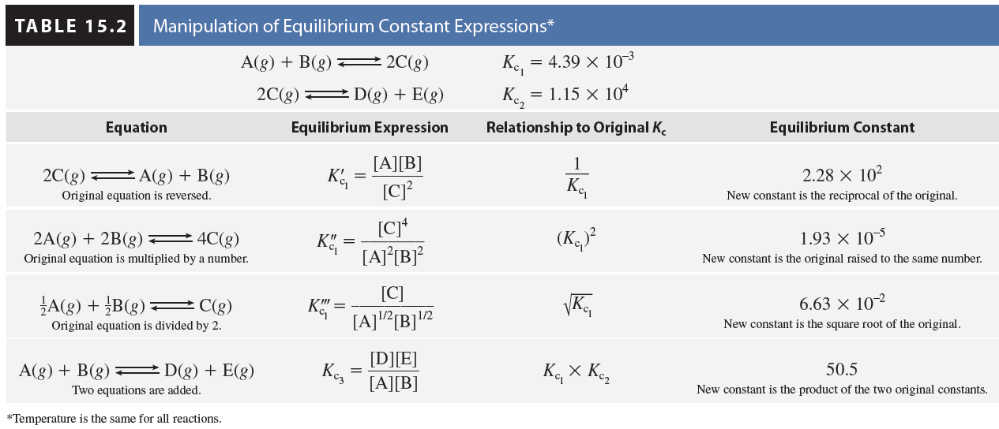
15.3
Equilibrium Expressions
Manipulating Equilibrium Expressions
Copyright © 2012, The McGraw-Hill Compaies, Inc. Permission required for reproduction or display.
30

Slide 31
15.4
The following reactions have the indicated equilibrium constants at 100°C:
Determine the value of K_{c} for the following reactions at 100°C:
Copyright © 2012, The McGraw-Hill Compaies, Inc. Permission required for reproduction or display.
31

Slide 32
15.4
Solution
Copyright © 2012, The McGraw-Hill Compaies, Inc. Permission required for reproduction or display.
32

Slide 33
15.4
Solution
Copyright © 2012, The McGraw-Hill Compaies, Inc. Permission required for reproduction or display.
33

Slide 34
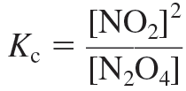
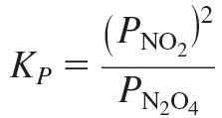
15.3
Equilibrium Expressions
Equilibrium Expressions Containing Only Gases
Copyright © 2012, The McGraw-Hill Compaies, Inc. Permission required for reproduction or display.
34

Slide 35
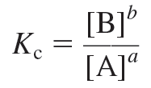
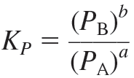
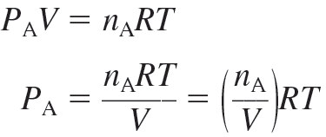
15.3
Equilibrium Expressions
Equilibrium Expressions Containing Only Gases
Copyright © 2012, The McGraw-Hill Compaies, Inc. Permission required for reproduction or display.
35

Slide 36
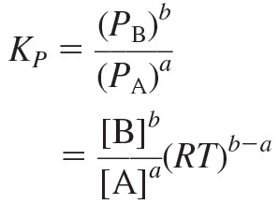
15.3
Equilibrium Expressions
Equilibrium Expressions Containing Only Gases
Copyright © 2012, The McGraw-Hill Compaies, Inc. Permission required for reproduction or display.
36

Slide 37
15.3
Equilibrium Expressions
Equilibrium Expressions Containing Only Gases
Copyright © 2012, The McGraw-Hill Compaies, Inc. Permission required for reproduction or display.
37

Slide 38
15.5
Write K_{P} expressions for
Solution
Copyright © 2012, The McGraw-Hill Compaies, Inc. Permission required for reproduction or display.
38

Slide 39
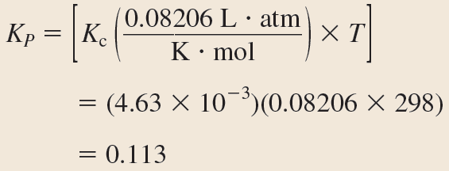
15.6
The equilibrium constant, K_{c}, for the reaction
is 4.63 × 10^{–3} at 25°C. What is the value of K_{P} at this temperature?
Setup
Solution
Copyright © 2012, The McGraw-Hill Compaies, Inc. Permission required for reproduction or display.
39

Slide 40
15.4
Using Equilibrium Expressions to Solve Problems
Predicting the Direction of a Reaction
Calculating Equilibrium Concentrations
Copyright © 2012, The McGraw-Hill Compaies, Inc. Permission required for reproduction or display.
40

Slide 41
15.4
Using Equilibrium Expressions to Solve Problems
Predicting the Direction of a Reaction
To determine the direction of a reaction, compare Q with K:
Q < K The ratio of initial concentrations of products to reactants is too small. To reach equilibrium, reactants must be converted to products. The system proceeds in the forward direction (from left to right).
Q = K The initial concentrations are equilibrium concentrations. The system is already at equilibrium, and there will be no net reaction in either direction
Copyright © 2012, The McGraw-Hill Compaies, Inc. Permission required for reproduction or display.
41

Slide 42
15.4
Using Equilibrium Expressions to Solve Problems
Predicting the Direction of a Reaction
Q > K The ratio of initial concentrations of products to reactants is too large. To reach equilibrium, products must be converted to reactants. The system proceeds in the reverse direction (from right to left).
The comparison of Q with K can refer either to Q_{c} and K_{c} or Q_{P} and K_{P}.
Copyright © 2012, The McGraw-Hill Compaies, Inc. Permission required for reproduction or display.
42

Slide 43
15.7
At 375°C, the equilibrium constant for the reaction
is 1.2.
At the start of a reaction, the concentrations of N₂, H₂, and NH₃ are 0.071 M, 9.2 × 10^{–3} M, and 1.83 × 10^{–4} M, respectively.
Determine whether this system is at equilibrium, and if not, determine in which direction it must proceed to establish equilibrium.
Copyright © 2012, The McGraw-Hill Compaies, Inc. Permission required for reproduction or display.
43

Slide 44
15.7
Setup
Solution
The calculated value of Q_{c} is less than K_{c}.
Therefore, the reaction is not at equilibrium and must proceed to the right to establish equilibrium.
Copyright © 2012, The McGraw-Hill Compaies, Inc. Permission required for reproduction or display.
44

Slide 45
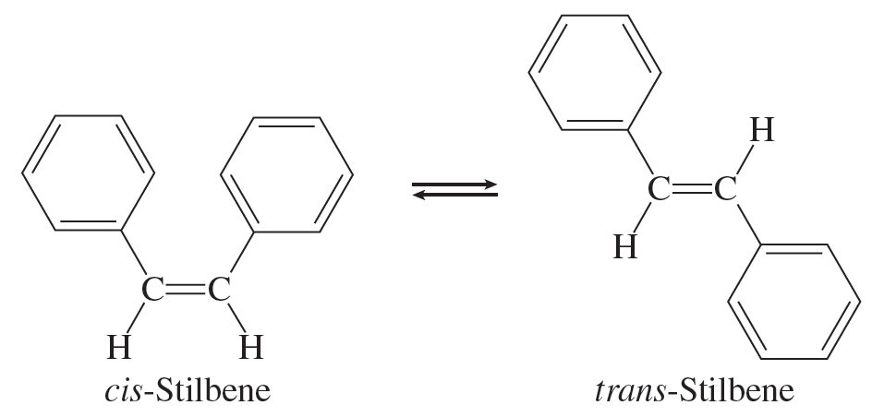
15.4
Using Equilibrium Expressions to Solve Problems
Calculating Equilibrium Concentrations
Copyright © 2012, The McGraw-Hill Compaies, Inc. Permission required for reproduction or display.
45

Slide 46
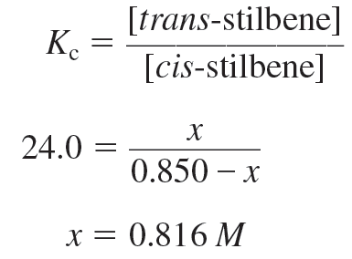
15.4
Using Equilibrium Expressions to Solve Problems
Calculating Equilibrium Concentrations
Copyright © 2012, The McGraw-Hill Compaies, Inc. Permission required for reproduction or display.
46

Slide 47
15.4
Using Equilibrium Expressions to Solve Problems
Calculating Equilibrium Concentrations
Check:
Copyright © 2012, The McGraw-Hill Compaies, Inc. Permission required for reproduction or display.
47

Slide 48
15.8
K_{c} for the reaction of hydrogen and iodine to produce hydrogen iodide,
is 54.3 at 430°C. What will the concentrations be at equilibrium if we start with 0.240 M concentrations of both H₂ and I₂?
Copyright © 2012, The McGraw-Hill Compaies, Inc. Permission required for reproduction or display.
48

Slide 49
15.8
Setup
Copyright © 2012, The McGraw-Hill Compaies, Inc. Permission required for reproduction or display.
49

Slide 50
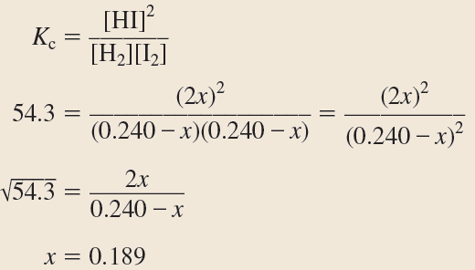
15.8
Solution
Copyright © 2012, The McGraw-Hill Compaies, Inc. Permission required for reproduction or display.
50

Slide 51
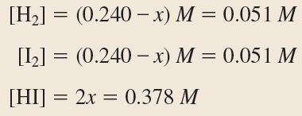
15.8
Solution
Copyright © 2012, The McGraw-Hill Compaies, Inc. Permission required for reproduction or display.
51

Slide 52
15.9
For the same reaction and temperature as in Sample Problem 15.8, calculate the equilibrium concentrations of all three species if the starting concentrations are as follows: [H₂] = 0.00623 M, [I₂] = 0.00414 M, and [HI] = 0.0424 M.
Setup
Q_{c} > K_{c}, so the system will have to proceed to the left.
Copyright © 2012, The McGraw-Hill Compaies, Inc. Permission required for reproduction or display.
52

Slide 53
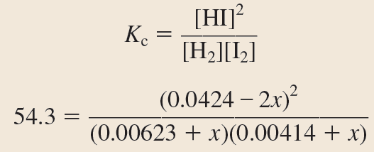
15.9
Solution
Copyright © 2012, The McGraw-Hill Compaies, Inc. Permission required for reproduction or display.
53

Slide 54
15.9
Solution
Copyright © 2012, The McGraw-Hill Compaies, Inc. Permission required for reproduction or display.
54

Slide 55
15.9
Solution
Copyright © 2012, The McGraw-Hill Compaies, Inc. Permission required for reproduction or display.
55

Slide 56
15.4
Using Equilibrium Expressions to Solve Problems
Calculating Equilibrium Concentrations
When the magnitude of K (either K_{c} or K_{P}) is very small, the solution to an equilibrium problem can be simplified—making it unnecessary to use the quadratic equation.
Copyright © 2012, The McGraw-Hill Compaies, Inc. Permission required for reproduction or display.
56

Slide 57
15.10
At elevated temperatures, iodine molecules break apart to give iodine atoms according to the equation
K_{c} for this reaction at 205°C is 3.39 × 10^{–13}. Determine the concentration of atomic iodine when a 1.00-L vessel originally charged with 0.00155 mol of molecular iodine at this temperature is allowed to reach equilibrium.
Setup
The initial concentration of I₂(g) is 0.00155 M and the original concentration of I(g) is zero. K_{c} = 3.39 × 10^{–12}.
Copyright © 2012, The McGraw-Hill Compaies, Inc. Permission required for reproduction or display.
57

Slide 58
15.10
Solution
Copyright © 2012, The McGraw-Hill Compaies, Inc. Permission required for reproduction or display.
58

Slide 59
15.10
Solution
According to our ice table, the equilibrium concentration of atomic iodine is 2x; therefore,
[I(g)] = 2 × 3.62 × 10^{–8} = 7.24 × 10^{–8} M.
Copyright © 2012, The McGraw-Hill Compaies, Inc. Permission required for reproduction or display.
59

Slide 60
15.4
Using Equilibrium Expressions to Solve Problems
Calculating Equilibrium Concentrations
Summary
Construct an equilibrium table, and fill in the initial concentrations (including any that are zero).
Use initial concentrations to calculate the reaction quotient, Q, and compare Q to K to determine the direction in which the reaction will proceed.
Define x as the amount of a particular species consumed, and use the stoichiometry of the reaction to define (in terms of x) the amount of other species consumed or produced
Copyright © 2012, The McGraw-Hill Compaies, Inc. Permission required for reproduction or display.
60

Slide 61
15.4
Using Equilibrium Expressions to Solve Problems
Calculating Equilibrium Concentrations
For each species in the equilibrium, add the change in concentration to the initial concentration to get the equilibrium concentration.
Use the equilibrium concentrations and the equilibrium expression to solve for x.
Using the calculated value of x, determine the concentrations of all species at equilibrium.
Copyright © 2012, The McGraw-Hill Compaies, Inc. Permission required for reproduction or display.
61

Slide 62
15.4
Using Equilibrium Expressions to Solve Problems
Calculating Equilibrium Concentrations
Check your work by plugging the calculated equilibrium concentrations into the equilibrium expression. The result should be very close to the K_{c} stated in the problem.
The same procedure applies to K_{P}.
Copyright © 2012, The McGraw-Hill Compaies, Inc. Permission required for reproduction or display.
62

Slide 63
15.11
A mixture of 5.75 atm of H₂ and 5.75 atm of I₂ is contained in a 1.0-L vessel at 430°C. The equilibrium constant (K_{P}) for the reaction
at this temperature is 54.3. Determine the equilibrium partial pressures of H₂, I₂, and HI.
Copyright © 2012, The McGraw-Hill Compaies, Inc. Permission required for reproduction or display.
63

Slide 64
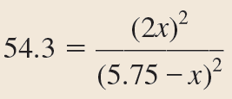
15.11
Setup
Solution
Copyright © 2012, The McGraw-Hill Compaies, Inc. Permission required for reproduction or display.
64

Slide 65
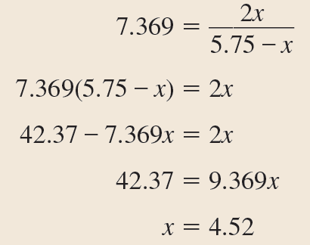
15.11
Solution
Copyright © 2012, The McGraw-Hill Compaies, Inc. Permission required for reproduction or display.
65

Slide 66
15.5
Factors That Affect Chemical Equilibrium
Addition or Removal of a Substance
Changes in Volume and Pressure
Changes in Temperature
Catalysis
Copyright © 2012, The McGraw-Hill Compaies, Inc. Permission required for reproduction or display.
66

Slide 67
15.5
Factors That Affect Chemical Equilibrium
Le Châtelier’s Principle
Le Châtelier’s principle states that when a stress is applied to a system at equilibrium, the system will respond by shifting in the direction that minimizes the effect of the stress.
In this context, “stress” refers to a disturbance of the system at equilibrium by any of the following means:
The addition of a reactant or product
The removal of a reactant or product
A change in volume of the system, resulting in a change in concentration or partial pressure of the reactants and products
A change in temperature
Copyright © 2012, The McGraw-Hill Compaies, Inc. Permission required for reproduction or display.
67

Slide 68
15.5
Factors That Affect Chemical Equilibrium
Le Châtelier’s Principle
“Shifting” refers to the occurrence of either the forward or reverse reaction such that the effect of the stress is partially offset as the system reestablishes equilibrium.
Copyright © 2012, The McGraw-Hill Compaies, Inc. Permission required for reproduction or display.
68

Slide 69
15.5
Factors That Affect Chemical Equilibrium
Addition or Removal of a Substance
Increase [N₂] from 2.05 M to 3.51 M:
Copyright © 2012, The McGraw-Hill Compaies, Inc. Permission required for reproduction or display.
69

Slide 70
15.5
Factors That Affect Chemical Equilibrium
Addition or Removal of a Substance
Q is less than K, so the reaction will proceed to the right to achieve equilibrium.
An equilibrium that is stressed in such a way that Q becomes less than K will shift to the right to reestablish equilibrium.
Likewise, an equilibrium that is stressed in such a way that Q becomes greater than K will shift to the left to reestablish equilibrium.
Copyright © 2012, The McGraw-Hill Compaies, Inc. Permission required for reproduction or display.
70

Slide 71
15.12
Hydrogen sulfide (H₂S) is a contaminant commonly found in natural gas. It is removed by reaction with oxygen to produce elemental sulfur.
For each of the following scenarios, determine whether the equilibrium will shift to the right, shift to the left, or neither:
addition of O₂(g),
removal of H₂S(g),
removal of H₂O(g), and
addition of S(s).
Copyright © 2012, The McGraw-Hill Compaies, Inc. Permission required for reproduction or display.
71

Slide 72
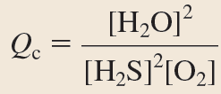
15.12
Strategy
Use Le Châtelier’s principle to predict the direction of shift for each case. Remember that the position of the equilibrium is only changed by the addition or removal of a species that appears in the reaction quotient expression.
Setup
Copyright © 2012, The McGraw-Hill Compaies, Inc. Permission required for reproduction or display.
72

Slide 73
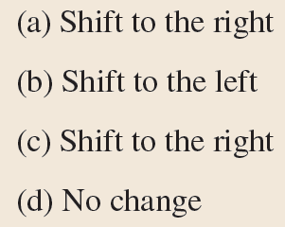
15.12
Solution
addition of O₂(g),
removal of H₂S(g),
removal of H₂O(g), and
addition of S(s).
Copyright © 2012, The McGraw-Hill Compaies, Inc. Permission required for reproduction or display.
73

Slide 74
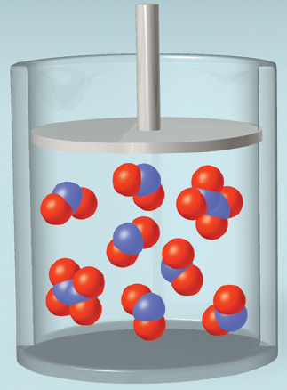
15.5
Factors That Affect Chemical Equilibrium
Changes in Volume and Pressure
Copyright © 2012, The McGraw-Hill Compaies, Inc. Permission required for reproduction or display.
74

Slide 75
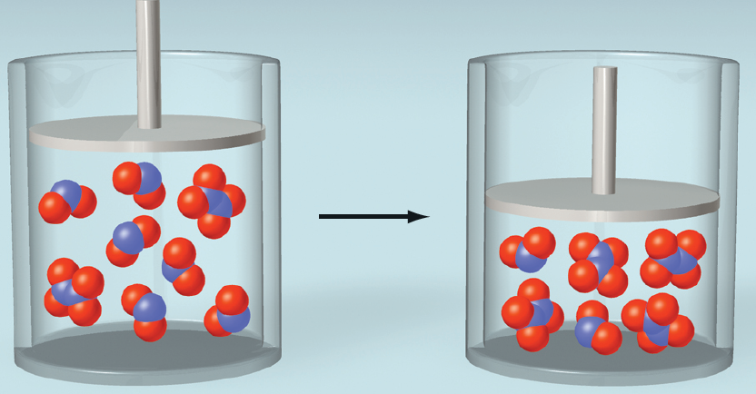
15.5
Factors That Affect Chemical Equilibrium
Changes in Volume and Pressure
Copyright © 2012, The McGraw-Hill Compaies, Inc. Permission required for reproduction or display.
75

Slide 76
15.5
Factors That Affect Chemical Equilibrium
Changes in Volume and Pressure
In general, a decrease in volume of a reaction vessel will cause a shift in the equilibrium in the direction that minimizes the total number of moles of gas.
Conversely, an increase in volume will cause a shift in the direction that maximizes the total number of moles of gas.
Copyright © 2012, The McGraw-Hill Compaies, Inc. Permission required for reproduction or display.
76

Slide 77
15.13
For each reaction, predict in what direction the equilibrium will shift when the volume of the reaction vessel is decreased.
Strategy
Determine which direction minimized the number of moles of gas in the reaction. Count only moles of gas.
Copyright © 2012, The McGraw-Hill Compaies, Inc. Permission required for reproduction or display.
77

Slide 78
15.13
Setup
We have
1 mole of gas on the reactant side and 2 moles of gas on the product side,
3 moles of gas on the reactant side and 2 moles of gas on the product side, and
2 moles of gas on each side.
Copyright © 2012, The McGraw-Hill Compaies, Inc. Permission required for reproduction or display.
78

Slide 79
15.13
Setup
We have
1 mole of gas on the reactant side and 2 moles of gas on the product side,
3 moles of gas on the reactant side and 2 moles of gas on the product side, and
2 moles of gas on each side.
Solution
Shift to the left
Shift to the right
No shift
Copyright © 2012, The McGraw-Hill Compaies, Inc. Permission required for reproduction or display.
79

Slide 80
15.5
Factors That Affect Chemical Equilibrium
Changes in Temperature
A change in concentration or volume may alter the position of an equilibrium (i.e., the relative amounts of reactants and products), but it does not change the value of the equilibrium constant.
Only a change in temperature can alter the value of the equilibrium constant.
Copyright © 2012, The McGraw-Hill Compaies, Inc. Permission required for reproduction or display.
80

Slide 81
15.5
Factors That Affect Chemical Equilibrium
Changes in Temperature
If we treat heat as though it were a reactant, we can use Le Châtelier’s principle to predict what will happen if we add or remove heat.
Increasing the temperature (adding heat) will shift the reaction in the forward direction because heat appears on the reactant side.
Lowering the temperature (removing heat) will shift the reaction in the reverse direction.
Copyright © 2012, The McGraw-Hill Compaies, Inc. Permission required for reproduction or display.
81

Slide 82
15.14
The Haber process, which is used industrially to generate ammonia—largely for the production of fertilizers—is represented by the equation
Using data from Appendix 2, determine the ΔH°_{rxn} for the process and indicate what direction the equilibrium will shift if the temperature is increased. What direction will it shift if the temperature is decreased?
Copyright © 2012, The McGraw-Hill Compaies, Inc. Permission required for reproduction or display.
82

Slide 83
15.14
Setup
From Appendix 2,
Solution
The reaction is exothermic; therefore, the equilibrium will shift to the left if temperature is increased and to the right if temperature is decreased.
Copyright © 2012, The McGraw-Hill Compaies, Inc. Permission required for reproduction or display.
83

Slide 84
15.5
Factors That Affect Chemical Equilibrium
Catalysis
A catalyst speeds up a reaction by lowering the reaction’s activation energy.
However, a catalyst lowers the activation energy of the forward and reverse reactions to the same extent.
The presence of a catalyst, therefore, does not alter the equilibrium constant, nor does it shift the position of an equilibrium system.
Copyright © 2012, The McGraw-Hill Compaies, Inc. Permission required for reproduction or display.
84

